Slide 1

Recurrence Relations

Slide 2
Recurrence Relations
When we analyze the running time of a recursive algorithm, we often end up with a recurrence relation.
There is no universal solutions for solving recurrence relations.
However, there are standard methods for solving many commonly seen recurrence relations.

Slide 3
General Form
Very often, the time complexity T(n) of an algorithm is given by a recurrence relation. We need to solve it to get its asymptotic notation. The following is the general form:
T(n) = a T(n/b) + f(n), a ≥ 1 and b > 1.
Example: T(n) = T(n/2) + 1
Example: T(n) = 2T(n/2) + f(n), where f(n) ∈ 𝚯𝚯(n)
Example: T(n) = 8T(n/2) + f(n), where f(n) ∈ 𝚯𝚯(n²)
Example: T(n) = 7T(n/2) + f(n), where f(n) ∈ 𝚯𝚯(n²)

Slide 4
Example
Let T(n) be the time to search a sorted array of n elements, using binary search. Then we have
T(n) = T(n/2) + 1
The parameters in the general form are
a=1
b=2
f(n)=1.

Slide 5
Example
Let A be an N-by-N matrix and B be an N-by-N matrix. We can use block multiplication to get the product of A with B. https://en.wikipedia.org/wiki/Matrix_multiplication
http://mathworld.wolfram.com/BlockMatrix.html
Assume that we partition A into A₁₁, A₁₂, A₂₁, A₂₂. We partition B into B₁₁, B₁₂, B₂₁, B₂₂. Let C be the product of A with B. Then
^{C}ij ^{= A}i1 ^{B}1j ^{+ A}i2 ^{B}2j
Therefore, the time complexity of multiplying two N-by-N matrices is T(N), where
T(n) = 8T(n/2) + n², a=8, b=2, f(n)=n².

Slide 6
Example
Volker Strassen discovered a very smart algorithm for block matrix multiplication.
https://en.wikipedia.org/wiki/Strassen_
The time complexity of multiplying two N-by-N matrices using Strassen’s algorithm is T(n), where
T(n) = 7T(n/2) + c×n², a=7, b=2, f(n)= c×n².

Slide 7
Example
Example: T(n) = T(n/2) + 1
T(1) is a constant
T(2) = 1 + T(1)
T(4) = 1 + T(2) = 2 + T(1)
T(8) = 1 + T(4) = 3 + T(1)
T(16) = 1 + T(8) = 4 + T(1)
T(32) = 1 + T(16) = 5 + T(1)
It looks like T(n) ∈ 𝚯𝚯(log
𝐧𝐧 )

Slide 8
Example
Example: T(n) = T(0.7n) + T(0.2n) + n²
T(n) = n² + T(0.7n) + T(0.2n) = n² + (0.7n)² + (0.2n)² +
T(0.49n) + 2T(0.14n) + T(0.04n) = ???
This does not seem to be easy.
We will present a very general method, known as the Master Method.

Slide 9
The Master Method, Case 2
If 𝒇𝒇 𝒏𝒏 ∈ 𝚯𝚯(𝐧𝐧^{log𝐛𝐛𝐚𝐚}), then 𝑻𝑻 𝒏𝒏 ∈ 𝚯𝚯(𝐧𝐧^{log𝐛𝐛𝐚𝐚} log 𝐧𝐧)
We call the above case 2.

Slide 10
The Master Method, Case 1
If 𝒇𝒇 𝒏𝒏 ∈ 𝚯𝚯(𝐧𝐧^{log𝐛𝐛𝐚𝐚}), then 𝑻𝑻 𝒏𝒏 ∈ 𝚯𝚯(𝐧𝐧^{log𝐛𝐛𝐚𝐚} log 𝐧𝐧)
We call the above case 2.
Consider the case where 𝒇𝒇(𝒏𝒏) grows asymptotically slower than 𝐧𝐧^{log𝐛𝐛𝐚𝐚}.
_{∈ 𝐎𝐎 𝐧𝐧}(log_{𝐛𝐛}𝐚𝐚)−𝝐𝝐
If 𝒇𝒇 𝒏𝒏 for some constant 𝝐𝝐 > 𝟎𝟎,
then 𝑻𝑻 𝒏𝒏 ∈ 𝚯𝚯(𝐧𝐧^{log𝐛𝐛𝐚𝐚})
We call the above case 1.

Slide 11
The Master Method, Case 3
If 𝒇𝒇 𝒏𝒏 ∈ 𝚯𝚯(𝐧𝐧^{log𝐛𝐛𝐚𝐚}), then 𝑻𝑻 𝒏𝒏 ∈ 𝚯𝚯(𝐧𝐧^{log𝐛𝐛𝐚𝐚} log 𝐧𝐧)
We call the above case 2.
Consider the case where 𝒇𝒇(𝒏𝒏) grows asymptotically faster than 𝐧𝐧^{log𝐛𝐛𝐚𝐚}.
_{∈ 𝛀𝛀 𝐧𝐧}(log_{𝐛𝐛}𝐚𝐚)+𝝐𝝐
If 𝒇𝒇 𝒏𝒏 for some constant 𝝐𝝐 > 𝟎𝟎,
and 𝒂𝒂 × 𝒇𝒇
𝒏𝒏
≤ 𝒄𝒄 × 𝒇𝒇(𝒏𝒏) for 𝒏𝒏 ≥ 𝑵𝑵, where N is a
𝒃𝒃
constant and 𝒄𝒄 ∈ 𝟎𝟎, 𝟏𝟏 , then 𝑻𝑻 𝒏𝒏 ∈ 𝚯𝚯 𝐟𝐟 𝐧𝐧 .
We call the above case 3.

Slide 12
How to Use the Master Method?
■
We start with checking whether it is Case_2.
Study lim
𝐟𝐟(𝐧𝐧)
log 𝐚𝐚
𝒏𝒏→∞ 𝐧𝐧
𝐛𝐛
If lim
𝐟𝐟(𝐧𝐧)
_{𝐚𝐚} = 𝒄𝒄 for some positive constant c, then
𝒏𝒏→∞ 𝐧𝐧
log
𝐛𝐛
_{∈ 𝚯𝚯 𝐧𝐧}log_{𝐛𝐛}𝐚𝐚
𝒇𝒇 𝒏𝒏
This implies that we have Case_2.
As a result, T 𝒏𝒏 ∈ 𝚯𝚯 log(𝒏𝒏) × 𝐧𝐧^{log𝐛𝐛𝐚𝐚}

Slide 13
How to Use the Master Method?
Now assume that it is NOT Case_2.
If lim
𝐟𝐟(𝐧𝐧)
_{𝐚𝐚} = 𝟎𝟎, we will check for Case_1, as it
𝒏𝒏→∞ 𝐧𝐧
log
𝐛𝐛
cannot be Case_3.
If lim
𝐟𝐟(𝐧𝐧)
_{𝐚𝐚} = ∞, we will check for Case_3, as it
𝒏𝒏→∞ 𝐧𝐧
log
𝐛𝐛
cannot be Case_1.

Slide 14
How to Use the Master Method?
■
Suppose we want to check whether it is Case_1.
A necessary condition for Case_1 is lim
𝐟𝐟(𝐧𝐧)
_{𝐚𝐚} = 𝟎𝟎.
𝒏𝒏→∞ 𝐧𝐧
log
𝐛𝐛
But this condition is not sufficient.
We need to find a constant 𝝐𝝐 > 𝟎𝟎 such that
_{∈ 𝑶𝑶(𝒏𝒏}(log_{𝐛𝐛}𝒂𝒂)−𝝐𝝐_{).}
𝒇𝒇 𝒏𝒏
𝐟𝐟(𝐧𝐧)
_{∈ 𝑶𝑶(𝒏𝒏}(log_{𝐛𝐛}𝒂𝒂)−𝝐𝝐_{).}
If lim
< ∞, then 𝒇𝒇 𝒏𝒏
_{𝒏𝒏→∞ 𝐧𝐧}(log_{𝐛𝐛}𝐚𝐚)−𝝐𝝐
This implies that we have Case_1.
_{∈ 𝚯𝚯 𝐧𝐧}log_{𝐛𝐛}𝐚𝐚
As a result, T 𝒏𝒏

Slide 15
How to Use the Master Method?
■
Suppose we want to check whether it is Case_3.
A necessary condition for Case_3 is lim
𝐟𝐟(𝐧𝐧)
_{𝐚𝐚} = ∞.
𝒏𝒏→∞ 𝐧𝐧
log
𝐛𝐛
But this condition is not sufficient.
We need to find a constant 𝝐𝝐 > 𝟎𝟎 such that
_{∈ 𝛀𝛀(𝒏𝒏}(log_{𝐛𝐛}𝒂𝒂)+𝝐𝝐_{).}
𝒇𝒇 𝒏𝒏
𝐟𝐟(𝐧𝐧)
_{∈ 𝛀𝛀(𝒏𝒏}(log_{𝐛𝐛}𝒂𝒂)+𝝐𝝐_{).}
If lim
> 𝟎𝟎, then 𝒇𝒇 𝒏𝒏
_{𝒏𝒏→∞ 𝐧𝐧}(log_{𝐛𝐛}𝐚𝐚)+𝝐𝝐
This alone does not imply that we have Case_3.
We need to check the regularity condition.

Slide 16
How to Use the Master Method?
We need to find a constant c, 𝟎𝟎 < 𝒄𝒄 < 𝟏𝟏 and an
𝒏𝒏
integer N such that 𝒂𝒂𝒇𝒇 ≤ 𝒄𝒄 × 𝒇𝒇 𝒏𝒏 , ∀𝒏𝒏 ≥ 𝑵𝑵.
𝒃𝒃
_{∈ 𝛀𝛀 𝒏𝒏}(log_{𝐛𝐛}𝒂𝒂)+𝝐𝝐
If 𝒇𝒇 𝒏𝒏 for some constant 𝝐𝝐 > 𝟎𝟎 and
the regularity condition also holds, then we have Case_3.
As a result, T 𝒏𝒏 ∈ 𝚯𝚯 𝒇𝒇(𝒏𝒏) .

Slide 17
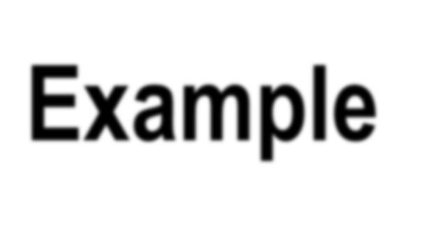


Example: T(n) = 8T(n/2) + n²
This is the recurrence we got from the block matrix multiplication. a=8, b=2, f(n)=n².
𝐟𝐟(𝐧𝐧)
_{𝒏𝒏}𝟐𝟐
lim
_{𝐚𝐚} = lim _{𝟑𝟑} = 𝟎𝟎. This is not Case_2.
log
𝐛𝐛
𝒏𝒏→∞ 𝐧𝐧 𝒏𝒏→∞ 𝒏𝒏
Check for Case_1.
𝐟𝐟(𝐧𝐧)
_{𝒏𝒏}𝟐𝟐
For 𝝐𝝐 = 𝟎𝟎. 𝟓𝟓, we have lim
_{𝐚𝐚−𝝐𝝐} = lim _{𝟐𝟐.𝟓𝟓} = 𝟎𝟎.
𝒏𝒏→∞ 𝐧𝐧
log
𝐛𝐛
𝒏𝒏→∞ 𝒏𝒏
Therefore we have Case_1.
T(n) = Θ(n³).

Slide 18
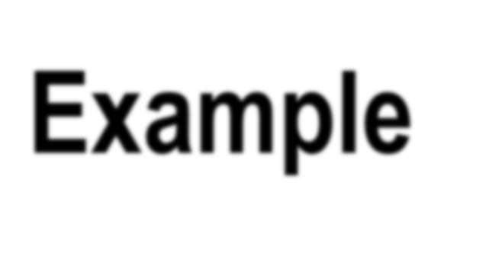









Example: T(n) = 7T(n/2) + 𝒄𝒄 × 𝒏𝒏^{𝟐𝟐}
This is the recurrence we got from This is the recurrence for Strassen’s matrix multiplication.
a=7, b=2, f(n)= 𝒄𝒄 × 𝒏𝒏^{𝟐𝟐}
lim
𝐟𝐟(𝐧𝐧) 𝒄𝒄×𝒏𝒏^{𝟐𝟐}
_{𝐚𝐚} = lim _{𝟐𝟐.𝟖𝟖𝟎𝟎𝟖𝟖} = 𝟎𝟎. This is not Case_2.
log
𝐛𝐛
𝒏𝒏→∞ 𝐧𝐧 𝒏𝒏→∞ 𝒏𝒏
Check for Case_1.
For 𝝐𝝐 = 𝟎𝟎. 𝟏𝟏, we have lim
𝐟𝐟(𝐧𝐧)
_{𝐚𝐚−𝝐𝝐} = lim
𝒄𝒄×𝒏𝒏^{𝟐𝟐}
𝟐𝟐.𝟖𝟖𝟎𝟎𝟖𝟖 ^{= 𝟎𝟎.}
𝒏𝒏→∞ 𝐧𝐧
log
𝐛𝐛
𝒏𝒏→∞ 𝒏𝒏
Therefore we have Case_1.
T(n) = Θ(n^{2.807}).

Slide 19
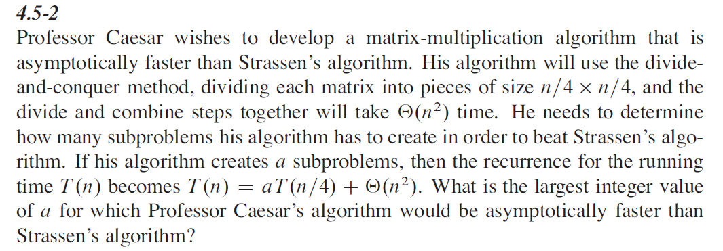
More Examples
< log_{𝟐𝟐} 𝟖𝟖
Find the largest integer a such that ^{log𝟐𝟐 𝒂𝒂}
log_{𝟐𝟐} 𝟒𝟒
log_{𝟐𝟐} 𝒂𝒂 < 𝟐𝟐 × log_{𝟐𝟐} 𝟖𝟖 = log_{𝟐𝟐}(𝟒𝟒𝟒𝟒)
log_{𝟐𝟐} 𝟐𝟐
𝒂𝒂 = 𝟒𝟒𝟖𝟖 is the answer to this question.
Need to verify this is indeed the case.

Slide 20
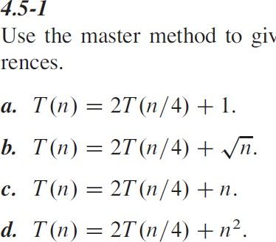
More Examples
(a): Case 1
(b): Case 2
(c): Case 3.
(d): Case 3.

Slide 21
More Examples

Slide 22
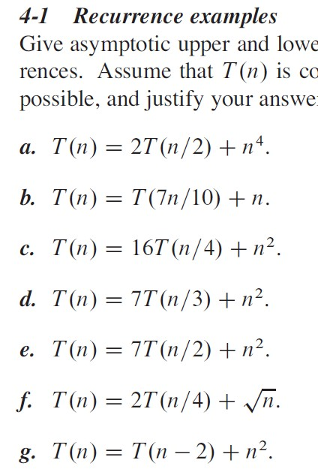
More Examples
(a): Case 3
(b): Case 3
(c): Case 2
(d): Case 3
(e): Case 1
(f): Case 2
(g): None of the three cases. However, we can prove that
𝑻𝑻 𝒏𝒏 = 𝚯𝚯(𝐧𝐧^{𝟑𝟑})

Slide 23
More Examples

Slide 24
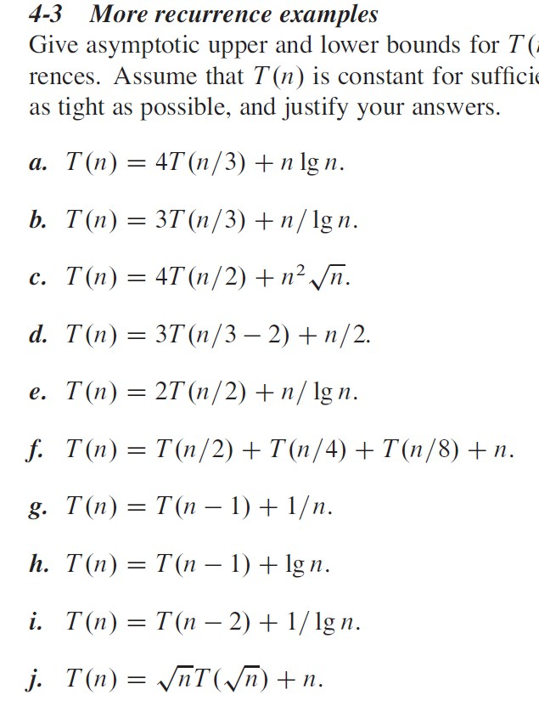
More Examples
(a): Case 1
(b): None of the three cases
(c): Case 3
(d): Case 2
(e): None of the three cases
(f): 𝑻𝑻 𝒏𝒏
(g): 𝑻𝑻 𝒏𝒏
(h): 𝑻𝑻 𝒏𝒏
= 𝚯𝚯(𝐧𝐧)
= 𝚯𝚯(log 𝐧𝐧)
= 𝚯𝚯(𝐧𝐧𝐧𝐧𝐧 𝐧𝐧)

Slide 25
More Examples

Slide 26
It Does Not Work All the Time
There are some cases where the master method does not work.
Consider the straightforward method for computing the n-th Fibonacci number.
T(n) = T(n-1) + T(n-2) + 1.
Well, the master method is not always useful.

Slide 27
The Substitution Method (Section 4.3)
T(n) = 2T(n/2) + 5n
Guess: T(n) ≤ c×n lg (n) for all n ≥ N, for c≥5
Proof: for any n s.t. N < n ≤ 2N, we have
𝒏𝒏
𝟐𝟐
𝒏𝒏
𝟐𝟐
𝒏𝒏
𝟐𝟐
+ 𝟓𝟓𝒏𝒏 =
𝟓𝟓 − 𝒄𝒄 𝒏𝒏 ≤
𝑻𝑻 𝒏𝒏 = 𝟐𝟐𝑻𝑻
+ 𝟓𝟓𝒏𝒏 ≤ 𝟐𝟐 𝒄𝒄
lg
𝒄𝒄𝒏𝒏 lg 𝒏𝒏 − 𝟏𝟏 + 𝟓𝟓𝒏𝒏 = 𝒄𝒄𝒏𝒏 × lg 𝒏𝒏 +
𝒄𝒄𝒏𝒏 × lg 𝒏𝒏
Take 𝒄𝒄 = max
𝑻𝑻 𝟐𝟐 , 𝑻𝑻 𝟑𝟑 , 𝟓𝟓
and N=2, we have
≤ 𝒄𝒄 ≤ 𝒄𝒄𝒏𝒏 × lg 𝒏𝒏 .
𝑻𝑻 𝟐𝟐 ≤ 𝒄𝒄 ≤ 𝒄𝒄𝒏𝒏 × lg 𝒏𝒏 , 𝑻𝑻 𝟐𝟐
This proves that 𝑻𝑻 𝒏𝒏
∈ 𝑶𝑶(𝒏𝒏 lg 𝒏𝒏)

Slide 28
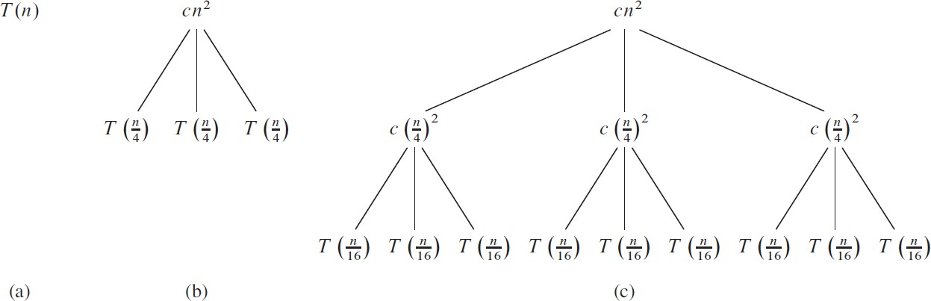
Recursion Tree (Section 4.4)
T(n) = 3T(n/4) + c×n²
𝑻𝑻 𝒏𝒏 ∈ 𝑶𝑶(𝒏𝒏^{𝟐𝟐})

Slide 29
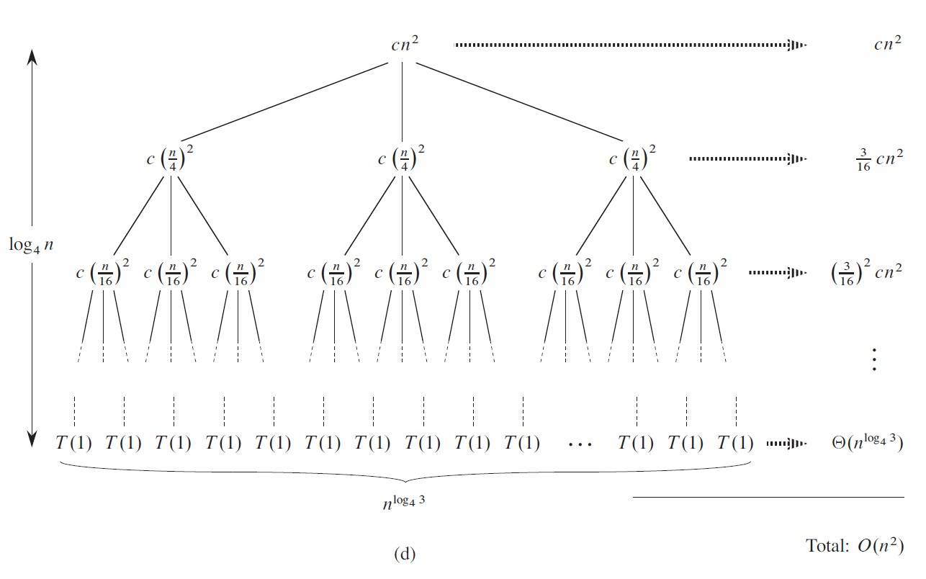
Recursion Tree (Section 4.4)
𝟏𝟏 + 𝒙𝒙 + 𝒙𝒙^{𝟐𝟐} + ⋯ + 𝒙𝒙^{𝒌𝒌} ≤
𝑻𝑻 𝒏𝒏 ∈ 𝑶𝑶 𝒏𝒏^{𝟐𝟐} .
𝟏𝟏
𝟑𝟑
, 𝒙𝒙 =
𝟏𝟏−𝒙𝒙
𝟏𝟏𝟏𝟏

Slide 30


