Slide 1

Activation Records, Divide and Conquer, Recursive Algorithms

Slide 2
Sorting
Sorting is the process of arranging a sequence of objects into order (either increasing or decreasing)
Mergesort is a sorting algorithm

Slide 3
Divide and Conquer, Merge Sort, Recursion
Divide and Conquer
Divide: break an instance of a problem into several smaller instances of the same problem
Conquer: Compute solutions for the smaller instances
Combine: Use the solutions to the smaller instances to obtain the solution of the original instance
Merge Sort: A sorting algorithm that uses divide and conquer.
Recursive Algorithm: An algorithm that calls itself.

Slide 4
Merge
Merge(A, p, q, r) 01: nL = q – p + 1; 02: nR = r – q;
03: new L[0:nL-1]; new R[0:nR-1];
04: for i=0 to nL-1
// A[p:q]and A[q+1:r] are already sorted
// nL is the length of A[p:q]
// nR is the length of A[q+1:r]
// two new arrays
//
// L[0:nL-1] = A[p:q]
//
// R[0:nR-1] = A[q+1:r]
// i points to the start of L[]
// j points to the start of R[]
// k points to the start of A[]
05: L[i] = A[p+i];
06: for j=0 to nR-1
07: R[j] = A[q+j+1];
08: i = 0;
09: j = 0;
10: k = p;
12: while i < nL and j < nR 13: if L[i] <= R[j];
//
//
14: A[k] = L[i];
15: i = i+1;
// L[i] is k-th smallest
//
16: else A[k] = R[j]; 17: j = j+1;
// R[j] is k-th smallest
//
18: k = k+1;
20: while i < nL
//
// 20-23 and 24-27 are mutually exclusive
21: A[k] = L[i];
22: i = i+1;
// copy rest of L[] to A[]
//
23: k = k+1;
24: while j < nR
//
//
25: A[k] = R[j];
26: j = j+1;
// copy rest of R[] to A[]
//
27: k = k+1;
//

Slide 5
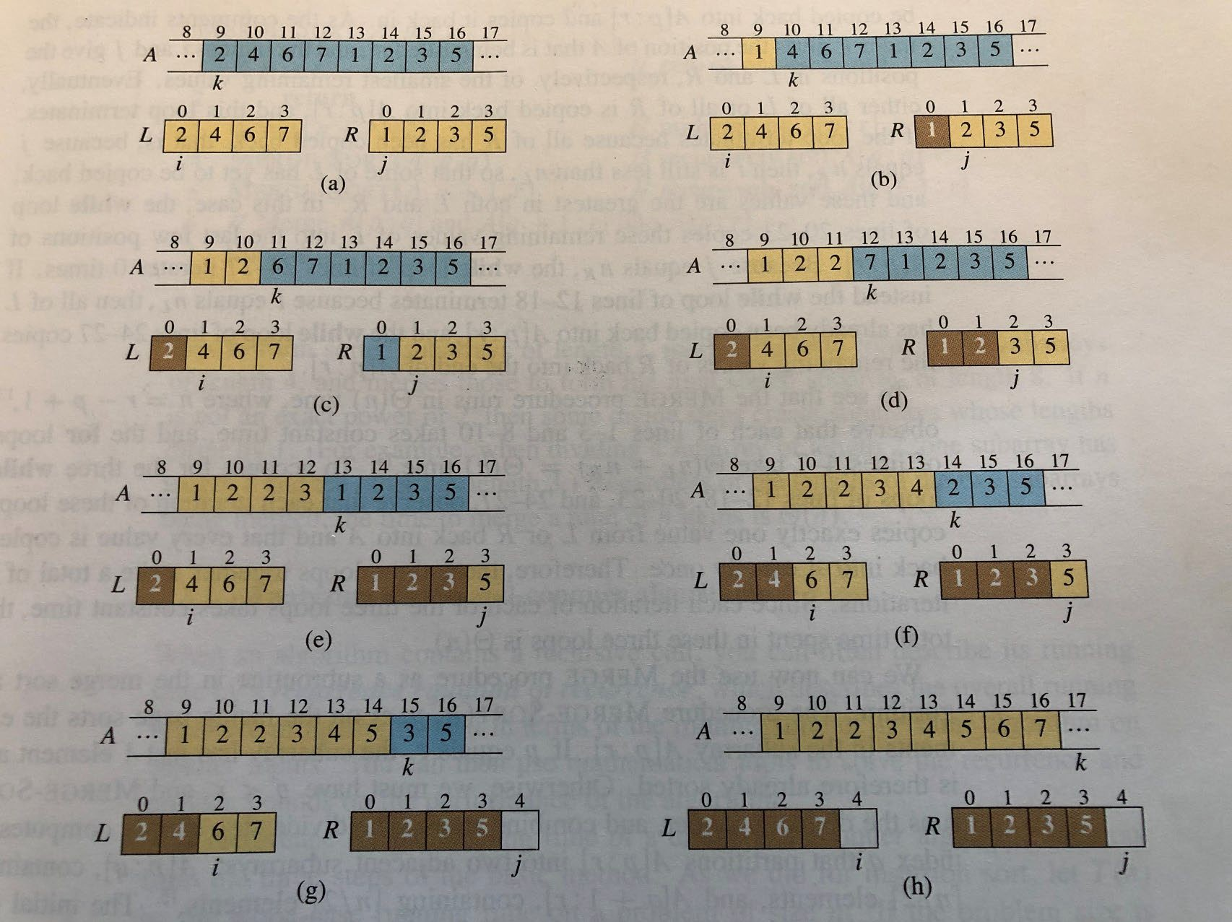
Example of Merge

Slide 6
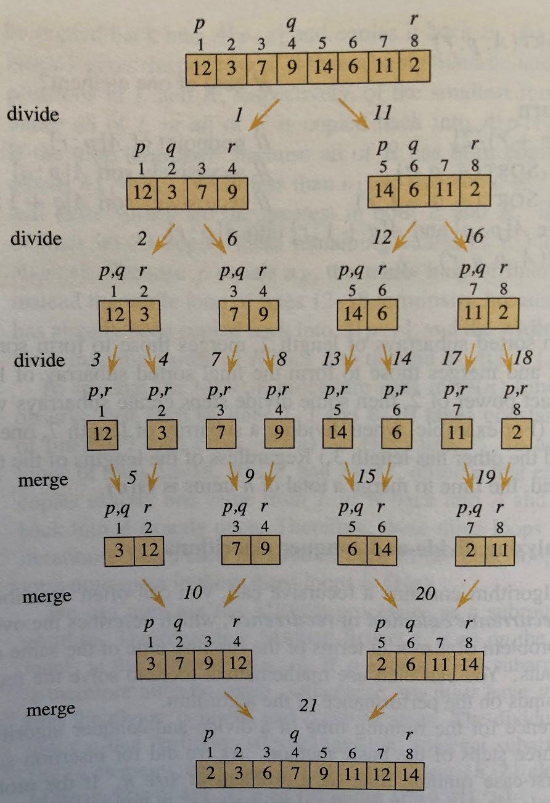
Mergesort
Merge-Sort(A, p, r) 1: if p >= r
2: return; 3: q = (p+r)/2;
4: Merge-Sort(A, p, q);
5: Merge-Sort(A, q+1, r);
7: Merge(A, p, q, r);
Note for line 1:
When p=r, we have 1 element. When p>r, we have 0 element.
We may call Merge-Sort with p>r.
Note for line 3:
q is the floor of (p+r)/2. Integer division always the floor.
Note for lines 4-5:
Conquer left, then conquer right.

Slide 7
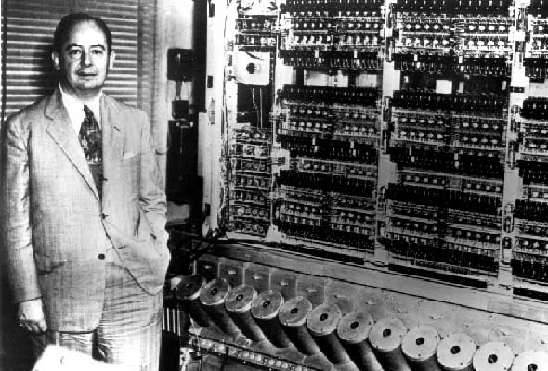
Mergesort
Merge sort was invented by John von Neumann in 1945
Divide: break A[p:r] into A[p:q] and A[q+1:r], where q=(p+r)/2
Conquer: sort A[p:q] and A[q+1:r], using merge sort
Combine: merge A[p:q] and A[q+1:r]
John von Neumann

Slide 8
Activation Records and Recursive Calls
Run-time stack
Activation record (AR)
One activation record per function call
The activation records are managed via a stack
The AR of the callee is on top of the AR of the caller
When a function completes, its AR is popped off
Recursive vs iterative algorithms

Slide 9
Activation Records and Recursive Calls
For each function call, there is an activation record
The activation record reserves space for the program, the variables, and intermediate results
The activation records form the run-time stack
When a function is called, we push an AR to the stack.
When a function is completed, we pop the AR off.

Slide 10
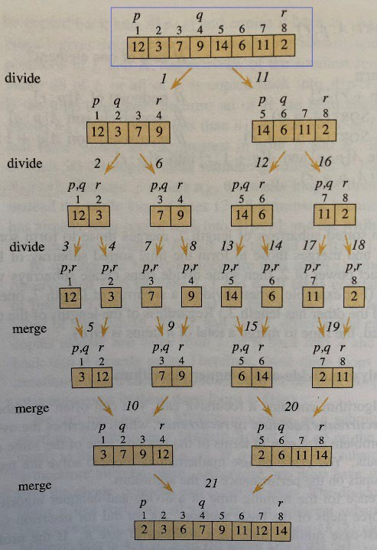
Activation Records and Recursive Calls
Merge-Sort(A, 1, 8)

Slide 11
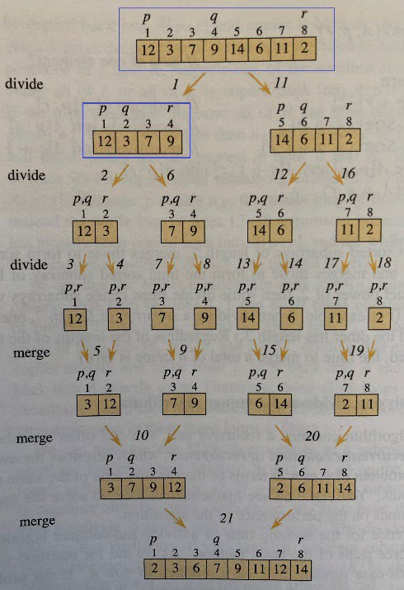
Activation Records and Recursive Calls
Merge-Sort(A, 1, 4)
Merge-Sort(A, 1, 8)
Merge-Sort(A, 1, 8)

Slide 12
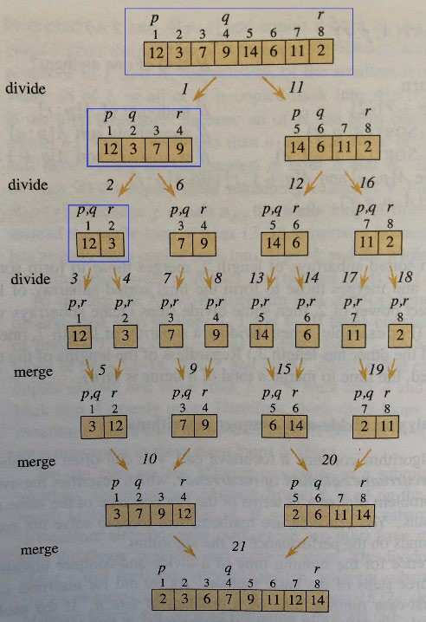
Activation Records and Recursive Calls
Merge-Sort(A, 1, 2)
Merge-Sort(A, 1, 4)
Merge-Sort(A, 1, 4)
Merge-Sort(A, 1, 8)
Merge-Sort(A, 1, 8)

Slide 13
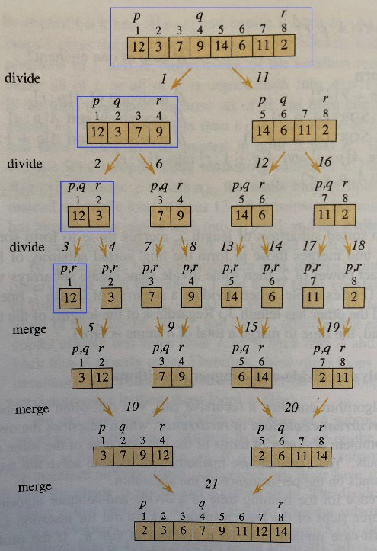
Activation Records and Recursive Calls
Merge-Sort(A, 1, 1)
Merge-Sort(A, 1, 2)
Merge-Sort(A, 1, 4)
Merge-Sort(A, 1, 8)
Merge-Sort(A, 1, 2)
Merge-Sort(A, 1, 4)
Merge-Sort(A, 1, 8)

Slide 14
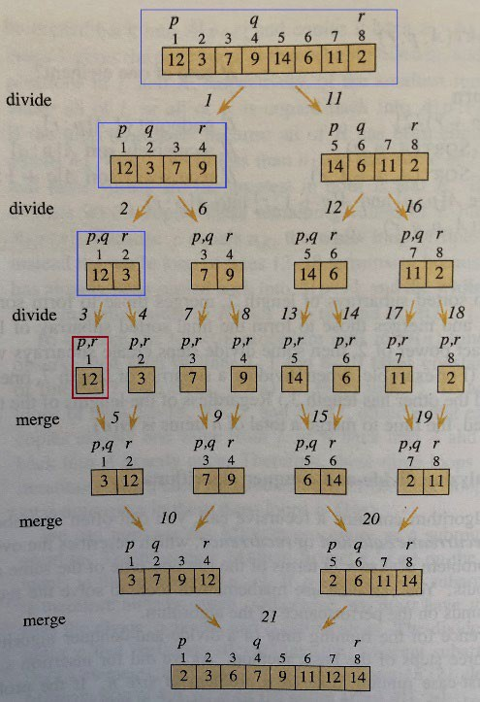
Activation Records and Recursive Calls
Merge-Sort(A, 1, 1)
Merge-Sort(A, 1, 2)
Merge-Sort(A, 1, 4)
Merge-Sort(A, 1, 8)
Merge-Sort(A, 1, 2)
Merge-Sort(A, 1, 4)
Merge-Sort(A, 1, 8)

Slide 15
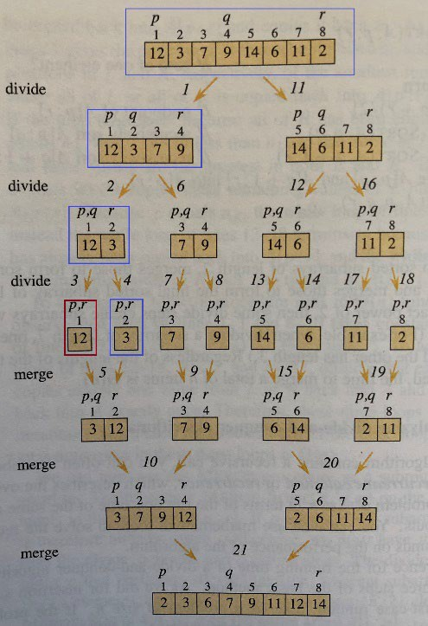
Activation Records and Recursive Calls
Merge-Sort(A, 2, 2)
Merge-Sort(A, 1, 2)
Merge-Sort(A, 1, 4)
Merge-Sort(A, 1, 8)
Merge-Sort(A, 1, 2)
Merge-Sort(A, 1, 4)
Merge-Sort(A, 1, 8)

Slide 16
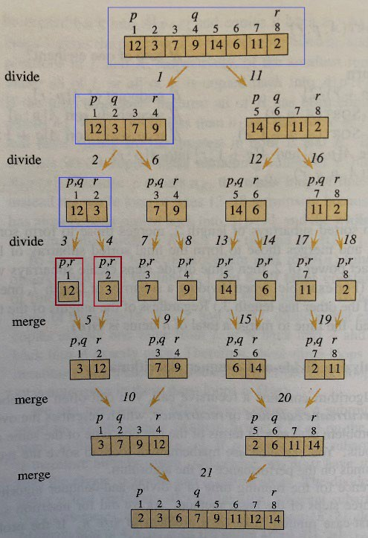
Activation Records and Recursive Calls
Merge-Sort(A, 2, 2)
Merge-Sort(A, 1, 2)
Merge-Sort(A, 1, 4)
Merge-Sort(A, 1, 8)
Merge-Sort(A, 1, 2)
Merge-Sort(A, 1, 4)
Merge-Sort(A, 1, 8)

Slide 17
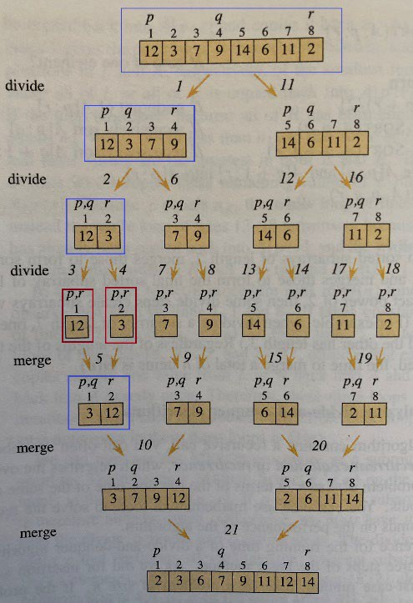
Activation Records and Recursive Calls
Merge(A, 1, 1, 2)
Merge-Sort(A, 1, 2)
Merge-Sort(A, 1, 4)
Merge-Sort(A, 1, 8)
Merge-Sort(A, 1, 2)
Merge-Sort(A, 1, 4)
Merge-Sort(A, 1, 8)

Slide 18
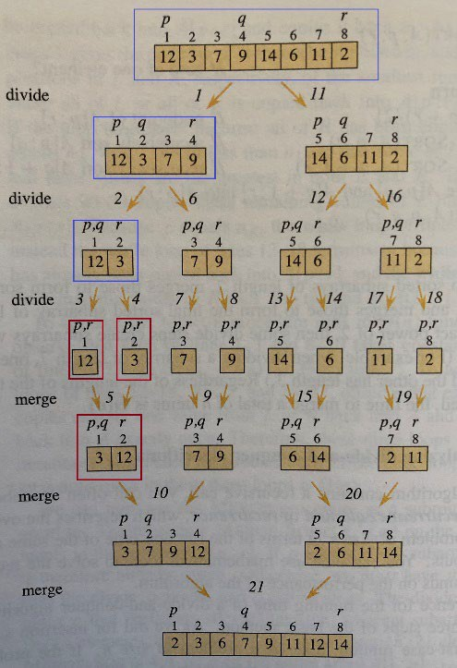
Activation Records and Recursive Calls
Merge(A, 1, 1, 2)
Merge-Sort(A, 1, 2)
Merge-Sort(A, 1, 4)
Merge-Sort(A, 1, 8)
Merge-Sort(A, 1, 2)
Merge-Sort(A, 1, 4)
Merge-Sort(A, 1, 8)

Slide 19
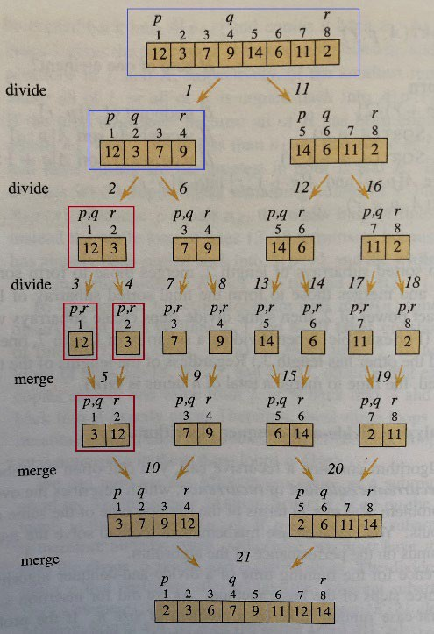
Activation Records and Recursive Calls
Merge-Sort(A, 1, 2)
Merge-Sort(A, 1, 4)
Merge-Sort(A, 1, 8)
Merge-Sort(A, 1, 4)
Merge-Sort(A, 1, 8)

Slide 20
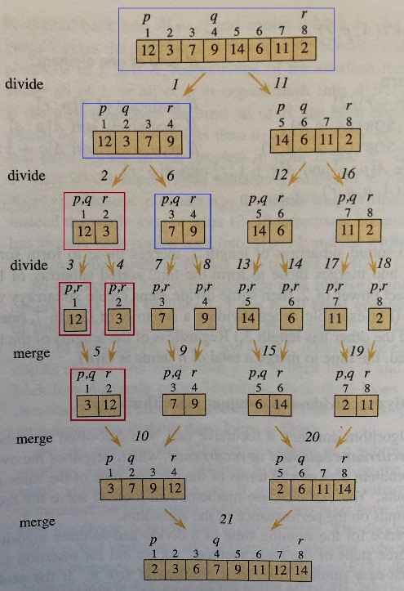
Activation Records and Recursive Calls
Merge-Sort(A, 3, 4)
Merge-Sort(A, 1, 4)
Merge-Sort(A, 1, 8)
Merge-Sort(A, 1, 4)
Merge-Sort(A, 1, 8)

Slide 21
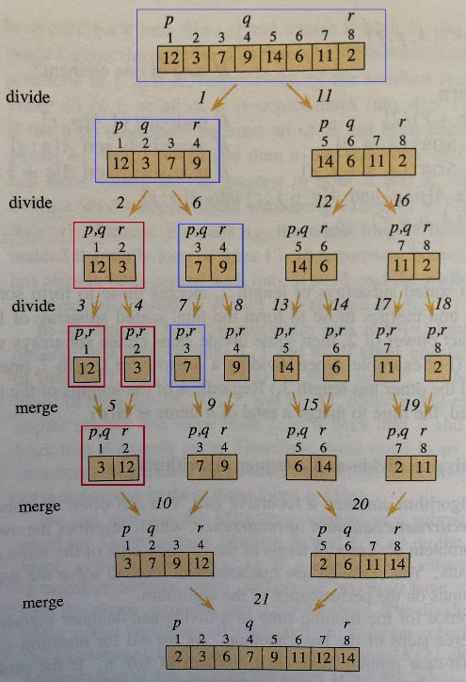
Activation Records and Recursive Calls
Merge-Sort(A, 3, 3)
Merge-Sort(A, 3, 4)
Merge-Sort(A, 1, 4)
Merge-Sort(A, 1, 8)
Merge-Sort(A, 3, 4)
Merge-Sort(A, 1, 4)
Merge-Sort(A, 1, 8)

Slide 22

Activation Records and Recursive Calls
Merge-Sort(A, 3, 3)
Merge-Sort(A, 3, 4)
Merge-Sort(A, 1, 4)
Merge-Sort(A, 1, 8)
Merge-Sort(A, 3, 4)
Merge-Sort(A, 1, 4)
Merge-Sort(A, 1, 8)

Slide 23
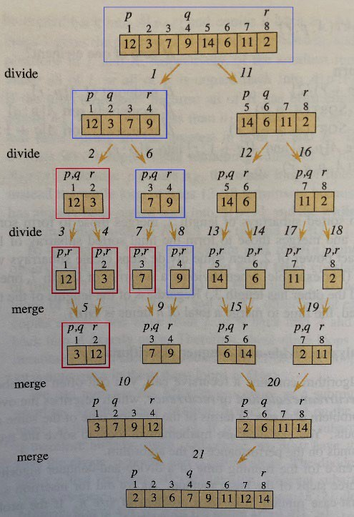
Activation Records and Recursive Calls
Merge-Sort(A, 4, 4)
Merge-Sort(A, 3, 4)
Merge-Sort(A, 1, 4)
Merge-Sort(A, 1, 8)
Merge-Sort(A, 3, 4)
Merge-Sort(A, 1, 4)
Merge-Sort(A, 1, 8)

Slide 24

Activation Records and Recursive Calls
Merge-Sort(A, 4, 4)
Merge-Sort(A, 3, 4)
Merge-Sort(A, 1, 4)
Merge-Sort(A, 1, 8)
Merge-Sort(A, 3, 4)
Merge-Sort(A, 1, 4)
Merge-Sort(A, 1, 8)

Slide 25
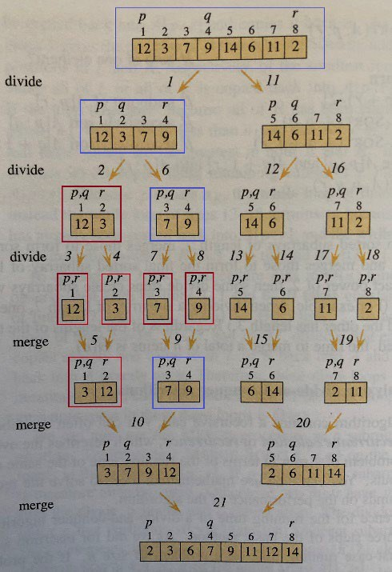
Activation Records and Recursive Calls
Merge(A, 3, 3, 4)
Merge-Sort(A, 3, 4)
Merge-Sort(A, 1, 4)
Merge-Sort(A, 1, 8)
Merge-Sort(A, 3, 4)
Merge-Sort(A, 1, 4)
Merge-Sort(A, 1, 8)

Slide 26
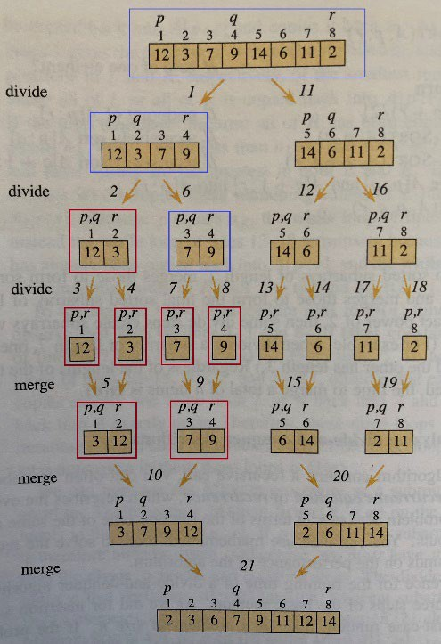
Activation Records and Recursive Calls
Merge(A, 3, 3, 4)
Merge-Sort(A, 3, 4)
Merge-Sort(A, 1, 4)
Merge-Sort(A, 1, 8)
Merge-Sort(A, 3, 4)
Merge-Sort(A, 1, 4)
Merge-Sort(A, 1, 8)

Slide 27
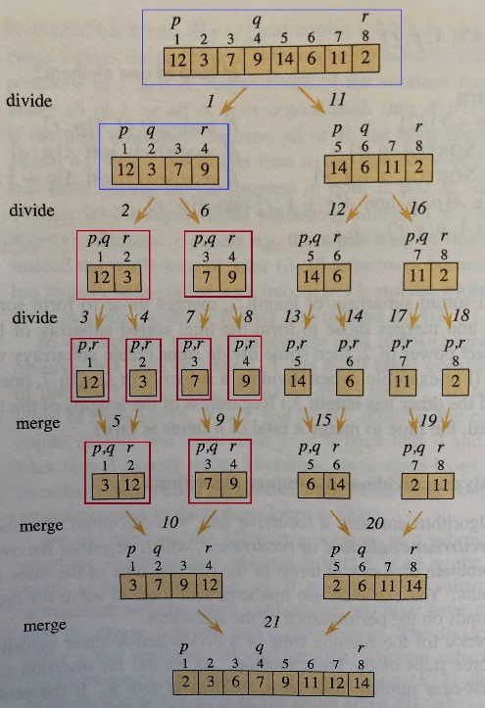
Activation Records and Recursive Calls
Merge-Sort(A, 3, 4)
Merge-Sort(A, 1, 4)
Merge-Sort(A, 1, 8)
Merge-Sort(A, 1, 4)
Merge-Sort(A, 1, 8)

Slide 28
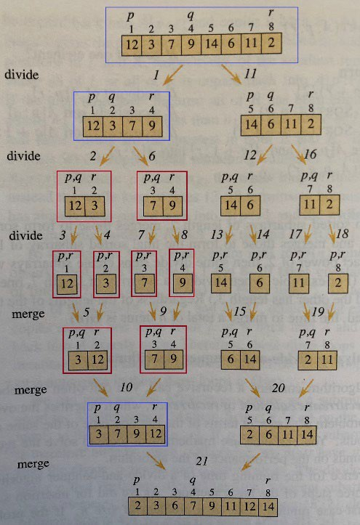
Activation Records and Recursive Calls
Merge(A, 1, 2, 4)
Merge-Sort(A, 1, 4)
Merge-Sort(A, 1, 8)
Merge-Sort(A, 1, 4)
Merge-Sort(A, 1, 8)

Slide 29
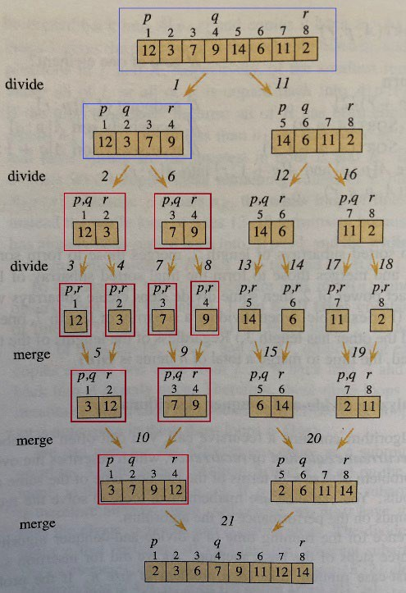
Activation Records and Recursive Calls
Merge(A, 1, 2, 4)
Merge-Sort(A, 1, 4)
Merge-Sort(A, 1, 8)
Merge-Sort(A, 1, 4)
Merge-Sort(A, 1, 8)

Slide 30
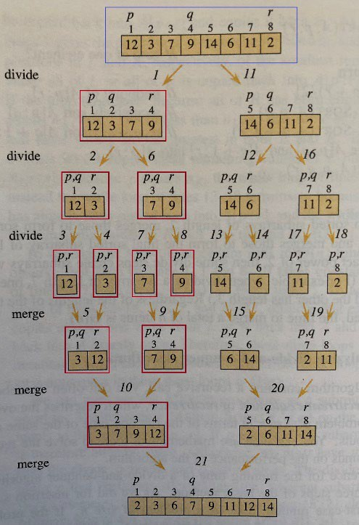
Activation Records and Recursive Calls
Merge-Sort(A, 1, 4)
Merge-Sort(A, 1, 8)
Merge-Sort(A, 1, 8)

Slide 31
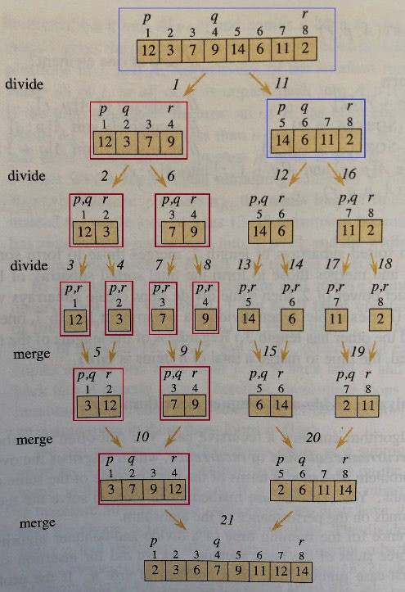
Activation Records and Recursive Calls
Merge-Sort(A, 5, 8)
Merge-Sort(A, 1, 8)
Merge-Sort(A, 1, 8)

Slide 32
Activation Records and Recursive Calls
Merge-Sort(A, 5, 6)
Merge-Sort(A, 5, 8)
Merge-Sort(A, 1, 8)
Merge-Sort(A, 5, 8)
Merge-Sort(A, 1, 8)

Slide 33
Activation Records and Recursive Calls
Merge-Sort(A, 5, 5)
Merge-Sort(A, 5, 6)
Merge-Sort(A, 5, 8)
Merge-Sort(A, 1, 8)
Merge-Sort(A, 5, 6)
Merge-Sort(A, 5, 8)
Merge-Sort(A, 1, 8)

Slide 34
Activation Records and Recursive Calls
Merge-Sort(A, 5, 5)
Merge-Sort(A, 5, 6)
Merge-Sort(A, 5, 8)
Merge-Sort(A, 1, 8)
Merge-Sort(A, 5, 6)
Merge-Sort(A, 5, 8)
Merge-Sort(A, 1, 8)

Slide 35
Activation Records and Recursive Calls
Merge-Sort(A, 6, 6)
Merge-Sort(A, 5, 6)
Merge-Sort(A, 5, 8)
Merge-Sort(A, 1, 8)
Merge-Sort(A, 5, 6)
Merge-Sort(A, 5, 8)
Merge-Sort(A, 1, 8)

Slide 36
Activation Records and Recursive Calls
Merge-Sort(A, 6, 6)
Merge-Sort(A, 5, 6)
Merge-Sort(A, 5, 8)
Merge-Sort(A, 1, 8)
Merge-Sort(A, 5, 6)
Merge-Sort(A, 5, 8)
Merge-Sort(A, 1, 8)

Slide 37
Activation Records and Recursive Calls
Merge(A, 5, 5, 6)
Merge-Sort(A, 5, 6)
Merge-Sort(A, 5, 6)
Merge-Sort(A, 5, 8)
Merge-Sort(A, 5, 8)
Merge-Sort(A, 1, 8)
Merge-Sort(A, 1, 8)

Slide 38
Activation Records and Recursive Calls
Merge(A, 5, 5, 6)
Merge-Sort(A, 5, 6)
Merge-Sort(A, 5, 6)
Merge-Sort(A, 5, 8)
Merge-Sort(A, 1, 8)
Merge-Sort(A, 5, 8)
Merge-Sort(A, 1, 8)

Slide 39
Activation Records and Recursive Calls
Merge-Sort(A, 5, 6)
Merge-Sort(A, 5, 8)
Merge-Sort(A, 1, 8)
Merge-Sort(A, 5, 8)
Merge-Sort(A, 1, 8)

Slide 40
Activation Records and Recursive Calls
Merge-Sort(A, 7, 8)
Merge-Sort(A, 5, 8)
Merge-Sort(A, 1, 8)
Merge-Sort(A, 5, 8)
Merge-Sort(A, 1, 8)

Slide 41
Activation Records and Recursive Calls
Merge-Sort(A, 7, 7)
Merge-Sort(A, 7, 8)
Merge-Sort(A, 5, 8)
Merge-Sort(A, 1, 8)
Merge-Sort(A, 7, 8)
Merge-Sort(A, 5, 8)
Merge-Sort(A, 1, 8)

Slide 42
Activation Records and Recursive Calls
Merge-Sort(A, 7, 7)
Merge-Sort(A, 7, 8)
Merge-Sort(A, 7, 8)
Merge-Sort(A, 5, 8)
Merge-Sort(A, 5, 8)
Merge-Sort(A, 1, 8)
Merge-Sort(A, 1, 8)

Slide 43
Activation Records and Recursive Calls
Merge-Sort(A, 8, 8)
Merge-Sort(A, 7, 8)
Merge-Sort(A, 7, 8)
Merge-Sort(A, 5, 8)
Merge-Sort(A, 5, 8)
Merge-Sort(A, 1, 8)
Merge-Sort(A, 1, 8)

Slide 44
Activation Records and Recursive Calls
Merge-Sort(A, 8, 8)
Merge-Sort(A, 7, 8)
Merge-Sort(A, 7, 8)
Merge-Sort(A, 5, 8)
Merge-Sort(A, 5, 8)
Merge-Sort(A, 1, 8)
Merge-Sort(A, 1, 8)

Slide 45
Activation Records and Recursive Calls
Merge(A, 7, 7, 8)
Merge-Sort(A, 7, 8)
Merge-Sort(A, 7, 8)
Merge-Sort(A, 5, 8)
Merge-Sort(A, 5, 8)
Merge-Sort(A, 1, 8)
Merge-Sort(A, 1, 8)

Slide 46
Activation Records and Recursive Calls
Merge(A, 7, 7, 8)
Merge-Sort(A, 7, 8)
Merge-Sort(A, 7, 8)
Merge-Sort(A, 5, 8)
Merge-Sort(A, 1, 8)
Merge-Sort(A, 5, 8)
Merge-Sort(A, 1, 8)

Slide 47
Activation Records and Recursive Calls
Merge-Sort(A, 7, 8)
Merge-Sort(A, 5, 8)
Merge-Sort(A, 1, 8)
Merge-Sort(A, 5, 8)
Merge-Sort(A, 1, 8)

Slide 48
Activation Records and Recursive Calls
Merge(A, 5, 6, 8)
Merge-Sort(A, 5, 8)
Merge-Sort(A, 1, 8)
Merge-Sort(A, 5, 8)
Merge-Sort(A, 1, 8)

Slide 49
Activation Records and Recursive Calls
Merge(A, 5, 6, 8)
Merge-Sort(A, 5, 8)
Merge-Sort(A, 1, 8)
Merge-Sort(A, 5, 8)
Merge-Sort(A, 1, 8)

Slide 50
Activation Records and Recursive Calls
Merge-Sort(A, 5, 8)
Merge-Sort(A, 1, 8)
Merge-Sort(A, 1, 8)

Slide 51
Activation Records and Recursive Calls
Merge(A, 1, 4, 8)
Merge-Sort(A, 1, 8)
Merge-Sort(A, 1, 8)

Slide 52
Activation Records and Recursive Calls
Merge(A, 1, 4, 8)
Merge-Sort(A, 1, 8)
Merge-Sort(A, 1, 8)

Slide 53
Activation Records and Recursive Calls
Merge-Sort(A, 1, 8)

Slide 54
Running Time of Mergesort
Time needed for size n instance is T(n)
The base case (n = 1): 𝚯𝚯(1)
Time needed to divide the instance: D(n) = 𝚯𝚯(1)
Time needed for 2 sub-instances is 2T(n/2)
T(n) = 2T(n/2) + n
T(n) = 𝚯𝚯(n log(n))

Slide 55


