Slide 1
Schottky Barrier in QCAD
Suzey Gao
June 1, 2015

Slide 2
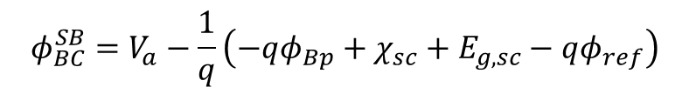
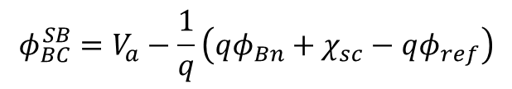
Potential BC at Schottky Contact
The empirical expressions^{[1]-[4]} for electric potential at Schottky contacts, when solving the Thomas-Fermi Poisson equation in QCAD, are given by
$$φ_{BC}^{SB}=V_{a}−\frac{1}{q}\left(qφ_{Bn}+χ_{sc}−qφ_{ref}\right)$$
for Schottky contact on n-type semiconductor, in unit of Volts
applied voltage
Schottky barrier height on n-type semiconductor, equal to Ec - Ef > 0
Electron affinity of the n-type semiconductor
Constant shift between vacuum potential and electric potential
$$φ_{BC}^{SB}=V_{a}−\frac{1}{q}\left(−qφ_{Bp}+χ_{sc}+E_{g,sc}−qφ_{ref}\right)$$
for Schottky contact on p-type semiconductor
Schottky barrier height on p-type semiconductor, equal to Ef – Ev > 0
Band gap of the semiconductor
[1] S. M. Sze and Kwok K. Ng, Chapter 3 of Physics of Semiconductor Devices, Third Edition (2007).
[2] Raymond T. Tung, Appl. Phys. Rev. 1, 011304 (2014).
[3] L. X. Zhang et al., Phys. Rev. B 69, 245301 (2004).
[4] M. Stopa, Phys. Rev. B 54, 13767 (1996).

Slide 3


GaAs/AlGaAs Stack
gaaspsub contact, Ohmic or Schottky
GaAs, Na = 1.0x10¹⁵ cm⁻³, 1610 nm
T = 4 K
Fermi-Dirac
Al_{0.27}Ga_{0.73}As, undoped, 20 nm
Al_{0.27}Ga_{0.73}As, Nd = 0.31x10¹⁸ cm⁻³, 65 nm
nschottkygate contact, Ohmic or Schottky
GaAs, Nd = 1.5x10¹⁸ cm⁻³, 5 nm
Stack comes from L. X. Zhang et al., Phys. Rev. B 69, 245301 (2004).

Slide 4
Contact Specification in QCAD
(1) Both contacts are Ohmic
<ParameterList name="Dirichlet BCs">
<Parameter name="DBC on NS gaaspsub for DOF Phi" type="double" value="0.0" />
<Parameter name="DBC on NS nschottkygate for DOF Phi" type="double" value="0.0" />
</ParameterList>
(2) nschottkygate is Schottky, while gaaspsub is Ohmic
The “Dirichlet BCs” section remains the same
<ParameterList name="Schottky Barrier">
<Parameter name="Schottky Barrier Height for NS nschottkygate" type="double" value="0.8" />
</ParameterList>
(3) Both contacts are Schottky
The “Dirichlet BCs” section remains the same
<ParameterList name="Schottky Barrier">
<Parameter name="Schottky Barrier Height for NS nschottkygate" type="double" value="0.8" />
<Parameter name="Schottky Barrier Height for NS gaaspsub" type="double" value="0.6" />
</ParameterList>
Material properties for GaAs and Al0.27Ga0.73As are added to material_gaas.xml.

Slide 5
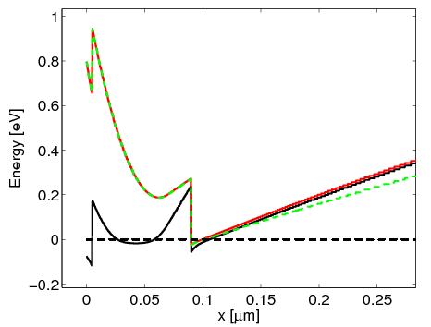
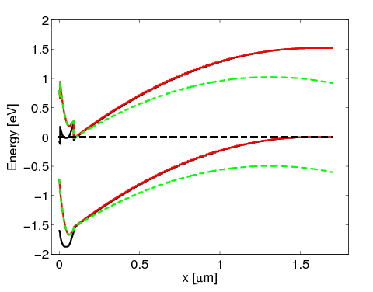

Energy Band at Equilibrium
nschottkygate
gaaspsub
Ec
0.8 eV
Ef = 0
0.6 eV
(1)
(2)
(3)
Ev
Barrier height for Schottky contact on n-type semiconductor refers to the difference between Ec and Ef and is positive
Barrier height for Schottky contact on p-type semiconductor refers to the difference between Ef and Ev and is positive
Flat band at the Ohmic gaaspsub contact implies good Ohmic
No flat band for the Ohmic nschottkygate implies that Ohmic assumption is not good

Slide 6
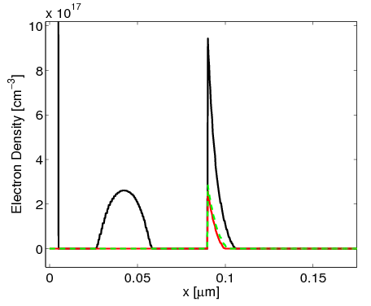
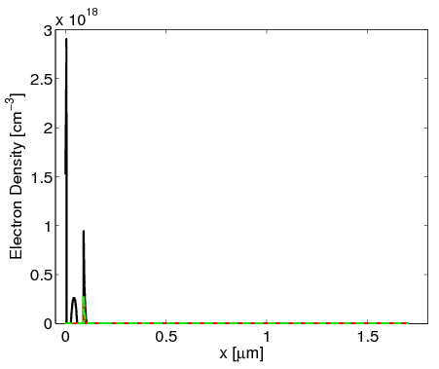
Electron Density at Equilibrium
(1)
(2)
(3)
2DEG
AlGaAs
Electron accumulation in the AlGaAs layer when assuming Ohmic condition for the nschottky contact.

Slide 7
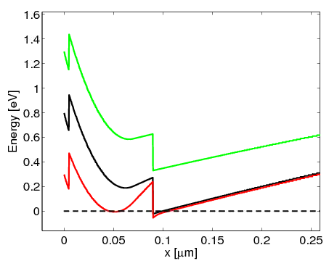

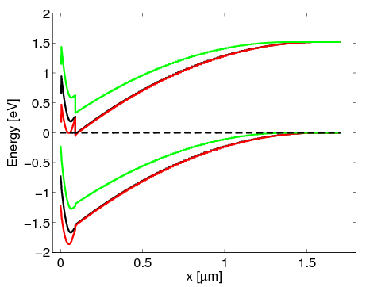
Energy Band Under Bias
nschottkygate, Schottky
gaaspsub, Ohmic
Ec
0.8 eV
Ev
nschottkygate is a Schottky contact with barrier height of 0.8 eV.
Positive voltage at nschottky lowers the conduction band
Negative voltage at nschottky raises the conduction band

Slide 8
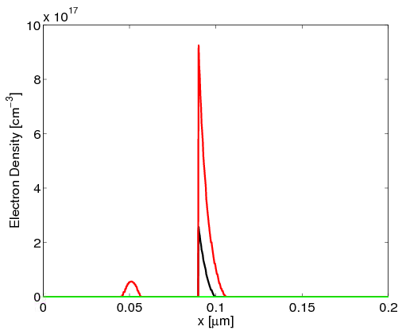
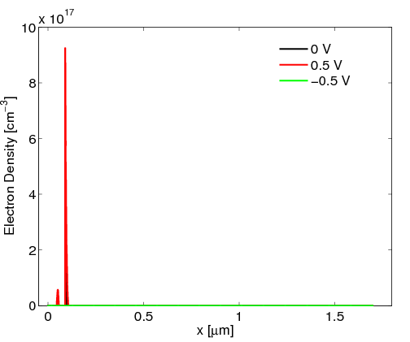

Electron Density Under Bias
2DEG density increases when 0.5 V is applied to nschottkygate
2DEG disappears when -0.5 V is applied to nschottkygate

Slide 9
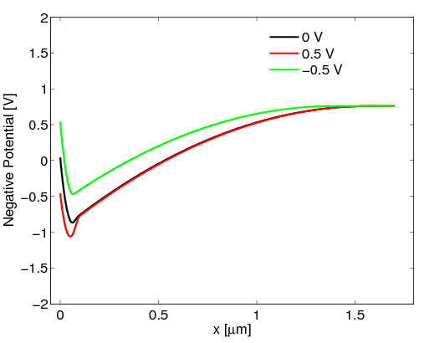

Negative Potential Under Bias
nschottkygate, Schottky
Ec
Ev
Conduction bands show quite different profiles from those of the negative potentials, hence one needs to be careful about which quantity to use for further analysis.
They are related by [X. Gao et. al, JAP 114, 164302 (2013) ]
potential
conduction band
electron affinity

