Slide 1
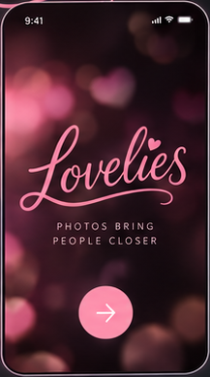
Notes:
01 · Splash
Source: Lovelies dark storyboard, board 1 of 4.
Exact crop: 217 × 390 px. Original proportions preserved.
Image-based screen, not separately editable text, icons, or controls.
Original generated content is preserved as provided; this transfer is not a new UX/functionality audit.

Slide 2
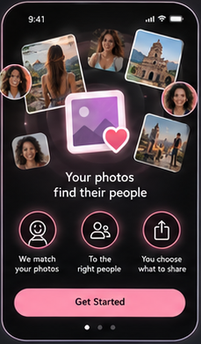
Notes:
02 · Introduction and how it works
Source: Lovelies dark storyboard, board 1 of 4.
Exact crop: 229 × 391 px. Original proportions preserved.
Image-based screen, not separately editable text, icons, or controls.
Original generated content is preserved as provided; this transfer is not a new UX/functionality audit.

Slide 3
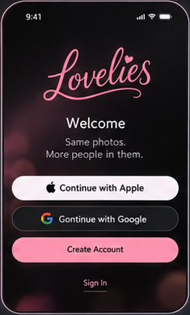
Notes:
03 · Sign in and join
Source: Lovelies dark storyboard, board 1 of 4.
Exact crop: 235 × 389 px. Original proportions preserved.
Image-based screen, not separately editable text, icons, or controls.
Original generated content is preserved as provided; this transfer is not a new UX/functionality audit.

Slide 4
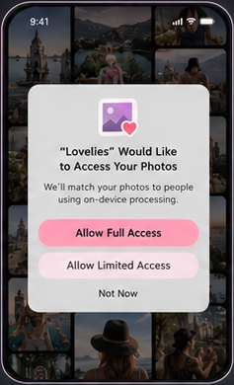
Notes:
04 · Photo access prompt
Source: Lovelies dark storyboard, board 1 of 4.
Exact crop: 237 × 390 px. Original proportions preserved.
Image-based screen, not separately editable text, icons, or controls.
Original generated content is preserved as provided; this transfer is not a new UX/functionality audit.

Slide 5
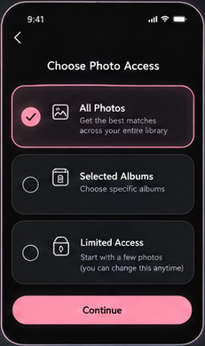
Notes:
05 · Photo access options
Source: Lovelies dark storyboard, board 1 of 4.
Exact crop: 231 × 390 px. Original proportions preserved.
Image-based screen, not separately editable text, icons, or controls.
Original generated content is preserved as provided; this transfer is not a new UX/functionality audit.

Slide 6
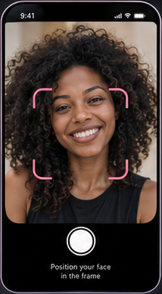
Notes:
06 · Face enrollment
Source: Lovelies dark storyboard, board 1 of 4.
Exact crop: 214 × 389 px. Original proportions preserved.
Image-based screen, not separately editable text, icons, or controls.
Original generated content is preserved as provided; this transfer is not a new UX/functionality audit.

Slide 7
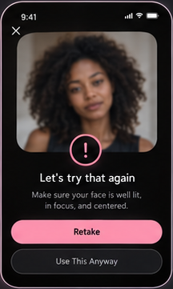
Notes:
07 · Face quality retry
Source: Lovelies dark storyboard, board 1 of 4.
Exact crop: 216 × 361 px. Original proportions preserved.
Image-based screen, not separately editable text, icons, or controls.
Original generated content is preserved as provided; this transfer is not a new UX/functionality audit.

Slide 8
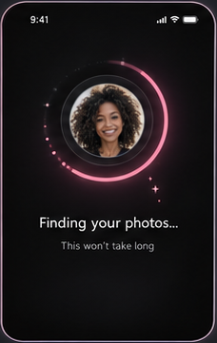
Notes:
08 · Processing
Source: Lovelies dark storyboard, board 1 of 4.
Exact crop: 228 × 361 px. Original proportions preserved.
Image-based screen, not separately editable text, icons, or controls.
Original generated content is preserved as provided; this transfer is not a new UX/functionality audit.

Slide 9
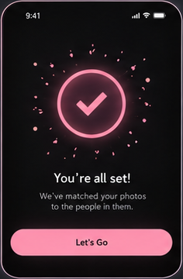
Notes:
09 · Setup complete
Source: Lovelies dark storyboard, board 1 of 4.
Exact crop: 236 × 360 px. Original proportions preserved.
Image-based screen, not separately editable text, icons, or controls.
Original generated content is preserved as provided; this transfer is not a new UX/functionality audit.

Slide 10
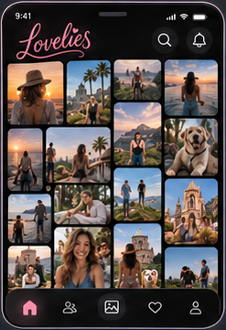
Notes:
10 · Home gallery
Source: Lovelies dark storyboard, board 1 of 4.
Exact crop: 247 × 361 px. Original proportions preserved.
Image-based screen, not separately editable text, icons, or controls.
Original generated content is preserved as provided; this transfer is not a new UX/functionality audit.

Slide 11
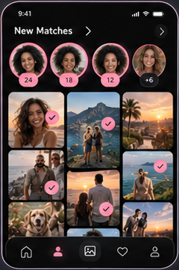
Notes:
11 · New matches
Source: Lovelies dark storyboard, board 1 of 4.
Exact crop: 240 × 361 px. Original proportions preserved.
Image-based screen, not separately editable text, icons, or controls.
Original generated content is preserved as provided; this transfer is not a new UX/functionality audit.

Slide 12
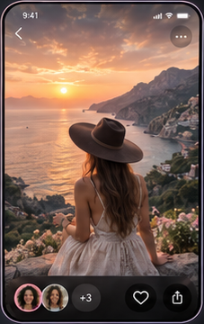
Notes:
12 · Photo viewer
Source: Lovelies dark storyboard, board 1 of 4.
Exact crop: 227 × 360 px. Original proportions preserved.
Image-based screen, not separately editable text, icons, or controls.
Original generated content is preserved as provided; this transfer is not a new UX/functionality audit.

Slide 13
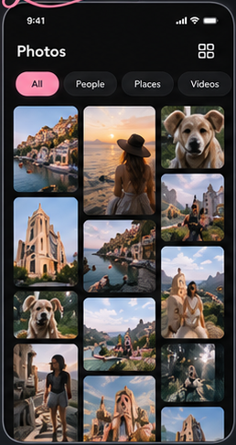
Notes:
13 · All photos
Source: Lovelies dark storyboard, board 2 of 4.
Exact crop: 258 × 487 px. Original proportions preserved.
Image-based screen, not separately editable text, icons, or controls.
Original generated content is preserved as provided; this transfer is not a new UX/functionality audit.

Slide 14
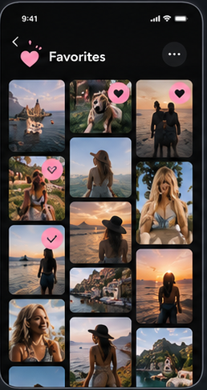
Notes:
14 · Favorites and saved
Source: Lovelies dark storyboard, board 2 of 4.
Exact crop: 258 × 487 px. Original proportions preserved.
Image-based screen, not separately editable text, icons, or controls.
Original generated content is preserved as provided; this transfer is not a new UX/functionality audit.

Slide 15
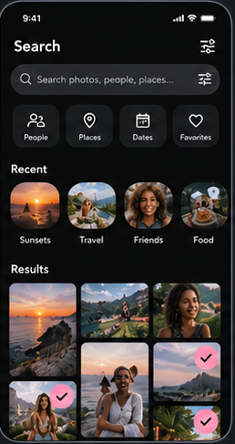
Notes:
15 · Search
Source: Lovelies dark storyboard, board 2 of 4.
Exact crop: 258 × 487 px. Original proportions preserved.
Image-based screen, not separately editable text, icons, or controls.
Original generated content is preserved as provided; this transfer is not a new UX/functionality audit.

Slide 16
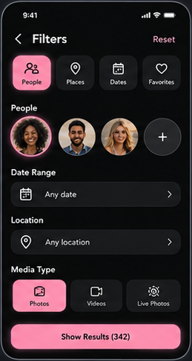
Notes:
16 · Filters
Source: Lovelies dark storyboard, board 2 of 4.
Exact crop: 259 × 487 px. Original proportions preserved.
Image-based screen, not separately editable text, icons, or controls.
Original generated content is preserved as provided; this transfer is not a new UX/functionality audit.

Slide 17
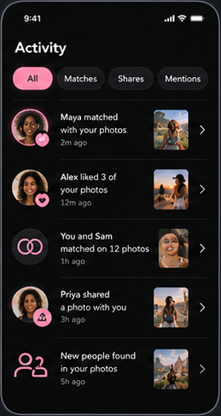
Notes:
17 · Activity inbox
Source: Lovelies dark storyboard, board 2 of 4.
Exact crop: 259 × 486 px. Original proportions preserved.
Image-based screen, not separately editable text, icons, or controls.
Original generated content is preserved as provided; this transfer is not a new UX/functionality audit.

Slide 18
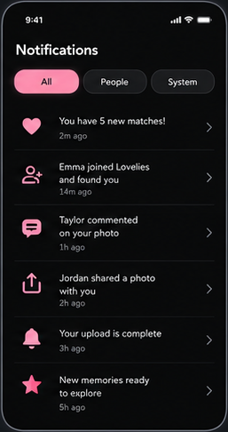
Notes:
18 · Notifications
Source: Lovelies dark storyboard, board 2 of 4.
Exact crop: 257 × 486 px. Original proportions preserved.
Image-based screen, not separately editable text, icons, or controls.
Original generated content is preserved as provided; this transfer is not a new UX/functionality audit.

Slide 19
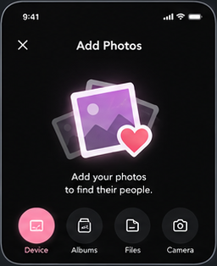
Notes:
19 · Upload entry
Source: Lovelies dark storyboard, board 2 of 4.
Exact crop: 256 × 314 px. Original proportions preserved.
Image-based screen, not separately editable text, icons, or controls.
Original generated content is preserved as provided; this transfer is not a new UX/functionality audit.

Slide 20
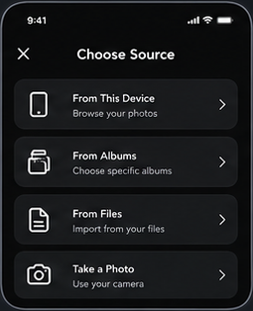
Notes:
20 · Upload source picker
Source: Lovelies dark storyboard, board 2 of 4.
Exact crop: 255 × 314 px. Original proportions preserved.
Image-based screen, not separately editable text, icons, or controls.
Original generated content is preserved as provided; this transfer is not a new UX/functionality audit.

Slide 21
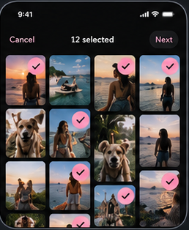
Notes:
21 · Select upload photos
Source: Lovelies dark storyboard, board 2 of 4.
Exact crop: 258 × 314 px. Original proportions preserved.
Image-based screen, not separately editable text, icons, or controls.
Original generated content is preserved as provided; this transfer is not a new UX/functionality audit.

Slide 22
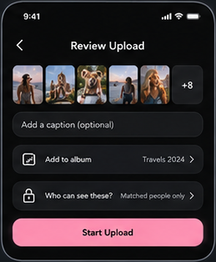
Notes:
22 · Review upload
Source: Lovelies dark storyboard, board 2 of 4.
Exact crop: 259 × 314 px. Original proportions preserved.
Image-based screen, not separately editable text, icons, or controls.
Original generated content is preserved as provided; this transfer is not a new UX/functionality audit.

Slide 23
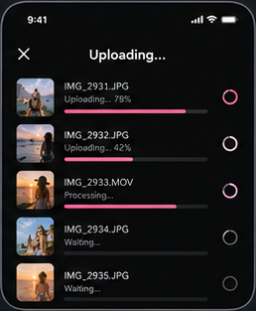
Notes:
23 · Upload progress
Source: Lovelies dark storyboard, board 2 of 4.
Exact crop: 258 × 313 px. Original proportions preserved.
Image-based screen, not separately editable text, icons, or controls.
Original generated content is preserved as provided; this transfer is not a new UX/functionality audit.

Slide 24
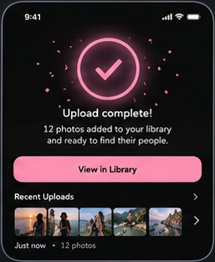
Notes:
24 · Upload complete
Source: Lovelies dark storyboard, board 2 of 4.
Exact crop: 257 × 313 px. Original proportions preserved.
Image-based screen, not separately editable text, icons, or controls.
Original generated content is preserved as provided; this transfer is not a new UX/functionality audit.

Slide 25
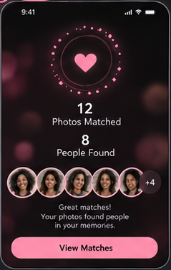
Notes:
25 · Match results summary
Source: Lovelies dark storyboard, board 3 of 4.
Exact crop: 239 × 377 px. Original proportions preserved.
Image-based screen, not separately editable text, icons, or controls.
Original generated content is preserved as provided; this transfer is not a new UX/functionality audit.

Slide 26
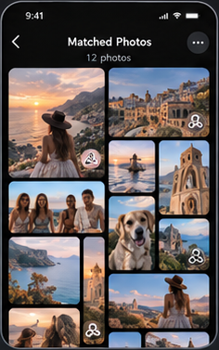
Notes:
26 · Matched photos gallery
Source: Lovelies dark storyboard, board 3 of 4.
Exact crop: 236 × 377 px. Original proportions preserved.
Image-based screen, not separately editable text, icons, or controls.
Original generated content is preserved as provided; this transfer is not a new UX/functionality audit.

Slide 27
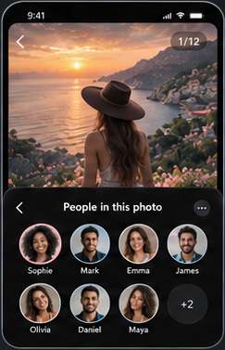
Notes:
27 · Photo to people
Source: Lovelies dark storyboard, board 3 of 4.
Exact crop: 243 × 377 px. Original proportions preserved.
Image-based screen, not separately editable text, icons, or controls.
Original generated content is preserved as provided; this transfer is not a new UX/functionality audit.

Slide 28
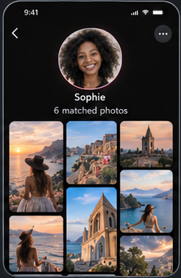
Notes:
28 · Person to photos
Source: Lovelies dark storyboard, board 3 of 4.
Exact crop: 246 × 377 px. Original proportions preserved.
Image-based screen, not separately editable text, icons, or controls.
Original generated content is preserved as provided; this transfer is not a new UX/functionality audit.

Slide 29
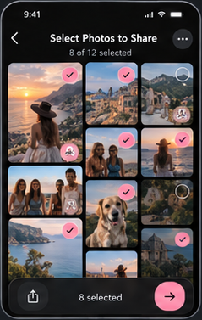
Notes:
29 · Select photos to share
Source: Lovelies dark storyboard, board 3 of 4.
Exact crop: 239 × 377 px. Original proportions preserved.
Image-based screen, not separately editable text, icons, or controls.
Original generated content is preserved as provided; this transfer is not a new UX/functionality audit.

Slide 30
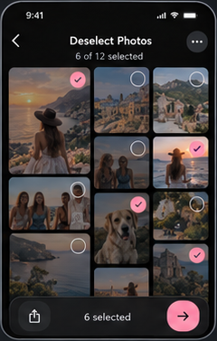
Notes:
30 · Deselect photos
Source: Lovelies dark storyboard, board 3 of 4.
Exact crop: 240 × 377 px. Original proportions preserved.
Image-based screen, not separately editable text, icons, or controls.
Original generated content is preserved as provided; this transfer is not a new UX/functionality audit.

Slide 31
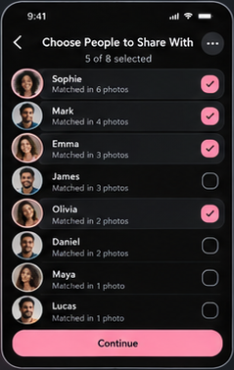
Notes:
31 · Select people to share with
Source: Lovelies dark storyboard, board 3 of 4.
Exact crop: 239 × 378 px. Original proportions preserved.
Image-based screen, not separately editable text, icons, or controls.
Original generated content is preserved as provided; this transfer is not a new UX/functionality audit.

Slide 32
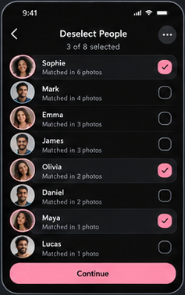
Notes:
32 · Deselect people
Source: Lovelies dark storyboard, board 3 of 4.
Exact crop: 237 × 378 px. Original proportions preserved.
Image-based screen, not separately editable text, icons, or controls.
Original generated content is preserved as provided; this transfer is not a new UX/functionality audit.

Slide 33
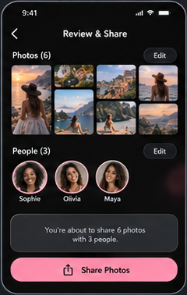
Notes:
33 · Review and share
Source: Lovelies dark storyboard, board 3 of 4.
Exact crop: 240 × 378 px. Original proportions preserved.
Image-based screen, not separately editable text, icons, or controls.
Original generated content is preserved as provided; this transfer is not a new UX/functionality audit.

Slide 34
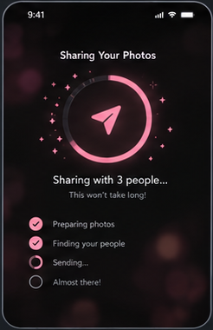
Notes:
34 · Sharing progress
Source: Lovelies dark storyboard, board 3 of 4.
Exact crop: 246 × 380 px. Original proportions preserved.
Image-based screen, not separately editable text, icons, or controls.
Original generated content is preserved as provided; this transfer is not a new UX/functionality audit.

Slide 35
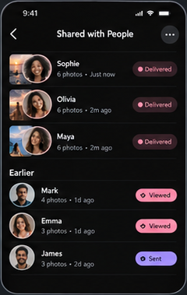
Notes:
35 · Shared history
Source: Lovelies dark storyboard, board 3 of 4.
Exact crop: 240 × 379 px. Original proportions preserved.
Image-based screen, not separately editable text, icons, or controls.
Original generated content is preserved as provided; this transfer is not a new UX/functionality audit.

Slide 36
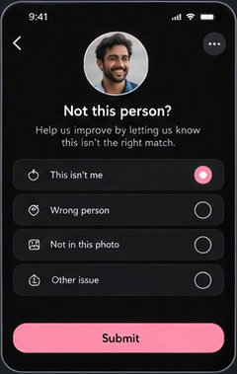
Notes:
36 · Report incorrect match
Source: Lovelies dark storyboard, board 3 of 4.
Exact crop: 240 × 379 px. Original proportions preserved.
Image-based screen, not separately editable text, icons, or controls.
Original generated content is preserved as provided; this transfer is not a new UX/functionality audit.

Slide 37
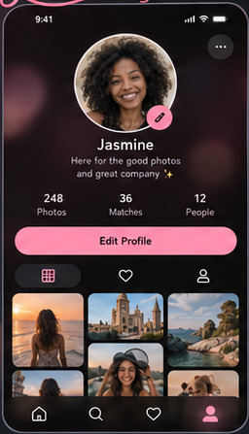
Notes:
37 · Profile overview
Source: Lovelies dark storyboard, board 4 of 4.
Exact crop: 256 × 447 px. Original proportions preserved.
Image-based screen, not separately editable text, icons, or controls.
Original generated content is preserved as provided; this transfer is not a new UX/functionality audit.

Slide 38
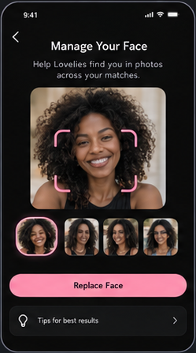
Notes:
38 · Face management
Source: Lovelies dark storyboard, board 4 of 4.
Exact crop: 249 × 447 px. Original proportions preserved.
Image-based screen, not separately editable text, icons, or controls.
Original generated content is preserved as provided; this transfer is not a new UX/functionality audit.

Slide 39
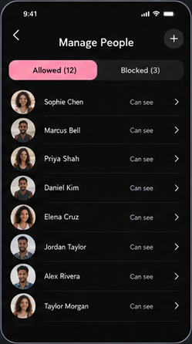
Notes:
39 · Manage allowed recipients
Source: Lovelies dark storyboard, board 4 of 4.
Exact crop: 249 × 446 px. Original proportions preserved.
Image-based screen, not separately editable text, icons, or controls.
Original generated content is preserved as provided; this transfer is not a new UX/functionality audit.

Slide 40
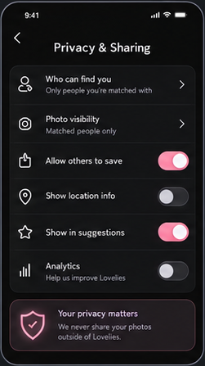
Notes:
40 · Privacy and sharing
Source: Lovelies dark storyboard, board 4 of 4.
Exact crop: 251 × 447 px. Original proportions preserved.
Image-based screen, not separately editable text, icons, or controls.
Original generated content is preserved as provided; this transfer is not a new UX/functionality audit.

Slide 41
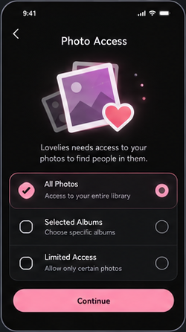
Notes:
41 · Photo access settings
Source: Lovelies dark storyboard, board 4 of 4.
Exact crop: 250 × 446 px. Original proportions preserved.
Image-based screen, not separately editable text, icons, or controls.
Original generated content is preserved as provided; this transfer is not a new UX/functionality audit.

Slide 42
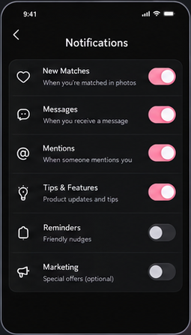
Notes:
42 · Notification settings
Source: Lovelies dark storyboard, board 4 of 4.
Exact crop: 255 × 447 px. Original proportions preserved.
Image-based screen, not separately editable text, icons, or controls.
Original generated content is preserved as provided; this transfer is not a new UX/functionality audit.

Slide 43
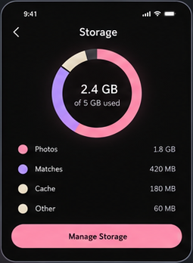
Notes:
43 · Storage
Source: Lovelies dark storyboard, board 4 of 4.
Exact crop: 255 × 348 px. Original proportions preserved.
Image-based screen, not separately editable text, icons, or controls.
Original generated content is preserved as provided; this transfer is not a new UX/functionality audit.

Slide 44
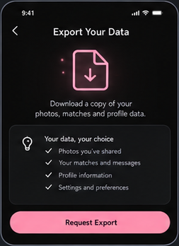
Notes:
44 · Data export
Source: Lovelies dark storyboard, board 4 of 4.
Exact crop: 253 × 348 px. Original proportions preserved.
Image-based screen, not separately editable text, icons, or controls.
Original generated content is preserved as provided; this transfer is not a new UX/functionality audit.

Slide 45
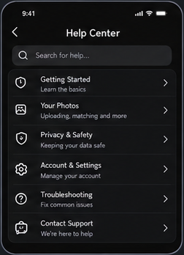
Notes:
45 · Help center
Source: Lovelies dark storyboard, board 4 of 4.
Exact crop: 252 × 348 px. Original proportions preserved.
Image-based screen, not separately editable text, icons, or controls.
Original generated content is preserved as provided; this transfer is not a new UX/functionality audit.

Slide 46
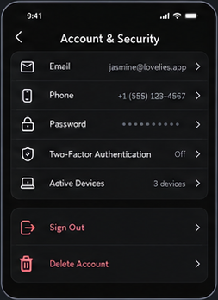
Notes:
46 · Account security and devices
Source: Lovelies dark storyboard, board 4 of 4.
Exact crop: 253 × 348 px. Original proportions preserved.
Image-based screen, not separately editable text, icons, or controls.
Original generated content is preserved as provided; this transfer is not a new UX/functionality audit.

Slide 47
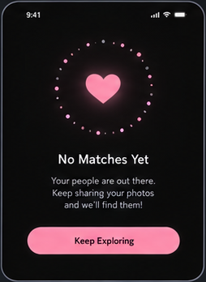
Notes:
47 · No matches
Source: Lovelies dark storyboard, board 4 of 4.
Exact crop: 254 × 348 px. Original proportions preserved.
Image-based screen, not separately editable text, icons, or controls.
Original generated content is preserved as provided; this transfer is not a new UX/functionality audit.

Slide 48
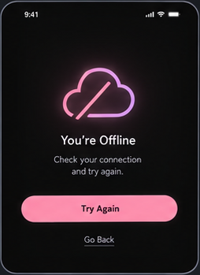
Notes:
48 · Offline and error
Source: Lovelies dark storyboard, board 4 of 4.
Exact crop: 254 × 349 px. Original proportions preserved.
Image-based screen, not separately editable text, icons, or controls.
Original generated content is preserved as provided; this transfer is not a new UX/functionality audit.

