Slide 1
Onboarding Plan for New
Students
03/24/2020
Ishita Kapoor

Slide 2
Agenda
eLearning Overview
1
Client Introduction & Problem Statement
2
Methodology
3
Exploratory Data Analysis
4
Modeling
5
Recommendations
6
Future Scope
7

Slide 3




eLearning Overview
Convenient
Budget-friendly
Interactive
Self-paced
$325 Bn
projected e-learning market worth by 2025¹
3 Mn
students chose exclusively e-learning courses in 2018²
https://techjury.net/stats-about/elearning/#gref
https://nces.ed.gov/fastfacts/display.asp?id=80

Slide 4




Open University
Flexible, Innovative Teaching
157 countries worldwide
200 qualifications to choose from
75% students' study while working
Open University wants to create a better onboarding plan to enhance student experience

Slide 5


Methodology
EDA
Individual Features v/s Performance
Visualizations - Tableau
Understand
Data sets
Column names
Field abbreviations
Data Manipulation
Remove NA’s
Feature Engineering – Avg Clicks per Day
Feature Importance – Backward Selection
Modeling
Data balancing – imbalanced target
Baseline models – Logistic, RF, GBM
Hyperparameter Tuning
Stacked Ensemble – DT, RF, GBM
Finalize
Consolidate insights
Recommendations and future scope

Slide 6
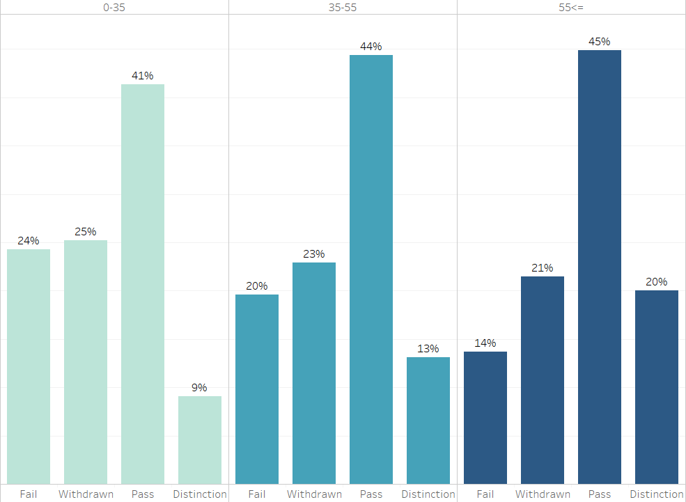
Exploratory Data Analysis
50%
people aged <=35 failed or withdrawn
43%
people aged 35-55 failed/withdrawn course
65%
out of 180 people aged >=55 have passed

Slide 7
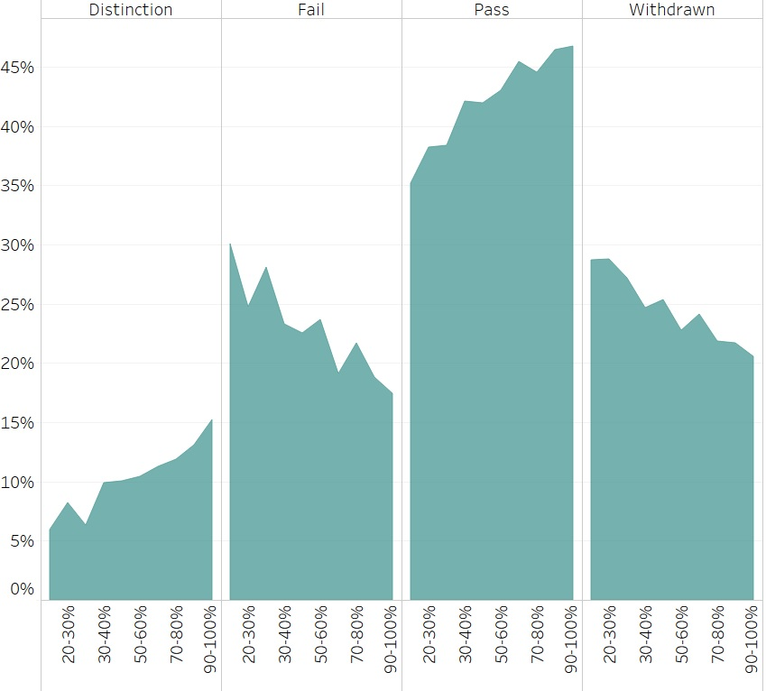
Exploratory Data Analysis
IMD – Index of Multiple Deprivation
IMD 20% indicates areas in the top 20% in terms of deprivation
% of Students
Pass and Distinction rates have a positive correlation with the IMD Band
IMD Band

Slide 8
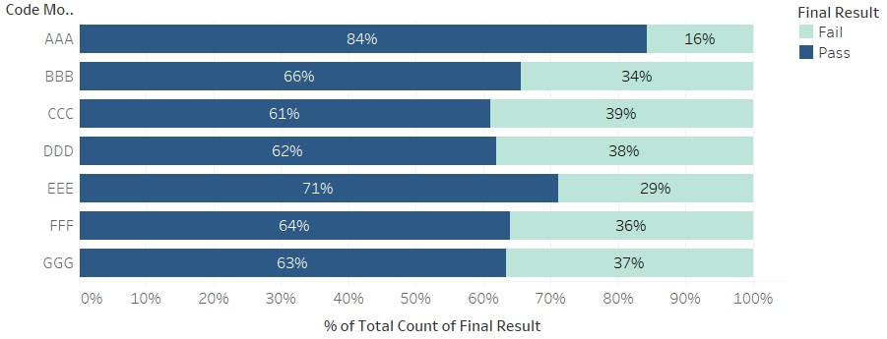
Exploratory Data Analysis
84%
highest pass rate was in course AAA
FFF has the 2000 Virtual Learning Experiences
High VLE resources do not translate to a high pass rate
% of Students

Slide 9
Predicting Student Outcomes
Modeling objective – identify potential high performing students
Low log loss – indicates low chances of missing out on ideal students
1
2
3
4
Baseline Logistic Regression
Random Forest Classifier
Gradient Boosting Machine
Stacked Ensemble – GBM, Decision Trees & RF
Log Loss
1.32
Log Loss
1.06
Log Loss
1.14
Log Loss
0.87

Slide 10






Recommendations
Provide monetary support to low IMD areas, having high withdrawals
Check quality of VLEs as high resources do not translate to high pass rates
Provide Activity Status to better judge completion of VLE materials
Ensure courses are equally accessible for students with disabilities
Recommended courses to students based on prior experience/education
Analyze why certain courses have high withdrawal rates

Slide 11




Future Scope
Leveraging type of VLE and activity status to predict the result
Tracking performance at regular intervals – Progress Bar
Provide actual score as the result instead of pass/fail
Gamify the platform – leaderboards, points-based scholarship

Slide 12


Thank You

Slide 13
Appendix

Slide 14
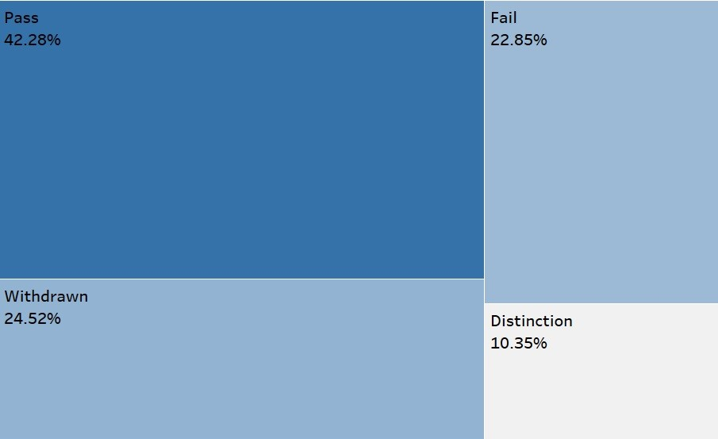
Overall Performance

Slide 15
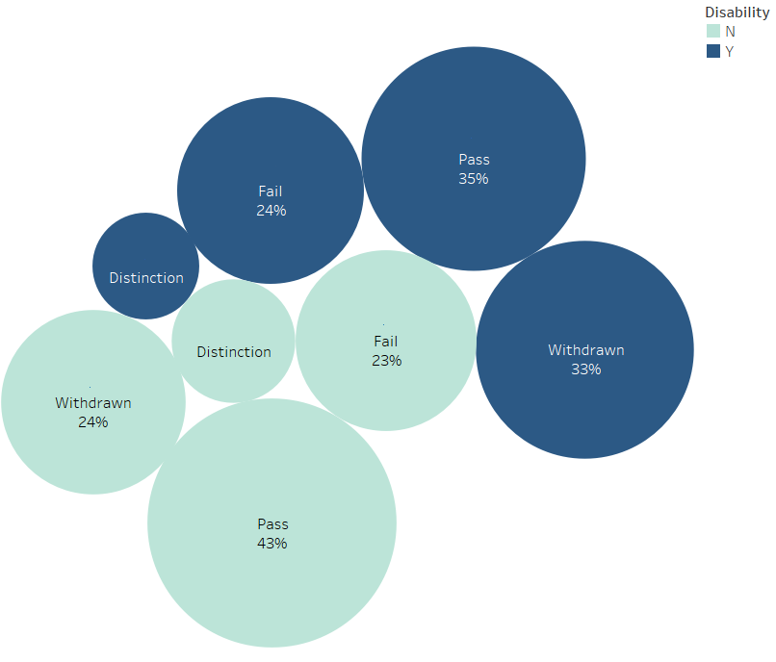
Performance v/s Disability

Slide 16
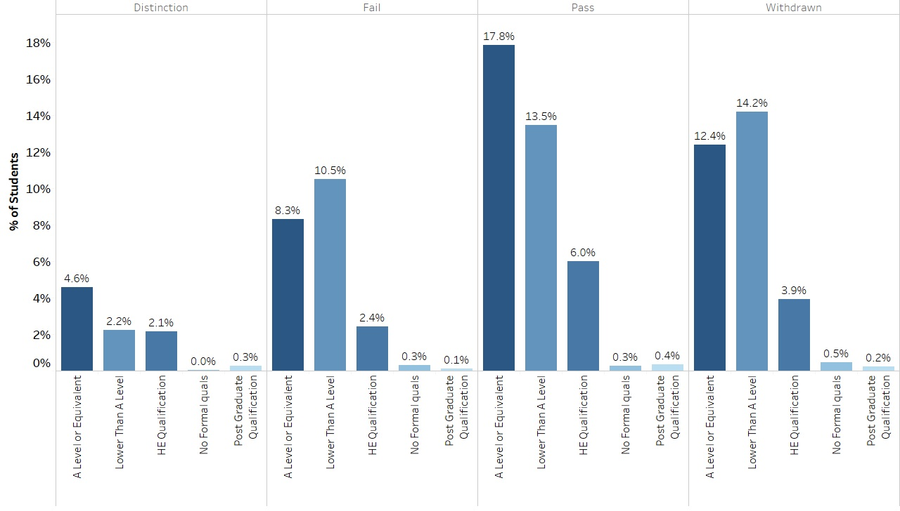
Performance v/s Prior Education

Slide 17
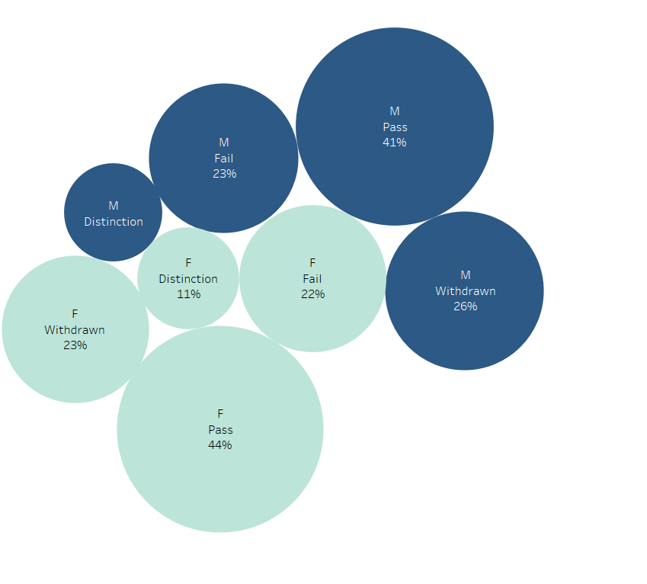
Performance v/s Gender

Slide 18
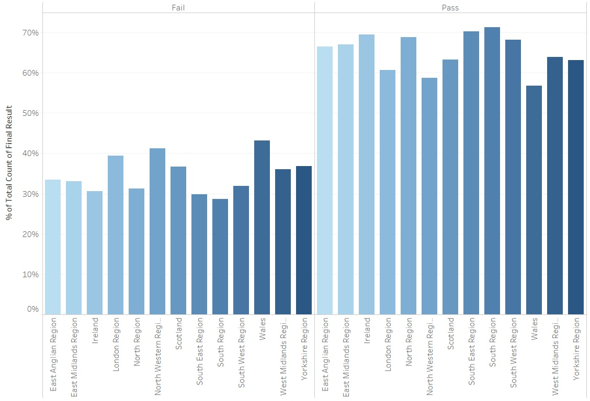
Performance v/s Region

