Slide 1
EasyColoc
Smarter Roommate Expense Management
Ali Kara

Slide 2
Problem & Solution
Calculating shared household expenses manually is tedious, error-prone, and often leads to conflicts among roommates.
EasyColoc is a web application that automatically tracks shared expenses, instantly calculates who owes whom, and enforces financial accountability.

Slide 3




Tech Stack
Blade

Slide 4
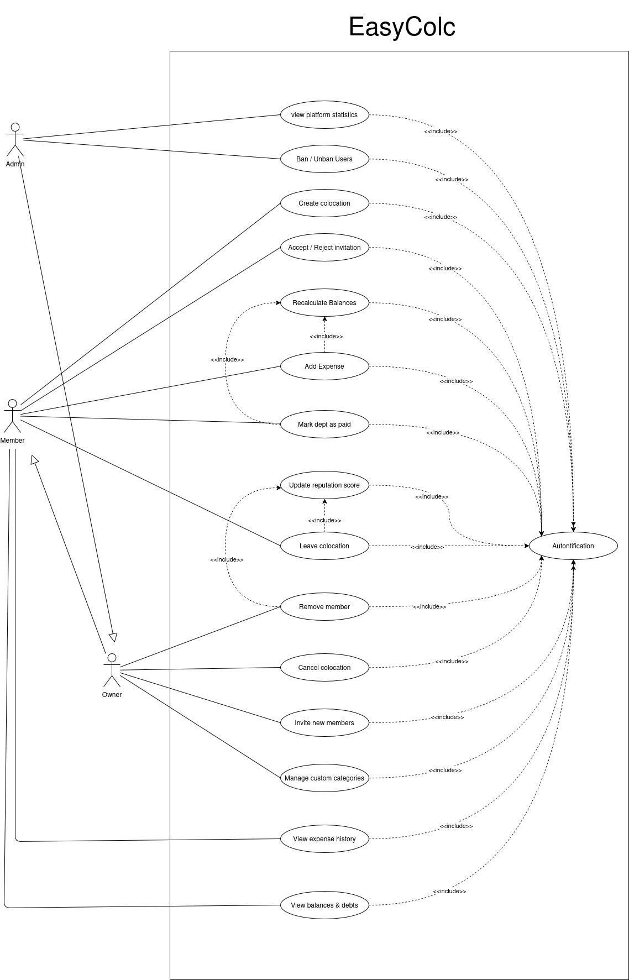
Use-case

Slide 5
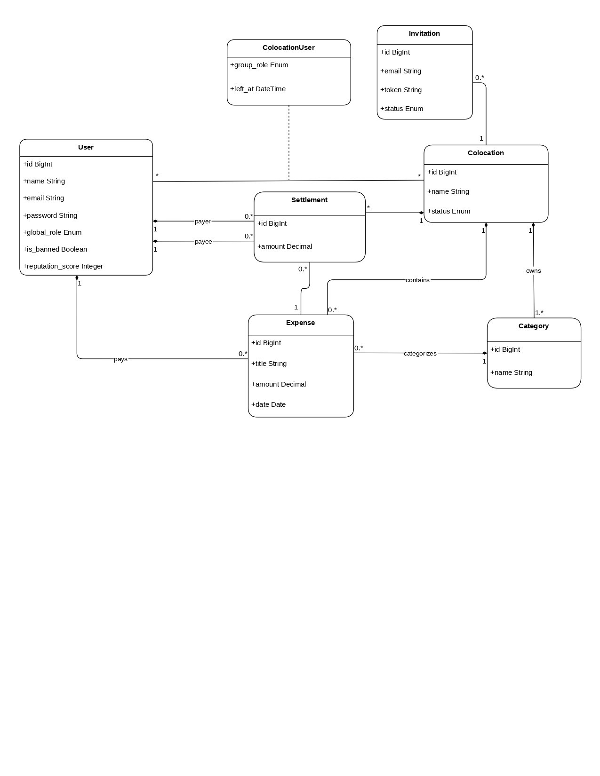
class-diagram
(UML)

Slide 6
web-site demonstration

