Slide 1
CUS1166 – Software Engineering Technology Presentation
Flask-Pundit
Imaya Karunanayake
March 27, 2019

Slide 2
Pundit
Overview
Pundit is an easy way to organize who has access and control of what (for your models)
Wouldn’t want everyone to have the same amount of control because it easily could potentially create problems.
Having designated access and control to specific people will help keep order and less problems are likely to arise.
Notes:
Provide any information need to orient the audience what topic you are about to present.

Slide 3
Situation where using Pundit would be useful
Purpose/Goal of Technology
For a Blog:
The privileges would vary for:
Admin – (would potentially have more control)
User – (would have their own capabilities but not as much control as an Admin)
Guest – (probably have the least amount of options)
An Admin: could monitor what gets posted and has the ability to delete certain unappropriated or irrelevant posts.
A User: would have the ability to post and edit whatever it is they have posted. Users would be restricted to change another users post for instance.
A Guest: would only be able to see the view the posts and not create a post or edit (read only). The privileges for the guests would be very limited.
Notes:
Motivate. what problem does this technology tries to solve; What is its purpose

Slide 4
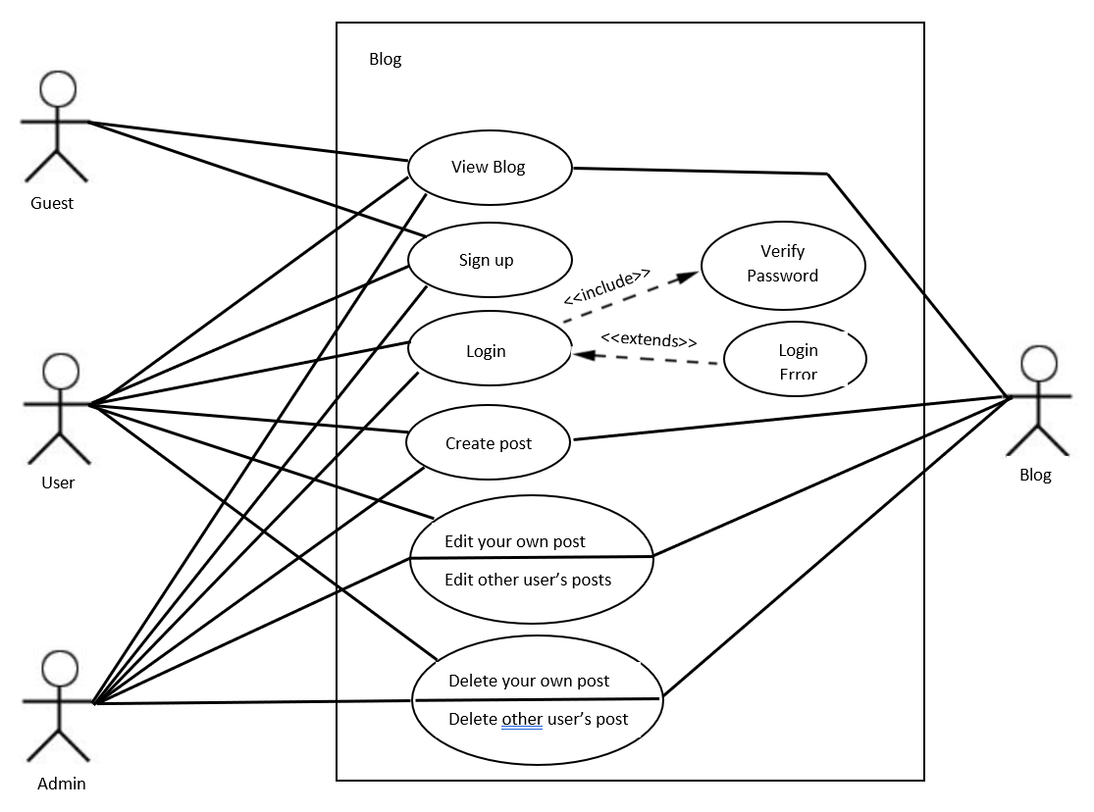
Case
Use Cases Diagram
Notes:
Identify possible use cases, examples, problems someone could consider using this technology.

Slide 5
Steps When Working with Pundit
Background – Key Concepts
Step 1: Create a ‘Policy’ class (this is where you authorize access to a specific type of record – e.g. Blog or User or Guest etc.)
Step 2: Call the built-in ‘authorize’ function (this is where you pass whoever you want to allow to have access)
Step 3: Now Pundit will search and find the ‘Policy’ class and call the ‘Policy’ method (this is the method you are authorizing).
If true, you will then have permission to perform whatever action.
If not, it will then throw an exception.
Notes:
Introduce any background, key concepts and terminology needed for the audience to understand the technology your are presenting.

Slide 6
Using Pundit
Background – Key Concepts
First Step: Installation
pip install flask-pundit
Initializing the extension:
pundit = FlaskPundit(app) where app is the application object.
pundit.init_app(app) after constructing the FlaskPundit without an app object.
Notes:
Introduce any background, key concepts and terminology needed for the audience to understand the technology your are presenting.

Slide 7
Using Pundit
Getting Started Tutorial
Initializing the extension (continued):
Can provide an optional policies_path
This tells Flask-Pundit where to find your policy classes (location)
Default to policies if no value is specified.
It is expected that there is 1 policy per model class.
It needs to know where to look in order to find the Policy for a particular model (policies_path).
Notes:
Present a getting tutorial; this should cover the basic activities for someone to start using the technology and solving a basic problem using this technology (This might need more that one slides)

Slide 8
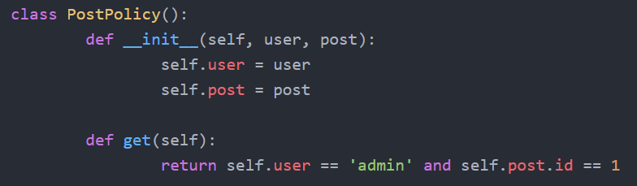
Using Pundit
Getting Started Tutorial
Policy Class:
Defines/lays out the ‘rules’ used to authorize a model.
User object: is the currently logged in user
Post object: is the model instance you intend to authorize.
Get method: is an authorization handler.
Ex: Might want to execute when a user is trying to read a post
Notes:
Present a getting tutorial; this should cover the basic activities for someone to start using the technology and solving a basic problem using this technology (This might need more that one slides)

Slide 9
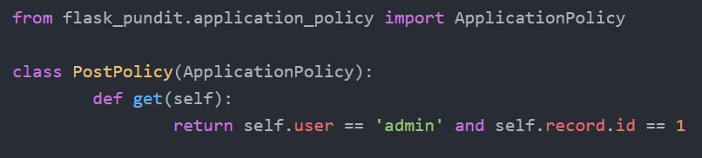
Using Pundit
Getting Started Tutorial
Policy Class (alternative way):
Define your own ‘BasePolicy’ class and extend it, or use the ‘ApplicationPolicy’ class provided by the extension.
Record: Since we are inheriting from the ‘ApplicationPolicy’ class, all instance methods now use records. These records are used to represent the model instance being authorized.
Notes:
Present a getting tutorial; this should cover the basic activities for someone to start using the technology and solving a basic problem using this technology (This might need more that one slides)

Slide 10
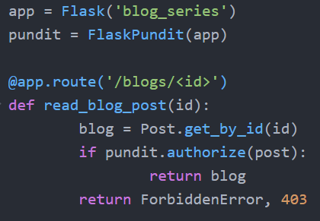
Using Pundit
Getting Started Tutorial
This code shows how to use the authorize method in a single model.
Recap: Invoking ‘authorize’ executes the ‘get’ method in the PostPolicy class.
This authorize method take 3 parameters:
Record: can either be an object or class and corresponds to a ‘model’ that is being authorized.
Action: This depends on what policy method that you want to invoke for doing the authorization.
It will default to the request.method.lowercase() meaning the get method (from the previous snippet).
User: the currently logged in user. If no user object is provided, pundit tries to pick either flask.g.user or flask.g.current_user (whichever is available).
Notes:
Present a getting tutorial; this should cover the basic activities for someone to start using the technology and solving a basic problem using this technology (This might need more that one slides)

Slide 11
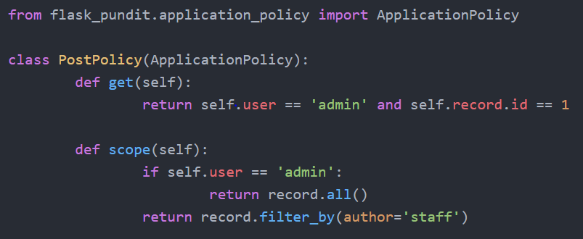
Using Pundit
Getting Started Tutorial
Scopes
The policy_scope method returns a ‘scoped’ version of a model.
Ex: Just like the blog example, with the different privileges for the admins and users (in this code ‘staff’)
This is where you’d want to use ‘policy_scope’ instead of ‘authorize.’
Define the scope method in your policy.
Notes:
Present a getting tutorial; this should cover the basic activities for someone to start using the technology and solving a basic problem using this technology (This might need more that one slides)

Slide 12
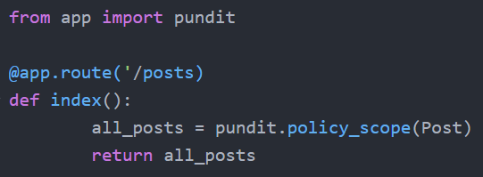
Using Pundit
Getting Started Tutorial
When you call the policy_scope(model) with a model class, the ‘scope’ method gets called (on the previous slide).
Keep in mind not to pass an object here.
This example returns all the post for an admin and staff posts for a user.
The policy-scope method take 2 arguments:
A model: the class that is to be ‘scoped’.
A user object: the user object in the authorize case.
Notes:
Present a getting tutorial; this should cover the basic activities for someone to start using the technology and solving a basic problem using this technology (This might need more that one slides)

Slide 13
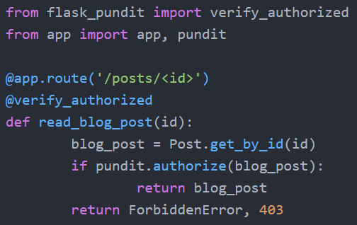
Using Pundit
Getting Started Tutorial
Verification: Flask-Pundit has 2 decorators you can use to verify authorize/policy_scope has been called.
verify_authorized
verify_policy_scope
If you remove the call to ‘authorize’ there will be a RuntimeError since it expects a call but did not find any.
Similarly verify_policy_scoped would be used in the same way.
Notes:
Present a getting tutorial; this should cover the basic activities for someone to start using the technology and solving a basic problem using this technology (This might need more that one slides)

Slide 14
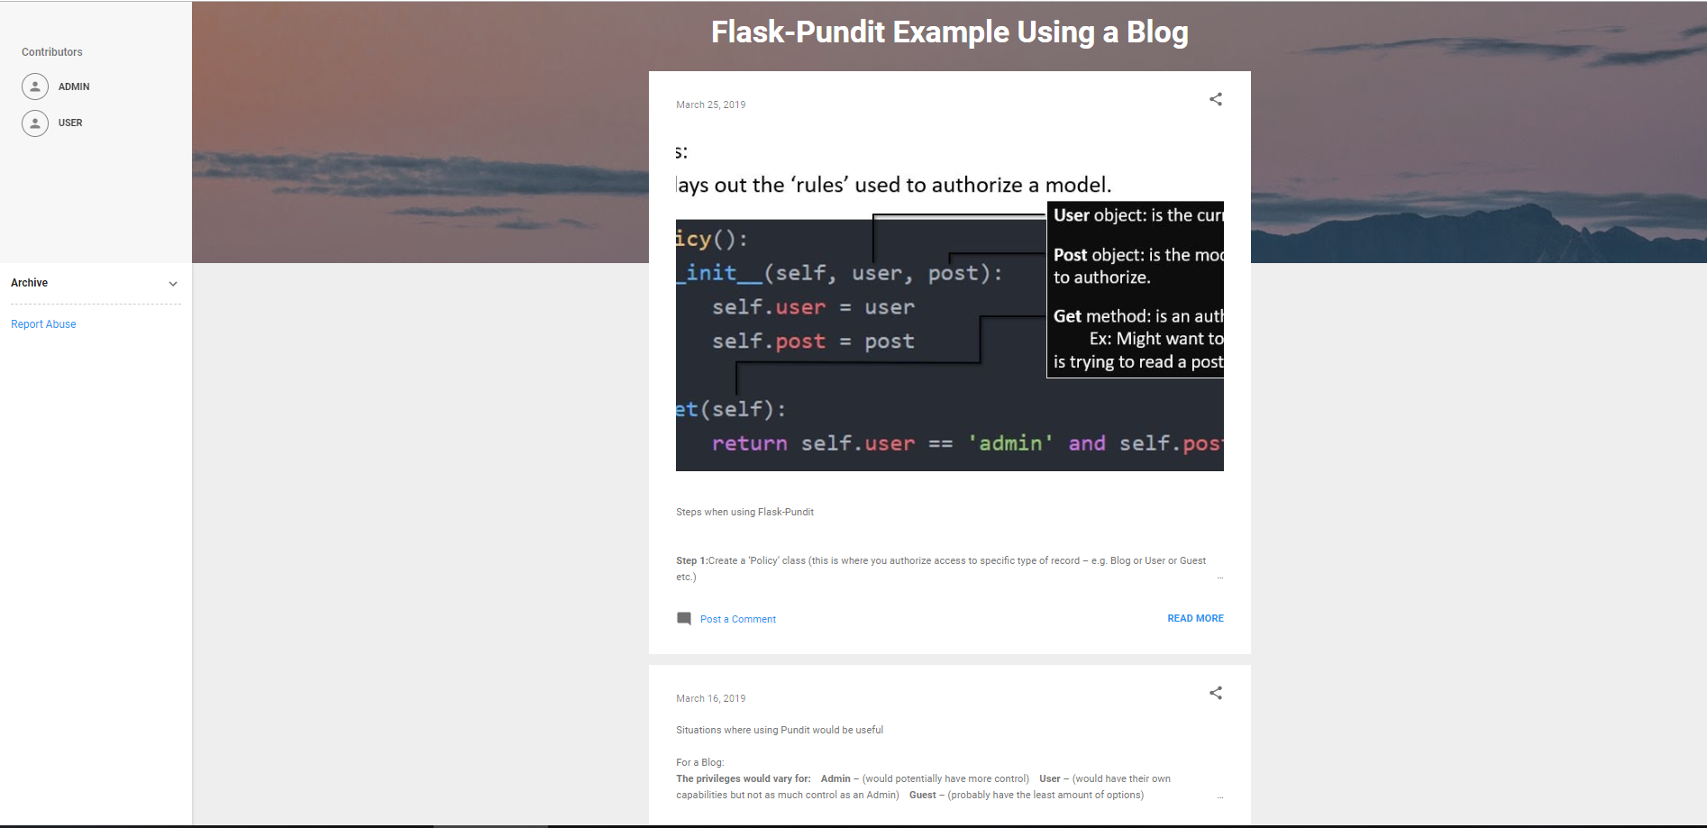
Non-Trivial Application
Notes:
Demonstrate a non-trivial use case/application of the technology that you coded/prepared. This should be a custom example you coded yourself. Possibly this can be an example demonstrating how you could use this technology in your team’s project. You might need more that one slide for this section.

Slide 15
Resources
https://github.com/anurag90x/flask-pundit
https://www.youtube.com/watch?v=PWizyTjCAdg
https://www.youtube.com/watch?v=qruGD_8ry7k
Notes:
Resources for further reading. Provide a list of resources to help your classmates to learn more about this technolgy.

Slide 16
Thank you!!!
Q&A

