Slide 1
Prison Break
breaking out of kiosk mode environments
PRESENTED BY:
Gerhard “IKARUS” Klostermerier
@iiiikarus · www.icaria.de · contact@icaria.de

Slide 2

Me
Gerhard / IKARUS
Pentester, hacker, researcher, IT/HW/RF security enthusiast
Especially interested in hardware hacking and wireless systems
Maybe you know me from MIFARE Classic Tool

Slide 3
Agenda
What is a kiosk mode environment?
What is this talk about and what not?
What interfaces / attack vectors do we have?
Tips, tricks, stories and demos for kiosk mode breakouts
Lessons learned
Q&A + tell your stories, tips and tricks

Slide 4
What is a kiosk mode environment?
“A kiosk mode environment is a system setup where a device or application is locked down to only allow specific functionality, preventing users from accessing anything outside of the intended purpose.“
The interface is streamlined and restricted
Users can't access system settings or other applications
It often runs a single application, like a web browser
Security measures prevent unauthorized modifications

Slide 5
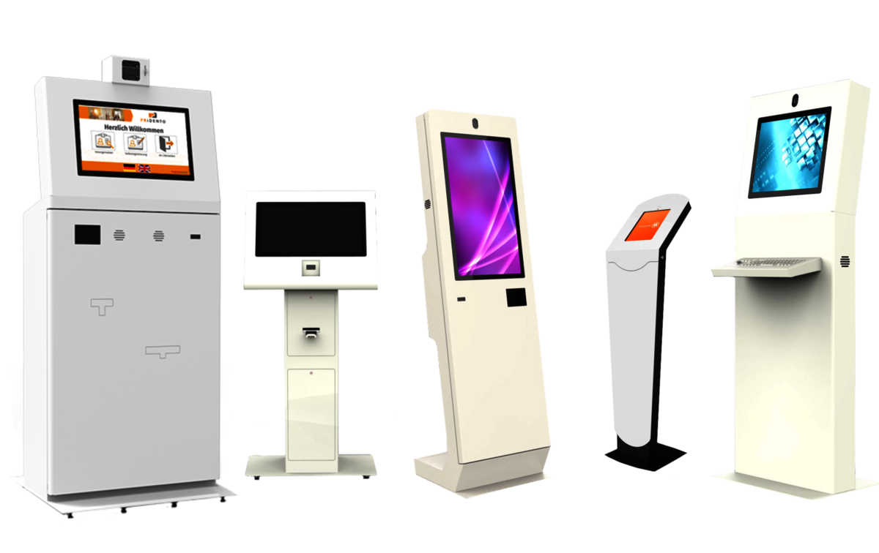
What is a kiosk mode environment?
https://besucherverwaltung.com/kiosk-terminals

Slide 6
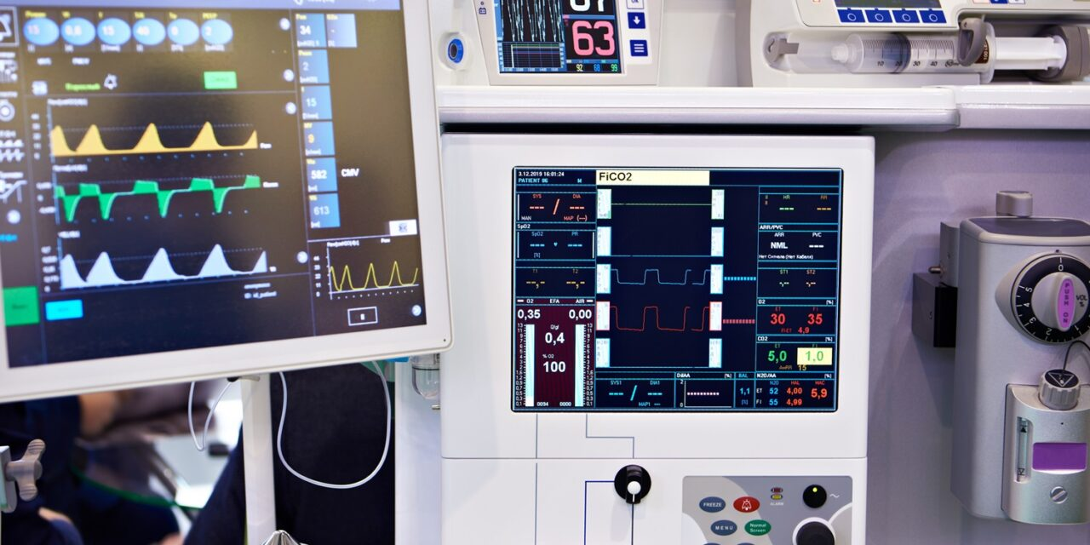
What is a kiosk mode environment?
https://besucherverwaltung.com/kiosk-terminalshttps://24x7mag.com/standards/safety/cybersecurity/fda-mitre-offer-cybersecurity-guide-for-legacy-medical-devices/

Slide 7
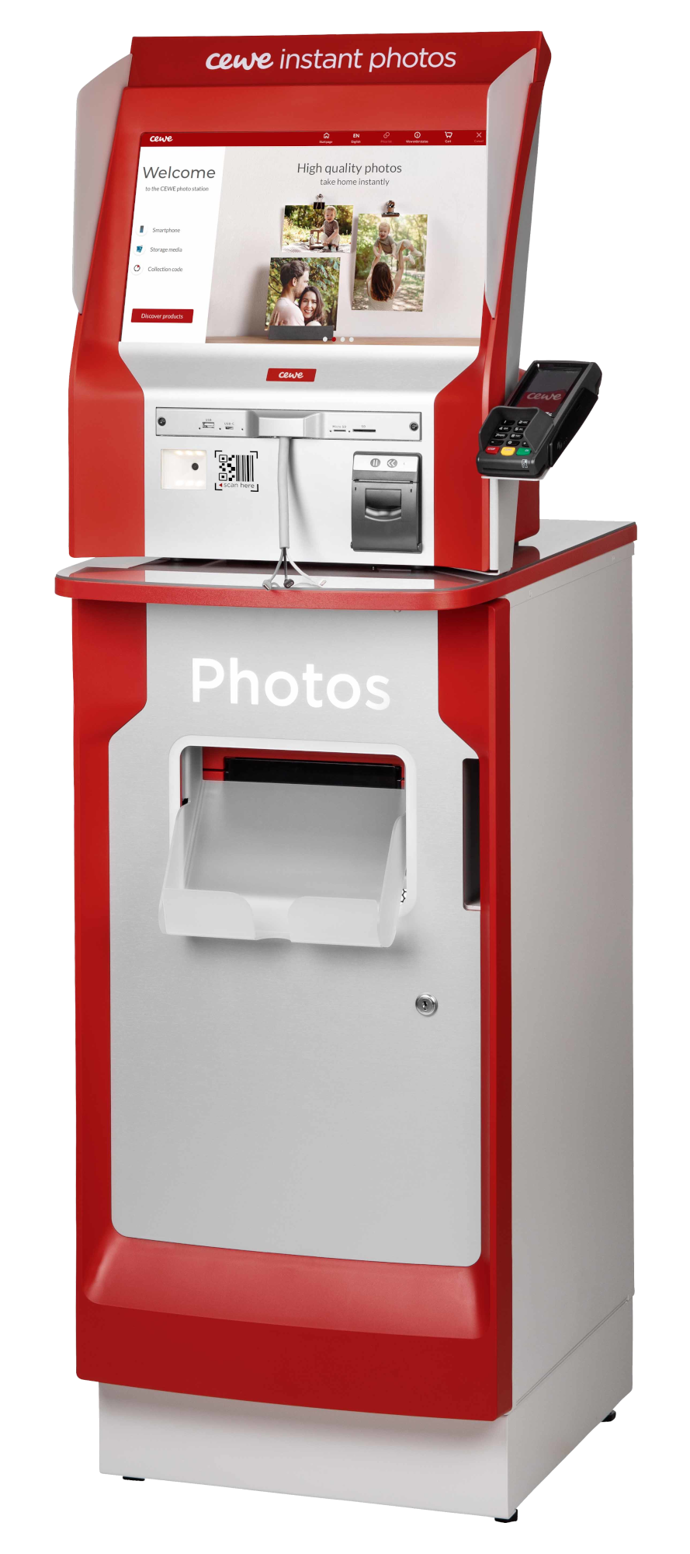
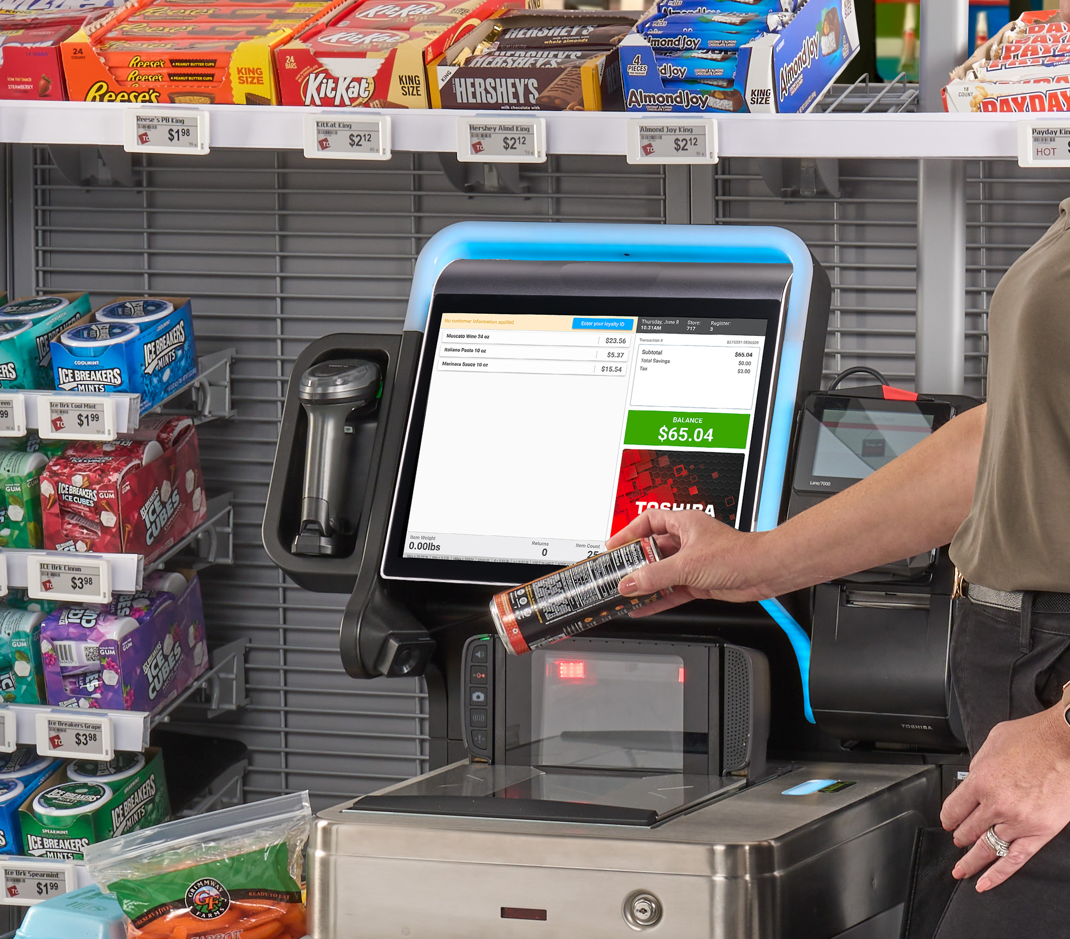
What is a kiosk mode environment?
https://financialit.net/news/payments/computop-equips-cewe-photo-stations-payment-function
https://commerce.toshiba.com/wps/portal/marketing/Home/tgcs/home/?urile=wcm%3apath%3a%2Fen-us%2Fhome%2Fhardware%2Fself-checkout

Slide 8
What is a kiosk mode environment?
Examples:
ATM
Visitor registration
Self-service order terminal
Ticket system for public transport
Info terminal in a museum

Slide 9
What is this talk about?
What is it about
  A collection of tips & tricks about kiosk mode breakouts
  Main focus on devices
  Stories and lessons learned from analyzing systems
What is it NOT about
  Privilege escalation attacks (out of scope)
  (Pictures of systems I have tested for a customer)

Slide 10

What is this talk about?
Not about Prison Break mems. Sorry, did not watch the show 😬

Slide 11
Previous work
There has been great research in the past e.g.:
Paul Craig (DEF CON talks, tools)
Swissky & community (cheatsheet)
Syed M. Huda (cheatsheet)
Shain Lakin (collection of useful breakout links)
Many more...

Slide 12
What interfaces / attack vectors do we have?
What can we do with the device/terminal?
What do we know about the platform?
(Windows/Linux/Android/etc. system, used software)
What input methods do we have? (touch, keyboard, barcode reader)
What interfaces do we have? (USB, Ethernet, Wi-Fi, Bluetooth)
What else can we access? (easy to open, power cord)

Slide 13
Tips & tricks
Kiosk application
Touchscreen/mouse
Keyboard
(Re-)booting & Login screen
Crashing
USB
Network (Ethernet/Wi-Fi)
Android
Other

Slide 14
Kiosk application
Most kiosk application have a designed breakout mechanism
Some require authentication (e.g. PIN)
Sometimes they are just hidden
Press/long press/repeatably press on “static” content
(logos, clock, version number, etc.)
Look for known breakout options & default PINs/passwords

Slide 15
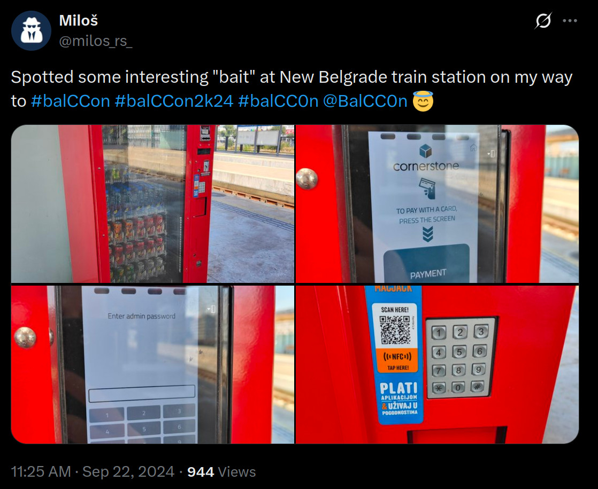
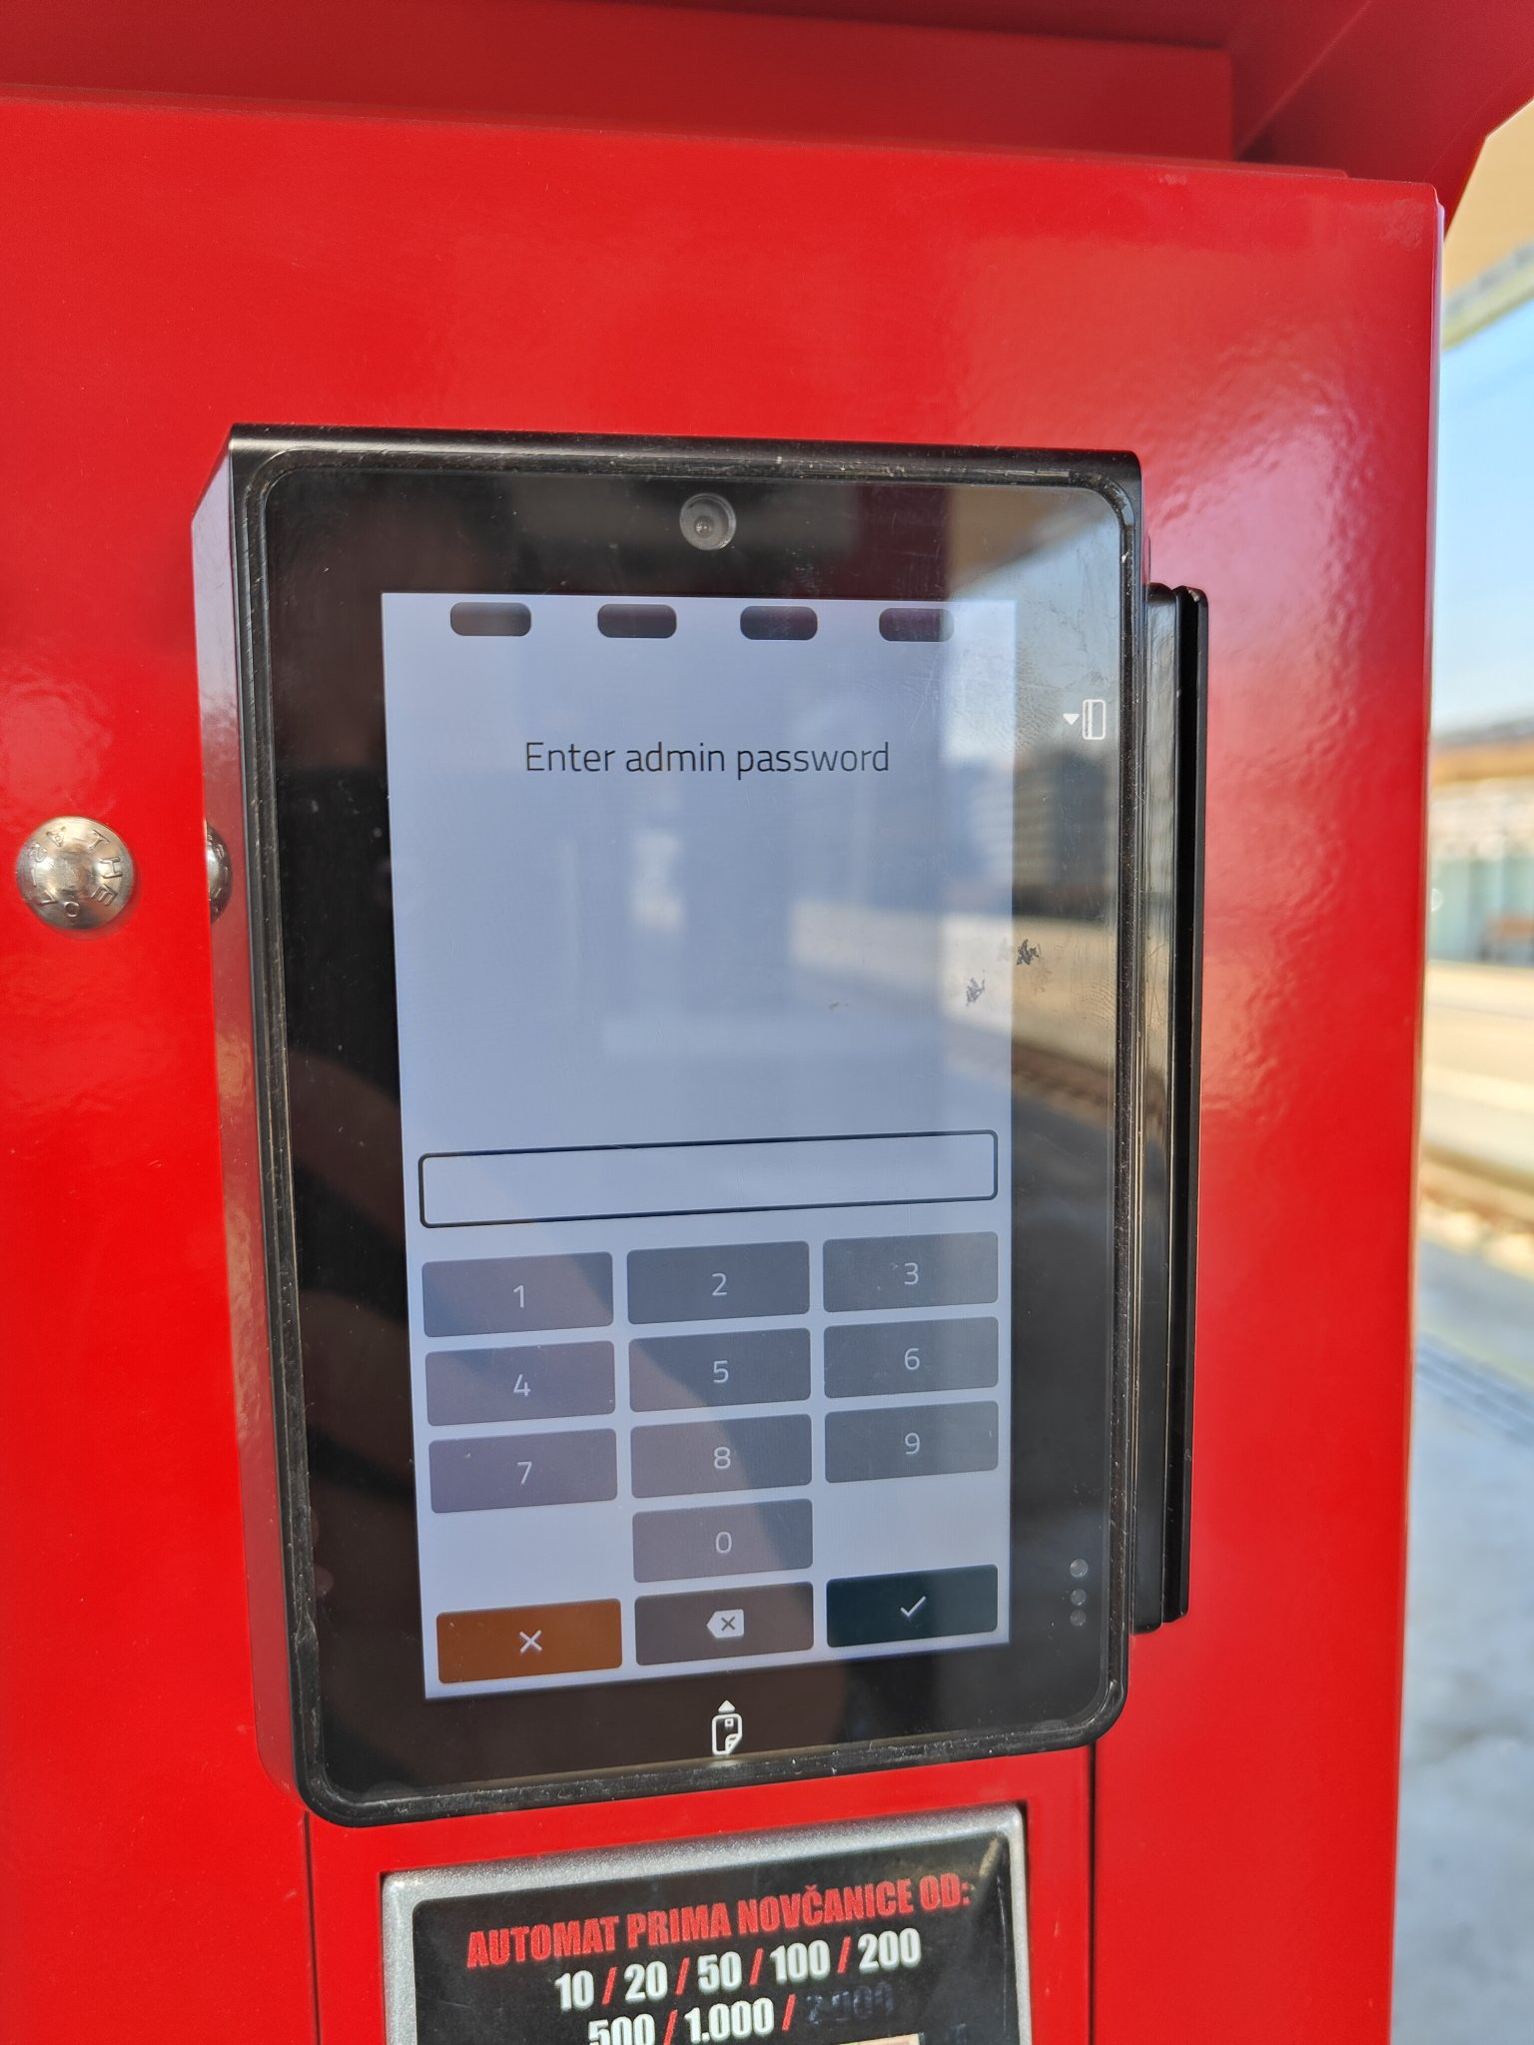
Kiosk application

Slide 16
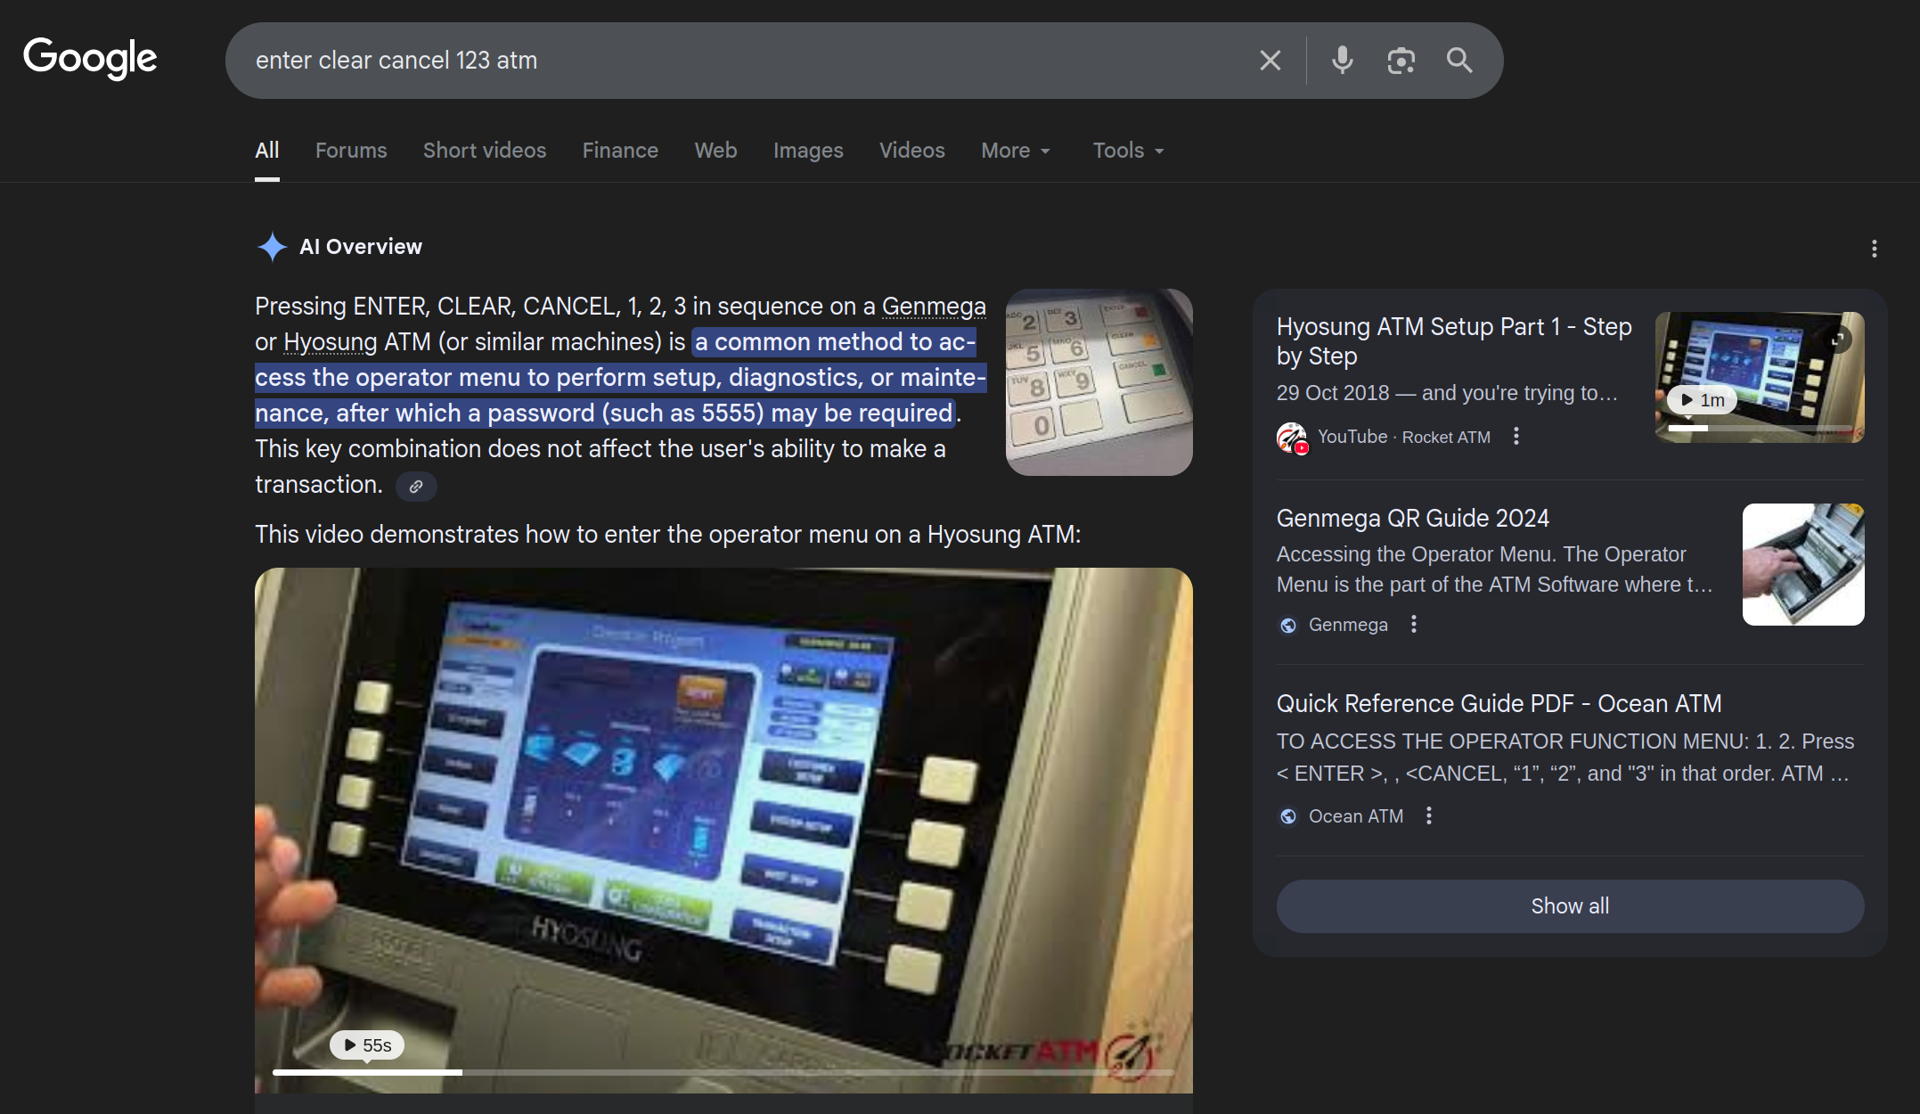
Kiosk application
Notes:
Sorry: ATM in Melbourne (Ruxcon2016)

Slide 17
Kiosk application
General things to look out for:
Links
Open/save/download options
Embedded elements (e.g. browser, PDF viewer, etc.)
(Sometimes: print options)

Slide 18
Kiosk application
Demo
breakout from edge with “PDF → open”

Slide 19
Touchscreen / Mouse
Things to look out for:
  Long touch/right click (context menus)
  Drag and drop
  Screen corners and edges
  Gestures

Slide 20
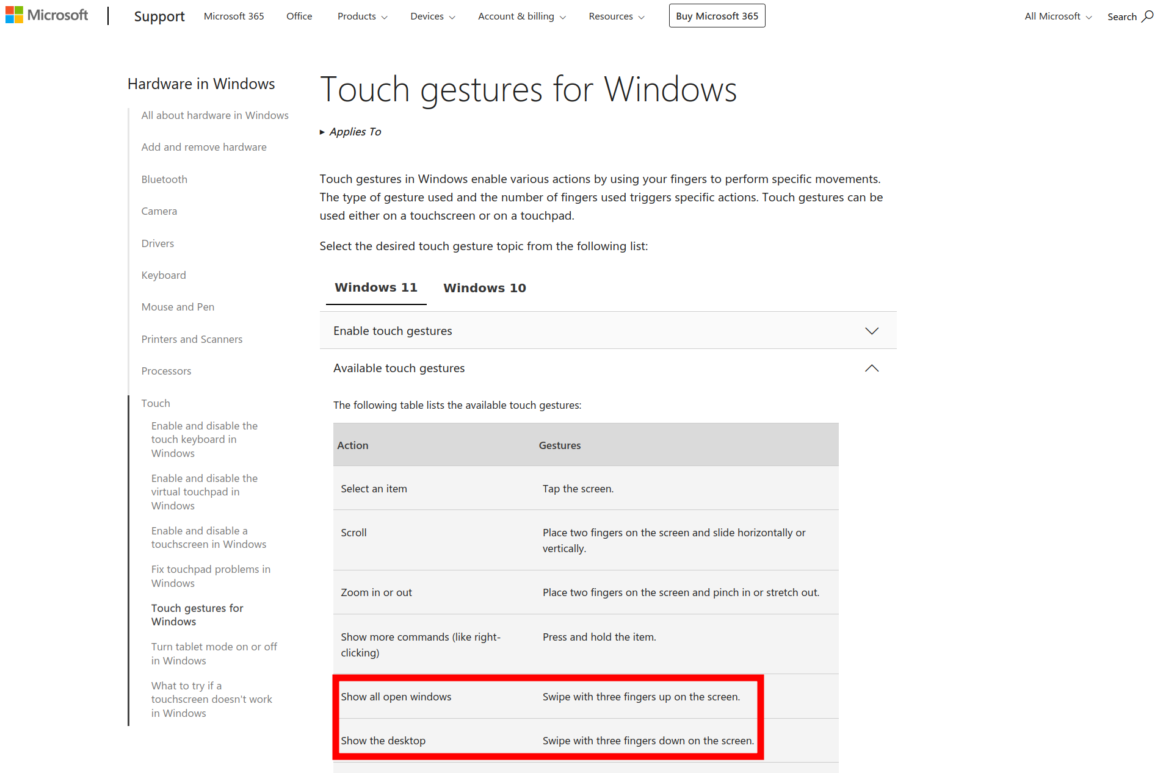
Touchscreen / Mouse
https://support.microsoft.com/en-us/windows/touch-gestures-for-windows-a9d28305-4818-a5df-4e2b-e5590f850741

Slide 21
Touchscreen / Mouse
Demo
gesture breakout on ticket system

Slide 22
Keyboard
Maybe the terminal has one build into it (likely to not have “all” keys)
Maybe you can plug in your own keyboard via USB
There are a LOT of keys and keyboard shortcuts which may help with breaking out
Some examples: Ctrl+Alt+Del, Ctrl+Shift+Esc, Win+X, Win+R, Win+E, Alt+Tab, Alt+Esc, Win+Tab, Win+D
Watch out for stateful/custom keyboard shortcuts (first X then Y)
Notes:
Story: stateful breakout with two shortcuts
Sotry: breakout with custom shortcut
Sotry: even if you don’t see it (e.g. taskmanager in background) you might be able to control it (alt, n, cmd, enter)

Slide 23
Keyboard
Demo
lesser known keyboard shortcuts
(Shift x5, Shift+Alt+Print)
Notes:
5x shift → link → finding keyboard shortcuts → ctrl+o → cmd
shift+alt+print → link → cmd

Slide 24
(Re-)booting & Login screen
Might give you access to system options (BIOS/UEFI)
  Time, boot order, build-in EFI shell
Might allow you to boot from a different medium
There might be timeframes where you can access other programs
Might allow you to access Windows repair & boot options
Notes:
Story: change time → firefox shows "reset profile" button

Slide 25
(Re-)booting & Login screen
Demo
deactivated sticky keys
Notes:
Deactivate sticky keys → reboot → hammer shift → hit enter → wait → ctrl, alt, esc → run new task → cmd

Slide 26
(Re-)booting & Login screen
Demo
from login screen to cmd
Notes:
Win+l → shift + click reboot → trouble shoot → advanced → start-up settings → restart

Slide 27
Crashing
Overexerted applications might crash or Windows might offer to kill the not responding application (e.g. rapidly change languages)
It might be to trigger a resource exhaustion via e.g. the network interface (SYN flooding, TLS (re)negotiation, etc.)
Slow external resources (e.g. emulated USB flash drive) might cause the UI to hang (kill not responding application)
Blue screen error might give access to Windows repair & boot options
Notes:
Story: public transport → zoom/scroll crash → cmd with running command → settings → cmd
Story: medical device → slow down via slow USB → app not responding → close
Story: Power reset → file system error → windows repair

Slide 28
Crashing
Demo
leftover cmd.exe running a program

Slide 29
USB
Obvious: try if a USB keyboard works
USB flash drive with “dirty bit” → might trigger repair popup
BitLocker to Go encrypted drives might trigger a popup
Devices might trigger a “co-driver installation” popup
If flash drives are forbidden, MTP devices (Android phone) might work
If the keyboard protocol is forbidden, a (emulated) mouse with a full keyboard might work
Notes:
Bitlocker popup on Win7 has link, > Win7 not
MTP devices might also trigger an auto play popup

Slide 30
USB
Demo
co-driver install on Windows

Slide 31
Network (Ethernet/Wi-Fi)
Sorry, no ready-to-use tips & tricks here (yet?)
There might be services running that help with breaking out
(RDP, SMB, etc.)
Do a portscan and work from there

Slide 32
Android
Look out for
Android Debug Bridge (adb)
  Check network and USB
  Also check when running in safeboot or fastboot
Recovery mode & bootloader (side loading apps)
Attach a keyboard and check typical keys & shortcuts
Check other interfaces (e.g. NFC, camera with QR code reader, etc.)

Slide 33
Other
(Android) devices with NFC
  Might support NDEF data format and act on it
Bluetooth enabled devices
  Force-pairing might work (CVE-2023-45866, great on “older” Android/Linux)
  Pairing a BT keyboard might work/help
Notes:
Story: Android room booking system with NFC → NDEF → open app → settings

Slide 34
Other
Barcode/QR code reader
  Often emulate a HID device (USB keyboard)
  Sometimes can be programmed to support keyboard shortcuts
  Sometimes can be programmed though barcodes
URI handlers
  Especially great if you can surf to a attacker controlled website

Slide 35
Other
Demo
Android and NDEF NFC tags

Slide 36
Other
Demo
URI handlers

Slide 37
Let’s recap
There are endless ways to break out!
There is no “one way to rule them all”
Possibilities to break out are mostly tied to available inputs, interfaces
and how the system can be accessed

Slide 38
Lessons learned – “Blue Team”
Don’t build your kiosk mode terminal on a full-featured platform
by removing features (e.g. “normal” Windows 10).
Build you platform with only the features needed for operation
(e.g. Yocto Linux, no Xserver, no desktop, no additional drivers, etc.)
All input is evil! Validate everything & build/use robust system
Hiding functions is not security; use strong authentication for admin
Don’t reinvent the wheel, use well known features/software

Slide 39
Lessons learned – “Red Team”
Check what interfaces/attack vectors are available
Be creative
Be persistent
Do your research

Slide 40
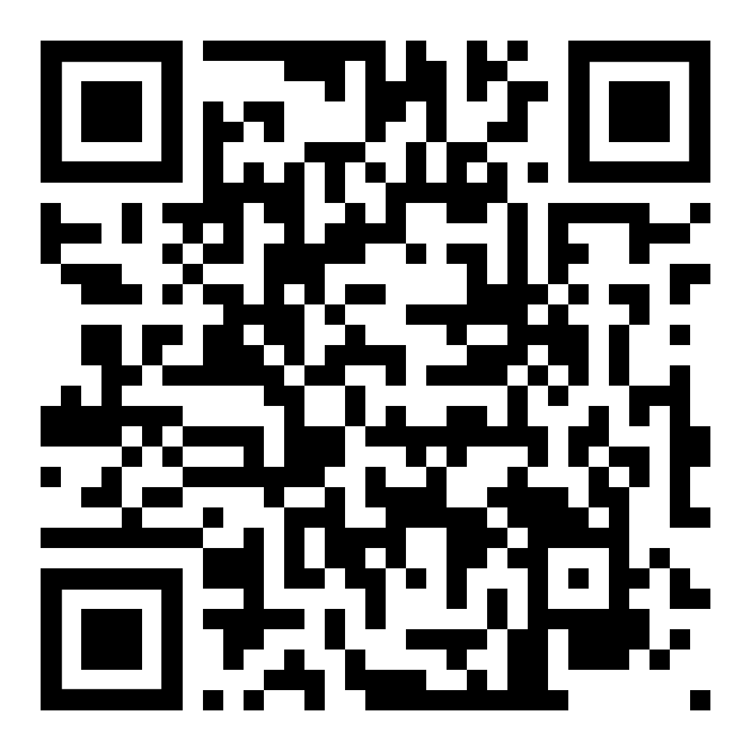
Kiosk mode breakout: tips & tricks
https://github.com/ikarus23/kiosk-mode-breakout
Contributions
Welcome!

Slide 41

Questions?
Share your stories, tips & tricks!
CONTACT:
𝕏 @iiiikarus · @iiiikarus@infosec.exchange · www.icaria.de · contact@icaria.de
Creative Commons Attribution-ShareAlike 4.0 International License, https://creativecommons.org/licenses/by-sa/4.0/

