Slide 1
IksanStudio
Its what you want it to be

Slide 2

Objectives

Slide 3

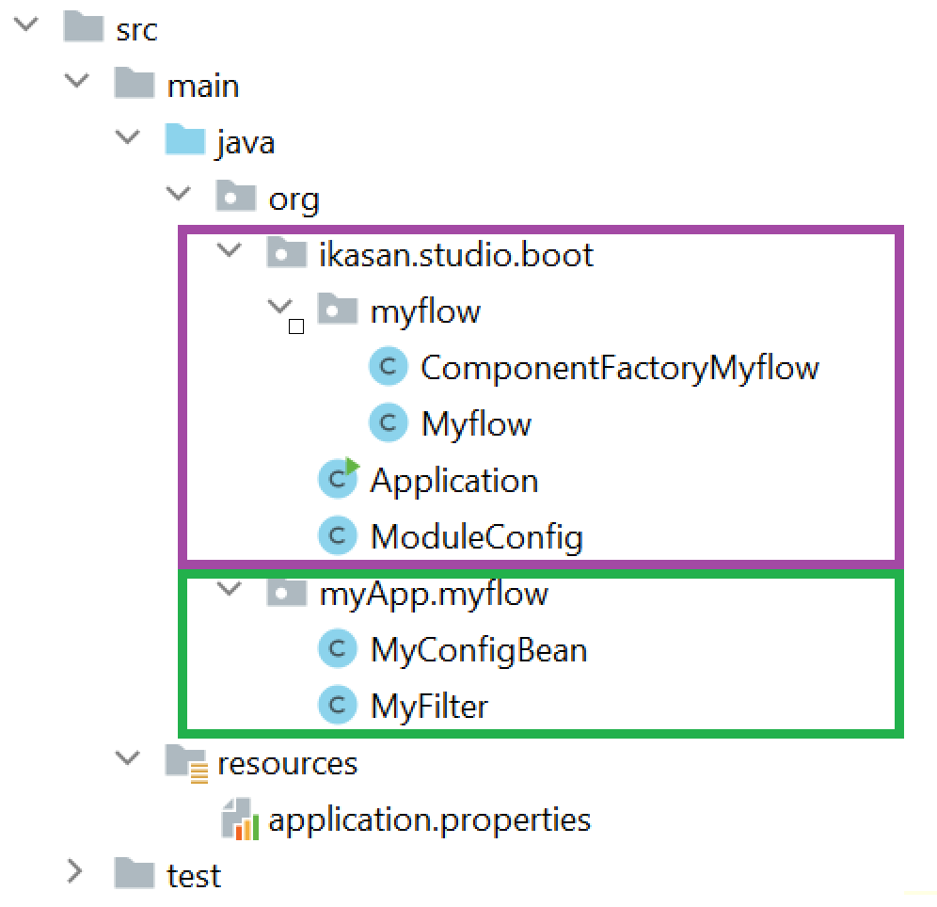
Studio vs Developer code

Slide 4
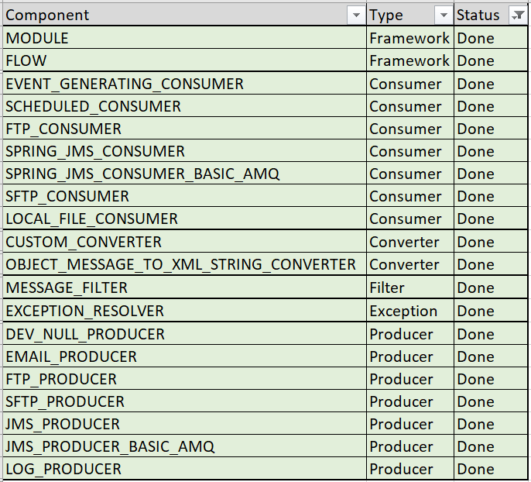
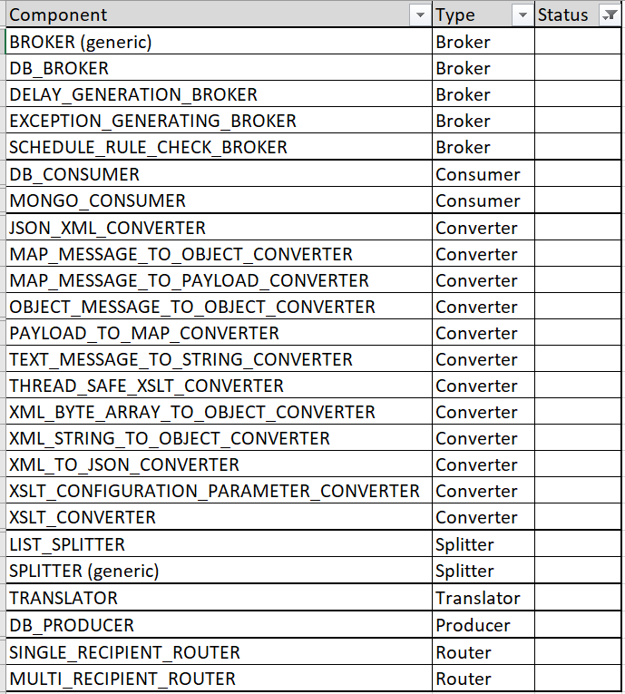
Progress
Done
Todo

