Slide 1

Open Source
Enterprise Integration Platform
Lightning Talk
Jeff Mitchell & Summer Hasani
ikasan.org
November 2010

Slide 2
Introduction
The Problem Domain
Architecture Strategies
Translating the Architecture
Technology Stack
Summary

Slide 3
Problem Domain
Problem Domain
Architecture Strategies
Translating Architecture
Technology Stack
Summary
[Domain] Enterprise Application Integration (EAI) space
  Integration of business systems in a landscape of interwoven and
  often complex finance processes
[Issue] EAI is complex, costly, & not the primary business concern
  Greater adoption of “Best of Breed” specialist applications
  Business applications distributed across disparate platforms
  Business data distributed across isolated silos
  Legacy data repositories
  Data duplication and integrity issues
  No clear business data owner
  Exponential integration requirements
  Greater complexity of business demand on data orchestration
  EAI is more than simply connecting applications
[Goal] To provide simple, robust, configurable commoditised solutions
  Expose business artifacts whilst isolating the integration specifics

Slide 4
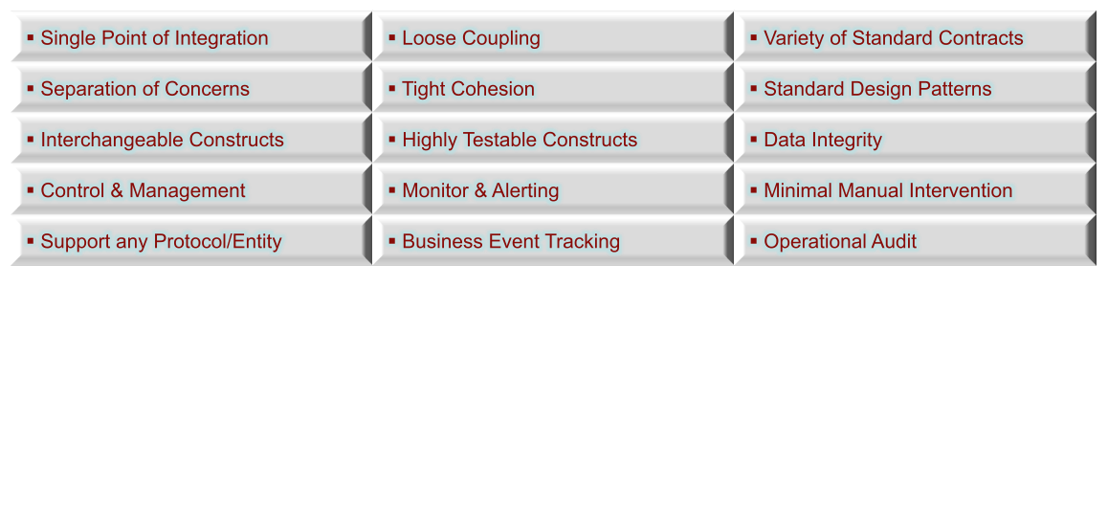
Architecture Strategies
Problem Domain
Architecture Strategies
Translating Architecture
Technology Stack
Summary
[Key Strategies]
Ensure traceability from architecture through to implementation
  All too often architecture fails to translate into the real world
  The right architecture can reduce complexity
Leverage existing domain knowledge
Utilize external domain knowledge
  Enterprise Integration Design Patterns
    [Ref. Enterprise Integration Patterns, Gregor Hohpe & Bobby Woolf, 2003]
  Enterprise Application Design Patterns
    [Ref. Patterns of Enterprise Application Architecture, Martin Fowler]

Slide 5
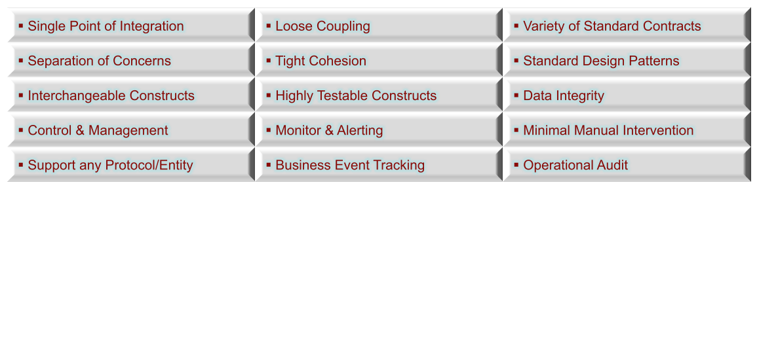
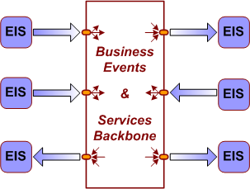
Translating the Architecture
Problem Domain
Architecture Strategies
Translating Architecture
Technology Stack
Summary
[Key Strategies]
[Concept] Standard Enterprise Application Integration (EAI) approach
  Provision of an Event/Service backbone
  Single point of integration for EIS business flow
  Ripple effect of change is localised (assuming best practice)

Slide 6
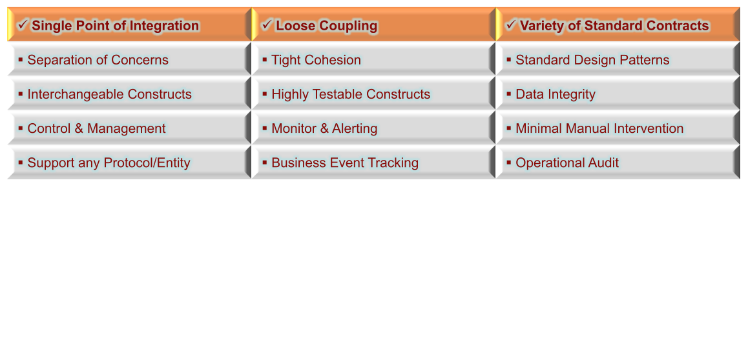
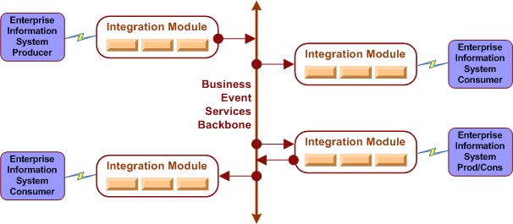
Translating the Architecture
Problem Domain
Architecture Strategies
Translating Architecture
Technology Stack
Summary
[Key Strategies]
[Construct] Integration Modules
  Provides a logical grouping of business operations as a single integration point
  Provide either a source, target, or bi-directional business flow.

Slide 7
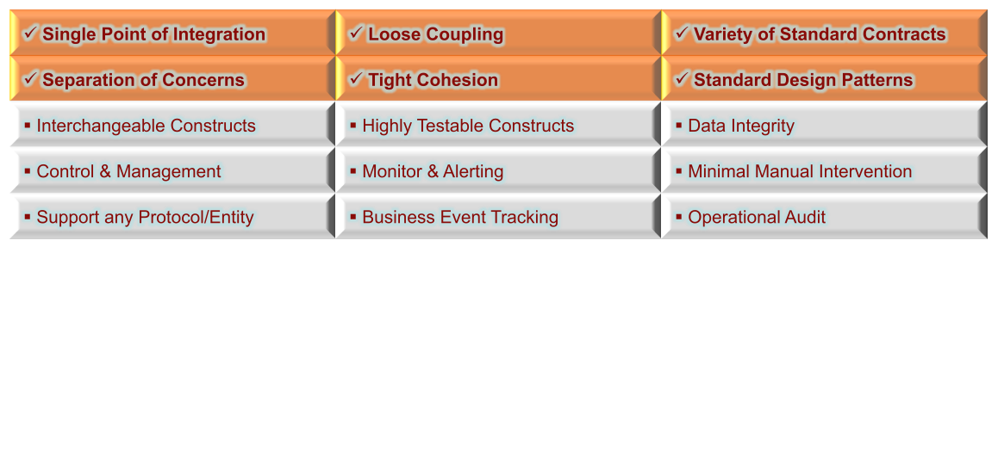
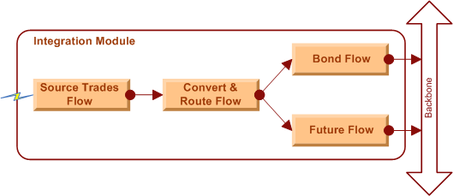
Translating the Architecture
Problem Domain
Architecture Strategies
Translating Architecture
Technology Stack
Summary
[Key Strategies]
[Construct] Flows
  Provide cohesive operations on a business artifact as a synchronous operation
  Multiple flows can be chained to isolate concerns
  Standard event container allows any data type to be transported

Slide 8
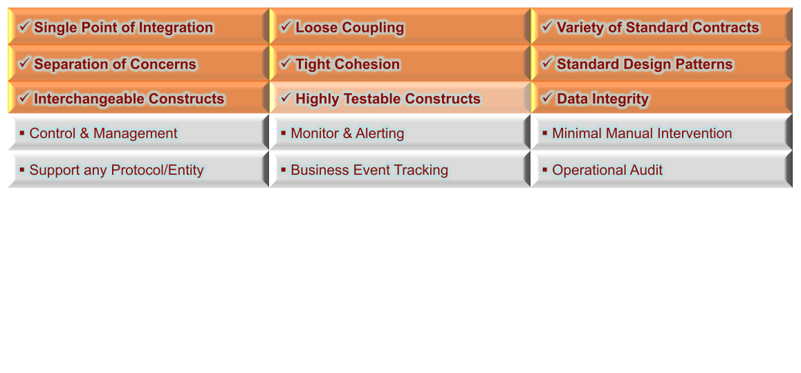
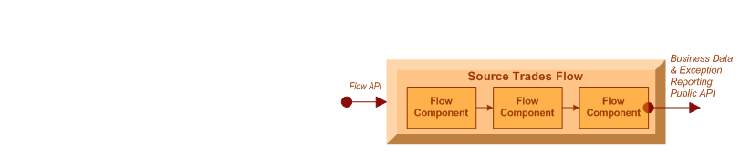
Translating the Architecture
Problem Domain
Architecture Strategies
Translating Architecture
Technology Stack
Summary
[Key Strategies]
[Construct] Flow Components
  POJO implementations provide independent, interchangeable operations
  Isolated component white box testing and chained black box testing
  All flow components within an atomic operation guaranteeing data integrity

Slide 9
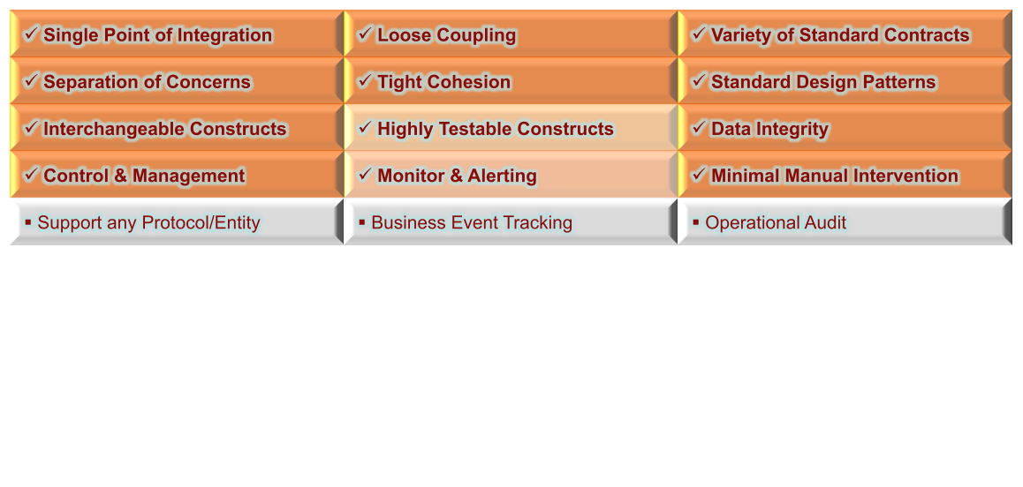
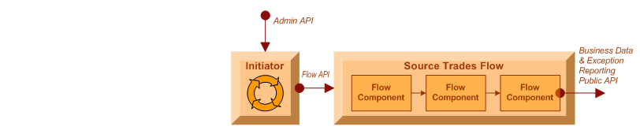
Translating the Architecture
Problem Domain
Architecture Strategies
Translating Architecture
Technology Stack
Summary
[Key Strategies]
[Construct] Initiators
  Business flow control (start & stop)
  Notification of flow status (running, stopped, recovery, stoppedInError)
  Configurable exception handling for automated flow recovery
  Public API for external client management

Slide 10
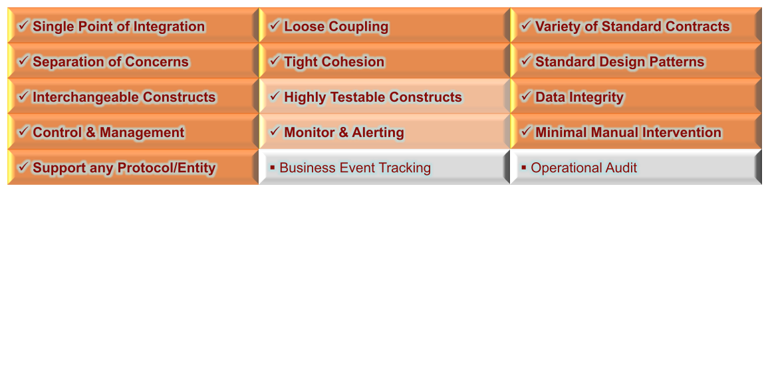
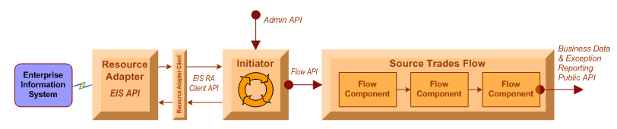
Translating the Architecture
Problem Domain
Architecture Strategies
Translating Architecture
Technology Stack
Summary
[Key Strategies]
[Construct] Resource Adapters
  Support any type of protocol / API
  Extend guaranteed integrity to non-guaranteed EIS sources/targets
  No proprietary knowledge required; only EIS API
  Resource adapters pluggable re-usable components (SUN JCA spec)
  3rd party off-the-shelf or internally developed

Slide 11
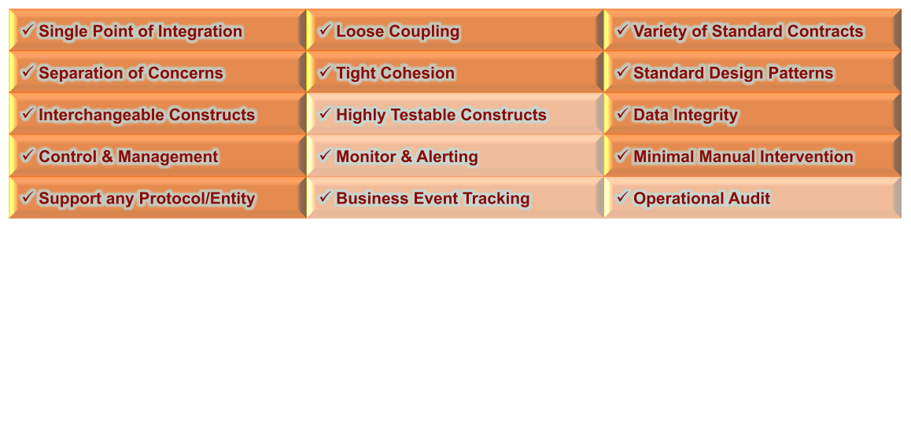
Translating the Architecture
Problem Domain
Architecture Strategies
Translating Architecture
Technology Stack
Summary
[Key Strategies]
[Construct] Administration Console
  Initiator management
    runtime status (stopped, running, recovery, stoppedInError)
    runtime control (start, stop, start-up type {auto, manual, disabled})
  Flow management
    flow component chain view and drill down
    audit log of flow actions (stop/start)
  Wiretap management
    dynamic creation/deletion of real-time in-flight data capture
  User management
    creation, deletion, and permission maintenance

Slide 12
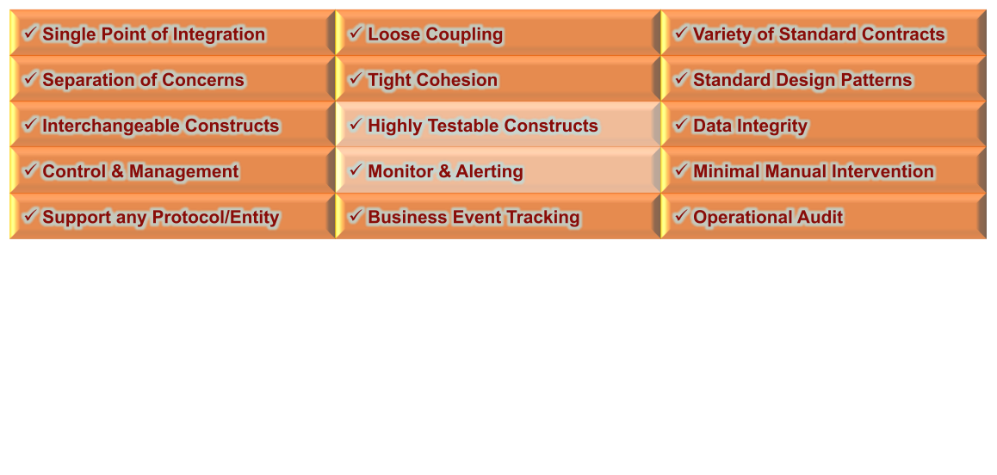
Translating the Architecture
Problem Domain
Architecture Strategies
Translating Architecture
Technology Stack
Summary
[Key Strategies]
[Construct] User Console
  In-flight business event searches
    by module(s)
    by flow(s)
    by business stream(s)
    parameter filters
      business content, date/time, names, etc
  Event “Life Identifier” linking
    flow component chain view and drill down
    audit log of flow actions (stop/start)
  User management
    creation, deletion, and permission maintenance

Slide 13
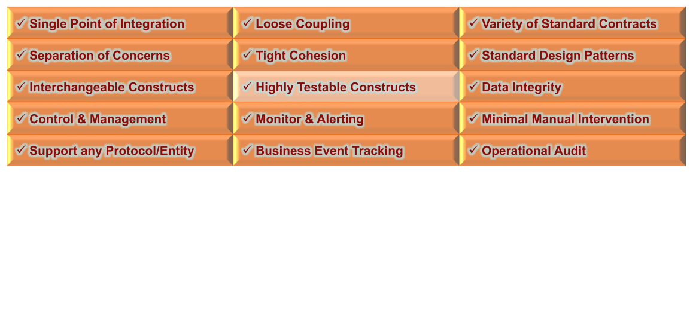
Translating the Architecture
Problem Domain
Architecture Strategies
Translating Architecture
Technology Stack
Summary
[Key Strategies]
[Construct] Monitor Clients
  Big Brother / Hobbit client
  Email client
  Log scrapper
  HTTP client

Slide 14
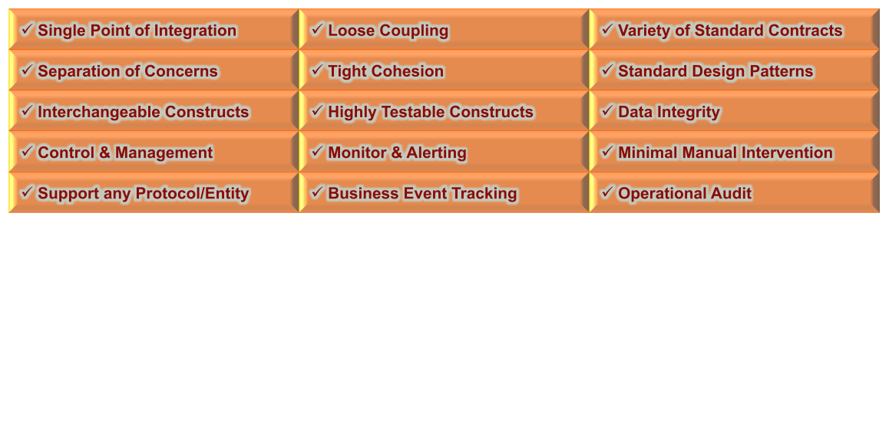
Translating the Architecture
Problem Domain
Architecture Strategies
Translating Architecture
Technology Stack
Summary
[Key Strategies]
[Construct] OSS Test Frameworks & Ikasan FlowTestHarness
  Flow component automated unit testing
    Junit, JMock, XMLUnit
  Initiator automated unit testing
    JUnit, JMock
  Flow automated unit (integration) testing
    Spring-test, Ikasan FlowTestHarness, HSQL in memory database
  Module integration testing
    Currently manual
    Future: automation through maven plugins

Slide 15
Technology Stack
Problem Domain
Architecture Strategies
Translating Architecture
Technology Stack
Summary
Development Stack
  Core technologies
    Java 1.5+ / JEE
    XML
    Spring Framework
  Test Frameworks
    JUnit
    JMock
    SpringTest
    Ikasan Flow Test Harness 0.7.10
  Scaffolding
    Source Management – Subversion
    Requirements and Issue Management – JIRA
    Peer Review and Acceptance Management – Crucible, FishEye
    Project Build Management – Maven
    Project Artefact Management – Sonotype Nexus
    Continuous Integration – Hudson

Slide 16
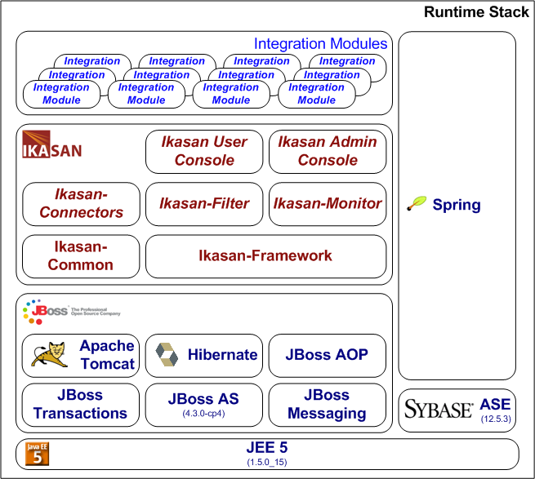
Technology Stack
Problem Domain
Architecture Strategies
Translating Architecture
Technology Stack
Summary
Runtime Stack

Slide 17
Summary
Problem Domain
Architecture Strategies
Translating Architecture
Technology Stack
Summary
Ikasan Project Resource Summary
  Web Site: http://www.ikasan.org
  SVN: http://open.jira.com/svn/IKASAN
  Wiki: http://sourceforge.net/apps/mediawiki/ikasaneip/index.php?title=Main_Page
  JIRA: http://open.jira.com/browse/IKASAN
  Mailing List: http://lists.sourceforge.net/lists/listinfo/ikasaneip-user
  IRC: http://sourceforge.net/apps/mediawiki/ikasaneip/index.php?title=IRC

Slide 18
Open Source
Enterprise Integration Platform
Lightning Talk
Jeff Mitchell & Summer Hasani
ikasan.org
November 2010

