Slide 1

Open Source
Enterprise Integration Platform
Jeff Mitchell
ikasan.org
July 2010

Slide 2
Introduction
The Problem Domain
Architecture Strategies
Translating the Architecture
Technology Stack
Features
Development Lifecycle
Roadmap
Summary

Slide 3
Problem Domain
Problem Domain
Architecture Strategies
Translating Architecture
Technology Stack
Features
Development Lifecycle
Roadmap
Summary
[Domain] Enterprise Application Integration (EAI) space
  Integration of business systems in a landscape of interwoven and
  often complex finance processes
[Issue] EAI is complex, costly, & not the primary business concern
  Greater adoption of “Best of Breed” specialist applications
  Business applications distributed across disparate platforms
  Business data distributed across isolated silos
  Legacy data repositories
  Data duplication and integrity issues
  No clear business data owner
  Exponential integration requirements
  Greater complexity of business demand on data orchestration
  EAI is more than simply connecting applications
[Goal] To provide simple, robust, configurable commoditised solutions
  Expose business artifacts whilst isolating the integration specifics

Slide 4
Architecture Strategies
Problem Domain
Architecture Strategies
Translating Architecture
Technology Stack
Features
Development Lifecycle
Roadmap
Summary
Simplicity
  Must not require in-depth proprietary knowledge
  Avoidance of overly complex or heavyweight frameworks
  Highly testable simple constructs
Commonality
  Reusable interchangeable constructs
  Standard contracts of interaction
  Simple repeatable implementation steps
Adaptability
  Ability to support any type of business entity
  Ability to integrate any type of Enterprise Information System
  Without breaking the first two strategies of Simplicity & Commonality
Robust & Guaranteed operation
  Maintain data integrity in business delivery and failure scenarios
  Require minimal manual intervention i.e. failure / automated recovery

Slide 5
Architecture Strategies
Problem Domain
Architecture Strategies
Translating Architecture
Technology Stack
Features
Development Lifecycle
Roadmap
Summary
Clear contract definition and separation of concerns

Slide 6
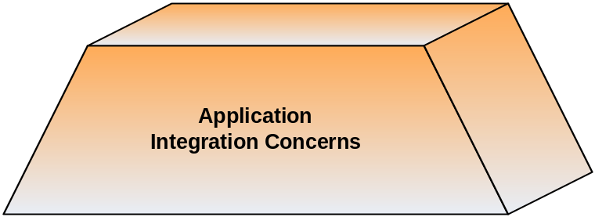
Architecture Strategies
Problem Domain
Architecture Strategies
Translating Architecture
Technology Stack
Features
Development Lifecycle
Roadmap
Summary
Clear contract definition and separation of concerns
  Application concerns
[Application] performant, robust & guaranteed operation

Slide 7
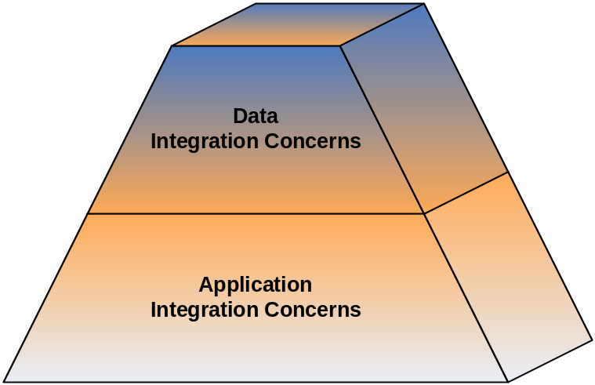
Architecture Strategies
Problem Domain
Architecture Strategies
Translating Architecture
Technology Stack
Features
Development Lifecycle
Roadmap
Summary
Clear contract definition and separation of concerns
  Application concerns
  Data concerns
[Data] presentation of standard, meaningful business data
[Application] performant, robust & guaranteed operation

Slide 8
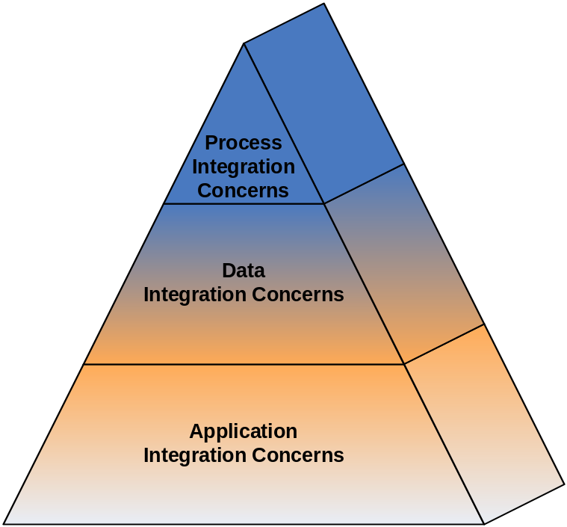
Architecture Strategies
Problem Domain
Architecture Strategies
Translating Architecture
Technology Stack
Features
Development Lifecycle
Roadmap
Summary
Clear contract definition and separation of concerns
  Application concerns
  Data concerns
  Business process concerns
[Process] business event & entity orchestration (STP is the goal)
[Data] presentation of standard, meaningful business data
[Application] performant, robust & guaranteed operation

Slide 9
Architecture Strategies
Problem Domain
Architecture Strategies
Translating Architecture
Technology Stack
Features
Development Lifecycle
Roadmap
Summary
Loose coupling
  Integrations should only require knowledge of each other through exchange of business artifacts
Tight cohesion
  An integration’s specifics must not bleed out unnecessarily
High visibility
  Business data tracking
  Fail scenarios
  Operational audit
Single logical point of integration
  Geographically agnostic / cross platform support
Open standards aligned with proven design patterns
  Adoption of industry standard Enterprise Design Patterns
  Avoidance of vendor lock-in

Slide 10
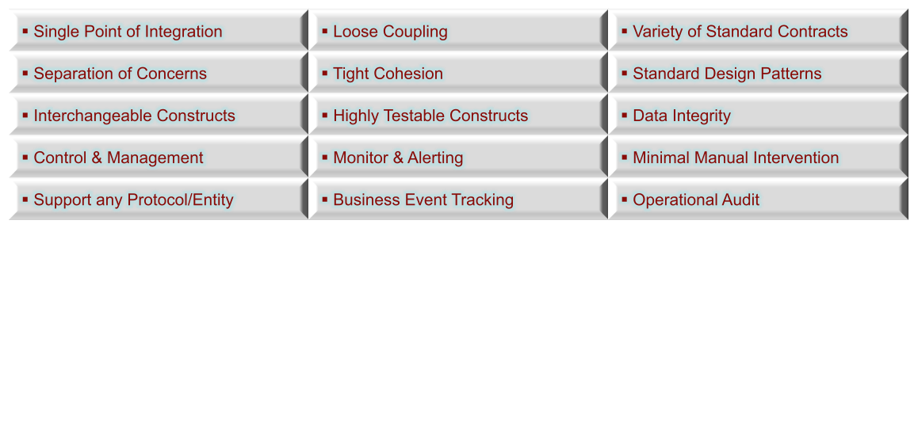
Architecture Strategies
Problem Domain
Architecture Strategies
Translating Architecture
Technology Stack
Features
Development Lifecycle
Roadmap
Summary
[Key Strategies]
Ensure traceability from architecture through to implementation
  All too often architecture fails to translate into the real world
  The right architecture can reduce complexity

Slide 11
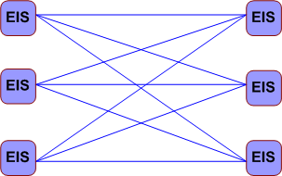
Translating the Architecture
Problem Domain
Architecture Strategies
Translating Architecture
Technology Stack
Features
Development Lifecycle
Roadmap
Summary
[Key Strategies]
[Issue] Commonly agreed that “spaghetti integration” is bad
  Integration can be exponentially complex
  Bleed out of APIs, data syntax and business semantics
  Ripple effect of change is massive

Slide 12
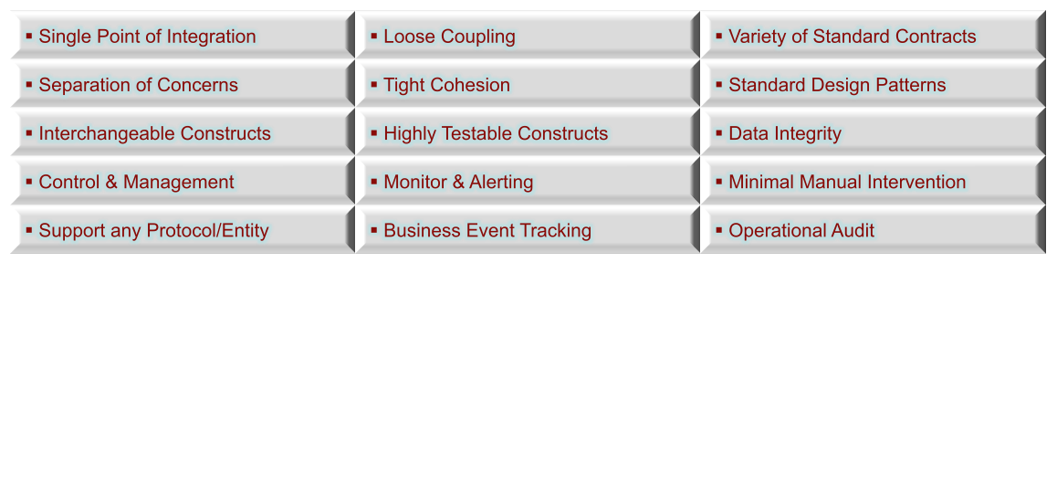
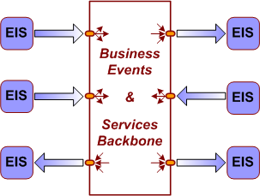
Translating the Architecture
Problem Domain
Architecture Strategies
Translating Architecture
Technology Stack
Features
Development Lifecycle
Roadmap
Summary
[Key Strategies]
[Concept] Standard Enterprise Application Integration (EAI) approach
  Provision of an Event/Service backbone
  Single point of integration for EIS business flow
  Ripple effect of change is localised (assuming best practice)

Slide 13
Translating the Architecture
Problem Domain
Architecture Strategies
Translating Architecture
Technology Stack
Features
Development Lifecycle
Roadmap
Summary
[Key Strategies]
[First Step] Modelling the Domain
  Defines fundamental entities, constructs, and their relationships
  Leverage existing domain knowledge
  External domain knowledge – we are not the first…
    Enterprise Integration Design Patterns
      [Ref. Enterprise Integration Patterns, Gregor Hohpe & Bobby Woolf, 2003]
    Enterprise Application Design Patterns
      [Ref. Patterns of Enterprise Application Architecture, Martin Fowler]

Slide 14
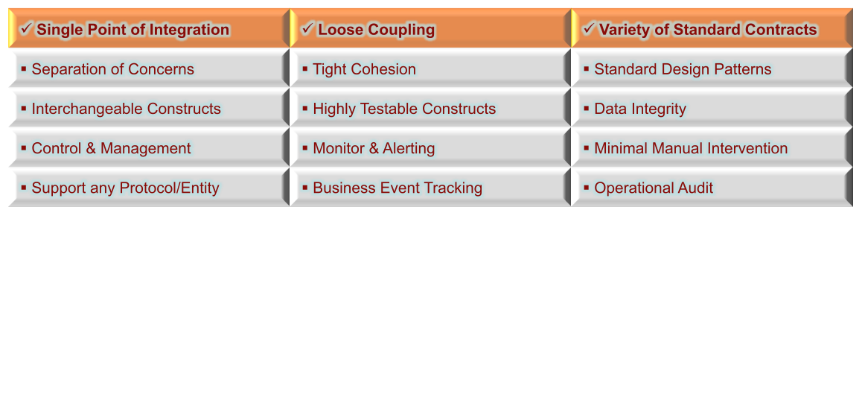
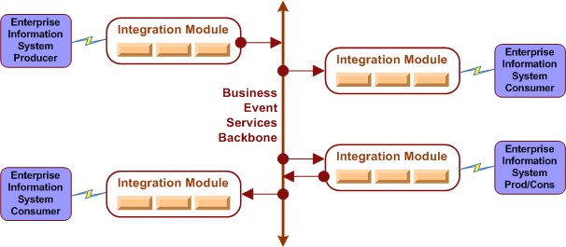
Translating the Architecture
Problem Domain
Architecture Strategies
Translating Architecture
Technology Stack
Features
Development Lifecycle
Roadmap
Summary
[Key Strategies]
[Construct] Integration Modules
  Provides a logical grouping of business operations as a single integration point
  Provide either a source, target, or bi-directional business flow.

Slide 15
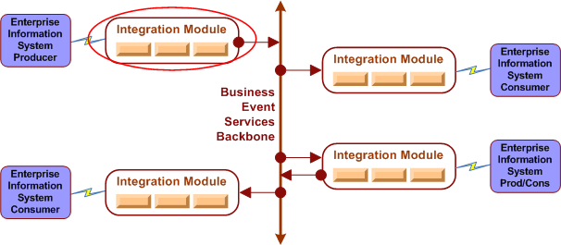
Translating the Architecture
Problem Domain
Architecture Strategies
Translating Architecture
Technology Stack
Features
Development Lifecycle
Roadmap
Summary
[Key Strategies]
[Construct] Integration Modules
  Provides a logical grouping of business operations as a single integration point
  Provide either a source, target, or bi-directional business flow.

Slide 16
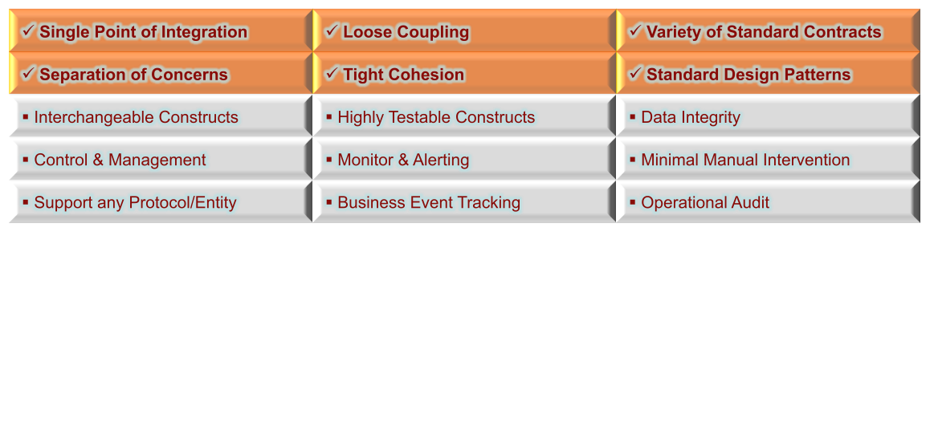
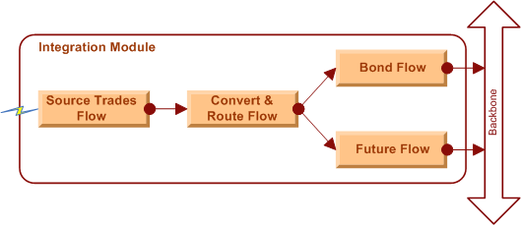
Translating the Architecture
Problem Domain
Architecture Strategies
Translating Architecture
Technology Stack
Features
Development Lifecycle
Roadmap
Summary
[Key Strategies]
[Construct] Flows
  Provide cohesive operations on a business artifact as a synchronous operation
  Multiple flows can be chained to isolate concerns
  Standard event container allows any data type to be transported

Slide 17
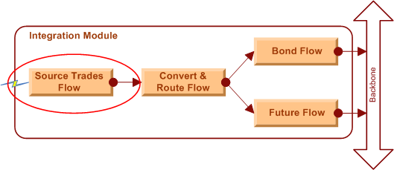
Translating the Architecture
Problem Domain
Architecture Strategies
Translating Architecture
Technology Stack
Features
Development Lifecycle
Roadmap
Summary
[Key Strategies]
[Construct] Flows
  Provide cohesive operations on a business artifact as a synchronous operation
  Multiple flows can be chained to isolate concerns
  Standard event container allows any data type to be transported

Slide 18
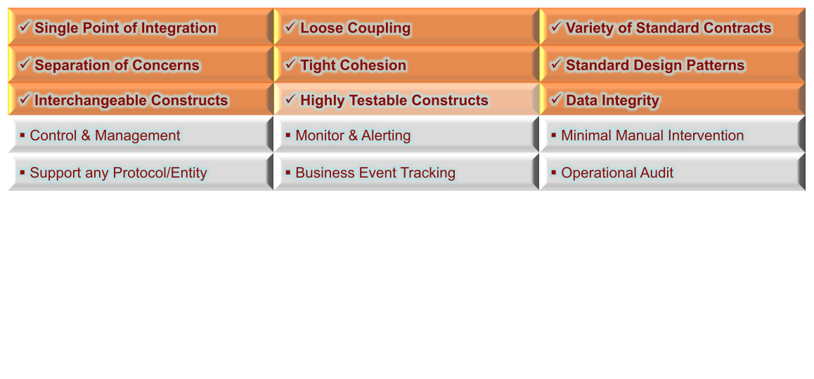
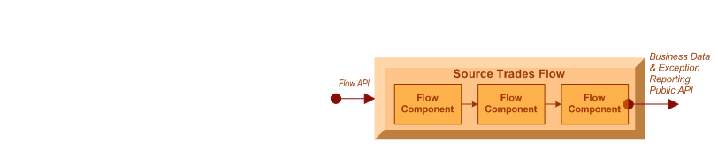
Translating the Architecture
Problem Domain
Architecture Strategies
Translating Architecture
Technology Stack
Features
Development Lifecycle
Roadmap
Summary
[Key Strategies]
[Construct] Flow Components
  POJO implementations provide independent, interchangeable operations
  Isolated component white box testing and chained black box testing
  All flow components within an atomic operation guaranteeing data integrity

Slide 19
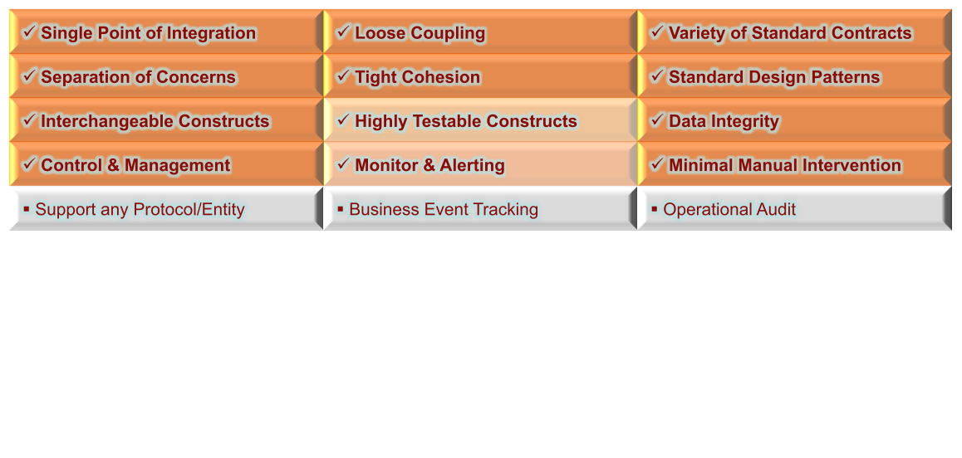
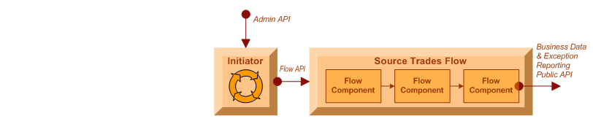
Translating the Architecture
Problem Domain
Architecture Strategies
Translating Architecture
Technology Stack
Features
Development Lifecycle
Roadmap
Summary
[Key Strategies]
[Construct] Initiators
  Business flow control (start & stop)
  Notification of flow status (running, stopped, recovery, stoppedInError)
  Configurable exception handling for automated flow recovery
  Public API for external client management

Slide 20
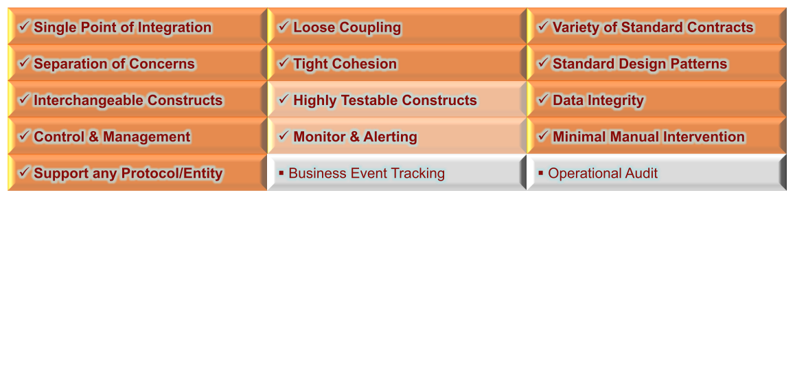
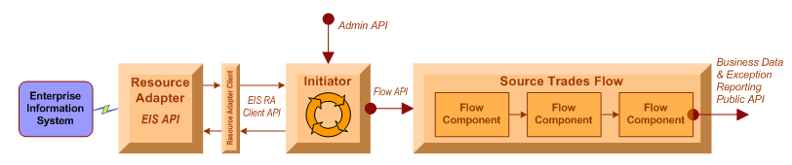
Translating the Architecture
Problem Domain
Architecture Strategies
Translating Architecture
Technology Stack
Features
Development Lifecycle
Roadmap
Summary
[Key Strategies]
[Construct] Resource Adapters
  Support any type of protocol / API
  Extend guaranteed integrity to non-guaranteed EIS sources/targets
  No proprietary knowledge required; only EIS API
  Resource adapters pluggable re-usable components (SUN JCA spec)
  3rd party off-the-shelf or internally developed

Slide 21
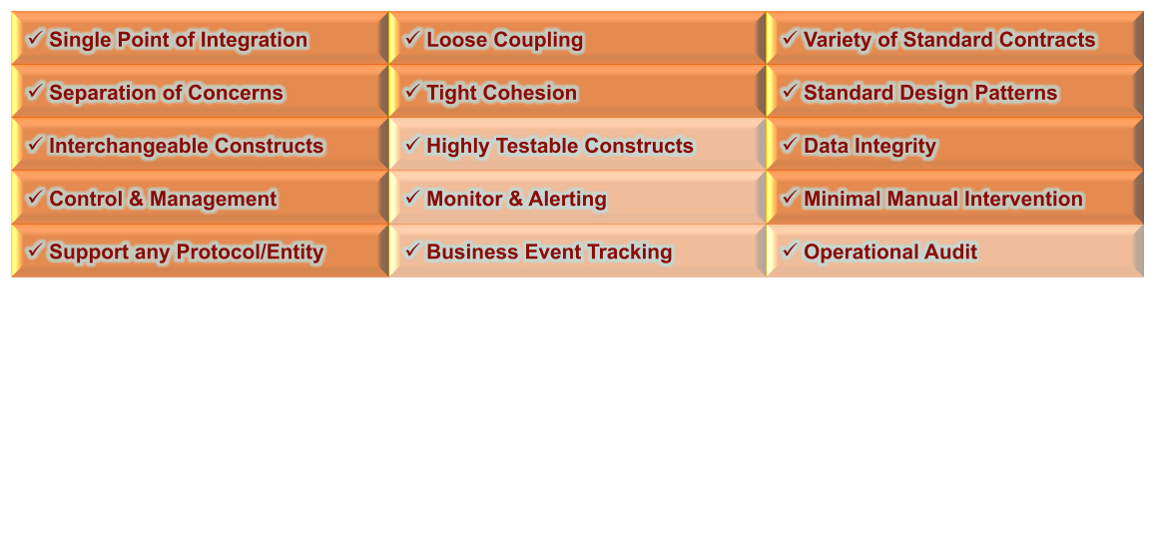
Translating the Architecture
Problem Domain
Architecture Strategies
Translating Architecture
Technology Stack
Features
Development Lifecycle
Roadmap
Summary
[Key Strategies]
[Construct] Administration Console
  Initiator management
    runtime status (stopped, running, recovery, stoppedInError)
    runtime control (start, stop, start-up type {auto, manual, disabled})
  Flow management
    flow component chain view and drill down
    audit log of flow actions (stop/start)
  Wiretap management
    dynamic creation/deletion of real-time in-flight data capture
  User management
    creation, deletion, and permission maintenance

Slide 22
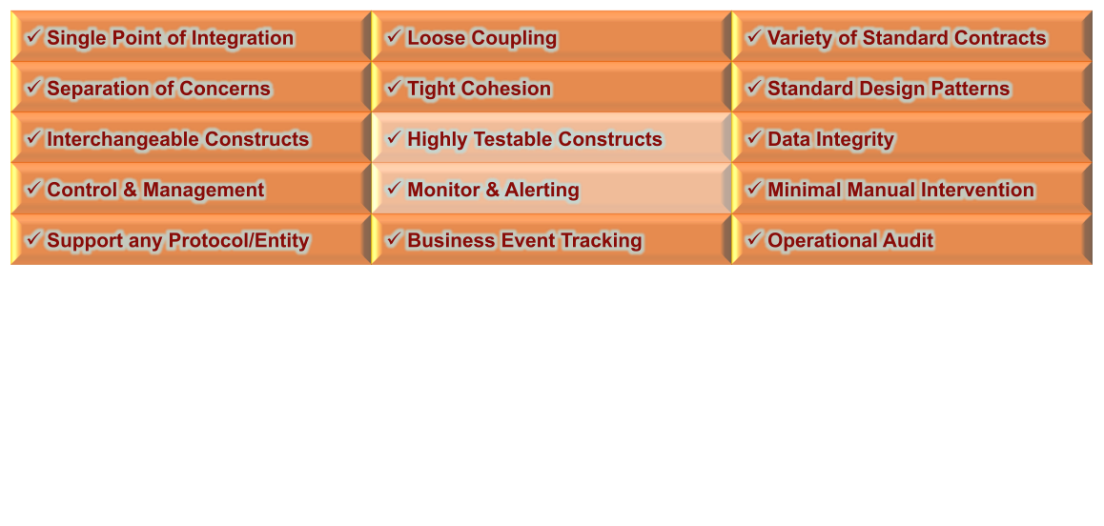
Translating the Architecture
Problem Domain
Architecture Strategies
Translating Architecture
Technology Stack
Features
Development Lifecycle
Roadmap
Summary
[Key Strategies]
[Construct] User Console
  In-flight business event searches
    by module(s)
    by flow(s)
    by business stream(s)
    parameter filters
      business content, date/time, names, etc
  Event “Life Identifier” linking
    flow component chain view and drill down
    audit log of flow actions (stop/start)
  User management
    creation, deletion, and permission maintenance

Slide 23
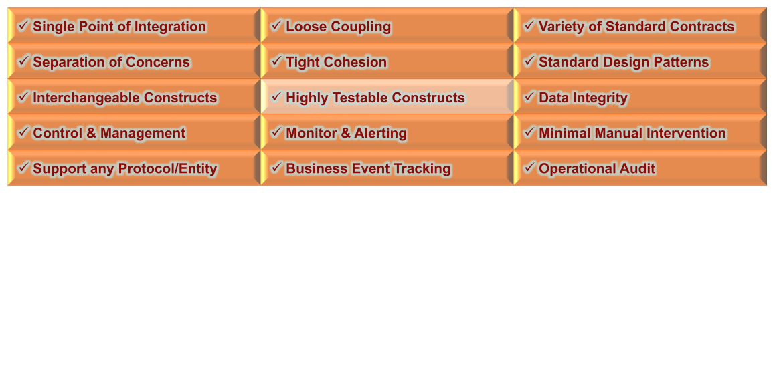
Translating the Architecture
Problem Domain
Architecture Strategies
Translating Architecture
Technology Stack
Features
Development Lifecycle
Roadmap
Summary
[Key Strategies]
[Construct] Monitor Clients
  Big Brother / Hobbit client
  Email client
  Log scrapper
  HTTP client

Slide 24
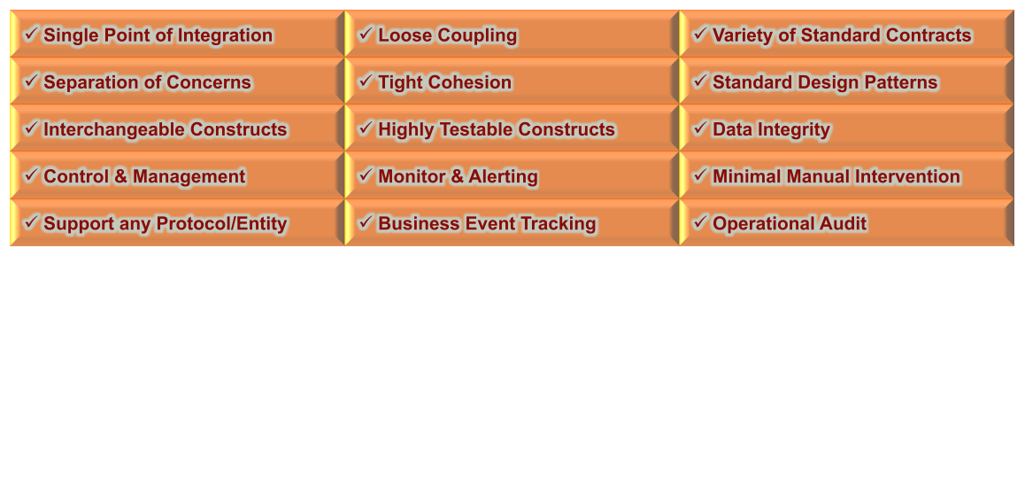
Translating the Architecture
Problem Domain
Architecture Strategies
Translating Architecture
Technology Stack
Features
Development Lifecycle
Roadmap
Summary
[Key Strategies]
[Construct] OSS Test Frameworks & Ikasan FlowTestHarness
  Flow component automated unit testing
    Junit, JMock, XMLUnit
  Initiator automated unit testing
    JUnit, JMock
  Flow automated unit (integration) testing
    Spring-test, Ikasan FlowTestHarness, HSQL in memory database
  Module integration testing
    Currently manual
    Future: automation through maven plugins

Slide 25
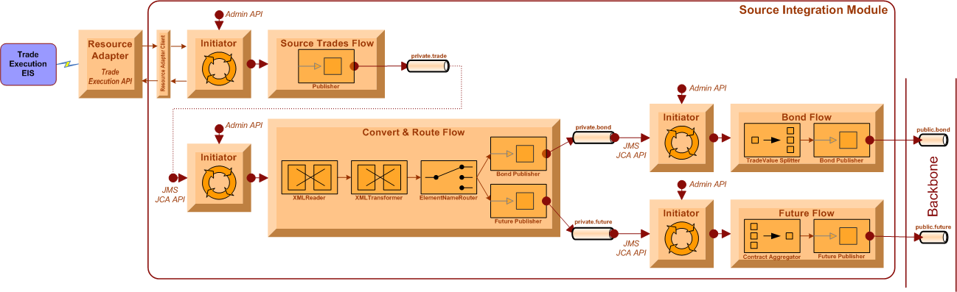
Translating the Architecture
Problem Domain
Architecture Strategies
Translating Architecture
Technology Stack
Features
Development Lifecycle
Roadmap
Summary
Sample Source Integration Module
    Source Trades Flow
      Get trades (CSV format) from EIS with minimal failure potential
    Convert & Route Flow
      Transform CSV -> XML syntax; Transform XML semantics; Route on type
    Bond Flow
      Split one bond event into many bond events based on trade size rule
    Future Flow
      Aggregate multiple future contract events until x then push as single event

Slide 26
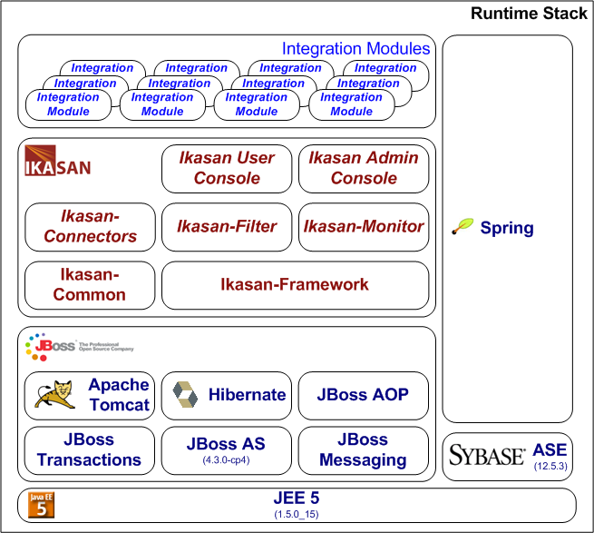
Technology Stack
Problem Domain
Architecture Strategies
Translating Architecture
Technology Stack
Features
Development Lifecycle
Roadmap
Summary
Runtime Stack

Slide 27
Technology Stack
Problem Domain
Architecture Strategies
Translating Architecture
Technology Stack
Features
Development Lifecycle
Roadmap
Summary
Development Stack
  Core technologies
    Java 1.5+ / JEE
    XML
    Spring Framework 2.6
  Test Frameworks
    JUnit
    JMock
    SpringTest
    Ikasan Flow Test Harness 0.7.10
  Scaffolding
    Source Management – Subversion
    Requirements and Issue Management – JIRA
    Peer Review and Acceptance Management – Crucible, FishEye
    Project Build Management – Maven
    Project Artefact Management – Sonotype Nexus
    Continuous Integration – Hudson

Slide 28
Features
Problem Domain
Architecture Strategies
Translating Architecture
Technology Stack
Features
Development Lifecycle
Roadmap
Summary
Version 0.7.10 current production release
Interoperability
  Protocols
    JMS
    FTP (transactional & chunking support)
    SFTP (transactional & chunking support)
    RDBMS (via Hibernate ORM)
    SMTP (Email)
    HTTP(s)
  Vendor APIs
    Trax Messaging
    PATS Trade Feed
    Espeed Trade feed
    Tradeweb Trade Feed
    Bloomberg Data License Per Security
  Data Constructs
    Event – Ikasan internal entity container
    Payload – actual entity in-flight

Slide 29
Features
Problem Domain
Architecture Strategies
Translating Architecture
Technology Stack
Features
Development Lifecycle
Roadmap
Summary
Functionality
  Initiators – business flow control
    Allows a client to stop, start, enable, disable, query runtime status
    Event Driven Type
      Any resource adapter protocol
    Schedule Driven Type
      Quartz Scheduler for absolute and relative invocation scheduling
  Flows
    Full Transactional Semantics
      Non-transactional
      Local transactions
      2-Phase transactions
      Last resource commit optimisation (LRCO)
        incorporate non-transactional resources within a distributed transaction
    Configurable Automated Recovery
      Rollback operations & stop
      Rollback operations and retry in x seconds
      Rollback operations and retry a number of times or indefinitely
      Report the exception and continue

Slide 30
Features
Problem Domain
Architecture Strategies
Translating Architecture
Technology Stack
Features
Development Lifecycle
Roadmap
Summary
Functionality
  Flow Components
    Transformers
      XSLT
      XML Reader
      XML Validator
      any POJO implementing Transformer interface
    Routers
      Recipient list
      Content
      Xpath
      Any POJO implementing Ikasan router interface
    Sequencers
      Aggregator
      Splitter
      Any POJO implementing Ikasan sequencer interface
    Endpoints
      Loggers
      Hard wiretap
      Any POJO implementing Ikasan endpoint interface
      Any resource adapter client API

Slide 31
Features
Problem Domain
Architecture Strategies
Translating Architecture
Technology Stack
Features
Development Lifecycle
Roadmap
Summary
Functionality
  Dynamically capture runtime data at any point in the flow
  Users able to search on business content across a flow

Slide 32
Development Lifecycle
Problem Domain
Architecture Strategies
Translating Architecture
Technology Stack
Features
Development Lifecycle
Roadmap
Summary
Approach based on TDD/BDD Agile dogma
  Gather/refine user stories and create use cases
  Sketch the stories into a module/flow design
  Create/refine the Flow Test Harness reflecting the design
  Create modules/flows/components to meet test harness acceptance
  Peer/pair walk through (10 minute daily stroll)
    Design reviews
    Code reviews
  Continuous Integration (CI) test coverage increases
  Deliver functionality to users for proofs
  Repeat!
Recent Example Implementation Times
  3 days – Completed module delivery for transformed XML; real-time and batch aggregation; delivered over HTTP(S) to downstream application
Demo

Slide 33
Roadmap
Problem Domain
Architecture Strategies
Translating Architecture
Technology Stack
Features
Development Lifecycle
Roadmap
Summary
Version 0.8.0 due shortly, currently in beta
New Features
  Event hospital
    Resubmission of failed business events
    Public API invocable over HTTP
    Full history of exceptions on a given event
  Simplified Domain Model
    Support any user defined entity in the domain model
    Support of any user defined domain properties

Slide 34
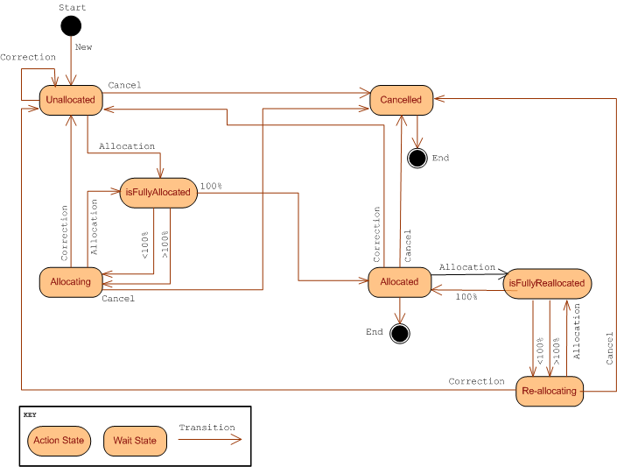
Roadmap
Problem Domain
Architecture Strategies
Translating Architecture
Technology Stack
Features
Development Lifecycle
Roadmap
Summary
Version 0.8.x or 0.9.0
New Feature
  State Modeling
    Standard Event Condition Action (ECA) State Pattern supporting
      wait states
      action states
      conditional & default transitions

Slide 35
Roadmap
Problem Domain
Architecture Strategies
Translating Architecture
Technology Stack
Features
Development Lifecycle
Roadmap
Summary
Future Releases
  Functionality
    event replay
    business subscription streams as an exposed registration service
  Monitoring & Management
    Flow status notification management service
      metrics and stats
      active monitoring rules
  Documentation
    Quick Start Guide
    Developer Guide

Slide 36
Summary
Problem Domain
Architecture Strategies
Translating Architecture
Technology Stack
Features
Development Lifecycle
Roadmap
Summary
Ikasan Project Resource Summary
  Web Site: http://www.ikasan.org
  SVN: http://open.jira.com/svn/IKASAN
  Wiki: http://sourceforge.net/apps/mediawiki/ikasaneip/index.php?title=Main_Page
  JIRA: http://open.jira.com/browse/IKASAN
  Mailing List: http://lists.sourceforge.net/lists/listinfo/ikasaneip-user
  IRC: http://sourceforge.net/apps/mediawiki/ikasaneip/index.php?title=IRC

Slide 37
Open Source
Enterprise Integration Platform
Jeff Mitchell
ikasan.org
July 2010

