Slide 1

Open Source
Enterprise Integration Platform
Jeff Mitchell & Jun Suetake
ikasan.org
July 2014

Slide 2
Introduction
The Problem Domain
Architecture Strategies
Translating the Architecture
Technology Stack
Features
Development Lifecycle
Roadmap
Summary

Slide 3
Problem Domain
Problem Domain
Architecture Strategies
Translating Architecture
Technology Stack
Features
Development Lifecycle
Roadmap
Summary
[Domain] Enterprise Application Integration (EAI) space
  Integration of business systems in a landscape of interwoven and
  often complex finance processes
[Issue] EAI is complex, costly, & not the primary business concern
  Greater adoption of “Best of Breed” specialist applications
  Business applications distributed across disparate platforms
  Business data distributed across isolated silos
  Legacy data repositories
  Data duplication and integrity issues
  No clear business data owner
  Exponential integration requirements
  Greater complexity of business demand on data orchestration
  EAI is more than simply connecting applications
[Goal] To provide simple, robust, configurable commoditised solutions
  Expose business artifacts whilst isolating the integration specifics

Slide 4
Architecture Strategies
Problem Domain
Architecture Strategies
Translating Architecture
Technology Stack
Features
Development Lifecycle
Roadmap
Summary
Simplicity
  Must not require in-depth proprietary knowledge
  Avoidance of overly complex or heavyweight frameworks
  Highly testable simple constructs
Commonality
  Reusable interchangeable constructs
  Standard contracts of interaction
  Simple repeatable implementation steps
Adaptability
  Ability to support any type of business entity
  Ability to integrate any type of Enterprise Information System
  Without breaking the first two strategies of Simplicity & Commonality
Robust & Guaranteed operation
  Maintain data integrity in business delivery and failure scenarios
  Require minimal manual intervention i.e. failure / automated recovery

Slide 5
Architecture Strategies
Problem Domain
Architecture Strategies
Translating Architecture
Technology Stack
Features
Development Lifecycle
Roadmap
Summary
Clear contract definition and separation of concerns

Slide 6
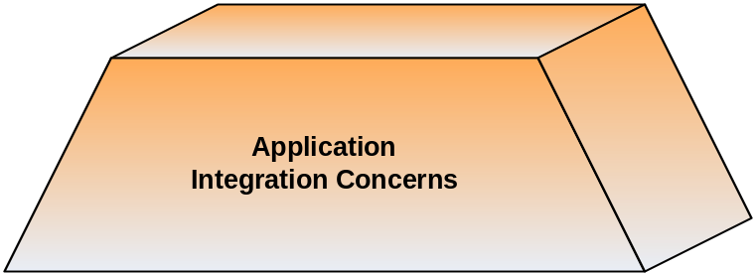
Architecture Strategies
Problem Domain
Architecture Strategies
Translating Architecture
Technology Stack
Features
Development Lifecycle
Roadmap
Summary
Clear contract definition and separation of concerns
  Application concerns
[Application] performant, robust & guaranteed operation

Slide 7
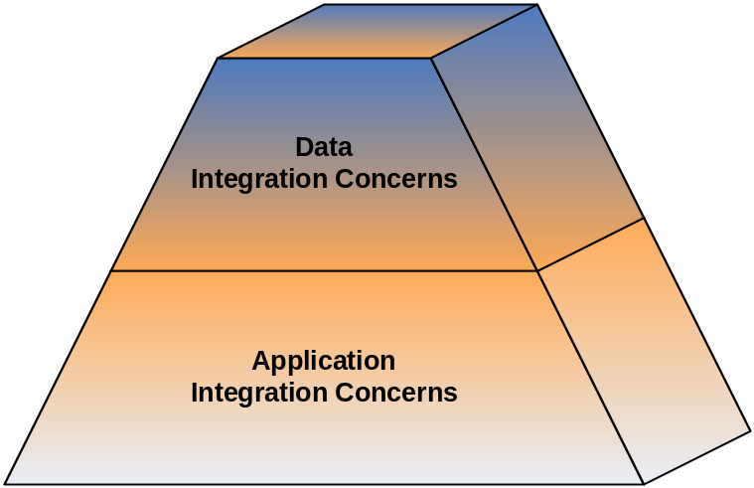
Architecture Strategies
Problem Domain
Architecture Strategies
Translating Architecture
Technology Stack
Features
Development Lifecycle
Roadmap
Summary
Clear contract definition and separation of concerns
  Application concerns
  Data concerns
[Data] presentation of standard, meaningful business data
[Application] performant, robust & guaranteed operation

Slide 8
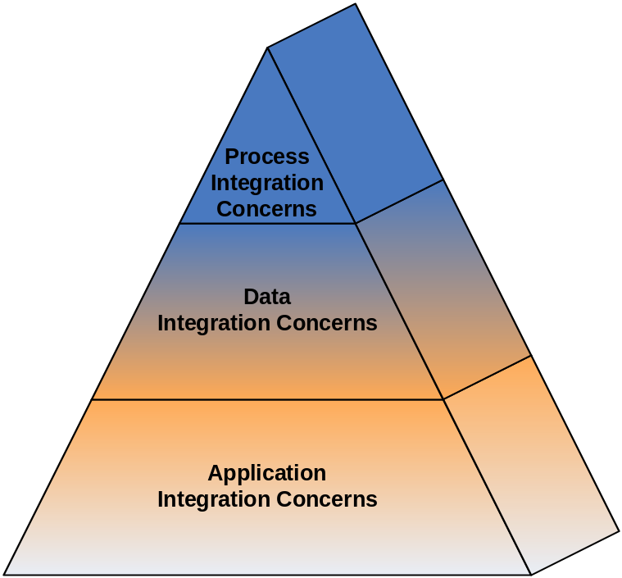
Architecture Strategies
Problem Domain
Architecture Strategies
Translating Architecture
Technology Stack
Features
Development Lifecycle
Roadmap
Summary
Clear contract definition and separation of concerns
  Application concerns
  Data concerns
  Business process concerns
[Process] business event & entity orchestration (STP is the goal)
[Data] presentation of standard, meaningful business data
[Application] performant, robust & guaranteed operation

Slide 9
Architecture Strategies
Problem Domain
Architecture Strategies
Translating Architecture
Technology Stack
Features
Development Lifecycle
Roadmap
Summary
Loose coupling
  Integrations should only require knowledge of each other through exchange of business artifacts
Tight cohesion
  An integration’s specifics must not bleed out unnecessarily
High visibility
  Business data tracking
  Fail scenarios
  Operational audit
Single logical point of integration
  Geographically agnostic / cross platform support
Open standards aligned with proven design patterns
  Adoption of industry standard Enterprise Design Patterns
  Avoidance of vendor lock-in

Slide 10
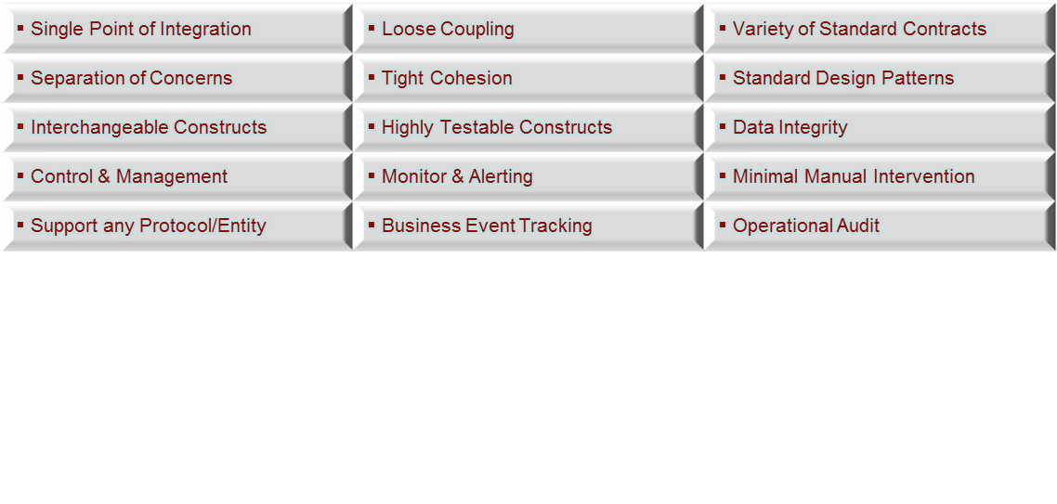
Architecture Strategies
Problem Domain
Architecture Strategies
Translating Architecture
Technology Stack
Features
Development Lifecycle
Roadmap
Summary
[Key Strategies]
Ensure traceability from architecture through to implementation
  All too often architecture fails to translate into the real world
  The right architecture can reduce complexity

Slide 11
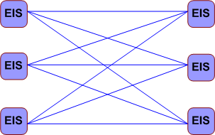
Translating the Architecture
Problem Domain
Architecture Strategies
Translating Architecture
Technology Stack
Features
Development Lifecycle
Roadmap
Summary
[Key Strategies]
[Issue] Commonly agreed that “spaghetti integration” is bad
  Integration can be exponentially complex
  Bleed out of APIs, data syntax and business semantics
  Ripple effect of change is massive

Slide 12
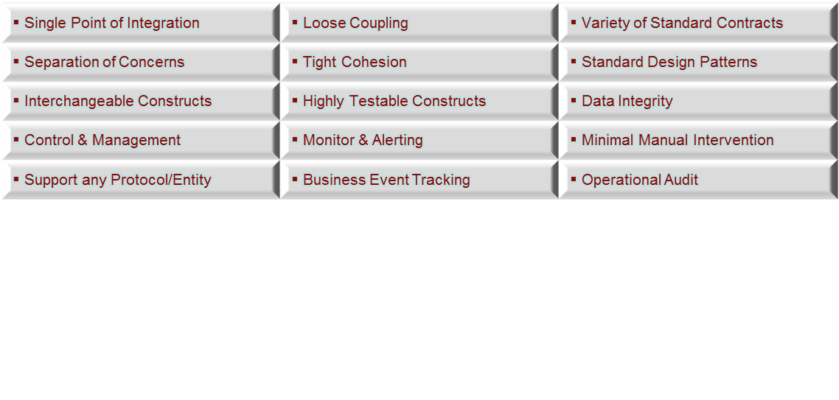
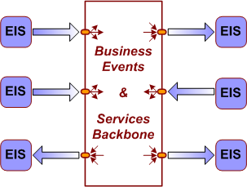
Translating the Architecture
Problem Domain
Architecture Strategies
Translating Architecture
Technology Stack
Features
Development Lifecycle
Roadmap
Summary
[Key Strategies]
[Concept] Standard Enterprise Application Integration (EAI) approach
  Provision of an Event/Service backbone
  Single point of integration for EIS business flow
  Ripple effect of change is localised (assuming best practice)

Slide 13
Translating the Architecture
Problem Domain
Architecture Strategies
Translating Architecture
Technology Stack
Features
Development Lifecycle
Roadmap
Summary
[Key Strategies]
[First Step] Modelling the Business Domain
  Defines fundamental entities, constructs, and their relationships
  Leverage existing domain knowledge
  External domain knowledge – we are not the first…
    Enterprise Integration Design Patterns
      [Ref. Enterprise Integration Patterns, Gregor Hohpe & Bobby Woolf, 2003]
    Enterprise Application Design Patterns
      [Ref. Patterns of Enterprise Application Architecture, Martin Fowler]
  Goal is a Rich Domain Model (data & behavior)
    Anemic Domain Models (data only) fail over time

Slide 14
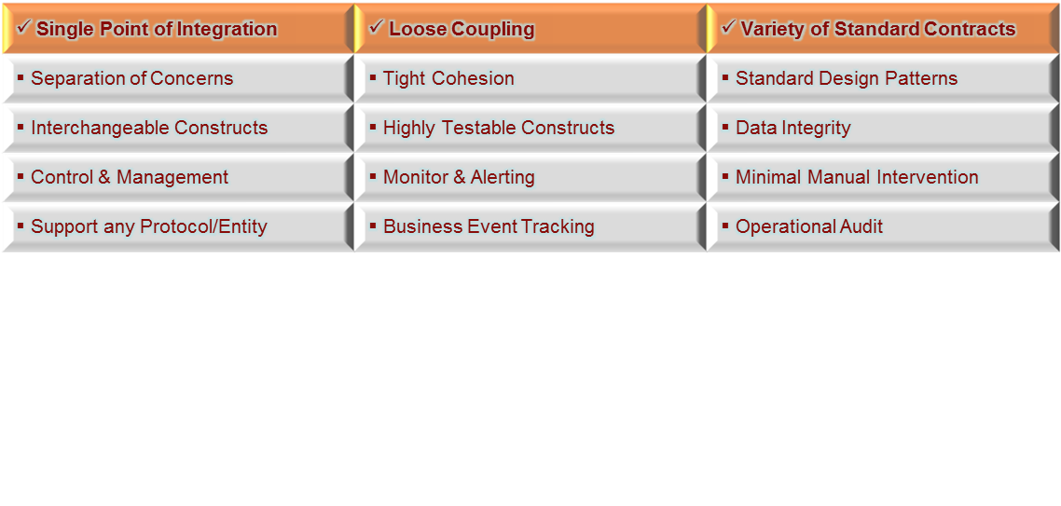
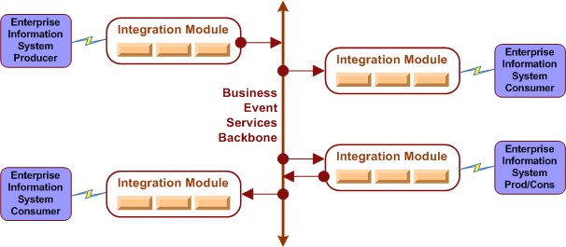
Translating the Architecture
Problem Domain
Architecture Strategies
Translating Architecture
Technology Stack
Features
Development Lifecycle
Roadmap
Summary
[Key Strategies]
[Construct] Integration Modules
  Provides a logical grouping of business operations as a single integration point
  Provide either a source, target, or bi-directional business flow.

Slide 15
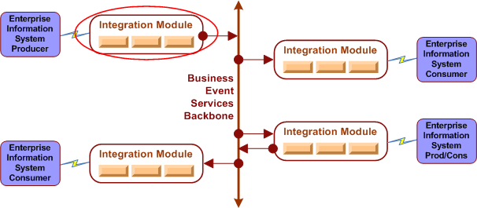
Translating the Architecture
Problem Domain
Architecture Strategies
Translating Architecture
Technology Stack
Features
Development Lifecycle
Roadmap
Summary
[Key Strategies]
[Construct] Integration Modules
  Provides a logical grouping of business operations as a single integration point
  Provide either a source, target, or bi-directional business flow.

Slide 16
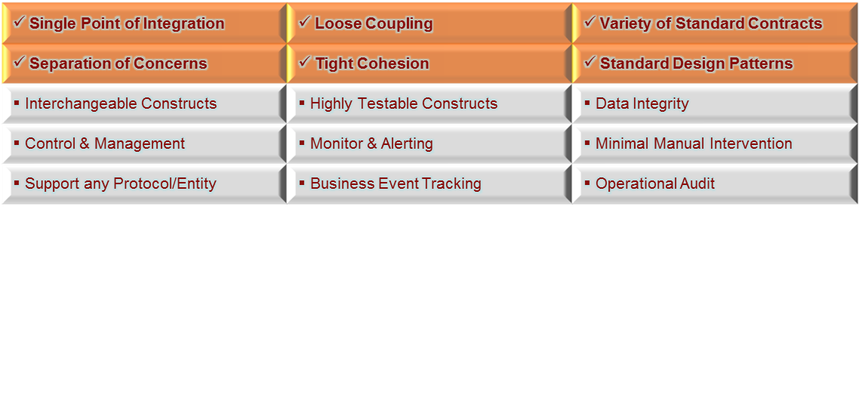
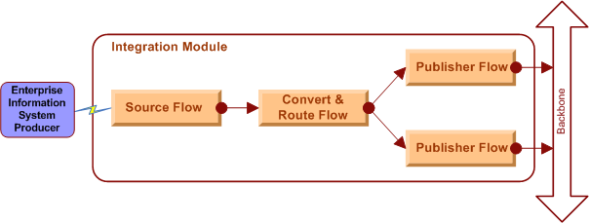
Translating the Architecture
Problem Domain
Architecture Strategies
Translating Architecture
Technology Stack
Features
Development Lifecycle
Roadmap
Summary
[Key Strategies]
[Construct] Flows
  Provide cohesive operations on a business artifact as a synchronous operation
  Multiple flows can be chained to isolate concerns
  Standard event container allows any data type to be transported

Slide 17
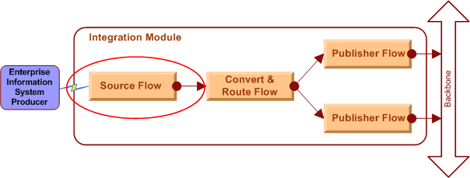
Translating the Architecture
Problem Domain
Architecture Strategies
Translating Architecture
Technology Stack
Features
Development Lifecycle
Roadmap
Summary
[Key Strategies]
[Construct] Flows
  Provide cohesive operations on a business artifact as a synchronous operation
  Multiple flows can be chained to isolate concerns
  Standard event container allows any data type to be transported

Slide 18
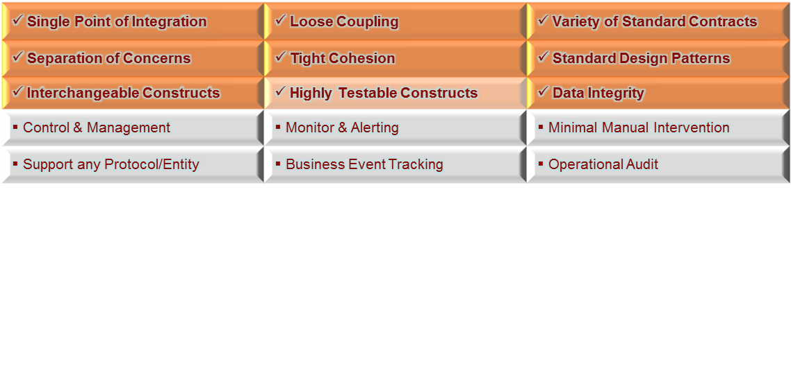
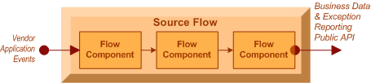
Translating the Architecture
Problem Domain
Architecture Strategies
Translating Architecture
Technology Stack
Features
Development Lifecycle
Roadmap
Summary
[Key Strategies]
[Construct] Flow Components
  POJO implementations provide independent, interchangeable operations
  Isolated component white box testing and chained black box testing
  All flow components within an atomic operation guaranteeing data integrity
  Unfettered event transport without casting or serialization overheads

Slide 19
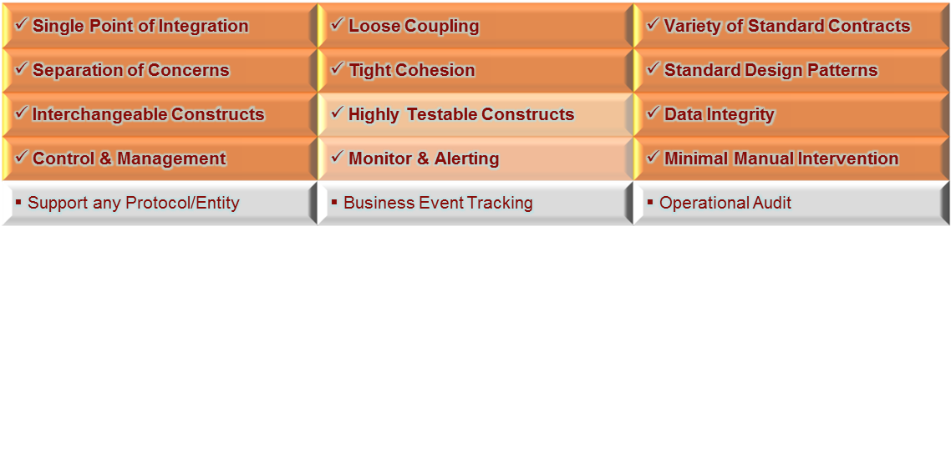
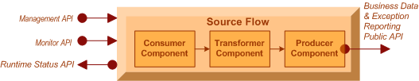
Translating the Architecture
Problem Domain
Architecture Strategies
Translating Architecture
Technology Stack
Features
Development Lifecycle
Roadmap
Summary
[Key Strategies]
[Construct] Flow Contracts
  Management API provides business flow control (start, stop, pause, resume)
    Pause/Resume for fine grained consumer component resource management only
    Stop/Start for course grained general component resource management
  Runtime Status API provides real-time health status (running, stopped, recovery, stoppedInError)
  Monitor API provides pluggable runtime health notifiers i.e. (Email, Zenoss, Hobbit, SMS, etc)
  Recovery Manager for configurable exception handling for automated flow recovery
    Invocable by any component to change flow state

Slide 20
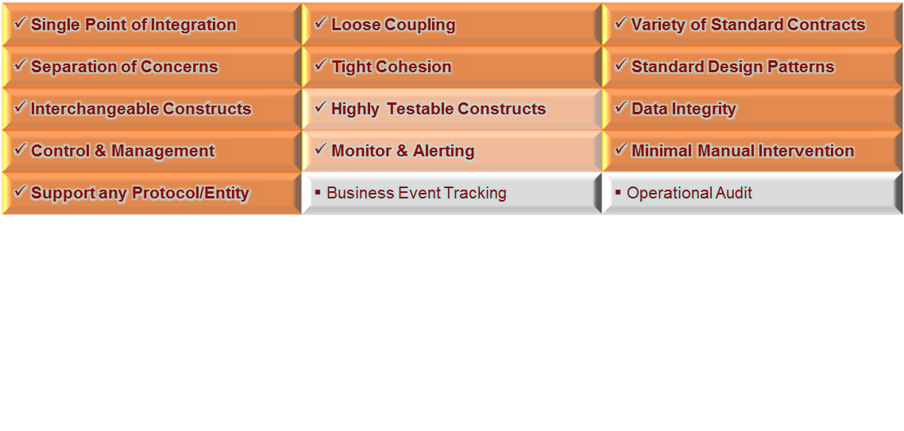
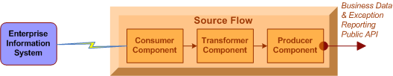
Translating the Architecture
Problem Domain
Architecture Strategies
Translating Architecture
Technology Stack
Features
Development Lifecycle
Roadmap
Summary
[Key Strategies]
[Construct] EIS / Application Integration
  Consumers can support any type of protocol / API
  Extend guaranteed integrity to non-guaranteed EIS sources/targets
  No proprietary knowledge required; only EIS API
  Resource adapters pluggable re-usable components (Java Connector Architecture spec)
  3rd party off-the-shelf or internally developed

Slide 21
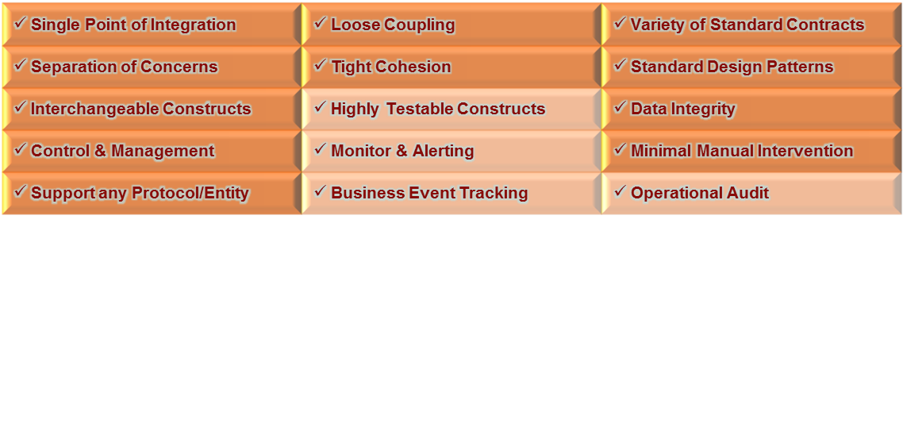
Translating the Architecture
Problem Domain
Architecture Strategies
Translating Architecture
Technology Stack
Features
Development Lifecycle
Roadmap
Summary
[Key Strategies]
[Construct] Administration Console
  Flow management
    runtime status (stopped, running, recovery, stoppedInError)
    runtime control (start, stop, pause, resume)
    deployment control (start-up type {auto, manual, disabled})
    flow component chain view and drill down
    audit log of flow actions (stop/start/pause/resume)
  Wiretap management
    dynamic creation/deletion of real-time in-flight data capture
  User management
    creation, deletion, and permission maintenance

Slide 22
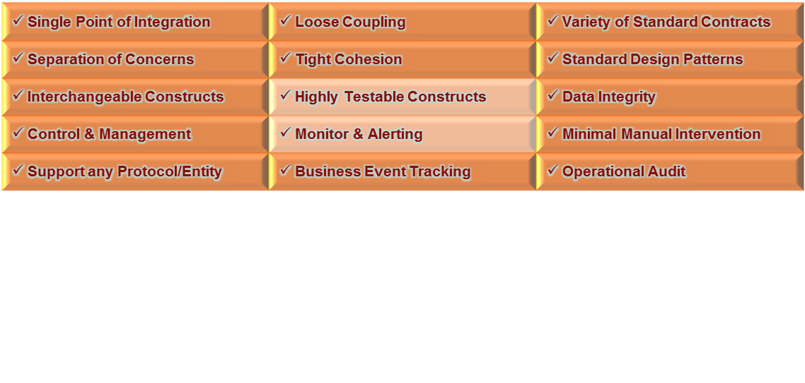
Translating the Architecture
Problem Domain
Architecture Strategies
Translating Architecture
Technology Stack
Features
Development Lifecycle
Roadmap
Summary
[Key Strategies]
[Construct] User Console
  In-flight business event searches
    by module(s)
    by flow(s)
    by business stream(s)
    parameter filters
      business content, date/time, names, etc
  Event “Life Identifier” support for full end to end business event tracking
    flow component chain view and drill down
    audit log of flow actions (stop/start/pause/resume)
  User management
    creation, deletion, and permission maintenance

Slide 23
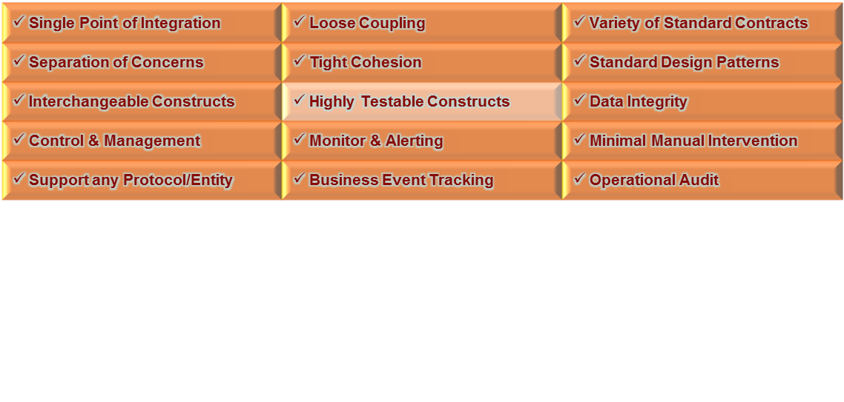
Translating the Architecture
Problem Domain
Architecture Strategies
Translating Architecture
Technology Stack
Features
Development Lifecycle
Roadmap
Summary
[Key Strategies]
[Construct] Monitors & Notifiers
  Big Brother / Hobbit client
  Zenoss
  Email client
  Log scraper
  HTTP client

Slide 24
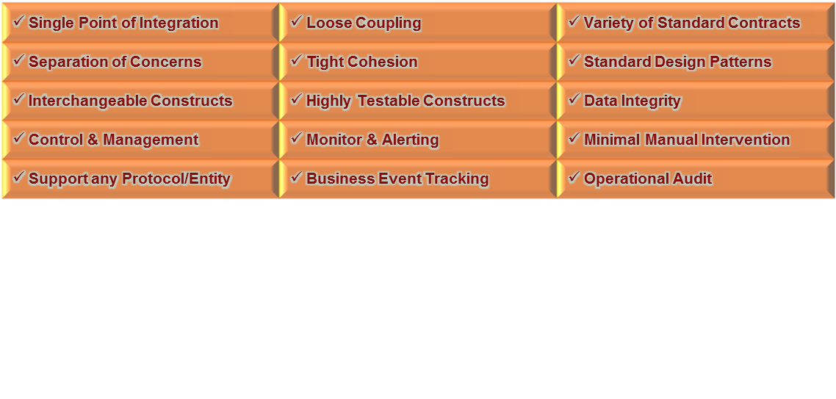
Translating the Architecture
Problem Domain
Architecture Strategies
Translating Architecture
Technology Stack
Features
Development Lifecycle
Roadmap
Summary
[Key Strategies]
[Construct] OSS Test Frameworks & Ikasan FlowTestHarness
  Flow component automated unit testing
    Junit, JMock, XMLUnit
  Initiator automated unit testing
    JUnit, JMock
  Flow automated unit (integration) testing
    Spring-test, Ikasan FlowTestHarness, HSQL & H2 in memory database
  Business Stream end to end testing
    FitNesse

Slide 25
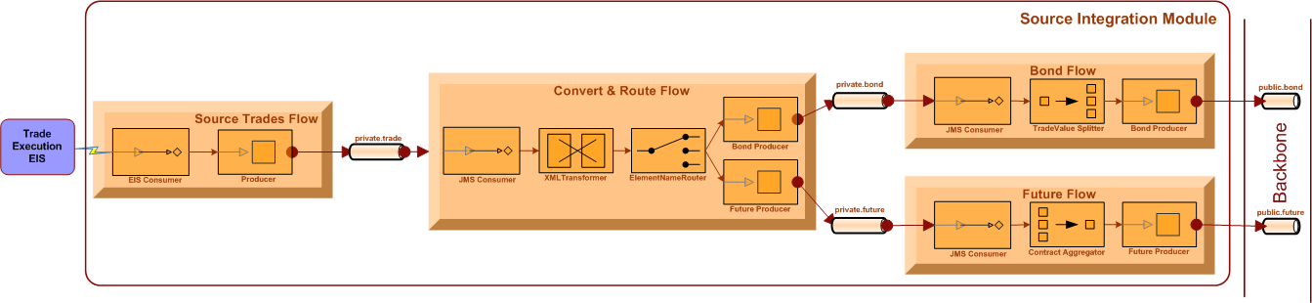
Translating the Architecture
Problem Domain
Architecture Strategies
Translating Architecture
Technology Stack
Features
Development Lifecycle
Roadmap
Summary
Sample Source Integration Module
    Source Trades Flow
      Get trades (CSV format) from EIS with minimal failure potential
    Convert & Route Flow
      Transform CSV -> XML syntax; Transform XML semantics; Route on type
    Bond Flow
      Split one bond event into many bond events based on trade size rule
    Future Flow
      Aggregate multiple future contract events until “complete” then push as single event

Slide 26
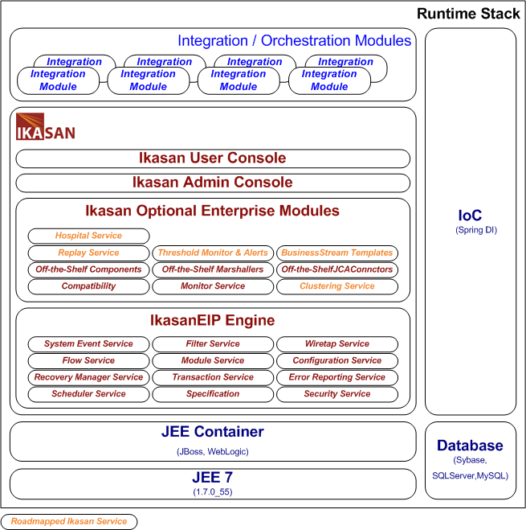
Technology Stack
Problem Domain
Architecture Strategies
Translating Architecture
Technology Stack
Features
Development Lifecycle
Roadmap
Summary
Runtime Stack

Slide 27
Technology Stack
Problem Domain
Architecture Strategies
Translating Architecture
Technology Stack
Features
Development Lifecycle
Roadmap
Summary
Development Stack
  Core technologies
    Java 1.7+ / JEE
    XML
    Spring 3.1.1.RELEASE
    Hibernate
  Test Frameworks
    JUnit
    Jmock
    FitNesse
    SpringTest
    Ikasan Flow Test Harness
  Scaffolding
    Source Management – GitHub
    Requirements and Issue Management – JIRA
    Peer Review and Acceptance Management – Crucible/FishEye
    Project Build Management – Maven
    Project Artefact Management – Sonotype Nexus
    Continuous Integration – Jenkins/Bamboo

Slide 28
Technology Stack
Problem Domain
Architecture Strategies
Translating Architecture
Technology Stack
Features
Development Lifecycle
Roadmap
Summary
IkasanEIP Stack
  IkasanEIP Engine
    IkasanEIP - engine underpinning all operations and services
  Ikasan Optional Enterprise Modules
    Compatibility – provides runtime inter-op between Ikasan versions
    Monitor Service – default monitor & notifiers
    Off-the-Shelf Flow Components i.e. JSON <-> XML, XSLT, MongoDB, JMS, Quartz
    Clustering Service (beta) – makes Ikasan cluster aware
    Threshold Monitor & Alerts (beta) – business throughput monitoring
    Replay Service (dev)
      event record & replay
      Module revert to point in time state & replay (TBC)
    Hospital Service (dev)
      Management of failed events for review/resolution resubmission/discard
      Management of failed events & dependents
    Business Stream Templates (planning)
      Boilerplate commoditisation of standard business orchestration (TBC)
  Ikasan Admin Console & Ikasan User Console

Slide 29
Technology Stack
Problem Domain
Architecture Strategies
Translating Architecture
Technology Stack
Features
Development Lifecycle
Roadmap
Summary
IkasanEIP Stack
  IkasanEIP is agnostic to the Operating System i.e. Linux, Windows, OSX
  IkasanEIP runs In Container
    Can run in any JEE compliant container
    Proven in WebLogic 10+, JBoss 6+
  IkasanEIP runs Standalone (outside container)
    Can run standalone with reduced Enterprise Services
  IkasanEIP Persistence
    Proven with JDBC implementations ie. Sybase, SQLServer, MySQL, HSQLDB, H2
Version 0.9.4 current production release
Stable production backbone since 2007

Slide 30
Features
Problem Domain
Architecture Strategies
Translating Architecture
Technology Stack
Features
Development Lifecycle
Roadmap
Summary
Technical Integration
  Off-the-Shelf Protocols
    JMS (HornetQ, JBossA-MQ, ActiveMQ, WebLogic, IBM WebSphere MQ)
    FTP (transactional & chunking support)
    SFTP (transactional & chunking support)
    RDBMS (via Hibernate ORM, Sybase, MS SQL, MySQL, Oracle)
    SMTP (Email)
    HTTP(s)
  Data Constructs
    Event – Ikasan internal entity container
    EventIdentifier – Ikasan internal Event Life Identifier
    Timestamp – Ikasan internal Event creation timestamp
    Payload – actual entity in-flight – can be anything

Slide 31
Features
Problem Domain
Architecture Strategies
Translating Architecture
Technology Stack
Features
Development Lifecycle
Roadmap
Summary
Functionality
  Flow Runtime Management – control at the runtime thread level
    Allows a client to stop, start, pause, resume, enable, disable, query runtime status
  Flow Drivers
    Real-time Event Driven
    Batch Event Driven
    Schedule Driven
  Flow Non-Functional Features
    Full Transactional Semantics
      Non-transactional
      Local transactions
      2-Phase transactions
      Last resource commit optimisation (LRCO)
        incorporate non-transactional resources within a distributed transaction
    Configurable Automated Recovery
      Rollback operations & stop
      Rollback operations and retry in x seconds
      Rollback operations and retry a number of times or indefinitely
      Report the exception and continue

Slide 32
Features
Problem Domain
Architecture Strategies
Translating Architecture
Technology Stack
Features
Development Lifecycle
Roadmap
Summary
Functionality
  Flow Components
    Transformers
      XSLT
      XML Reader, Validator
      any POJO implementing Translator/Converter interface
    Routers
      Recipient list
      Content
      Xpath
      Any POJO implementing Ikasan Router interface
    Sequencers
      Aggregator
      Any POJO implementing Ikasan Sequencer interface
    Splitters
      Any POJO implementing Ikasan Splitter interface
    Filters
      Any POJO implementing Ikasan FilterRule/Filter interface

Slide 33
Features
Problem Domain
Architecture Strategies
Translating Architecture
Technology Stack
Features
Development Lifecycle
Roadmap
Summary
Functionality
  Flow Components
    Endpoints
      Consumers
        JMS Standalone
        JMS Container Based
        Scheduled
        Any resource adapter client or third-party API
        Any POJO implementing Ikasan Consumer interface
      Brokers
        MongoDB
        JDBC
        Any resource adapter client or third-party API
        Any POJO implementing Ikasan Broker interface
      Producers
        JMS Standalone
        JMS Container Based
        Loggers
        Any resource adapter client or third-party API
        Any POJO implementing Ikasan Producer interface
    Dynamically capture runtime data at any point in the flow
    Users able to search business content over Flows/Business Streams

Slide 34
Features
Problem Domain
Architecture Strategies
Translating Architecture
Technology Stack
Features
Development Lifecycle
Roadmap
Summary
Business Integration
  Post Trade Execution
    Bloomberg
      Trade Feed
      Consolidated Message Feed
      Derivative Settlement Feed
      Daily Trade Reporting
    PATS Post Trade Feed
    Espeed Post Trade feed
    Tradeweb Post Trade Feed (US Treasuries & JGBs)
    ION Post Trade Feed
    Fidessa ETP Execution Report and Allocation FIX messages
    ANVIL Repo Trading
  Positions
    ION
    Bloomberg Position Feed
    Intellimatch
  Price Marks
    ION (Price Marks)
    Bloomberg (Price UMTM)

Slide 35
Features
Problem Domain
Architecture Strategies
Translating Architecture
Technology Stack
Features
Development Lifecycle
Roadmap
Summary
Business Integration
  Trade Matching, Reporting & Reconciliation
    TRAX
    Bloomberg Daily Trade Reporting
  Sales Commission Reporting
    FIOS
  Reference Data
    Bloomberg Data License Per Security; Data License Back Office
    MACE Convertible Bonds
    Swap Monitor Financial Calendar Holidays
    Fidessa ETP MIS & FDA
    GoldenSource
  Market Data
    Markit CDS Service
    Markit iBoxx Benchmark Indices
    Bank of America Merrill Lynch Indices
    Xenomorph Timescape

Slide 36
Features
Problem Domain
Architecture Strategies
Translating Architecture
Technology Stack
Features
Development Lifecycle
Roadmap
Summary
Business Integration
  Settlements & Operations
    SWIFT Alliance
    GlobeOp
  Ratings
    Moodys
    Standard & Poors
  Compliance
    Thomson Reuters TransWatch Securities Data
  Corporate Actions
    FTI Corporate Action & Securities Universe

Slide 37
Development Lifecycle
Problem Domain
Architecture Strategies
Translating Architecture
Technology Stack
Features
Development Lifecycle
Roadmap
Summary
Approach based on TDD/BDD Agile dogma
  Gather/refine user stories and create use cases
  Sketch the stories into a stream/module/flow design
  Create/refine the Flow Test Harness reflecting the design
  Create modules/flows/components to meet test harness acceptance
  Peer/pair walk through (10 minute daily stroll)
    Design reviews
    Code reviews
  Continuous Integration (CI) test coverage increases
  Deliver functionality to users for proofs
  Repeat!
Recent Example Implementation Times
  1 day – Completed module delivery for raw to raw message transport (RMS: Raw Message Service);
  1 - 15 days – Completed module delivery for transformed XML (CMS: Common Message Service); real-time feed and batch aggregation;
  50 days – Completed delivery of complex business work flow (BPAWS: Business Process Application Workflow Service). Orchestrating Fixed Income Bond Trading flows between two business entities.

Slide 38
Roadmap
Problem Domain
Architecture Strategies
Translating Architecture
Technology Stack
Features
Development Lifecycle
Roadmap
Summary
Version 0.9.0 released on 29-July-2013
  Main Features
    Simplicity (0.9.0)
      No more initiators
      Clearer more modular structure to the Ikasan platform
    Significant Performance Improvement (0.9.0)
      Changed the nature of Event and payload to utilise Java Generics
      Improved handling of exceptions
      Improved recovery cycle management
    Simplified Domain Model (0.9.0+)
      Support any user defined entity in the domain model
      Support of any user defined domain properties
Version 0.9.4 (Latest and Stable)
Version 1.0.0 due shortly, currently in beta

Slide 39
Roadmap
Problem Domain
Architecture Strategies
Translating Architecture
Technology Stack
Features
Development Lifecycle
Roadmap
Summary
Version 1.1.0 due Q3 2014
  Threshold Monitor & Alerts
  Clustering Service
  Hospital Service
  Replay Service
  Greater focus on Developer Documentation
Version 1.2.0 (TBC)
  Dynamic Provisioning
  Business Stream Templates

Slide 40
Summary
Problem Domain
Architecture Strategies
Translating Architecture
Technology Stack
Features
Development Lifecycle
Roadmap
Summary
Ikasan Project Resource Summary
  Web Site: http://www.ikasan.org
  GitHub: https://github.com/ikasanEIP/ikasan
  Wiki: http://sourceforge.net/apps/mediawiki/ikasaneip/index.php?title=Main_Page
  JIRA/Confluence/Bamboo: http://ikasan.atlassian.net
  Mailing List: http://lists.sourceforge.net/lists/listinfo/ikasaneip-user
  IRC: http://sourceforge.net/apps/mediawiki/ikasaneip/index.php?title=IRC

Slide 41
Open Source
Enterprise Integration Platform
Jeff Mitchell & Jun Suetake
ikasan.org
July 2014

