Slide 1





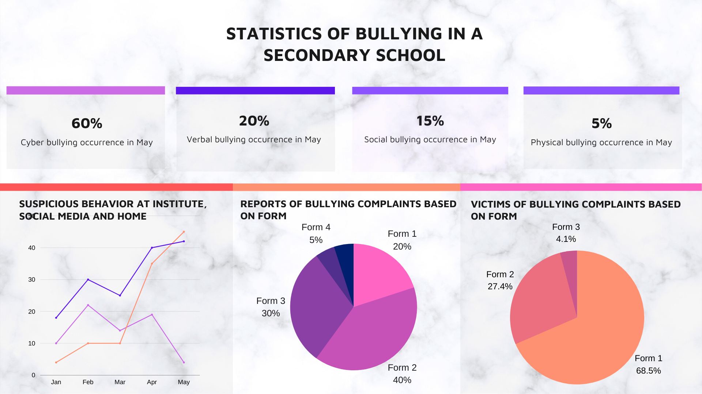
Education Infographic
Problem
4 in 5
Bullying is considered a cliché problem faced by students. The problem is THE VICTIM RARELY SPEAKS UP.
Below are the statistics for the main type of bullying in academic institutes
Students encounter bullying everyday
Data Science for Education
64%
76%
Social Bullying
Cyber Bullying
Solution
24%
84%
Instead of waiting for students to report the bullying case. It would be more efficient to detect it early on.
This will trigger early responses and prevent students experience traumatic situations.
Physical Bullying
Verbal Bullying
Datasets
Student – This dataset contains information regarding student’s name, behavior, performance and etc Social_media – an initial manual search of common slurs and terms used pertaining to abusive and negative words towards a certain account.
Family_Behavior – This dataset including behavior of family members, occupation, income, hobbies and etc
Ins_Env – This dataset contains information regarding the student’s complaint and data regarding suspicious activity occurrence in institute
Bully - This dataset includes all the list name of students who are suspected that are to be either a victim, the bully and accomplices, also include types of bully done.
Technology
IoT
Detect changes in students’ daily behavior. (smart watch, CCTV and smartphone
Big Data
Collect large worldwide information about the situation of selected student
Snowflake
Allows authorities to store and analyze data using cloud-based hardware and software
Mock Up Dashboard

