Slide 1
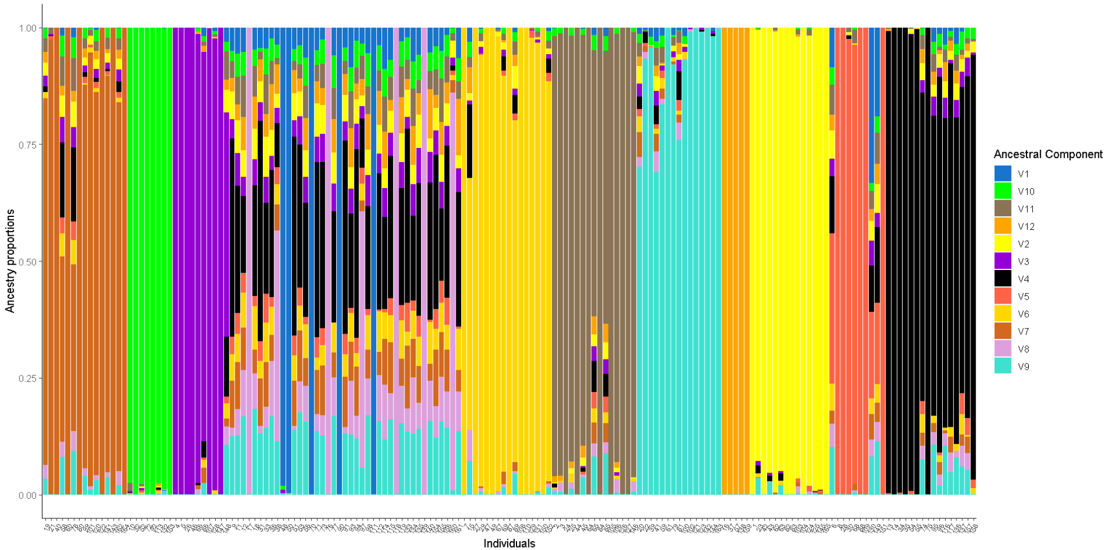
FCR
TC
SELU
BR + PIN +BF + BF + SP + CC
SP + BF + BR + CC + PIN
KM + PIN
SC
LE
SLR
PH
SP
SH

