Slide 1
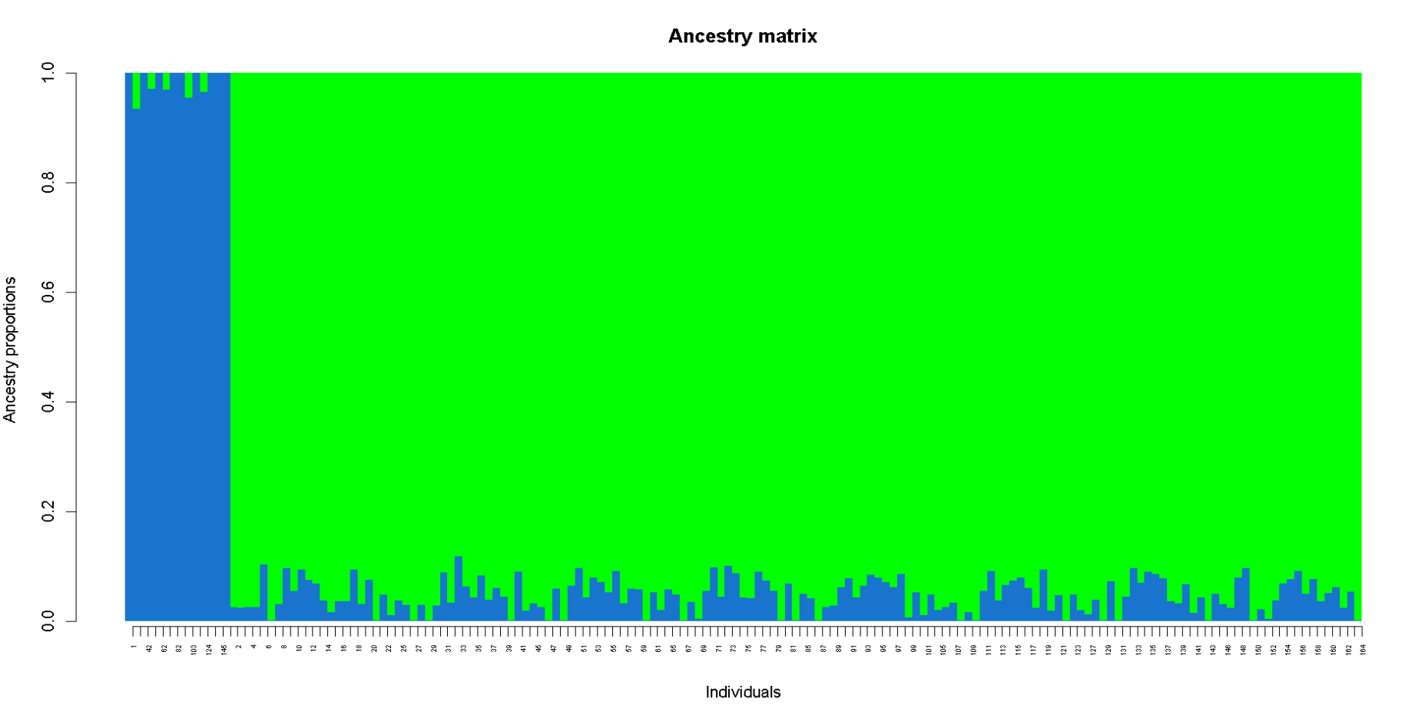
Powers Hollow
All other populations

