Slide 1
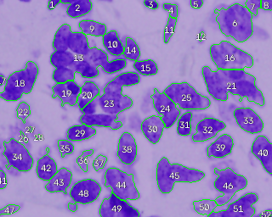
Microscopic Cell Image
Adhesion Segmentation & Automatic Counting
INTRODUCTION TO AI · FINAL PROJECT · TOPIC 3
U-Net probability maps + distance transform + watershed, delivered as a local web app
52
cells found
Presented by: Your Name · Student ID
Advisor: Huang Qing
Wuhan Institute of Technology · October 2026
Notes:
Good morning everyone. My project is Topic 3: a system that segments touching cells in microscope images and counts them automatically. In one sentence: you give it a stained microscopy image, and it gives back every cell outlined and numbered, the area of each cell, an area histogram and a CSV file. On the right you can see a real result from my software: 52 nuclei found in a crowded image.

Slide 2





Why I chose this topic
01 · MOTIVATION
A real lab problem
Hardest case: touching cells
Biologists count hundreds of cells for drug tests, cancer grading and growth studies. One image can take minutes by hand.
Cells stick together (adhesion). Simple thresholding merges them into one blob, so the count comes out wrong.
Counting cells by hand is slow, tiring and different from person to person.
Deep learning + classic vision
Results I can measure
I wanted to see if AI could do this job in under a second, and show its work so a biologist can trust it.
The topic joins a trained U-Net with distance transform and watershed, so I could learn modern AI and classic image processing.
The public DSB 2018 dataset has expert-drawn ground truth, so every result can be checked with numbers, not just by eye.
Notes:
Why did I pick this topic? First, it is a real problem: in biology and medicine people still count cells by hand, which is slow and subjective. Second, the hard part is cells that touch each other. If you just threshold the image, two touching cells become one blob and the count is wrong, so there is a real technical challenge. Third, the topic mixes deep learning with classical computer vision, which is exactly what this course covers. And fourth, there is a public dataset with ground truth, so I can prove my results with numbers.

Slide 3
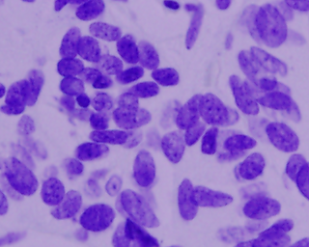
The problem: counting cells that touch
01 · PROBLEM
ASSIGNMENT BRIEF · TOPIC 3
Input
Stained microscopy images with many overlapping cells
Output
Numbered cell contours, area of each cell, area histogram
Technical focus
Pre-trained U-Net probability map, distance transform, watershed
Input
87 nuclei, many touching in clumps
Output
Each cell outlined and numbered
Must iterate on
Threshold tuning to avoid over/under-segmentation; show probability heatmaps for manual review
Key challenge: after thresholding, touching cells form one white blob. The system must cut each blob back into single cells.
Notes:
This is the official brief. Input: stained microscope images with many overlapping cells. Output: every cell outlined and numbered, its area, and an area histogram. The required techniques are a pre-trained U-Net, distance transform and watershed. The brief also says I must iterate on the probability threshold and must show the probability heatmap so a human can check it. On the right: the input has 87 nuclei, many touching. The challenge is to split those clumps back into single cells.

Slide 4
Presentation roadmap
01 · OVERVIEW
1
2
3
4
Motivation & problem
Development process
Architecture design
Dataset
Why this topic, what the brief asks
From the first sketch to working software
Layers, modules and interfaces
DSB 2018 nuclei, split and augmentation
5
6
7
8
Pipeline & model
Parameters & tuning
Results & robustness
Live demo & conclusion
Preprocess, U-Net, watershed, analysis
What each slider does, how I tuned them
Test-set numbers, error handling, tests
The software running on my laptop
Notes:
Here is the plan for the talk: eight parts. I will finish with a live demo of the software running locally on my laptop.

Slide 5
From sketch to software: how the project was built
02 · DEVELOPMENT PROCESS
1
2
3
4
5
6
Sketch
Phase 1
Phase 2
Training
Phase 3
Tuning & UI
Architecture and UI drawn first: 6 design pages
Folder layout + typed class signatures, approved by instructor
15 modules (M1–M15) coded one by one with the AI agent
U-Net trained on my GPU, best val Dice 0.902
Integration, error handling, 58 unit tests
288-setting grid search, final dashboard
15
29
58
288
modules built step by step
logged agent iteration rounds
automated unit tests
parameter settings searched
Notes:
The course required a strict process, and I followed it. I started with a sketch: six design pages for the architecture, the pipeline, the model, the code layout, the UI and error handling. Phase 1 was only structure: folders and typed class signatures, and my instructor approved it. Phase 2: I built fifteen modules one at a time together with an AI coding agent, testing each one before moving on. Then I trained the U-Net on my own GPU. Phase 3 was integration and debugging: error handling and 58 unit tests. Finally I tuned the parameters with a grid search and polished the interface. Every correction was logged: 29 rounds in my iteration log.

Slide 6
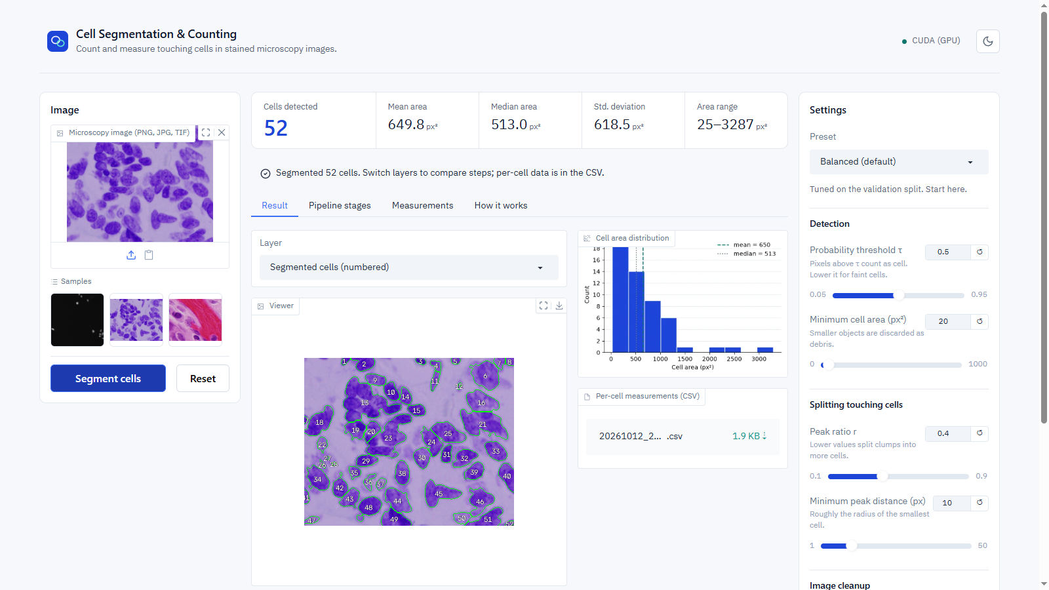
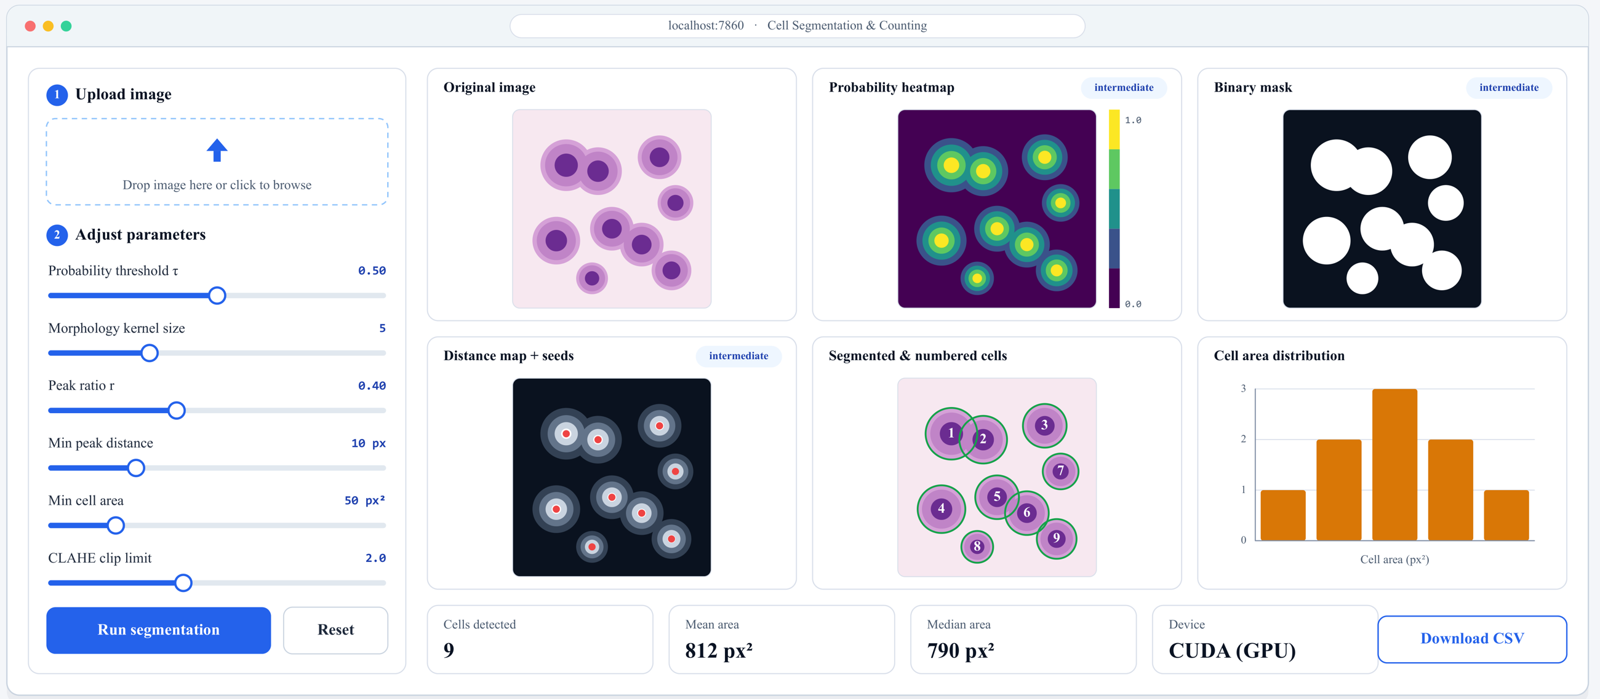
Design sketch vs. final software
02 · DEVELOPMENT PROCESS
BEFORE · PHASE 1 MOCKUP
AFTER · RUNNING SOFTWARE
Planned: upload, 6 sliders, intermediate views, count, mean/median area, CSV download
Delivered + added: image-type presets, layer viewer, measurements tab, 5 summary statistics, dark mode
Notes:
This slide shows sketch versus final. On the left is the mockup I drew in Phase 1, before writing any code. On the right is the real software today. Everything I planned is there: upload, sliders, intermediate images, statistics and CSV export. During development I added presets for different image types, a layer viewer, a measurements table and a dark mode.

Slide 7
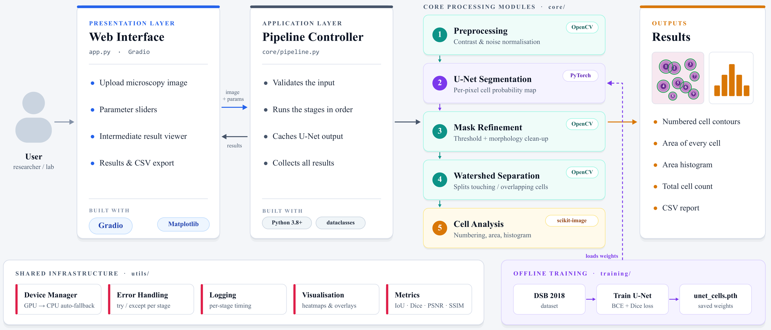
System architecture
03 · ARCHITECTURE DESIGN
Notes:
This is the system architecture. Left to right: the user works with the web interface built in Gradio. The interface sends the image and slider values to the pipeline controller, which validates input, runs the stages in order and caches the U-Net output so moving a slider is fast. The five core modules are preprocessing, U-Net segmentation, mask refinement, watershed separation and cell analysis. Outputs are numbered contours, areas, a histogram, the count and a CSV. At the bottom: shared utilities for GPU/CPU selection, error handling, logging, visualisation and metrics, and the offline training part that produces the weights file the app loads.

Slide 8
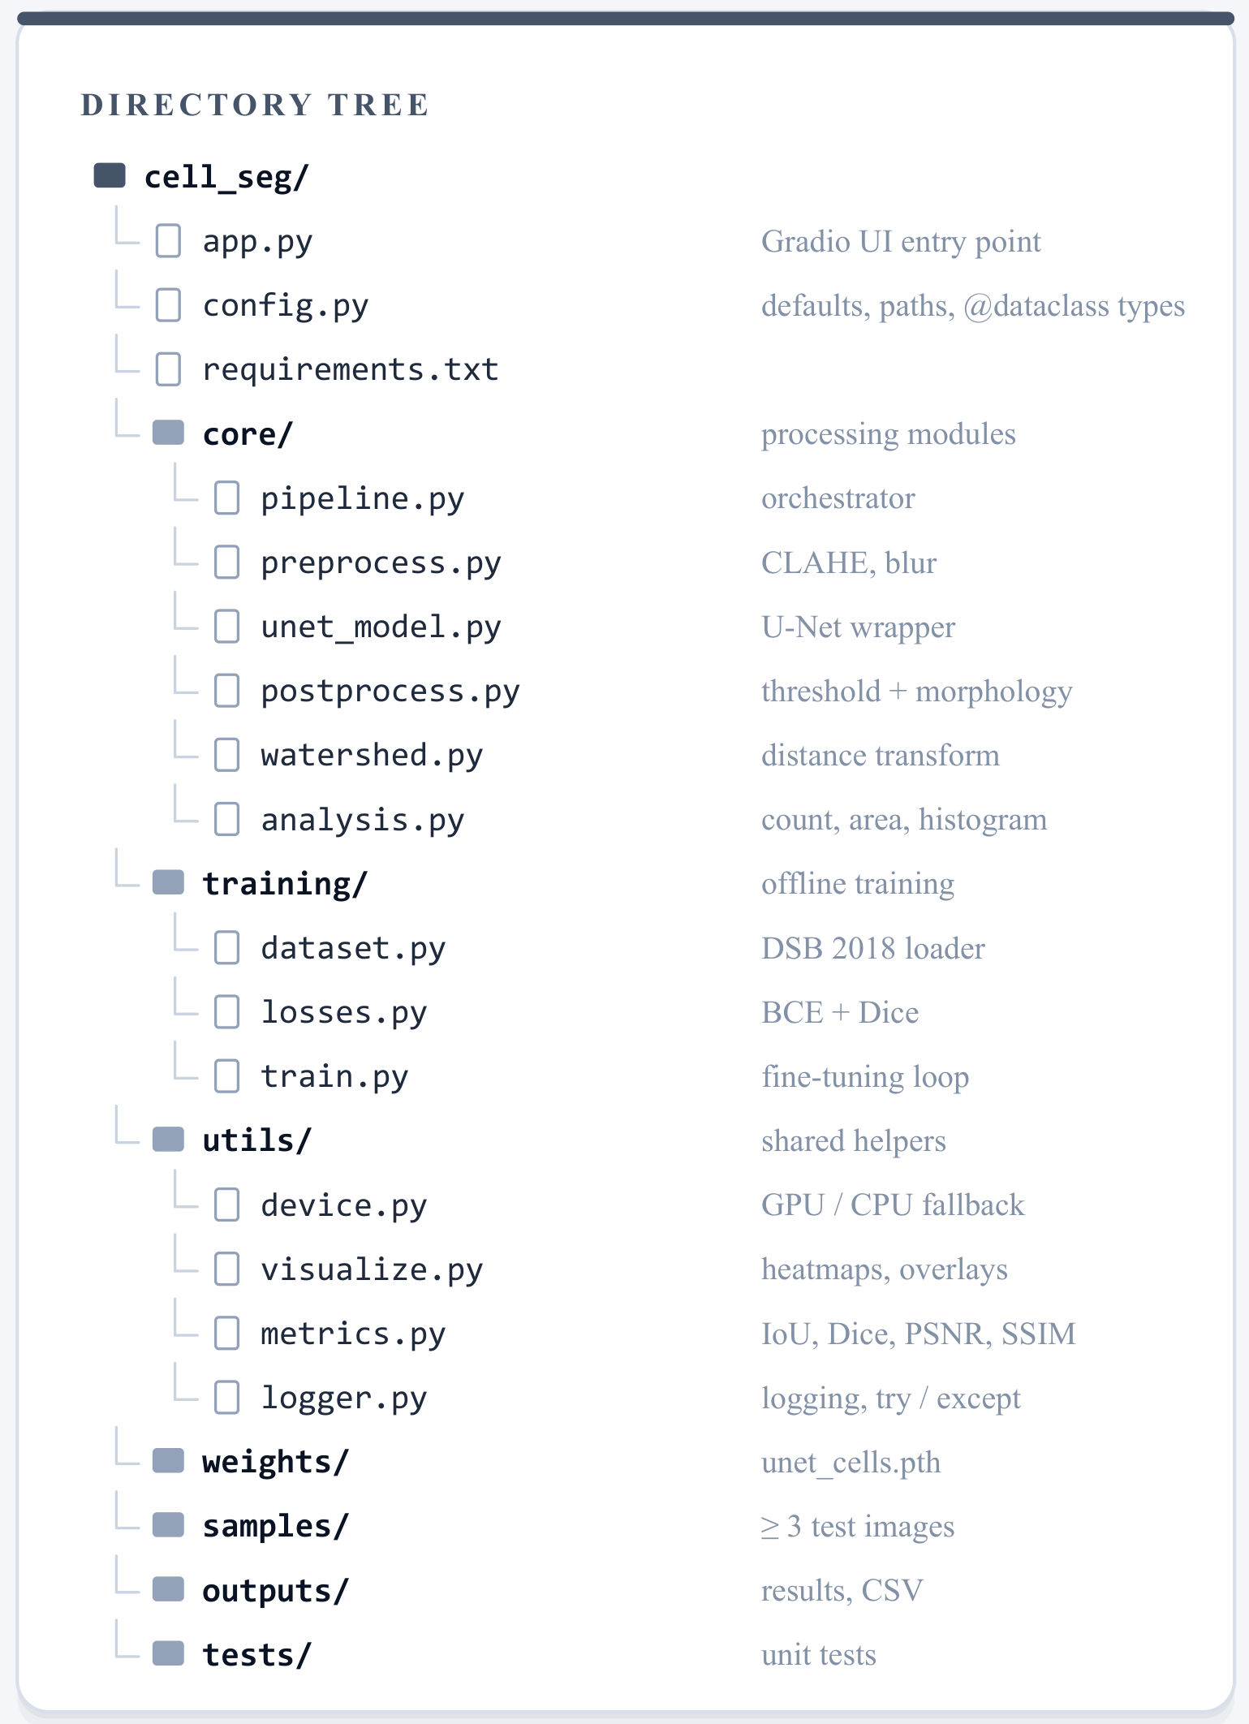
Code organisation and module interfaces
03 · ARCHITECTURE DESIGN
Class | File | Input → output
Preprocessor | core/preprocess.py | image → grayscale, CLAHE, blur
UNetSegmenter | core/unet_model.py | image → probability map (0–1)
MaskRefiner | core/postprocess.py | probability → clean binary mask
WatershedSplitter | core/watershed.py | mask → distance map + labels
CellAnalyzer | core/analysis.py | labels → cell list + histogram
CellCountingPipeline | core/pipeline.py | image + Params → PipelineResult
Shared data types in config.py
Params (all slider values) · CellInfo (id, area, centroid, bbox) · PipelineResult (images, cells, count, raw arrays, warnings)
Notes:
This is how the code is organised. Each processing step is its own class with one clear job and a typed run method, so I could build and test them one at a time. The pipeline class chains them together. Three small dataclasses in config.py are the contracts between modules: Params holds all the slider values, CellInfo describes one cell, and PipelineResult carries everything back to the UI.

Slide 9








Technology stack
03 · ARCHITECTURE DESIGN
Python 3.11
PyTorch 2.6 + CUDA
SMP library
OpenCV
Language, conda environment
U-Net training and inference
segmentation-models-pytorch: U-Net builder
CLAHE, blur, morphology, distance transform
scikit-image + SciPy
Albumentations
Gradio 6
pytest
Watershed, peak finding, region measures
Training data augmentation
Web interface on localhost
58 automated unit tests
Hardware: NVIDIA RTX 2060 SUPER (8 GB), Windows 10. GPU used automatically, CPU fallback if none is found.
Notes:
These are the tools. Python with PyTorch for the neural network, and segmentation-models-pytorch to build the U-Net with a pretrained ResNet34 encoder. OpenCV and scikit-image for the classical image processing, Albumentations for data augmentation, Gradio for the web interface, and pytest for testing. I trained on my own RTX 2060 SUPER, but the software also runs on CPU.

Slide 10
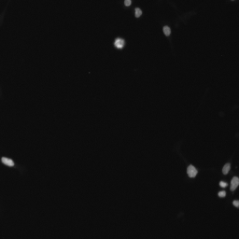
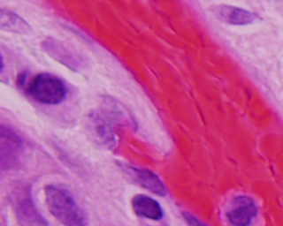
Dataset: Data Science Bowl 2018
04 · DATASET
670
THREE TEST SAMPLES SHIPPED WITH THE APP
stained nucleus images (stage1_train)
3 types
fluorescence, bright-field, H&E tissue
536 / 67 / 67
Sparse
Dense, touching
Low contrast
Fluorescence, isolated nuclei
87 cells in 30 blobs
H&E tissue, faint borders
train / validation / test (80/10/10, seed 42)
Kaggle DSB 2018 via Broad BBBC038 (CC0). One mask PNG per nucleus = instance ground truth.
11 GT cells
87 GT cells
12 GT cells
Notes:
For training I used the Kaggle Data Science Bowl 2018 dataset: 670 images of cell nuclei with a separate mask for every single nucleus, drawn by experts. It mixes fluorescence, bright-field and H&E tissue images, so the model sees many styles. I split it 80/10/10 with a fixed seed: 536 for training, 67 for validation, which I used for choosing parameters, and 67 for the final test. I also picked three sample images that cover the three hard cases: sparse, dense and touching, and low contrast.

Slide 11





Data preparation and augmentation
04 · DATASET
Load
Merge
Preprocess
Resize
Normalise
Augment
Image + all nucleus masks
Union of masks → one binary target
Same as app: gray, CLAHE, blur
256 × 256 pixels
Gray → 3 channels, ImageNet mean/std
Flips, 90° turns, elastic warp, brightness
Why the same preprocessing?
Why augmentation?
Fast training
Training and the app run the exact same Preprocessor code, so the network never sees a different kind of input after training.
536 images is small. Random flips, rotations and warps create new variations every epoch and reduce overfitting.
All 670 images are preprocessed once and kept in RAM (~90 MB), so one epoch takes only 3.6 s on the GPU.
Notes:
Before training, each image goes through six steps. All nucleus masks are merged into one binary mask, because the U-Net only has to say cell or not cell. Then I run exactly the same preprocessing code that the app uses, resize to 256 by 256, normalise, and apply random augmentation. Using the same preprocessing in training and in the app is important: otherwise the network would see different inputs at run time.

Slide 12
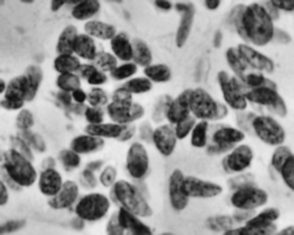
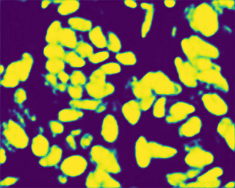
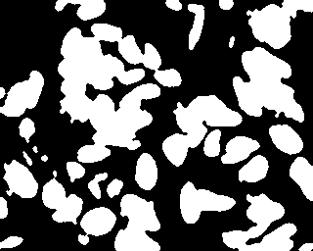
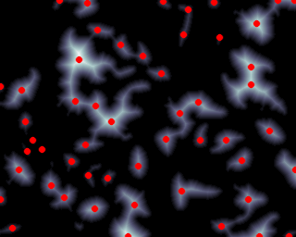
The processing pipeline at a glance
05 · PROCESSING PIPELINE
0
Input
1
Preprocess
2
U-Net
3
Mask
4
Distance map
5
Watershed
Stained image
Gray + CLAHE + blur
Cell probability 0–1
Threshold + morphology
Peaks = cell seeds
Numbered + measured
PNG / JPG / TIF
clip
weights
τ, kernel
r, min dist
min area
Deep learning answers WHERE the cells are: a smooth probability for every pixel.
Classical vision answers WHICH pixels belong to WHICH cell: it splits the touching ones.
Notes:
These are real outputs from my software for the dense sample, one per stage. Stage 0 is the input. Stage 1 converts to gray and boosts contrast. Stage 2 is the U-Net probability heatmap: yellow means very likely cell. Stage 3 thresholds it into a binary mask and cleans it. Stage 4 computes the distance map: the brightest point of each blob is the centre of a cell, and the red dots are the seeds. Stage 5 grows a region from each seed with watershed, then numbers and measures the cells. The chips show which slider controls each step. The key idea: deep learning finds where the cells are, and classical vision separates them.

Slide 13
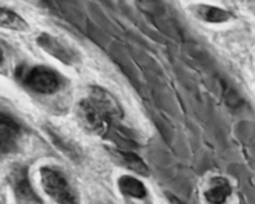
Step 1 · Preprocessing
05 · STEP 1
1
Convert to grayscale
Different stains give different colours. Brightness is what the network needs; colour is extra noise.
2
CLAHE contrast boost (clip = 2.0)
Adaptive histogram equalisation raises local contrast tile by tile, so faint cells become visible without over-brightening the rest.
Before: H&E tissue, faint nuclei
After: gray, contrast boosted
3
Gaussian blur (kernel = 3)
A light blur removes pixel noise before segmentation, while keeping cell edges.
Notes:
Step one is preprocessing, shown on the hardest sample, an H&E tissue image with faint nuclei. Three operations: grayscale, because colour depends on the stain; CLAHE, which boosts contrast locally so faint cells stand out; and a small Gaussian blur to remove noise. The CLAHE clip limit is a slider in the app for very dim images.

Slide 14
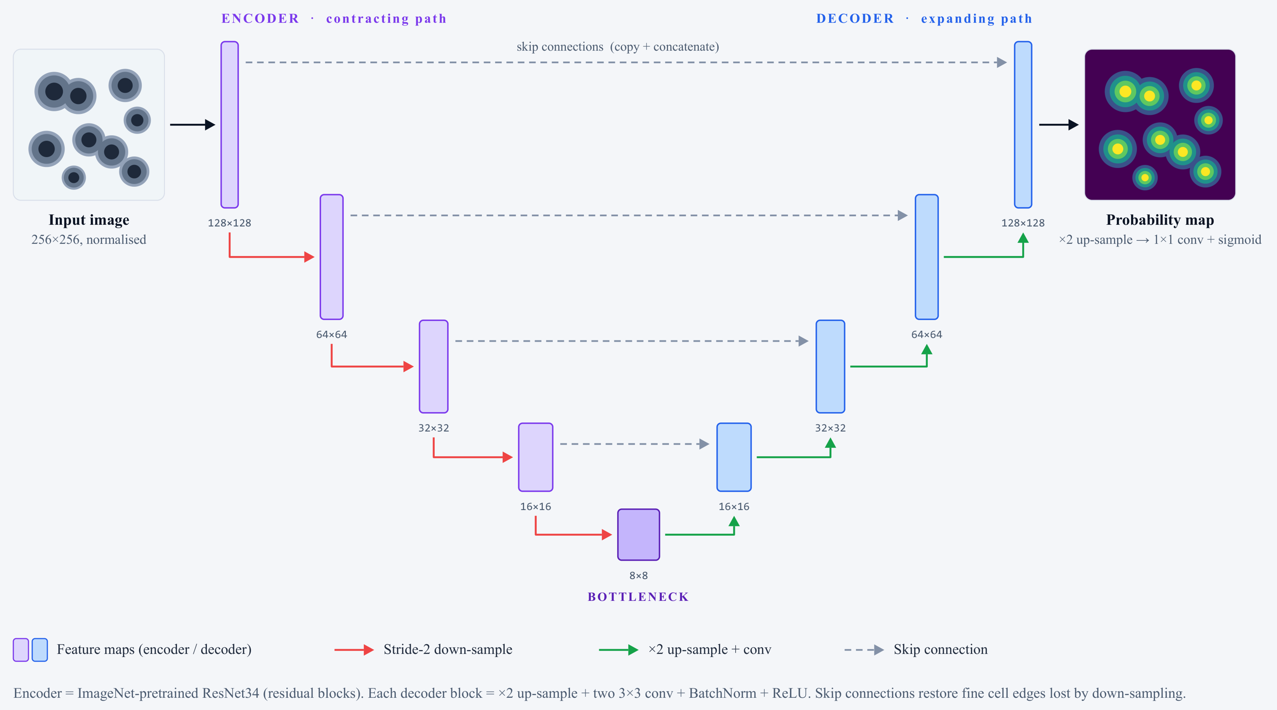
Step 2 · U-Net segmentation model
05 · STEP 2
Architecture
Encoder–decoder + skip connections
Encoder
ResNet34 pretrained on ImageNet
Output
1 channel + sigmoid = probability per pixel
Any image size
Reflect-pad to a multiple of 32, crop after
Big images
GPU out of memory → 512 px tiles → CPU
Why U-Net? Built for biomedical images, works with small datasets, and skip connections keep the exact cell borders.
Notes:
Step two is the U-Net, the deep learning part. The encoder on the left shrinks the image and learns what a nucleus looks like; I used a ResNet34 encoder already pretrained on ImageNet, so it starts with good features. The decoder on the right grows it back to full size. The grey dashed skip connections copy fine detail across, which keeps cell borders sharp. The output is one number per pixel between 0 and 1: the probability that the pixel is part of a cell. To handle any image size, I pad to a multiple of 32, and for very large images I fall back to tiles or the CPU.

Slide 15
Training the U-Net
05 · STEP 2
Loss L = BCE + (1 − Dice)
Adam, lr 1e-4 · batch 8 · max 50 epochs · early stop after 8 epochs without gain · mixed precision · 3.6 s / epoch
20
0.902
0.914
best epoch (stopped at 28)
best validation Dice
Dice on unseen test set
Notes:
Training. The loss is binary cross-entropy plus Dice loss: cross-entropy works per pixel, Dice rewards overlap of the whole mask, which helps because background pixels outnumber cell pixels. I used Adam with learning rate 1e-4 and batch size 8. Both losses fall together, so there is no overfitting. Validation Dice reached its best value, 0.902, at epoch 20, and early stopping ended training at epoch 28. On the 67 test images the model never saw, Dice is 0.914. Training took under two minutes on my GPU.

Slide 16
Steps 3–4 · Mask refinement and watershed
05 · STEPS 3–4
Why distance transform + watershed?
1
Touching cells merge into one white blob in the binary mask.
Binary mask
Distance map + seeds
Watershed result
2
Distance to background is highest at each cell’s centre, so every cell gets its own peak.
touching cells = one blob
red dot = one seed per cell
each seed grows one region
Mask refinement: keep pixels with P > τ → opening removes specks → closing fills small gaps → fill holes → drop blobs smaller than min area
Seeds: pixels with distance ≥ r × the blob’s own maximum, at least min dist apart; every blob gets at least one seed
3
Watershed floods outward from every peak; where two floods meet, a border is drawn.
Notes:
Steps three and four solve the touching-cell problem. The mask step thresholds the probability map at tau, then morphological opening and closing clean it up, and tiny blobs are removed. But touching cells are still one blob. So I compute the distance transform: every white pixel gets its distance to the nearest background pixel. The centre of each cell is a local peak, and those peaks become seeds. Then watershed floods outward from each seed like water; where two floods meet, it draws a border. One improvement I made: the peak threshold is relative to each blob's own maximum, not the global maximum, so small cells next to big ones still get a seed.

Slide 17
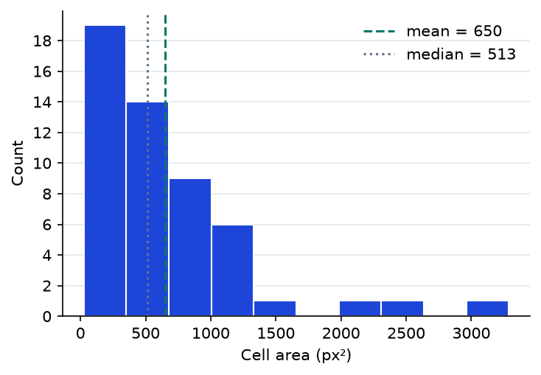


Step 5 · Counting, measuring and exporting
05 · STEP 5
PER-CELL CSV EXPORT (first rows, real output)
id | area_px | centroid_y | centroid_x | bbox (r0, c0, r1, c1)
1 | 113 | 4.34 | 62.00 | 0, 56, 12, 71
2 | 528 | 8.34 | 91.22 | 0, 71, 21, 108
3 | 143 | 4.48 | 177.52 | 0, 169, 11, 186
4 | 206 | 11.12 | 201.41 | 4, 192, 23, 209
5 | 129 | 4.06 | 230.75 | 0, 224, 10, 239
… | … | … | … | …
Reading-order numbering
Measured with regionprops
52
649.8
513
Top-left to bottom-right, so number 7 on the image is row 7 in the CSV.
Area, centroid and bounding box for every cell; tiny fragments under min area dropped.
cells
mean px²
median px²
Notes:
Step five turns the labelled regions into numbers. Cells are numbered in reading order, top-left to bottom-right, and the number on the image is the same as the id in the CSV, so you can find any cell. For each cell I measure area, centroid and bounding box. The app shows the area histogram with mean and median lines, and you can download the full table as CSV for Excel.

Slide 18
Parameters and what they control
06 · PARAMETERS
Parameter | Stage | Range | Default | Effect when you change it
Probability threshold τ | Mask | 0.05 – 0.95 | 0.5 | Lower → faint cells kept, neighbours may merge. Higher → cells shrink or vanish
Morphology kernel | Mask | 1 – 15 | 3 (was 5) | Bigger closes the gaps between touching cells → fewer splits
Peak ratio r | Watershed | 0.1 – 0.9 | 0.4 | Lower → more seeds → clumps split into more cells
Min peak distance | Watershed | 1 – 50 px | 10 | About the radius of the smallest cell; lower splits more
Min cell area | Mask + count | 0 – 1000 px² | 20 (was 50) | Objects smaller than this are treated as debris
CLAHE clip limit | Preprocess | 0.5 – 8 | 2.0 | Higher → stronger local contrast for dim images
Blur kernel | Preprocess | odd size | 3 (fixed) | Light noise removal; kept the same as in training
Presets in the app: Balanced (default, tuned) · Faint / low contrast · Dense, touching clumps · Sparse, large cells · Noisy / debris
Notes:
These are the parameters. Six of them are sliders in the app, grouped by stage. The most important is the probability threshold tau, which the brief asks us to tune: too low and neighbouring cells merge, too high and cells shrink or disappear. The kernel controls how much the mask is smoothed, peak ratio and min distance control how aggressively watershed splits clumps, and min area removes debris. The two red values were changed by my tuning, which I explain next. For users who do not want to touch sliders, there are presets for common image types.

Slide 19
Parameter tuning: four iteration rounds
06 · PARAMETER TUNING
R22
Small nuclei lost
Sparse sample: 8 → 11 of 11 cells
min area 50 → 20
R23
Touching cells merged
Dense sample: 36 → 50 cells
kernel 5 → 3
R24
Try min distance 5?
Helped one image, test F1 fell 0.852 → 0.815
Rejected
R25
Check it properly
On validation split → kernel 3, min area 20 confirmed
Median count error 10.0 % → 6.9 %
Chosen on validation data, reported on test data
Grid search, 288 settings
Notes:
Tuning was done in rounds, as the assignment requires. Round 22: the sparse sample found only 8 of 11 cells; the smallest nuclei were deleted by the min-area filter, so I lowered it from 50 to 20 and got all 11. Round 23: in the dense sample a big clump was counted as one cell; the closing kernel of 5 filled the gaps between cells, so I reduced it to 3. Round 24: I tested min distance 5, which helped the dense image but over-split others; on the test split F1 dropped, so I rejected it. That taught me not to tune on a single picture. Round 25: a systematic grid search of 288 combinations on the validation split confirmed the changes. On the test split recall rose from 0.78 to 0.84 and median count error dropped from 10 to 6.9 percent.

Slide 20
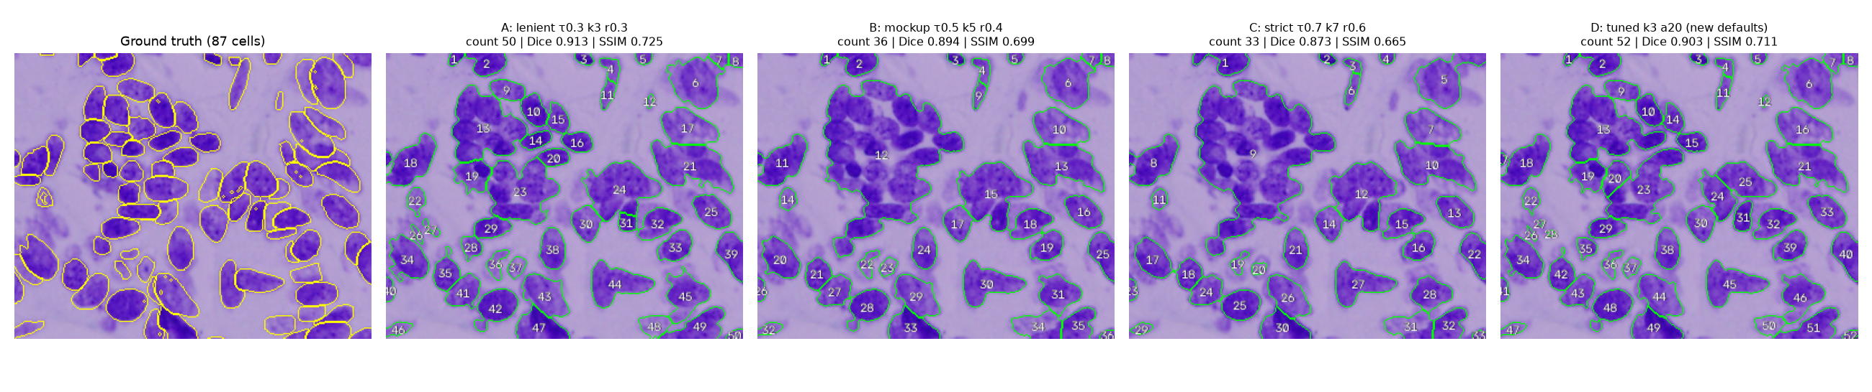
Ablation: one image, four parameter sets
06 · ABLATION STUDY
Set | τ | kernel | r | min area | Count | Dice | PSNR dB | SSIM | Precision | Recall
A lenient | 0.3 | 3 | 0.3 | 50 | 50 | 0.913 | 11.16 | 0.725 | 0.68 | 0.39
B mockup | 0.5 | 5 | 0.4 | 50 | 36 | 0.894 | 10.34 | 0.699 | 0.64 | 0.26
C strict | 0.7 | 7 | 0.6 | 50 | 33 | 0.873 | 9.70 | 0.665 | 0.67 | 0.25
D tuned | 0.5 | 3 | 0.4 | 20 | 52 | 0.903 | 10.84 | 0.711 | 0.73 | 0.44
What it shows
Higher τ and a bigger kernel merge and shrink cells (C: 33). The tuned set D finds the most cells with the best per-cell precision and recall.
Notes:
For the ablation study I ran the dense sample with four parameter sets and compared each mask to the real ground truth with IoU, Dice, PSNR and SSIM. A is lenient, B is the original mockup default, C is strict, and D is my tuned default. The strict set merges cells: only 33 found. The tuned set finds 52, with the best precision and recall per cell. An honest note: this image is in the training split, so the absolute numbers are a bit optimistic; the fair numbers are on the test split, next slide.

Slide 21
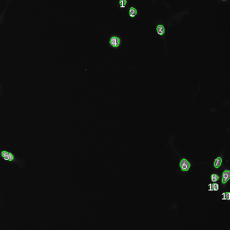
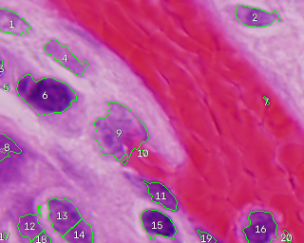
Results on the unseen test split
07 · RESULTS
0.915
0.852
0.867
0.837
6.9 %
Dice (pixel overlap)
Cell F1 (IoU ≥ 0.5)
Cell precision
Cell recall
Median count error
67 test images the model never saw during training or tuning
Sparse
Dense, touching
H&E low contrast
11 found / 11 true
52 found / 87 true
20 found / 12 true
All cells found
Hardest case: many cells touch with no gap
Elongated nuclei get over-split
Notes:
Final results on the 67 test images, which were never used for training or tuning. Pixel Dice is 0.915. Counting each cell as correct when it overlaps a true cell with IoU of at least 0.5, precision is 0.867 and recall 0.837, F1 0.852. The median error in the cell count is 6.9 percent. Below are the three samples: the sparse image is perfect, 11 of 11. The dense image is the hardest: 52 of 87, because many nuclei touch with no visible gap. The H&E image over-splits elongated nuclei: 20 instead of 12. I will come back to these in limitations.

Slide 22

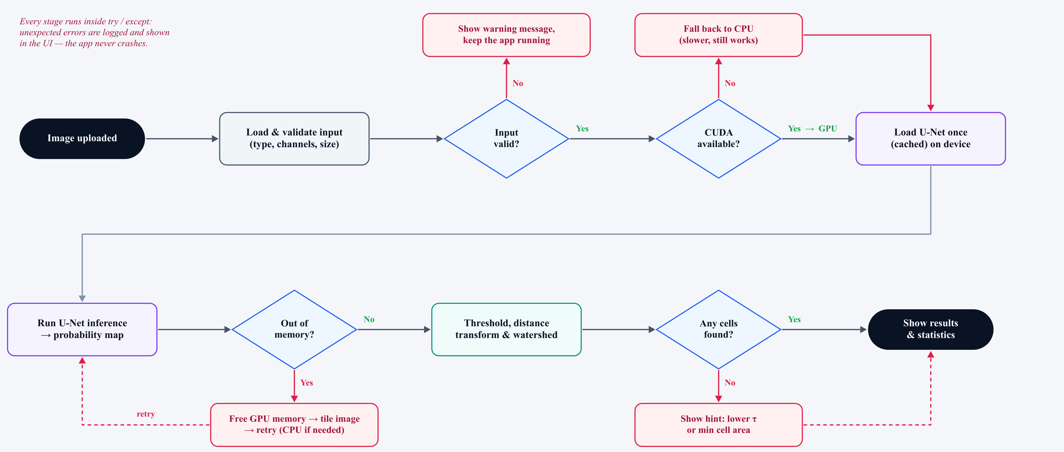



Robustness, error handling and testing
07 · RELIABILITY
58 unit tests
All pass in 4.4 s on CPU with a fake U-Net
Out of GPU memory
Retry in 512 px tiles, then CPU: 99.98 % same mask
Any input
Gray, RGBA, 16-bit TIF, float; bad files get a clear message
Fast
1024 × 819 image in 0.5 s; > 4096 px auto-downscaled
Notes:
A tool for scientists must not crash. This flow chart was part of my original design and is now fully implemented. Invalid input gives a clear message instead of a crash. No GPU means the app falls back to CPU. If the GPU runs out of memory, it splits the image into tiles and retries, then falls back to CPU; I tested this by forcing the error, and the result matched the normal run on 99.98 percent of pixels. If no cells are found, it suggests which slider to change. There are 58 automated tests, and a normal image is processed in about half a second.

Slide 23




The finished software
08 · SOFTWARE
Upload or pick a sample
PNG, JPG, TIF; 3 samples built in
Presets + 6 sliders
Help text under every slider
Layer viewer
Overlay, probability, mask, distance map
Statistics
Count, mean, median, std, range + histogram
Export + extras
Per-cell CSV, dark mode, GPU/CPU badge
Notes:
This is the finished software, a web app that runs locally in the browser. On the left you upload an image or pick a sample. In the middle is a summary strip with the count and area statistics, and tabs for the result, every pipeline stage, the per-cell measurements and a short guide. On the right are the settings: a preset dropdown and six sliders, each with a one-line explanation. Now let me show it live.

Slide 24
Live demo: running the software locally
08 · LIVE DEMO
1
Pick the dense sample → Segment cells
START THE APP
cd "Microscopic Cell Image\cell_seg"
D:\envs\cellseg\python.exe app.py
2
Pipeline stages tab: heatmap, mask, distance map
3
Move τ to 0.3, then 0.7: watch the count change
THEN OPEN
http://127.0.0.1:7860
4
Preset “Dense, touching clumps” → more splits
Runs fully offline on this laptop. Uses the GPU if present, otherwise the CPU. Needs the trained weights file weights/unet_cells.pth.
5
Measurements tab → download the CSV
6
Try my own image, toggle dark mode
Notes:
[Switch to the browser now.] Start the app with the command shown, then open localhost port 7860. Demo plan: 1) choose the dense sample and press Segment cells; the count and histogram appear. 2) Open Pipeline stages to show the heatmap the brief asks for. 3) Move the threshold down to 0.3 and up to 0.7 and show how the count changes: this is the over/under-segmentation trade-off. 4) Choose the Dense clumps preset. 5) Open Measurements and download the CSV. 6) If there is time, upload another image and toggle dark mode. Backup if the demo fails: the screenshots on the previous slides.

Slide 25


Limitations and future work
09 · DISCUSSION
Limitations
Future work
Nuclei touching with no gap stay merged (dense sample: 52 of 87)
H&E tissue: elongated nuclei over-split (20 vs 12)
Model learned DSB cell sizes; very different magnification fails
Huge images: watershed takes about half the time, sliders slower
2 of 3 samples are in the training split, so their scores are optimistic
Instance-aware model (e.g. boundary channel, StarDist, Cellpose)
More H&E training data, or a separate tissue model
Auto-rescale input to the training magnification
Re-run watershed only inside changed blobs
Batch mode: process a whole folder, one CSV
Notes:
Being honest about limitations. The biggest is very dense nuclei that touch without any gap: the U-Net sees one region and the distance transform has only one peak. H&E tissue nuclei are elongated and get over-split. The model learned the cell sizes in the dataset, so a very different magnification fails. Future work: an instance-aware model that also predicts cell borders, more tissue training data, automatic rescaling, faster watershed, and batch processing.

Slide 26


Conclusion
09 · CONCLUSION
Complete system
AI + classic vision
Tuned the right way
Usable and robust
Stained image in → numbered cells, areas, histogram and CSV out
U-Net (test Dice 0.915) with distance transform + watershed
Chosen on validation data: F1 0.852, median count error 6.9 %
Local web app, GPU/CPU fallback, 58 tests, 29 logged iterations
Thank you
Questions?
Notes:
To conclude: I built a complete system that goes from a stained microscope image to numbered cells, areas, a histogram and a CSV. It combines a U-Net with distance transform and watershed. I tuned the parameters on validation data and reported honest test results. And it is a usable, robust local app. Thank you for listening. I am happy to answer questions.

