Slide 1

Machine Learning -NumPy Usage Summary

Slide 2
Contents of this chapter
01 NumPy Overview
02 NumPy Array (ndarry) object
03 ufunc function
04 NumPy's function library

Slide 3
1.NumPy Overview
01 NumPy Overview
02 NumPy Array (ndarry) object
03 ufunc function
04 NumPy's function library

Slide 4
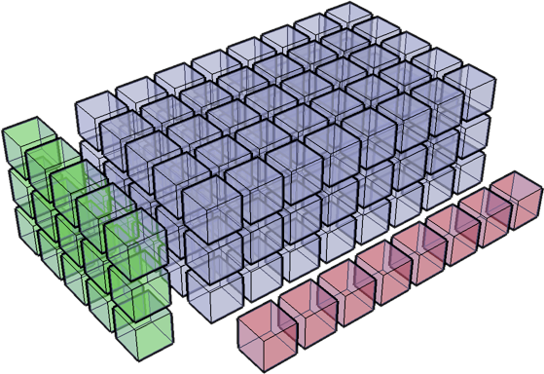
What is NumPy?
NumPy (Numeric Python) is an open source numerical computing extension library for Python. It contains many features:
· Create n-dimensional arrays (matrices)
· Perform function operations on arrays
· Numerical integration
· Linear algebra operations
· Fourier Transform
· Random number generation
· · · · · ·

Slide 5
What is NumPy?
NumPy provides many advanced numerical programming tools, such as matrix data types, vector processing, and a sophisticated arithmetic library. Numpy is designed for strict numerical manipulation. It is used by many large financial companies, as well as key scientific computing organizations such as Lawrence Livermore, and NASA for tasks that would otherwise be done in C++, Fortran, or Matlab.

Slide 6
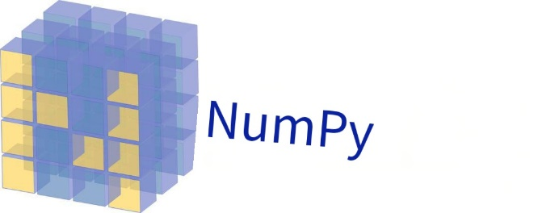
What is NumPy?
Standard Python uses a list to hold values, which can be used as an array, but because the elements in the list can be any object, it wastes CPU time and memory.
NumPy was created to remedy these shortcomings. It provides two basic types of objects:
ndarray: An n-dimensional array object is a multidimensional array that stores a single data type.
ufunc: universal function object (UFUNC) It is a function that can handle arrays.
The official documentation for NumPy:
https://docs.scipy.org/doc/numpy/reference/

Slide 7
NumPy installation
NumPy is already installed in Anaconda.
Native Python installation:
· Type in cmd
After installation, we import this library
> pip install numpy
> import numpy as np

Slide 8
2.NumPy Array (ndarry) object
01 NumPy Overview
02 NumPy Array (ndarry) object
03 ufunc function
04 NumPy's function library

Slide 9
1.1 Understanding NumPy array objects
One of the most important features of NumPy is its n-dimensional array object ndarray, which is a collection of data of the same type and indexes the elements in the collection starting with 0 subscript.
A ndarray object is a multidimensional array that holds elements of the same type.
>import numpy as np # Import NumPy Toolkit > data = np.arange(12).reshape(3, 4) # Create an array of 3 rows and 4 columns > data
array([[ 0, 1, 2, 3], [ 4, 5, 6, 7], [ 8, 9, 10, 11]])
ndarray has no limit on the number of dimensions.
[] Axis 0, axis 1, axis 2, axis 3 from inside to outside.

Slide 10
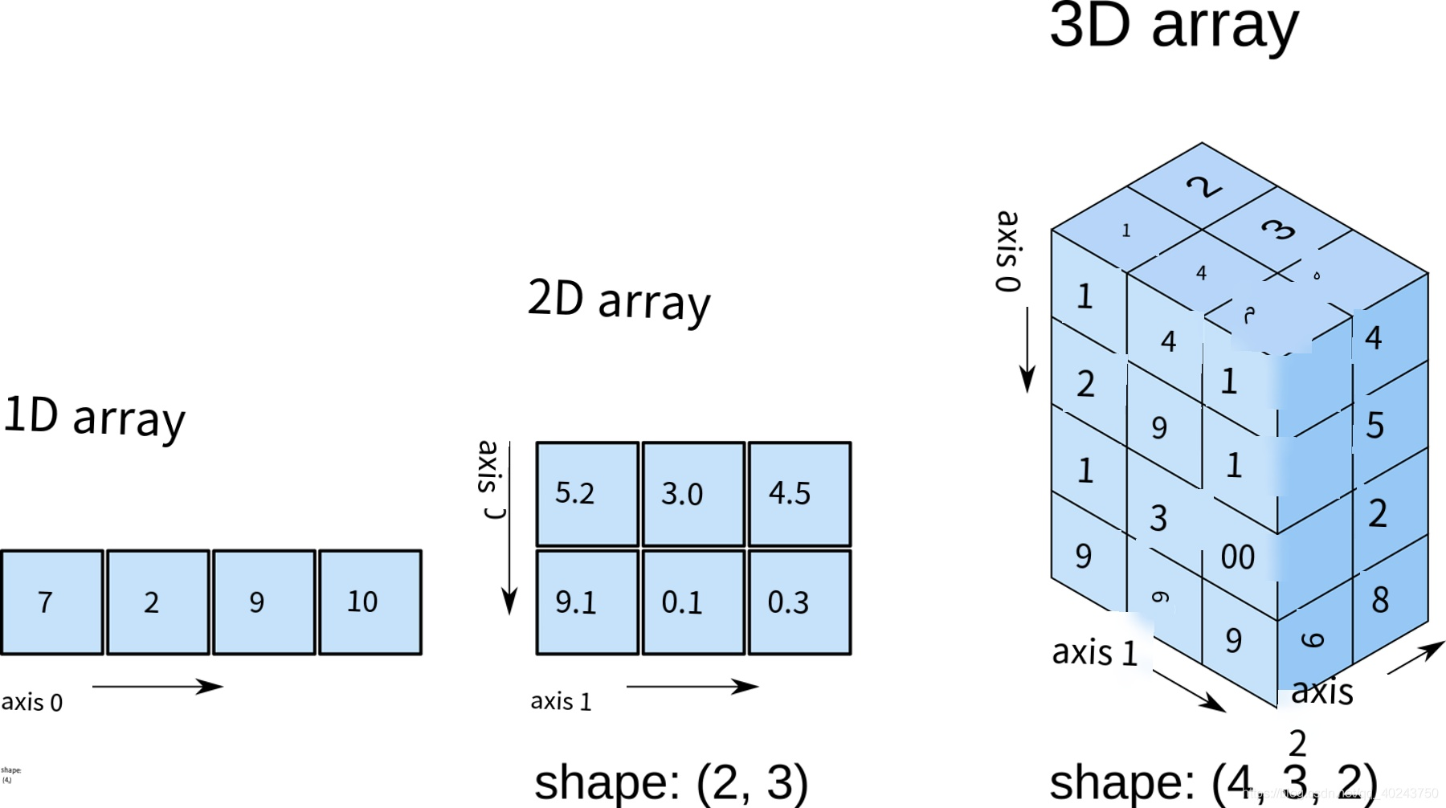
1.1 Learn about NumPy array objects
NumPy array icon
shape(4,)
Shape (3, 2)
Shape (31)

Slide 11
1.1 Recognize NumPy array objects
>type(data)
numpy.ndarray
>data.ndim # Number of array dimensions, output result 2, representing the two-dimensional array
2
>data.shape # Dimension of the array, output result (3, 4), representing 3 rows and 4 columns
(3, 4)
data.size # Number of array elements, which outputs 12, indicating a total of 12 elements
12
data.dtype # Type of array elements, output dtype('int64'), indicating that the element type is int64
dtype('int32')

Slide 12
Dtype (' int32 ') 2 Create NumPy arrays
>import numpy as np > data1 = np.array([1, 2, 3]) # Create a one-dimensional array > data1
array([1, 2, 3])
data2 = np.array([[1, 2, 3], [4, 5, 6]]) # Create a two-dimensional array data2
array([[1, 2, 3], [4, 5, 6]])
np.zeros ((3, 4))# Creates an array of all zeros
array([[0., 0., 0., 0.], [0., 0., 0., 0.], [0., 0., 0., 0.]])

Slide 13
1.2 Create NumPy array
>np.ones ((3, 4)) # Create an all-in-one array
array([[1., 1., 1., 1.], [1., 1., 1., 1.], [1., 1., 1., 1.]])
>np.empty ((5, 2)) # Create an all-empty array where each value is actually a number close to zero
array([6.95312756e-310, 2.12199579e-314], [2.12199579e-314, 4.94065646e-324], [0.00000000e+000, -7.06252554e-311], [0.00000000e+000, -8.12021073e-313], [1.29923372e-311, 2.07507571e-322]])

Slide 14
1.2 Create the NumPy array
>np.arange (1, 20, 5)
array([ 1, 6, 11, 16])
array([1., 2., 3., 4.])
array([[1., 1., 1.], [1., 1., 1.]])
>np.array ([1, 2, 3, 4], float)
>np.ones ((2, 3), dtype ='float64')

Slide 15
Creation of ndarray
NumPy provides functions specifically for generating ndarray, increasing the speed of creating ndarray.
> a = np.arange (0, 1, 0.1)
Array ([0, 0.1, 0.2, 0.3, 0.4, 0.5, 0.6, 0.7, 0.8, 0.9])
> b = np.linspace (0, 1, 10)
array([0., 0.11111111, 0.22222222, 0.33333333, 0.44444444,0.55555556, 0.66666667, 0.77777778, 0.88888889, 1.])
> c = np.linspace (0, 1, 10, endpoint=False)
Array ([0, 0.1, 0.2, 0.3, 0.4, 0.5, 0.6, 0.7, 0.8, 0.9])
> d = np.logspace(0, 2, 5)
array([1., 3.16227766, 10., 31.6227766, 100.])

Slide 16
The creation of ndarray
np.empty ((2,3), np.int) | Create an empty matrix of 2 * 3 integers and allocate only memory
np.zeros (4, np.int) | Create a matrix of length 4 with values of all zeros
np.full(4, np.pi) | Create a matrix of length 4 with values of all pi
You can also customize the function to generate ndarray.
> def func ( i ):
return i % 4 + 1
> np.fromfunction ( func , (10,))
array([ 1., 2., 3., 4., 1., 2., 3., 4., 1., 2.])
fromfunction The first argument accepts the compute function and the second argument accepts the shape of the array.

Slide 17
Properties of ndarray
Elements of ndarray have the same element type. Common ones are int (integer), float (floating point), complex (complex).
> a = np.array([1, 2, 3, 4], dtype=float)
array([ 1., 2., 3., 4.])
> a.dtype
dtype ('float64')
ndarray's shape attribute is used to get its shape, or you can specify it yourself.
> c = np.array ([[1, 2, 3, 4], [4, 5, 6, 7], [7, 8, 9, 10]])
> c.shape
(3, 4)
> a = np.array ([1, 2, 3, 4])
> d = a.leshape ((2,2))
array([[1, 2],
[3, 4]])

Slide 18
ndarray's slice
ndarray slices are the same as list.
> a = np.arange (10)
> a
array([0, 1, 2, 3, 4, 5, 6, 7, 8, 9])
a[5] a[3:5] a[:5] a[:-1]
---- ------ --------------- ---------------------------
5 [3, 4] [0, 1, 2, 3, 4] [0, 1, 2, 3, 4, 5, 6, 7, 8]
a[1:-1:2] a[::-1] a[5:1:-2]
------------ ------------------------------ ---------
[1, 3, 5, 7] [9, 8, 7, 6, 5, 4, 3, 2, 1, 0] [5, 3]
Changes can be made to elements in ndarray by slicing them.
> a[2:4] = 100, 101
> a
array([ 0, 1, 100, 101, 4, 5, 6, 7, 8, 9])

Slide 19
ndarray's slice
ndarray slicing creates a new array b, where b and A share the same block of data storage space.
> b = a[3:7]
> b[2] = -10
b a
-------------------- --------------------------------------------------
[101, 4, -10, 6] [0, 1, 100, 101, 4, -10, 6, 7, 8, 9]
If we want to change this situation, we can slice the array elements with a list.
> b = a[[3, 3, -3, 8]]
> b
array([3, 3, 7, 8])
> b[2] = 100
b a
-------------------- --------------------------------------------------
[3, 3, 100, 8] [0, 1, 2, 3, 4, 5, 6, 7, 8, 9]

Slide 20
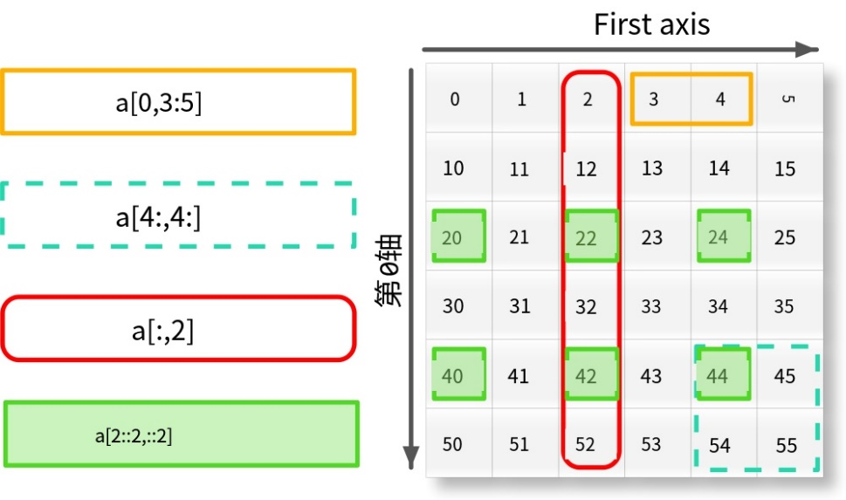
Multi-dimensional array
NumPy's multi-dimensional arrays are similar to one-dimensional arrays. A multi-dimensional array has multiple axes.
We already mentioned that from the inside out there are axis 0, axis 1...
> a = np.arange (0, 60, 10).reshape(-1, 1) + np.arange (0, 6)
array([[ 0, 1, 2, 3, 4, 5],
[10, 11, 12, 13, 14, 15],
[20, 21, 22, 23, 24, 25],
[30, 31, 32, 33, 34, 35],
[40, 41, 42, 43, 44, 45],
[50, 51, 52, 53, 54, 55])
a[0, 3:5] a[4:, 4:] a[2::2, ::2]
--------- ---------- --------------
[3, 4] [[44, 45], [20, 22, 24],
[54, 55] [40, 42, 44]]
# The above method shares the storage space of the original array for the slices of the array.

Slide 21
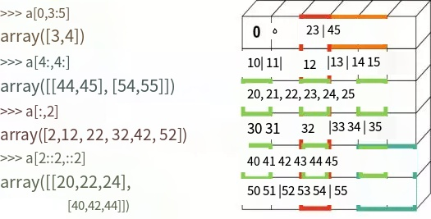
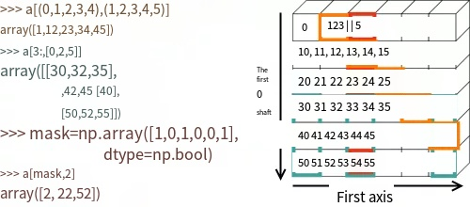
Multi-dimensional array
If we want to create a copy of the original array, we can slice it with integer tuples, lists, integer arrays, Boolean arrays.

Slide 22
Struct Arrays
C language can be defined by the struct keyword structure type. NumPy has a similar array of structs.
> persontype = np.dtype ({
'names':['name', 'age', 'weight'],
'formats':['S30','i', 'f']})
> a = np. Array ([(" Zhang ", 32, 75.5), (" Wang ", 24, 65.2)].
dtype = persontype )
 | name | age | weight
0 | zhang | 32 | 75.5
1 | wang | 24 | 65.2
We have created an array of structures, and each row can be indexed.
> print a[0]
('Zhang', 32, 75.5)

Slide 23
ufunc function 3
01 NumPy Overview
02 NumPy Array (ndarry) object
03 ufunc function
04 NumPy's function library

Slide 24
ufunc function
ufunc is short for universal function, and it's a function that performs operations on every element of an array. Many of NumPy's ufunc functions are implemented in C, so they operate very fast.
> x = np.linspace(0, 2*np.pi, 10)
> y = np.sin(x)
> y
array([0.00000000e+00, 6.42787610e-01, 9.84807753e-01,
.....,
2.44929360 e-16])
Note that for ndarray of the same length, np.sin () is faster than math.sin ()
But for a single value, math.sin () is faster.

Slide 25
Four operations
NumPy provides a number of ufunc functions that have the same result as their respective operators.
> a = np.arange (0, 4)
> b = np.arange (1, 5)
> np.add (a, b)
array([1, 3, 5, 7])
> a+b
array([1, 3, 5, 7])
> np.subtract (a, b) # Subtract
> np.multiply (a, b) # multiply
> np.divide (a, b) # If both numbers are integers, it is integer division
> np.power (a, b) # power

Slide 26
Comparison operations and Boolean operations
Comparing two arrays using ==, > returns a Boolean array with each element being the result of the comparison of the corresponding element.
> np.array ([1, 2, 3]) < np.array ([3, 2, 1])
array([ True, False, False], dtype =bool)
Boolean operations also have ufunc equivalents in NumPy.
Expression | ufunc function
y=x1==x2 | equal(x1,x2[,y])
y=x1! =x2 | not_equal(x1,x2[,y])
y=x1<x2 | less(x1,x2[,y])
y=x1<=x2 | not_equak(x1,x2[,y])
y=x1>x2 | greater(x1,x2[,y])
y=x1>=x2 | gerater_equal (x1,x2[,y])

Slide 27
Custom ufunc functions
The standard ufunc functions provided by NumPy can compose composite expressions, but in some cases it is more convenient to write your own. You can convert your own function from frompyfunc () to a ufunc function.
> def num_judge (x, a): # for a number if it is a multiple of 3 or 5
if x%3 == 0: return 0, otherwise return a.
r = 0
elif x%5 == 0:
r = 0
else:
r = a
return r
> x = np.linspace (0, 10, 11)
> y = np.array ([num_judge (t, 2) for t in x])# list generator
array([0, 2, 2, 0, 2, 0, 0, 2, 2, 0, 0])

Slide 28
Custom ufunc functions
Convert with frompyfunc(), the call format is as follows:
frompyfunc ( func , nin , nout )
func: Compute function
nin: func () The number of input arguments
nout: func () The number of output parameters
> numb_judge = np.frompyfunc ( num_judge , 2, 1)
> y = numb_judge (x,2)
array([0, 2, 2, 0, 2, 0, 0, 2, 2, 0, 0], dtype =object)
Since the last element output is of type object, we also need to convert it to an integer.
y.astype (np.int)

Slide 29
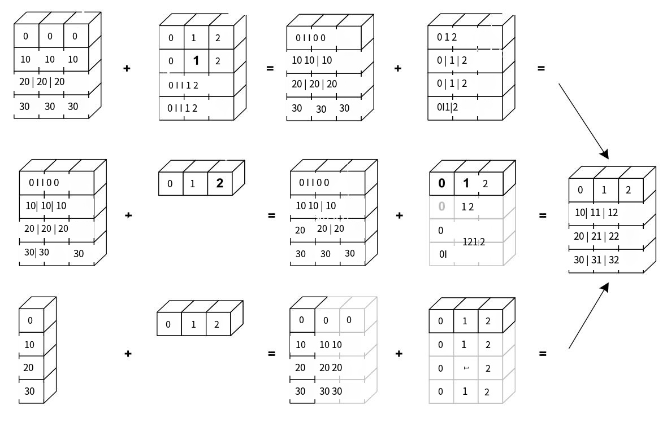
Y.astype (broadcasting)
When you use ufunc to evaluate two arrays, the ufunc function evaluates the corresponding elements of both arrays. If the shapes of the arrays are not the same, the next broadcast process is performed.
In short, it aligns to the maximum value of each dimension of the two arrays.

Slide 30
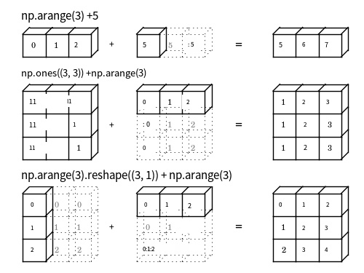
broadcasting

Slide 31
broadcasting (broadcasting)
Let's look at some specific examples:
> a = np.arange (0, 60, 10).reshape(-1, 1)
> b = np.arange (0, 5)
> c = a+b
c c.shape
---------------------- -------
[[0, 1, 2, 3, 4], (6, 5)
[10, 11, 12, 13, 14],
[20, 21, 22, 23, 24],
[30, 31, 32, 33, 34],
[40, 41, 42, 43, 44],
[50, 51, 52, 53, 54]

Slide 32
3. broadcasting
ogrid is used to generate an array for broadcast operations.
> x, y = np.ogrid[:5, :5]
x y
----- -----------------
[[0], [[0, 1, 2, 3, 4]]
[1].
[2].
[3].
[4]]
The following operations are the same as a.Rishape (1,-1), a.rishape (-1,1).
> a = np.arange(4)
a[None, :] a[:, None]
-------------- ----------
[[0, 1, 2, 3]] [[0],[1],[2],3]]

Slide 33
4. NumPy's function library
01 NumPy Overview
02 NumPy Array (ndarry) object
03 ufunc function
04 NumPy's function library

Slide 34
Random numbers
In addition to the ufunc() function described earlier, NumPy also provides a number of functions for array operations. They simplify logic and speed up operations.
Let's look at random numbers first. NumPy generates random numbers in the module Random, which has a large number of distributions.
> from numpy import random as nr
> np.set_printoptions (precision=2) # Display two decimal places
> r1 = nr.rand (4, 3)
[[0.87, 0.42, 0.34],
[0.25, 0.87, 0.42],
[0.49, 0.18, 0.44],
[0.53, 0.23, 0.81]
> r2 = nr.poisson (2.0, (4, 3))
[[3, 1, 5],
[2, 2, 3],
[2, 4, 4],
[2, 2, 3]]

Slide 35
Random numbers
rand | Random number between 0 and 1 | normal | Normally distributed random numbers
randint | Make random integers in the range | uniform | Evenly distributed
randn | Standard normal random number | poisson | Poisson distribution
choice | A random sample | shuffle | Shuffle the order at random

Slide 36
Sum, mean, variance
NumPy's commonly used functions for mean, etc., are as follows:
Function name | Function
sum | Sum
average | Weighted average
var | Variance
mean | Expectations
std | Standard Deviation
product | Continued product
> np.random.seed (42)
> a = np.random.randint (0,10,size=(4,5))
> np.sum (a)
96

Slide 37
Sum, mean, variance
a
--------------
[[6, 3, 7, 4, 6],
[9, 2, 6, 7, 4],
[3, 7, 7, 2, 5],
[4, 1, 7, 5, 1]]
np.sum(a, axis=1) np.sum(a, axis=0)
----------------- --------------------
[26, 28, 24, 18] [22, 13, 27, 18, 16]
keepdims can keep the dimensions of the original array.
np.sum (a,1,keepdims=True) np.sum (a,0,keepdims=True)
--------------------------- ---------------------------
[[26], [22, 13, 27, 18, 16]]
[28].
[24].
[18]]

Slide 38
Size and sort
Functions commonly used by NumPy for sorting, etc. :
Name of a function | Function | Function name | Function
min | Min | max | Max
ptp | Range | argmin | The subscript of the minimum
mininum | Binary minimum | maxinum | Binary maximum
sort | Array sort | argsort | Array sort index
percentile | Quantile | median | Median
min,max have parameters such as axis,out,keepdims, let's look at other functions.
> a = np.array ([1, 3, 5, 7])
> b = np.array ([2, 4, 6])
> np.maximum (a[None, :], b[:, None])#maxinum returns two groups
array([[2, 3, 5, 7], matrix broadcast after computation
[4, 4, 5, 7], the result
[6, 6, 6, 7]])

Slide 39
Size and sort
sort() Sorting an array changes its contents, returning a new array. The default value for axis is both -1, that is, sort by final axis. axis=0 sorts the values on each column.
np.sort(a) np.sort(a, axis=0)
----------------- ------------------
[[3, 4, 6, 6, 7], [[3, 1, 6, 2, 1],
[2, 4, 6, 7, 9], [4, 2, 7, 4],
[2, 3, 5, 7, 7], [6, 3, 7, 5, 5],
[1, 1, 4, 5, 7] [9, 7, 7, 6]
percentile calculates the value on p%.
> r = np.abs(np.random.randn(100000))
> np.percentile(r, [68.3, 95.4, 99.7])
array([1.00029686, 1.99473003, 2.9614485])

Slide 40
Statistical function
Common statistical functions used in NumPy are: unique(), bicount(), histogram(). Let's go through them one by one. Let's start with unique():
> np.random.seed(42)
> a = np.random.randint(0, 8, 10)
> np.unique(a)
a np.unique(a)
------------------------------ ------------------
[6, 3, 4, 6, 2, 7, 4, 4, 6, 1], [1, 2, 3, 4, 6, 7]
unique takes two arguments, return_index =True, which also returns the subscript in the original array, and return_inverse =True, which represents the subscript of the original data in the new array.
> x, index = np.unique (a, return_index =True)]
x index a[index]
------------------ ------------------ ------------------
[1, 2, 3, 4, 6, 7] [9, 4, 1, 2, 0, 5] [1, 2, 3, 4, 6, 7]

Slide 41
Statistical function
> x, rindex = np.unique (a, return_inverse =True)
rindex x[rindex]
------------------------------ ------------------------------
[4, 2, 3, 4, 1, 5, 3, 3, 4, 0] [6, 3, 4, 6, 2, 7, 4, 4, 6, 1)
bincount () counts the number of occurrences of each element in an array of non-negative integers, returning the number of occurrences of the I-th element in the array as the integer i.
> a = np.array ([6, 3, 4, 6, 2, 7, 4, 4, 6, 1])
> np.bincount (a)
array([0, 1, 1, 1, 3, 0, 3, 1])
> x = np.array ([0 , 1, 2, 2, 1, 1, 0])
> w = np. Array ([0.1, 0.3, 0.2, 0.4, 0.5, 0.8, 1.2])
> np.bincount (x, w)
array([1.3, 1.6, 0.6])

Slide 42
Statistical function
histogram() performs histogram statistics on an array with the parameters:
histogram(a, bins=10, range=None, weights=None)
Function returns two one-dimensional arrays, hist is the statistic result of each interval and bin_edges returns the boundary values of the interval.
> a = np.random.rand (100)
> np.histogram (a, bins=5, range=(0, 1))
(array([28, 18, 17, 19, 18]),
array([0., 0.2, 0.4, 0.6, 0.8, 1.]))
> np.histogram(a, bins=[0, 0.4, 0.8, 1.0])
(array ([18] 46, 36,), array ([0., 0.4, 0.8, 1]))

Slide 43
Manipulating multi-dimensional arrays
Multi-dimensional arrays can be concatenated, segmented and many other operations. Let's first look at the vstack (), hstack (), column_stack () functions.
> a = np.arange (3)
> b = np.arange (10, 13)
> v = np.vstack ((a, b)) # Join the array on axis 1
> h = np.hstack ((a, b)) # Connect the array on axis 0
> c = np.column_stack ((a, b)) # concatenate multiple one-dimensional arrays by column
v h c
-------------- ------------------------ ----------
[[0, 1, 2], [0, 1, 2, 10, 11, 12] [[0, 10],
[10, 11, 12]] [1, 11],
[2, 12]]

Slide 44
Manipulating multidimensional arrays
split() function for segmentation.
> a = np.array ([6, 3, 7, 4, 6, 9, 2, 6, 7, 4, 3, 7])
> b = np.array ([ 1, 3, 6, 9, 10]
> np.split (a, idx) # Split by element position
[array([6]),
array([3, 7]),
array([4, 6, 9]),
array([2, 6, 7]),
array([4]),
array([3, 7])]
> np.split (a, 2) # Split by number of arrays
[array([6, 3, 7, 4, 6, 9]),
array([2, 6, 7, 4, 3, 7])]

Slide 45
Polynomial function
A polynomial function is the product of a power of an integer multiplied by a coefficient, such as:
f(x)= an(x^n)+ an-1(x^(n-1))+… + a1(x)+ a0
Polynomial functions in NumPy can be represented as one-dimensional arrays. a[0] is the highest degree, and a[-1] is the constant term.
> a = np.array ([1.0, 0, -2, 1])
> p = np.poly1d(a)
> print type(p)
<class 'numpy.lib.polynomial.poly1d'>
> p( np.linspace (0, 1, 5))
array([1., 0.515625, 0.125, -0.078125, 0.])
A polynomial function can perform four operations, where the list of operations is automated into a polynomial function.

Slide 46
Polynomial function
> p + [-2, 1]
poly1d([ 1., 0., -4., 2.])
> p * p
poly1d([ 1., 0., -4., 2., 4., -4., 1.])
> p / [1, 1] # is quotient and congruence, respectively
(poly1d([ 1., -1., -1.]), poly1d([ 2.]))
Polynomials can also be integrated and differentiated.
> p.deriv ()
poly1d([ 3., 0., -2.])
> p.integ ()
poly1d([0.25, 0., -1., 1., 0.])

Slide 47
Polynomial function
Roots can find the roots of a polynomial.
> r = np.roots (p)
> r
array([-1.61803399, 1., 0.61803399])
polyfit () can make polynomial fits to the data. x, y data points, deg is the highest order of the polynomial.
> a = np.polyfit (x , y, deg)
poly() returns an array of polynomial coefficients.
> a = np.poly (x )

Slide 48
References
NumPy's official website http://www.numpy.org/
NumPy source: https://github.com/numpy/numpy

Slide 49

Thank you!

