Slide 1
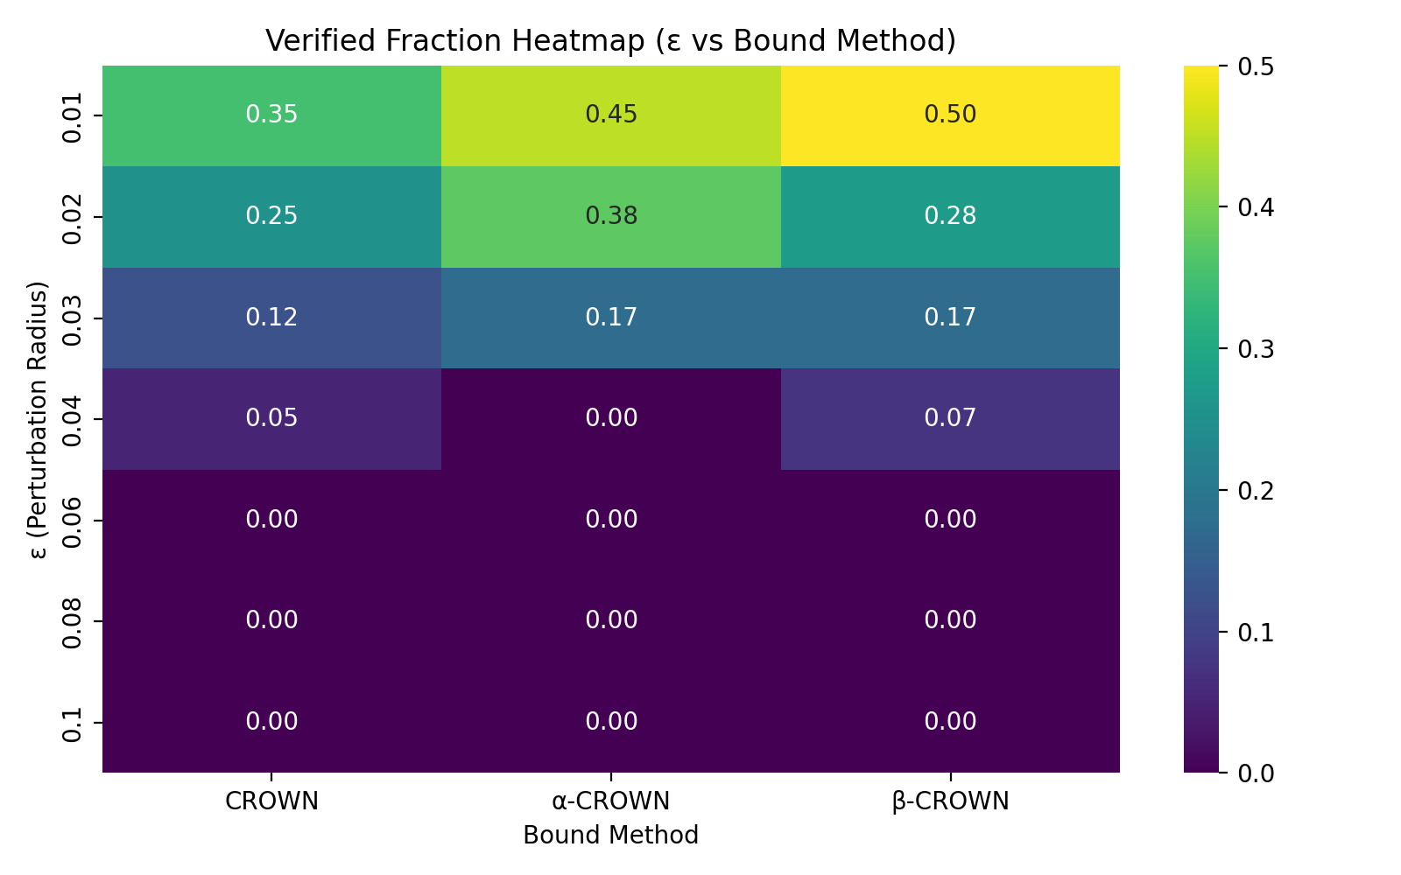
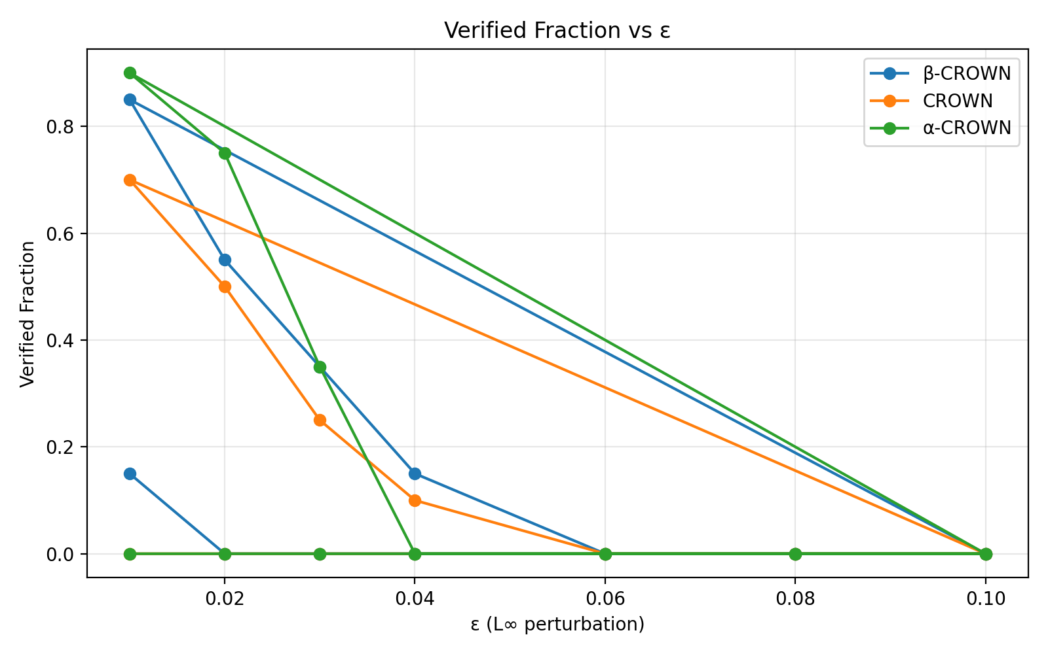
Certified Robustness Verification for Tiny Recursive Models (TRM)
🔹 **Verification Pipeline:**
1️⃣ Train TRM-MLP on MNIST (with adversarial fine-tuning)
2️⃣ Apply attack-guided verification (FGSM + I-FGSM)
3️⃣ Use formal α/β-CROWN verification via auto-LiRPA
4️⃣ Aggregate and visualize verified robustness across ε levels
Bound Method | Avg Verified Fraction
CROWN | 0.111
α-CROWN | 0.143
β-CROWN | 0.146
✅ β-CROWN achieved the highest certified robustness (~15%) on adversarially trained TRM models. Demonstrates GPU-accelerated attack-guided formal verification pipeline.

