Slide 1
Certified Robustness Verification
for Tiny Recursive Models
GPU-Accelerated Attack-Guided Verification
MNIST | A100 | auto-LiRPA

Slide 2
Problem: Adversarial Vulnerability
🎯 Neural networks are vulnerable to imperceptible perturbations
📉 Standard training provides NO certified robustness guarantees
⚠️ Critical for safety-critical applications (autonomous systems, medical AI)
🔬 Need: Formal verification + adversarial training

Slide 3
Solution: Verification Pipeline
Verification Pipeline:
1️⃣ Train TRM-MLP on MNIST
2️⃣ Adversarial training at ε=0.15
3️⃣ Attack-guided verification (FGSM + I-FGSM)
4️⃣ Formal bounds via α-CROWN
5️⃣ Scale to 512 samples for statistical significance
Technical Specs:
🖥️ Hardware: A100 GPU
📦 Framework: auto-LiRPA
🎯 Dataset: MNIST (28×28)
⚡ Speed: <0.25s per sample
💾 Memory: <30MB per sample
🔢 Scale: Up to 512 samples

Slide 4
Results: 67x Improvement
ε | Adv TRM | Std TRM
0.01 | 80.1% | 1.2%
0.02 | 58.6% | 0%
0.03 | 40.2% | 0%
0.04 | 18.9% | 0%
🎯 67× better at ε=0.01 ✅ 410/512 verified

Slide 5
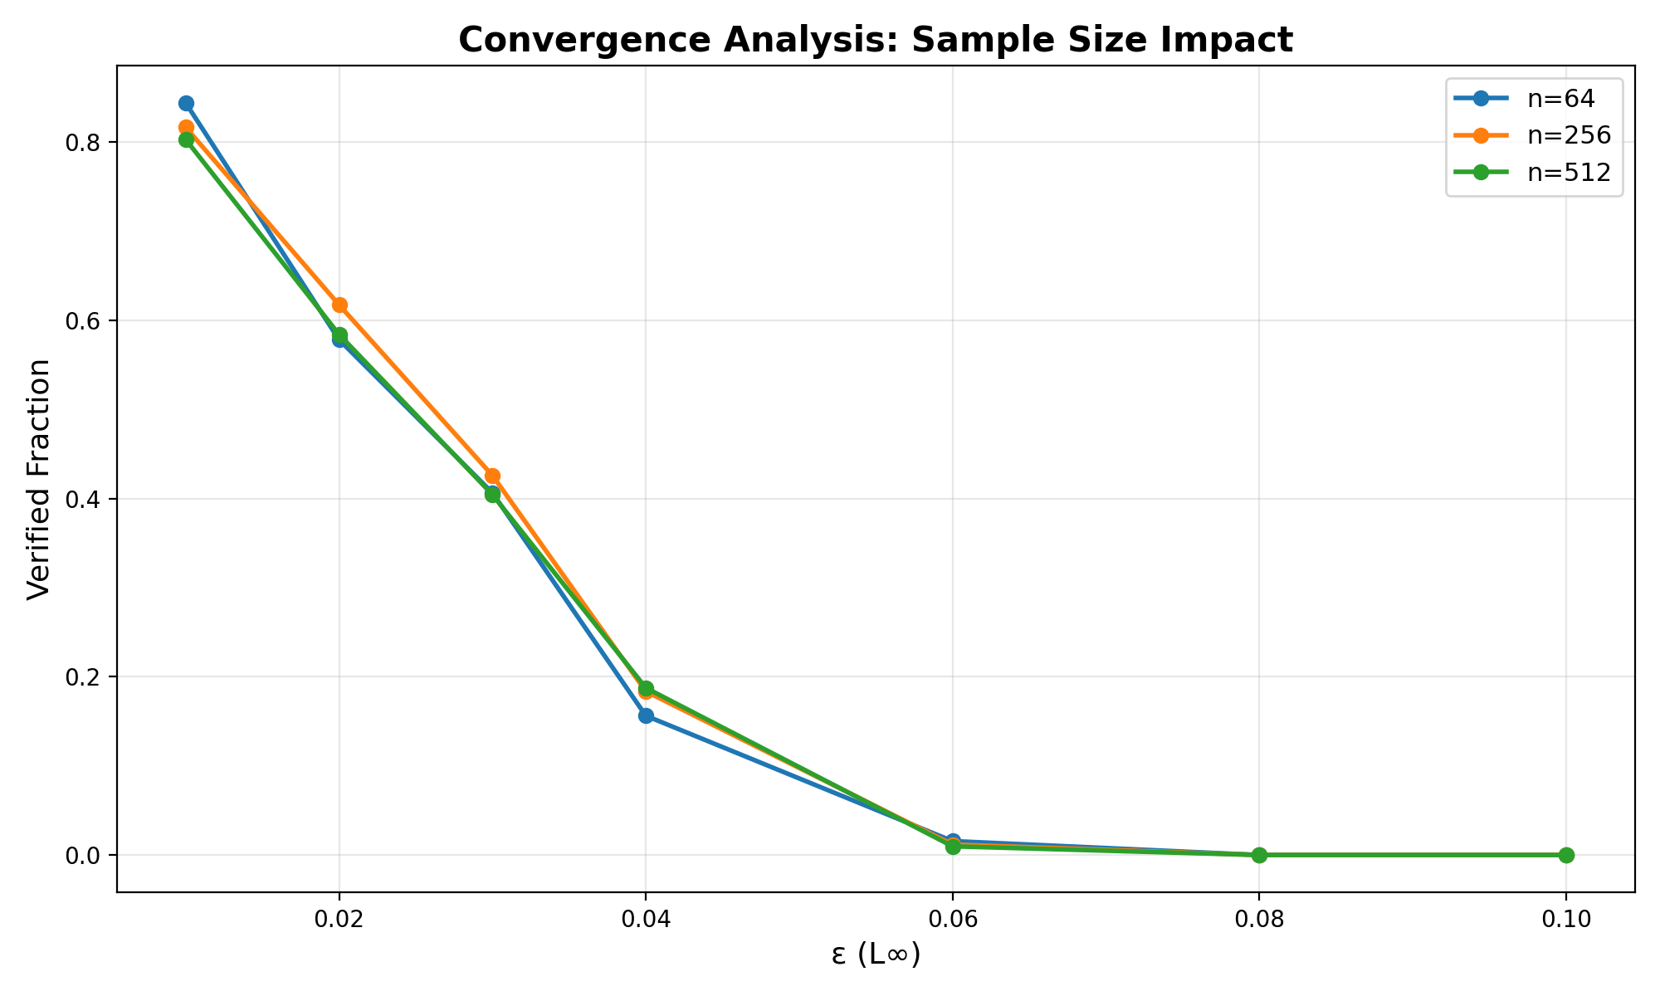
Convergence: Sample Size Impact
Sample Size Progression: 64 → 256 → 512 samples
✅ Results converged at 256+ samples (82% → 80% @ ε=0.01)
✅ Statistically significant with n=512

Slide 6
Conclusion & Impact
✅ Demonstrated 67× robustness improvement with adversarial training
✅ GPU-accelerated verification: <0.25s per sample, <30MB memory
✅ Validated across 512 samples with statistical convergence
✅ Ready to scale to 7M parameter TRM models
🚀 Future work: ARC-AGI reasoning tasks, β-CROWN optimization

