Slide 1

WELCOME TO
C++ FOR NEWBIES
TECH COUNCIL
By ACJC Tech Council
WELCOME.HTML

Slide 2





Table of Contents
TECH COUNCIL
?
?
?
IF .. ELSE
Why C++?
Running C++
Syntax
Conditionals
Loops
Functions
Data Structures
CONTENT.HTML
Notes:
So today, we’ll be going through:
syntax - structure of the words to make sense to the computer
conditionals - if else stuff
Loops - repeated
Function - general instruction to tell the computer to do
Data structure - how data can be organized in the computer

Slide 3

/01
/Why is C++ important?
TECH COUNCIL
Should I use C++? Is it good?
WHY.HTML

Slide 4
Why is C++ Important?
General purpose programming language
TECH COUNCIL
High efficiency and low memory usage
WHY.HTML

Slide 5
Why is C++ Important?
TECH COUNCIL
FOR INDUSTRY
PURPOSES
Operating systems
Servers and databases
Applications
Photoshop, Firefox
COD, Quake, Half Life 2
Aircrafts
F-16/F-35
WHY.HTML
Notes:
For industry purposes:
used to write operating systems, servers, databases, graphics libraries, desktop applications, mobile applications, etc
Found in aircraft (F-16/F-35!), games (WoW, Diablo, MapleStory, etc), telephone systems, web browsers (firefox), Google, Facebook, Apple, Amazon, etc

Slide 6
Why is C++ Important?
TECH COUNCIL
FOR YOU
Competitive Programming
National/International Olympiad in Informatics (NOI/IOI)
Google Code Jam
Facebook Hacker Cup
Jobs in the future
WHY.HTML

Slide 7
/02
/Running C++
TECH COUNCIL
HOW.HTML

Slide 8
Compiler
TECH COUNCIL
a program that processes statements written in a programming language and turns them into machine language
HOW.HTML
Notes:
First, let’s get to know some definitions.
The first one is compiler, which is …
This basically means that the program will TRANSLATE whatever code you write

Slide 9


IDE
TECH COUNCIL
Stands for Integrated Development Environment
Software that helps you to code
HOW.HTML
Notes:
Normally its better to code and run C++ programs locally by downloading an IDE and compiler, but its also possible to do it online
IDE helps with Syntax Highlighting, autocomplete, debugging

Slide 10

Online
TECH COUNCIL
CodeCollab
https://codecollab.io
CODECOLLAB.HTML

Slide 11

TECH COUNCIL
CODECOLLAB.HTML
Notes:
Normally its better to code and run C++ programs locally by downloading an IDE and compiler, but its also possible to do it online

Slide 12
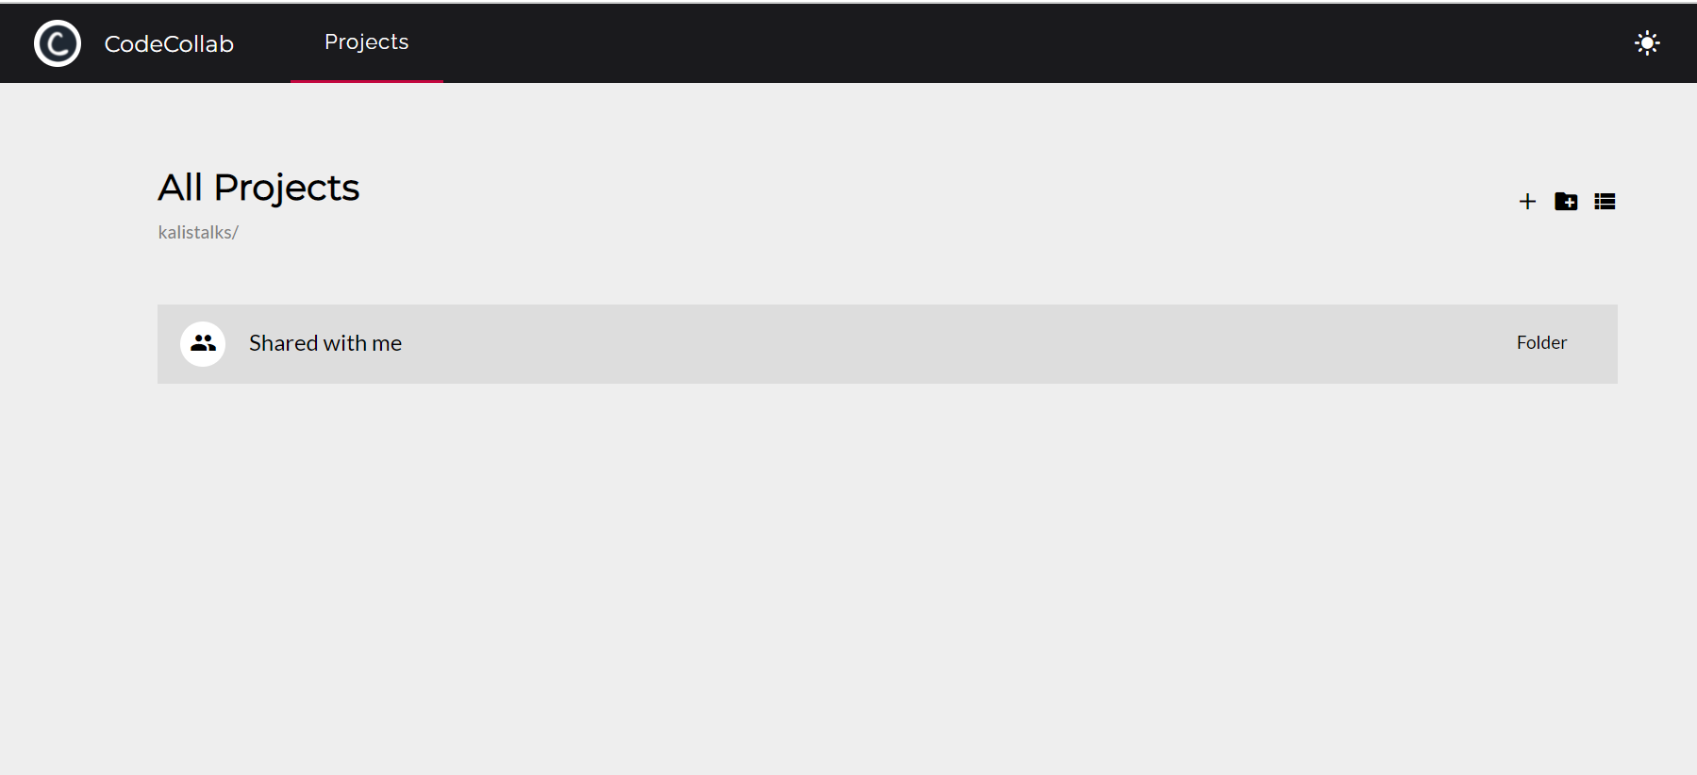
TECH COUNCIL
CODECOLLAB.HTML
Notes:
Normally its better to code and run C++ programs locally by downloading an IDE and compiler, but its also possible to do it online

Slide 13
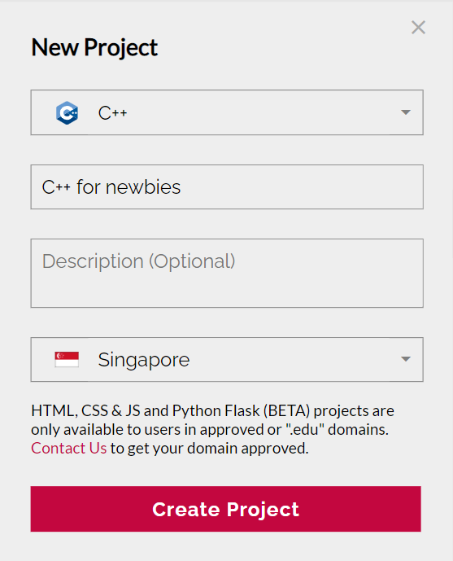
TECH COUNCIL
CODECOLLAB.HTML
Notes:
Normally its better to code and run C++ programs locally by downloading an IDE and compiler, but its also possible to do it online

Slide 14
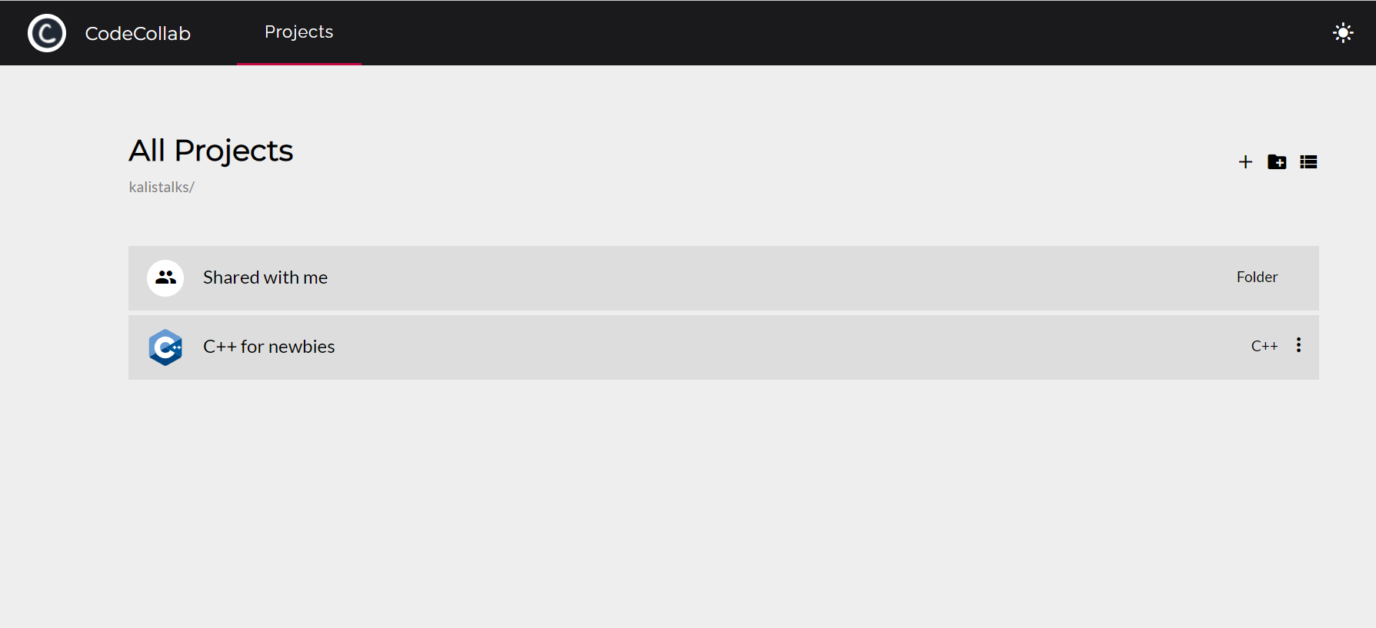
TECH COUNCIL
CODECOLLAB.HTML
Notes:
Normally its better to code and run C++ programs locally by downloading an IDE and compiler, but its also possible to do it online

Slide 15
TECH COUNCIL
CODECOLLAB.HTML
Notes:
Normally its better to code and run C++ programs locally by downloading an IDE and compiler, but its also possible to do it online

Slide 16
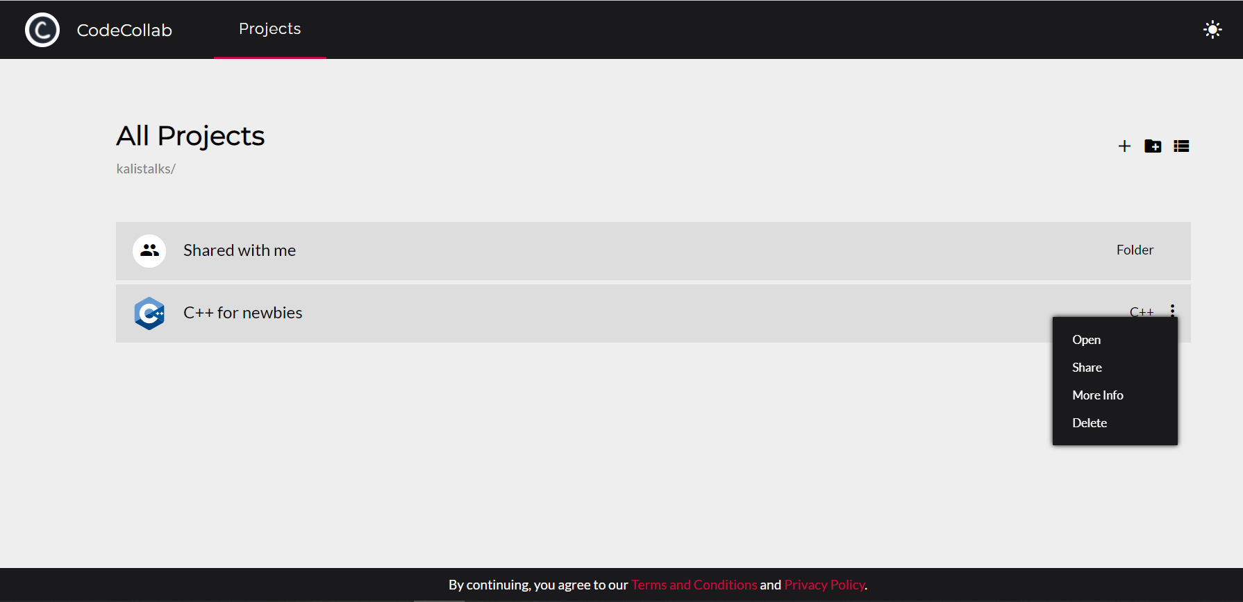
TECH COUNCIL
CODECOLLAB.HTML
Notes:
Normally its better to code and run C++ programs locally by downloading an IDE and compiler, but its also possible to do it online

Slide 17
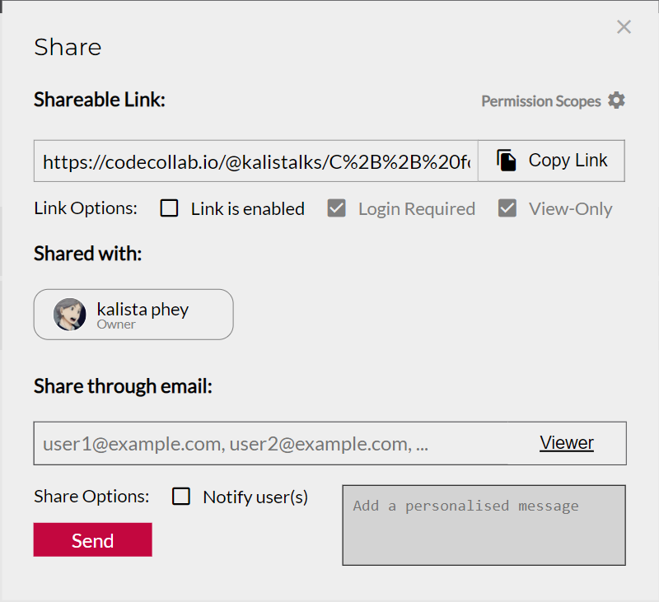
TECH COUNCIL
CODECOLLAB.HTML
Notes:
Normally its better to code and run C++ programs locally by downloading an IDE and compiler, but its also possible to do it online

Slide 18
TECH COUNCIL
tinyurl.com/cppfornewbies
CODECOLLAB.HTML
Notes:
Normally its better to code and run C++ programs locally by downloading an IDE and compiler, but its also possible to do it online

Slide 19
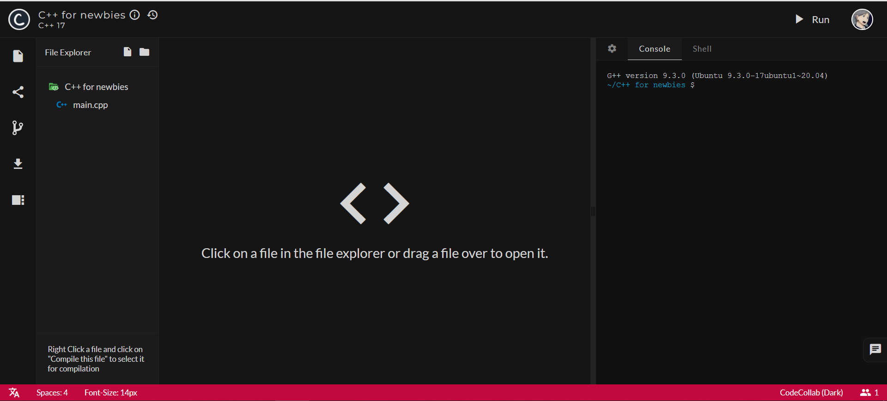
TECH COUNCIL
CODECOLLAB.HTML
Notes:
Normally its better to code and run C++ programs locally by downloading an IDE and compiler, but its also possible to do it online

Slide 20
TECH COUNCIL
CODECOLLAB.HTML
Notes:
Normally its better to code and run C++ programs locally by downloading an IDE and compiler, but its also possible to do it online

Slide 21
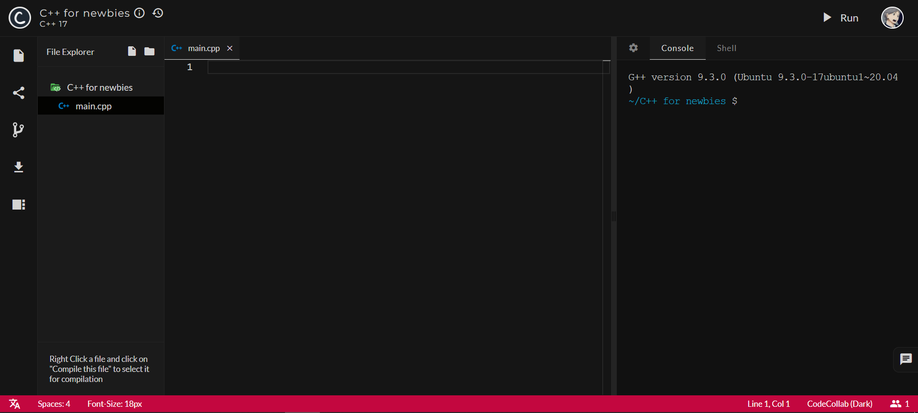
TECH COUNCIL
CODECOLLAB.HTML
Notes:
Normally its better to code and run C++ programs locally by downloading an IDE and compiler, but its also possible to do it online

Slide 22
TECH COUNCIL
CODECOLLAB.HTML
Notes:
Normally its better to code and run C++ programs locally by downloading an IDE and compiler, but its also possible to do it online

Slide 23
TECH COUNCIL
CODECOLLAB.HTML
Notes:
Normally its better to code and run C++ programs locally by downloading an IDE and compiler, but its also possible to do it online

Slide 24
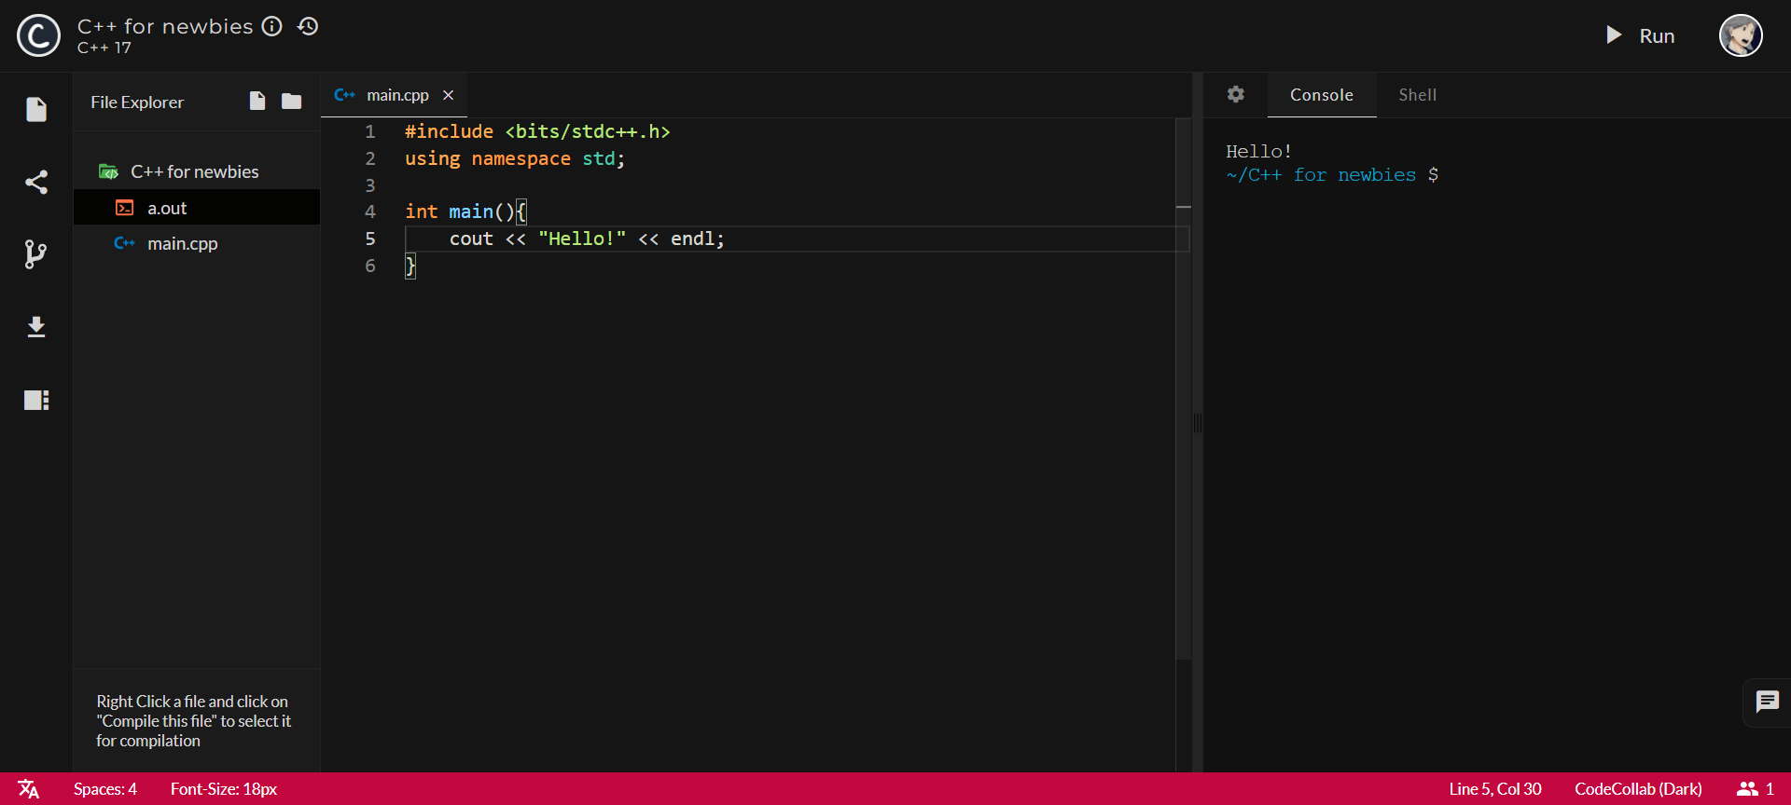
TECH COUNCIL
CODECOLLAB.HTML
Notes:
Normally its better to code and run C++ programs locally by downloading an IDE and compiler, but its also possible to do it online

Slide 25
/03
/Syntax
TECH COUNCIL
#include <bits/stdc++.h>
string abc; int number;
= / %
- +
SYNTAX.HTML
Notes:
Hello everyone, my name is Ling Song and i will be teaching you guys about the basics of writing C++
Thoughout this ill be asking if u guys can keep up, so just type in the chat if u cannot
If u have any questions, type it into the chat and my teammates will answer u guys.

Slide 26

/Starting Out
TECH COUNCIL
#include <bits/stdc++.h>
libraries that your program might need
BASICS.HTML
Notes:
To start out, we have this include <
The first line includes the necessary libraries that your program might need. So what does that mean?
Think of libraries as bookcases full of books, each book contains a set of instruction that tells the computer what to do.
The ‘include’ tells the computer which bookcases the program will use, o the computer is ready with the knowledge.
There are actually many different ‘include’s, but this is the most broad one
The second line basically tells the computer that you want to use the “std” or standard library throughout ur code
Meaning that everything that you write will use this standard library
As you guys follow along the slides, you can try typing these lines of code into ur Replit too to see how it’s like.

Slide 27
/Starting Out
TECH COUNCIL
using namespace std;
tells the compiler that you will be using C++’s standard library.
BASICS.HTML
Notes:
The second line will be using namespace std, note that you have this semicolon after this. I will explain the importance of semicolons on the next few slides
2nd line basically tells the computer that you want to use the or standard library throughout ur code
Meaning that everything that you write will use this standard library, which consist of some of the most basic c++ functions
As you guys follow along the slides, you can try typing these lines of code into ur Codecollab too to see how it’s like.

Slide 28
/Starting Out
TECH COUNCIL
#include <bits/stdc++.h> using namespace std;
int main() { code; }
the main area where your code will go
BASICS.HTML
Notes:
Next, what we will want to write is int main() {}
Dont worry, lets write this together. (switch to codecollab)
We start off writing #include….
Press enter for a new line, then using namespace std. Remember to type the semicolon
Press enter twice to have a spacing, this is a personal preference but i prefer to have that empty line cos it looks less cluttered.
The empty line will not affect any code so u can have more or less.
Then u have th int main(){}, code collab actually hepes u to type the close brackets. While inside the curly brackets, press enter.
Ur curly brackets will in a way open up, then u can type ur code in this space. You also notice that u automatically have an indentation.
This can really help u to organise, especially when later on when u learn conditionals.
Now, your shld type ur code within this {}
Lets break down what this all means.
This is the main block of code that your compiler will look at. It will be important when you learn about functions later on
The compiler will start looking at the first curly bracket here, and will end at the curly bracket.
Last but not least, all statements and arguments need to end with a semicolon. It basically tells the compiler that that statement has ended, and should look at the next one
Is everyone still keeping up?

Slide 29
Syntax
/01
/Data Types
/02
/Variable
/03
/Input/Output
/04
/Operators
TECH COUNCIL
Integer, Strings, Bool, Float, Double, Char
x, y ,z
cin, cout
+, -, *, /, %
SYNTAX.HTML
Notes:
I will be going through this 4 basics which are data types, variables, input/output and finally operators

Slide 30
/3-01
/Data Types
TECH COUNCIL
DATA TYPES.HTML
Notes:
I will be going through 6 main data types. In c++, there is actually more, but this is the basics

Slide 31
TECH COUNCIL
Data Type | Descriptions | Example
int | 32 bit signed integer (max: 2,147,483,647) | 23, -4, 5004986
float | Decimals (typically 7 d.p.) | 2.0, -9.876, 0.00078
double | More precise decimals (typically 16 d.p.) | 9.759305740465457
DATA TYPES.HTML

Slide 32
TECH COUNCIL
Data Type | Descriptions | Example
string | Words and phrases. Combinations of characters, enclosed by double quotes “ “ | “Hello”, “hello world”, “webs34id&%*@sf”
char | Character. It may contain any single character, enclosed by single quotes ‘ ‘ | ‘x’, ‘ ‘, ‘&’
bool | Boolean. It may contain only one of two values - true or false | true, false
DATA TYPES.HTML

Slide 33
/3-02
/Variables
TECH COUNCIL
VARIABLES.HTML
Notes:
So data types on its own is not that useful, its just a definition in a way. So we can use data types in variables

Slide 34
TECH COUNCIL
data_type variable_name = initial_value;
int x; int y = 8;
float decimal_points = 8.123; bool b = true; char c = ‘x’;
string str = “hello world”;
int y = “hello world”; <ERROR>
VARIABLES.HTML
Notes:
Variables are kinda similar to math, in algebra. U know how u need to find the value of x in those math questions? Its very similar.
Variables in c++ can store all kinds of data, like numbers and words
To use a variable, u have to first defined it. Thats where data types comes in.
First thing is to state the data type of your variable (int if i want my variable to whole numbers, or string if i want my variable to hold words)
Then u need to give it a name, you will be using this name when u want to use the variable. Names can be a single character, or a word, or even 2 words, though u need to use a underscore instead of a space.
Lastly, its optional but u can also include a initial value. The value must be of the same data type!!
If u dont, x will have a null value. Some compiler automatically makes it 0 but not all. So take note of this
There are also special ways of inputting a character and a string. So for a character, u have to put it between single quotes
For strings, its double quotes. If u dont, there will be an error message. (show error on code collab)
Remember to put ur semicolons after declaring a variable becos they are all statements.

Slide 35
/Notes
TECH COUNCIL
int a;
int b;
int c;
int d;
int a, b, c, d;
VARIABLES.HTML
Notes:
Lets say i want to declare many variables that i want to use and I dont need a initial value since ill give them a value later on.
I could write like this, but this takes up 4 lines and quite a hassle to type, since u have to keeping typing int and the semicolon.
So what if i say u can shorten it
Like this! This essentially declares the same thing as the left box, but shorter and much easier to write. Both are perfectly acceptable in c++

Slide 36
/3-03
/Input/Output
TECH COUNCIL
INPUT OUTPUT.HTML
Notes:
Now that we have variables, how can we assign it values, or how can we extract the value from it, in other words, how do we input and output values from variables.

Slide 37
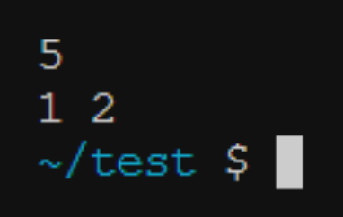
/Input & Output
TECH COUNCIL
/cin >>
int x, a, b;
cin >> x;
cin >> a >> b;
INPUT OUTPUT.HTML
Notes:
We can use cin to input values.
So the syntac is cin >>
But first, u need to declare the variables in order to input values into it
Then next you will cin >> variable_name, semicolon
One thing to note is that spaces and enter ends the input. I will explain this more as we go along
Lets type this together (switch)
Type int x, cin >> x, show how to input.
U may wonder what the 3rd line means, let me show u
(switch)
Lets say i have 3 variables, x, a, and b. I want to input value into each of them.
I cld do this….
But instead, i can shorten it like this
Rmb how spaces and enter ends the input? What i mean is that when i type 5 and press enter, the program knows that the variable x has a value of 5……

Slide 38


/Input & Output
TECH COUNCIL
/cout <<
int x = 8;
cout << x;
string str = “Hello World”;
cout << str;
INPUT OUTPUT.HTML
Notes:
You can use cout to output variables and text
The syntax will be cout << variable_name, semicolon
So in my example, you can see how i see out a variable with an integer, and a variable with a string.
Ill give u guys arnd 30s to try around with cin and cout and after that, we will continue

Slide 39

/Input & Output
TECH COUNCIL
cout << 8;
cout << ‘c’;
cout << “Hello World”;
INPUT OUTPUT.HTML
Notes:
You can also cout numbers, characters and words like this
Jut\st rmb for character and strings, u need the respective quotes

Slide 40


/Input & Output
TECH COUNCIL
/cout <<
int x = 8;
cout << x;
cout << “Hello World”;
int x = 8;
cout << x << ‘ ’ << “Hello World”;
INPUT OUTPUT.HTML
Notes:
Many times, we dont just output once but what happens when we try to cout multiple variables? (switch)
So lets say i have 2 things to output…..
Cout doesnt automatically give u a space, so you will have to add it in yourself
However, u see how this takes up three lines? Just like how you can do multiple inputs at the same time, you can do multiple outputs as well.

Slide 41


/Special Characters
TECH COUNCIL
/New line
cout << "Hello World";
cout << "New Day";
cout << "Hello World" << endl;
cout << "New Day\n";
INPUT OUTPUT.HTML
Notes:
Sometimes, we also want outputs to be on different lines, u see how previously, the outputs are on one line?
Putting an endl indicates the next output will be on a new line
Alternatively, you can also use \n

Slide 42

PRACTICE TIME
TECH COUNCIL
/In and Out
I will input 2 strings (name and word)
Expected output
PRACTICE.HTML

Slide 43
Answer
TECH COUNCIL
#include<bits/stdc++.h>
using namespace std;
int main() {
string name, word;
cin >> name >> word;
cout << name << " said this:" << endl;
cout << word;
}
PRACTICE

Slide 44
/3-04
/Operators
TECH COUNCIL
OPERATORS.HTML

Slide 45
/Operators
TECH COUNCIL
manipulate variables
only between two variables of the same type
OPERATORS.HTML
Notes:
C++ has operators which you can use to manipulate variables with.
Most of the time, you can only use an operator between two variables of the same type. (give example)

Slide 46
TECH COUNCIL
Operator | Description | Example
+ | Addition | 5 + 2 becomes 7
- | Subtraction | 5 - 2 becomes 3
* | Multiplication | 5 * 2 becomes 10
/ | Division | 5 / 2 becomes 2
% | Remainder (Modulo) | 5 % 2 becomes 1
OPERATORS.HTML

Slide 47
TECH COUNCIL
Operator | Description | Example
++ / -- | Add/Subtract 1 to the variable | x++ means x = x+1 x-- means x = x-1
+= / -= / *= / /= | Add/Subtract/Multiply/ Divide a certain value to the variable | x+=5 means x = x+5 x-=3 means x = x-3 x*=2 means x = x*2 x/=-10 means x = x/-10
// | Comment. Compiler will not see and execute this line | //this is a comment
OPERATORS.HTML
Notes:
Some of you may think that this doesnt make sense mathematically. You are right! But this is not math soooo what this means is that u r reassigning the value of x. U can think of it like theres a new variable x1, which hold the value of x and plus 1;
Show in code collab
U can sum up variables also like this

Slide 48
/Notes
TECH COUNCIL
int x = 1;
float y = 2.5;
float z = x + y;
cout << z;
// output is 3.5
int x = 1;
float y = 2.5;
int z = x + y;
cout << z;
// output is 3
OPERATORS.HTML

Slide 49
/Notes
TECH COUNCIL
int x = 5;
float y = 2.0;
float z = x / y;
cout << z;
// output is 2.5
int x = 5;
int y = 2;
float z = x / y;
cout << z;
// output is 2
OPERATORS.HTML
Notes:
Do the operations (answer) then the data type

Slide 50
/Operator Example (Other data types)
TECH COUNCIL
string s1, s2, s3;
s1 = “Hello”;
s2 = “World”;
s3 = s1 + ‘ ‘ + s2;
S3 becomes:
“Hello World”
OPERATORS.HTML

Slide 51

PRACTICE TIME
TECH COUNCIL
/Division Calculator
I will input 2 numbers
You have to perform a division operation and output a float.
PRACTICE.HTML

Slide 52
Answer
TECH COUNCIL
#include<bits/stdc++.h>
using namespace std;
int main() {
float x, y;
float ans;
cin >> x >> y;
ans = x/y;
cout << ans;
}
PRACTICE

Slide 53
/4
/Conditionals
TECH COUNCIL
CONDITIONALS.HTML
Notes:
The root word for conditionals is just conditions. Conditions are like, for example, …
These are conditions. So before I teach you how to implement these conditions into C++, let’s talk about some useful operations for conditionals

Slide 54
TECH COUNCIL
Operator | Description | Example | Ans
== | Is Equals to | 5 + 3 == 10 - 2 → | true
> / >= | More than / more than or equal to | 10 * 2 >= 3 → | true
< / <= | Less than / less than or equal to | 4 * 5 < 7 → | false
!= | Not equals to | 2 * 5 != 10 → | false
CONDITIONALS.HTML
Notes:
First we have … which means is equals to or equivalent to
..
.
.
An important thing to take note of is that all of these conditionals returns Boolean values, so either True or False. Very important when coming to conditionals, we’ll see more of this later

Slide 55


TECH COUNCIL
Operator | Description | Example | Ans
&& | AND: gives TRUE if BOTH events are true | ( 1 + 1 == 2 ) && ( 2 + 3 != 4 ) → | true
 |  | ( 2 + 3 == 5 ) && ( 5 - 2 > 5 ) → | false
|| | OR: gives TRUE if at least ONE of the events is true | ( 5 * 2 > 4 ) || ( 2 + 1 == 3 ) → | true
 |  | ( 5 * 2 == 4 ) || ( 5 + 5 == 10 ) → | true
CONDITIONALS.HTML
Notes:
Gives TRUE if the condition on the left AND the condition on the right is TRUE.
As you can see we have this long chunk of code here. so lets break it down. we have this left condition and this right condition which are both seperated by brackets. similarly to maths, whatever in the brackets takes priority, so the computer will process the brackets first.
alright so lets see, is ….. and is ……
.
.
.
Important note again is that these are always boolean values, which either true or false.

Slide 56
/ IF statements
TECH COUNCIL
if (is_raining == true) {
// bring umbrella
}
MUST BE BOOLEAN
if (condition) {
// do this
}
if (maths_score > 50) {
// Tell mom I passed!!
}
if (maths_score <= 50) {
// The dog ate my
work!!
}
CONDITIONALS.HTML
Notes:
So this is the basic syntax for an IF statement in C++.
This is p self explanatory because it’ls just seeing if this particular condition is being met. If it is true, it wil process the code. If not, it will ignore it and move on.
.
.

Slide 57
/ IF + ELSE statements
TECH COUNCIL
MUST BE BOOLEAN
if (is_raining == true) {
// bring umbrella
}
else {
// don’t need umbrella
}
if (condition) {
// do this
}
else {
// do this
}
if (maths_score > 50) {
// Tell mom I passed!!
}
else {
// The dog ate my work!!
}
CONDITIONALS.HTML
Notes:
Now that we’ve talked about IF statements, let’s talk about ELSE
As mentioned before, must be boolean
Concept o ELSE is simple. Means the flipside/opposite of whatever condtions are above it. so if this means true, then else is the opposite which is false.
For example..
.
.
.

Slide 58
/ COMPARISON
TECH COUNCIL
if (is_raining == true) {
// bring umbrella
}
if (is_raining == false) {
// don’t need bring umbrella
}
if (is_raining == true) {
// bring umbrella
}
else {
// don’t need umbrella
}
CONDITIONALS.HTML
Notes:
Lets take a look at these 2 codes side by side. On the left we do not use ELSE but on the right we do. What’s the difference?
If we analyse the code, we realise that these two portions of the code are quite similar and do basically the same things.
However, let’s see how the computer would process these different code.
.
.
So why would we choose 1 over the other?

Slide 59
/ COMPARISON
TECH COUNCIL
if (maths_score > 50) {
// Tell mom I passed!!
}
if (maths_score <= 50) {
// The dog ate my work!!
}
if (maths_score > 50) {
// Tell mom I passed!!
}
else {
// The dog ate my work!!
}
CONDITIONALS.HTML

Slide 60
/ COMPARISON
Less redundant code
Reduce unnecessary processing
Looks neater
TECH COUNCIL
CONDITIONALS.HTML
Notes:
Usually use ELSE to have less redundant code
Reduce unnecessary processing, altho doesnt affect efficiency that much
Overall has a neater look to ur code

Slide 61
PRACTICE TIME
Take in an integer, x
If x is even, output true
If x is odd, output false
Hints!
Use cin to get input (RECAP)
Use cout to output (RECAP)
Use: x % 2 == 0 to check if x is even. But why?
(RECAP: what does the operation % mean?)
TECH COUNCIL
PRACTICE

Slide 62
WHAT IF :
Multiple continuous conditions
Not only True / False or Yes / No
TECH COUNCIL
CONDITIONALS.HTML

Slide 63
TECH COUNCIL
Is it raining?
No
Yes
Cycle to school
Do I have enough money?
No
Yes
Take public transport to school
Take taxi to school
CONDITIONALS.HTML

Slide 64
TECH COUNCIL
Is it raining?
No
Yes
Cycle to school
Do I have enough money?
No
Yes
Take public transport to school
Take taxi to school
CONDITIONALS.HTML

Slide 65
/ ELSE IF statements
TECH COUNCIL
if (condition1) {
// do this
}
if (is_raining == false) {
// cycle to school
}
else if (have_money == true) {
// take taxi to school
}
else {
// take bus to school
}
MUST BE BOOLEAN
else if (condition2) {
// do this
}
else {
// do this
}
CONDITIONALS.HTML

Slide 66
TECH COUNCIL
Is it raining?
No
Yes
Cycle to school
Am I late for school?
No
Yes
Take public transport to school
Do I have enough money?
No
Yes
Yes
Are parents busy?
Take taxi to school
Cry and take public transport
Ask them to send you
No
CONDITIONALS.HTML

Slide 67
TECH COUNCIL
Is it raining?
No
Yes
Cycle to school
Am I late for school?
No
Yes
Take public transport to school
Do I have enough money?
No
Yes
Yes
Are parents busy?
Take taxi to school
Cry and take public transport
Ask them to send you
No
CONDITIONALS.HTML

Slide 68
/ NESTED IF statements
TECH COUNCIL
No
Is it raining?
Yes
Cycle to school
No
Am I late for school?
Yes
Take public transport to school
Do I have enough money?
No
Yes
Yes
Are parents busy?
Cry and take public transport
Take taxi to school
Ask them to send you
No
CONDITIONALS.HTML

Slide 69
/ NESTED IF statements
TECH COUNCIL
if (is_raining == false) {
// cycle to school
}
No
Is it raining?
Yes
Cycle to school
No
Am I late for school?
Yes
Take public transport to school
Do I have enough money?
No
Yes
Yes
Are parents busy?
Cry and take public transport
Take taxi to school
Ask them to send you
No
CONDITIONALS.HTML

Slide 70
/ NESTED IF statements
TECH COUNCIL
if (is_raining == false) {
// cycle to school
}
else if (late_for_school == true) {
Is it raining?
No
Yes
Cycle to school
No
Am I late for school?
Yes
Take public transport to school
Do I have enough money?
No
Yes
Yes
Are parents busy?
Cry and take public transport
Take taxi to school
Ask them to send you
No
CONDITIONALS.HTML

Slide 71
/ NESTED IF statements
TECH COUNCIL
if (is_raining == false) {
// cycle to school
}
else if (late_for_school == true) {
Is it raining?
if (enough_money == true) {
// take taxi to school
}
No
Yes
Cycle to school
No
Am I late for school?
Yes
Take public transport to school
Do I have enough money?
No
Yes
Yes
Are parents busy?
Cry and take public transport
Take taxi to school
Ask them to send you
No
CONDITIONALS.HTML

Slide 72
/ NESTED IF statements
TECH COUNCIL
if (is_raining == false) {
// cycle to school
}
else if (late_for_school == true) {
Is it raining?
if (enough_money == true) {
// take taxi to school
}
No
Yes
Cycle to school
No
Am I late for school?
Yes
else if (parents_busy = true) {
// cry and take public
// transport to school
}
Take public transport to school
Do I have enough money?
No
Yes
Yes
Are parents busy?
Cry and take public transport
Take taxi to school
Ask them to send you
No
CONDITIONALS.HTML

Slide 73
/ NESTED IF statements
TECH COUNCIL
if (is_raining == false) {
// cycle to school
}
else if (late_for_school == true) {
Is it raining?
if (enough_money == true) {
// take taxi to school
}
No
Yes
Cycle to school
No
Am I late for school?
Yes
else if (parents_busy = true) {
// cry and take public
// transport to school
}
Take public transport to school
Do I have enough money?
No
Yes
else {
// ask parents to send
// you to school
}
Yes
Are parents busy?
Cry and take public transport
Take taxi to school
Ask them to send you
No
CONDITIONALS.HTML

Slide 74
/ NESTED IF statements
TECH COUNCIL
if (is_raining == false) {
// cycle to school
}
else if (late_for_school == true) {
Is it raining?
if (enough_money == true) {
// take taxi to school
}
No
Yes
Cycle to school
No
Am I late for school?
Yes
else if (parents_busy = true) {
// cry and take public
// transport to school
}
Take public transport to school
Do I have enough money?
No
Yes
else {
// ask parents to send
// you to school
}
Yes
Are parents busy?
Cry and take public transport
Take taxi to school
} else {
// take public transport
}
Ask them to send you
No
CONDITIONALS.HTML

Slide 75
PRACTICE TIME
Take in an integer, s
Output the corresponding grade with the score
i.e.
if score == 95, output “A*”
if score == 60, output “B”
if score == 49, output “F”
TECH COUNCIL
A*: 90 - 100
A : 70 - 89
B : 60 - 69
C : 50 - 59
F : 0 - 49
PRACTICE

Slide 76
PRACTICE TIME
TECH COUNCIL
Suppose our input is stored in the variable s
A*: 90 - 100
A : 70 - 89
B : 60 - 69
C : 50 - 59
F : 0 - 49
90 <= s <= 100
70 <= s < 90
70 <= s <= 89
60 <= s < 70
60 <= s <= 69
50 <= s < 60
50 <= s <= 59
0 <= s <= 49
PRACTICE

Slide 77
PRACTICE TIME
TECH COUNCIL
90 <= s <= 100
( s >= 90 ) && (s <= 100)
70 <= s <= 89
( s >= 70 ) && (s <= 89)
60 <= s <= 69
( s >= 60 ) && (s <= 69)
50 <= s <= 59
( s >= 50 ) && (s <= 59)
0 <= s <= 49
( s >= 0 ) && (s <= 49)
PRACTICE

Slide 78
PRACTICE TIME
TECH COUNCIL
Yes
As
No
Output “A*”
A
Yes
No
Output “A”
B
Yes
No
Output “B”
C
Yes
Output “C”
Output “F”
PRACTICE

Slide 79
/5
/Loops
TECH COUNCIL
LOOPS.HTML

Slide 80
Loops
TECH COUNCIL
Allow us repeatedly execute a block of statements until a given condition is met.
LOOPS.HTML
Notes:
Allows you to repeatedly execute a block of statements until a given condition is met

Slide 81

/Why do we need loops?
TECH COUNCIL
cout << 1 << 2 << 3 << 4 << 5 << 6 << 7 << 8 << 9 << 10;
cout << 1 << 2 << 3 << 4 << ... << 97 << 98 << 99 << 100;
LOOPS.HTML

Slide 82
Loops
While
For
TECH COUNCIL
LOOPS.HTML

Slide 83
/While loop
TECH COUNCIL
MUST BE BOOLEAN
while (condition) { // do something }
LOOPS.HTML

Slide 84
/While loop
TECH COUNCIL
int counter = 1;
while (counter <= 100) {
cout << counter << endl;
counter += 1; }
int counter = 1;
while (counter <= 100) {
cout << counter << endl;
counter += 1; }
LOOPS.HTML
Notes:
ENSURE YOU HAVE A TERMINATING CONDITION

Slide 85
Loops
While
For
TECH COUNCIL
LOOPS.HTML

Slide 86
/For loop
TECH COUNCIL
for (int counter = 0; counter < 5; counter++) {
// do something
}
LOOPS.HTML
Notes:
The for loop is divided into 3 portions. SO lets break them down

Slide 87
/For loop
TECH COUNCIL
for (int counter = 0; counter < 5; counter++) {
// do something
}
LOOPS.HTML
Notes:
Similar to the while loop, we have a counter initiated. So when the FOR loop starts, we have a variable called counter, which is initialized as 0. So this part of the for loop is only run once, at the beginning of the for loop.

Slide 88
/For loop
TECH COUNCIL
for (int counter = 0; counter < 5; counter++) {
// do something
}
LOOPS.HTML
Notes:
Next, this is our condition, whether or not our counter is less than 5.
In other words, this value is our end limit for counter and to ensure we don't have an infinite loop.

Slide 89
/For loop
TECH COUNCIL
++ is the same as += 1
for (int counter = 0; counter < 5; counter++) {
// do something
}
counter += 1
LOOPS.HTML
Notes:
Lastly, we have this counter++ over here. As we recall from what ling song had gone through before, ++ simply means += 1. So hence, this portion is basically the incrementing of the counter. So ++ just repeatedly increments counter by 1, and this portion of the code is always run at the end of loop.

Slide 90
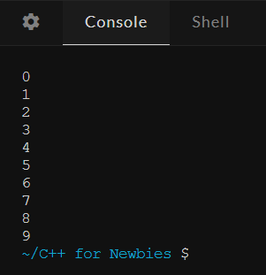
/For loop
TECH COUNCIL
for (int counter = 0; counter < 10; counter++) {
cout << counter << endl;
}
LOOPS.HTML

Slide 91
PRACTICE TIME
Take in an integer, n.
Add up all the numbers from 1 to n
Output the final answer
For example if n = 10,
Output: 1 + 2 + 3 + 4 + 5 + 6 + 7 + 8 + 9 + 10 = 55
Hints!
Create an additional variable, answer
Use a loop to repeatedly add to answer, n times
TECH COUNCIL
PRACTICE

Slide 92
/6
/Functions
TECH COUNCIL
FUNCTIONS.HTML

Slide 93
/Functions
TECH COUNCIL
“chunk” of code that can be reused rather than writing it out multiple times
break down a problem into smaller chunks which perform particular tasks
clean and neater code
FUNCTIONS.HTML
Notes:
A function is simply a “chunk” of code that you can use over and over again, rather than writing it out multiple times.
Functions enable programmers to break down or decompose a problem into smaller chunks, each of which performs a particular task.

Slide 94
/Functions
TECH COUNCIL
<return type> <name>(variable1, variable2, variable3, ...) {
// do something
return <output>
}
int main() {
// do something
}
FUNCTIONS.HTML
Notes:
So first you may wonder, why is is this sample function, OUTSIDE of the main function? Didn’t ling song say the main part of the code has to be inside the main function?
Well, as I mentioned before, functions are the broken down subproblems of the entire main problem. So hence i want to separate these smaller subproblems away from the main function. I’ll show you guys how to use these functions later on. But first, let’s learn the syntax of how to write functions first

Slide 95
/Functions
TECH COUNCIL
<return type> <name>(variable1, variable2, variable3, ...) {
// do something
return <output>
}
FUNCTIONS.HTML

Slide 96
/Functions
TECH COUNCIL
<return type> <name>(variable1, variable2, variable3, ...) {
// do something
return <output>
}
FUNCTIONS.HTML
Notes:
First, we have the return type. So return type is very simple to understand. It is basically the data type of the output u want your function to return.
For example if I want to find out a phone number of someone, I want the function to return an integer, right? Since a phone number is an integer. So thus the return type is an integer.

Slide 97
/Functions
TECH COUNCIL
<return type> <name>(variable1, variable2, variable3, ...) {
// do something
return <output>
}
FUNCTIONS.HTML
Notes:
Next, this is just the name of your function, it can be anything you want.

Slide 98
/Functions
TECH COUNCIL
<return type> <name>(variable1, variable2, variable3, ...) {
// do something
return <output>
}
FUNCTIONS.HTML
Notes:
Finally, we have the variables part over here. In technical terms, these are called “Arguments”, but i labelled them variables here for simplicity. So what these variables are, are the information the function needs to run.
For example if I want this function to give me the sum of 2 numbers, the information I would have to give the function ARE the two numbers. Let’s take a look at an example.

Slide 99
/Functions
TECH COUNCIL
int addition (int a, int b) {
int c;
c = a + b;
return c;
}
int main() {
cout << addition(1,2);
cout << subtract(5,3);
}
int main() {
int sum, diff;
sum = addition(1,2);
diff = subtract(4,2);
// do something
}
int subtract (int a, int b) {
int c;
c = a - b;
return c;
}
FUNCTIONS.HTML

Slide 100
PRACTICE TIME
Take in an integer, n.
Using a for loop, add each iteration from 1 to n while processing the following:
If the number is a multiple of 3, times 2
If the number is a multiple of 2, add 3
If both, minus 5
If neither, add 10
TECH COUNCIL
PRACTICE

Slide 101
PRACTICE TIME
For example, if n = 10,
Output:
TECH COUNCIL
PRACTICE

Slide 102
PRACTICE TIME
For example, if n = 10,
Output:
TECH COUNCIL
(1 + 10)
PRACTICE

Slide 103
PRACTICE TIME
For example, if n = 10,
Output:
TECH COUNCIL
(1 + 10) + (2 + 3)
PRACTICE

Slide 104
PRACTICE TIME
For example, if n = 10,
Output:
TECH COUNCIL
(1 + 10) + (2 + 3) + (3 * 2)
PRACTICE

Slide 105
PRACTICE TIME
For example, if n = 10,
Output:
TECH COUNCIL
(1 + 10) + (2 + 3) + (3 * 2) + (4 + 3)
PRACTICE

Slide 106
PRACTICE TIME
For example, if n = 10,
Output:
TECH COUNCIL
(1 + 10) + (2 + 3) + (3 * 2) + (4 + 3) + (5 + 10)
PRACTICE

Slide 107
PRACTICE TIME
For example, if n = 10,
Output:
TECH COUNCIL
(1 + 10) + (2 + 3) + (3 * 2) + (4 + 3) + (5 + 10) + (6 - 5)
PRACTICE

Slide 108
PRACTICE TIME
For example, if n = 10,
Output:
TECH COUNCIL
(1 + 10) + (2 + 3) + (3 * 2) + (4 + 3) + (5 + 10) + (6 - 5) + (7 + 10)
PRACTICE

Slide 109
PRACTICE TIME
For example, if n = 10,
Output:
TECH COUNCIL
(1 + 10) + (2 + 3) + (3 * 2) + (4 + 3) + (5 + 10) + (6 - 5) + (7 + 10) + (8 + 3)
PRACTICE

Slide 110
PRACTICE TIME
For example, if n = 10,
Output:
TECH COUNCIL
(1 + 10) + (2 + 3) + (3 * 2) + (4 + 3) + (5 + 10) + (6 - 5) + (7 + 10) + (8 + 3) + (9 * 2)
PRACTICE

Slide 111
PRACTICE TIME
For example, if n = 10,
Output:
TECH COUNCIL
(1 + 10) + (2 + 3) + (3 * 2) + (4 + 3) + (5 + 10) + (6 - 5) + (7 + 10) + (8 + 3) + (9 * 2) + (10 + 3)
PRACTICE

Slide 112
PRACTICE TIME
For example, if n = 10,
Output:
TECH COUNCIL
(1 + 10) + (2 + 3) + (3 * 2) + (4 + 3) + (5 + 10) + (6 - 5) + (7 + 10) + (8 + 3) + (9 * 2) + (10 + 3) = 104
PRACTICE

Slide 113
PRACTICE TIME
Take in an integer, n.
Using a for loop, add each iteration from 1 to n while processing the following:
If the number is a multiple of 3, times 2
If the number is a multiple of 2, add 3
If both, minus 5
If neither, add 10
TECH COUNCIL
PRACTICE

Slide 114
/7
/Data Structures
TECH COUNCIL
DATA_STRUCTURES..HTML

Slide 115
Data Structures
/01
/02
/Array
/Vector
/03
/Map
TECH COUNCIL
DATA_STRUCTURES.HTML

Slide 116
/7-01
/Array
TECH COUNCIL
ARRAYS.HTML

Slide 117
/Array definition and syntax
TECH COUNCIL
<type> name[size] = {values};
Array: A series of elements of the same type placed in contiguous memory locations
E.g.
int numbers[5] = {10, 20, 20, 10, 5};
string names[5];
//array of size 5 with uninitialised values
10 | 20 | 20 | 10 | 5
ARRAYS.HTML
Notes:
You can either initialize an array with values, or declare an array with uninitialized values
You can declare an array of any data type

Slide 118
/Accessing elements
TECH COUNCIL
char letter[5] = {‘a’, ‘b’, ‘c’, ‘d’, ‘e’};
// the value ‘a’ is at the 0th position, the value ‘d’ is at the 3rd position
cout << letter[2];
// the output will be c
for (int i = 0; i < 5; ++i){
cout << letter[i] << ‘ ‘;
}
// outputs a b c d e
Arrays are 0-indexed, meaning that the first value is at the 0 position.
ARRAYS.HTML

Slide 119
/Example
TECH COUNCIL
int even[6];
for (int i = 0; i < 6; i++){
even[i] = i*2;
}
0
i = 0
ARRAYS.HTML

Slide 120
/Example
TECH COUNCIL
int even[6];
for (int i = 0; i < 6; i++){
even[i] = i*2;
}
0 | 2
i = 1
ARRAYS.HTML

Slide 121
/Example
TECH COUNCIL
int even[6];
for (int i = 0; i < 6; i++){
even[i] = i*2;
}
0 | 2 | 4
i = 2
ARRAYS.HTML

Slide 122
/Example
TECH COUNCIL
int even[6];
for (int i = 0; i < 6; i++){
even[i] = i*2;
}
0 | 2 | 4 | 6
i = 3
ARRAYS.HTML

Slide 123
/Example
TECH COUNCIL
int even[6];
for (int i = 0; i < 6; i++){
even[i] = i*2;
}
0 | 2 | 4 | 6 | 8
i = 4
ARRAYS.HTML

Slide 124
/Example
TECH COUNCIL
int even[6];
for (int i = 0; i < 6; i++){
even[i] = i*2;
}
0 | 2 | 4 | 6 | 8 | 10
i = 5
ARRAYS.HTML

Slide 125
Practice
TECH COUNCIL
Write a program that inputs integers into an array of size n. Then output the number of elements that is strictly less than x.
E.g. n = 5, x = 10
{5, 3, 1, 10, 13} → 5, 3, 1 is less than 10, thus there are 3 elements less than 10
ARRAYS.HTML

Slide 126
/7-02
/Vectors
TECH COUNCIL
Vectors are similar to arrays, but with variable size!
VECTORS..HTML

Slide 127
Methods
TECH COUNCIL
Functions that belong to a certain data structure
General syntax: Data_structure_name.method_name()
VECTORS..HTML

Slide 128
TECH COUNCIL
Method | Description
v.push_back(val) | Adds an item with value val to the end of the vector v
v.insert(v.begin()+i, val) | Inserts an item with value val to the specified index i in vector v
v.erase(v.begin() + i) | Erases the item at index i in vector v
v.size() | Returns the size of the vector v
VECTORS..HTML

Slide 129
/Vector syntax
TECH COUNCIL
vector<<type>> name(size,initial_value);
//initial value is optional
vector<int> three_fives(3, 5);
//{5,5,5}
vector<int> numbers = {10, 20, 20, 10, 5};
numbers.push_back(60);
//numbers becomes {10,20,20,10,5,60}
numbers.insert(numbers.begin()+3,15);
//numbers becomes {10,20,20,15,10,5,60}
numbers.erase(numbers.begin()+4);
//numbers becomes {10,20,20,15,5,60}
10 | 20 | 20 | 10 | 5
Before modification
VECTORS..HTML

Slide 130
/Vector syntax
TECH COUNCIL
vector<<type>> name(size,initial_value);
//initial value is optional
vector<int> three_fives(3, 5);
//{5,5,5}
vector<int> numbers = {10, 20, 20, 10, 5};
numbers.push_back(60);
//numbers becomes {10,20,20,10,5,60}
numbers.insert(numbers.begin()+3,15);
//numbers becomes {10,20,20,15,10,5,60}
numbers.erase(numbers.begin()+4);
//numbers becomes {10,20,20,15,5,60}
10 | 20 | 20 | 10 | 5 | 60
After push_back()
VECTORS..HTML

Slide 131
/Vector syntax
TECH COUNCIL
vector<<type>> name(size,initial_value);
//initial value is optional
vector<int> three_fives(3, 5);
//{5,5,5}
vector<int> numbers = {10, 20, 20, 10, 5};
numbers.push_back(60);
//numbers becomes {10,20,20,10,5,60}
numbers.insert(numbers.begin()+3,15);
//numbers becomes {10,20,20,15,10,5,60}
numbers.erase(numbers.begin()+4);
//numbers becomes {10,20,20,15,5,60}
10 | 20 | 20 | 10 | 5 | 60
score.begin()
score.begin()+3
Before insert()
VECTORS..HTML

Slide 132
/Vector syntax
TECH COUNCIL
vector<<type>> name(size,initial_value);
//initial value is optional
vector<int> three_fives(3, 5);
//{5,5,5}
vector<int> numbers = {10, 20, 20, 10, 5};
numbers.push_back(60);
//numbers becomes {10,20,20,10,5,60}
numbers.insert(numbers.begin()+3,15);
//numbers becomes {10,20,20,15,10,5,60}
numbers.erase(numbers.begin()+4);
//numbers becomes {10,20,20,15,5,60}
10 | 20 | 20 | 15 | 10 | 5 | 60
score.begin()
score.begin()+3
After insert()
VECTORS..HTML

Slide 133
/Vector syntax
TECH COUNCIL
vector<<type>> name(size,initial_value);
//initial value is optional
vector<int> three_fives(3, 5);
//{5,5,5}
vector<int> numbers = {10, 20, 20, 10, 5};
numbers.push_back(60);
//numbers becomes {10,20,20,10,5,60}
numbers.insert(numbers.begin()+3,15);
//numbers becomes {10,20,20,15,10,5,60}
numbers.erase(numbers.begin()+4);
//numbers becomes {10,20,20,15,5,60}
10 | 20 | 20 | 15 | 10 | 5 | 60
score.begin()
score.begin()+4
Before erase()
VECTORS..HTML

Slide 134
/Vector syntax
TECH COUNCIL
vector<<type>> name(size,initial_value);
//initial value is optional
vector<int> three_fives(3, 5);
//{5,5,5}
vector<int> numbers = {10, 20, 20, 10, 5};
numbers.push_back(60);
//numbers becomes {10,20,20,10,5,60}
numbers.insert(numbers.begin()+3,15);
//numbers becomes {10,20,20,15,10,5,60}
numbers.erase(numbers.begin()+4);
//numbers becomes {10,20,20,15,5,60}
10 | 20 | 20 | 15 | 5 | 60
score.begin()
score.begin()+4
After erase()
VECTORS..HTML

Slide 135
/Accessing elements
TECH COUNCIL
vector<double> numbers={1.5,2.3,4.0};
cout << numbers[2];
//outputs 4.0
for (int i = 0;i<numbers.size();i++){
cout << numbers[i] << ‘ ‘;
}
//outputs 1.5 2.3 4.0
string s = “abc”;
s += “de”;
cout << s[3];
//outputs d
Same as array!
Strings and vectors?
VECTORS..HTML

Slide 136
Practice
TECH COUNCIL
Write a function that swaps two elements in a vector of characters and returns the vector with the swapped elements.
E.g. swap({‘a’, ‘b’, ‘c’, ‘d’}, 0, 2) → {‘c’, ‘b’, ‘a’, ‘d’}
VECTORS..HTML

Slide 137
Hint
TECH COUNCIL
How do we swap element at index i with element at index j?
d | c | a | f | e | b
0
1
2
3
4
5
Change element at index 1 to element at index 4
VECTORS..HTML

Slide 138
Hint
TECH COUNCIL
How do we swap element at index i with element at index j?
d | e | a | f | e | b
0
1
2
3
4
5
Change element at index 4 to element at index 1?
VECTORS..HTML

Slide 139
Hint
TECH COUNCIL
How do we swap element at index i with element at index j?
d | c | a | f | e | b
0
1
2
3
4
5
Temp = element at index 1 before it was changed (c)
Change element at index 1 to element at index 4
VECTORS..HTML

Slide 140
Hint
TECH COUNCIL
How do we swap element at index i with element at index j?
d | e | a | f | e | b
0
1
2
3
4
5
Temp = element at index 1 before it was changed (e)
Change element at index 4 to temp
VECTORS..HTML

Slide 141
Hint
TECH COUNCIL
How do we swap element at index i with element at index j?
d | e | a | f | c | b
0
1
2
3
4
5
Temp = element at index 1 before it was changed (e)
Change element at index 4 to temp
VECTORS..HTML

Slide 142
Answers
TECH COUNCIL
#include<bits/stdc++.h>
using namespace std;
vector<char> swap(vector<char> v, int a, int b){
char temp = v[a];
v[a] = v[b];
v[b] = temp;
return v;
}
int main(){
vector<char> characters = {‘a’, ‘b’, ‘c’, ‘d’, ‘e’};
characters = swap(characters, 1, 3);
for (int i = 0; i < characters.size(); i++){
cout << characters[i] << ' ';
} //outputs a d c b e
}
The swapping function
INDEX.HTML

Slide 143
/7-03
/Maps
TECH COUNCIL
MAPSHTML

Slide 144
/Map syntax
TECH COUNCIL
Similar to python dictionary
Maps a key to a value
Array
10 | 20 | 100
0
1
2
MAPSHTML

Slide 145
/Map syntax
TECH COUNCIL
map<type1,type2> name;
name[key] = value; //inserting
cout << name[key]; //accessing
Similar to python dictionary
Maps a key to a value
map <string, char> grades;
grades[“English”] = ‘D’;
grades[“Math”] = ‘A’;
grades[“Computing”] = ‘A’;
cout << grades[“English”];
//outputs D
Map
10 | 20 | 100
Dave
James
Albert
MAPSHTML

Slide 146
TECH COUNCIL
Method | Description
m.size() | Returns the size of the map m
m.erase(val) | Erases the key, value pair in the map m with the value val
MAPSHTML

Slide 147
/Usage of methods
TECH COUNCIL
map<string, int> m;
m[“Joe”] = 25;
m[“Ron”] = 4;
cout << m.size();
//outputs 2;
m.erase(“Ron”);
cout << m.size();
//outputs 1;
.erase(4) will not work
MAPSHTML

Slide 148
Practice
TECH COUNCIL
Using a map, write a function that returns true if two students are from the same class and false otherwise
E.g. Mario is from 2SA2 and Carl is from 2SB3
same_class(Mario, Carl) → false
MAPSHTML

Slide 149
Answer (Map)
TECH COUNCIL
#include<bits/stdc++.h>
using namespace std;
bool same_class(map<string, string> m, string student1, string student2){
return m[student1] == m[student2];
}
int main(){
map<string, string> classes;
classes["John"] = "2SC6";
classes["Rob"] = "2AA1";
classes["Barry"] = "2SC6";
cout << same_class(classes, "John", "Rob") << '\n'; //outputs 0 (false)
cout << same_class(classes, "John", "Barry") << '\n'; //outputs 1 (true)
}
INDEX.HTML

Slide 150
Recap
TECH COUNCIL
?
?
?
IF .. ELSE
Why C++?
Running C++
Syntax
Conditionals
Loops
Functions
Data Structures
CONTENT.HTML
Notes:
So today, we’ll be going through:
syntax - structure of the words to make sense to the computer
conditionals - if else stuff
Loops - repeated
Function - general instruction to tell the computer to do
Data structure - how data can be organized in the computer

Slide 151
Thank You
Please don’t go yet, we need you to do a quick exit ticket!!

