Slide 1
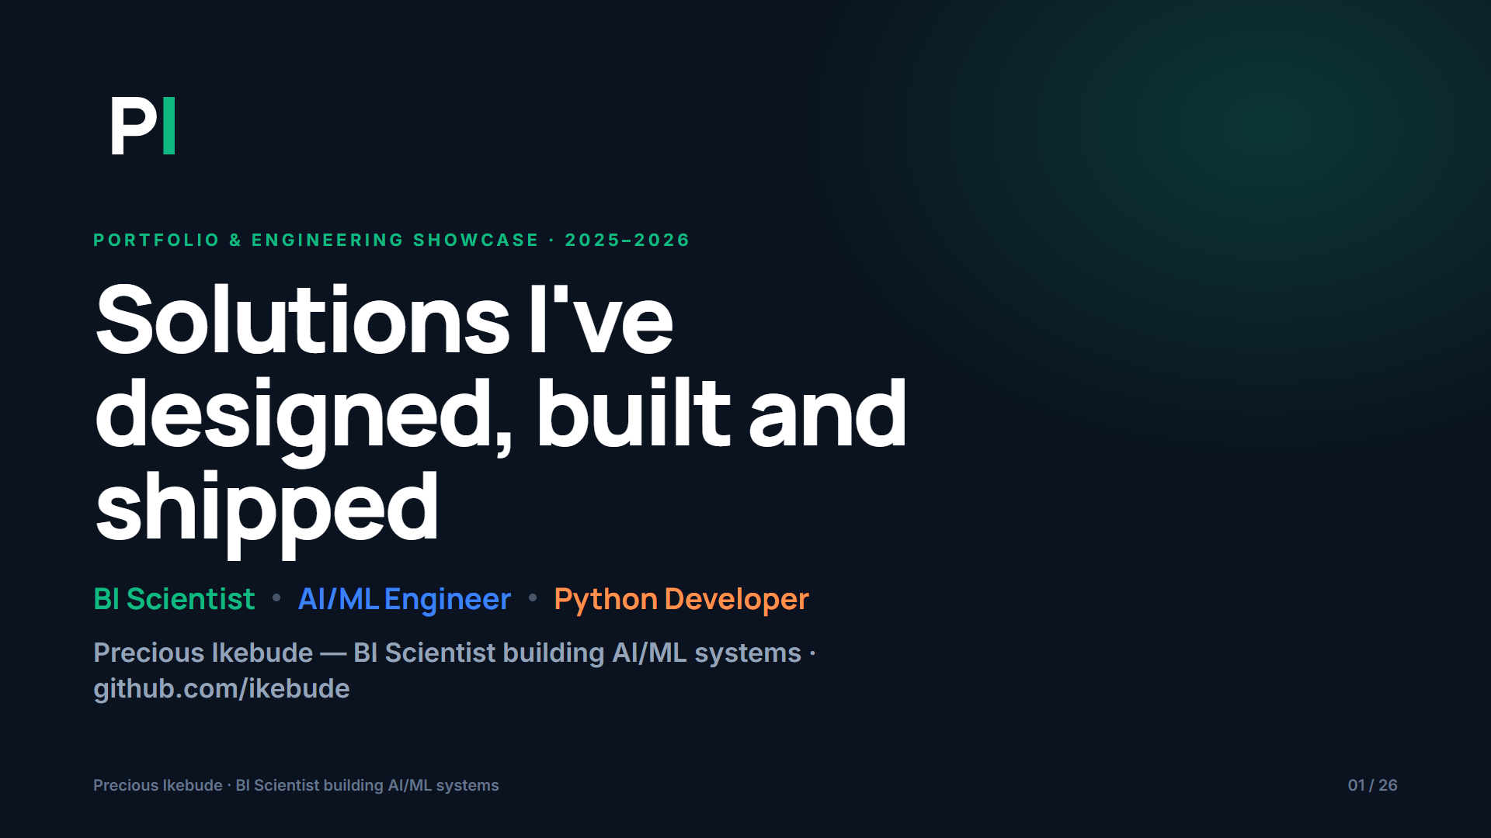
Notes:
Solutions I've designed, built and shipped
Precious Ikebude — BI Scientist building AI/ML systems · github.com/ikebude

Slide 2
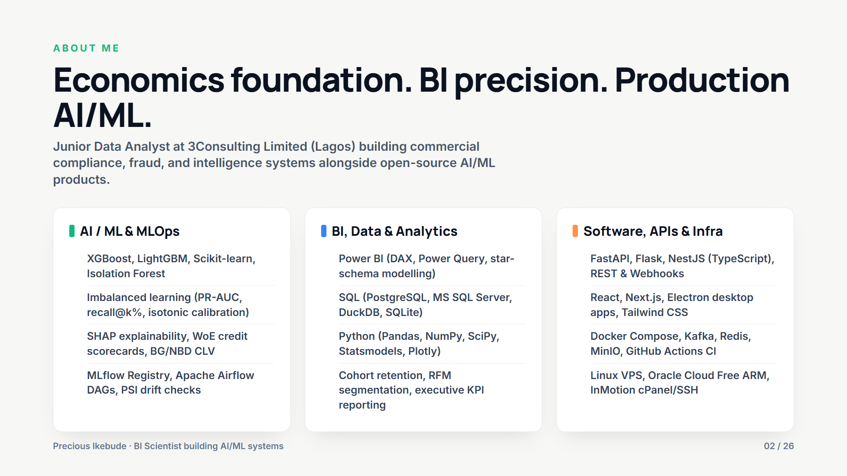
Notes:
Economics foundation. BI precision. Production AI/ML.
Junior Data Analyst at 3Consulting Limited (Lagos) building commercial compliance, fraud, and intelligence systems alongside open-source AI/ML products.
AI / ML & MLOps ():
BI, Data & Analytics ():
Software, APIs & Infra ():

Slide 3
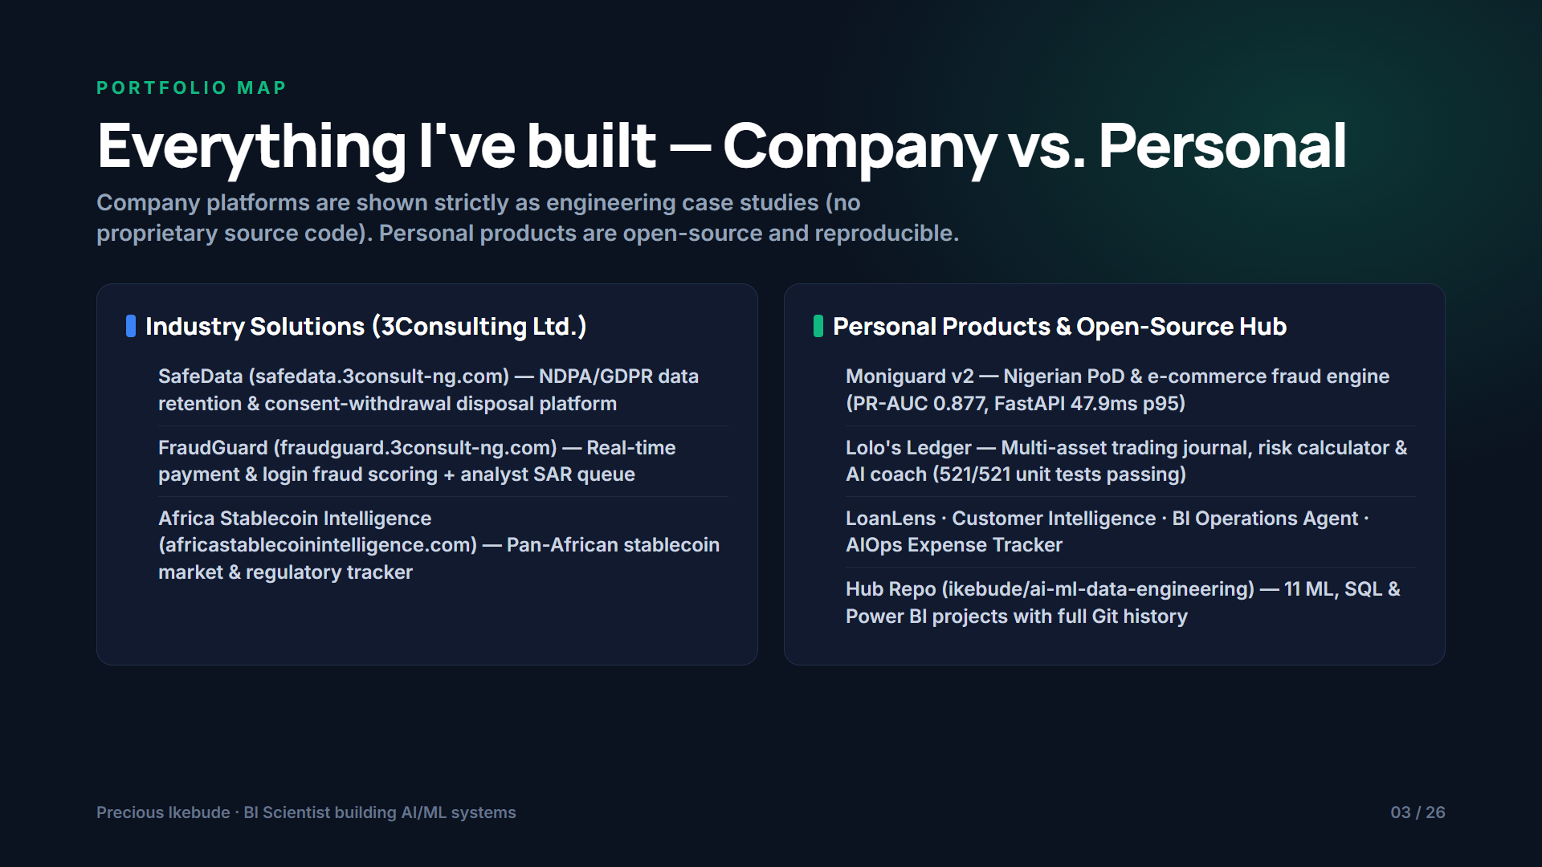
Notes:
Everything I've built — Company vs. Personal
Company platforms are shown strictly as engineering case studies (no proprietary source code). Personal products are open-source and reproducible.
Industry Solutions (3Consulting Ltd.) ():
Personal Products & Open-Source Hub ():

Slide 4
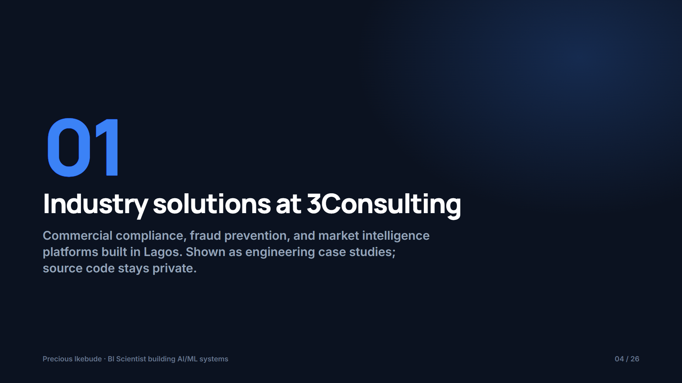
Notes:
Industry solutions at 3Consulting
Commercial compliance, fraud prevention, and market intelligence platforms built in Lagos. Shown as engineering case studies; source code stays private.

Slide 5
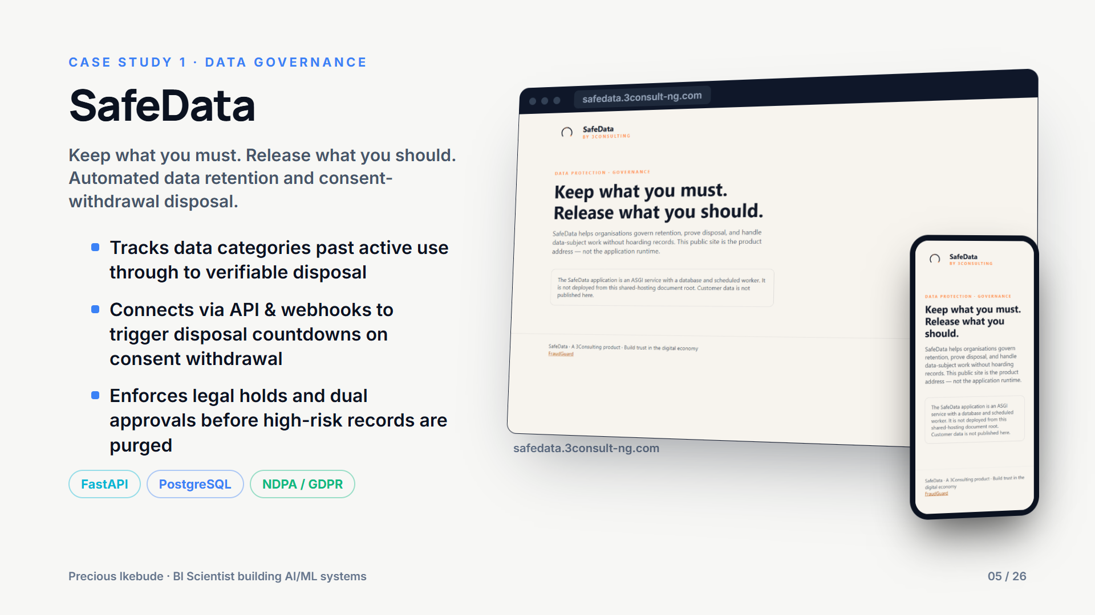
Notes:
SafeData
Keep what you must. Release what you should. Automated data retention and consent-withdrawal disposal.
- Tracks data categories past active use through to verifiable disposal
- Connects via API & webhooks to trigger disposal countdowns on consent withdrawal
- Enforces legal holds and dual approvals before high-risk records are purged

Slide 6
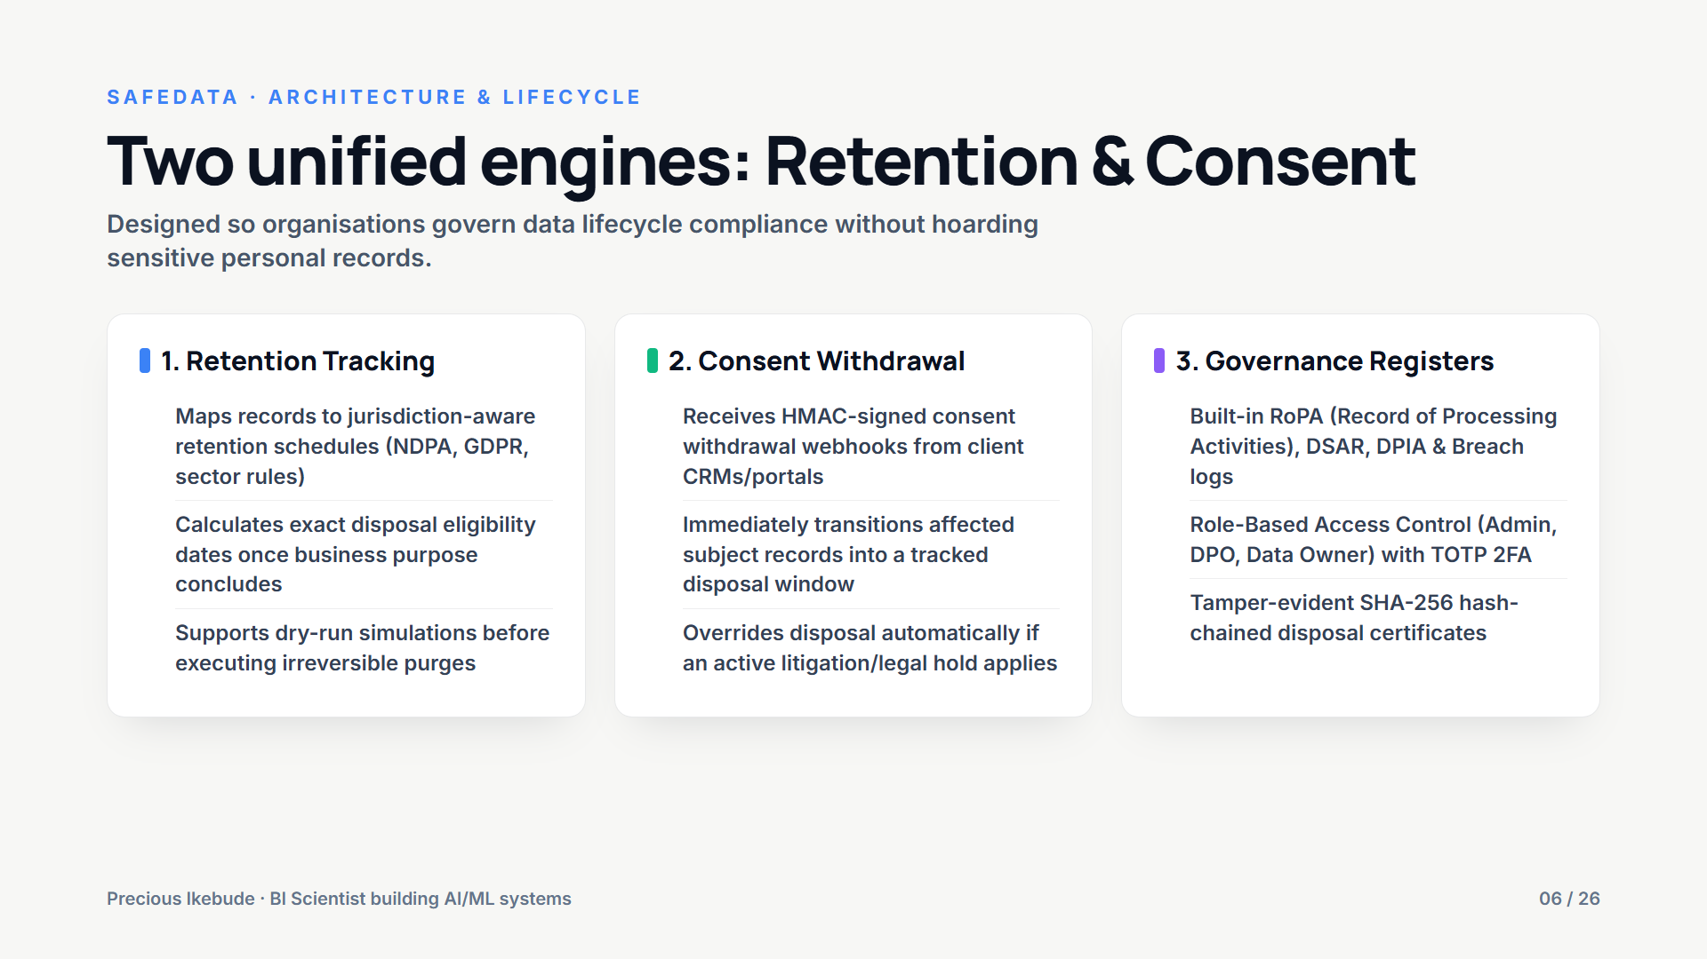
Notes:
Two unified engines: Retention & Consent
Designed so organisations govern data lifecycle compliance without hoarding sensitive personal records.
1. Retention Tracking ():
2. Consent Withdrawal ():
3. Governance Registers ():

Slide 7
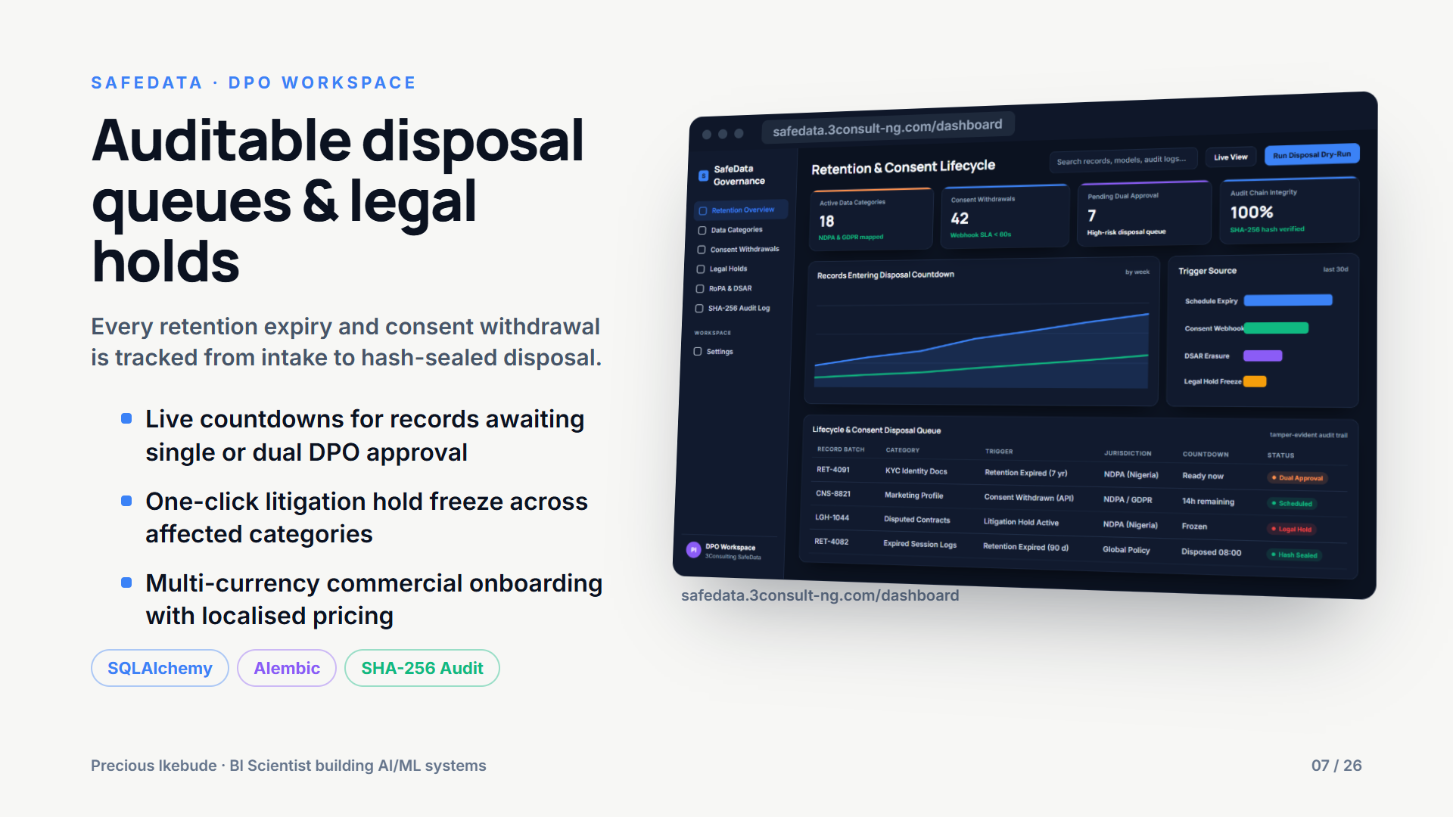
Notes:
Auditable disposal queues & legal holds
Every retention expiry and consent withdrawal is tracked from intake to hash-sealed disposal.
- Live countdowns for records awaiting single or dual DPO approval
- One-click litigation hold freeze across affected categories
- Multi-currency commercial onboarding with localised pricing

Slide 8
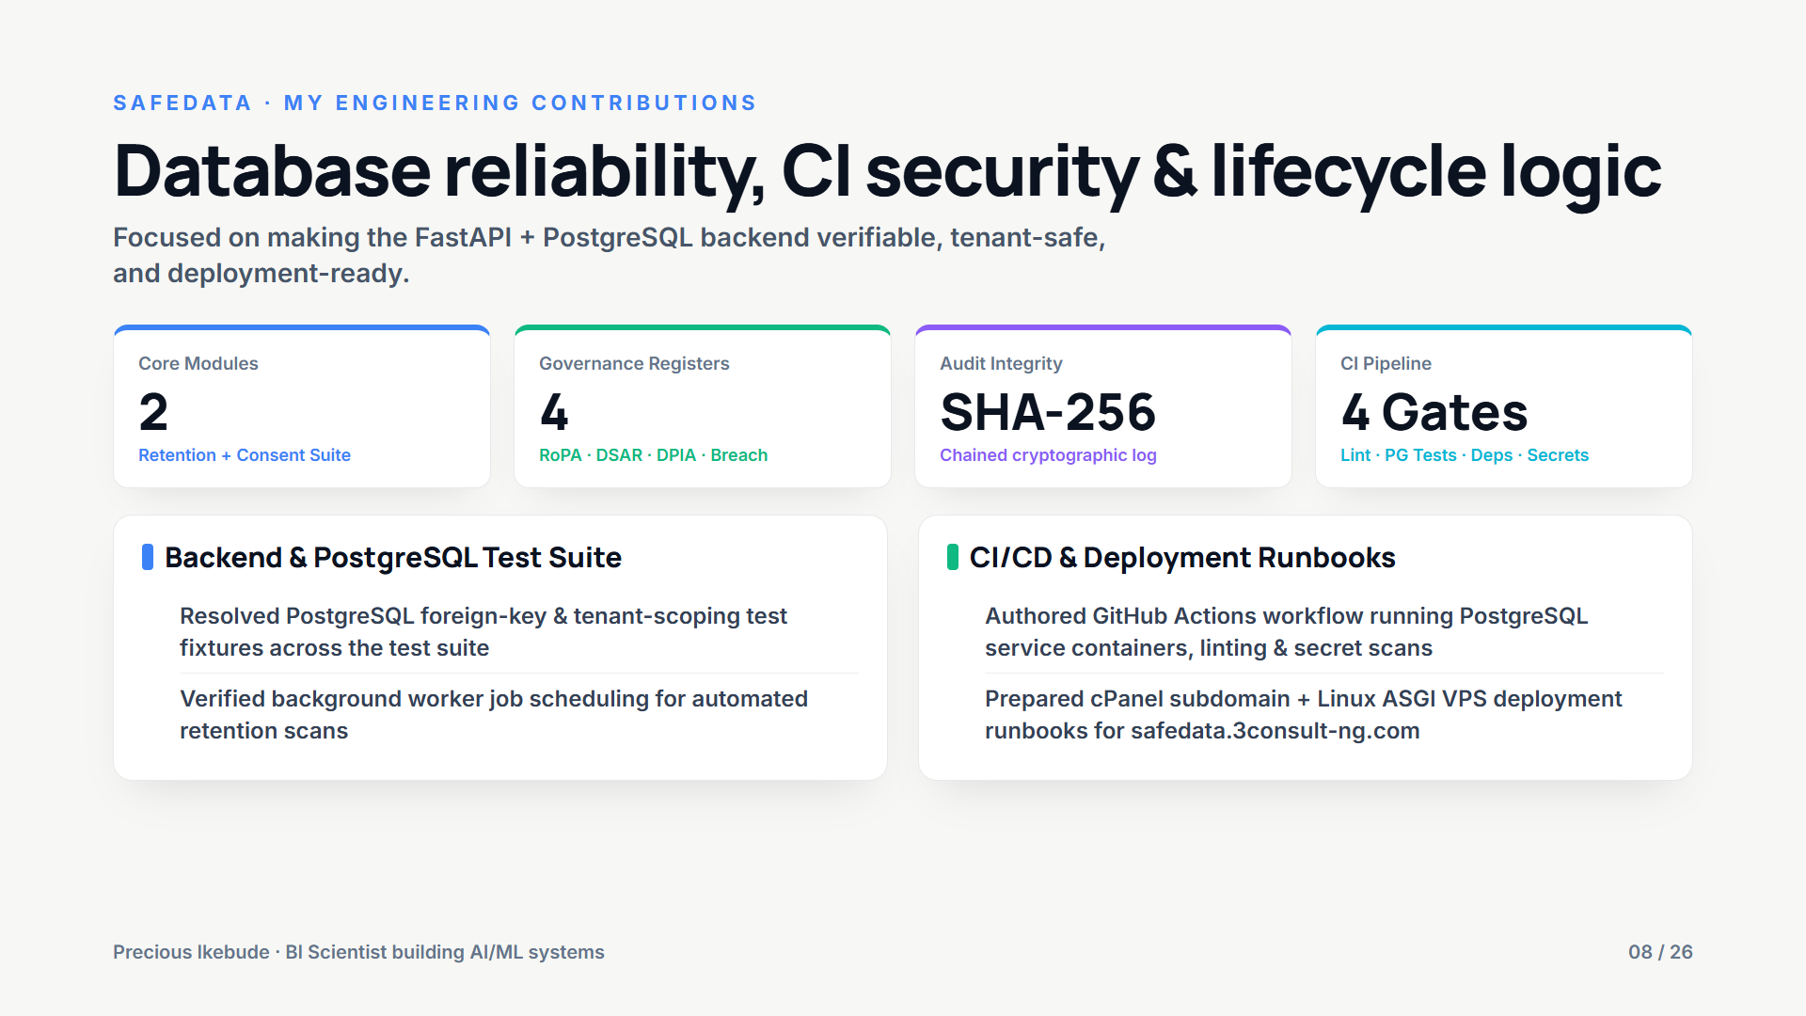
Notes:
Database reliability, CI security & lifecycle logic
Focused on making the FastAPI + PostgreSQL backend verifiable, tenant-safe, and deployment-ready.
Backend & PostgreSQL Test Suite ():
CI/CD & Deployment Runbooks ():

Slide 9
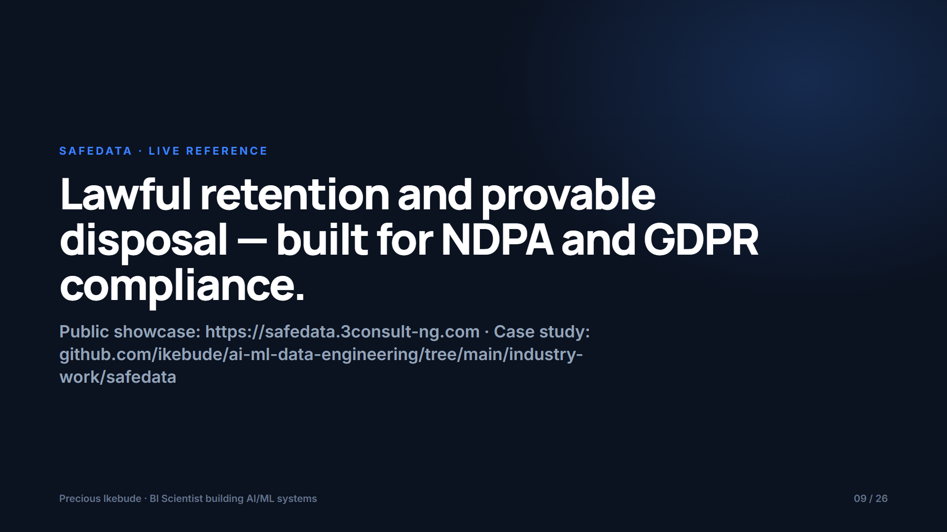
Notes:
Lawful retention and provable disposal — built for NDPA and GDPR compliance.
Public showcase: https://safedata.3consult-ng.com · Case study: github.com/ikebude/ai-ml-data-engineering/tree/main/industry-work/safedata

Slide 10
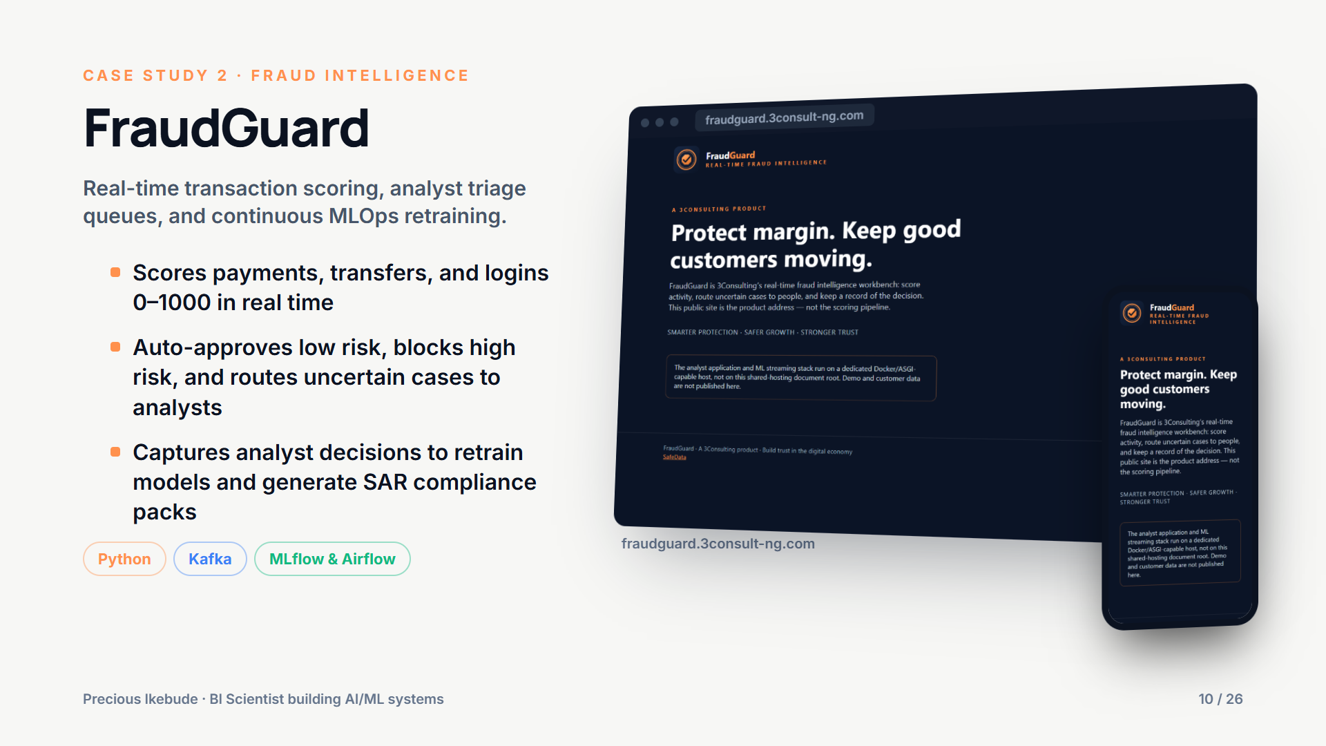
Notes:
FraudGuard
Real-time transaction scoring, analyst triage queues, and continuous MLOps retraining.
- Scores payments, transfers, and logins 0–1000 in real time
- Auto-approves low risk, blocks high risk, and routes uncertain cases to analysts
- Captures analyst decisions to retrain models and generate SAR compliance packs

Slide 11
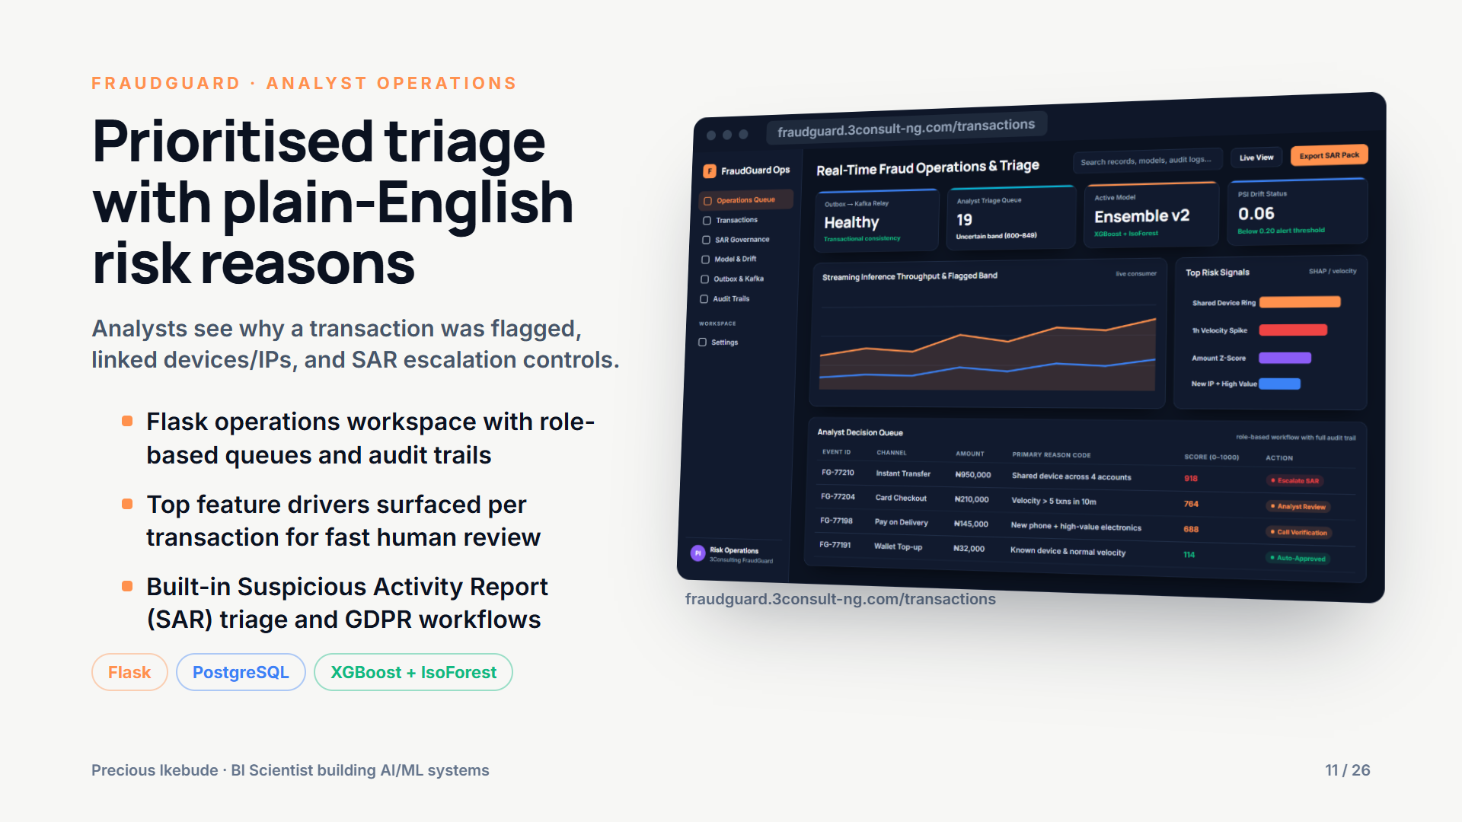
Notes:
Prioritised triage with plain-English risk reasons
Analysts see why a transaction was flagged, linked devices/IPs, and SAR escalation controls.
- Flask operations workspace with role-based queues and audit trails
- Top feature drivers surfaced per transaction for fast human review
- Built-in Suspicious Activity Report (SAR) triage and GDPR workflows

Slide 12
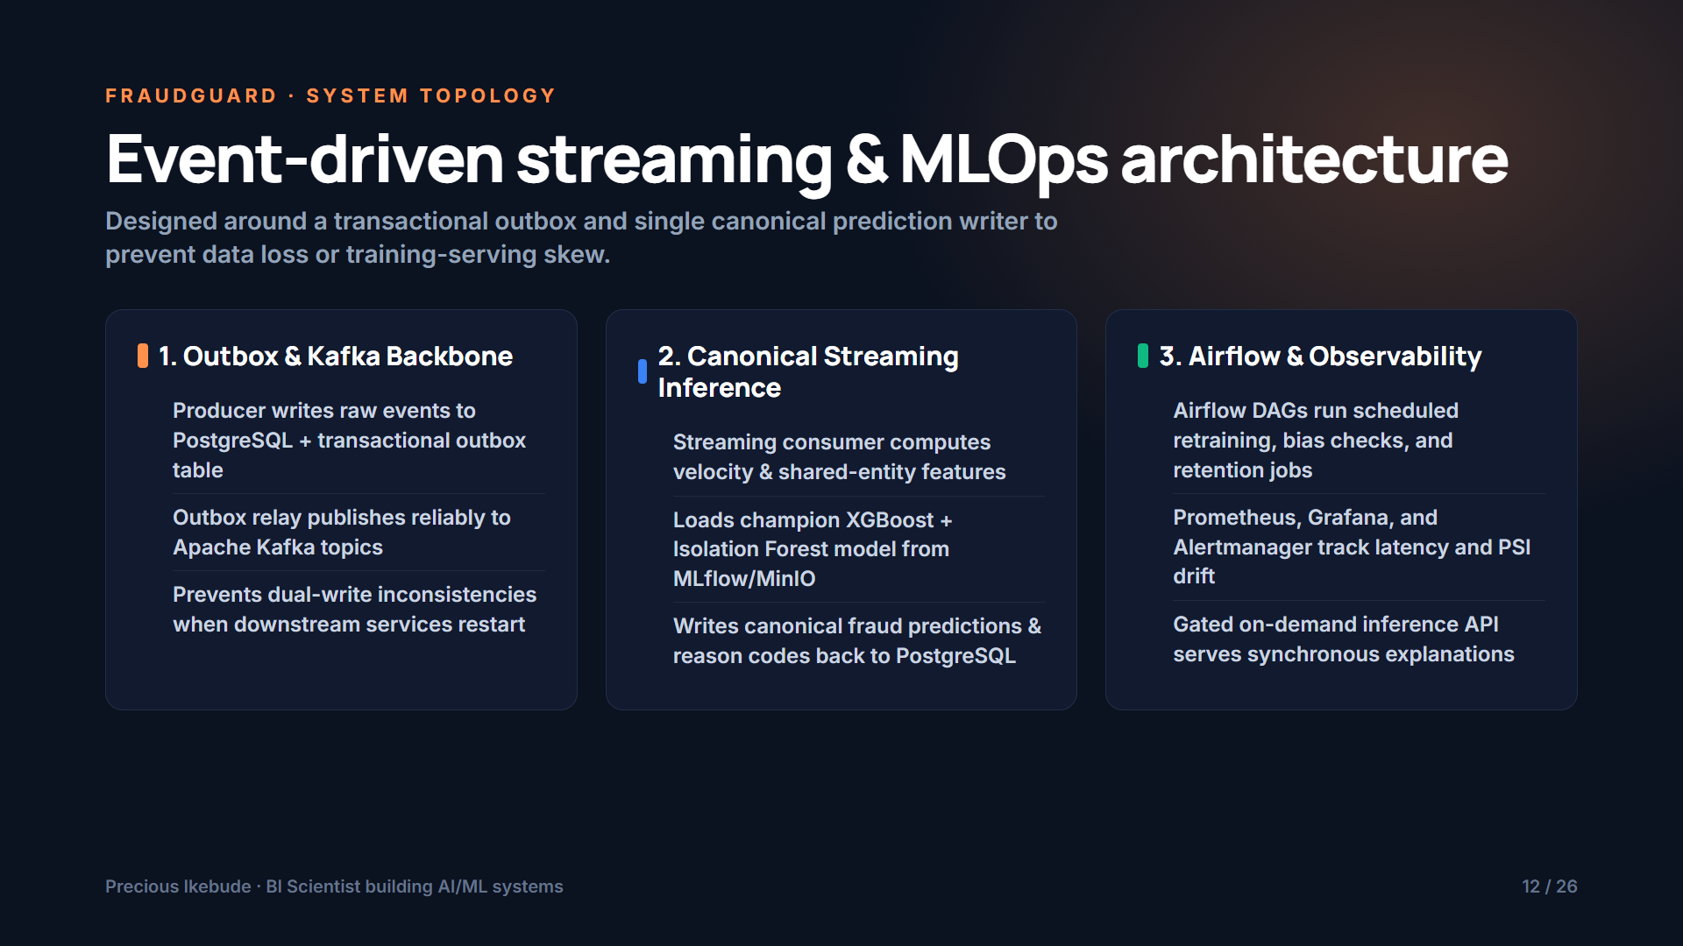
Notes:
Event-driven streaming & MLOps architecture
Designed around a transactional outbox and single canonical prediction writer to prevent data loss or training-serving skew.
1. Outbox & Kafka Backbone ():
2. Canonical Streaming Inference ():
3. Airflow & Observability ():

Slide 13
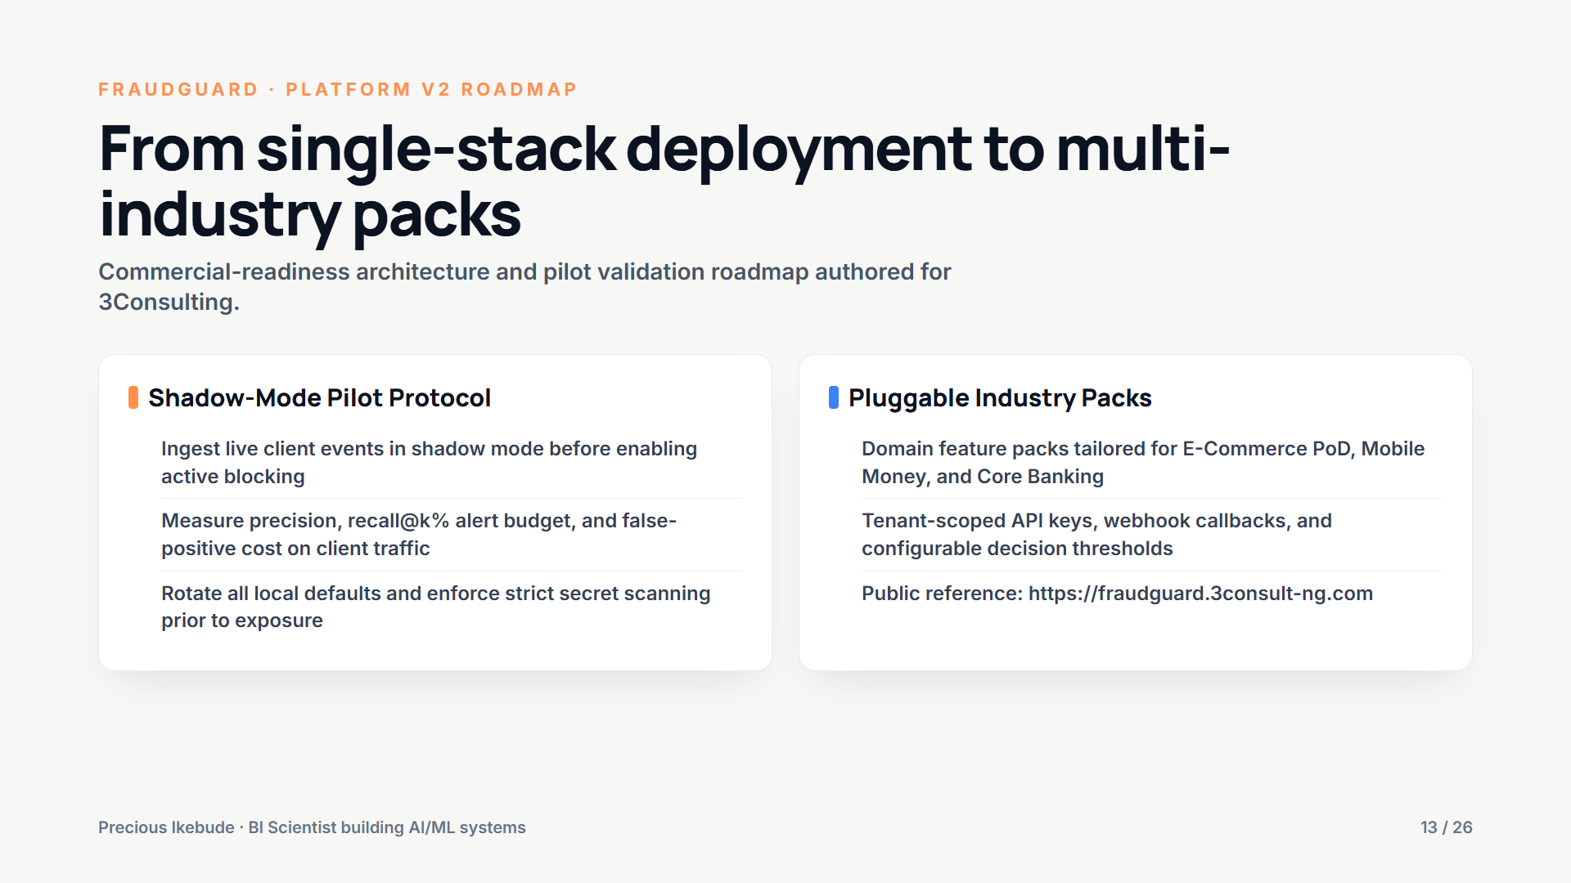
Notes:
From single-stack deployment to multi-industry packs
Commercial-readiness architecture and pilot validation roadmap authored for 3Consulting.
Shadow-Mode Pilot Protocol ():
Pluggable Industry Packs ():

Slide 14
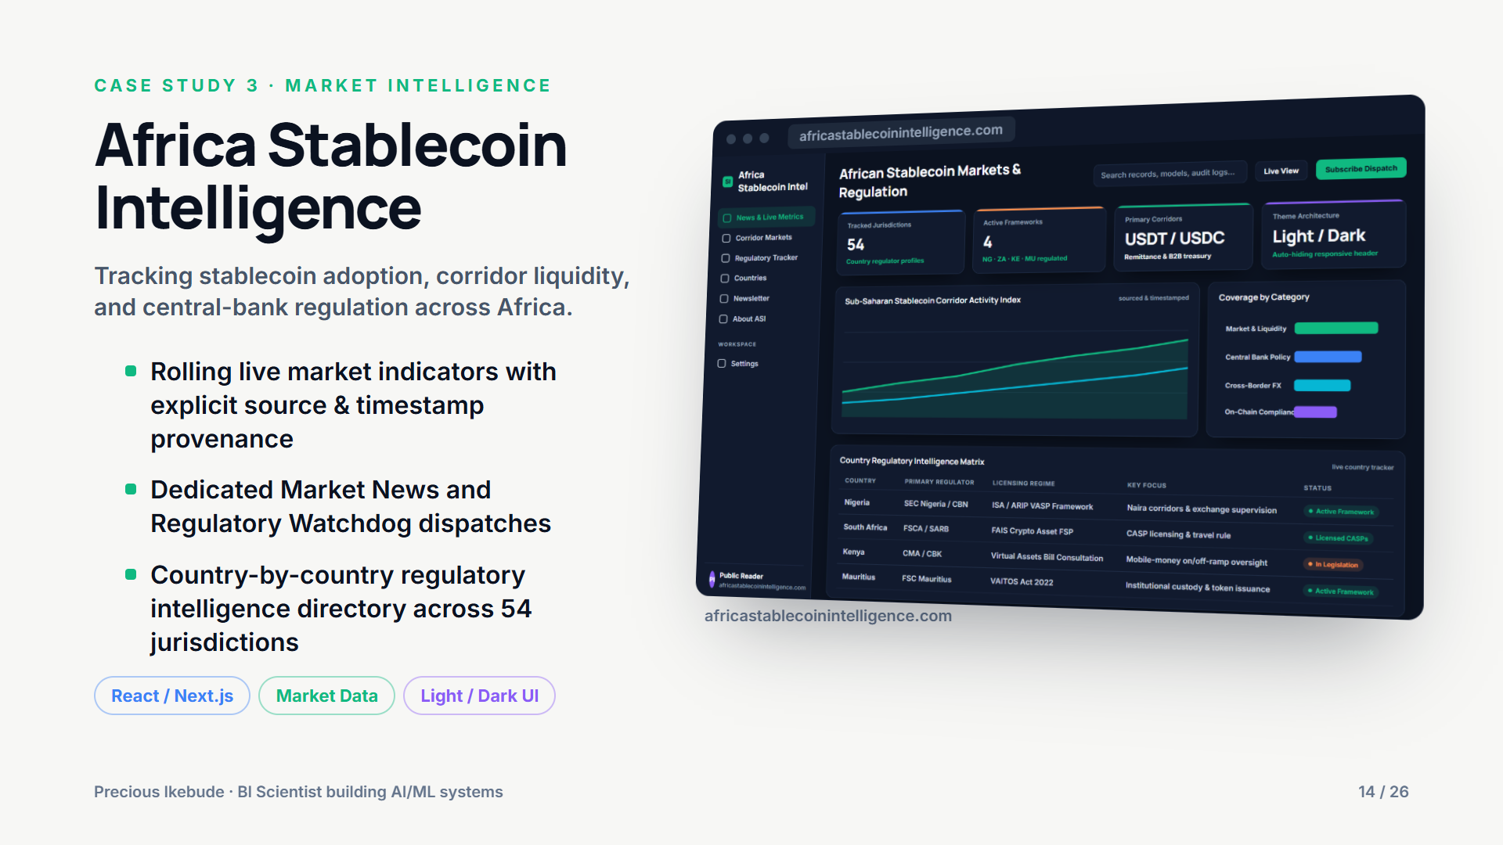
Notes:
Africa Stablecoin Intelligence
Tracking stablecoin adoption, corridor liquidity, and central-bank regulation across Africa.
- Rolling live market indicators with explicit source & timestamp provenance
- Dedicated Market News and Regulatory Watchdog dispatches
- Country-by-country regulatory intelligence directory across 54 jurisdictions

Slide 15
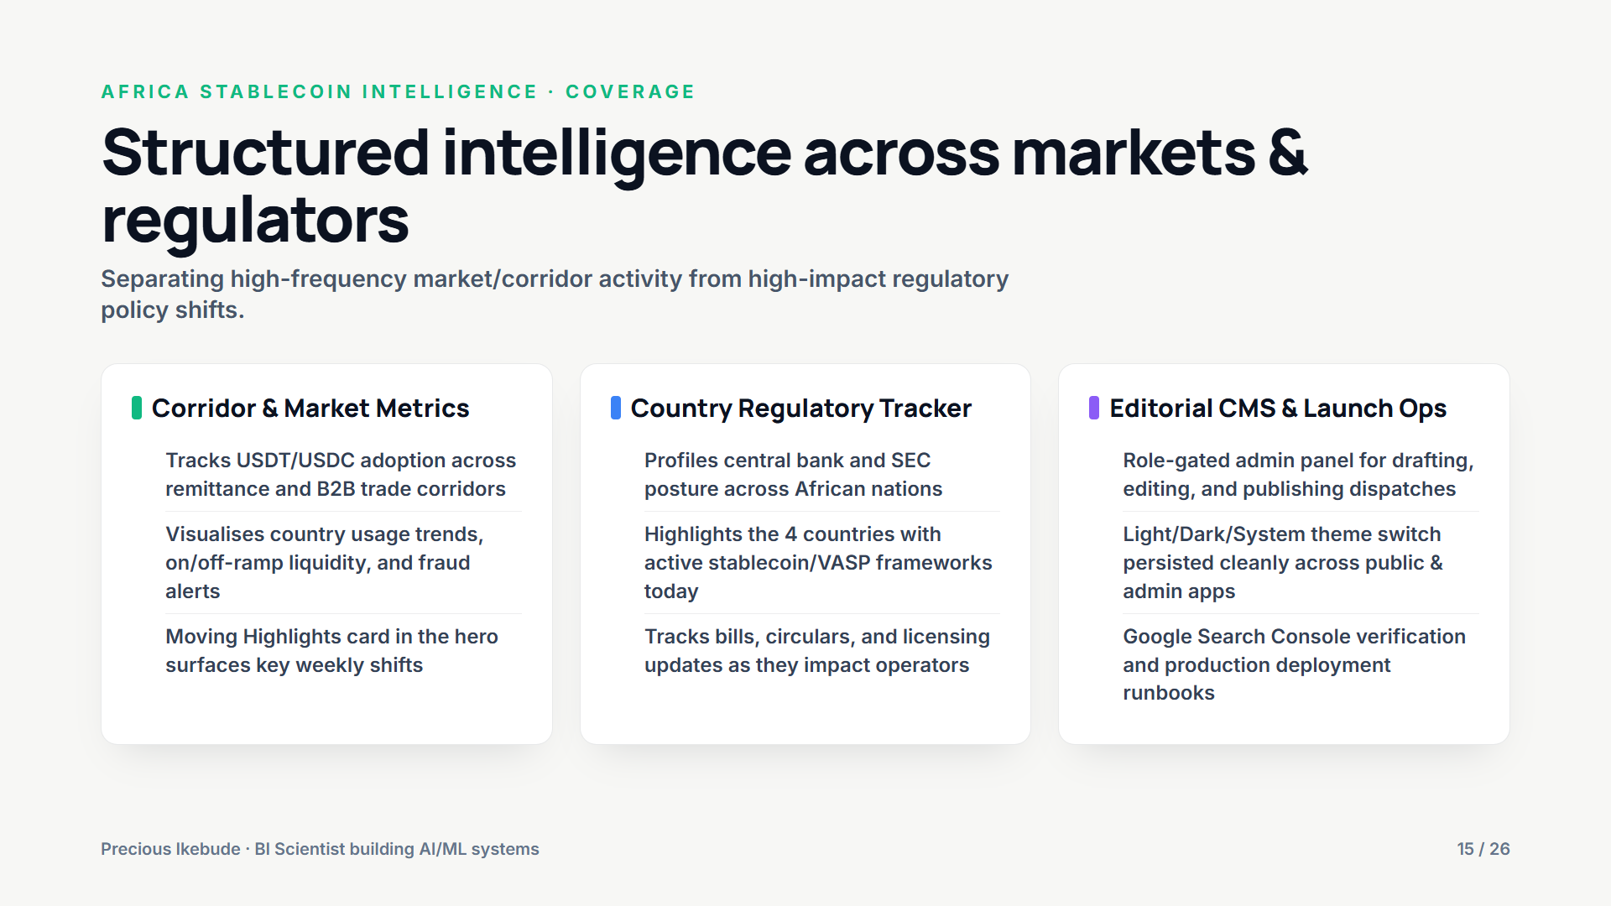
Notes:
Structured intelligence across markets & regulators
Separating high-frequency market/corridor activity from high-impact regulatory policy shifts.
Corridor & Market Metrics ():
Country Regulatory Tracker ():
Editorial CMS & Launch Ops ():

Slide 16
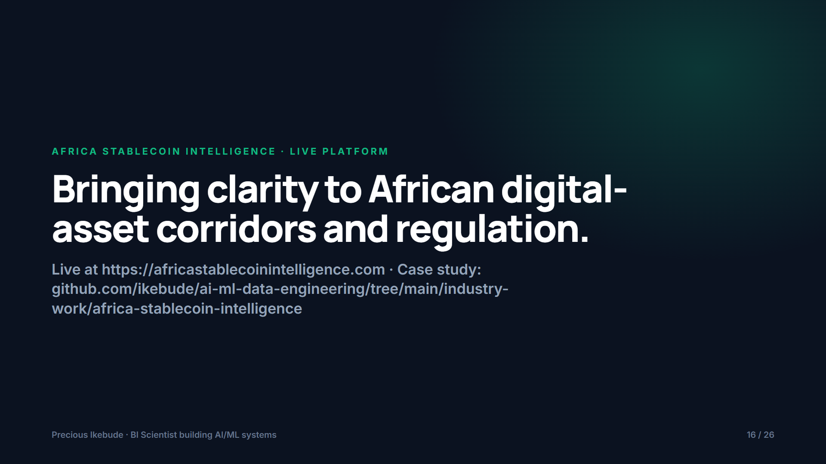
Notes:
Bringing clarity to African digital-asset corridors and regulation.
Live at https://africastablecoinintelligence.com · Case study: github.com/ikebude/ai-ml-data-engineering/tree/main/industry-work/africa-stablecoin-intelligence

Slide 17
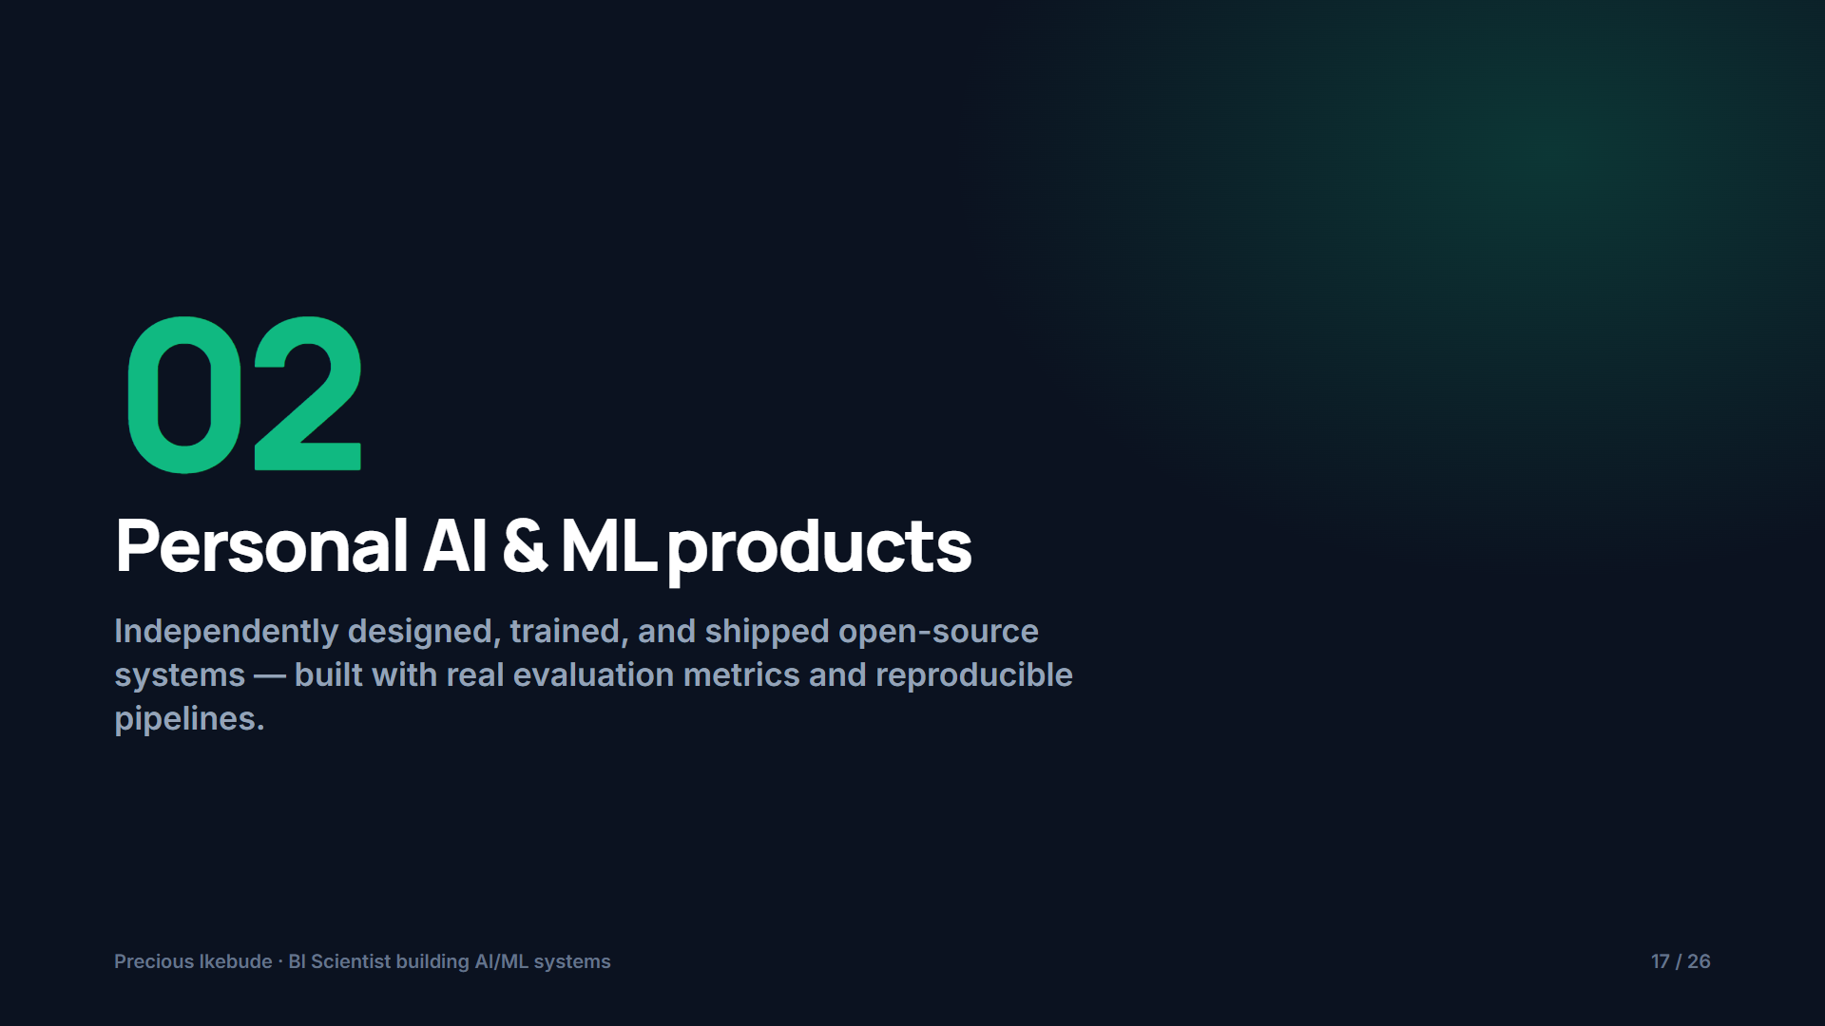
Notes:
Personal AI & ML products
Independently designed, trained, and shipped open-source systems — built with real evaluation metrics and reproducible pipelines.

Slide 18
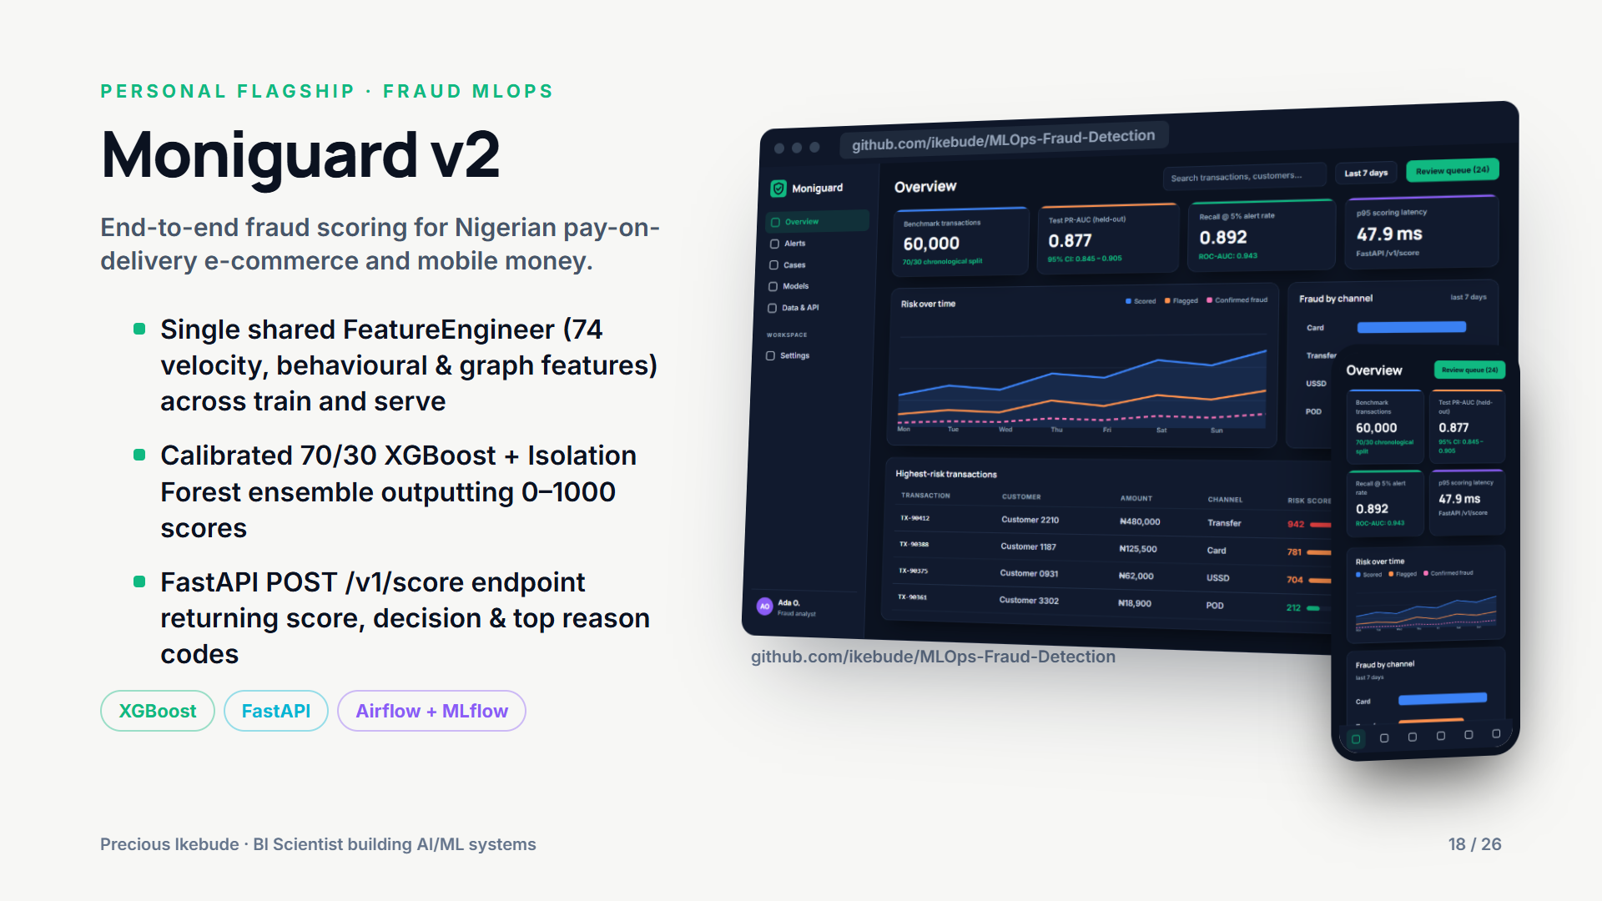
Notes:
Moniguard v2
End-to-end fraud scoring for Nigerian pay-on-delivery e-commerce and mobile money.
- Single shared FeatureEngineer (74 velocity, behavioural & graph features) across train and serve
- Calibrated 70/30 XGBoost + Isolation Forest ensemble outputting 0–1000 scores
- FastAPI POST /v1/score endpoint returning score, decision & top reason codes

Slide 19
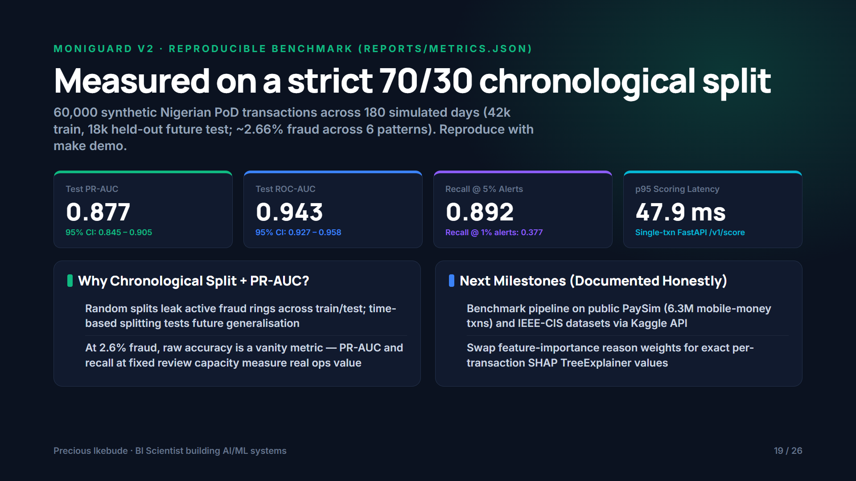
Notes:
Measured on a strict 70/30 chronological split
60,000 synthetic Nigerian PoD transactions across 180 simulated days (42k train, 18k held-out future test; ~2.66% fraud across 6 patterns). Reproduce with make demo.
Why Chronological Split + PR-AUC? ():
Next Milestones (Documented Honestly) ():

Slide 20
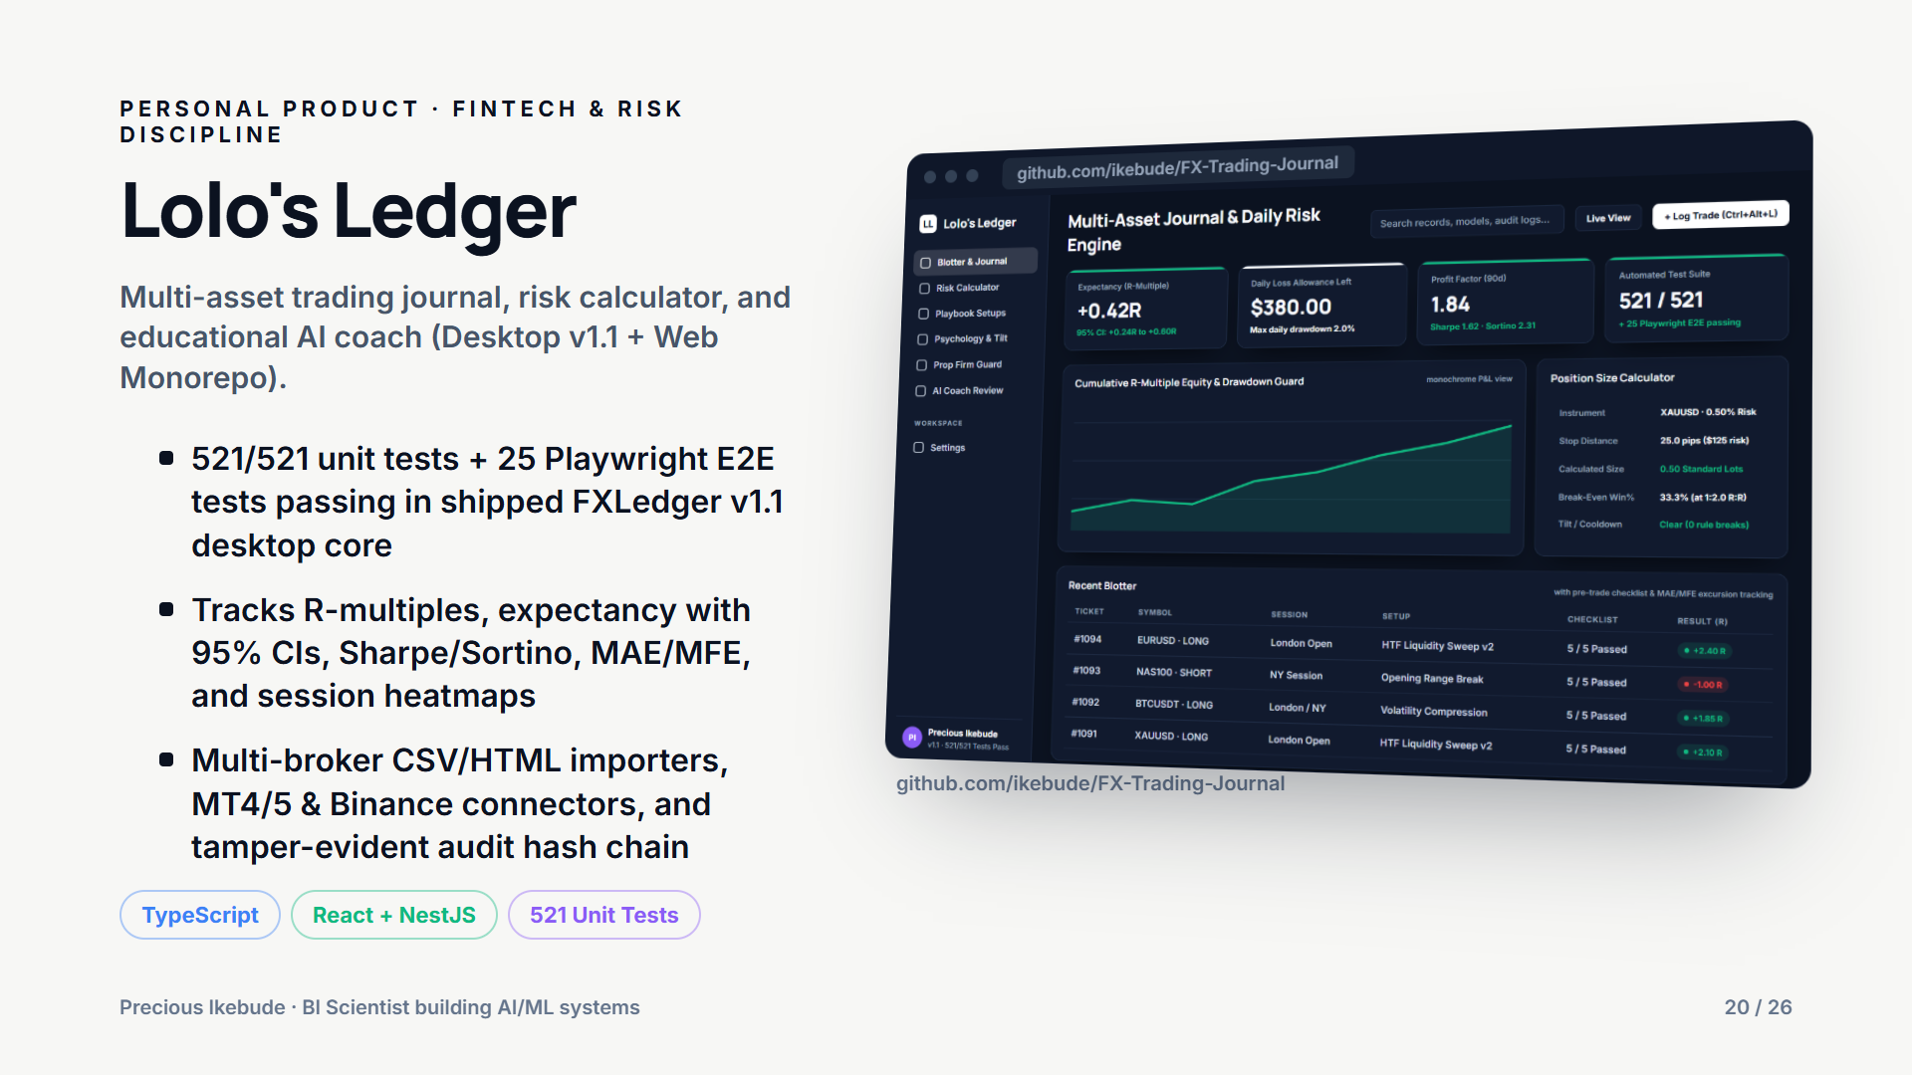
Notes:
Lolo's Ledger
Multi-asset trading journal, risk calculator, and educational AI coach (Desktop v1.1 + Web Monorepo).
- 521/521 unit tests + 25 Playwright E2E tests passing in shipped FXLedger v1.1 desktop core
- Tracks R-multiples, expectancy with 95% CIs, Sharpe/Sortino, MAE/MFE, and session heatmaps
- Multi-broker CSV/HTML importers, MT4/5 & Binance connectors, and tamper-evident audit hash chain

Slide 21
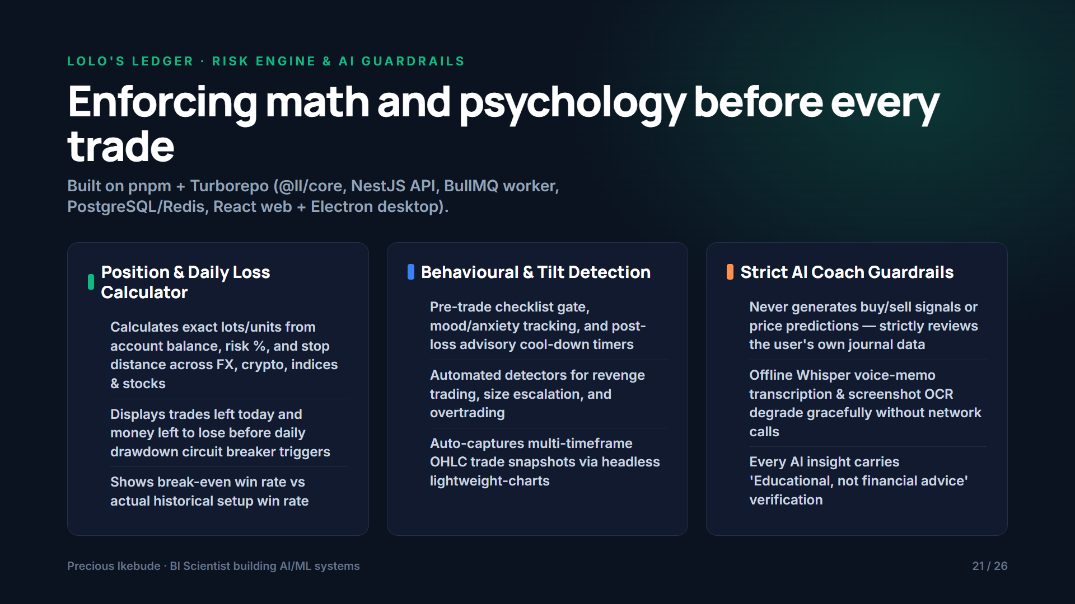
Notes:
Enforcing math and psychology before every trade
Built on pnpm + Turborepo (@ll/core, NestJS API, BullMQ worker, PostgreSQL/Redis, React web + Electron desktop).
Position & Daily Loss Calculator ():
Behavioural & Tilt Detection ():
Strict AI Coach Guardrails ():

Slide 22
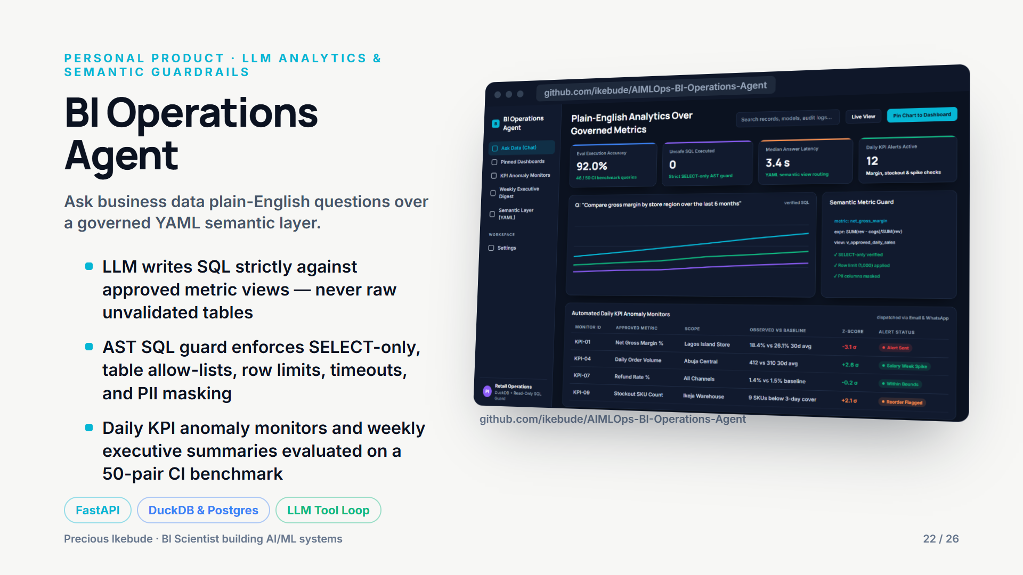
Notes:
BI Operations Agent
Ask business data plain-English questions over a governed YAML semantic layer.
- LLM writes SQL strictly against approved metric views — never raw unvalidated tables
- AST SQL guard enforces SELECT-only, table allow-lists, row limits, timeouts, and PII masking
- Daily KPI anomaly monitors and weekly executive summaries evaluated on a 50-pair CI benchmark

Slide 23
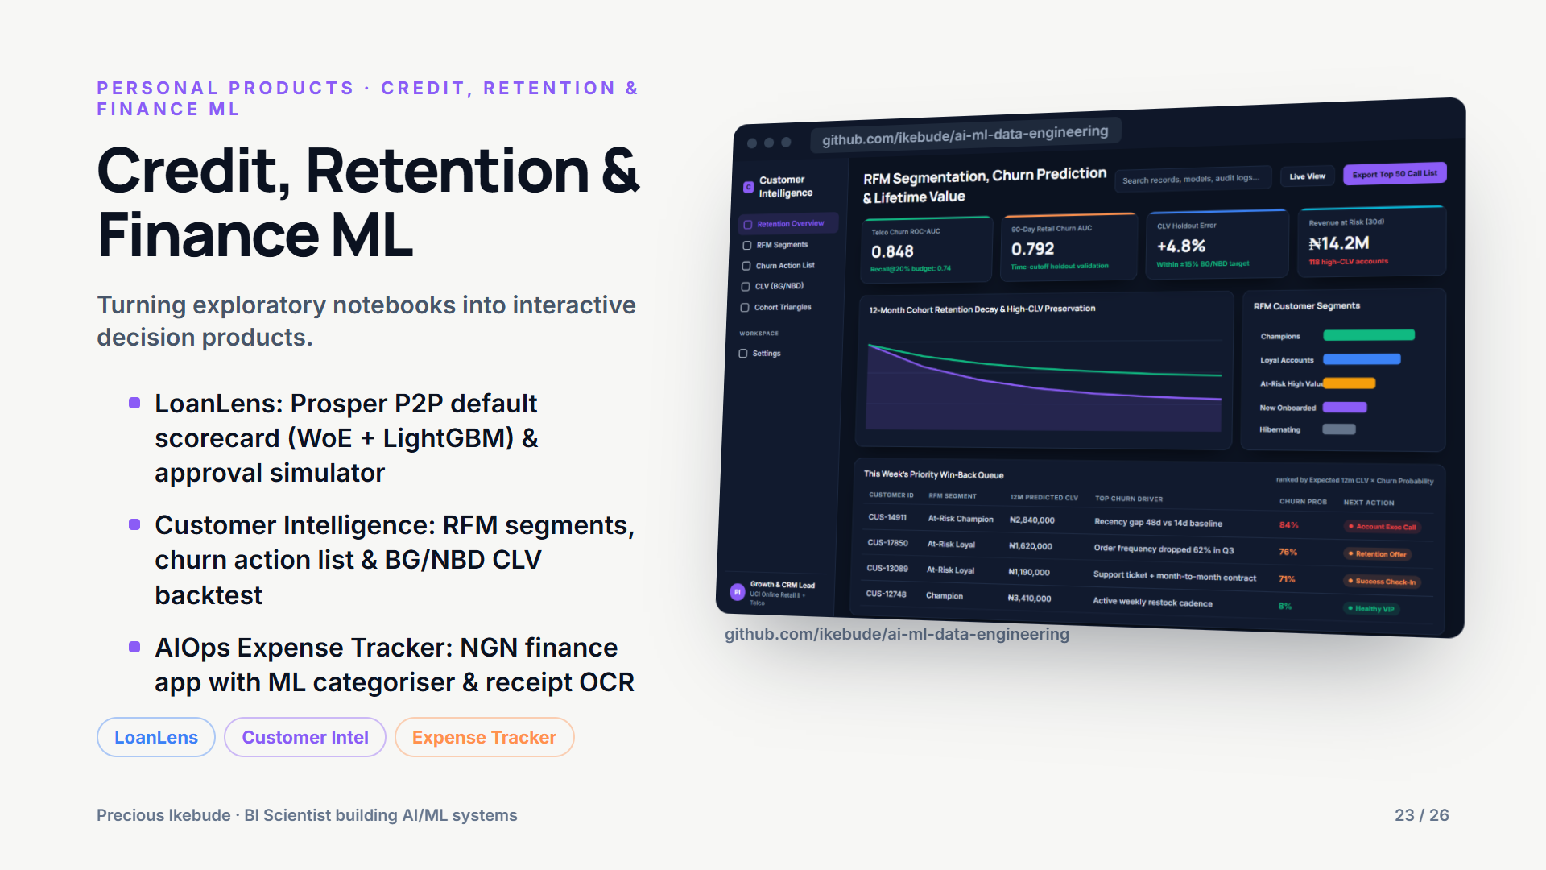
Notes:
Credit, Retention & Finance ML
Turning exploratory notebooks into interactive decision products.
- LoanLens: Prosper P2P default scorecard (WoE + LightGBM) & approval simulator
- Customer Intelligence: RFM segments, churn action list & BG/NBD CLV backtest
- AIOps Expense Tracker: NGN finance app with ML categoriser & receipt OCR

Slide 24
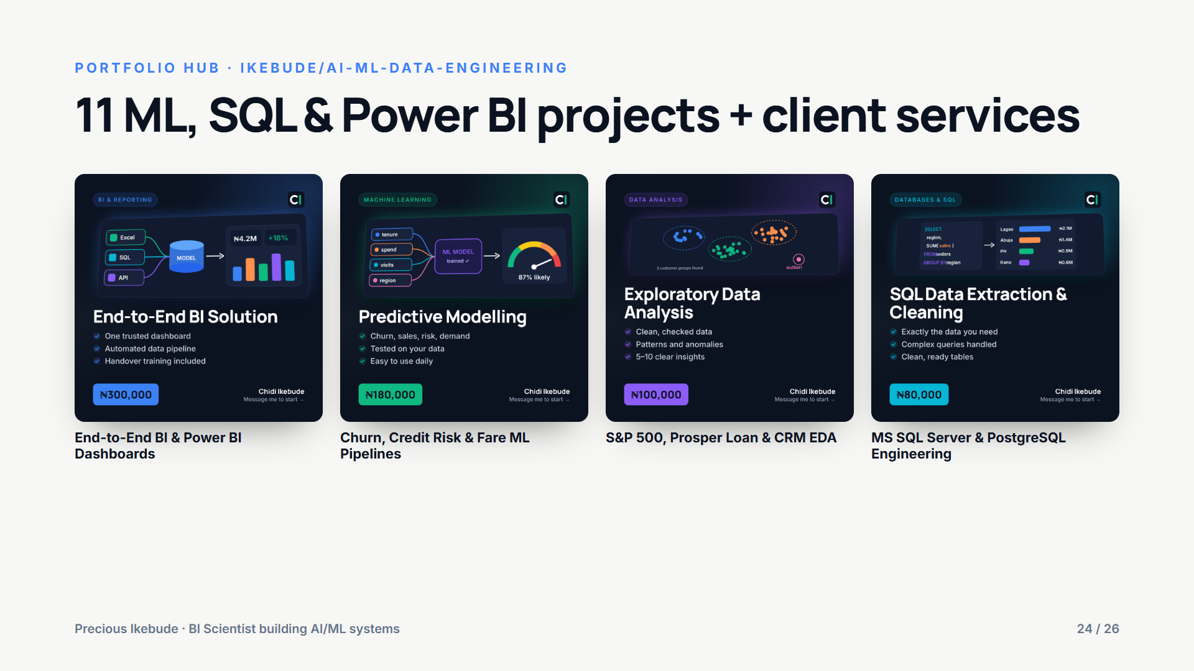
Notes:
11 ML, SQL & Power BI projects + client services

Slide 25
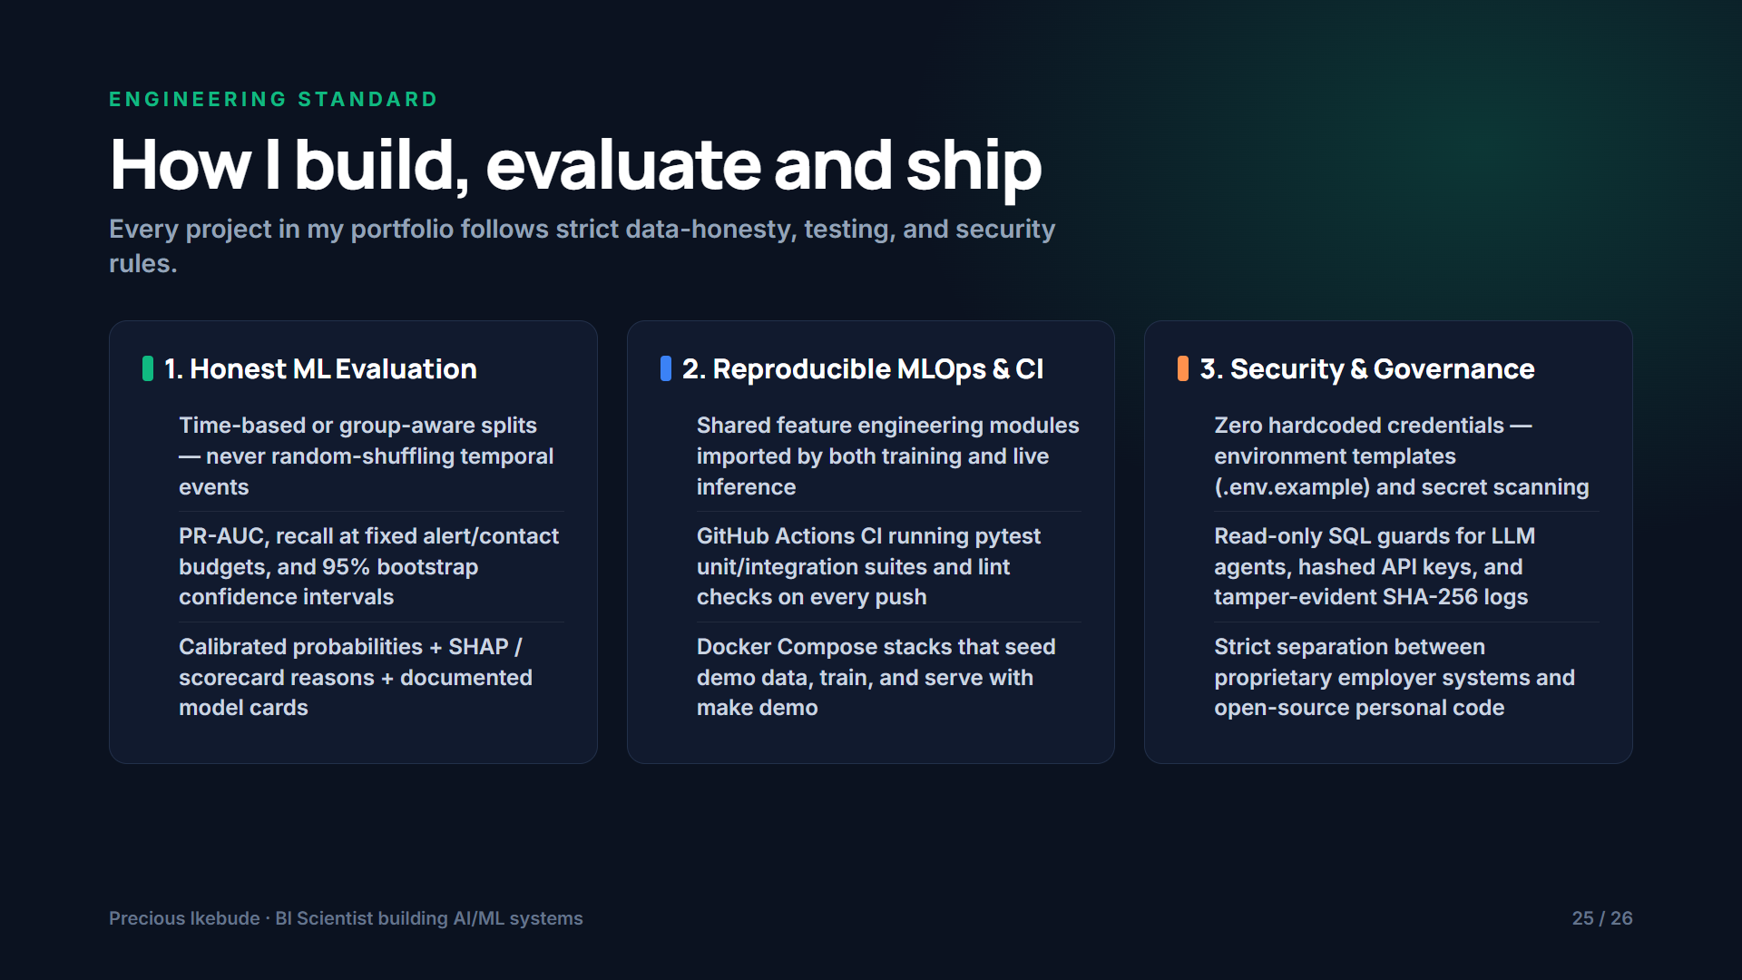
Notes:
How I build, evaluate and ship
Every project in my portfolio follows strict data-honesty, testing, and security rules.
1. Honest ML Evaluation ():
2. Reproducible MLOps & CI ():
3. Security & Governance ():

Slide 26
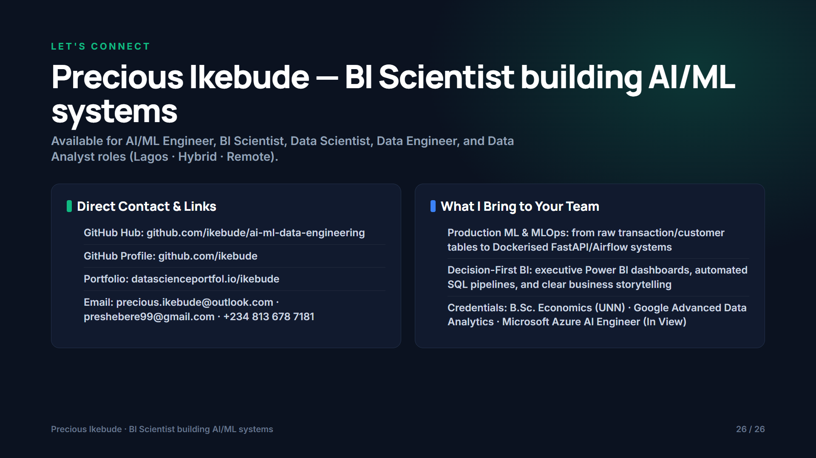
Notes:
Precious Ikebude — BI Scientist building AI/ML systems
Available for AI/ML Engineer, BI Scientist, Data Scientist, Data Engineer, and Data Analyst roles (Lagos · Hybrid · Remote).
Direct Contact & Links ():
What I Bring to Your Team ():

