Slide 1
Atlassian Plugin Development
An Overview

Slide 2
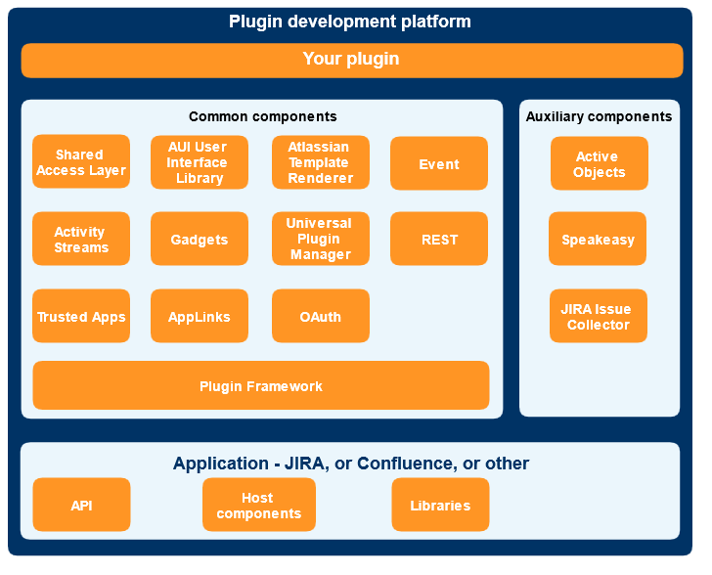
Plugin Architecture

Slide 3

Data Flow
Custom-made Components
Built-in Components
Browser (UI)
REST Module
Gadget
OAuth
JIRA, GH Application
API
JIRA DB
Notes:
To emphasize on the data-flow aspects, an over-simplified representation of the architecture is shown here.

Slide 4
Implementation Steps
Develop REST Module to serve data (Java classes implement the data collection logic)
1
Develop the Gadget Specifications (Gadget XML defines the gadget’s UI)
2
Package REST Module & Gadget as a plugin (Atlassian-plugin.xml – to package the REST Module and Gadget Spec that make a plugin)
3

Slide 5
Hands-On / Demo

Slide 6
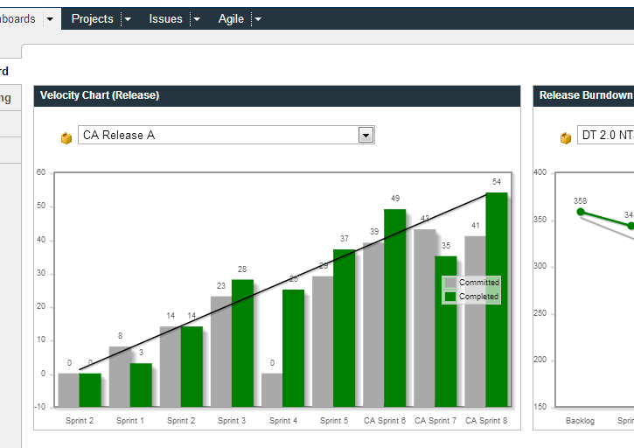
Sample Gadget

