Slide 1
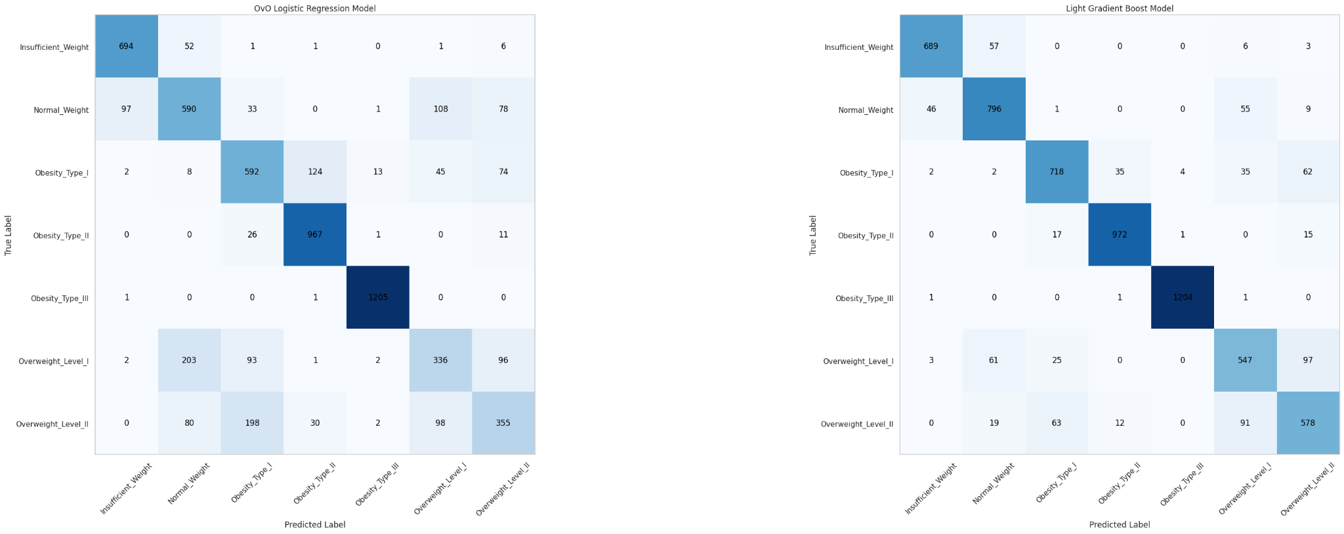
OBESITY MULTI-CLASS RISK PREDICTION
Project Overview
The project aimed to develop a multiclass prediction model for obesity risk using a dataset containing information on individuals from Mexico, Peru, and Colombia. The dataset included various attributes related to eating habits, physical condition, and demographic factors. The goal was to create a model that could accurately predict the level of obesity based on these attributes.
The dataset contained a mix of numerical and categorical data, with a total of 17 attributes and 2111 records.
The target variable was multiclass, with six different levels of obesity.
The data was preprocessed to handle missing values, duplicates, and outliers, particularly focusing on the 'Age' column to manage outliers.
Exploratory Data Analysis (EDA) revealed that the most common class of obesity was Obesity Type III, with a significant percentage of the population having a positive history of overweight in family members.
Feature engineering was applied to create a new variable, BMI, which was found to be a significant predictor in the model.
The Light Gradient Boost Model was identified as the champion model, achieving an accuracy of 88% on the validation set.
Deploy the model as a web service or integrate it into an existing healthcare application.
Set up monitoring systems to track the model's performance over time.
Collaborate with healthcare professionals to understand the practical implications of the model's predictions.
Conduct ongoing research and development to refine the model and explore new techniques.
Ensure ethical considerations are met, particularly in terms of privacy and fairness.

