Slide 1
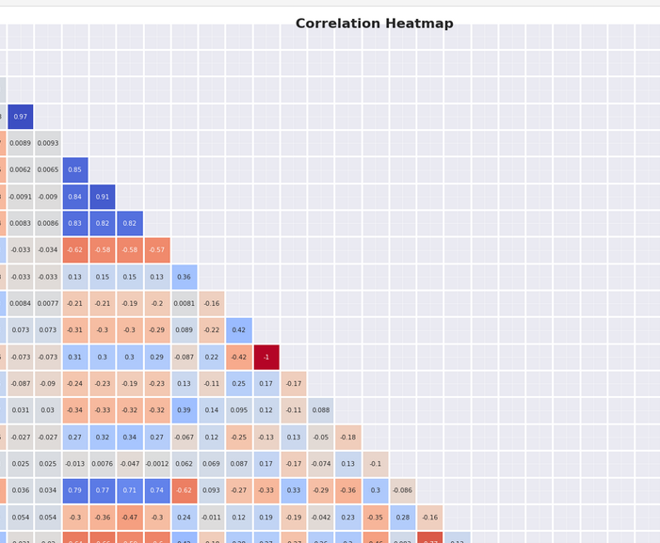
STEEL DEFECT PREDICTION
The project aims to develop a predictive model for detecting faults in steel plates using machine learning techniques. The dataset consists of various features related to steel plate defects, and the objective is to build a robust classification model capable of accurately identifying different types of faults.
The project has progressed through two main stages: data exploration and feature engineering. In the data exploration phase, descriptive statistics and visualizations were utilized to gain insights into the dataset's structure and characteristics. This phase provided valuable insights into the distribution of features and the prevalence of different fault types. Subsequently, in the feature engineering phase, various techniques such as mutual information analysis, principal component analysis (PCA), reduce dimensionality, and enhance model performance.
The initial data exploration revealed significant variations in feature distributions across different fault types, highlighting the complexity of the classification task.
Mutual information analysis identified key features with high relevance to fault detection, such as 'Outside_X_Index' and 'LogOfAreas', among others.
PCA was utilized to reduce the dimensionality of the dataset while preserving relevant information. The resulting principal components provided insights into the underlying structure of the data, enabling better understanding of feature relationships.
Deployment and Monitoring: Once a satisfactory model is developed, deployment to production environments will be considered, followed by ongoing monitoring and maintenance to ensure continued effectiveness.

