Slide 1
INSIGHT INTO SUBMISSIONS ON THE SPREADSHEET (METADATA)
Arrival: There is limited data to show trends over the calendar year
Sex
Level
Seen by a consultant in 5 minutes: All level 1 plus patients who didn’t go through ED are n/a
Admitting service
Operations
Critical care
GCS
CFS: All patients <65 are n/a
Outcome

Slide 2
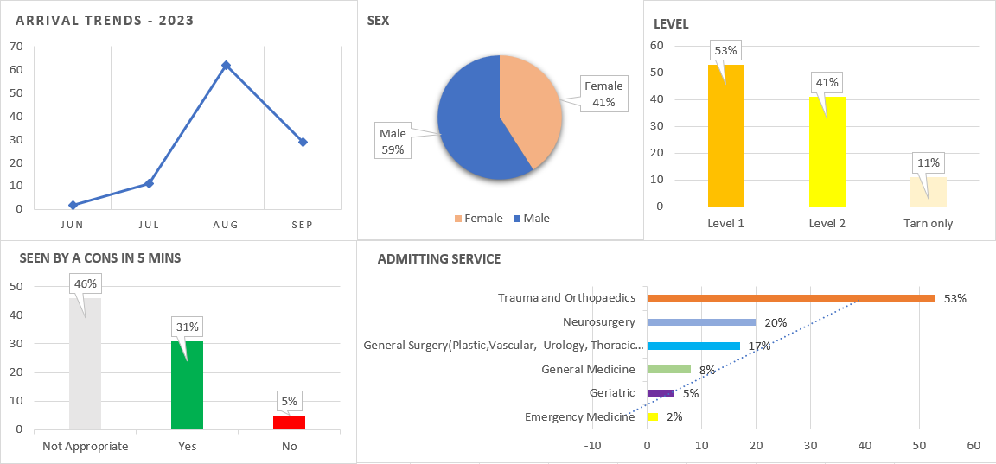

Slide 3
