Slide 1
Hypothesis Testing

Slide 2
Hypothesis Testing
Greensboro has significantly lower crime rates as compared to the national average.
Code peer review improves students’ programming abilities.
Drug A improves students’ ability to not fall asleep during class.

Slide 3
Hypothesis Testing
Null Hypothesis (H₀)
Alternative Hypothesis (H₁)

Slide 4
Null Hypothesis: H₀
The null hypothesis : value of a parameter is equal to some claimed value.
We test the null hypothesis directly.
Either reject H₀ or fail to reject H₀.
Notes:
Emphasize “equal to”.

Slide 5
Alternative Hypothesis: H₁
The alternative hypothesis : parameter that somehow differs from the null hypothesis.
The symbolic form of the alternative hypothesis must use one of these symbols: ≠, <, >.
Notes:
Give examples of different ways to word “not equal to,” < and >, such as ‘is different from’, ‘fewer than’, ‘more than’, etc.

Slide 6
Hypothesis testing
Formulate
hypotheses
Collect data to test null hypothesis
Accept null hypothesis
Reject null hypothesis

Slide 7
Null and alternate hypothesis
Null Hypothesis (H₀)
The difference is caused by random chance.
Alternate hypothesis (H₁)
“The difference is real”.
(H₁) always contradicts the H_{0.}
One (and only one) of these explanations must be true.

Slide 8
Forming Your Own Hypotheses
If you are conducting a study and want to use a hypothesis test to support your claim, the claim must be worded so that it becomes the alternative hypothesis.
Notes:
By examining the flowchart for the Wording of the Final Conclusion, Figure 8-7, page 397 of Elementary Statistics, 10th Edition, this requirement for support of a statement becomes clear.

Slide 9
Example - Efficacy Test for New drug
Drug company has new drug
FDA tells company that they must demonstrate that new drug is better than current treatment.
Firm runs clinical trial where some patients receive new drug, and others receive standard treatment
Numeric response of therapeutic effect is obtained (higher scores are better).

Slide 10
One sample vs. two sample tests
Crimes in Greensboro
100
23
34
5
67
89
34
33
20
Old drug- Cholesterol level
54
23
34
32
45
55
34
33
20
33
New drug- Cholesterol level
45
33
22
10
8
7
6
5
41
22
National average: 78

Slide 11
Two-tailed vs. One-tailed Tests
Two-tailed test: “is there a significant difference?”
One-tailed tests: “is the sample mean greater than P_{u}?”
“is the sample mean less than P_{u}?”

Slide 12
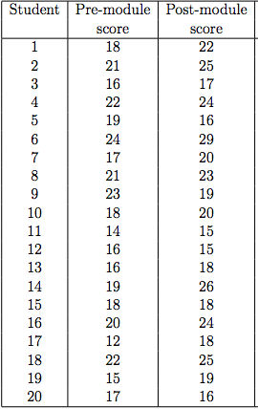
Paired vs. Unpaired tests

Slide 13
Conclusions in Hypothesis Testing
We always test the null hypothesis.
1. Reject the null hypothesis.
2. Fail to reject the null hypothesis.
Notes:
page 394 of Elementary Statistics, 10th Edition

Slide 14
p-Value
p-value is the probability of obtaining the observed sample results by chance.
The null hypothesis is rejected if the p-value is very small, such as 0.05 or less.

Slide 15
T-test
One or two samples.
Test the null hypothesis that the mean of the sample is equal to a given mean.
Test the null hypothesis that the means of the two samples are equal.

Slide 16
T-test in Python
scipy.stats.ttest_1samp(a, popmean)
Calculates the T-test for the mean of ONE group of scores.
scipy.stats.ttest_ind(a, b)
Calculates the T-test for the means of TWO INDEPENDENT samples of scores.
scipy.stats.ttest_rel(a, b)
Calculates the T-test on TWO RELATED samples of scores, a and b.
Returns:
t-statistic
pvalue

Slide 17
Apply T-tests
Crimes in Greensboro
100
23
34
5
67
89
34
33
20
Old drug- Cholesterol level
54
23
34
32
45
55
34
33
20
33
New drug- Cholesterol level
45
33
22
10
8
7
6
5
41
22
National average: 78

Slide 18
Apply T-tests

Slide 19
Rock-Paper-Scissors
(-Lizard-Spock)
Which did you throw?
Rock
Paper
Scissors

Slide 20
Rock-Paper-Scissors
ROCK | PAPER | SCISSORS
34 | 24 | 40
How would we test whether all of these categories are equally likely?

Slide 21
Hypotheses
Let p_{i} denote the proportion in the i^{th} category.
H₀ : All p_{i} are the same
H₁ : At least one p_{i} differs from the others

Slide 22
Observed Counts
The observed counts are the actual counts observed in the study
 | ROCK | PAPER | SCISSORS
Observed | 34 | 24 | 40

Slide 23
Expected Counts
The expected counts are the expected counts if the null hypothesis were true
 | ROCK | PAPER | SCISSORS
Observed | 34 | 24 | 40
Expected | 33 | 33 | 33

Slide 24
Chi-Square Statistic
A test statistic is one number, computed from the data, which we can use to assess the null hypothesis
The chi-square statistic is a test statistic for categorical variables:

Slide 25
Rock-Paper-Scissors
 | ROCK | PAPER | SCISSORS
Observed | 34 | 24 | 40
Expected | 33 | 33 | 33

Slide 26
Chi-Square Test for Goodness of Fit
Calculate the expected counts for each cell. Make sure they are all greater than 5 to proceed.
Calculate the χ² statistic
Compute the p-value
Interpret the p-value in context.

Slide 27
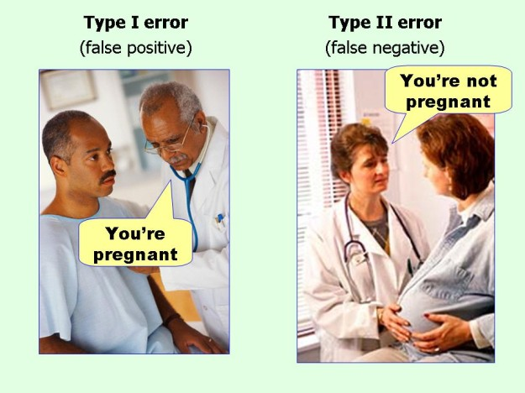

Slide 28
Type I and Type II errors
Keep α, β reasonably small

Slide 29
Why multiple testing matters
= 0.05
= 0.95
0.99, m= 100
Notes:
M = 40
P(Not making)

Slide 35
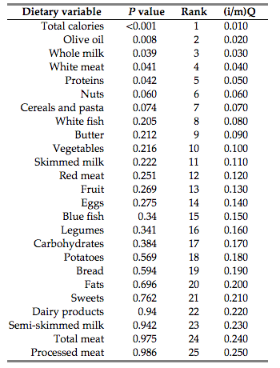
FDR example

Slide 36

Multiple Testing
The probability of falsely rejecting the jth null hypothesis is alpha .
The probability of falsely rejecting at least one of M null hypotheses is (under independence).
Number of hypotheses | Probability of false rejecting at least one null hypothesis
1 | 0.05
2 | 0.0975
10 | 0.40
200 | 0.99

Slide 37
Bonferroni Correction
Rather than rejecting the j th null hypothesis if its p-value is less than 0.05, we reject the j th null hypothesis if its p-value is less than 0.05/M .
More generally, to control the overall Type I error probability of falsely rejecting the null hypothesis at level alpha , we must reject the j th null hypothesis if its p-value is below alpha/M .

Slide 38
A less conservative notion
The Bonferroni correction allows us to be confident that we will almost never falsely reject the null hypothesis.
This approach can be a little too conservative.
In other words: willing to have some false positives, in exchange for more true positives.
A new notion of error control: false discovery rate .

Slide 39
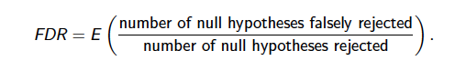
False Discovery Rate
This is the fraction of discoveries that are false positives

