Slide 1
CNN Accelerator Architecture

Slide 2
Parallelism --------------------------------------------------- ------------------------------------------------------------------
Because of savings in Fourier domain, 3 forms of parallelism we can now exploit

Slide 3
Initial Stage -------------------------------------------- ------------------------------------------------------------
As zero-padded image data is transferred will go through FFT
Each row is sent through 1D FFT engines until all rows are done
After rows are done, reorder logic to arrange data in col-wise streaming fashion to do FFT on cols

Slide 4
Reorder Stage 0 -------------------------------------------- ------------------------------------------------------------------
As partial Fourier maps are produced, data is reordered for column wise streaming
~[] cycles to reorder all the data

Slide 5
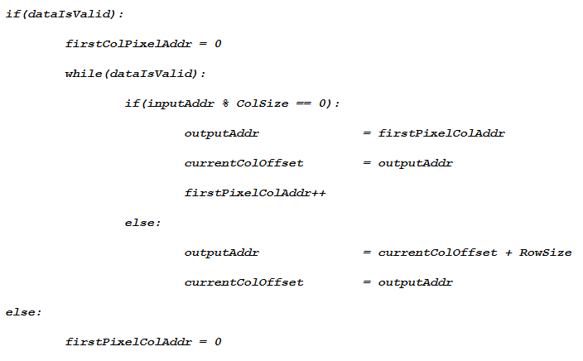
Reorder Stage 0 (cont.) ----------------------------------- ------------------------------------------------------------------
As partial Fourier maps are produced, data is reordered for column wise streaming
~[] cycles to reorder all the data

Slide 6
Reorder Stage 1 ------------------------------------------ ------------------------------------------------------------------
As complete Fourier maps are produced, data is reordered to take advantage of depth parallelism
Data is put into multiple BRAM’s to take advantage of pixel parallelism
~N cycles to reorder all the data (N is total number of pixels)
Output Address is input address multiplied by the current Layer Depth Size

Slide 7
CNN Kernel Module ---------------------------------------------------------------------------------------------------------
Each module is responsible for individual kernels
Within each module, DSP blocks will iteratively multiply and accum depth wise
Multiple DSP blocks to take advantage of Pixel Parallelism

Slide 8
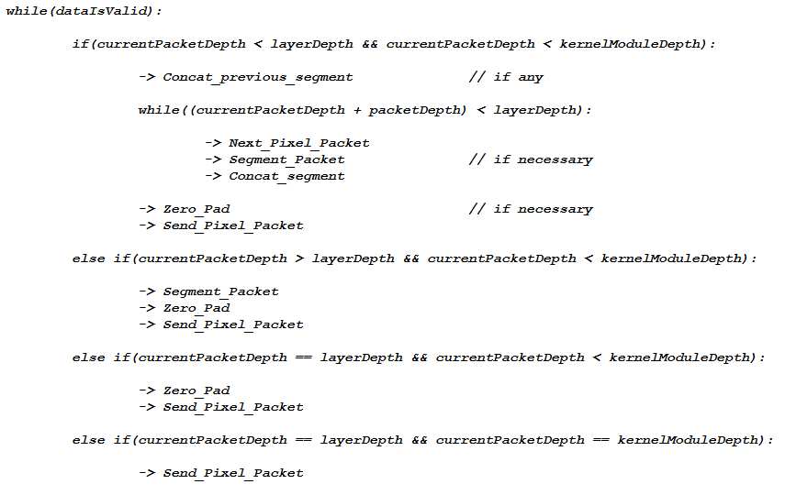
CNN Kernel Module (cont.)-------------------------------------------------------------------------------------------------
Kernel Module Depth will always be greater than or equal to largest network depth or BRAM output size
Because of different depths and one BRAM output size, must “package” inputted pixel packet through zero padding and segmentation
DSP’s will be clocked at 500Mhz while accelerator will be clocked at []Mhz

Slide 9
CNN Kernel Module (cont.)-------------------------------------------------------------------------------------------------
DSP blocks will be arranged in
Output data will be zero padded based on the next layer’s kernel Size

Slide 10
Largest ALEXNet Layer ------------------------------------------------------------------------------------------
First Version of Accelerator will be used to optimize largest AlexNet Layer
Image Data Flow to each module is pipelined to avoid memory contention for filter data
Final results will be in BRAM_1
Image is converted back to Spatial Domain using similar configuration as in slide 2
Performance for Layer has [] latency

Slide 11
Final CNN Accelerator ------------------------------------------------------------------------------------------
The BRAM’s will be used as a circular buffer for data between layers
DataFlow to each module is still pipelined to avoid memory contention
Performance Per Layer is []

