Slide 1
CNN Accelerator Implementation Plan

Slide 2
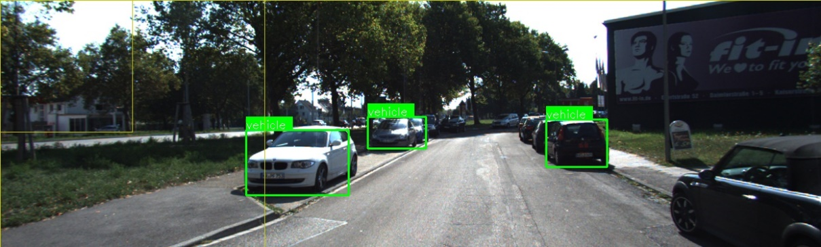
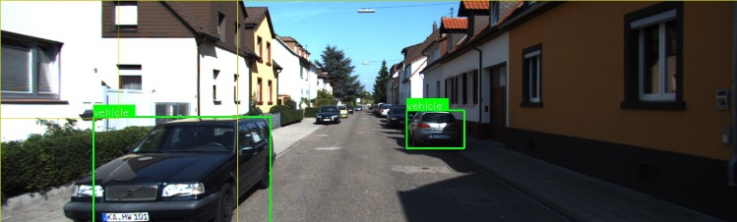
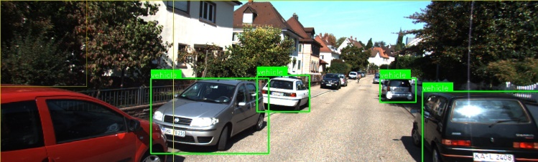
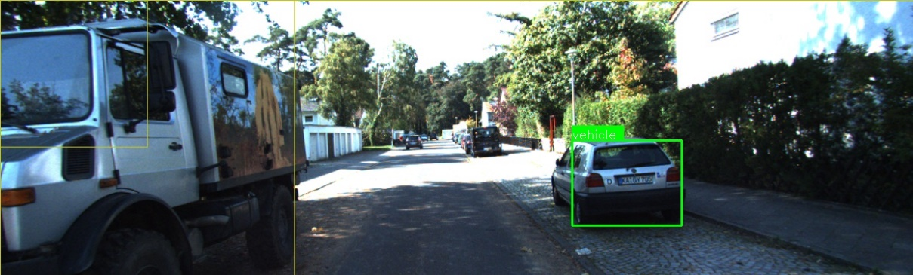
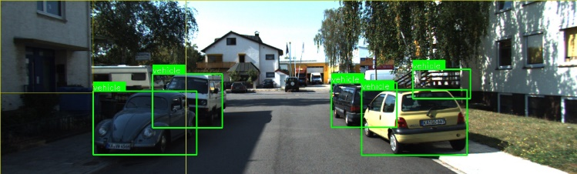
CNN Acceleration

Slide 3
System Architecture

Slide 4
CNN Layer Attributes
Kernel-Width {Wide, Narrow}
Describes the relative width ‘KW’ of a single kernel
Also corresponds to input map width
Narrow: ‘KW’ =< 8
Wide: ‘KW’ > 8
Layer-Width {Wide, Narrow}
Describes the relative width ‘LW’ of a layer
Narrow: ‘LW’ =< 8
Wide: ‘LW’ > 8

Slide 5
CNN Layer Attributes (cont.)
Pooling
Specifies whether the layer includes a pooling stage
Pooling subsamples a 2D window from a convolved input map
The subsampling operation can be min, max, average, etc.
The stride of the subsampling window determines the dimension of pooling output map
Example: the result of convolving a 256x256x3 input with a 3x3x3 kernel is a 256x256x1 map (ignoring boundary effects). Passing this map to a MAX pooling operator with 2x2 stride results in a 128x128x1 map. Each pixel in this map corresponds to the max value in the convolved map at window centered at the pixel

Slide 6
CNN Layer Attributes (cont.)
Activation
Specifies whether the layer includes an activation stage
Activation transforms each input map pixel according to f(x)
Activation does not alter the dimensions of the input map
The implementation of Activation is relatively cheap when f(x) =
Rectified Linear (ReLU)
Activation may require LUT based interpolation when f(x) =
Sigmoid
Hyperbolic tangent
Other differentiable functions of ‘x’

Slide 7
CNN Layer Attributes (cont.)
Squeeze
Specifies whether the layer implements a map reducing “Squeeze” operation
Squeezing a layer reduces the width of the output map leaving the layer
The width of an output map is equal to the number of kernels in the layer
By performing a convolution across the original K output maps, a single final output map is produced
Note that there may be several (SQ) Squeeze kernels, each producing a single output map
Generally |SQ| << K
Typically the squeeze kernel is a 1x1 but is not necessary
Stretch (Expand)
Specifies whether the layer implements a map increasing “Stretch” operation
Stretching a layer increases the width of the output map leaving the layer
Operation is identical to “Squeeze” however the number of Stretch (ST) kernels follows: |ST| > K
Typically the stretch kernel is a 1x1 but is not necessary

Slide 8
Accelerating a Single Kernel

Slide 9
Single Convolution Engine
Single Engine capable of performing:
3x3x1 convolution (CPI = 0.9)
1x1x10 convolution (CPI = 1.0)
Uses optimized DSP48E2 tile architecture consisting of two DSP48E2 macros
Operates at 5x datapath clock- (500Mhz)
Requires pixels to be evenly distributed across row-buffer banks
A single row buffer bank consists of two row buffers of max length = L. A row buffer bank has a dedicated connection to an adjacent DSP48E2 unit in the enclosing DSP48E2 tile
DSP48E2 Tile

Slide 10
Adaptive Window Engine (AWE)
Dual convolution engines capable of performing the following:
3x3x2 (CPI = 0.9)
5x5x1 (CPI = 1.25)
1x1x20 (CPI = 1.0)
Support 3x3 or 5x5 pooling
Requires pixels to be evenly distributed across row-buffer banks
In pooling mode the row-buffers feed a MAX/MIN/AVG module. Pooling can be performed over the two row buffers of a single engine or over the four combined row-buffers of two engines.

Slide 11
Load Balancing in AWE
To minimize logic delay, each buffer is directly connected to the adjacent DSP48 in the tile.
Since we are overclocking to reduce resource utilization of DSP48, it is important that each DSP48 as nearly equal work
Row renaming is accomplished by (1) reordering of weights based on the current row we operating on, and (2) a specific matriculation of rows across the buffers
In the case of odd kernels, a duplicate of one row is required in the buffer
Dual
Row Buffers
Dual
Row Buffers
BRAM0
BRAM1
BRAM2
BRAM3
Row Matriculation for 3x3 Config

Slide 12
Load Balancing in AWE
Row Matriculation for 5x5 Config

Slide 14
Row Buffer Logic
Supports up to 512 x 512 images
BRAMS are 1024 elements deep
Each Convolution Engines use 2 dual ported (one port for reading, another port to write while reading for row matriculation) 1024 element BRAM’s as row buffers; Each BRAM is partitioned into 512 chunks, to support up to 4 rows
Switching to different partitions on different row combinations is accomplished by toggling MSB, gray code counter, and OR’ing the LSB with a parity bit
Convolution engines start 1 cycle after each other

Slide 15
MSB
LSB
BRAM0
Addr Bits
0 | . | . | . | . | . | . | . | . | . | . | . | . | 0 | 0
0
Preloaded Sequence
0 2 512 513 514
MSB
LSB
BRAM1
Addr Bits
0 | . | . | . | . | . | . | . | . | . | . | . | . | 0 | 1
1
OR
0 1 2 N
0 1 2 N
Image
1023
512
511
0
BRAM0
Row 0
X
Row 1
BRAM1
Row 1
Row 0
X
Cycle 0

Slide 16
MSB
LSB
BRAM0
Addr Bits
0 | . | . | . | . | . | . | . | . | . | . | . | . | 0 | 0
2
Preloaded Sequence
0 2 512 513 514
MSB
LSB
BRAM1
Addr Bits
0 | . | . | . | . | . | . | . | . | . | . | . | . | X | X
X
Weight Value of 0 Needed here
0 1 2 N
0 1 2 N
Image
1023
512
511
0
BRAM0
Row 2
Row 0
X
Row 2
Row 0
Row 1
BRAM1
Row 1
Row 0
X
Cycle 1

Slide 17
MSB
LSB
BRAM0
Addr Bits
1 | . | . | . | . | . | . | . | . | . | . | . | . | 0 | 0
512
Preloaded Sequence
0 2 512 513 514
MSB
LSB
BRAM1
Addr Bits
1 | . | . | . | . | . | . | . | . | . | . | . | . | 0 | 0
512
0 1 2 N
0 1 2 N
Image
1023
512
511
0
BRAM0
Row 0
X
Row 2
Row 1
BRAM1
Row 1
Row 0
X
Cycle 2

Slide 18
MSB
LSB
BRAM0
Addr Bits
1 | . | . | . | . | . | . | . | . | . | . | . | . | 0 | 1
513
Preloaded Sequence
0 2 512 513 514
MSB
LSB
BRAM1
Addr Bits
1 | . | . | . | . | . | . | . | . | . | . | . | . | 0 | 1
513
0 1 2 N
0 1 2 N
Image
1023
512
511
0
BRAM0
Row 0
X
Row 2
Row 1
BRAM1
Row 1
Row 0
X
Cycle 3

Slide 19
MSB
LSB
BRAM0
Addr Bits
1 | . | . | . | . | . | . | . | . | . | . | . | . | 1 | 0
514
Preloaded Sequence
0 2 512 513 514
MSB
LSB
BRAM1
Addr Bits
1 | . | . | . | . | . | . | . | . | . | . | . | . | 1 | 0
514
0 1 2 N
0 1 2 N
Image
1023
512
511
0
BRAM0
Row 0
X
Row 2
Row 1
Row 0
BRAM1
Row 1
Row 0
X
Cycle 4

Slide 20
Weight Table logic
1 dual ported weight table per convolution engine
Weights are supplied from both ports

Slide 21
Weight Table logic (3x3)
0 1 2
0 1 2
0 | 1 | 2 | 3 | 4 | 5 | 6 | 7 | 8 | 9

Slide 22
Adaptive Window Quad
Four cascaded Adaptive Window Engines (AWE)
Quad shares a single bidirectional Tile Router port
Supports Narrow Convolution or wide Pooling
Routable output for the following:
3x3x8, 5x5x4, or 1x1x80 convolutions plus optional activation and pooling
8-3x3 pooling or 4-5x5 pooling

Slide 23
Accelerating Wide Kernels
AW Quad Cascade Path
Adaptive Window Quads can be cascaded at the output/input of the top/bottom quads respectively
Quads are asynchronous wrt. each other requiring shallow buffering at the interface

Slide 24
Accelerating Multiple Kernels (Wide Layers)

Slide 25
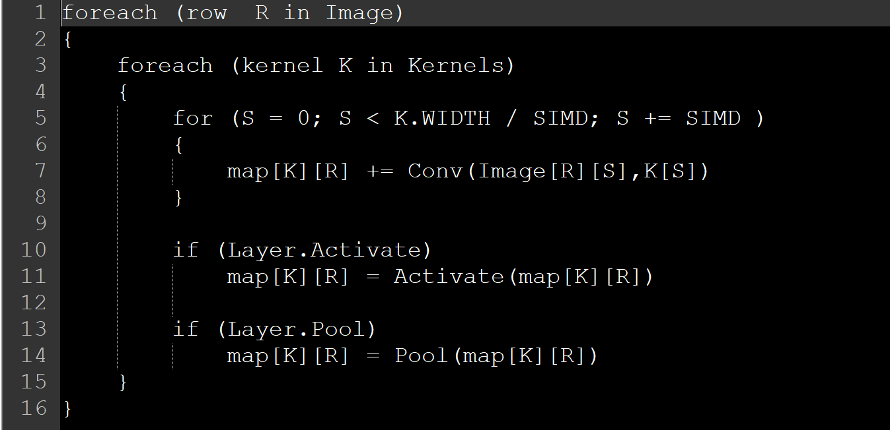
Accelerating multiple Kernels
Make full use of current row buffer contents across all kernels
Since kernels share identical input maps (different kernel weights)
Reduces demand on Input interface particularly for Wide Layers

Slide 26
Fetch-Aggregate-Store (FAS) Unit
The FAS unit is responsible for:
fetching data and forwarding to one or more AWP
Accumulating the partial maps arriving from multiple AWPs and/or memory
Storing maps to memory in particular format
Each FAS has two dedicated SOC-IT interfaces for I/O
It is possible for FAS to share its I/O bandwidth with other FAS in a “teaming” configuration (advanced)
From the software perspective, a FAS represents a CNN accelerator
Application software acquires a resource lock on a FAS for the duration of a CNN compute
Software invokes the FAS which in turn dispatches work to AWP at a per layer granularity

Slide 27
Fetch-Aggregate-Store (FAS) Unit

Slide 28
Single Adaptive Window Processor
Kintex Ultrascale

Slide 29
Implementation Roles
AWP – Ikenna & Geetha
FAS – Saambhavi
Functional Verification – Kevin & Ikenna
Software development – Kevin

Slide 30
Map size: Depth x NumRows x NumCols
8x20x20
Kernel size: NumKernels x Depth x NumKrnlRows x NumKrnlCols
5x8x3x3
Stride is 1
No padding
No UpSampling

Slide 31
Image Input Format
[D₀C₀R₀, D₁C₀R₀, ... D₇C₀R₀] [D₀C₁R₀, D₁C₁R₀, ... D₇C₁R₀] ....... [D₀C₁₉R₀, D₁C₁₉R₀, ... D₇C₁₉R₀]
[D₀C₀R₁, D₁C₀R₁, ... D₇C₀R₀] [D₀C₁R₀, D₁C₁R₁, ... D₇C₁R₀] ....... [D₀C₁₉R₁, D₁C₁₉R₁, ... D₇C₁₉R₁]
.
.
.
.
[D₀C₀R₁₉, D₁C₀R₁₉, ... D₇C₀R₁₉] [D₀C₁R₁₉, D₁C₁R₁₉, ... D₇C₁R₁₉] ....... [D₀C₁₉R₁₉, D₁C₁₉R₁₈, ... D₇C₁₉R₁₉]

Slide 32
Feature Maps
Columns
Rows
Depth
0 | 1 | 2 | . . . . . . . . . . | N

Slide 33
Feature Map
Columns
Rows
Depth
0 | 1 | 2 | . . . . . . . . . . | N

Slide 34
3x3 Kernel Input Format

Slide 35
Misc Notes
We load weight data at 5x clock bc we need both ports on the weight table BRAM to run at 5x to feed conv engs

Slide 36
Conv_out_fmt == 0
Ideally output will be 5x18x18
However output is be 5x18x20, with the result in the top left
[R₀C₀D₀, R₀C₁D₀, ... R₀C₁₉D₀] [R₀C₀D₁, R₀C₁D₁, ... R₀C₁₉D₁] ….... [R₀C₁₉D₄, R₀C₁D₄, ... R₀C₁₉D₄]
[R₁C₀D₀, R₁C₁D₀, ... R₁C₁₉D₀] [R₁C₀D₁, R₁C₁D₁, ... R₁C₁₉D₁] ….... [R₁C₁₉D₄, R₁C₁D₄, ... R₁C₁₉D₄]
.
.
.
[R₁₇C₀D₀, R₁₇C₁D₀, ... R₁₇C₁₉D₀] [R₁₇C₀D₁, R₁₇C₁D₁, ... R₁₇C₁₉D₁] ….... [R₁₇C₀D₄, R₁₇C₁D₄, ... R₁₇C₁₉D₄]

Slide 37
Conv_out_fmt == 0
Ideally output will be 5x18x18
However output is be 5x18x20, with the result in the top left
[R₀C₀D₀, R₀C₁D₀, ... R₀C₁₉D₀] [R₀C₀D₁, R₀C₁D₁, ... R₀C₁₉D₁] ….... [R₀C₁₉D₄, R₀C₁D₄, ... R₀C₁₉D₄]
[R₁C₀D₀, R₁C₁D₀, ... R₁C₁₉D₀] [R₁C₀D₁, R₁C₁D₁, ... R₁C₁₉D₁] ….... [R₁C₁₉D₄, R₁C₁D₄, ... R₁C₁₉D₄]
.
.
.
[R₁₇C₀D₀, R₁₇C₁D₀, ... R₁₇C₁₉D₀] [R₁₇C₀D₁, R₁₇C₁D₁, ... R₁₇C₁₉D₁] ….... [R₁₇C₀D₄, R₁₇C₁D₄, ... R₁₇C₁₉D₄]

Slide 38
Conv_out_fmt is 1
For 3x3 followed by 1x1 Ideally output will be 5x18x18
However output is be 5x18x20, with the result in the top left
[R₀C₀D₀, R₀C₀D₁, ... R₀C₀D₄] [R₀C₁D₀, R₀C₁D₁, ... R₀C₁D₄] ............ [R₀C₁₉D₀, R₀C₁₉D₁, ... R₀C₁₉D₄]
[R₁C₀D₀, R₁C₀D₁, ... R₁C₀D₄] [R₁C₁D₀, R₁C₁D₁, ... R₁C₁D₄] ............ [R₁C₁₉D₀, R₁C₁₉D₁, ... R₁C₁₉D₄]
.
.
.
[R₁₇C₀D₀, R₁₇C₀D₁, ... R₁₇C₀D₄] [R₁₇C₁D₀, R₁₇C₁D₁, ... R₁₇C₁D₄] ............ [R₁₇C₁₉D₀, R₁₇C₁₉D₁, ... R₁₇C₁₉D₄]

Slide 39
Cycle 0 | Cycle 1 | Cycle 2 |  | Cycle N | Action
(0_{D}, 0_{P}, 0_{Y}, 0_{X}) | (0_{D}, 0_{P}, 0_{Y}, 1_{X}) | (0_{D}, 0_{P}, 0_{Y}, 2_{X}) |  | (0_{D}, 0_{P}, 0_{Y}, N_{X}) | Next Kernel / Output Depth
(1_{D}, 0_{P}, 0_{Y}, 0_{X}) | (1_{D}, 0_{P}, 0_{Y}, 1_{X}) | (1_{D}, 0_{P}, 0_{Y}, 2_{X}) |  | (1_{D}, 0_{P}, 0_{Y}, N_{X}) | Next Kernel / Output Depth
(2_{D}, 0_{P}, 0_{Y}, 0_{X}) | (2_{D}, 0_{P}, 0_{Y}, 1_{X}) | (2_{D}, 0_{P}, 0_{Y}, 2_{X}) |  | (2_{D}, 0_{P}, 0_{Y}, N_{X}) | Next Kernel / Output Depth
 |  |  |  | (N_{D}, 0_{P}, 0_{Y}, N_{X}) | Next Row
(0_{D}, 0_{P}, 1_{Y}, 0_{X}) | (0_{D}, 0_{P}, 1_{Y}, 1_{X}) | (0_{D}, 0_{P}, 1_{Y}, 2_{X}) |  | (0_{D}, 0_{P}, 1_{Y}, N_{X}) | Next Kernel / Output Depth
(1_{D}, 0_{P}, 1_{Y}, 0_{X}) | (1_{D}, 0_{P}, 1_{Y}, 1_{X}) | (1_{D}, 0_{P}, 1_{Y}, 2_{X}) |  | (1_{D}, 0_{P}, 1_{Y}, N_{X}) | Next Kernel / Output Depth
(2_{D}, 0_{P}, 1_{Y}, 0_{X}) | (2_{D}, 0_{P}, 1_{Y}, 1_{X}) | (2_{D}, 0_{P}, 1_{Y}, 2_{X}) |  | (2_{D}, 0_{P}, 1_{Y}, N_{X}) | Next Kernel / Output Depth
 |  |  |  | (N_{D}, 0_{P}, 1_{Y},N_{X}) | Next Row
 |  |  |  | (N_{D}, 0_{P}, N_{Y},N_{X}) | Next Partial Map
(0_{D}, 1_{P}, 0_{Y}, 0_{X}) | (0_{D}, 1_{P}, 0_{Y}, 1_{X}) | (0_{D}, 1_{P}, 0_{Y}, 2_{X}) |  | (0_{D}, 1_{P}, 0_{Y}, N_{X}) | Next Kernel / Output Depth
(1_{D}, 1_{P}, 0_{Y}, 0_{X}) | (1_{D}, 1_{P}, 0_{Y}, 1_{X}) | (1_{D}, 1_{P}, 0_{Y}, 2_{X}) |  | (1_{D}, 1_{P}, 0_{Y}, N_{X}) | Next Kernel / Output Depth
(2_{D}, 1_{P}, 0_{Y}, 0_{X}) | (2_{D}, 1_{P}, 0_{Y}, 1_{X}) | (2_{D}, 1_{P}, 0_{Y}, 2_{X}) |  | (2_{D}, 1_{P}, 0_{Y}, N_{X}) | Next Kernel / Output Depth
 |  |  |  | (N_{D}, 1_{P}, 0_{Y}, N_{X}) | Next Row
 |  |  |  | (N_{D}, 1_{P}, N_{Y}, N_{X}) | Next Partial Map
 |  |  |  | (N_{D}, N_{P}, N_{Y}, N_{X})
Cycle N
(N_{D}, N_{P}, N_{Y}, N_{X})

Slide 40
Cycle 0 | Cycle 1 | Cycle 2 |  | Cycle N | Action
(0_{D}, 0_{P}, 0_{Y}, 0_{X}) | (1_{D}, 0_{P}, 0_{Y}, 0_{X}) | (2_{D}, 0_{P}, 0_{Y}, 0_{X}) |  | (N_{D}, 0_{P}, 0_{Y}, 0_{X}) | Next Column
(0_{D}, 0_{P}, 0_{Y}, 1_{X}) | (1_{D}, 0_{P}, 0_{Y}, 1_{X}) | (2_{D}, 0_{P}, 0_{Y}, 1_{X}) |  | (N_{D}, 0_{P}, 0_{Y}, 1_{X}) | Next Column
(0_{D}, 0_{P}, 0_{Y}, 2_{X}) | (1_{D}, 0_{P}, 0_{Y}, 2_{X}) | (2_{D}, 0_{P}, 0_{Y}, 2_{X}) |  | (N_{D}, 0_{P}, 0_{Y}, 2_{X}) | Next Column
 |  |  |  | (N_{D}, 0_{P}, 0_{Y}, N_{X}) | Next Row
(0_{D}, 0_{P}, 1_{Y}, 0_{X}) | (1_{D}, 0_{P}, 1_{Y}, 0_{X}) | (2_{D}, 0_{P}, 1_{Y}, 0_{X}) |  | (N_{D}, 0_{P}, 1_{Y}, 0_{X}) | Next Column
(0_{D}, 0_{P}, 1_{Y}, 1_{X}) | (1_{D}, 0_{P}, 1_{Y},1) | (2_{D}, 0_{P}, 1_{Y}, 1_{X}) |  | (N_{D}, 0_{P}, 1_{Y}, 1_{X}) | Next Column
(0_{D}, 0_{P}, 1_{Y}, 2_{X}) | (1_{D}, 0_{P}, 1_{Y},2) | (2_{D}, 0_{P}, 1_{Y}, 2_{X}) |  | (N_{D}, 0_{P}, 1_{Y}, 2_{X}) | Next Column
 |  |  |  | (N_{D}, 0_{P}, 1_{Y}, N_{X}) | Next Row
 |  |  |  | (N_{D}, 0_{P}, N_{Y},N_{X}) | Next Partial Map
(0_{D}, 1_{P}, 0_{Y}, 0_{X}) | (1_{D}, 1_{P}, 0_{Y}, 0_{X}) | (2_{D}, 1_{P}, 0_{Y}, 0_{X}) |  | (N_{D}, 1_{P}, 0_{Y}, 0_{X}) | Next Column
(0_{D}, 1_{P}, 0_{Y}, 1_{X}) | (1_{D}, 1_{P}, 0_{Y}, 1_{X}) | (2_{D}, 1_{P}, 0_{Y}, 1_{X}) |  | (N_{D}, 1_{P}, 0_{Y}, 1_{X}) | Next Column
(0_{D}, 1_{P}, 0_{Y}, 2_{X}) | (1_{D}, 1_{P}, 0_{Y}, 2_{X}) | (2_{D}, 1_{P}, 0_{Y}, 2_{X}) |  | (N_{D}, 1_{P}, 0_{Y}, 2_{X}) | Next Column
 |  |  |  | (N_{D}, 1_{P}, 0_{Y}, N_{X}) | Next Row
 |  |  |  | (N_{D}, 1_{P}, N_{Y}, N_{X}) | Next Partial Map
 |  |  |  | (N_{D}, N_{P}, N_{Y}, N_{X})
Cycle N
(N_{D}, N_{P}, N_{Y}, N_{X})

Slide 41
The order to config accel
1st config regs
2nd pixel sequence data
3rd kernel data

Slide 42
Config
Config reg data comes in at the 1x clock.
All config data goes into job_parameters bus. Place data on bus, then on next clock cycle assert job_parameters_valid and the accel will accept the configuration.
See cnn_layer_accel_defs.vh section 6 on how to set the job_parameters bus with the config reg values
See cnn_layer_configs.cxx section 1 for how to generate the config reg values

Slide 43
Pix Sequence Data
Pixel Sequence Data comes in at the 1x clock.
Place data on the bus. On the next clock cycle assert config_valid[0], continue to do so until all the data is read
See cnn_layer_configs.cxx section 2 on how to generate pixel sequence data and how to lay the data out on the config_data bus. See cnn_layer_accel_defs.vh section 4.0 for the pixel sequence data fields

Slide 44
Kernel Data
Kernel data comes in at the 5x clock. Place data on the weight_data bus and assert weight_valid
See Slide 49 for individual filter window data layout. Note position 9 of an individual filter has a value of 0. So a single filter takes up 10 slots
Accel can handle up to 64 kernels of max depth 8 at a time
See cnn_layer_config.cxx section 3 on how to layout kernel data on weight_data bus

Slide 45
Weight Table logic (3x3)
0 1 2
0,0 | 0,1 | 0,2
1,0 | 1,1 | 1,2
2,0 | 2,1 | 2,2
0 1 2
0,0 | 0,1 | 0,2 | 1,0 | 1,1 | 1,2 | 2,0 | 2,1 | 2,2 | 0
0 | 1 | 2 | 3 | 4 | 5 | 6 | 7 | 8 | 9

Slide 46
Address Space Name | Address Space Size | Address Space Size (bytes) | Address Space Range (Hex)
Pixel Sequence | 32768 |  | 0x00000 – 0x07FFF
Kernel Data | 32768 |  | 0x08000 – 0x0FFFF
Slave Regs | 16 |  | 0x10000 – 0x1000C
Slave data output width is 128 bits
Each slave address bit accesses 128 bits of data
Slave Regs:
128 bits total
1 address space size
Pixel Sequence
Datum is 16 bits -> 8 values per word
NumWindowCycles * MaxInputCols = 5 * 1024 = 5120; next power of 2 -> 8192 total 16 bit values
Divide by Num words per bus: 8192 / 8 = 1024 address space size
Kernel Data
Datum is 16 bits -> 8 values per word; 8 Weight tables;
Weight Table depth is 1024 -> 8192, add some padding 16384
16384 / 8 = 1024 address space size

