Slide 1
Discourse Annotation:
Discourse Connectives and Discourse Relations
Aravind Joshi and Rashmi Prasad
University of Pennsylvania
Bonnie Webber
University of Edinburgh
COLING/ACL 2006 Tutorial
Sydney, July 16, 2006

Slide 2
Outline
PART I
  Introduction
  Defining discourse relations
  Different approaches and their annotation
  Summary
  Discussion and Questions
PART II
  Presentation of PDTB
  Experiments with PDTB
  Demo
  Final Discussion and Questions

Slide 3
Introduction
Overall Motivation
  Richly annotated discourse corpora can facilitate theoretical advances
  as well as contribute to language technology.
Specific Goals
  Discuss issues related to describing and annotating discourse relations.
  Describe briefly some specific approaches, which involve reasonably large corpora, highlighting the similarities and differences and how this shapes the resulting annotations.
  Describe in detail the predominantly lexicalized approach to discourse relation annotation in the Penn Discourse Treebank (PDTB) – partly released in April 2006, final release, April 2007– and illustrate some of its uses.
  ☞ Encourage you to provide feedback and USE the PDTB!

Slide 4
What is a discourse relation?
The meaning and coherence of a discourse results partly from how its constituents relate to each other.
  Reference relations
  Discourse relations
Informational discourse relations convey relations that hold in the subject matter.
Intentional discourse relations specify how intended discourse effects relate to each other.
[Moore & Pollack, 1992] argue that discourse analysis requires both types.
This tutorial focuses on the former – informational or semantic relations (e.g, CONTRAST, CAUSE, CONDITIONAL, TEMPORAL, etc.) between abstract entities of appropriate sorts (e.g., facts, beliefs, eventualities, etc.), commonly called Abstract Objects (AOs) [Asher, 1993].
Discourse Coherence
Reference Relations
Discourse Relations
Informational
Intentional

Slide 5
Why Discourse Relations?
Discourse relations provide a level of description that is
  theoretically interesting, linking sentences (clauses) and discourse;
  identifiable more or less reliably on a sufficiently large scale;
  capable of supporting a level of inference potentially relevant to many NLP applications.

Slide 6
How are Discourse Relations declared?
Broadly, there are two ways of specifying discourse relations:
Abstract specification
  Relations between two given Abstract Objects are always inferred, and declared by choosing from a pre-defined set of abstract categories.
  Lexical elements can serve as partial, ambiguous evidence for inference.
  Lexically grounded
  Relations can be grounded in lexical elements.
  Where lexical elements are absent, relations may be inferred.

Slide 7
Where are Discourse Relations declared?
Similarly, there are two types of triggers for discourse relations considered by researchers:
Structure
  Discourse relations hold primarily between adjacent components with respect to some notion of structure.
  Lexical Elements and Structure
  Lexically-triggered discourse relations can relate the Abstract Object interpretations of non-adjacent as well as adjacent components.
  Discourse relations can be triggered by structure underlying adjacency, i.e., between adjacent components unrelated by lexical elements.

Slide 8
Triggering Discourse Relations
Lexical Elements
  Cohesion in Discourse (Halliday & Hasan)
Structure
  Rhetorical Structure Theory (Mann & Thompson)
  Linguistic Discourse Model (Polanyi and colleagues)
  Discourse GraphBank (Wolf & Gibson)
Lexical Elements and Structure
  Discourse Lexicalized TAG (Webber, Joshi, Stone, Knott)
Different triggers encourage different annotation schemes.

Slide 9
Halliday and Hasan (1976)
H&H associate discourse relations with conjunctive elements:
  Coordinating and subordinating conjunctions
  Conjunctive adjuncts (aka discourse adjuncts), including
    Adverbs such as but, so, next, accordingly, actually, instead, etc.
    Prepositional phrases (PPs) such as as a result, in addition, etc.
    PPs with that or other referential item such as in addition to that, in spite of that, in that case, etc.
Each such element conveys a cohesive relation between
  its matrix sentence and
  a presupposed predication from the surrounding discourse

Slide 10
Halliday and Hasan (1976)
H&H use presupposition to mean that a discourse element cannot
be effectively decoded except by recourse to another element
  To help resolve reference
  To help identify sense
  To help recover missing (ellipsed) material
On a level site you can provide a cross pitch to the entire slab by raising one side of the form, but for a 20-foot-wide drive this results in an awkward 5-inch slant. Instead, make the drive higher at the center.
Here instead cannot be effectively decoded without reference to
  the presupposed predication: raising one side of the form
⇒ Instead of raising one side of the form, make the drive higher at the center.

Slide 11
Conjunctive Relations and Discourse Structure
Discourse relations are not associated with discourse structure because H&H explicitly reject any notion of structure in discourse:
Whatever relation there is among the parts of a text – the sentences, the paragraphs, or turns in a dialogue – it is not the same as structure in the usual sense, the relation which links the parts of a sentence or a clause. [pg. 6]
Between sentences, there are no structural relations. [pg. 27]

Slide 12
H&H’s Coding Scheme for Discourse
Each cohesive item in a sentence is labeled with:
(1) The type of cohesion
(2) The discourse element it presupposes
(3) The distance and direction to that item
For conjunctive elements, type of cohesion can be coded in more or less detail – e.g.:
  C – Conjunction
  C.3 – Causal conjunction
  C.3.1 – Conditional causal conjunction
  C.3.1.1 – Emphatic conditional causal conjunction
  (e.g., in that case, in such an event)

Slide 13
H&H’s Coding Scheme for Discourse
Distance and direction:
  Immediate (same or adjacent sentence): o
  Non-immediate
    Mediated (# of intervening sentences): M[n]
    Remote Non-mediated (# of intervening sentences): N[n]
    Cataphoric: K
All types of cohesion are to be annotated simultaneously:
  Reference
  Substitution
  Ellipsis
  Conjunction (Discourse relations)
  Lexical cohesion
but we illustrate only the annotation of conjunction.

Slide 14
Annotation Scheme: Example
(6) Then we moved into the country, to a lovely little village called Warley. (7) It is about three miles from Halifax. (8) There are quite a few about. (9) There is a Warley in Worcester and one in Essex. (10) But the one not far out of Halifax had had a maypole, and a fountain. (11) By this time the maypole has gone, but the pub is still there called the Maypole. [from Meeting Wilfred Pickles, by Frank Haley]
Sentence # | Cohesive item | Type | Distance | Presupposed item
6 | Then | C.4.1.1 | N.26 | <preceding text>
C.4 – Temporal conjunction
C.4.1 – Sequential temporal conjunction
C.4.1.1 – Simple sequential temporal conjunction (then, next)

Slide 15
Annotation Scheme: Example
(6) Then we moved into the country, to a lovely little village called Warley. (7) It is about three miles from Halifax. (8) There are quite a few about. (9) There is a Warley in Worcester and one in Essex. (10) But the one not far out of Halifax had had a maypole, and a fountain. (11) By this time the maypole has gone, but the pub is still there called the Maypole.
[from Meeting Wilfred Pickles, by Frank Haley]
Sentence # | Cohesive item | Type | Distance | Presupposed item
10 | But | C.2.3.1 | o | (S.9)
C.2 – Adversative conjunction
C.2.3 – Contrastive adversative conjunction
C.2.3.1 – Simple contrastive adversative conjunction (but, and)

Slide 16
Annotation Scheme: Example
(6) Then we moved into the country, to a lovely little village called Warley. (7) It is about three miles from Halifax. (8) There are quite a few about. (9) There is a Warley in Worcester and one in Essex. (10) But the one not far out of Halifax had had a maypole, and a fountain. (11) By this time the maypole has gone, but the pub is still there called the Maypole.
[from Meeting Wilfred Pickles, by Frank Haley]
Sentence # | Cohesive item | Type | Distance | Presupposed item
11 | By this time | C.4.4.6 | N.4 | Then we moved (S.6)
C.4 – Temporal conjunction
C.4.4 – Terminal temporal conjunction
C.4.4.6 – Complex terminal temporal conjunction (until then, by this time)

Slide 17
Rhetorical Structure Theory (RST)
In contrast, RST [Mann & Thompson, 1988] only associates discourse relations with discourse structure.
Discourse structure reflects context-free rules called schemas.
Applied to a text, schemas define a tree structure in which:
  Each leaf is an elementary discourse unit (a continuous text span);
  Each non-terminal covers a contiguous, non-overlapping text span;
  The root projects to a complete, non-overlapping cover of the text;
  Discourse relations (aka rhetorical relations) hold only between daughters of the same non-terminal node.

Slide 18
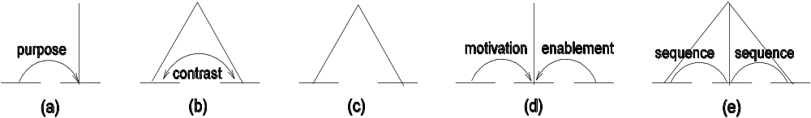
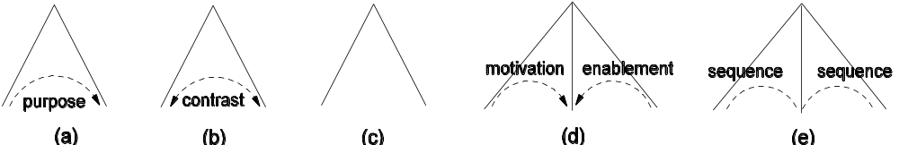
Types of Schemas in RST
RST schemas differ with respect to:
  what rhetorical relation, if any, hold between right-hand side (RHS) sisters;
  whether or not the RHS has a head (called a nucleus);
  whether or not the schema has binary, ternary, or arbitrary branching.
RST schema types in RST annotation
RST schema types in standard tree notation

Slide 19
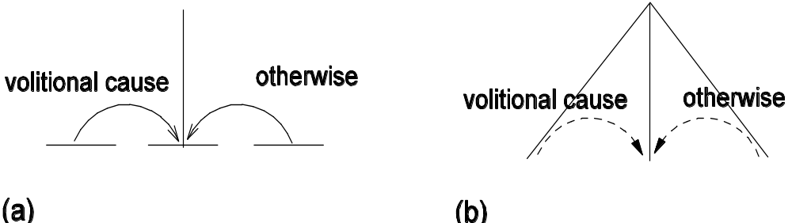
RST Example
(1) George Bush supports big business. (2) He’s sure to veto House Bill 1711. (3) Otherwise, big business won’t support him.
Modified version of example from [Moore and Pollack, 1992]

Slide 20
RST Corpus [Carlson, Marcu & Okurowski, 2001]
The annotated RST corpus illustrates a tension between
  Mann and Thompson’s sole focus on discourse relations associated with structure underlying adjacency;
  Carlson et al's recognition that rhetorical relations can hold of elements other than adjacent clauses.
E.g., the following all express the same CONSEQUENCE relation:
  He needed $10. So he asked his father for the money.
  Needing $10, he asked his father for the money.
  His need for $10 led him to ask his father for the money.

Slide 21
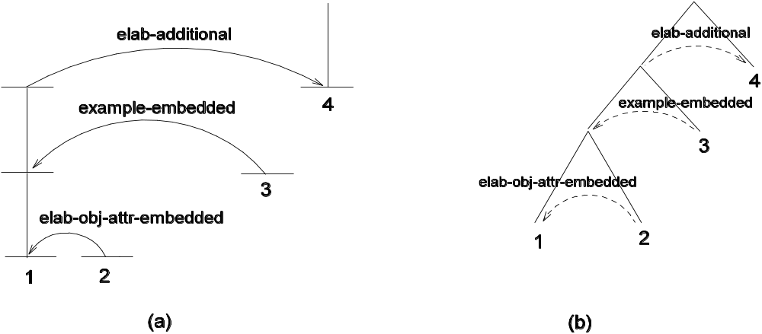
RST Corpus [Carlson, Marcu & Okurowski, 2001]
Carlson et al. extend RST to cover appositive, complement and relative clauses, in order to capture more rhetorical relations.
To do this, they add embedded versions of RST schemas.
[In addition to the practical purpose¹] [they serve^{,2}] [to permit or prohibit passage for example³], [gates also signify a variety of other things.⁴]

Slide 22
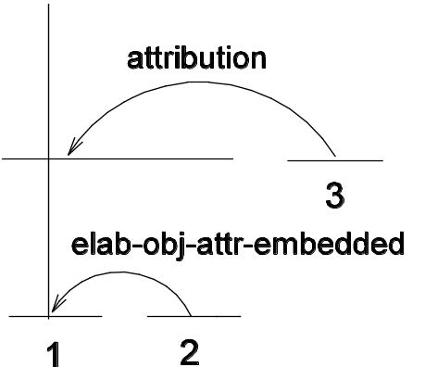
RST Corpus [Carlson, Marcu & Okurowski, 2001]
They also add an ATTRIBUTION relation to relate a reporting clause and its complement clause, for speech act and cognitive verbs.
(1) This is in part because of the effect
  (2) of having the number of shares outstanding,
  (3) she said.
from [Carlson et al, 2001]
N.B. Mann and Thompson reject ATTRIBUTION (aka QUOTE) as a rhetorical relation:
(1) Each RST relation has a rhetorical proposition that follows from attributing material to an agent other than the attribution itself. QUOTE doesn’t.
(2) A reporting clause functions as evidence for the attributed material and thus belongs with it.

Slide 23
RST Annotation Procedure
Step 1: Segment the text into elementary discourse units.
Step 2: Connect pairs of units and label their status as nucleus (N) or satellite (S).
(N.B. Similar content may be expressed with different nuclearity.)
    He tried hard, but he failed.
    Although he tried hard, he failed.
    He tried hard, yet he failed.
Step 3: Assess which of 53 mono-nuclear and 25 multi-nuclear relations holds in each case.
Steps (2) and (3) can be interleaved, with (2) always preceding (3).
The result must be a singly-rooted hierarchical cover of each text.
N
N
S
N
S
N

Slide 24
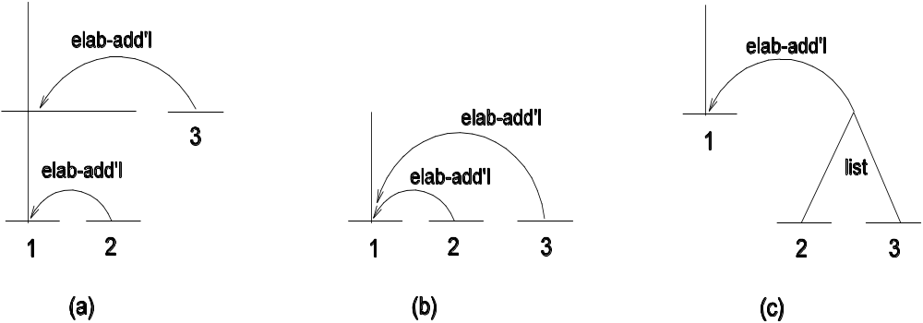
Resolving Ambiguities in RST Annotation
Attachment ambiguities:
Principle: Choose same level of embedding (b) if the units and their
relations are independent of each other.
Labeling ambiguities: A protocol specifies the order in which to consider rhetorical relations. The first one to be satisfied is the one that is assigned.

Slide 25
Linguistic Discourse Model (LDM)
The LDM resembles RST in associating discourse relations only with discourse structure, in the form of a tree that projects to a complete, non-overlapping cover of the text.
The LDM differs from RST in distinguishing discourse structure from discourse interpretation.
Discourse relations belong to discourse interpretation.
Discourse structure comes from three context-free rules, each with its own rule for semantic composition (SC).
[Polanyi 1988; Polanyi & van den Berg 1996; Polanyi et al 2004]

Slide 26
Discourse Structure Rules in the LDM
(1) an N-ary branching rule for discourse coordination (lists and narratives)
SC rule: The parent is interpreted as the information common to its children.
(2) a binary branching rule for discourse subordination, in which the subordinate child elaborates what is described by the dominant child.
SC rule: The parent receives the interpretation of its dominant child.
(3) an N-ary branching rule in which a logical or rhetorical relation, or genre-based or interactional convention, holds of the RHS elements.
SC rule: The parent is interpreted as the interpretation of its children and the relationship between them.

Slide 27
LDM Annotation Procedure
Step 1: Segment the text into basic discourse units, including:
  Clauses denoting events and their participants, including independent clauses, complement clauses and relative clauses
    [ Section 4 describes ] [ how audio segments are clustered. ]
  Infinitive clauses
    [ We aim ] [ to group the segments. ]
  Subordinating and coordinating conjunctions
    [ Though ] [ these methods are applicable to general media,] [ we concentrate here on audio. ]
    [ As a result ] [ we do not weigh segments’ importance by their lengths, ] [ but rather ] [ by their frequency of repetition. ]

Slide 28
LDM Annotation Procedure
Step 2: Proceeding left-to-right through the text, determine
(a) the node to which the next basic discourse unit attaches as a right child.
(b) its relationship to this attachment point:
    Coordinate?
    Subordinate?
    N-ary relation?

Slide 29
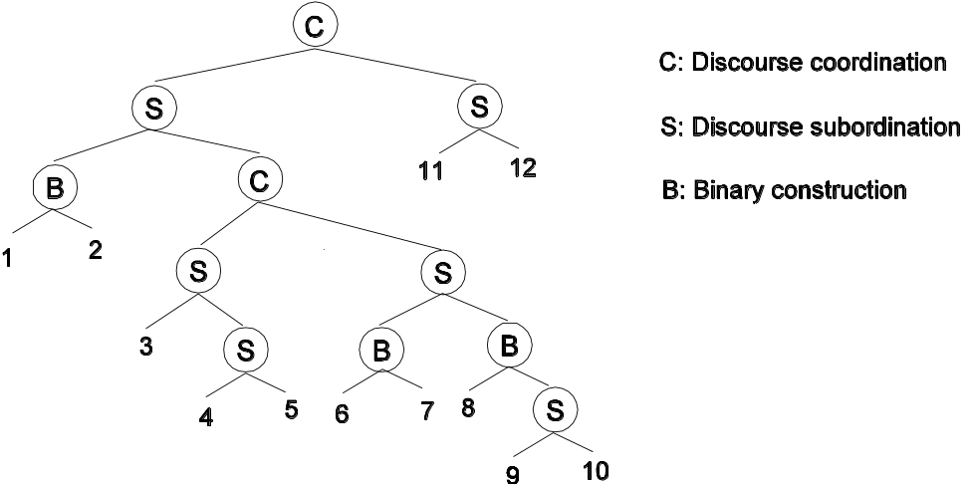
Example LDM Annotation
[₁ Whatever advances we may have seen in knowledge management, ]
[₂ knowledge sharing remains a major issue. ] [₃ A key problem is ] [₄ that
documents only assume value ] [₅ when we reflect upon their content. ]
[₆ Ultimately, ] [₇ the solution to this problem will probably reside in the documents
themselves. ] [₈ In other words, ] [₉ the real solution to the problem of knowledge
sharing involves authoring, ] [₁₀ rather than document management. ] [₁₁ This paper
is a discussion of several new approaches to authoring and opportunities for new
technologies ] [₁₂ to support those approaches. ]

Slide 30
The Discourse GraphBank [Wolf & Gibson 2005]
DG associates all discourse relations with discourse structure, but
  does not take that structure to be a tree;
  allows the same discourse unit to be an argument to many discourse relations;
  admits two bases for structure:
    Adjacent clauses can be grouped by common attribution or topic;
    Any two adjacent or non-adjacent segments or groupings can be linked by a discourse relation.
☞ The first can yield hierarchical structure, while the second cannot.

Slide 31
Discourse GraphBank Annotation Procedure
Step 1: Produce discourse segments by inserting a segment boundary at every
  sentence boundary,
  semicolon, colon or comma that marks a clause boundary,
  quotation mark,
  Conjunction (coordinating, subordinating or adverbial).
The economy,
according to some analysts,
is expected to improve by early next year.
[Wolf & Gibson 2005, p.255]

Slide 32
Discourse GraphBank Annotation Procedure
Step 2: Create groupings of adjacent segments that are either
  enclosed by pairs of quotation marks,
  attributed to the same source,
  part of the same sentence,
  topically centered on the same entities or events.
if not doing so would change truth conditions.
(6) The securities-turnover tax has been long criticized by the West German financial community
(7) because it tends to drive securities trading and other banking activities out of Frankfurt into rival financial centers,
(8) especially London,
(9) where trading transactions isn’t taxed.
from [Wolf, Gibson, Fisher & Knight, 2003, p.18]

Slide 33
Discourse GraphBank Annotation Procedure
Step 3: Proceeding left-to-right, assess the possibility of a discourse relation holding between the current segment or grouping and each discourse segment or grouping to its left.
  If one holds, create a new non-terminal node labeled with the selected discourse relation, whose children are the two selected segments or groupings.
☞ This produces a relatively flat discourse structure, in which arcs can cross and nodes can have multiple parents.

Slide 34
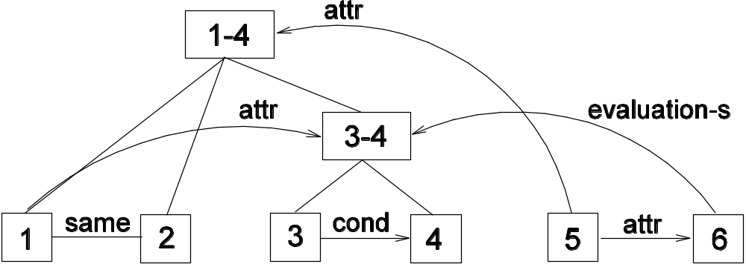
Example Discourse GraphBank Analysis
(1) The administration should now state
(2) that
(3) if the February election is voided by the Sandinistas
(4) they should call for military aid,
(5) said former Assistant Secretary of State Elliot Abrams.
(6) In these circumstances, I think they'd win.
[Wolf and Gibson, 2005, Example 26]

Slide 35
Discourse Structure as a Chain Graph
The resulting structure is a chain graph:
  a graph with both directed and undirected edges,
  whose nodes can be partitioned into subsets
    within which all edges are undirected, and
    between which, edges are directed but with no directed cycles.
N.B. A Directed Acyclic Graph (DAG) is a special case of a chain graph, in which each subset contains only a single node.
While this is a much more complex structure than a tree, debate continues as to how to interpret W&G’s results – cf.
http://itre.cis.upenn.edu/~myl/languagelog/archives/000541.html

Slide 36
Discourse Lexicalized TAG (D-LTAG)
D-LTAG considers discourse relations triggered by lexical elements, focusing on
  the source of arguments to such relations
  the additional content that the relations contribute.
D-LTAG also considers discourse relations that may hold between unmarked adjacent clauses.

Slide 37
Motivation behind D-LTAG
D-LTAG holds that the sources of discourse meaning resemble the sources of sentence meaning - i.e,
  structure: e.g., verbs, subjects and objects conveying pred-arg relations;
  adjacency: e.g., noun-noun modifiers conveying relations implicitly;
  anaphora: e.g., modifiers like other and next, conveying relations anaphorically.
Lexicalized grammars associate a lexical entry with the set of trees that represent its local syntactic configurations.
D-LTAG is a lexicalized grammar for discourse, associating a lexical entry with the set of trees that represent its local discourse configurations.

Slide 38
A Lexicalized Grammar for Discourse
What lexical entries head local discourse structures?
Discourse connectives:
  coordinating conjunctions
  subordinating conjunctions and subordinators
  paired (parallel) constructions
  discourse adverbials
N.B. While these all have two arguments, D-LTAG does not take one to be dominant (ie, a nucleus) and the other subordinate (ie, a satellite).

Slide 39
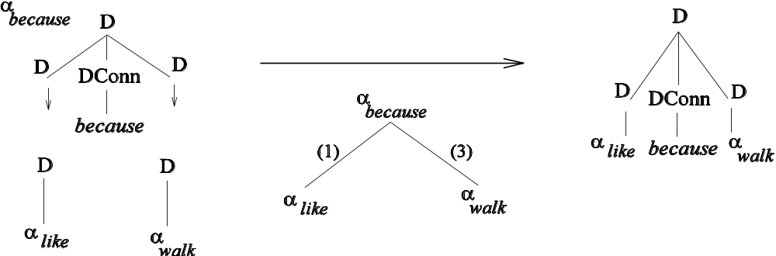
Example: Structural Arguments to Conjunctions
John likes Mary because she walks Fido.
Derived Tree (right of →)
Derivation Tree (below →)

Slide 40
Discourse Adverbials as Discourse Connectives
Like other discourse connectives, discourse adverbials have two Abstract Objects involved in their interpretation.
This distinguishes them from clausal adverbials, which have only one [Forbes et al., 2006]
  Frequently, clients express interest but don’t buy.
  Instead, clients express interest but don’t buy.
One Abstract Object derives locally (matrix clause).
The other comes from the previous discourse, through anaphor resolution.

Slide 41
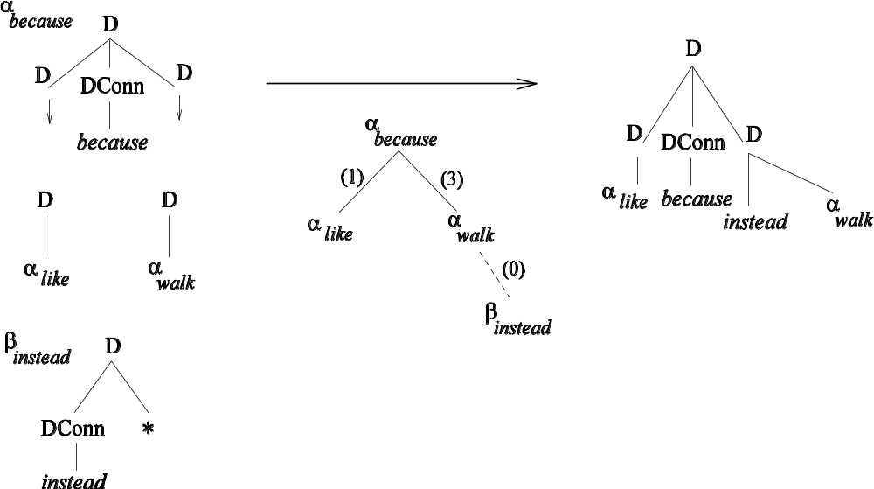
D-LTAG Example
John likes Mary because instead she walks Fido.
Arg1 of instead is resolved from the previous discourse.

Slide 42
Summary
Discourse relations can be associated with
  Structure
  Lexical elements
  Other things: information structure, intonation, etc.
Theories differ in the attention they give to each.
Different emphases lead to different approaches to discourse annotation.
☞ Part II presents annotation that follows in a theory-independent way from D-LTAG.

Slide 43
The Penn Discourse Treebank (PDTB)
(Other collaborators: Nikhil Dinesh, Alan Lee, Eleni Miltsakaki)
The PDTB aims to encode a large scale corpus with
  Discourse relations and their Abstract Object arguments
  Semantics of relations
  Attribution of relations and their arguments.
While the PDTB follows the D-LTAG approach, for theory-independence, relations and their arguments are annotated uniformly – the same way for
  Structural arguments of connectives
  Arguments to relations inferred between adjacent sentences
  Anaphoric arguments of discourse adverbials.
☞ Uniform treatment of relations in the PDTB will provide evidence for testing the claims of different approaches towards discourse structure form and discourse semantics.

Slide 44
Corpus and Annotation Representation
Wall Street Journal
  2304 articles, ~1M words
Annotations record
  the text spans of connectives and their arguments
  features encoding the semantic classification of connectives, and attribution of connectives and their arguments.
While annotations are carried out directly on WSJ raw texts,
text spans of connectives and arguments are represented as
stand-off, i.e., as
  their character offsets in the WSJ raw files.

Slide 45
Corpus and Annotation Representation
Text span annotations of connectives and arguments are also aligned with the Penn TreeBank – PTB (Marcus et al., 1993), and represented as
  their tree node address in the PTB parsed files.
Because of the stand-off representation of annotations, PDTB must be used with the PTB-II distribution, which contains the WSJ raw and PTB parsed files.
http://www.ldc.upenn.edu/Catalog/CatalogEntry.jsp?catalogId=LDC95T7
PDTB first release (PDTB-1.0) appeared in March 2006.
http://www.seas.upenn.edu/~pdtb
PDTB final release (PDTB-2.0) is planned for April 2007.

Slide 46
Explicit Connectives
Explicit connectives are the lexical items that trigger discourse relations.
Subordinating conjunctions (e.g., when, because, although, etc.)
  The federal government suspended sales of U.S. savings bonds because Congress hasn't lifted the ceiling on government debt.
Coordinating conjunctions (e.g., and, or, so, nor, etc.)
  The subject will be written into the plots of prime-time shows, and viewers will be given a 900 number to call.
Discourse adverbials (e.g., then, however, as a result, etc.)
  In the past, the socialist policies of the government strictly limited the size of … industrial concerns to conserve resources and restrict the profits businessmen could make. As a result, industry operated out of small, expensive, highly inefficient industrial units.
Only 2 AO arguments, labeled Arg1 and Arg2
Arg2: clause with which connective is syntactically associated
Arg1: the other argument

Slide 47
Identifying Explicit Connectives
Explicit connectives are annotated by
Identifying the expressions by RegEx search over the raw text
Filtering them to reject ones that don’t function as discourse connectives.
Primary criterion for filtering: Arguments must denote Abstract Objects.
The following are rejected because the AO criterion is not met
  Dr. Talcott led a team of researchers from the National Cancer Institute and the medical schools of Harvard University and Boston University.
  Equitable of Iowa Cos., Des Moines, had been seeking a buyer for the 36-store Younkers chain since June, when it announced its intention to free up capital to expand its insurance business.
  These mainly involved such areas as materials -- advanced soldering machines, for example -- and medical developments derived from experimentation in space, such as artificial blood vessels.

Slide 48
Modified Connectives
Connectives can be modified by adverbs and focus particles:
  That power can sometimes be abused, (particularly) since jurists in smaller jurisdictions operate without many of the restraints that serve as corrective measures in urban areas.
  You can do all this (even) if you're not a reporter or a researcher or a scholar or a member of Congress.
Initially identified connective (since, if) is extended to include modifiers.
Each annotation token includes both head and modifier (e.g., even if).
Each token has its head as a feature (e.g., if)

Slide 49
Parallel Connectives
Paired connectives take the same arguments:
  On the one hand, Mr. Front says, it would be misguided to sell into "a classic panic." On the other hand, it's not necessarily a good time to jump in and buy.
  Either sign new long-term commitments to buy future episodes or risk losing "Cosby" to a competitor.
Treated as complex connectives – annotated discontinuously
Listed as distinct types (no head-modifier relation)

Slide 50
Complex Connectives
Multiple relations can sometimes be expressed as a conjunction of connectives:
  When and if the trust runs out of cash -- which seems increasingly likely -- it will need to convert its Manville stock to cash.
  Hoylake dropped its initial #13.35 billion ($20.71 billion) takeover bid after it received the extension, but said it would launch a new bid if and when the proposed sale of Farmers to Axa receives regulatory approval.
Treated as complex connectives
Listed as distinct types (no head-modifier relation)

Slide 51
Argument Labels and Linear Order
Arg2 is the sentence/clause with which connective is syntactically associated.
Arg1 is the other argument.
No constraints on relative order. Discontinuous annotation is allowed.
  Linear:
    The federal government suspended sales of U.S. savings bonds because Congress hasn't lifted the ceiling on government debt.
  Interposed:
    Most oil companies, when they set exploration and production budgets for this year, forecast revenue of $15 for each barrel of crude produced.
    The chief culprits, he says, are big companies and business groups that buy huge amounts of land "not for their corporate use, but for resale at huge profit." … The Ministry of Finance, as a result, has proposed a series of measures that would restrict business investment in real estate even more tightly than restrictions aimed at individuals.

Slide 52
Location of Arg1
Same sentence as Arg2:
  The federal government suspended sales of U.S. savings bonds because Congress hasn't lifted the ceiling on government debt.
Sentence immediately previous to Arg2:
  Why do local real-estate markets overreact to regional economic cycles? Because real-estate purchases and leases are such major long-term commitments that most companies and individuals make these decisions only when confident of future economic stability and growth.
Previous sentence non-contiguous to Arg2 :
  Mr. Robinson … said Plant Genetic's success in creating genetically engineered male steriles doesn't automatically mean it would be simple to create hybrids in all crops. That's because pollination, while easy in corn because the carrier is wind, is more complex and involves insects as carriers in crops such as cotton. "It's one thing to say you can sterilize, and another to then successfully pollinate the plant," he said. Nevertheless, he said, he is negotiating with Plant Genetic to acquire the technology to try breeding hybrid cotton.

Slide 53
Types of Arguments
Simplest syntactic realization of an Abstract Object argument is:
  A clause, tensed or non-tensed, or ellipsed.
The clause can be a matrix, complement, coordinate, or subordinate clause.
A Chemical spokeswoman said the second-quarter charge was "not material" and that no personnel changes were made as a result.
In Washington, House aides said Mr. Phelan told congressmen that the collar, which banned program trades through the Big Board's computer when the Dow Jones Industrial Average moved 50 points, didn't work well.
Knowing a tasty -- and free -- meal when they eat one, the executives gave the chefs a standing ovation.
Syntactically implicit elements for non-finite and extracted clauses are assumed to be available.
  Players for the Tokyo Giants, for example, must always wear ties when on the road.

Slide 54
Multiple Clauses: Minimality Principle
Any number of clauses can be selected as arguments:
  Here in this new center for Japanese assembly plants just across the border from San Diego, turnover is dizzying, infrastructure shoddy, bureaucracy intense. Even after-hours drag; "karaoke" bars, where Japanese revelers sing over recorded music, are prohibited by Mexico's powerful musicians union. Still, 20 Japanese companies, including giants such as Sanyo Industries Corp., Matsushita Electronics Components Corp. and Sony Corp. have set up shop in the state of Northern Baja California.
But, the selection is constrained by a Minimality Principle:
  Only as many clauses and/or sentences should be included as are minimally required for interpreting the relation. Any other span of text that is perceived to be relevant (but not necessary) should be annotated as supplementary information:
    Sup1 for material supplementary to Arg1
    Sup2 for material supplementary to Arg2

Slide 55
Exceptional Non-Clausal Arguments
VP coordinations:
  It acquired Thomas Edison's microphone patent and then immediately sued the Bell Co.
  She became an abortionist accidentally, and continued because it enabled her to buy jam, cocoa and other war-rationed goodies.
Nominalizations:
  Economic analysts call his trail-blazing liberalization of the Indian economy incomplete, and many are hoping for major new liberalizations if he is returned firmly to power.
  But in 1976, the court permitted resurrection of such laws, if they meet certain procedural requirements.

Slide 56
Exceptional Non-Clausal Arguments
Anaphoric expressions denoting Abstract Objects:
  "It's important to share the risk and even more so when the market has already peaked."
  Investors who bought stock with borrowed money -- that is, "on margin" -- may be more worried than most following Friday's market drop. That's because their brokers can require them to sell some shares or put up more cash to enhance the collateral backing their loans.
Responses to questions:
  Are such expenditures worthwhile, then? Yes, if targeted.
  Is he a victim of Gramm-Rudman cuts? No, but he's endangered all the same.
N.B. Referent is annotated as Sup – in these examples, as Sup1.

Slide 57
Conventions
An argument includes any non-clausal adjuncts, prepositions, connectives, or complementizers introducing or modifying the clause:
  Although Georgia Gulf hasn't been eager to negotiate with Mr. Simmons and NL, a specialty chemicals concern, the group apparently believes the company's management is interested in some kind of transaction.
  players must abide by strict rules of conduct even in their personal lives -- players for the Tokyo Giants, for example, must always wear ties when on the road.
  We have been a great market for inventing risks which other people then take, copy and cut rates."

Slide 58
Conventions
Discontinuous annotation is allowed when including non-clausal modifiers and heads:
  They found students in an advanced class a year earlier who said she gave them similar help, although because the case wasn't tried in court, this evidence was never presented publicly.
  He says that when Dan Dorfman, a financial columnist with USA Today, hasn't returned his phone calls, he leaves messages with Mr. Dorfman's office saying that he has an important story on Donald Trump, Meshulam Riklis or Marvin Davis.

Slide 59
Annotation Overview (PDTB 1.0):
Explicit Connectives
All WSJ sections (25 sections; 2304 texts)
100 distinct types
    Subordinating conjunctions – 31 types
    Coordinating conjunctions – 7 types
    Discourse Adverbials – 62 types
Some additional types will be annotated for PDTB-2.0.
18505 distinct tokens

Slide 60
Implicit Connectives
When there is no Explicit connective present to relate adjacent sentences, it may be possible to infer a discourse relation between them due to adjacency.
  Some have raised their cash positions to record levels. Implicit=because (causal) High cash positions help buffer a fund when the market falls.
  The projects already under construction will increase Las Vegas's supply of hotel rooms by 11,795, or nearly 20%, to 75,500. Implicit=so (consequence) By a rule of thumb of 1.5 new jobs for each new hotel room, Clark County will have nearly 18,000 new jobs.
Such discourse relations are annotated by inserting an “Implicit connective” that “best” captures the relation.
Sentence delimiters are: period, semi-colon, colon
Left character offset of Arg2 is “placeholder” for these implicit connectives.

Slide 61
Multiple Implicit Connectives
Where multiple connectives can be inserted between adjacent sentences (arguments), all of them are annotated:
  The small, wiry Mr. Morishita comes across as an outspoken man of the world. Implicit=when for example (temporal, exemplification) Stretching his arms in his silky white shirt and squeaking his black shoes, he lectures a visitor about the way to sell American real estate and boasts about his friendship with Margaret Thatcher's son.
  The third principal in the South Gardens adventure did have garden experience. Implicit=since for example (causal, exemplification) The firm of Bruce Kelly/David Varnell Landscape Architects had created Central Park's Strawberry Fields and Shakespeare Garden.

Slide 62
Semantic Classification for Implicit Connectives
A coarse-grained seven-way semantic classification is followed for Implicit connectives:
  Additional-info (includes Continuation, Elaboration, Exemplification, Similarity)
  Causal
  Temporal
  Contrast (includes Opposition, Concession, Denial of Expectation)
  Condition
  Consequence
  Restatement/summarization
A finer-grained classification is planned for PDTB-2.0.
N.B. Semantic classification in PDTB-1.0 is done only for Implicit connectives. PDTB-2.0 will also contain semantic classification for Explicit connectives.

Slide 63
Where Implicit Connectives are Not Yet Annotated
Across paragraphs
  All the sentences in the second paragraph provide an Explanation for the claim in the last sentence of the first paragraph. It is possible to insert a connective like because to express this relation.
  The Sept. 25 "Tracking Travel" column advises readers to "Charge With Caution When Traveling Abroad" because credit-card companies charge 1% to convert foreign-currency expenditures into dollars. In fact, this is the best bargain available to someone traveling abroad.
  In contrast to the 1% conversion fee charged by Visa, foreign-currency dealers routinely charge 7% or more to convert U.S. dollars into foreign currency. On top of this, the traveler who converts his dollars into foreign currency before the trip starts will lose interest from the day of conversion. At the end of the trip, any unspent foreign exchange will have to be converted back into dollars, with another commission due.

Slide 64
Where Implicit Connectives are Not Annotated
Intra-sententially, e.g., between main clause and free adjunct:
  (Consequence: so/thereby) Second, they channel monthly mortgage payments into semiannual payments, reducing the administrative burden on investors.
  (Continuation: then) Mr. Cathcart says he has had "a lot of fun" at Kidder, adding the crack about his being a "tool-and-die man" never bothered him.
Implicit connectives in addition to explicit connectives: If at least one connective appears explicitly, any additional ones are not annotated:
  (Consequence: so) On a level site you can provide a cross pitch to the entire slab by raising one side of the form, but for a 20-foot-wide drive this results in an awkward 5-inch slant. Instead, make the drive higher at the center.

Slide 65
Extent of Arguments of Implicit Connectives
Like the arguments of Explicit connectives, arguments of Implicit connectives can be sentential, sub-sentential, multi-clausal or multi-sentential:
  Legal controversies in America have a way of assuming a symbolic significance far exceeding what is involved in the particular case. They speak volumes about the state of our society at a given moment. It has always been so. Implicit=for example (exemplification) In the 1920s, a young schoolteacher, John T. Scopes, volunteered to be a guinea pig in a test case sponsored by the American Civil Liberties Union to challenge a ban on the teaching of evolution imposed by the Tennessee Legislature. The result was a world-famous trial exposing profound cultural conflicts in American life between the "smart set," whose spokesman was H.L. Mencken, and the religious fundamentalists, whom Mencken derided as benighted primitives. Few now recall the actual outcome: Scopes was convicted and fined $100, and his conviction was reversed on appeal because the fine was excessive under Tennessee law.

Slide 66
Non-insertability of Implicit Connectives
There are three types of cases where Implicit connectives cannot be inserted between adjacent sentences.
AltLex: A discourse relation is inferred, but insertion of an Implicit connective leads to redundancy because the relation is Alternatively Lexicalized by some non-connective expression:
  Ms. Bartlett's previous work, which earned her an international reputation in the non-horticultural art world, often took gardens as its nominal subject. AltLex = (consequence) Mayhap this metaphorical connection made the BPC Fine Arts Committee think she had a literal green thumb.

Slide 67
Non-insertability of Implicit Connectives
EntRel: the coherence is due to an entity-based relation.
  Hale Milgrim, 41 years old, senior vice president, marketing at Elecktra Entertainment Inc., was named president of Capitol Records Inc., a unit of this entertainment concern. EntRel Mr. Milgrim succeeds David Berman, who resigned last month.
NoRel: Neither discourse nor entity-based relation is inferred.
  Jacobs is an international engineering and construction concern. NoRel Total capital investment at the site could be as much as $400 million, according to Intel.
☞ Since EntRel and NoRel do not express discourse relations, no semantic classification is provided for them.

Slide 68
Annotation overview (PDTB 1.0): Implicit Connectives
3 WSJ sections:
  Sections 08, 09, 10
  206 texts, ~93K words
2003 tokens
  Implicit connectives: 1496 tokens
  AltLex: 19 tokens
  EntRel: 435 tokens
  NoRel: 53 tokens
Semantic Classification provided for all annotated tokens of Implicit Connectives and AltLex. PDTB-2.0 will provide a finer-grained semantic classification, and annotate Implicit connectives across the entire corpus.

Slide 69
Attribution
Attribution captures the relation of “ownership” between agents and Abstract Objects.
☞ But it is not a discourse relation!
Attribution is annotated in the PDTB to capture:
(1) How discourse relations and their arguments can be attributed to different individuals:
  When Mr. Green won a $240,000 verdict in a land condemnation case against the state in June 1983, [he says] Judge O’Kicki unexpectedly awarded him an additional $100,000.
  Relation and Arg2 are attributed to the Writer.
  Arg1 is attributed to another agent.

Slide 70
Attribution
(2) How syntactic and discourse arguments of connectives don’t always align:
  When referred to the questions that matched, he said it was coincidental.
  Attribution constitutes main predication in Arg1 of the temporal relation.
  When Mr. Green won a $240,000 verdict in a land condemnation case against the state in June 1983, [he says] Judge O’Kicki unexpectedly awarded him an additional $100,000.
  Attribution is outside the scope of the temporal relation.
☞ Attribution may or not be part of the syntactic arguments of connectives.

Slide 71
Attribution
(3) The type of the Abstract Object:
  “Assertions”
    Since the British auto maker became a takeover target last month, its ADRs have jumped about 78%.
    The public is buying the market when in reality there is plenty of grain to be shipped," [said Bill Biedermann, Allendale Inc. research director].
  “Beliefs”
    [Mr. Marcus believes] spot steel prices will continue to fall through early 1990 and then reverse themselves.
N.B. PDTB-2.0 will contain extensions to the types of Abstract Objects – to also include attribution of “facts” and “eventualities” [Prasad et al., 2006]

Slide 72
Attribution
(4) How surface negated attributions can take narrow semantic scope over the attributed content – over the relation or over one of the arguments:
  "Having the dividend increases is a supportive element in the market outlook, but [I don't think] it's a main consideration," [he says].
Arg2 for the Contrast relation: it’s not a main consideration

Slide 73
Attribution Features
Attribution is annotated on relations and arguments, with three features
  Source: encodes the different agents to whom proposition is attributed
    Wr: Writer agent
    Ot: Other non-writer agent
    Inh: Used only for arguments; attribution inherited from relation
  Factuality: encodes different types of Abstract Objects
    Fact: Assertions
    NonFact: Beliefs
    Null: Used only for arguments, when they have no explicit attribution
  Polarity: encodes when surface negated attribution interpreted lower
    Neg: Lowering negation
    Pos: No Lowering of negation

Slide 74
Attribution Features: Examples
Since the British auto maker became a takeover target last month, its ADRs have jumped about 78%.
 | Rel | Arg1 | Arg2
Source | Wr | Inh | Inh
Factuality | Fact | Null | Null
Polarity | Pos | Pos | Pos
When Mr. Green won a $240,000 verdict in a land condemnation case against the state in June 1983, [he says] Judge O’Kicki unexpectedly awarded him an additional $100,000.
 | Rel | Arg1 | Arg2
Source | Wr | Ot | Inh
Factuality | Fact | Fact | Null
Polarity | Pos | Pos | Pos

Slide 75
Attribution Features: Examples
The public is buying the market when in reality there is plenty of grain to be shipped," [said Bill Biedermann, Allendale Inc. research director].
 | Rel | Arg1 | Arg2
Source | Ot | Inh | Inh
Factuality | Fact | Null | Null
Polarity | Pos | Pos | Pos
[Mr. Marcus believes] spot steel prices will continue to fall through early
1990 and then reverse themselves.
 | Rel | Arg1 | Arg2
Source | Ot | Inh | Inh
Factuality | NonFact | Null | Null
Polarity | Pos | Pos | Pos

Slide 76
Attribution Features: Examples
"Having the dividend increases is a supportive element in the market
outlook, but [I don't think] it's a main consideration," [he says].
 | Rel | Arg1 | Arg2
Source | Ot | Inh | Ot
Factuality | Fact | Null | NonFact
Polarity | Pos | Pos | Neg

Slide 77
Annotation Overview (PDTB-1.0): Attribution
Attribution features are annotated for
  Explicit connectives
  Implicit connectives
  AltLex
☞ 34% of discourse relations are attributed to an agent other than the writer.

Slide 78
PDTB-1.0 Resources
PDTB-1.0 is freely available from the PDTB website:
  http://www.seas.upenn.edu/~pdtb
Tools are available to browse and query the PDTB annotations, together with the alignments with PTB:
  http://www.seas.upenn.edu/~nikhild/PDTBAPI/
  (linked from PDTB website; PTB-II distribution required to use the tools)
The PDTB annotation manual (PDTB-Group, 2006) provides:
  The guidelines followed for the annotation
  A complete list of Explicit and Implicit connectives along with their distributions
Papers on PDTB-1.0: [Dinesh et al. (2005); Miltsakaki et al. (2004a/b);
Prasad et al. (2004, 2005); Webber et al. (2005)]

Slide 79
PDTB-2.0 (April 2007)
Implicit connectives on the entire corpus.
Semantic classification of Explicit connectives
  Preliminary studies in [Miltsakaki et al., 2005].
Extensions to Attribution annotation [Prasad et al., 2006] (COLING/ACL’06 Workshop on Sentiment and Subjectivity in Text.)
  Text span anchoring attribution
  Additional features of attribution
    Extension to the types of Abstract Objects:
      Propositions (assertions and beliefs)
      Facts
      Eventualities
    A “determinacy” feature to capture contexts canceling attribution.

Slide 80
Experiments with PDTB
Language technology beyond the sentence
Discourse parsing
Anaphora resolution of discourse adverbials
Sentence planning in natural language generation
Sense disambiguation of discourse connectives
Preliminary experiments have been conducted towards some of these goals.

Slide 81
Language Technology Beyond the Sentence
Role of higher order relations: PDTB provides information about the arguments to discourse connectives and thus indirectly of the relation between entities and/or the predication mentioned in those arguments.
This higher order information can be the basis of a level of inference that goes beyond the level of entities and relations as they appear in individual clauses or sentences.
Systems for IE, NLG, QA, and summarization either ignore connectives in a sentence or eliminate sentences containing connectives.
☞ PDTB can make this higher order information available.

Slide 82
Language Technology Beyond the Sentence
In the absence of extraordinary gains or losses the “typical” correlation between earnings and sales is positive, as signaled here by non-contrastive while.
199.8 Sales increased 11% to $2.5 billion from $2.25 billion while operating profit climbed 13% to $225.7 million from million.
The correlation between earnings/profits and sales can sometimes be “atypical”, even inversely correlated, as signaled here by contrastive however.
Sales in North America and the Far East were inflated by acquisitions, rising 62% to $278 million. Operating profit dropped 35%, however,
to $3.8 million.

Slide 83
Language Technology Beyond the Sentence
As we already know, the first argument of a connective, such as however, need not always be in the preceding sentence.
N.V. DSM said net income in the third quarter jumped 63% as the company had substantially lower extraordinary charges to account for a
restructuring program.
(… 9 sentences …)
Sales, however, were little changed at 2.46 billion guilders, compared with 2.42 billion guilders.
☞ Argument identification programs based on PDTB can therefore help systems for IE, NLG, QA, and summarization by providing higher order information.

Slide 84
Discourse Parsing
Identification of discourse-level predicate-argument structure along the lines of PDTB
PDTB will be useful for addressing questions such as
  what are the elementary component units of discourse and how can they be identified?
  what are the elementary structures projected by different discourse connectives?
  what is the nature of the global structure composed from the elementary units?
[Forbes et al., 2003] presents an early attempt to parse discourse using D-LTAG.

Slide 85
Discourse Parsing: Preliminary Experiment
Question: Can the PTB sentence-level structural arguments of subordinating conjunctions be simply taken as their discourse arguments? (Dinesh et al., 2005)
Since the budget measures cash flow, a new $1 direct loan is treated as a $1 expenditure.
Tree-subtraction Algorithm for Argument detection
(1) Arg2 is syntactic complement of connective
(2) Connective and Arg2
constitute SBAR which modifies an S whose other children make up Arg1
S₁₂
SBAR
NP
VP
A new $1
direct loan
is treated as a
$1 expenditure
IN
S₂
Since
the budget measures
cash flow

Slide 86
Discourse Parsing: Preliminary Experiment
Arguments cannot always be detected by the tree-subtraction algorithm: there is a lack of congruence between PTB and PDTB.
Some differences are due to a “disagreement” between the PTB and PDTB, but some occur because syntax forces the PTB to include elements that would alter the interpretation of the relation. These elements arise from attribution: 24% Arg1 and 9% Arg2 for 428 tokens.
When Mr. Green won a $240,000 verdict in a land condemnation case against the state in June 1983, he says Judge O’Kicki unexpectedly awarded him an additional $100,000.
S₁₂
SBAR
NP
VP
he
S₃
IN
S₂
V
When
Mr. Green won…
in June 1983
says
Judge O’Kicki unexpectedly
awarded him an additional
$100,000.

Slide 87
Resolving Discourse Adverbials
An independent mechanism of anaphora resolution is needed to find the Arg1 argument of discourse adverbials.
Since the PDTB also annotates anaphoric arguments, it can help to learn models of anaphora resolution
Preliminary Experiment:
Question: Can the search for Arg1 be narrowed down? Do all discourse adverbials have the same locality? (Prasad et al., 2004)
  In same sentence?
  In previous sentence?
  In multiple previous sentences?
  In distant sentence(s)?

Slide 88
Resolving Discourse Adverbials:
Preliminary Experiment
5 adverbials (229 tokens):
  nevertheless, instead, otherwise, as a result, therefore
Different patterns for different connectives
CONN | Same | Previous | Multiple Previous | Distant
nevertheless | 9.7% | 54.8% | 9.7% | 25.8%
otherwise | 11.1% | 77.8% | 5.6% | 5.6%
as a result | 4.8% | 69.8% | 7.9% | 19%
therefore | 55% | 35% | 5% | 5%
instead | 22.7% | 63.9% | 2.1% | 11.3%

Slide 89
Natural Language Generation:
Sentence Planning
In NLG, sentence planning tasks after content determination involve decisions regarding
  the relative linear order of component semantic units
  whether or not to explicitly realize discourse relations (occurrence), and if so, how to realize them (lexical selection and placement)
Explicit and Implicit connectives and their arguments in the PDTB will provide a useful resource for learning how to make these decisions.

Slide 90
NLG: Preliminary Experiment 1
Question: Given a subordinating conjunction and its arguments, in what relative order (placement) should the arguments be realized? Arg1-Arg2? Arg2-Arg1? (Prasad et al., 2004, 2005)
5 Subordinating conjunctions (2408 tokens ):
  when, because, (even) though, although, so that
Different patterns for different connectives
  When almost equally distributed:
    54% (Arg1-Arg2) and 46% (Arg2-Arg1)
  Although and (even) though have opposite patterns:
    Although: 37% (Arg1-Arg2) and 63% (Arg2-Arg1)
    (Even) though: 72% (Arg1-Arg2) and 28% (Arg2-Arg1)

Slide 91
NLG: Preliminary Experiment 2
Question: What constrains the lexical choice of a connective for a given discourse relation? (Prasad et al., 2005)
Testing a prediction for lexical choice rule for CAUSAL because and since (Elhadad and McKeown,1990):
  Assumption: New information tends to be placed at the end and given information at the beginning.
  Claim: Because presents new information, and since presents given information
  Lexical choice rule: Use because when subordinate clause is postposed (Arg1-Arg2); use since when subordinate clause is preposed (Arg2-Arg1)
Because does tend to appear with Arg1-Arg2 order (90%), but CAUSAL since is equally distributed as Arg1-Arg2 and Arg2-Arg1.

Slide 92
Sense Disambiguation of Connectives
Some discourse connectives are polysemous, e.g.,
  While: comparative, oppositive, concessive
  Since: temporal, causal, temporal/causal
  When: temporal/causal, conditional
Sense disambiguation is required for many applications:
  Discourse parsing: identification of arguments
  NLG: relative order of arguments
  MT: choice of connective in target language
N.B. Senses have not been annotated in PDTB-1.0, but will be annotated for PDTB-2.0.

Slide 93
Sense Disambiguation: Preliminary Experiment
Question: How much do surface and syntactic properties of arguments contribute towards sense disambiguation of connectives? (Miltsakaki et al., 2005)
Since (186 tokens)
  [TEMPORAL:] there have been more than 100 mergers and acquisitions within the European paper industry since the most-recent wave of friendly takeovers was completed in the U.S. in 1986.
  [CAUSAL:] It was a far safer deal for lenders since NWA had a healthier cash flow and more collateral on hand
  [TEMPORAL/CAUSAL:] and domestic car sales have plunged 19% since the Big Three ended many of their programs Sept. 30

Slide 94
Sense Disambiguation: Preliminary Experiment
Features (from raw text and PTB):
  Form of auxiliary have - Has, Have, Had or Not Found.
  Form of auxiliary be – Present (am, is, are), Past (was, were), Been, or Not Found.
  Form of the head - Present (part-of-speech VBP or VBZ), Past (VBD), Past Participial (VBN), Present Participial (VBG).
  Presence of a modal - Found or Not Found.
  Relative position of Arg1 and Arg2: preposed, postposed
  If the same verb was used in both arguments
  If the adverb “not” was present in the head verb phrase of a single argument
MaxEnt classifier (McCallum, 2002)
Baseline: most frequent sense (CAUSAL)
10-fold cross-validation
Experiment | Accuracy | Baseline
(T,C,T/C) | 75.5% | 53.6%
({T,T/C}, C) | 90.1% | 53.6%
(T,{C,T/C}) | 74.2% | 65.6%
(T,C) | 89.5% | 60.9%
T=temporal, C=causal, T/C=temporal/causal
15-20% improvement over baseline across the board, with state of the art.

Slide 95
Summary
We discussed issues related to describing and annotating discourse relations.
We described some specific approaches, which involve reasonably large corpora, highlighting the similarities and differences and how this shapes the resulting annotations.
We described the lexicalized approach to discourse relation annotation in PDTB-1.0 released March 2006; PDTB-2.0 to be released April 2007.
We illustrated some preliminary experiments with the PDTB.
☞ We encourage you to provide feedback and USE the PDTB!

Slide 96
Related Projects in Other Languages
German: Manfred Stede (2004). The Potsdam Commentary Corpus. In Proceedings of the ACL 2004 Workshop on Discourse Annotation.
Chinese: Nianwen Xue (2005). Annotating Discourse Connectives in the Chinese TreeBank. In Proceedings of the ACL 2005 Workshop on Frontiers in Corpus Annotation: Pie in the Sky II.
Hindi: Samar Husain, Preeti Agrawal, Rajeev Sangal, Rashmi Prasad, Aravind Joshi (2005). Guidelines for Annotating Discourse Connectives and their Arguments in Hindi. Ms. Indian Institute of Information Technology (IIIT), Hyderabad, India.
Greek: Eleni Miltsakaki (2006). Building the Greek DiscourseBank: Preliminary Annotations of Connectives and Their Arguments. To be presented at 'Work in Progress in Linguistics at AUTH', June 29th, Aristotle University of Thessaloniki.
Japanese:
  Akira Ichikawa et al. The Current Standardization of Discourse Tagging (in Japanese), Jinko Chino Gakkai Kenkyukai Shiryo, SIG-SLUD-9703-7, pp.31-36, 1998.
  Masahiro Araki et al. Progress Report of The Discourse Tagging Working Groupg (in Japanese), Jinko Chino Gakkai Kenkyukai Shiryo, SIG-SLUD-9701-6, pp.31-36, 1997.

Slide 97
Bibliography
Nicolas Asher (1993). Reference to Abstract Objects in Discourse. Kluwer Academic Publishers.
Lynn Carlson, Daniel Marcu, Mary Okurowski (2003). Building a Discourse-tagged Corpus in the Framework of RST. In J. van Kuppevelt & R. Smith (eds), Current Directions in Discourse. New York: Kluwer.
Nikhil Dinesh, Alan Lee, Eleni Miltsakaki, Rashmi Prasad, Aravind Joshi, Bonnie Webber (2005). Attribution and the (non-)alignment of the Syntactic and Discourse Arguments of Connectives. In Proceedings of the ACL Workshop on Frontiers in Corpus Annotation II: Pie in the Sky.
Michael Elhadad, Kathleen McKeown (1990). Generating Connectives. In Proceedings of COLING, pp. 97-101.
Katherine Forbes, Eleni Miltsakaki, Rashmi Prasad, Anoop Sarkar, Aravind Joshi, Bonnie Webber. D-LTAG System: Discourse Parsing with a Lexicalized Tree-Adjoining Grammar. Journal of Logic, Language and Information, "Special Issue on Discourse and Information Structure". Vol 12(3). Kluwer,, 2003.
Katherine Forbes-Reilly, Bonnie Webber, Aravind Joshi (2006). Computing Discourse Semantics in D-LTAG. Journal of Semantics 23, pp. 55-106.
Michael Halliday, Ruqaiya Hasan (1976). Cohesion in English. London: Longman.

Slide 98
Bibliography
William Mann, Sandra Thompson (1988). Rhetorical Structure Theory. Text 8(3), pp. 243-281.
Andrew McCallum (2002). Mallet: A Machine Learning for Language Toolkit.
http://mallet.cs.umass.edu
Mitchell Marcus, Beatrice Santorini, Mary Ann Marcinkiewicz (1993). Building a Large Annotated Corpus of English: The Penn Treebank. Computational Linguistics 19(2), pp 313-330.
Eleni Miltsakaki, Rashmi Prasad, Aravind Joshi, Bonnie Webber (2004). Annotating Discourse Connectives and their Arguments. In Proceedings of the HLT/NAACL Workshop on Frontiers in Corpus Annotation.
Eleni Miltsakaki, Rashmi Prasad, Aravind Joshi, Bonnie Webber (2004). The Penn Discourse Treebank. In Proceedings of LREC 2004.
Eleni Miltsakaki, Nikhil Dinesh, Alan Lee, Rashmi Prasad, Aravind Joshi, Bonnie Webber (2005). Experiments in Sense Annotation and Sense Disambiguation of Discourse Connectives. In Proceedings of Fourth Workshop on Treebanks and Linguistic Theories (TLT-2005).
Johanna Moore, Martha Pollack (1992). A problem for RST: The need for multi-level discourse analysis. Computational Linguistics, 18(4), pp. 537-544

Slide 99
Bibliography
Livia Polanyi, Martin van den Berg (1996). Discourse Structure and Discourse Interpretation. In P. Dekker & M. Stokhof (eds), Proceedings of the 10th Amsterdam Colloquium, pp. 113-131.
Livia Polanyi (1988). A Formal Model of the Structure of Discourse. Journal of Pragmatics 12, pp. 601-638.
Livia Polanyi, Chris Culy, Martin van den Berg, Gian Lorenzo Thione, David Ahn (2004). A Rule-based Approach to Discourse Parsing. In Proceedings of the Fifth SIGDial Workshop on Discourse and Dialogue.
Rashmi Prasad, Eleni Miltsakaki, Aravind Joshi, Bonnie Webber (2004). Annotation and Data Mining of the Penn Discourse Treebank. In Proceedings of the ACL Workshop on Discourse Annotation.
Rashmi Prasad, Nikhil Dinesh, Alan Lee, Eleni Miltsakaki, Aravind Joshi, Bonnie Webber (2005). The Penn Discourse Treebank as a Resource for Natural Language Generation. In Proceedings of the Corpus Linguistics Workshop on Using Corpora for NLG.
Rashmi Prasad, Nikhil Dinesh, Alan Lee, Aravind Joshi, Bonnie Webber (2006). Annotating Attribution in the Penn Discourse Treebank. In Proceedings of the ACL Workshop on Sentiment and Subjectivity in Text.

Slide 100
Bibliography
The PDTB-Group (2006). The Penn Discourse Treebank 1.0. Annotation Manual. IRCS Technical Report IRCS-0601. University of Pennsylvania
Bonnie Webber, Matthew Stone, Aravind Joshi, Alistair Knott (2003). Anaphora and Discourse Structure. Computational Linguistics 29(4), pp. 545-587.
Bonnie Webber, Aravind Joshi, Eleni Miltsakaki, Rashmi Prasad, Nikhil Dinesh, Alan Lee, Katherine Forbes (2005). A Short Introduction to the PDTB. In Copenhagen Working Papers on Speech and Language Processing.
Florian Wolf, Edward Gibson (2005). Representing Discourse Coherence: A Corpus-based Study. Computational Linguistics 31, pp. 249-287.
Florian Wolf, Edward Gibson, Amy Fisher, Meredith Knight (2003). A Procedure for Collecting a Database of Texts Annotated with Coherence Relations. http://tedlab.mit.edu/papers/database-documentation.pdf

