Slide 1
Betting on Uncertain Demand: Newsvendor Model
Spring, 2016
Matching Supply with Demand
Chapter 12
Byung-Hyun Ha

Slide 2
Introduction
Newsvendor model
  Used to choose a single order (production) quantity before a single selling season with stochastic demand
  Trade-off between “doing too much” and “doing to little”
  e.g., newspapers, technology products, fashion items
Example: O’Neill’s Hammer 3/2 Wetsuit
  Price
    Purchase price from TEC: $110/unit
    Selling price: $190/unit
    Discount price at end of season: $90/unit (savage value)
  Demand (for instance)
    25%: 2,200 units, 50%: 3,200 units, 25%: 4,200 units
  Optimal order quantity?

Slide 3
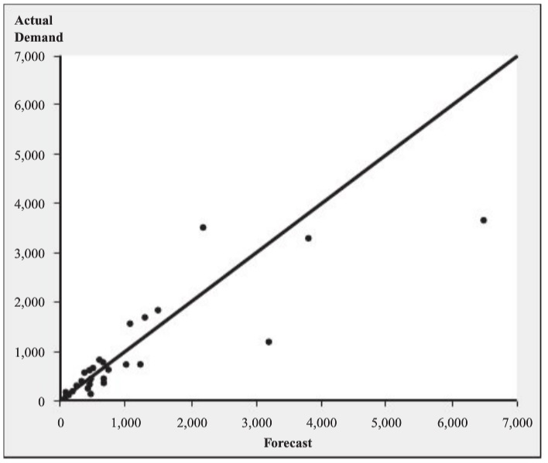
Constructing a Demand Forecast
Creating forecast
  Table 12.1: forecast and actual demand
    Actual demand?
  A/F ratio
    = Actual demand / Forecast
  Table 12.2: Sorted A/F ratios
    Expected A/F ratio: 0.9976
    Std. dev. of A/F ratio: 0.369
  Forecast: 3,200 units
    Considering redesign, market
    fashion trend, economy, etc.
  Actual demand
    = A/F ratio × Forecast
  Expected actual demand (μ) = Expected A/F ratio × Forecast = 3,192
  Std. dev. of demand = Std. dev. of A/F ratio × Forecast = 1,181

Slide 4
Constructing a Demand Forecast
Assumption
  Demand is normally distributed with μ = 3,192 and σ = 1,181
Demand distribution
  z-Statistics: z = (Q - μ) / σ
  F(Q) = Prob{Demand is less than or equal to Q} = Φ(z)
    where Φ(⋅) is the standard normal distribution function
  Table 12.3: standard normal distribution function table

Slide 5
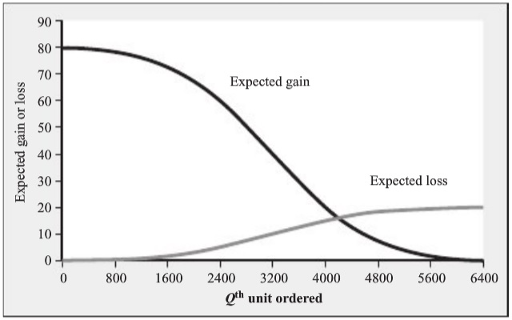
Expected Profit-Maximizing Order Quantity
Overage cost
  C_{o} = Cost – Salvage value = $20
  Loss when one unit is not sold
Underage cost
  C_{u} = Price – Cost = $80
  Gain when one unit is sold
Expected gain and
loss from Qth item
ordered
  C_{u} × (1 – F(Q))
  C_{o} × F(Q)

Slide 6
Expected Profit-Maximizing Order Quantity
Optimal order quantity, Q*
  C_{o} × F(Q*) = C_{u} × (1 – F(Q*))
  → F(Q*) = C_{u} / (C_{o} + C_{u}) = 80 / (20 + 80) = 0.8 (critical ratio)
  ∴ Q* = μ + z* × σ (where z* = Φ^{–1}(0.8) = 0.84)
  ∴ Q* = 3,192 + 0.85 × 1,181 = 4,196
  C.f. Appendix D
In case of discrete random demand
  Demand (for instance)
    25%: 2,200 units, 50%: 3,200 units, 25%: 4,200 units
   Round-up rule

Slide 7
Performance Measures
Expected lost sales
  = σ × L(z)
    where loss function L(z) = φ(z) – z⋅(1 – Φ(z)) with φ(x) = dΦ(x)/dx
  C.f. Appendix B, C, & D
  Q = 3,500 → z = 0.26 → E. lost sales = 1,181 × 0.2824 = 334
Expected sales
  Expected sales + Expected lost sales = Expected demand = μ
    ∴ Expected sales = μ – Expected lost sales
  Q = 3,500 → Expected sales = 3,192 – 334 = 2,858
     Expected sales is always less than expected demand
Expected leftover inventory
  Expected sales + Expected leftover inventory = Q
  Q = 3,500 → Expected leftover inventory = 3,500 – 2,858 = 642

Slide 8
Performance Measures
Expected profit
  = C_{u} × Expected sales – C_{o} × Expected leftover inventory
  Q = 3,500 → Expected profit = 80⋅2,858 – 20⋅642 = $215,800
In-stock probability and stockout probability
  In-stock probability = F(Q)
    Probability of end of season with satisfying all demand
  Stockout probability = 1 – F(Q)
  Q = 3,500 → z = 0.26 → F(Q) = Φ(z) = 0.6026
Choosing order quantity to meet service objective
  For minimum in-stock probability SL
  SL = 99% → z = Φ^{–1}(0.99) = 2.33 → Q = μ + 2.33⋅σ = 5,944
Fill rate
  = Expected sales / Expected demand
  Q = 3,500 → Fill rate = 2,858 / 3,192 = 89.5%

Slide 9
Managerial Lessons
Forecasting process
  Not only expected demand but also variability
  Tracking actual demand
    Lost sales? sales with discounted price?
  Tracking past forecast and forecast errors
Order quantity choice process
  Separated order quantity decision from forecasting process
    Marketing & operations departments
  Underestimate opportunity cost (from lost sales)
  Objective other than maximizing profit
    Customer service level, profit variability, etc.
    Fig. 12.6: trade-off between profit and service
  No ad hoc decision making (even though there is uncertainty)!!

