Slide 1
Service Levels and Lead Times in Supply Chains: Order-up-to Inventory Model
Spring, 2016
Matching Supply with Demand
Chapter 14
Byung-Hyun Ha

Slide 2
Introduction
Order-up-to model
  Used to manage inventory with multiple replenishments
  Still facing “too little–too much” problem
    Undesirable stockout (poor service) vs. inventory holding cost
   Newsvendor model (a single production)
Example: InSync’s Pacemaker
  Demand to DC
    Normally distributed with μ = 294 and σ = 122.38 (monthly)
  Demand to Susan
    Poisson-distributed with μ = 1.44 (weekly)
      → Exponentially distributed inter-arrival time
3 weeks
lead time
1 day
lead time
Production
DC
Susan

Slide 3
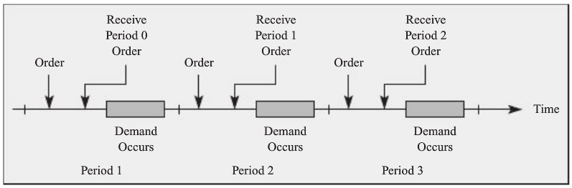
Order-up-to Model
Period, order, replenishment
Random demand
  Assume: same demand distribution represents demand in every period.
Lead time (l) (in integer periods)
Inventory leftover to the next period
  Assume: no obsolescence, theft, or spoilage

Slide 4
Order-up-to Model
On-hand inventory, on-order inventory
Back order
  Assume: no lost-sales on stockout (all demand is eventually filled)
     Order-up-to model is reasonable approximation if back orders are rare.
Inventory level
  = On-hand inventory – Back order
Inventory position
  = On-order inventory + On-hand inventory – Back order
  = On-order inventory + Inventory level

Slide 5
Order-up-to Model
Order-up-to level (S)
  Maximum inventory position that we are willing to have
Order quantity (at end of each period)
  = S – Inventory position
  = Demand in the previous period
Example
  S = 4, l = 2
  Demand: 2, 3, 0, 2, 1, 0, 2, ...
Inventory level at the end of a period
  = S – Demand over (l + 1) periods

Slide 6
Choosing Demand Distribution
Exhibit 14.1
  Suppose (random variables Y, X₁, X₂, ..., X_{n})
    Y = X₁ + X₂ + ... + X_{n}
    Expectation of X_{i} = μ and standard deviation of X_{i} = σ
    X_{i}’s are independent
  Then
    Expectation of Y = n × μ
    Standard deviation of Y = √n × σ
   If X_{i}’s are normally distributed, Y is normally distributed.
Example
  Expected weekly demand to DC
    = Expected monthly demand / 4.33 = 80.6
  Std. dev. of weekly demand to DC
    = Std. dev. of monthly demand / √4.33 = 58.81

Slide 7
Choosing Demand Distribution
Example (cont’d)
  Expected demand of 4 weeks to DC (l = 3)
    = Expected weekly demand × 4 = 322.4
  Std. dev. of demand of 4 weeks to DC
    = Std. dev. of monthly demand × √4 = 117.6
  Expected daily demand to Susan
    = Expected weekly demand / 5 = 0.29
  Expected demand of 2 days to Susan (l = 1)
    = Expected weekly demand × 2 = 0.58

Slide 8
Performance Measures
Settings
  DC: S = 625
  Susan: S = 3
Stockout probability
  = Prob{Inventory level at the end of a period < 0}
  = Prob{S – Demand over (l + 1) periods < 0}
  = Prob{Demand over (l + 1) periods > S}
  = 1 – Prob{Demand over (l + 1) periods ≤ S}
  DC: 1 – Φ(z) = 1 – Φ((625 – 322.4) / 117.6) = 1 – Φ(2.57) = 0.51%
  Susan: 1 – Prob{Demand over 2 days ≤ 3} = 0.30%
In-stock probability
  = 1 – Stockout probability
  = Prob{Demand over (l + 1) periods ≤ S}

Slide 9
Performance Measures
Expected back order
  Using loss function L.
  DC: σ × L(z) = 117.6 × L((625 – 322.4) / 117.6) = 0.19 units
  Susan: L(3) = 0.00335 units
Expected on-hand inventory
  = Expected inv. level at the end of a period + Expected back order
  = S – Expected demand over (l + 1) periods + Expected back order
  DC: 625 – 322.4 + 0.19 = 302.8 units
  Susan: 3 – 0.58 + 0.00335 = 2.42 units
Expected on-order inventory (pipeline inventory)
  = Expected demand in one period × Lead time (Little’s Law)
  DC: 80.6 × 3 = 241.8 units
  Susan: 0.29 × 1 = 0.29 units

Slide 10
Order-up-to Level to Meet a Service Target
Order-up-to level S for service level α
  = Minimum S that satisfies in-stock probability ≥ α.
  DC: 99.9% → S = μ + σ × Φ^{–1}(0.999) ≈ 322.4 + 117.62 × 3.08 = 685
  Susan: 99.9% → S = 4 (because F(3) = 0.997, F(4) = 0.9997)

Slide 11
Choosing Appropriate Server Level
Total cost of a period (to be minimized)
  = Cost of holding inventory + Cost of poor service
Cost of holding inventory
  Opportunity cost + cost of spoilage, obsolescence, insurance, storage, etc.
  Expressed as holding cost of a unit (h) for a period
  Susan: 75% gross margin → cost: (1 – 0.75) × Price
    h = 35% holding cost rate × (1 – 0.75) × Price / 260 days/year
    h = 0.000337 × Price
Cost of poor service
  Expressed as back-order penalty cost of a unit (b)
  Susan: b = 0.75 (gross margin) × Price ( assuming lost sales)
  DC: not easy (possibly via simulation)

Slide 12
Choosing Appropriate Server Level
Minimizing the total cost
  Approximation by newsvendor problem
    Expected inventory at the end of period
      = S – Demand over (l + 1) periods
    Expected back orders at the end of period
      = Demand over (l + 1) periods – S
    → Newsvendor problem
      Demand = Demand over (l + 1) periods
      Order quantity = S
      C_{u} = b, C_{o} = h
       Working well with rare back order (i.e., high in-stock probability)
  → Service level α that minimizes the total cost
    = C_{u} / (C_{o} + C_{u}) = b / (h + b)
    Susan: α = b / (h + b) = 99.96%
       “Too little–too much” problem with quite small C_{u}

Slide 13
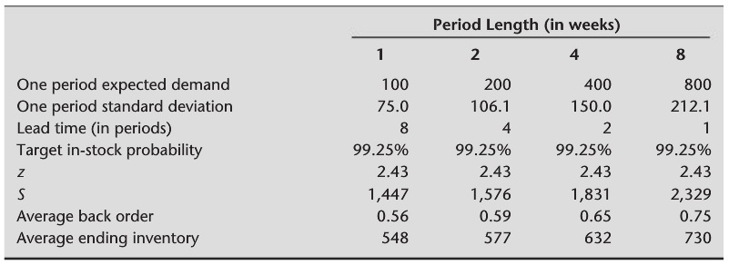
Controlling Ordering Cost
Determining order frequency
  ≡ Determining period length
  Case when ordering cost is not negligible
Example with lead time l = 8 weeks
  Weekly demand normally distributed with mean 100 and std. dev. 75
  α = 99.25%
  One period as 1, 2, 4, 8 weeks?
    Best period length when ordering cost is negligible or significant?

Slide 14
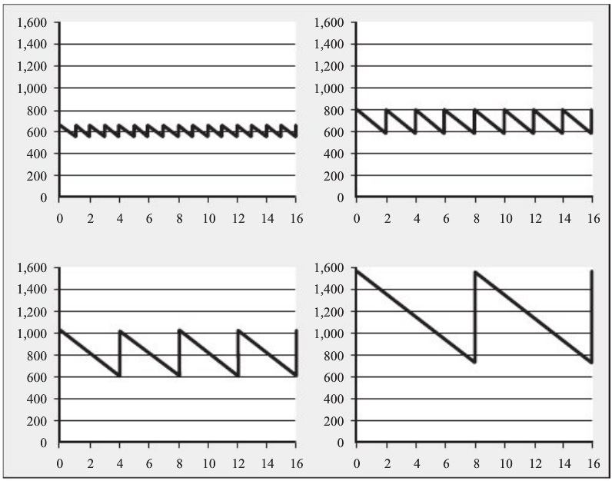
Controlling Ordering Cost
Example (cont’d)

Slide 15
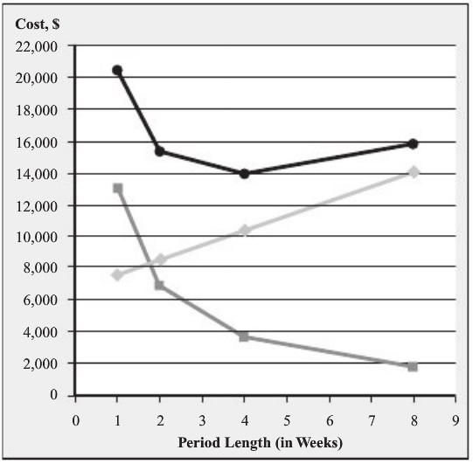
Controlling Ordering Cost
(Expected) Order frequency
  = (1 – Prob{Demand in one period = 0}) / Length of period
Example (cont’d)
  Holding and ordering cost
    Item cost: $50, annual holding cost rate: 25%
    Fixed cost per shipment: $275
  Total cost at 1 week period length
    Average inventory
      = 548 + 100 / 2 = 598
    Holding cost per year
      = $50 × 598 × 25% = $7,475
    Order frequency per year
      = 1 – Φ((0 – 100) / 75) / (1/52)
      = 0.91 × 52 = 47.53
    Order cost per year
      = $275 × 47.53 = $13,013

Slide 16
Controlling Ordering Cost
Approximation by EOQ model (Ch. 7)
  Q* = (2 × K × R / h)^{1/2}
    K: fixed ordering cost, R: annual demand, h: holding cost per unit
  Optimal period length = 1 / optimal order frequency
    = Q* / demand during one unit time
Example (cont’d)
  R = 100 × 52 = 5,200 units
  K = $275
  h = 25% × $50 = $12.5
  → Q* = (2 × K × R / h)^{1/2} = 478 units
  → Optimal period length = 478 / 100 = 4.78 weeks

Slide 17
Controlling Ordering Cost
Extensions (beyond the scope of textbook)
  Lead time that is not an integer number of periods
    e.g., a period = 4 weeks, lead time = 5 weeks
    e.g., a period = 1 day, lead time = 5 days
  Coordinating orders across multiple items
  Fixed order quantity model
    Varying time between orders
      → not easy to coordinate orders across multiple items
    Less safety inventory

Slide 18
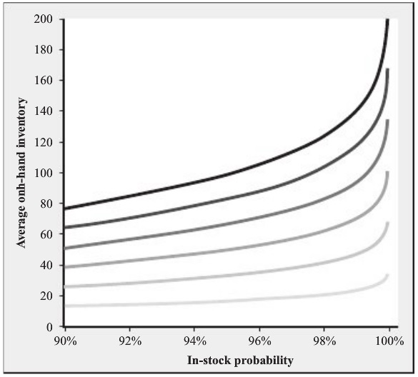
Managerial Insight
Variability in demand is costly.
  Example: on-hand inventory and in-stock probability
    Normal distributed demand with mean 100
    Std. dev. of demand over (l + 1) periods: 60, 50, 40, 30, 20, 10

Slide 19
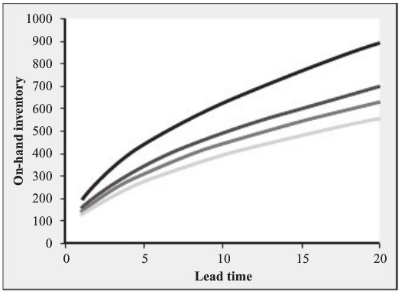
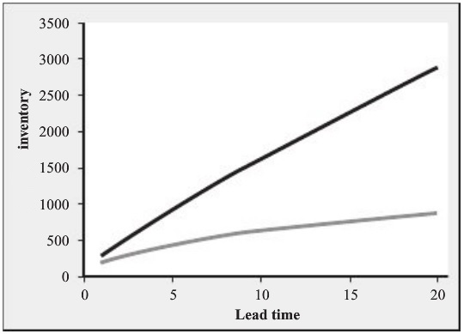
Managerial Insight
Lead time is costly.
  Example: on-hand inventory and lead time
    Normal distributed demand with mean 100 and std. dev. 60
    In-stock targets: 99.9, 99.5, 99.0, 98.0
  Example: on-hand inventory and pipeline inventory
    Normal distributed demand with mean 100 and std. dev. 60
    99.9 in-stock probability

