Slide 1
Batching and Other Flow Interruptions: Setup Times and the Economic Order Quantity model
Spring, 2016
Matching Supply with Demand
Chapter 7
Byung-Hyun Ha

Slide 2
Introduction
Batch flow in practice
  Causing flow interruption (no smooth item flow)
    Total inventory = Pipeline inventory (due to processing time) + α
  Mainly due to setups and variability (in processing times or quality levels) among others
  Setups: in this chapter -- cycle inventory
    Setup times -- batch production
    Setup costs -- batch ordering/production
  Variability: Ch. 8 & 9
  Quality: Ch. 10
Objective in this chapter
  To understand how setups influence the three basic performance measures: inventory, flow rate, and flow time

Slide 3
Impact of Setups on Capacity
Example: Xootr
  Milling machine with setup times for steer supports and ribs
Production cycle
Batch
Component set
Capacity given batch size
  = Batch size / (Setup time + Batch size × Processing time)

Slide 4
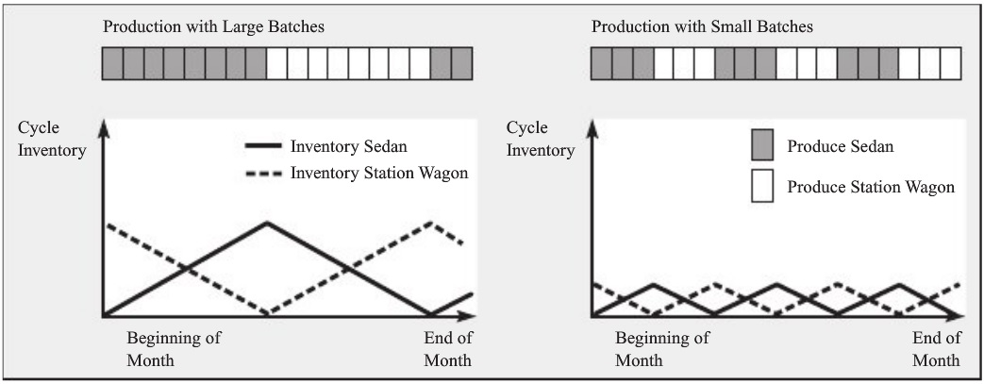
Interaction Between Batching & Inventory
Large batch size → increased capacity
  Great?
  No! Mismatch between the rate of supply and the rate of demand
Impact of batch sizes on inventory
  Max and average inventory level?
  Flow time? (Little’s Law)

Slide 5
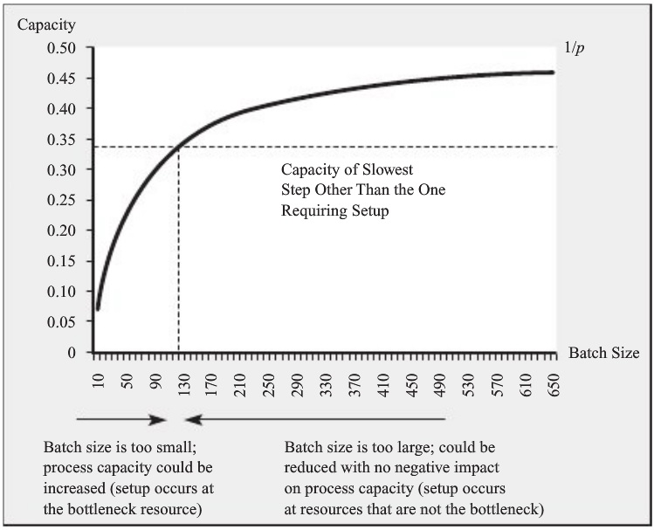
Choosing a Batch Size
Balance conflicting objective: capacity and inventory
  Bottleneck? Increase batch size.
  Nonbottleneck? Decrease batch size.

Slide 6
Setup Time Reduction
Setup times and product variety
  Henry Ford: “You can have any color Model-T you want, as long as it is black.”
Single minute exchange of die (SMED)
  Internal setup vs. external setup
For bottlenecks!

Slide 7
Economic Order Quantity (EOQ) model
Setup times of bottleneck
  Causing opportunity cost
Setup incurring direct costs
  Scrap of the first certain number of parts after setup
  Per-time-unit usage with setup time
  Fixed shipment cost
Economy of scale
  Spread out setup cost to items
Balancing setup cost with inventory cost
Two cases
  Batches delivered by an outside supplier
  Batches produced internally

Slide 8
Economic Order Quantity (EOQ) model
Average inventory
  = Order quantity (Q) / 2
Per unit time of cost, C(Q)
  = Setup cost + Inventory cost
Economic order quantity (Q*)

Slide 9
Observation Related to EOQ
Cost per unit of time with Q*, C(Q*)
  Sensitivity with regard to ordering fee (K) and flow rate (R)
Robustness in cost per unit of time
  e.g., Cost per unit of time with Q*/2
  Implications
    Ordering predefined quantity (e.g., multiples of 5,000)
    Hard-to-estimation of parameters
Quantity discounts
EOQ for everywhere?
  e.g., $9,000 milling machine for Xootr
  No.
    Setup at nonbottleneck is free.
    Setup at bottleneck incurs the cost from entire process capacity.

Slide 10
Other Flow Interruptions: Buffer or Suffer
Capacity of a continuous process flow
  Example
    3-step process
    2nd step only
      Production: 100 barrels/hour
      Setup time: 30 min following every four hours
      Capacity? 400 barrels / (0.5 + 4 hours) = 88.88 barrels/hour
    If 1st step’s capacity is 80 barrels/hour?
      2nd step’s capacity = 320 / (0.5 + 4) = 71.11 barrels/hour
Buffer can increase process capacity
  “Buffer or suffer”
  But how much minimally?

Slide 11
Summary
Batching
  Setup times and costs
Customer lead time, possibly
  Due to large inventory
  e.g., Paul Downs Cabinetmakers in Ch. 6
Extensions of EOQ model
  Perishability, learning effects, inflation, quality problems

Slide 12
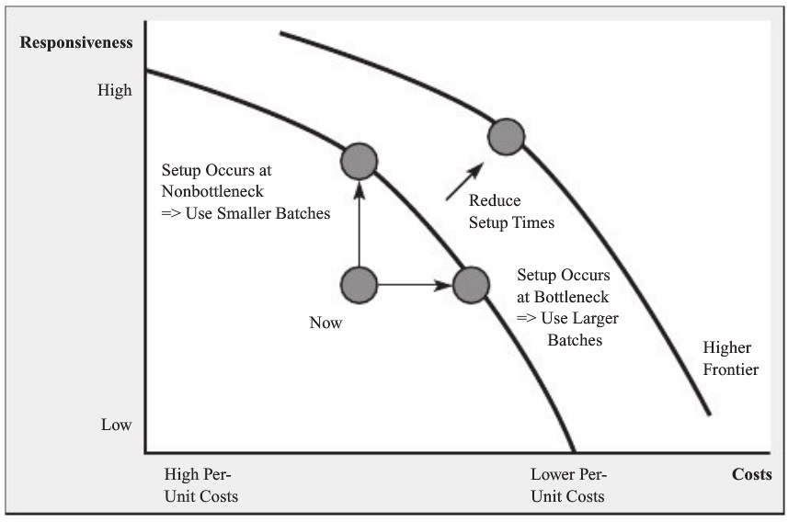
Summary
Choosing a batch size
  Reduce setup times and costs!

