Slide 1
Betting on Uncertain Demand: Newsvendor Model
Spring, 2016
Matching Supply with Demand
Chapter 12
Byung-Hyun Ha

Slide 2
Introduction
Newsvendor model
  Used to choose a single order (production) quantity before a single selling season with stochastic demand
  Trade-off between “doing too much” and “doing too little”
  e.g., newspapers, technology products, fashion items
Example: O’Neill’s Hammer 3/2 Wetsuit
  Price
    Purchase price from TEC: $110/unit
    Selling price: $190/unit
    Discount price at end of season: $90/unit (savage value)
  Demand (for instance)
    25%: 2,200 units, 50%: 3,200 units, 25%: 4,200 units
  Optimal order quantity?

Slide 3
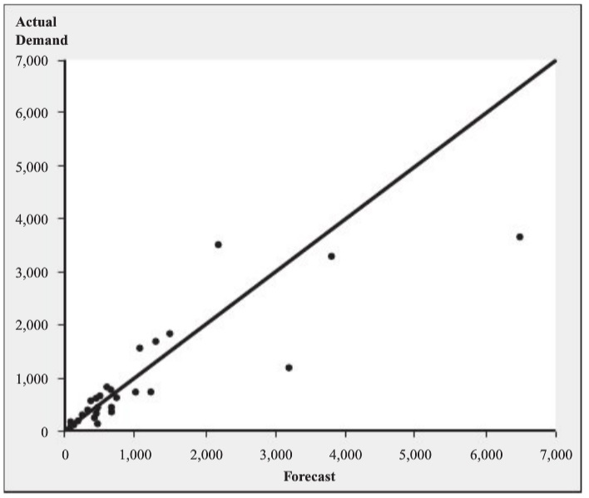
Constructing a Demand Forecast
Creating forecast
  Table 12.1: forecast and actual demand
    Actual demand?
  A/F ratio
    = Actual demand / Forecast
  Table 12.2: Sorted A/F ratios
    Expected A/F ratio: 0.9976
    Std. dev. of A/F ratio: 0.369
  Forecast: 3,200 units
    Considering redesign, market
    fashion trend, economy, etc.
  Actual demand
    = A/F ratio × Forecast
  Expected actual demand (μ) = Expected A/F ratio × Forecast = 3,192
  Std. dev. of demand = Std. dev. of A/F ratio × Forecast = 1,181

Slide 4
Constructing a Demand Forecast
Assumption
  Demand is normally distributed with μ = 3,192 and σ = 1,181
Demand distribution
  z-Statistics: z = (Q - μ) / σ
  F(Q) = Prob{Demand ≤ Q} = Φ(z)
    where Φ(⋅) is the standard normal distribution function
  Table 12.3: standard normal distribution function table

Slide 5
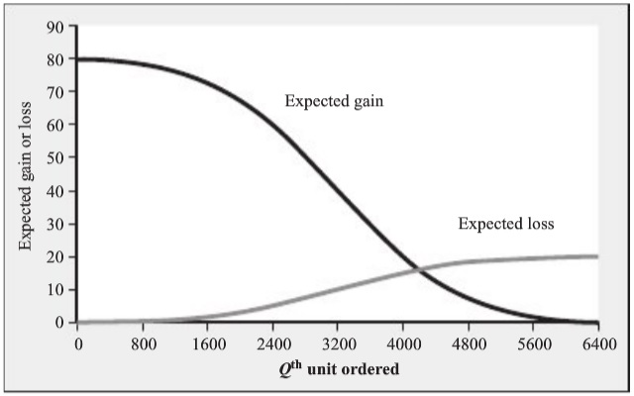
Expected Profit-Maximizing Order Quantity
Overage cost C_{o} and underage cost C_{u}
  C_{o} = Cost – Salvage value = $20
    Loss when one unit is not sold
  C_{u} = Price – Cost = $80
    Gain when one unit is sold (opportunity cost)
   Why using those?
Expected gain and
loss from Qth item
ordered
  C_{u} × (1 – F(Q))
  C_{o} × F(Q)

Slide 6
Expected Profit-Maximizing Order Quantity
Optimal order quantity Q*
  C_{o} × F(Q*) = C_{u} × (1 – F(Q*))
  → F(Q*) = C_{u} / (C_{o} + C_{u}) = 80 / (20 + 80) = 0.8 (critical ratio)
  ∴ Q* = μ + z × σ (where z = Φ^{–1}(0.8) ≈ 0.85)
  ∴ Q* = 3,192 + 0.85 × 1,181 = 4,196
  C.f. Appendix D
In case of discrete random demand
  Demand (for instance)
    25%: 2,200 units, 50%: 3,200 units, 25%: 4,200 units
   Round-up rule

Slide 7
Performance Measures
Expected lost sales (of order quantity Q)
  = σ × L(z)
    where loss function L(z) = φ(z) – z⋅(1 – Φ(z)) with φ(x) = dΦ(x)/dx
  C.f. Appendix B, C, & D
  Q = 3,500 → z = 0.26 → E. lost sales = 1,181 × 0.2824 = 334
Expected sales (of Q)
  = μ – Expected lost sales
     Expected sales + Expected lost sales = Expected demand = μ
  Q = 3,500 → 3,192 – 334 = 2,858
  Expected sales is always less than expected demand
Expected leftover inventory (of Q)
  = Q – Expected sales
  Q = 3,500 → 3,500 – 2,858 = 642

Slide 8
Performance Measures
Expected revenue (of Q)
  = Price × Expected sales + Salvage value × Expected leftover
  Q = 3,500 → $190 × 2,858 + $90 × 642 = $600,800
Expected profit (of Q)
  = C_{u} × Expected sales – C_{o} × Expected leftover inventory
  Q = 3,500 → E. profit = $80 × 2,858 – $20 × 642 = $215,800
  = Expected revenue – Purchase price × Q
  Q = 3,500 → E. profit = $600,800 – $110 × 3,500 = $215,800
In-stock probability and stockout probability (of Q)
  In-stock probability = F(Q)
    Probability of end of season with satisfying all demand
  Stockout probability = 1 – F(Q)
  Q = 3,500 → z = 0.26 → F(Q) = Φ(z) = 0.6026

Slide 9
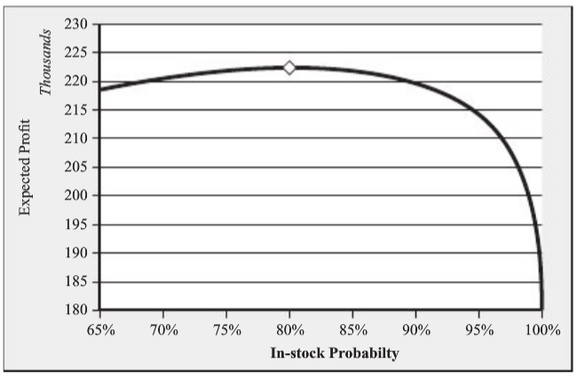
Performance Measures
Choosing order quantity to meet service objective
  For minimum in-stock probability SL
  SL = 99% → z = Φ^{–1}(0.99) = 2.33 → Q = μ + 2.33⋅σ = 5,944
Fill rate (of Q)
  = Expected sales / Expected demand
  Q = 3,500 → Fill rate = 2,858 / 3,192 = 89.5%

Slide 10
Managerial Lessons
Forecasting process
  Not only expected demand but also variability
  Tracking actual demand
    Lost sales? sales with discounted price?
  Tracking past forecast and forecast errors
Order quantity choice process
  Separate order quantity decision from forecasting process.
    Marketing & operations departments
  Don’t underestimate opportunity cost (from lost sales).
  Consider objectives other than maximizing profit.
    Customer service level, profit variability, etc.
    Fig. 12.6: trade-off between profit and service
  No ad hoc decision making (even though there is uncertainty)!!

