Slide 1
Revenue Management with Capacity Controls
Spring, 2016
Matching Supply with Demand
Chapter 16
Byung-Hyun Ha

Slide 2
Introduction
Up to now
  Focused on how the supply process can be better organized to make it more productive and responsive
Revenue management (yield management)
  Exploring how demand can be adjusted, when supply is so inflexible
  To maximize the revenue earned from a fixed supply
Examples
  Airline seats, hotel rooms (perishable and inflexible resources)
Topics in this chapter
  Protection levels/booking limits
  Overbooking

Slide 3
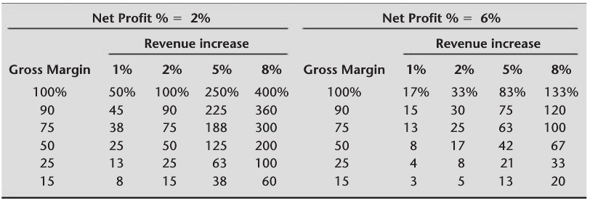
Margin Arithmetic
Profit
  = R × M – F = Net profit % × R
    R: revenue, M: gross margin as percentage of revenue, F: fixed cost
% change in profit
  = [{(100% + Revenue increase)×R×M – F} – (R×M – F)] / (R×M – F)
  = Revenue increase × R × M / (R×M – F)
  = Revenue increase × M / Net profit %

Slide 4
Protection Level and Booking Limit
Example: Park Hyatt Philadelphia
  Booking of 118 king/queen rooms for May 29th
  r_{l} = $159 discount fare for leisure travelers
  r_{h} = $255 regular fare for business travelers
    Number of business travelers: Poisson-distributed with μ = 27.3
Assumptions
  Zero variable cost (maximize-revenue → maximize-profit)
  Plenty of leisure travelers (low-fare demand)
  Earlier reservation by leisure travelers
First-come, first-served?
  Revenue: 118 × r_{l} = 118 × $159 = $18,762 (with high probability)

Slide 5
Protection Level and Booking Limit
A better way of controlling capacity
  Using high-fare protection level (Q) or low-fare booking limit
     High-fare protection level = Capacity – Low-fare booking limit
Determining optimal protection level, Q*
  (Newsvendor problem)
  Underage cost
    C_{u} = r_{h} – r_{l}
  Overage cost
    C_{o} = r_{l}
  Critical ratio
    C_{u} / (C_{o} + C_{u}) = (r_{h} – r_{l}) / r_{h} = (225 – 159) / 225 = 0.2933
  Q* = 24 rooms (F(23) = 0.2381, F(24) = 0.3040)

Slide 6
Protection Level and Booking Limit
Performance measures
  Expected high-fare bookings
    = Expected high-fare demand – Expected lost sales
    = μ – L(Q*) = 27.3 – 4.1 = 23.2
  Expected number of empty rooms
    = Q* – Expected high-fare bookings
    = 24 – 23.2 = 0.8
  Expected total revenue = $14,946 + $5,220 = $20,166
    Revenue from low-fare demand
      = (Capacity – Q*) × r_{l} = (118 – 24) × 159 = $14,946
    Expected revenue from high-fare demand
      = 23.2 × $225 = $5,220
    Expected revenue increase = ($20,166 – $18,762) / $18,762 = 7.5 %
  Maximum expected revenue
    27.3 × $225 + (118 – 27.3) × $159 = $20,564
    ($20,166 – $18,762) / ($20,564 – $18,762) = 78% capturing

Slide 7
Protection Level and Booking Limit
Revisit to assumptions
  If low-fare demand is limited
    Less valuable protected-level of high-fare
  If sum of low- and high-fare demand is lower than capacity
    No need to protect high fare
    → Protection level works in capacity-constrained situation.
  If some high-fare demand slips in before low-fare demand fills
    Revenue estimate without protection level $18,762 is too low.
More than two fare classes?
  Nested booking limits can be used.

Slide 8
Protection Level and Booking Limit
Characteristics of businesses conducive to application of booking limits
  The same unit of capacity can be used to sell to different customer segments.
  There are distinguishable customer segments.
    Using fences to discriminating between customer segments
      e.g., advanced purchase requirement, cancellation/change fees
  Capacity is perishable.
  Capacity is restrictive.
  Capacity is sold in advance.
    i.e., not allowed to cancel a low-fare reservation
  A firm has flexibility to charge different prices and may withhold capacity from certain segments. (No heath care industry!)
  A firm faces competition from a “discount competitor.”

Slide 9
Overbooking
No-shows in airline industry
  Estimated that prohibiting overbooking would cost world’s airlines $3 billion annually due to no-shows (Cross, 1995)
  Denying boarding to about one million passengers annually in U.S. (Stringer, 2002)
Overbooking
  Measured by number of additional reservation beyond capacity (Y)
  Required compensation for bumped customers
Example: Park Hyatt Philadelphia (cont’d)
  No-show: Poisson-distributed with μ = 8.5
  Assumption
    Number of no-shows is independent of number of reservations.
    There are plenty of customers and all rooms will be reserved always.

Slide 10
Overbooking
Determining optimal overbooking, Y*
  (Newsvendor problem)
  Underage cost
    C_{u} = r_{l}
  Overage cost
    C_{o} = Cost per bumped customer
  Critical ratio
    C_{u} / (C_{o} + C_{u}) = 159 / (350 + 159) = 0.3124
  Y* = 7 units (F(6) = 0.2562, F(7) = 0.3856)

Slide 11
Implementation of Revenue Management
Demand forecasting
  “Garbage in, garbage out”
  Complicated by seasonality, special events, changing fares (own & competitors), truncation
  Revenue management decisions themselves might influence demand.
Dynamic decision
Variability in available capacity
  e.g., aircraft type switch, car rental company
Reservation coming in groups
Effective segmenting of customers
  Fences are not perfect.

Slide 12
Implementation of Revenue Management
Multiple fare classes
Software implementation
Variation in capacity purchase
  Not all customers purchase one unit of capacity.
    e.g., Chicago → New York vs. Chicago → New York → London
  Some solutions
    O-D control
    Virtual nesting
    Bid price

