Slide 1
Impact of Variability on Process Performance: Throughput Loss
Spring, 2016
Matching Supply with Demand
Chapter 9
Byung-Hyun Ha

Slide 2
Introduction
Throughput loss, from
  limited buffer size
  impatient flow units
More complicated than Ch. 8
  Focusing on simplest case, where buffer size is zero
  e.g., a trauma center
Motivating example: why average do not work
  Table 9.1
  Flow rate = min{Demand, Capacity} = ?
  With inventory or buffer?

Slide 3
Throughput Loss for a Simple Process
Trauma center
  Arrival: every a = 3 hours (exponentially distributed)
  Processing: p = 2 hours per patient (general distribution)
  Servers: m = 3 bays
Question
  Percent of time when all servers are busy (P_{m})?
  Flow rate?
Analysis
  Capacity = m / p = 1.5 patients per hour
  Implied utilization u = Demand rate / Capacity = 0.33 / 1.5 = 0.22
  Let r = u⋅m = (1 / a) / (m / p) × m = p / a = 0.67
  P_{m} = 0.0255 (Erlang loss formula)
  Flow rate = Demand rate × (1 – P_{m}) = 1/3 ⋅ 0.975 = 0.325

Slide 4
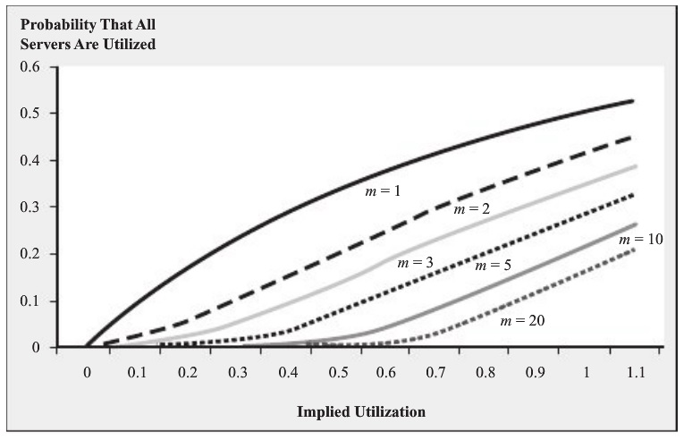
Throughput Loss for a Simple Process
Economy of scale (effect of pooling)?
  50% utilization, m = 1 or 3 or 10

Slide 5
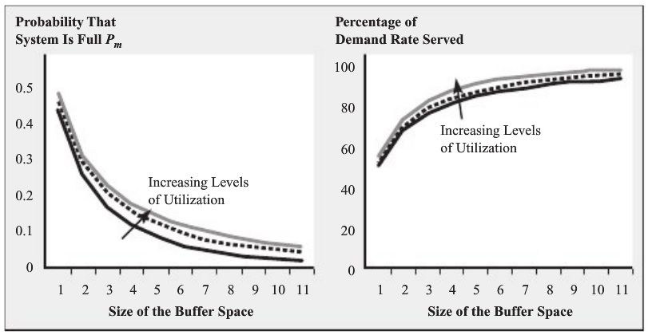
Customer Impatient and Throughput Loss
Two extreme cases
  Patient flow unit vs. no buffer
Intermediate cases
  Limit of buffer size but patient flow unit
    Throughput = (1 – Probability of buffer full) × Demand rate
  Balking

Slide 6
Customer Impatient and Throughput Loss
Improvement opportunity
  Reduce wait time.
  Increase the maximum number of flow units that can be in buffer.
  Avoid customers leaving that have already waited.

Slide 7
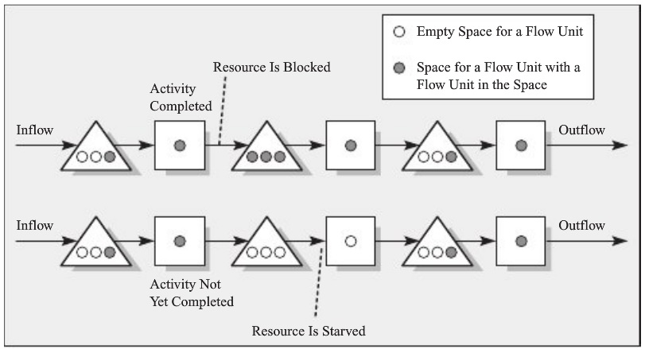
Several Resources in Sequence
Role of buffers
  Avoiding resource blockage and starvation
  Decoupling inventory
  Right before and after bottleneck

Slide 8
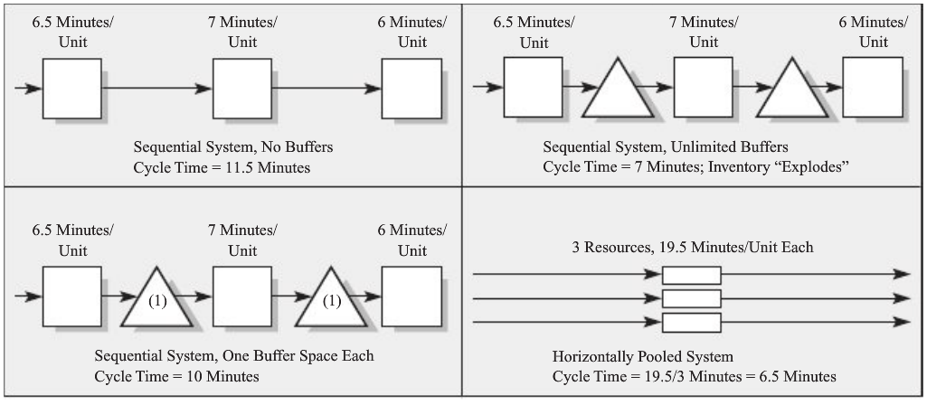
Several Resources in Sequence
Example four configuration
  Capacity-constrained

Slide 9
Summary
Variability
  Not only high inventory and long waiting time
  But also losses in throughput
Implications
  Use buffers.
  Keep track of demand.
  Use background work.

