Slide 1
Assemble-to-Order, Make-to-Order, and Quick Response with Reactive Capacity
Spring, 2016
Matching Supply with Demand
Chapter 13
Byung-Hyun Ha

Slide 2
Introduction
Two extremes
  Make-to-stock
    All items enter finished goods inventory before they are demanded.
    Unavoidable demand-supply mismatch (newsvendor problem)
  Make-to-order or assemble-to-order
    Delay of production until better demand information is learned
Quick response with reactive capacity
  Placing multiple orders during selling seasons based on unveiled demand of early season
  Conservative initial order followed by second order to respond to initial season sales
    Slow-selling products → no replenishment → reducing leftover
    Fast-selling products → replenishment → reducing lost sales

Slide 3
Demand-Supply Mismatch Cost
Terms
  (Expected demand-supply) mismatch cost
Mismatch cost (of order quantity Q)
  = (C_{o} × Expected leftover inventory) + (C_{u} × Expected lost sales)
  Q = 4,196 → ($20 × 1,134) + ($80 × 130) = $33,080
Mismatch cost (crystal ball approach)
  = Maximum profit – Expected profit
    (Expected) maximum profit = C_{u} × μ
       Assuming perfect demand information
  Q = 4,196 → $255,360 – $222,280 = $33,080
    $222,280 ≤ Expected profit with reactive capacity ≤ $244,960
   Price of crystal ball?
   Order quantity that minimizes mismatch cost?

Slide 4
Demand-Supply Mismatch Cost
How big is mismatch cost $33,080?
  To maximum profit
    $33,080 / $255,360 = 13%
  To expected sales
    $33,080 / 3,062 = $10.8 / unit
  To expected profit
    $33,080 / $222,280 = 14.9%
  To revenue
    $33,080 / $683,840 = 4.8%
     Net profit in range of 2% to 5% of revenue, in sport apparel

Slide 5
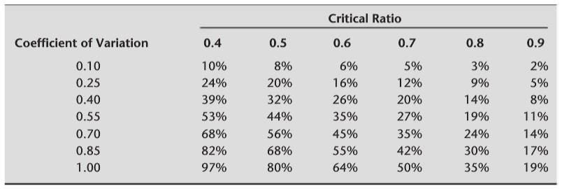
When Is Mismatch Cost High?
Settings
  Evaluating mismatch cost with regard to maximum profit
  Ordering Q* = μ + z⋅σ, which maximizes expected profit
Mismatch cost as % of the maximum profit
  = (φ(z) / Φ(z)) × (σ / μ)
    Appendix D (assuming normally distributed demand)
  Forecast accuracy by coefficient of variation σ / μ (Table 13.2)
  Critical ratio C_{u} / (C_{o} + C_{u}) ↑ → z ↑ → φ(z) / Φ(z) ↓
    Intuition? What kind of products?

Slide 6
Reducing Mismatch Cost by Make-to-Order
Make-to-order or assemble-to-order
  No leftover inventory, no lost sales → no mismatch cost
Cons
  Component inventory
  Long lead time
    Low utilization or idle capacity cost
      Ensuring reasonably short waiting time in queue
    Fast production or assembly cost
    Fast shipping cost, close-to-customer-location cost
      Including labor cost
  Lost sales by impatient customers
Examples
  Dell, automobile industry, Koss Corp.

Slide 7
Quick Response with Reactive Capacity
Using reactive capacity
  Initial order → some demand observation → additional orders
  In between make-to-stock and make-to-order
Settings
  One additional (second) order with 20% higher purchase price
Assumptions
  No running out of inventory before the second order arrives
  Perfect prediction of demand in the remaining of season
   Reasonable?
Another newsvendor problem
  Too-much: same (leftover inventory at the end of season)
  Too-little: no lost sales but second order at the higher cost

Slide 8
Quick Response with Reactive Capacity
Optimal initial order quantity Q*
  C_{o} = Cost – Salvage value = $20
  C_{u} = 20% × Cost = $22
  Critical ratio C_{u} / (C_{o} + C_{u}) = 0.5238
  ∴ Q* = μ + z × σ (where z = Φ^{–1}(0.5239) ≈ 0.06)
  ∴ Q* = 3,192 + 0.06 × 1,181 = 3,263 ( 4,196 without reactive)
Performance measures
  Expected second order quantity
    = Expected lost sales without reactive ( no lost sales actually)
    = σ × L(z) = 1,181 × L(0.06) = 437
  Expected leftover inventory
    = Expected leftover inventory without reactive
    = Q* – Expected sales without reactive
    = Q* – (μ – Expected lost sales without reactive) = 508

Slide 9
Quick Response with Reactive Capacity
Performance measures (cont’d)
  Mismatch cost
    = (C_{o} × E. leftover inventory) + (C_{u} × E. second order quantity)
    = ($20 × 508) + ($22 × 437) = $19,774
  Expected profit = Maximum profit – Mismatch cost
    = $255,360 – $19,774 = $235,586
Benefit from quick response
  Increased profit
    ($235,586 – $222,280) / $222,280 = 6.0%
  Reduced mismatch cost
    1 – $19,774 / $33,080 = 40%
  Decreased leftover inventory
    1,134 to 508
  Increased in-stock probability
    80% to 100%

