Slide 1
Risk-Pooling Strategies to Reduce and Hedge Uncertainty
Spring, 2016
Matching Supply with Demand
Chapter 15
Byung-Hyun Ha

Slide 2
Introduction
Reducing and hedging uncertainty in some ways
  Quantifying uncertainty
    Demand forecasting
  Queuing, newsvendor, order-up-to
    Combined servers, make-to-order, reactive capacity
Risk pooling in this chapter
  By redesigning the supply chain, the production process, or the product
  To mitigate the consequence of uncertainty by reducing or hedging the uncertainty

Slide 3
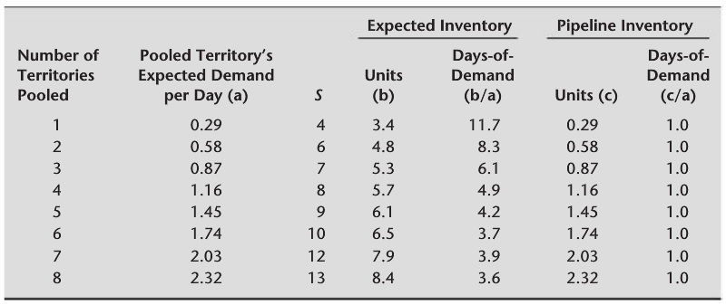
Location Pooling
Newsvendor and order-up-to models
  Focusing on single location
Example: pooling Pacemaker sales rep.’s inventory
  E. inv. in days-of-demand = E. inv. in units / E. daily demand

Slide 4
Location Pooling
Impact of pooled inventory
  Why? Decreased variability. (Fig. 15.1)
    Coefficient of variation of Poisson distribution
      = Std. dev. / Mean = √Mean / Mean
  Decreasing marginal returns → good news
    More territories pooled, more complicated operations
  Alternatives
    Maintaining the same inventory with higher service (Table 15.2)
    Reduce inventory and increase service simultaneously (Fig. 15.2)
  Some concerns
    Longer distance from customers, additional storage & handling cost
    Reducing theft and spoilage & shipping costs
     Virtual pooling
      Sharing inventory information without physically sharing
  Pipeline inventory?

Slide 5
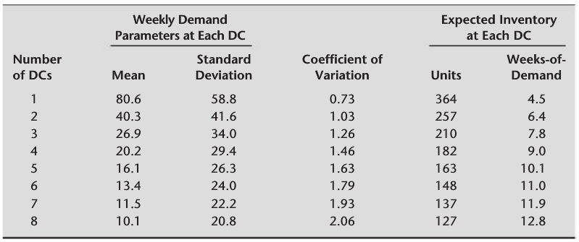
Location Pooling
Example: subdividing Pacemaker’s DC inventory
  Increased variability: Std. dev. (n DCs) = Std. dev. / √n
Electronic commerce
  Lower inventory by pooling but long-distance logistics
  Beneficial in case of slow-moving items

Slide 6
Product Pooling
Example: “universal design” of wetsuits
  Two types of Hammer 3/2
    Same demand distribution (normal): μ₁ = μ₂ = 3,192, σ₁ = σ₂ = 1,181
    Critical ratio = 0.8
  Serving separately
    Q₁* = Q₂* = 4,196
    Expected total profit = 2 × $222,280 = $444,560
  Combining to single product by universal design
    μ = μ₁ + μ₂ = 6,384, σ = (σ₁² + σ₂²)^{1/2} = 1,670
    Same critical ratio
    Q* = 7,804
    Expected profit = $463,920
    → Increase in 1.4% of expected revenue
       Profit is 2~5% of revenue in this industry

Slide 7
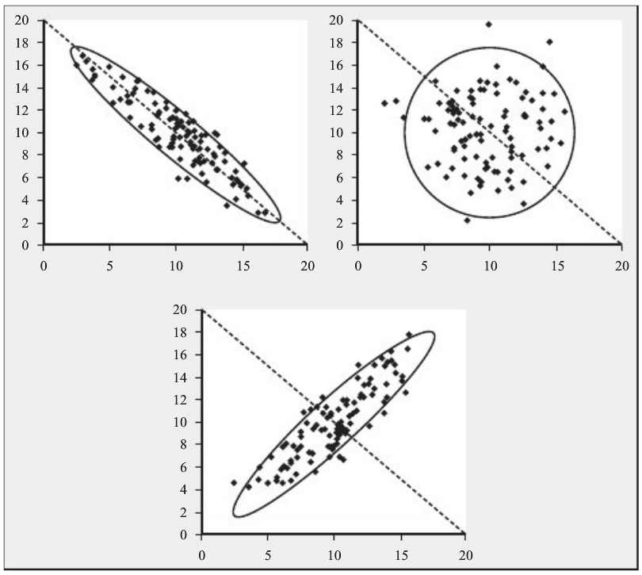
Product Pooling
Why? Decreased variability.
Always? No. It depends on correlation of demands
  Correlation
    Negative
    Zero (≡ independent)
      Previous cases
    Positive
  This also applies to
  location pooling.

Slide 8
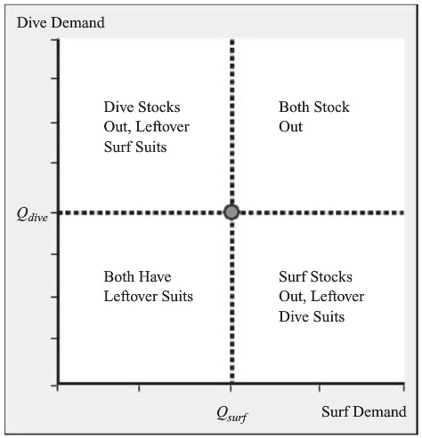
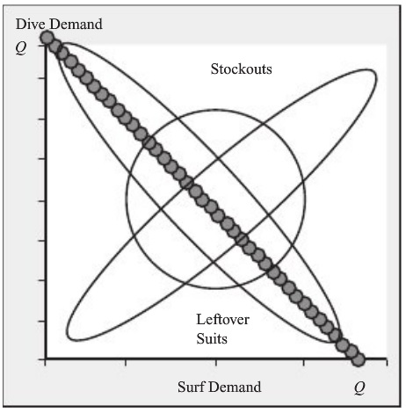
Product Pooling
Outcomes of combining two demands with μ and σ
  Expected pooled demand = 2 × μ
  Std. dev. of pooled demand = (2 × (1 + Correlation))^{1/2} × σ
    C.f. Appendix A

Slide 9
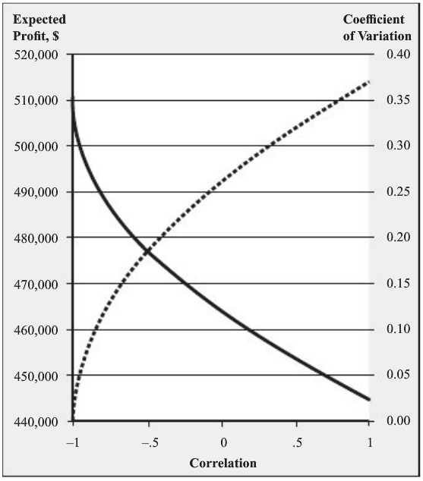
Product Pooling
Outcomes of combining two demands (cont’d)
  Coefficient of variation of pooled demand
    = (1/2 × (1 + Correlation))^{1/2} × σ/μ
  Supposing to use optimal order
  quantity
  Correlation = 1
    Expected profit = $444,560
      Same as separation
  Correlation = –1
    Expected profit = C_{u} × μ
      Maximum profit
Positive or negative?
  e.g., economic conditions
  e.g., same total demand

Slide 10
Product Pooling
Some drawbacks
  Difficulty of providing needed functionality
    e.g., road bikes & mountain bikes ⬄ hybrid bikes
  Expensive
  Losing brand/price segmentation opportunities
Yet
  No excessive product proliferation!

Slide 11
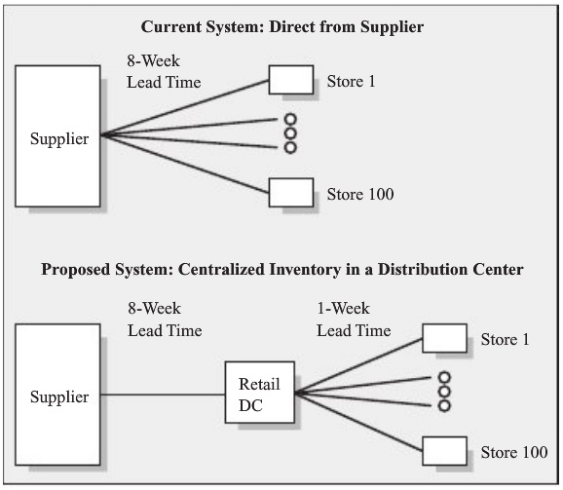
Lead Time Pooling: Consolidated Distribution
Consolidated distribution
  Providing some of benefits of location pooling without moving inventory far away from customers
Example
  Single product
  100 stores
  Demand per store
    Poisson distribution
    μ = 0.5 / week
    σ = √0.5 = 0.707
  Order-up-to model
  99.5% in-stock prob.

Slide 12
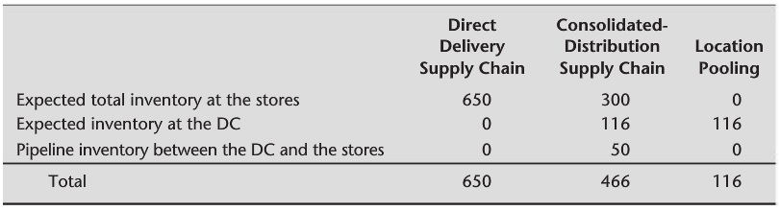
Lead Time Pooling: Consolidated Distribution
Performance analysis
  1. Direct delivery supply chain
  2. Consolidated-distribution supply chain
    DC’s demand: approximated to normal distribution
      μ = 100 × 0.5 = 50
      σ = 15 > 0.707 × √100 (positive correlated)
    Pipeline inventory between DC and stores
  3. Location pooling

Slide 13
Lead Time Pooling: Consolidated Distribution
Benefits from consolidated distribution
  Reducing expected inventory investment by 28%
  Reducing retail inventory by more than 50%
     Higher holding cost at store-side (shelf space, shrinkage, ...)
Why better even with longer total lead time?
  Direct delivery: uncertainty with total demand & demand allocation
  Consolidated distribution: less uncertainty with demand allocation
Lead time pooling
  Combining the lead times for multiple inventory location
    e.g., from supplier to retail DC

Slide 14
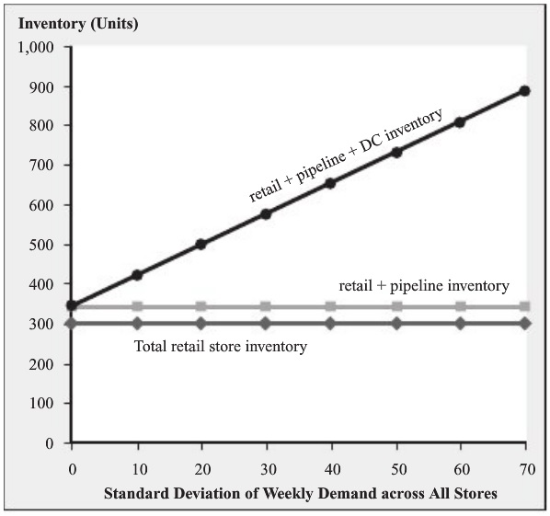
Lead Time Pooling: Consolidated Distribution
Effect of correlation
  More positively correlated, more std. dev. across all stores
   Outperforming direct delivery when std. dev < about 40

Slide 15
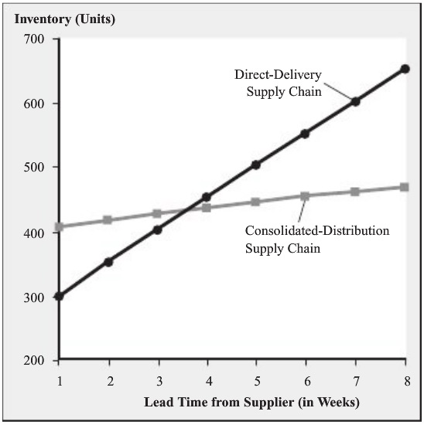
Lead Time Pooling: Consolidated Distribution
Effect of lead time from supplier
   Lead time before DC should be longer than lead time after DC.

Slide 16
Lead Time Pooling: Consolidated Distribution
Other effects than inventory impact
  Additional costs
    Extra cost of operating DC, extra transportation cost from DC to retailers
  Additional benefits
    Taking better advantage of temporary price discount (Ch. 17)
    More frequent delivery from DC to retail stores
      e.g., direct delivery: weekly (long-interval) shipment to avoid LTL (less-than-truck-load)
       Hub-and-spoke
      → Further reducing inventory (Ch. 14)
    Possibly more frequent delivery from supplier to DC

Slide 17
Lead Time Pooling: Delayed Differentiation
Delayed differentiation
  Providing some of benefits of product pooling without taking the variety away from customers
Example: Hammer 3/2 wetsuit
  Delayed differentiation by printing different logos
    Offering multiple wetsuits, so their demands are not pooled together as with a universal design
  Operational & technical challenges
    Silk-screening logo onto the generic wetsuit
    Quick silk-screening for fast delivery (required idle capacity)
    Suppose these challenges are resolved!
  Performance analysis
    Same as product pooling

Slide 18
Lead Time Pooling: Delayed Differentiation
Ideal strategy when
  1. Customers demand many versions, i.e., variety is important.
    If not, use universal design.
  2. There is less uncertainty with respect to total demand than there is for individual versions.
  3. Variety is created late in the production process.
    Analogous to long lead time from supplier to DC in consolidated distribution
  4. Variety can be added quickly and cheaply.
  5. The components needed to create variety are inexpensive relative to the generic component.

Slide 19
Lead Time Pooling: Delayed Differentiation
Some suitable products
  Drills in different packages for Home Depot and Walmart
  Paint: too huge possibility (variety)
    Retail inventory? No.
    Location pooling? No. (costly shipping, long customer waiting time)
    → Delayed differentiation in 5~15 min at retail store, with extra cost for in-store mixing equipment
  Generic components that can be sold without addition processing
    Holding fast printers and slow printers? No, only fast printers.
 Make-to-order, assemble-to-order

Slide 20
Capacity Pooling with Flexibility
Delayed differentiation
  Flexible capacity at the end of manufacturing process
  Complete flexibility? Extremely expensive. → Flexible capacity!
Example: GM with 10 plants and 10 models
  Demand for each model: μ = 100, σ = 40
    Normally-distributed, independent (zero correlation)
  Capacity for each plant: 100
    Lost sales on stockout

Slide 21
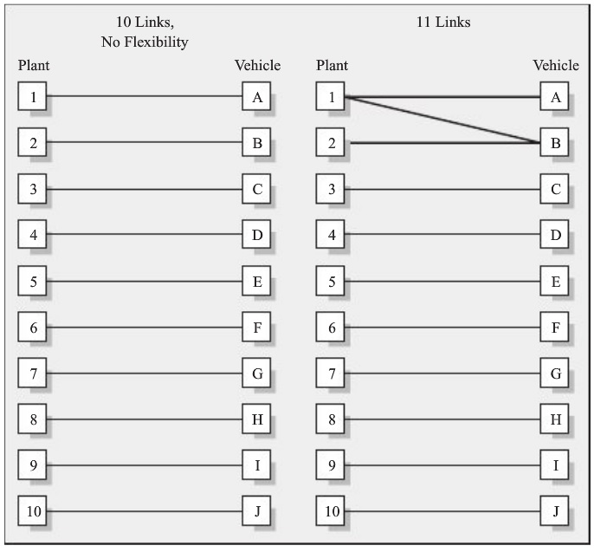
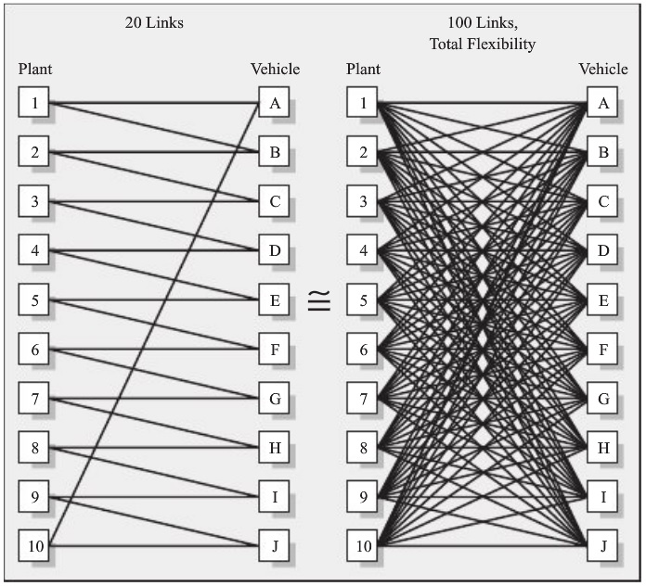
Capacity Pooling with Flexibility
Configuration of flexible capacity
  Measured by links and chains

Slide 22
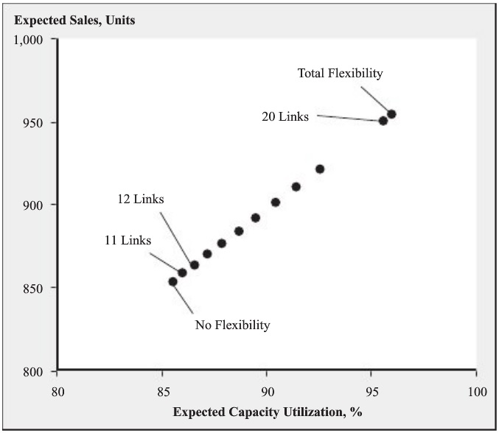
Capacity Pooling with Flexibility
Performance analysis
  Using simulation by supposing optimal allocation of production
  Adding 10 addition links produces nearly the same outcome as full flexibility.

Slide 23
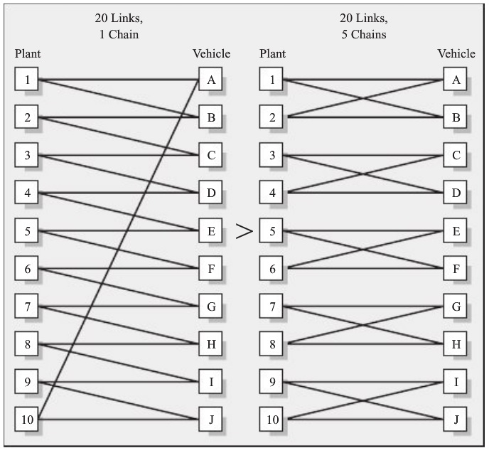
Capacity Pooling with Flexibility
Chaining
  20 links, 5 chains
    896 expected sales
  In general, longest and fewest chains perform best.
    Why?
  Negatively correlated products will be part of same chain.
  Long chain enables to avoid (very expensive) flexibility for quite different products.

Slide 24
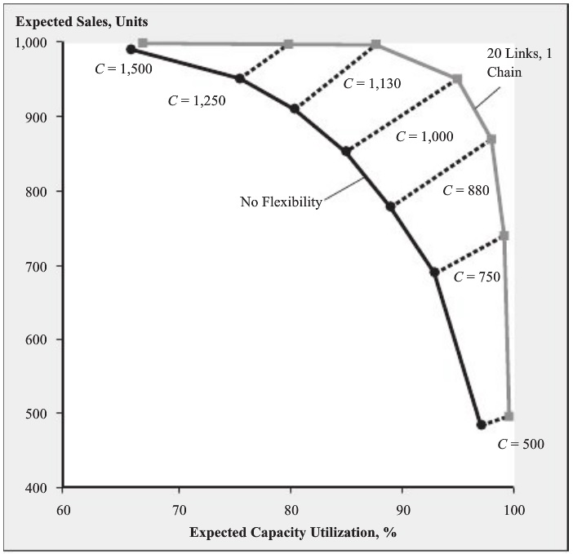
Capacity Pooling with Flexibility
Available capacity to effective flexibility
  Capacity of each plant is too low (e.g., 20) or too high (e.g., 180)?
    Flexibility has no value.
    Flexibility is valuable
    when capacity and
    demand are similar.
  Flexibility and capacity
  are substitutes.
    For 950 expected sales,
      Capacity 1,250 with
      no flexibility, or
      Capacity 1,000 with
      20-link flexibility
    Decision depends on
    which one is expensive.

Slide 25
Capacity Pooling with Flexibility
Contract manufacturing industry
  Who sells capacity
  e.g., Hon-Hai Precision (Foxconn)
Cross-train workers
  It is not necessary to handle every task (full-flexibility).

Slide 26
Summary
Strategies that exploit risk pooling to better match supply and demand
  Location pooling, consolidated distribution
  Product pooling, delayed differentiation
  Capacity pooling
Some consistent observations
  A little bit of risk pooling goes a long way.
  Risk-pooling strategies are most effective when demands are negatively correlated.
  Risk-pooling strategies do not help reduce pipeline inventory.

