Slide 1
Variability and Its Impact on Process Performance: Waiting Time Problem
Spring, 2016
Matching Supply with Demand
Chapter 8
Byung-Hyun Ha

Slide 2
Introduction
Waiting time
  For customers, most visible and annoying forms of supply-demand mismatches
Types of waiting time
  Predictable -- due to more than 100% implied utilization level (seasonal)
  Unpredictable -- due to the presence of variability even with enough capacity
Objective of this chapter
  To predict waiting times and derive some performance metrics capturing the service quality provided to customers
  To recommend ways of reducing waiting time by choosing appropriate capacity levels, redesigning the system, and outlining opportunities to reduce variability

Slide 3
Motivating Example: Unrealistic
Example: An-ser Services
  Flow rate = 12 calls/hour (arrival every 5 min)
  Capacity = 15 calls/hour (4 min processing)
  Utilization?
  Waiting time?
Fig. 8.2: Data gathered at a call center
Fig. 8.3: Detailed analysis of the call center
  Most customers waiting
  Idle times repeatedly
Why does variability not averaged out over time?
  There cannot be inventory.
   Buffer or suffer

Slide 4
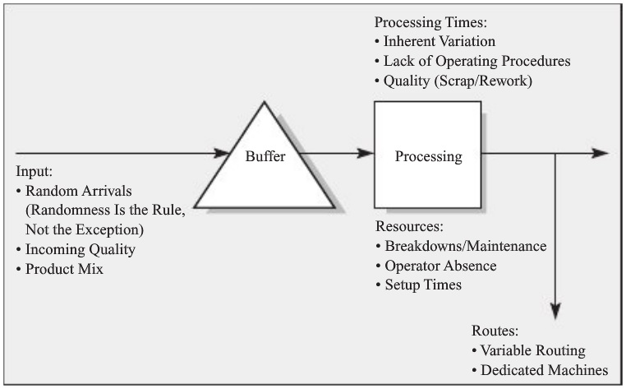
Variability: Where From and How Measured
Variability and where it comes from?

Slide 5
Variability: Where From and How Measured
Measurement of variability
  Standard deviation?
    e.g., does 5 min indicate high variability?
  Coefficient of variation (CV)
    = Standard deviation / Mean

Slide 6
Analyzing an Arrival Process
Stationary arrivals
  When the arrival process does not vary systematically over time
     Seasonality
  Testing: Fig. 8.7
     http://www.maths.bris.ac.uk/~guy/Research/LSTS/TOS.html
Exponential interarrival times
  Poisson arrival process
  Memoryless property
  Testing : Fig. 8.9
CV_{a}
  = Standard deviation of interarrival time / Average interarrival time
Fig. 8.10: How to analyze a arrival process

Slide 7
Processing Time Variability
Assume: stationary service process
CV_{p}
Numerous different shapes of processing time distribution
  We focus on only the mean and the standard deviation.

Slide 8
Average Waiting Time (One Resource)
Assume: no customers leave before service
Utilization, u
  u = Flow rate / Capacity = 1/a / 1/p = p / a < 100%
Flow time, T
  T = Time in queue + Processing time = T_{q} + p
Time in queue, T_{q}
  For stationary process
    M/G/1 → exact
    G/G/1 → approximation
  WRT p (utilization is function of p)
  2nd factor: utilization effect
  3rd factor: variability effect

Slide 9
Average Waiting Time (One Resource)
Overall inventory in system, I
  I = I_{q} + I_{p}
 I_{p}
  By Little’s Law, or
  I_{p} = Pr(server idle) × 0 + Pr(server busy) × 1 = (1 – u)⋅0 + u⋅1 = u
Long-run average!
Transient vs. steady-state

Slide 10
Average Waiting Time (Multiple Resource)
Number of servers, m
Utilization
  u = p / a⋅m
Flow time
Time in queue
  M/G/1 → approximation
  Works well for most settings, specifically if u/m is high

Slide 11
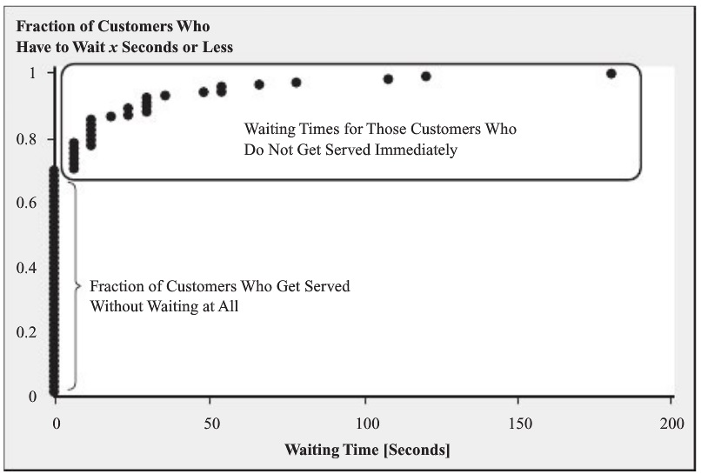
Service Levels in Waiting Time Problems
Average waiting time vs. waiting time of each customer
Target waiting time (TWT)
Service level (common performance measure)
  = Pr(Waiting time ≤ TWT)
Fig. 8.17
  Average: about 10 sec
  TWT = 30 → 90% SL
Formula? No.
  Except M/M/1
  Simulation

Slide 12
Economic Implication: Staffing Plan
Balancing
  Cost of waiting (e.g., line charges and customer dissatisfaction)
  Cost of service (e.g., labor cost of customer service rep.)
Fig. 8.18: Economic consequences of waiting
Number of CSRs to support target waiting time
  Table 8.2
Cost of direct labor
  = Total wages per unit of time / Flow rate = p × wage rate / u
Economic implication of various staffing levels
  Table 8.3
  Caution! No cost for customers’ waiting
Staffing plan for nonstationary arrival: Fig. 8.19

Slide 13
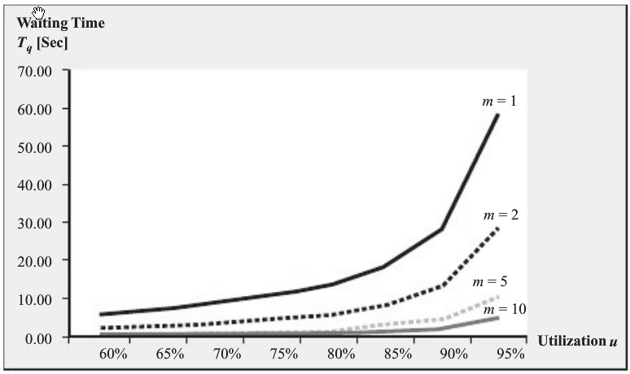
Impact of Pooling: Economy of Scale
Fig. 8.20: Concept of pooling
Reducing waiting time by pooling

Slide 14
Impact of Pooling: Economy of Scale
Pooling works always?
  Needed consistent service
  High job switching (setup) cost
  Needed broader range of skills
    Can increase variability

Slide 15
Priority Rules in Waiting Lines
Processing-time-dependent rules
  e.g. Shortest processing time (SPT) rule
    Minimizes average flow time
Processing-time-independent rules
  e.g. First-come, first-served (FCFS) rule
    Minimizes variance of flow time

Slide 16
Reducing Variability
Reducing arrival variability
  Appointment systems
   Reducing seasonality
    Early-bird specials restaurants or bars
Reducing processing time variability

Slide 17
Summary
Tradeoff between efficiency and responsiveness
Capacity-related improvement
System-design related improvement

