Slide 1
Introduction
Spring, 2016
Matching Supply with Demand
Chapter 1
Byung-Hyun Ha

Slide 2
Introduction
Effective production operations management
  → Matching supply and demand
  Results of supply-demand mismatch
Examples
  British Airway

Slide 3
Learning Objective and Framework
Tools of operations management
  Quantitative model
    Some math. procedure or equation, giving
      what to do
      relevant performance measure
  Qualitative strategy
    Guiding principle

Slide 4
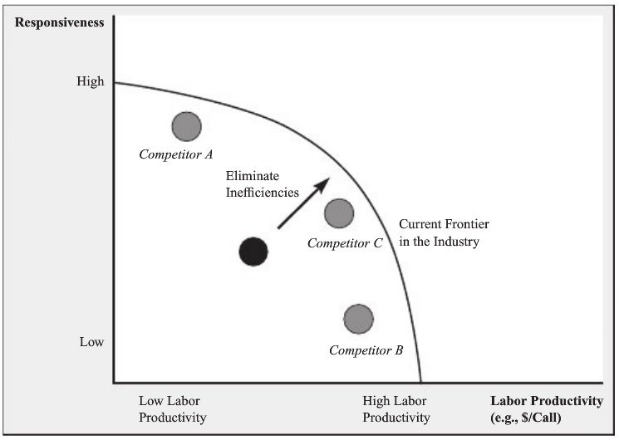
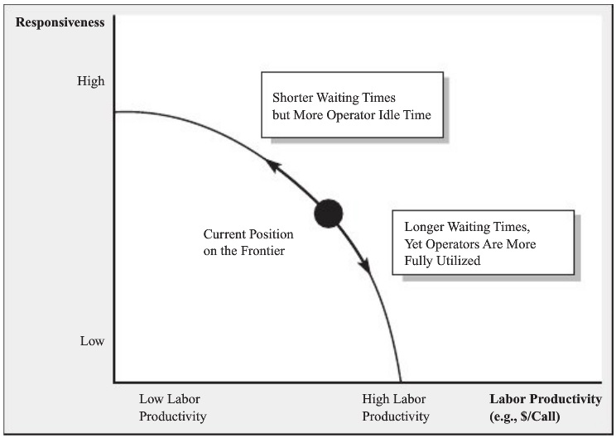
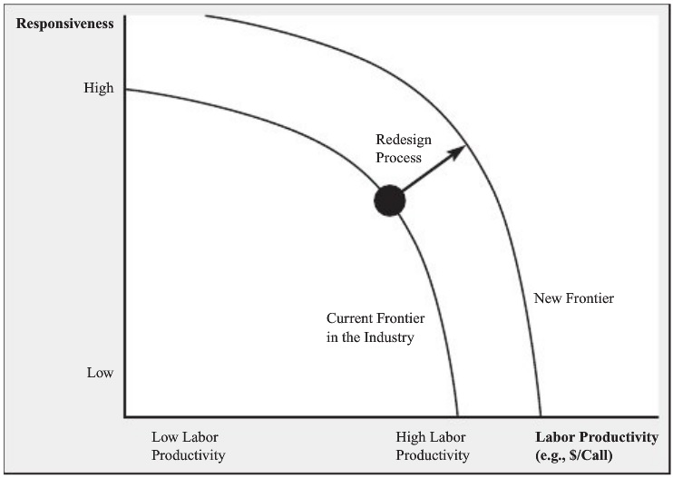
Learning Objective and Framework
Application of tools
  Ensuring resources are used as efficiently as possible
  Making desirable trade-offs between competing objective
  Redesigning our operations

