Slide 1
The Process View of the Organization
Spring, 2016
Matching Supply with Demand
Chapter 2
Byung-Hyun Ha

Slide 2
Introduction
Gantt diagram (chart)
  Activity time or processing time
Why waiting time?
  Limited process resource
  Uncertainty

Slide 3
Three Measures of Process Performance
Process (in most aggregated level)
  Black box that uses resources to transform inputs into outputs
Fundamental process performance measures
  Inventory (or work-in-process, WIP)
  Flow time
  Flow rate (or throughput rate)

Slide 4
Little’s Law
Cumulative inflow and outflow
  Flow time of each patient
  Inventory at each moment
Little’s Law
  Average inventory = Average flow rate × Average flow time
When does Little’s Law hold? Always!
  FIFO, LIFO
  Randomness

Slide 5
Inventory Turns and Inventory Costs
Measuring inventory in a common monetary unit
Examples: Kohl’s
  Cost of goods sold (COGS)
  Inventory
  Flow time
  Inventory turns
  Per-unit inventory costs
Inventory costs
  Financial investment
  + Obsolescence, perish & disappear, storage space & overhead cost, etc.

Slide 6
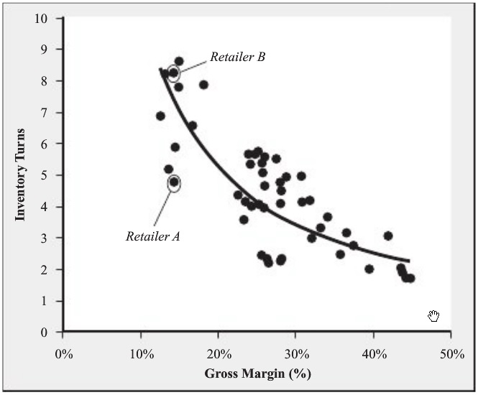
Inventory Turns and Inventory Costs
Relationship between inventory turns and gross margin

Slide 7
Five Reasons to Hold Inventory
Pipeline inventory
Seasonal inventory
Cycle inventory
Decoupling inventory/buffers
Safety inventory

Slide 8
Product-Process Matrix
Process types
  Job shop
  Batch process
  Worker-paced line flow
  Machine-paced line flow
  Continuous process
Product-process matrix
Some points
  Similar process types tend to have similar problems
  Evolution (natural drift)

Slide 9
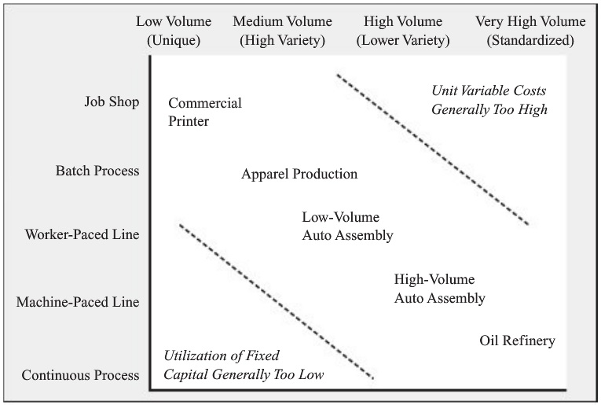
Product-Process Matrix
Product-process matrix

