Slide 1
Understanding the Supply Process: Evaluating Process Capacity
Spring, 2016
Matching Supply with Demand
Chapter 3
Byung-Hyun Ha

Slide 2
Introduction
Process capacity
  Maximum amount that a process can produce in a given unit of time
In this chapter
  Focusing on the underlying process in greater detail
    (not black box any more)
    (not taking the perspective of an engineer, but simplifying it to a level suitable for managerial analysis)

Slide 3
Process Flow Diagram
Example: Circored plant
Understanding the underlying process
  Visitor’s view
  Engineer’s view
  Flow unit’s view

Slide 4
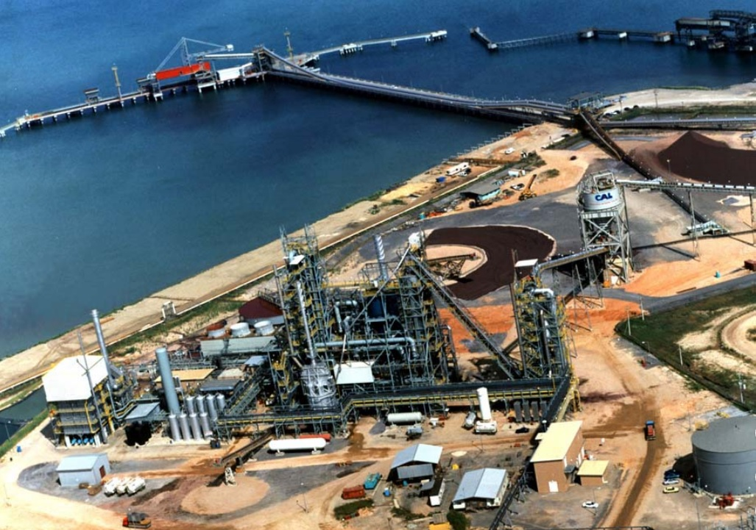
Process Flow Diagram
Visitor’s view

Slide 5
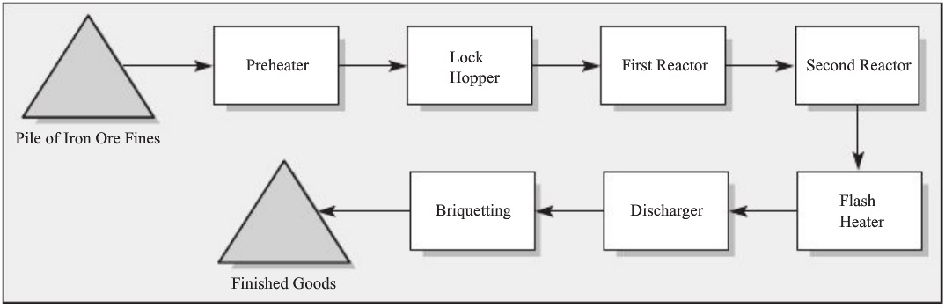
Process Flow Diagram
Flow unit’s view: process flow diagram
  Components: activity, arrow, inventory/buffer
  Process boundary
  Appropriate level of detail
  Which ones are included?
  Activity or buffer?

Slide 6
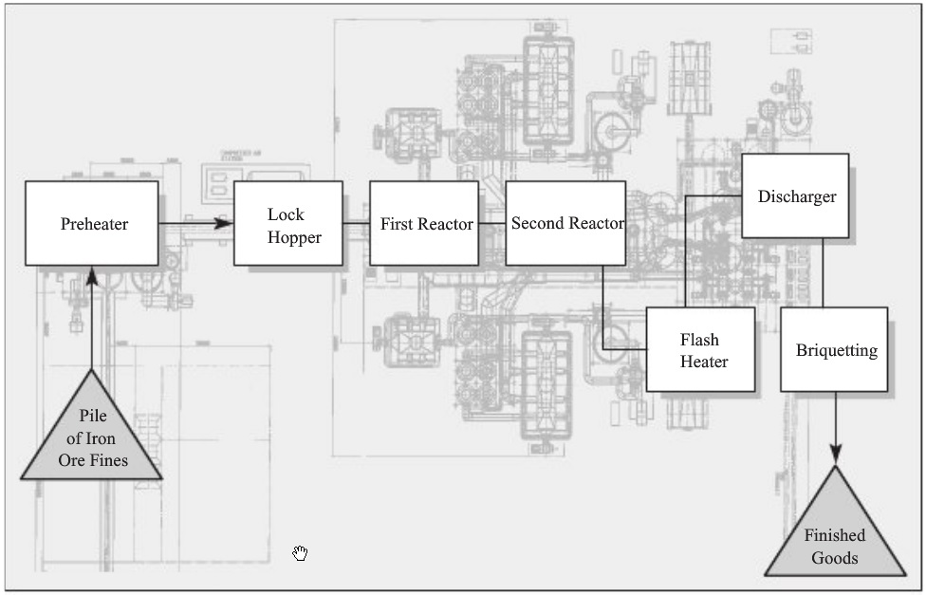
Process Flow Diagram
Physical layout?

Slide 7
Bottleneck, Process Capacity, Flow Rate
Process capacity
  = min{Capcity of resource 1, ..., Capcity of resource n}
Bottleneck

Slide 8
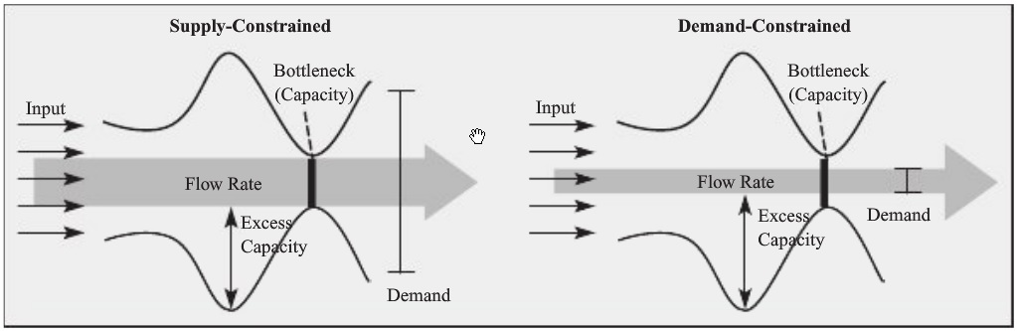
Bottleneck, Process Capacity, Flow Rate
Flow rate
  = min{Available input, Demand, Process capacity}
Types
  Demand-constrained
  Supply-constrained: input- or capacity-constrained

Slide 9
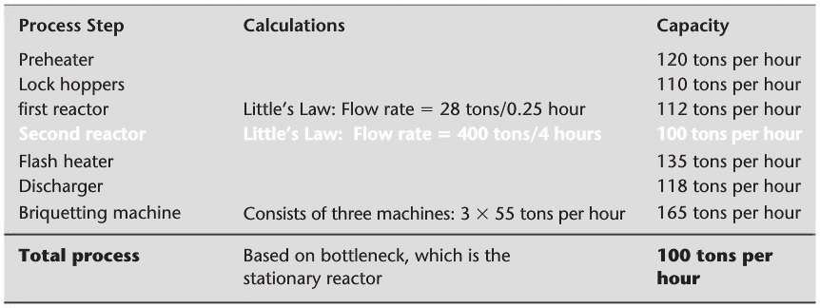
Bottleneck, Process Capacity, Flow Rate
Capacity calculation
Time to fulfill X units
  = X / Flow rate

Slide 10
Process & Capacity Utilization
Utilization
  = Flow rate / Capacity
Why not 100% utilization?
  Less demand than supply
  Insufficient supply
  Limited availability (e.g., maintenance and breakdown)
   Goal of business
    To maximize profit, not to maximize utilization

Slide 11
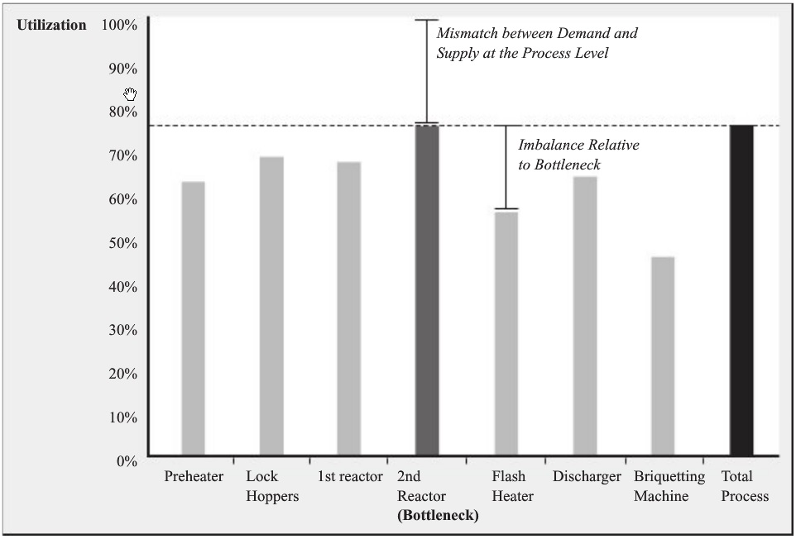
Process & Capacity Utilization
Utilization profile

Slide 12
Workload and Implied Utilization
Limitation of utilization?
  Utilization = Flow rate / Capacity,
    where Flow rate = min{Available input, Demand, Process capacity}
Implied utilization
  = Demand / Capacity

Slide 13
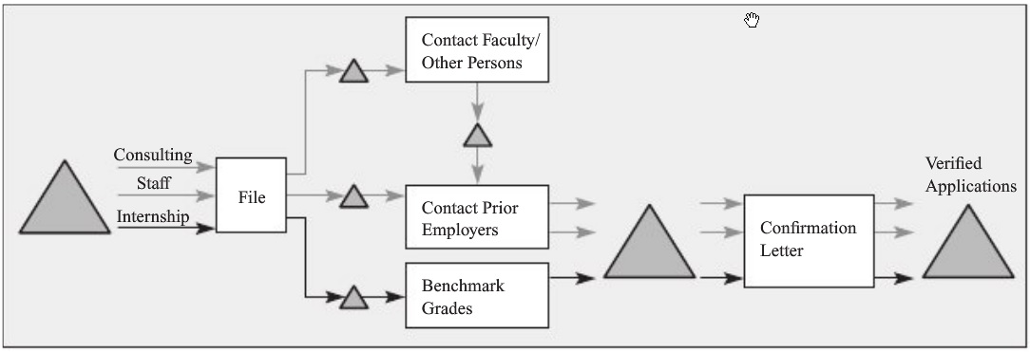
Multiple Types of Flow Units
Multiple flows and types
Example: An employee verification agency

Slide 14
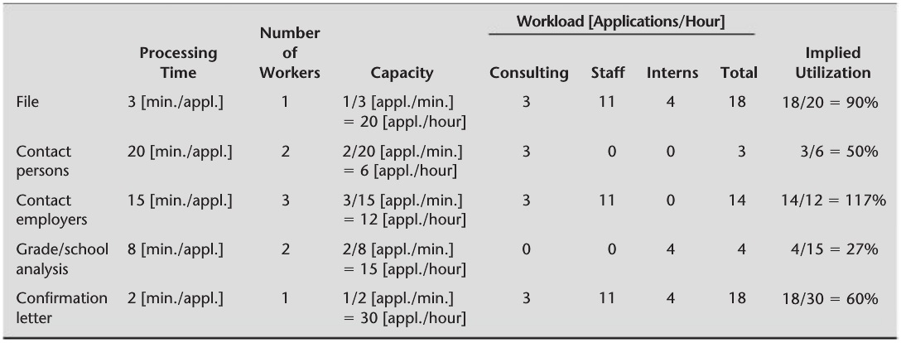
Multiple Types of Flow Units
Finding bottleneck
  Considering product mix

Slide 15
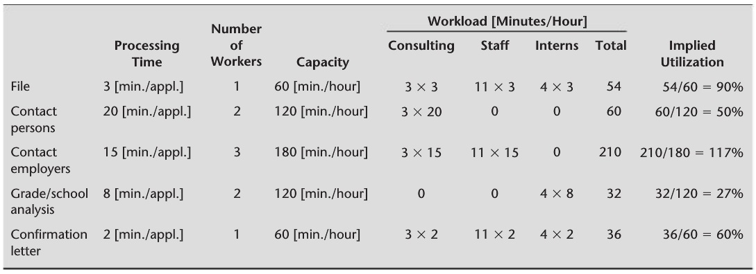
Multiple Types of Flow Units
Finding bottleneck 2

Slide 16
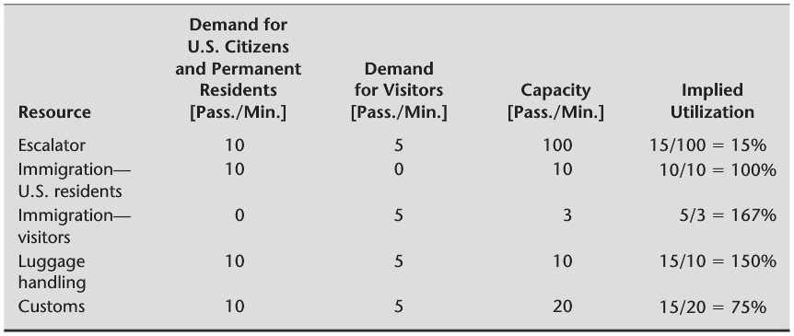
Multiple Types of Flow Units
Complicatedness and limitations
  Example: A major U.S. airport

