Slide 1
Estimating and Reducing Labor Costs
Spring, 2016
Matching Supply with Demand
Chapter 4
Byung-Hyun Ha

Slide 2
Introduction
Objective of any process
  To make profits
  NOT to maximize the utilization of every resource in the process
Yet, underutilization
  ➔ opportunities for process improvement
    To reduce the excess capacity → more efficient
    To use capacity from underutilized process to increase capacity of bottleneck step. → overall capacity increase
Line balancing (to improve process)
  Process of evenly distributing work across the resources of a process
   Matching supply with demand within the process itself

Slide 3
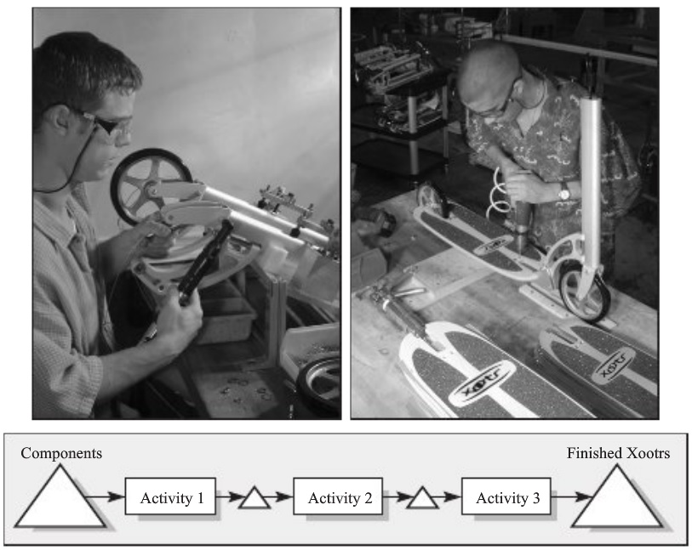
Analyzing and Assembly Operation
Example: Xootr of Novacruz Inc.
  Current process layout

Slide 4
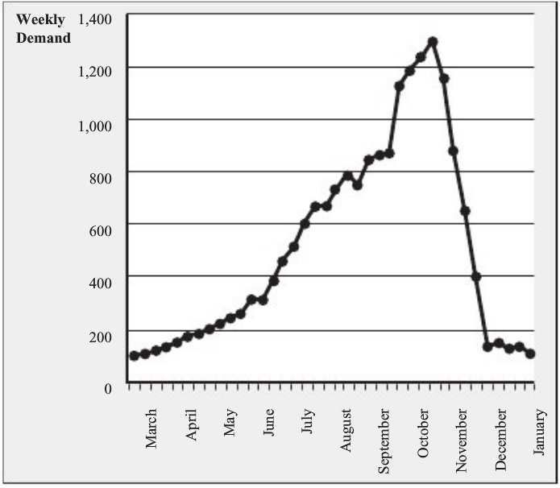
Analyzing and Assembly Operation
Example: Xootr of Novacruz Inc. (cont’d)
  Demand trajectory

Slide 5
Analyzing and Assembly Operation
Capacity
  = Number of resources / Processing time
Example (cont’d)
  Processing time and workers
    Activity 1: 13 min/unit, one worker
    Activity 2: 11 min/unit, one worker
    Activity 3: 08 min/unit, one worker
  Capacity
    Activity 1: 1 / 13 min/unit = 0.0769 unit/min = 4.6 unit/hour
    Activity 2?
    Activity 3?

Slide 6
Time to Process Quantity X
Time to finish X units starting with an empty process
  = Time through an empty process + (X – 1) unit / Flow rate
Time through an empty process
  Worker-paced line
    = Sum of the processing times
  Machine-paced line
    = # of resources in sequence × Processing time of the bottleneck step
Exhibit 4.1
  Flow rate
    = Process capacity

Slide 7
Labor Content and Idle Time
Labor content
  Amount of labor that is spend on a flow unit from the beginning to the end of the process
  In a purely manual process, we define labor content as the sum of all the activity times.
Example (cont’d)
  Labor content?
  Cost of labor per unit?
    Need to consider how the process actually operated
Cost of direct labor
  = Total wages per unit of time / Flow rate per unit of time
Example (cont’d)
  Flow rate per unit time = 125 units/week (demand-constrained)

Slide 8
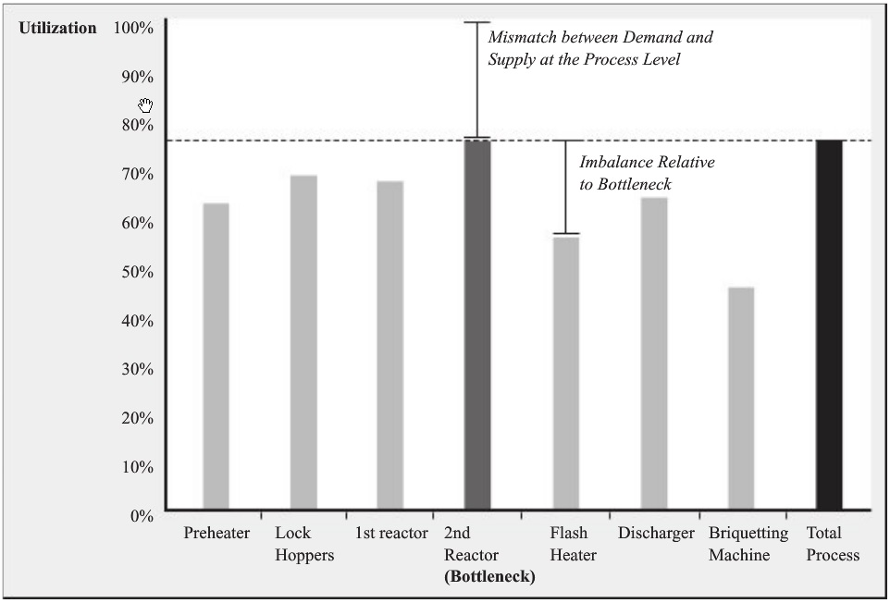
Labor Content and Idle Time
C.f. utilization profile in Chapter 3

Slide 9
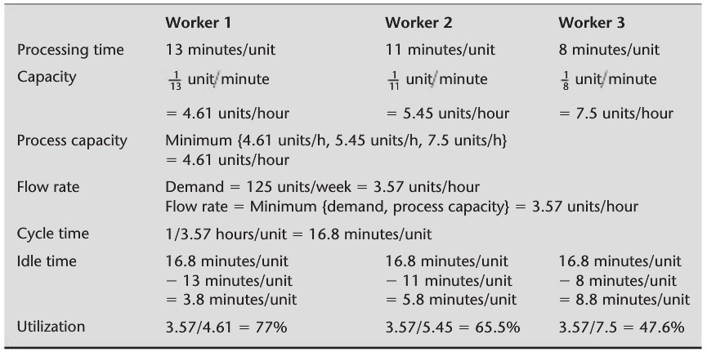
Labor Content and Idle Time
Cycle time
  = 1 / Flow rate
Idle time for a single worker
  = Cycle time – Processing time of the single worker

Slide 10
Labor Content and Idle Time
Average labor utilization
  = Labor content / (Labor content + Sum of idle times across workers)
  = Sum of utilizations of workers / # of workers
Exhibit 4.2
  H/W

Slide 11
Increasing Capacity by Line Balancing
Imbalances within a process
  Micro-level mismatches between one step and the following step
Process improvement by line balancing
  Act of reducing such imbalances
Example (cont’d)
  Demand increase: 200 units/week
  Utilization?
  Cost of direct labor?
  Line balancing (c.f. technical and other constraints)
    Alternative 1
    ...
    Alternative n (optimal?)
      Average labor utilization?

Slide 12
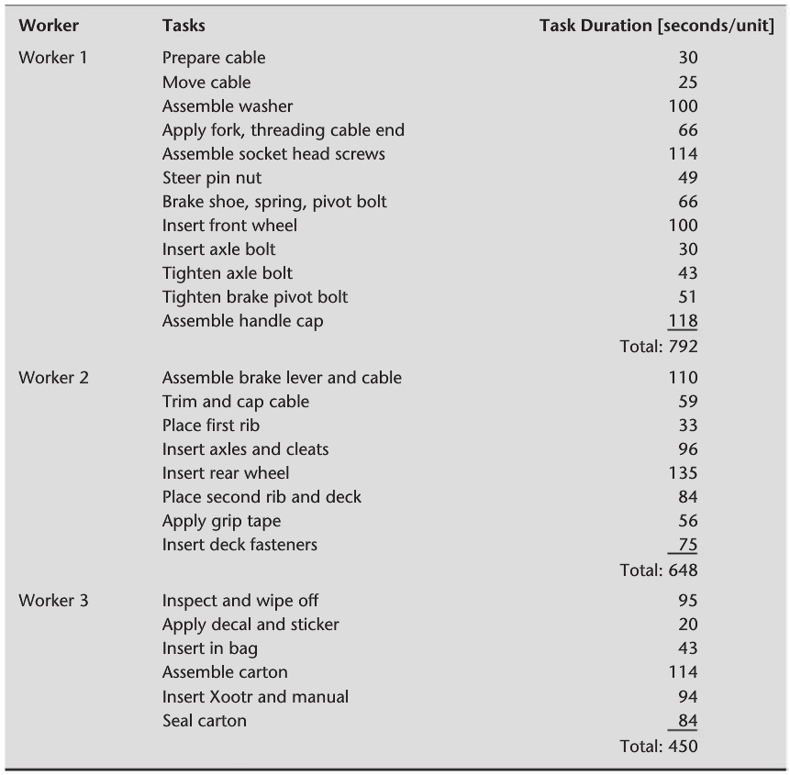
Task durations

Slide 13
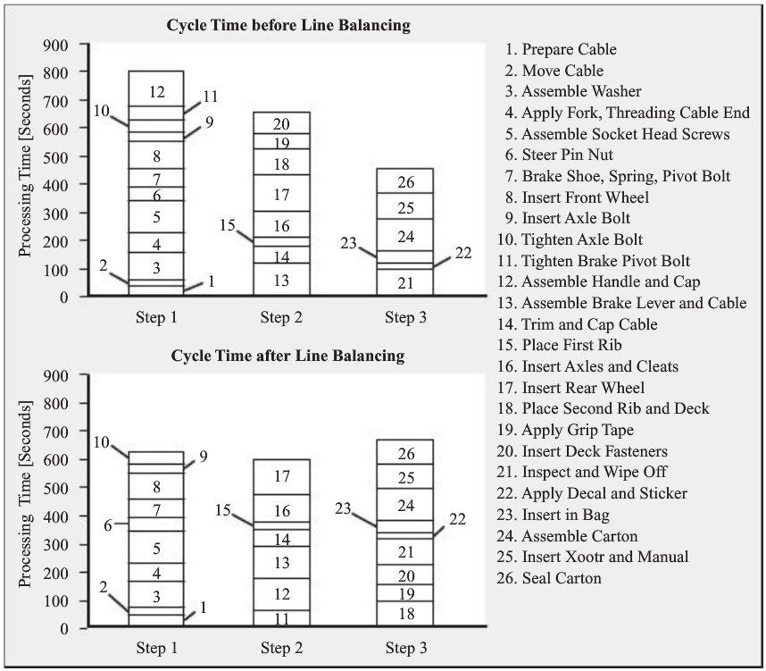

Slide 14
Scale Up to Higher Volume
Example (cont’d)
  Further demand increase: 700 units/week
Some options for increasing capacity
  Replicating the line
    Pros: knowledge reusable
    Cons: not necessarily the most efficient
    C.f. replication of unbalanced line → aggregation of waste (muda)
       Line balancing is not just hair-splitting.
  Selectively adding workers
  Further specializing tasks
    To alter fundamentally the way of task assignment
    Pros: specialization!
    Cons: negative effect on unitization (from granularity of tasks)
       Line balancing becomes easier with a decrease in specialization.

Slide 15
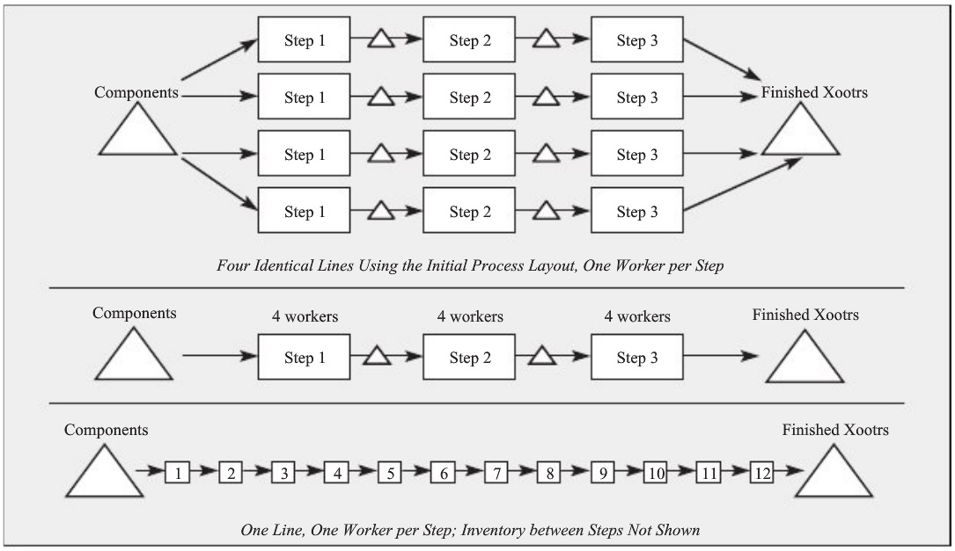
Scale Up to Higher Volume
Some options for increasing capacity (cont’d)

Slide 16
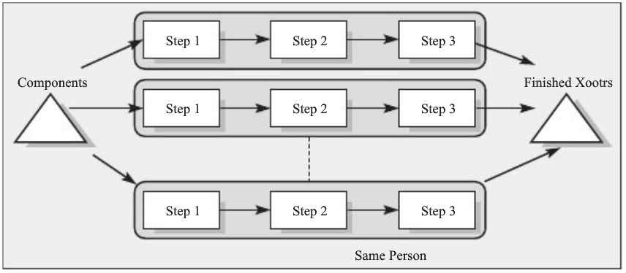
Scale Up to Higher Volume
Some options for increasing capacity (cont’d)
  Parallel work cells
    Pros: better balancing
    Cons: highly trained operator, no reduction in processing time by specialization

Slide 17
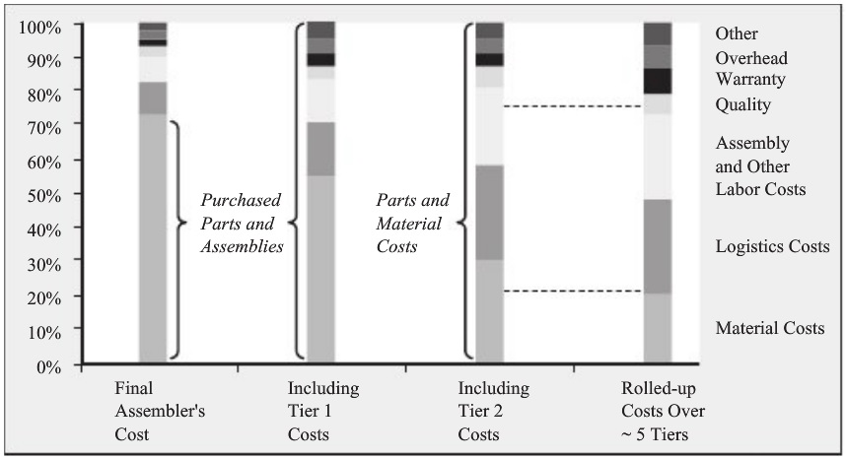
Discussion
Practical problems
Managerial benefits from line balancing
  Attacking labor cost that is under our control
  Idle time (muda in TPS) → to hide many other problems
    E.g., to finish or rework a task during idle time
  No penny-counting when whole supply chain is considered
  + No any financial investment in assets

Slide 18
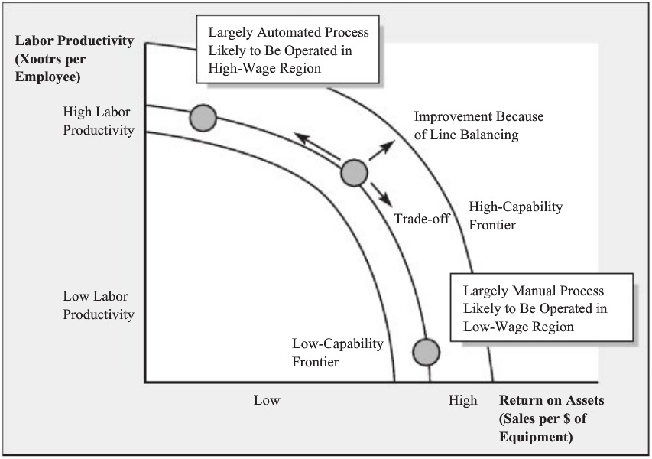
Discussion
Strategic perspective

