Slide 1
MIS2. Information Technology Infrastructure
산업및시스템공학개론
부산대학교
2016년 1학기
하병현

Slide 2
목차
IT Infrastructure and Emerging Technologies
Foundations of Business Intelligence: Databases and Information Management
Telecommunications, the Internet, and Wireless Technology
Securing Information Systems

Slide 3
IT Infrastructure and Emerging Technologies
Evolution of IT infrastructure
  Electronic accounting machine era: 1930-1950
  General-purpose mainframe and minicomputer era: 1959 to present
  Personal computer era: 1981 to present
  Client/server era: 1983 to present
  Enterprise Internet computing era: 1992 to present
  Cloud and mobile computing: 2000 to present
Technology drivers of infrastructure evolution
  Moore’s Law and microprocessing power
  The Law of Mass Digital Storage
    The amount of data being stored each year doubles
  Metcalfe’s Law and network economics
    Value or power of a network grows exponentially as a function of the number of network members
  Declining communications costs and the Internet
  Standards and network effects

Slide 4
IT Infrastructure and Emerging Technologies
Infrastructure components
  Computer hardware platforms
  Computer software platforms
  Enterprise software applications
  Data management and storage
  Networking/telecommunications platforms
  Internet platforms
  Consulting and system integration services
Hardware platform trends and emerging technologies
  Integration of computing and mobile digital platforms
  Grid computing, virtualization, cloud computing
    IaaS, PaaS, SasS
    Drawbacks: concerns of security, reliability
  Autonomic computing
    Systems that can configure, heal themselves when broken, and protect themselves from outside intruders

Slide 5
IT Infrastructure and Emerging Technologies
Software platform trends and emerging technologies
  Open-source software, Linux
  Software for the Web
    Java, HTML5, Ajax
  Software for enterprise integration
  Web services and service-oriented architecture (SOA)
    Web 2.0
  Software outsourcing and cloud services
    Three external sources for software
      Software packages and enterprise software
      Software outsourcing
      Cloud-based software services (SaaS)
    Mashups

Slide 6
IT Infrastructure and Emerging Technologies
Management issues
  Dealing with infrastructure change
  Management and governance
  Making wise infrastructure investments
    Competitive forces model for IT infrastructure investment
    Total cost of ownership of technology assets
Competitive forces for IT infrastructure investment
  Market demand for firm’s services
  Firm’s business strategy
  Firm’s IT strategy, infrastructure, and cost
  Information technology assessment
  Competitor firm services
  Competitor firm IT infrastructure investments

Slide 7
Databases and Information Management
Organizing data in a traditional file environment
  File organization concepts
  Problems with the traditional file environment
    Data redundancy and inconsistency
    Program-data dependence
    Lack of flexibility
    Poor security
    Lack of data sharing and availability

Slide 8
Databases and Information Management
Database approach to data management
  Database management systems
    How a DBMS solves the problems of the traditional file environment
    Relational DBMS
    Operations of a relational DBMS
    Hierarchical and network DBMS
    Object-oriented DBMS
    Non-relational databases: “NoSQL”
    Databases in the cloud
  Capabilities of database management systems
    Querying and reporting
  Designing databases
    Normalization and entity-relationship diagrams
    Distributing databases

Slide 9
Databases and Information Management
Using databases for decision making
  Big data
    Massive sets of unstructured/semi-structured data from Web traffic, social media, sensors, and so on
    Petabytes, exabytes of data
      Volumes too great for typical DBMS
    Can reveal more patterns and anomalies
  Business intelligence infrastructure
    An array of tools for separate systems, and big data
  Contemporary tools
    Data warehouses, data marts
    Hadoop
    In-memory computing
    Analytical tools
      Multidimensional data analysis (OLAP)
      Data mining, text mining, Web mining

Slide 10
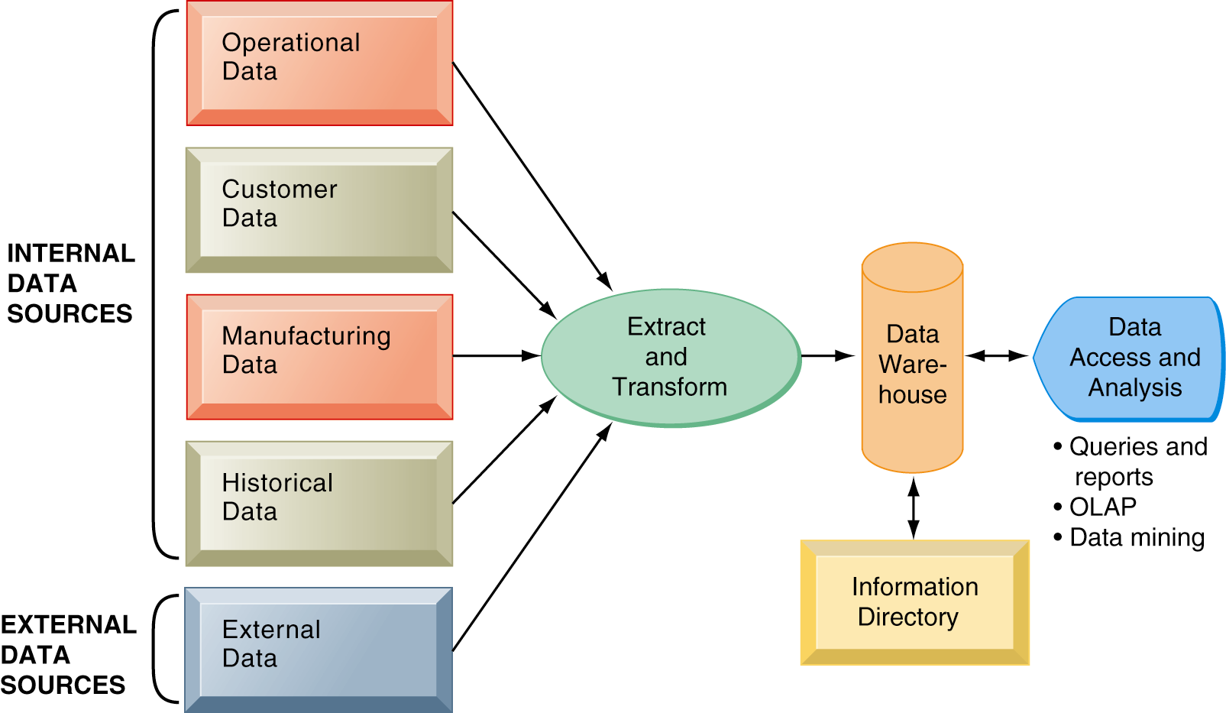
Databases and Information Management
Components of a data warehouse

Slide 11
Databases and Information Management
Managing data resources
  Establishing and information policy
    Firm’s rules, procedures, roles for sharing, managing, standardizing data
    Data administration
    Data governance
    Database administration
  Ensuring data quality
    Redundant data, inconsistent data, faulty input
    Data quality audit, data cleansing

Slide 12
Internet and Wireless Technology
Telecommunications and networking in today’s business world
  Networking and communication trends
    Convergence
    Broadband
    Broadband wireless
  Networks in large companies
    Hundreds of local area networks (LANs) linked to firmwide corporate network
    Various powerful servers
      Web site
      Backend systems
    Mobile wireless LANs (Wi-Fi networks)
    Videoconferencing system
    Telephone network, Wireless cell phones
  Key digital networking technologies
    Client/server computing
    Packet switching
    TCP/IP and connectivity

Slide 13
Internet and Wireless Technology
Communications networks
  Signals: digital vs. analog
    Modem
  Types of networks
    Local area networks (LAN)
    Metropolitan and wide area networks (MAN, WAN)
  Physical transmission media
    Twisted wire
    Coaxial cable
    Fiber optics and optical networks
    Wireless transmission media and devices
  Transmission speed
    Bits per second (bps)

Slide 14
Internet and Wireless Technology
The Internet
  World’s most extensive network
  Internet service providers (ISPs)
  Internet addressing and architecture
    The Domain Name System (DNS)
    Internet architecture and governance
      No formal management: IAB, ICANN, W3C
    The future Internet: IPv6 and Internet2
  Internet services
    The World Wide Web (www)
    ftp, smtp, telnet, ssh, nntp, ...
  Voice over IP (VoIP)
  Unified communications
    Communication systems that integrate voice, data, e-mail, conferencing
  Virtual private network (VPN)
    Secure, encrypted, private network run over Internet

Slide 15
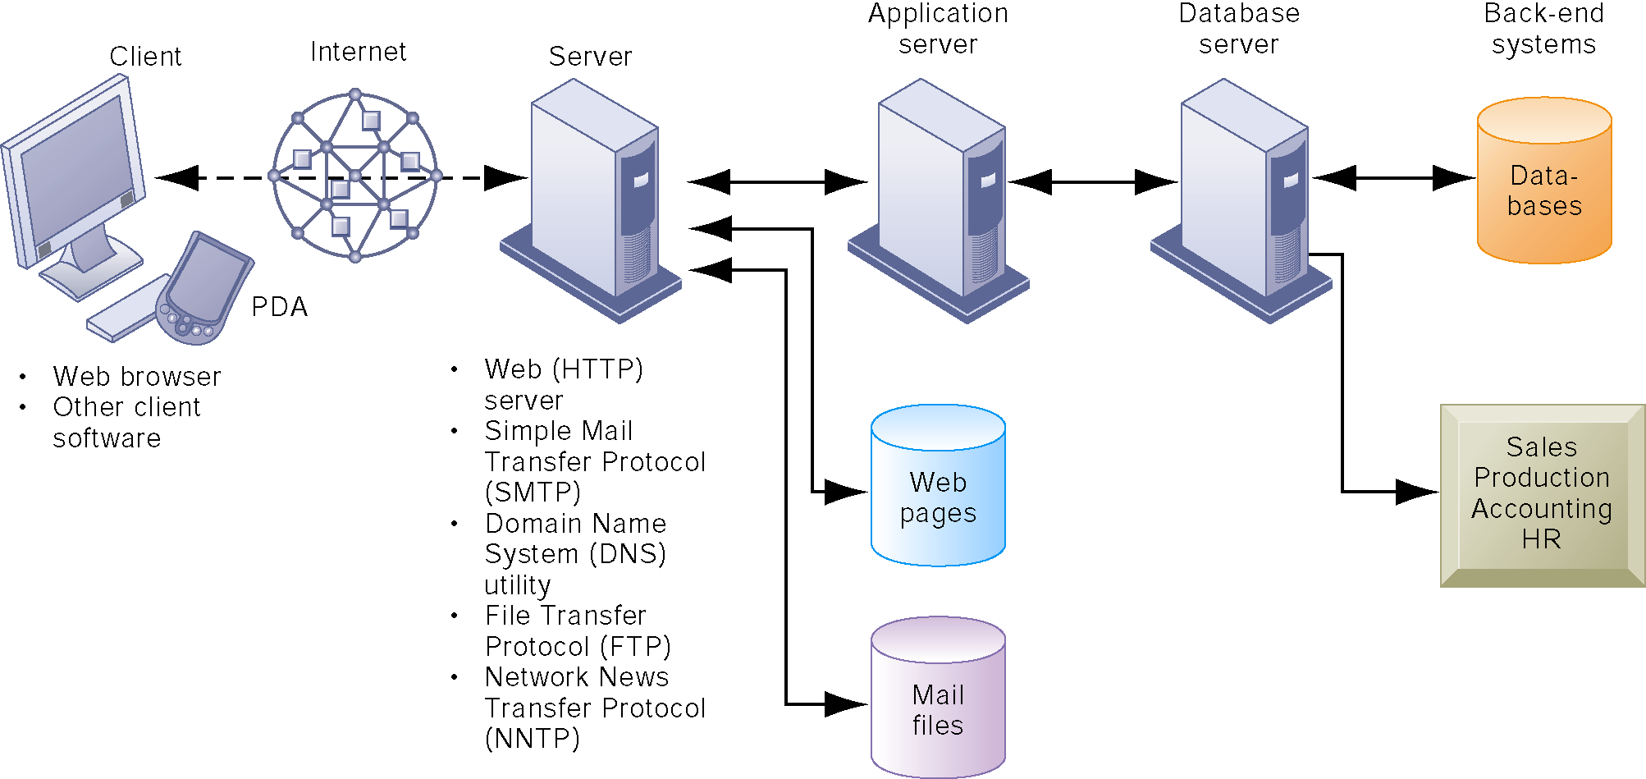
Internet and Wireless Technology
Client/server computing on the Internet

Slide 16
Internet and Wireless Technology
Web 2.0
  Second-generation services
  Enabling collaboration, sharing information, and creating new services online
  Features
    Interactivity, social participation (sharing), user-generated content
  Blogs, Wikis, social networking sites
Web 3.0: The “Semantic Web”
  A collaborative effort led by W3C to add layer of meaning to the existing Web
  Making Web more “intelligent” and intuitive
    Reduce human effort in searching for and processing information
  “Web of things”
    Increased communication and synchronization with computing devices, communities
  Increased cloud computing, mobile computing

Slide 17
Internet and Wireless Technology
The wireless revolution
  Cellular systems
    Cellular network standards and generations: CDMA/GSM, 3G/4G
  Wireless computer networks and Internet access
    Bluetooth
    Wi-Fi
    Wi-Fi and wireless Internet access
    WiMax
  RFID and wireless sensor networks (WSN)

Slide 18
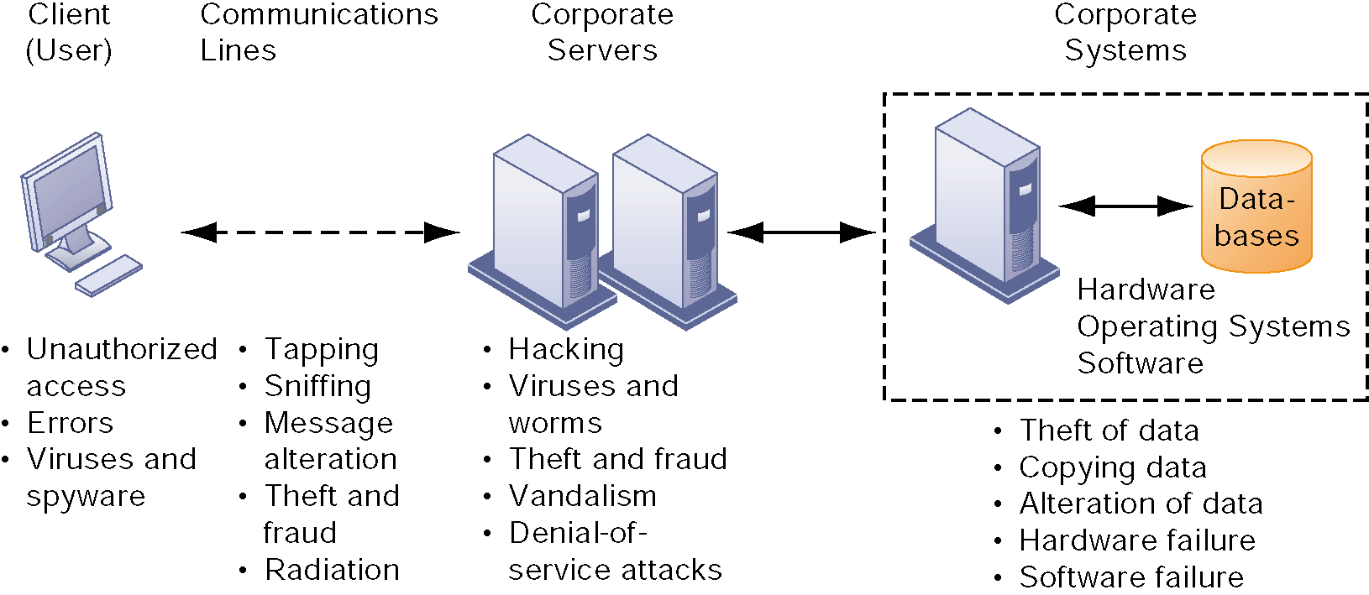
Securing Information Systems
Systems vulnerability and abuse
  Why systems are vulnerable
    Internet vulnerabilities
    Wireless security challenges
  Malicious software: Viruses, worms, Trojan horses, and spyware
  Hackers and cybervandalism
    Spoofing and sniffing
    Denial-of-service attacks

Slide 19
Securing Information Systems
Systems vulnerability and abuse (cont’d)
  Computer crime and cyberterrorism
    Identity theft
      Phishing
      Evil twins
      Pharming
    Click fraud
    Cyberterrorism and cyberwarfare
  Internal threats: Employees
  Software vulnerability

Slide 20
Securing Information Systems
Business value of security and control
  Legal and regulatory requirements for electronic records management
    ERM
    HIPAA
    Gramm-Leach-Bliley
    Sarbanes-Oxley
  Electronic evidence and computer forensics
Establishing a framework for security and control
  Risk Assessment
  Security policy
  Ensuring business continuity
    Disaster recovery planning and business continuity planning
    Security outsourcing
  The role of auditing

Slide 21
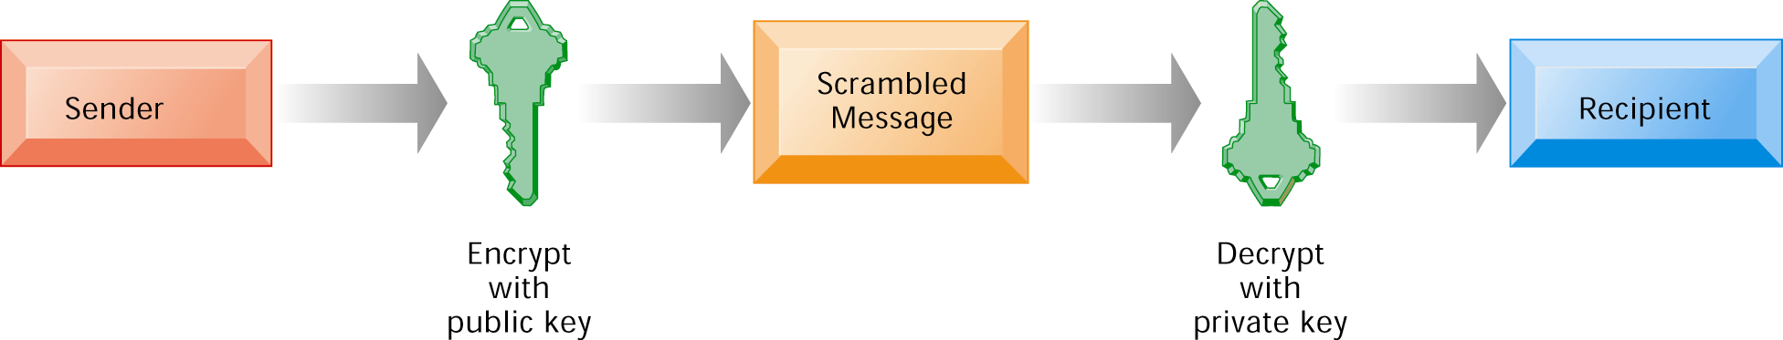
Securing Information Systems
Technologies and tools for security
  Access control
  Firewalls, intrusion detection systems, and antivirus software
  Securing wireless networks
  Encryption and public key infrastructure

