Slide 1
MIS3. Key System Applications
산업및시스템공학개론
부산대학교
2016년 1학기

Slide 2
Contents
Achieving Operational Excellence and Customer Intimacy: Enterprise Applications
  Enterprise systems
  Supply chain management systems
  Customer relationship management systems
E-Commerce: Digital Markets, Digital Goods
Managing Knowledge
Enhancing Decision Making

Slide 3
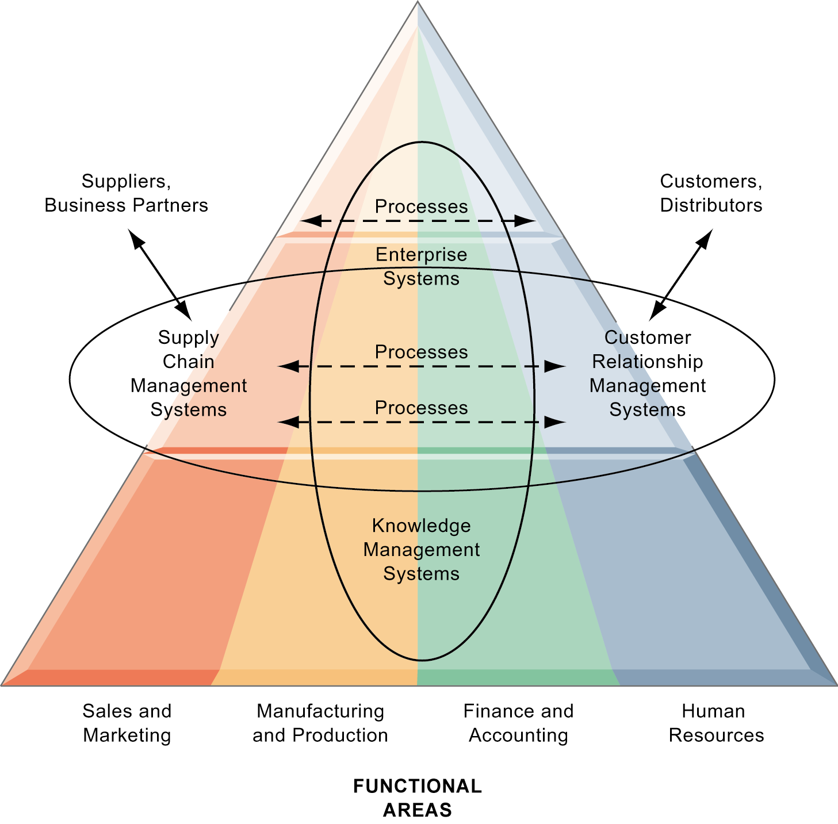
Enterprise Applications
Automating processes of organizations

Slide 4
Enterprise Systems
Enterprise systems
  Enterprise resource planning (ERP) systems
    e.g., Oracle application, SAP R/3, Epicor
  Suite of integrated software modules and a common central database
  Collects data from many divisions of firm for use in nearly all of firm’s internal business activities
  Information entered in one process is immediately available for other processes
  Built around thousands of predefined business processes that reflect “best practices”
Modules
  Finance and accounting
  Human resources
  Manufacturing and production
  Sales and marketing

Slide 5
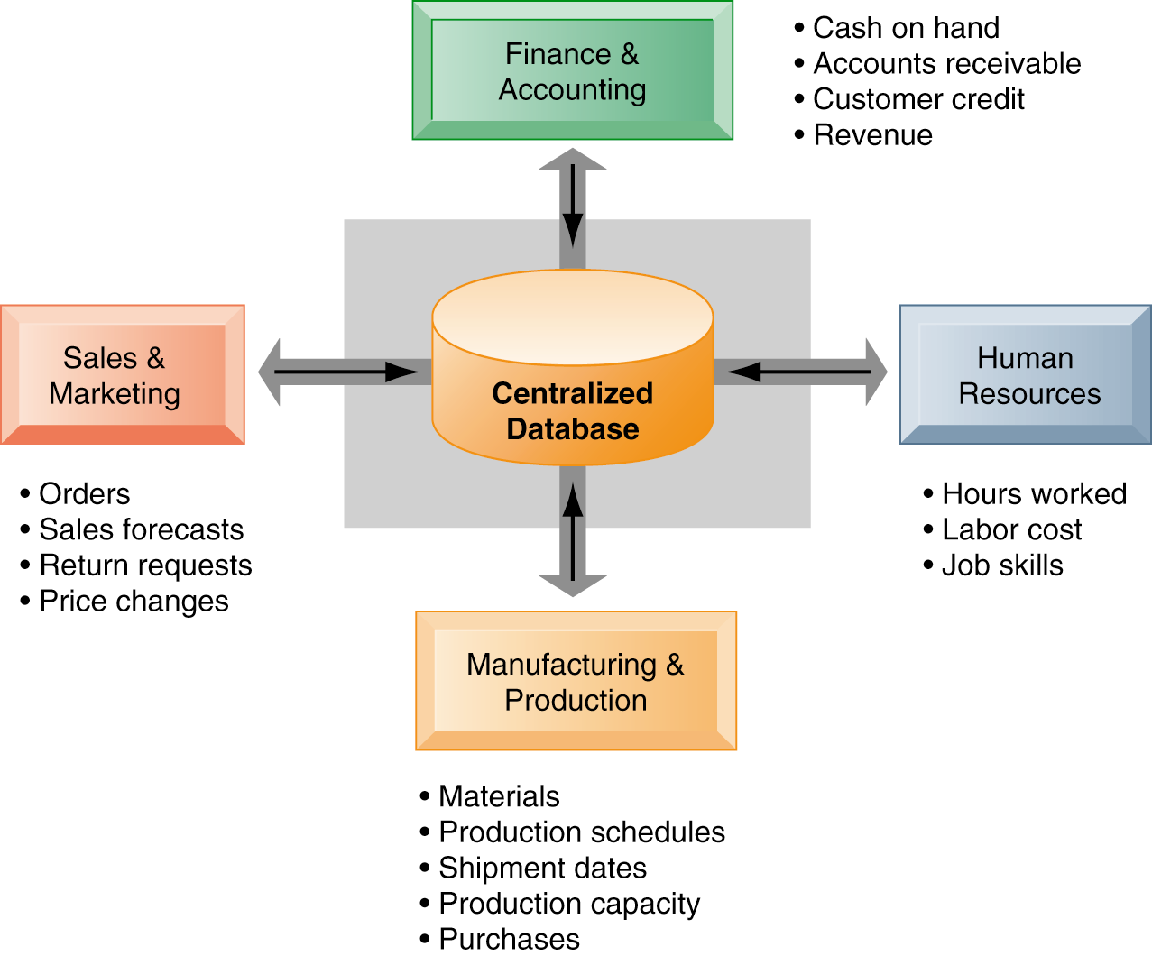
Enterprise Systems
Features

Slide 6
Enterprise Applications
To implement, firms:
  Select functions of system they wish to use
  Map business processes to software processes
  Use software’s configuration tables for customizing
  + Customization of off-the-shelf modules, process reengineering, ...
Business value of enterprise systems
  Increase operational efficiency
  Provide firm-wide information to support decision making
  Enable rapid responses to customer requests for information or products
  Include analytical tools to evaluate overall organizational performance

Slide 7
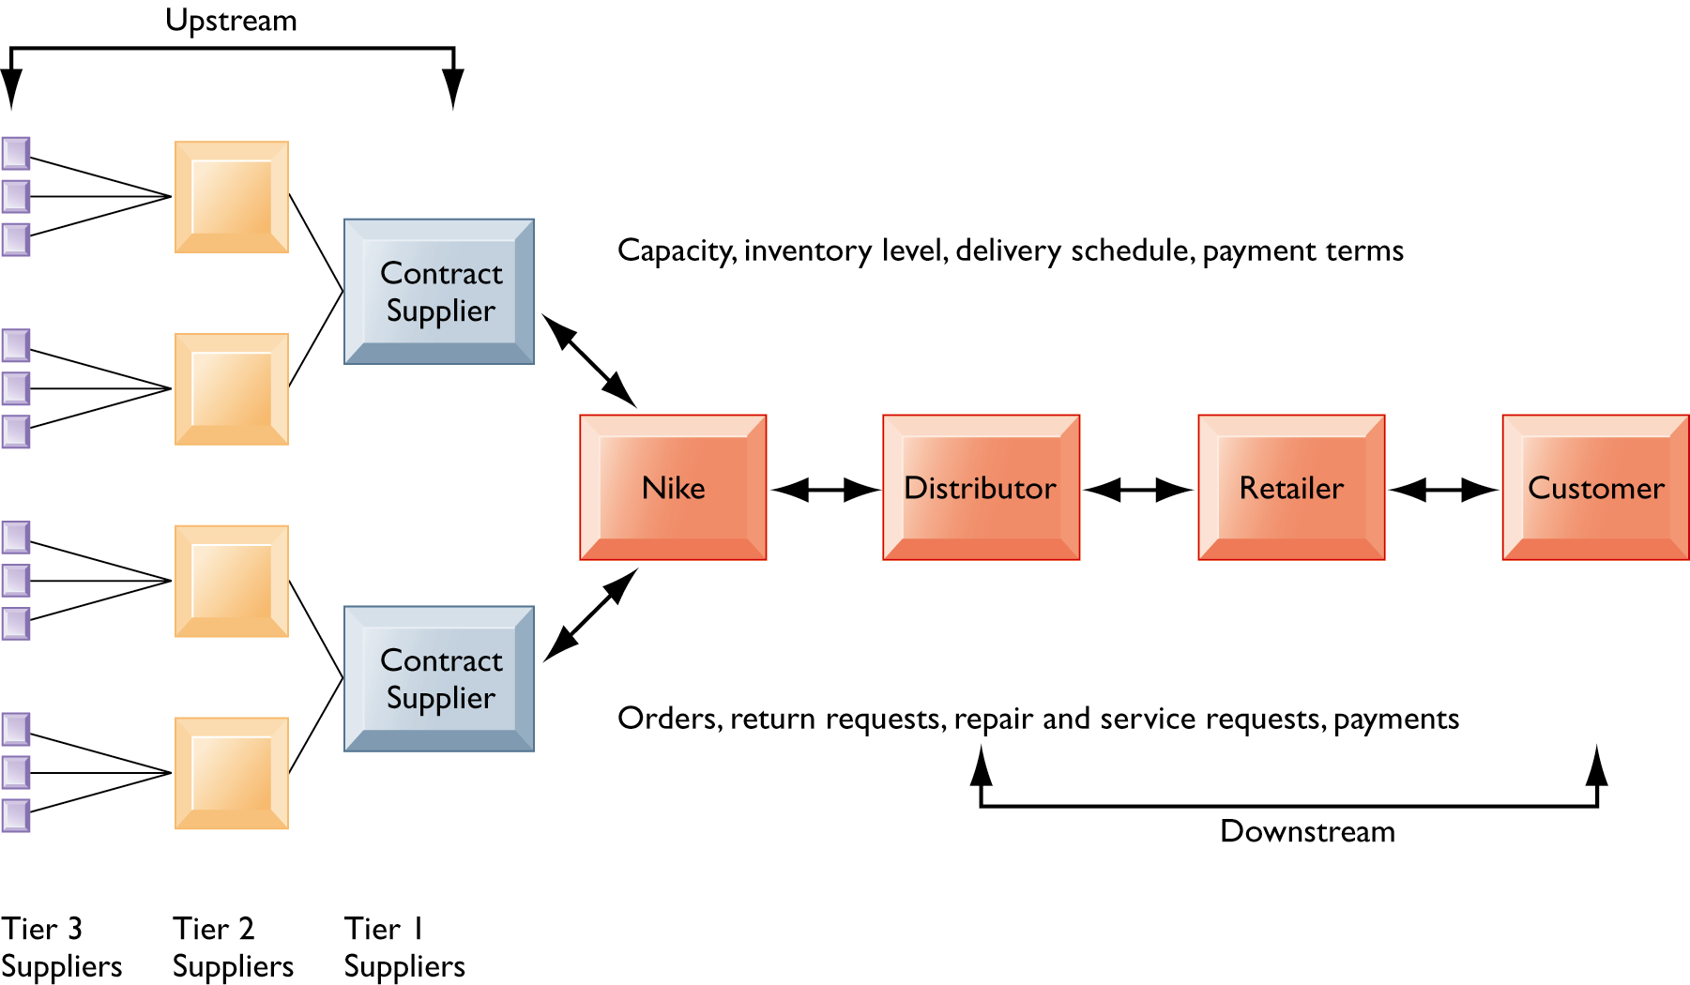
Supply Chain Management Systems
Supply chain
  Network of organizations and processes for
    Procuring materials, transforming them into products, and distributing the products
  Upstream supply chain
    Firm’s suppliers, suppliers’ suppliers, processes for managing relationships with them
  Downstream supply chain
    Organizations and processes responsible for delivering products to customers
  Internal supply chain

Slide 8
Supply Chain Management Systems
Supply chain management
  Inefficiencies cut into a company’s operating costs
    Can waste up to 25% of operating expenses
Just-in-time strategy
  Components arrive as they are needed
  Finished goods shipped after leaving assembly line
Safety stock
  Buffer for lack of flexibility in supply chain
Bullwhip effect
  Information about product demand gets distorted as it passes from one entity to next across supply chain

Slide 9
Supply Chain Management Systems
Supply chain management software
  Supply chain planning systems
    Model existing supply chain
    Enable demand planning
    Optimize sourcing, manufacturing plans
    Establish inventory levels
    Identify transportation modes
  Supply chain execution systems
    Manage flow of products through distribution centers and warehouses
Internet helps manage global complexities.
  Warehouse management
  Transportation management
  Logistics
  Outsourcing

Slide 10
Supply Chain Management Systems
Global supply chain issues
  Greater geographical distances
  Greater time differences
  Participants from different countries
    Different performance standards
    Different legal requirements
Business value of SCM systems
  Match supply to demand; reduce inventory levels
  Improve delivery service
  Speed product time to market
  Use assets more effectively
  Reduced supply chain costs lead to increased profitability
    Total supply chain costs can be 75% of operating budget
  Increase sales

Slide 11
Customer Relationship Management Systems
Customer relationship management (CRM)
  Knowing the customer
  In large businesses, too many customers and too many ways customers interact with firm
CRM systems
  Capture and integrate customer data from all over the organization
  Consolidate and analyze customer data
  Distribute customer information to various systems and customer touch points across enterprise
  Provide single enterprise view of customers

Slide 12
Customer Relationship Management Systems
Modules
  Partner relationship management (PRM)
    Integrating lead generation, pricing, promotions, order configurations, and availability
    Tools to assess partners’ performances
  Employee relationship management (ERM)
    Setting objectives, employee performance management, performance-based compensation, employee training
  Sales force automation (SFA)
    Sales prospect and contact information, sales quote generation capabilities
  Customer service
    Assigning and managing customer service requests, Web-based self-service capabilities
  Marketing
    Capturing prospect and customer data, scheduling and tracking direct‐marketing mailings or e-mail, cross-selling

Slide 13
Customer Relationship Management Systems
Operational CRM
  Customer-facing applications such as sales force automation, call center and customer service support, and marketing automation
Analytical CRM
  Based on data warehouses populated by operational CRM systems and customer touch points
  Analyzes customer data (OLAP, data mining, etc.)
    Customer lifetime value (CLTV)
Business value of CRM systems
  Increased customer satisfaction
  Reduced direct-marketing costs
  More effective marketing
  Lower costs for customer acquisition/retention
  Increased sales revenue

Slide 14
New Opportunities and Challenges
Enterprise application challenges
  Highly expensive to purchase and implement enterprise applications
    Average “large” system: $12 million +
    Average “small/midsize” system: $3.5 million
  Technology changes
  Business process changes
  Organizational learning, changes
  Switching costs, dependence on software vendors
  Data standardization, management, cleansing

Slide 15
New Opportunities and Challenges
Next-generation enterprise applications
  Enterprise solutions/suites
    Make applications more flexible, Web-enabled, integrated with other systems
  Open-source applications
  On-demand solutions
  Cloud-based versions
  Functionality for mobile platform
  Social CRM
  Business intelligence
    Inclusion of BI with enterprise applications
    Flexible reporting, ad hoc analysis, “what-if” scenarios, digital dashboards, data visualization

Slide 16
E-commerce and the Internet
E-commerce
  Use of the Internet and Web to transact business
  Began in 1995 and grew exponentially; still stable even in a recession
  Companies that survived the dot-com bubble burst and now thrive
  E-commerce revolution is still in its early stages
Unique features of Internet and Web as commercial medium
  Ubiquity
  Global reach
  Universal standards
  Richness
    Supports video, audio, and text messages
  Interactivity
  Information density
    e.g., greater price & cost transparency
  Personalization/customization
  Social technology

Slide 17
E-commerce and the Internet
Effect of the Internet on the marketplace
  Reduces information asymmetry
  Offers greater flexibility and efficiency because of:
    Reduced search costs and transaction costs
    Lower menu costs
    Greater price discrimination
    Dynamic pricing
  May reduce or increase switching costs
  May delay gratification: effects dependent on product
  Increased market segmentation
  Stronger network effects
  More disintermediation

Slide 18
E-commerce: Business and Technology
Three major types of e-commerce
  Business-to-consumer (B2C)
    e.g., Amazon.com
    Variety of Internet-enabled technologies used in B2B
      Electronic data interchange (EDI)
      Private industrial networks (private exchanges)
      Net marketplaces (e-hub)
      Exchanges
  Business-to-business (B2B)
    e.g., ChemConnect
  Consumer-to-consumer (C2C)
    e.g., eBay
Mobile commerce (m-commerce)
  Retail sales at top Mobile 400 (Amazon, eBay, etc.)
  Sales of digital content (music, TV, etc.)
  Local search for restaurants, museums, stores

Slide 19
E-commerce: Business and Technology
E-commerce business models
  E-tailer
  Content provider
  Community provider
  Transaction broker
  Market creator
  Portal
  Service provider
E-commerce revenue models
  Advertising
  Sales
  Subscription
  Free/Freemium
  Transaction fee
  Affiliate

Slide 20
E-commerce: Business and Technology
E-commerce marketing
  Internet provides new ways to identify and communicate with customers
  Long tail marketing
    Ability to reach a large audience inexpensively
  Behavioral targeting
    Tracking online behavior of individuals on thousands of Web sites
  Internet advertising formats
    Search engine marketing, display ads, rich media, e-mail, and so on

Slide 21
E-commerce and Social Networking
Social networking
  Most popular Web 2.0 service
    Social shopping sites: Swap shopping ideas with friends
  Wisdom of crowds by crowdsourcing
    Large numbers of people can make better decisions about topics and products than a single person
  Prediction markets
    Peer-to-peer betting markets on specific outcomes
    e.g., elections, sales figures, designs for new products
Social e-commerce
Four features of social e-commerce driving its growth
  Social sign-on
  Collaborative shopping
  Network notification
  Social search (recommendations)

Slide 22
E-commerce and Social Networking
Social media
  Fastest growing media for branding and marketing
Social network marketing
  Seeks to leverage individuals influence over others in social graph
  Target is a social network of people sharing interests and advice
  Facebook’s “Like button”
  Social networks have huge audiences
    Facebook: 150 million U.S. visitors monthly

Slide 23
Knowledge Management Landscape
Important dimensions of knowledge
  Knowledge is a firm asset.
    Intangible
    Creation of knowledge from data and information requires organizational resources.
    As it is shared, experiences network effects
  Knowledge has different forms.
    Explicit (documented) or tacit (residing in minds)
  Knowledge has a location.
    Both social and individual
    “Sticky” (hard to move), situated (enmeshed in firm’s culture), contextual (works only in certain situations)
  Knowledge is situational.
    Conditional: Knowing when to apply procedure
    Contextual: Knowing circumstances to use certain tool

Slide 24
Knowledge Management Landscape
Knowledge management
  Set of business processes developed in an organization to create, store, transfer, and apply knowledge
Knowledge management value chain
  Knowledge acquisition
  Knowledge storage
  Knowledge dissemination
  Knowledge application
   Each stage adds value to raw data and information as they are transformed into usable knowledge
Organizational roles and responsibilities
  Chief knowledge officer executives
  Dedicated staff / knowledge managers
  Communities of practice (COPs)

Slide 25
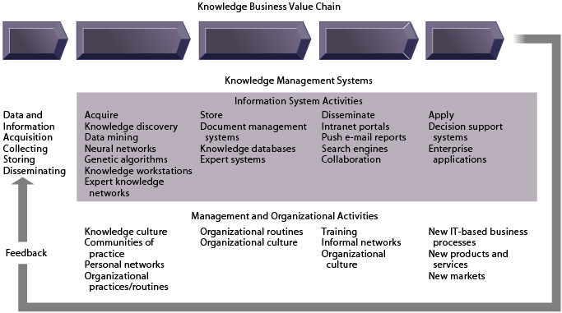
Knowledge Management Landscape

Slide 26
Knowledge Management Systems
Three major types of knowledge in enterprise
  Structured documents
    Reports, presentations
    Formal rules
  Semi-structured documents
    E-mails, videos
  Unstructured, tacit knowledge
   80% of an organization’s business content is semistructured or unstructured

Slide 27
Knowledge Management Systems
Enterprise-wide knowledge management
  General-purpose firm-wide efforts to collect, store, distribute, and apply digital content and knowledge
  Enterprise content management systems
    Developing taxonomy
    Digital asset management
  Knowledge network systems
    Provide online directory of corporate experts in well-defined knowledge domains
    Search tools enable employees to find appropriate expert in a company
  Collaboration and social tools
    Social bookmarking
    Folksonomies
      User-created taxonomies for tagging
  Learning management systems (LMS)

Slide 28
Knowledge Management Systems
Knowledge work systems (KWS)
  Knowledge workers
    Researchers, designers, architects, scientists, engineers who create knowledge for the organization
  Specialized systems built for engineers, scientists, other knowledge workers charged with discovering and creating new knowledge
  Requirements of knowledge work systems
    Sufficient computing power for graphics, complex calculations
    Powerful graphics and analytical tools
    Communications and document management
    Access to external databases
    Optimized for tasks to be performed (design engineering, financial analysis)
  Examples
    CAD (computer-aided design), 3D printing
    Virtual reality systems, augmented reality (AR) systems
    Investment workstations

Slide 29
Knowledge Management Systems
Intelligent techniques
  Diverse group of techniques such as data mining used for various goals: discovering knowledge, distilling knowledge, discovering optimal solutions
  Capturing tacit knowledge
    Expert systems
    Case-based reasoning (CBR)
    Fuzzy logic systems
  Knowledge discovery
    Neural networks
    Data mining
  Generating solutions to complex problems
    Genetic algorithms
  Automating tasks
    Intelligent agents

Slide 30
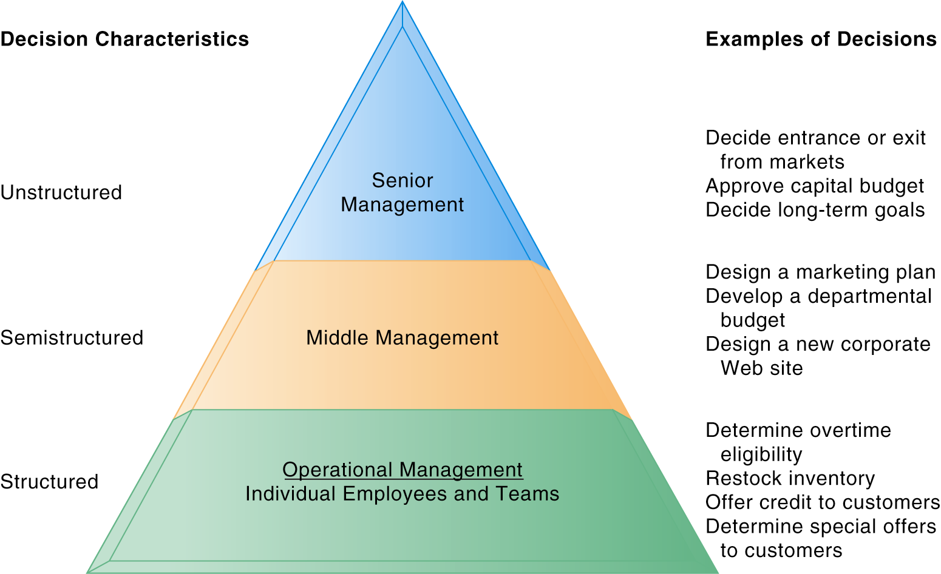
Decision Making and Information Systems
Business value of improved decision making
  Improving hundreds of thousands of “small” decisions adds up to large annual value for the business

Slide 31
Decision Making and Information Systems
The four stages of the decision-making process
  1. Intelligence
    Discovering, identifying, and understanding the problems occurring in the organization
  2. Design
    Identifying and exploring solutions to the problem
  3. Choice
    Choosing among solution alternatives
  4. Implementation
    Making chosen alternative work and continuing to monitor how well solution is working

Slide 32
Decision Making and Information Systems
Three main reasons why investments in information technology do not always produce positive results
  Information quality
  Management filters
  Organizational inertia and politics
High-velocity automated decision making
  Made possible through computer algorithms precisely defining steps for a highly structured decision
  Humans taken out of decision
    e.g., High-speed computer trading programs
      Trades executed in 30 milliseconds
      Responsible for “Flash Crash” of 2010
  Require safeguards to ensure proper operation and regulation

Slide 33
Business Intelligence in the Enterprise
Business intelligence (BI)
  Infrastructure for collecting, storing, analyzing data produced by business
  Using databases, data warehouses, data marts as infrastructure
Business analytics (BA)
  Tools and techniques for analyzing data
  OLAP, statistics, models, data mining
Business intelligence and analytics capabilities
  Goal is to deliver accurate real-time information to decision makers
  Main functionalities of BI systems
    Production reports
    Parameterized reports
    Dashboards/scorecards
    Ad hoc query/search/report creation
    Drill down
    Forecasts, scenarios, models

Slide 34
Business Intelligence in the Enterprise
Predictive analytics
  Use variety of data, techniques to predict future trends and behavior patterns
    Statistical analysis
    Data mining
    Historical data
    Assumptions
  Incorporated into numerous BI applications for sales, marketing, finance, fraud detection, health care
    Credit scoring
    Predicting responses to direct marketing campaigns

Slide 35
Business Intelligence Constituencies
Operational and middle managers
  Use MIS (running data from TPS) for
    Routine production reports
    Exception reports
“Super user” and business analysts
  Use DSS for:
    More sophisticated analysis and custom reports
    Semi-structured decisions
Decision support systems
  Use mathematical or analytical models
  Allow varied types of analysis
    “What-if” analysis
    Sensitivity analysis
    Backward sensitivity analysis
    Multidimensional analysis / OLAP
      For example: pivot tables

Slide 36
Business Intelligence Constituencies
ESS: decision support for senior management
  Help executives focus on important performance information
  Balanced scorecard method
    Measures outcomes on four dimensions:
      Financial
      Business process
      Customers
      Learning and growth
    Key performance indicators (KPIs) measure each dimension
  Business performance management (BPM)
    Translates firm’s strategies (e.g., differentiation, lowcost producer, scope of operation) into operational targets
    KPIs developed to measure progress toward targets
  Data for ESS
    Internal data from enterprise applications
    External data such as financial market databases
    Drill-down capabilities

