Slide 1
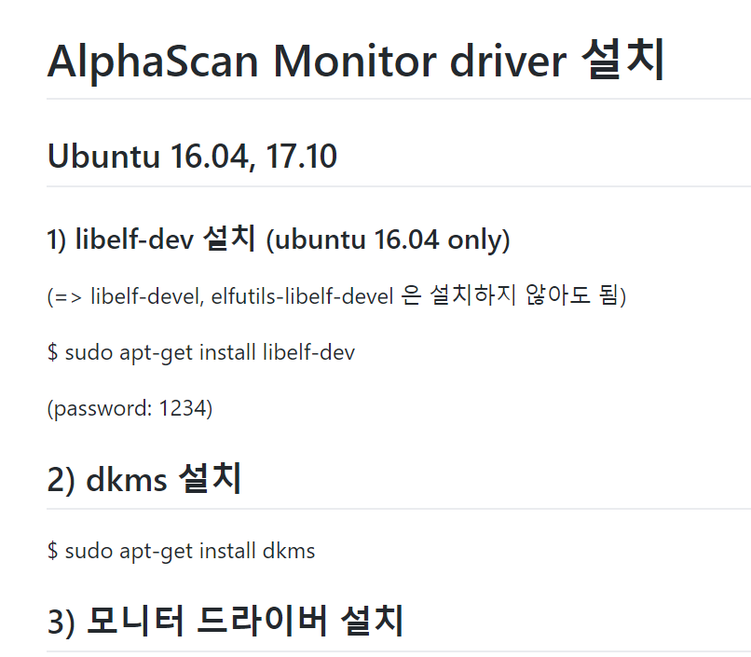

$ sudo apt-get install libelf-dev
$ sudo apt-get install dkms
$ sudo ./displaylink-driver-4.2.29.run

