Slide 1



Live Watermarking
Lorenzo Marino
s317703
Agostino Saviano
s307946
Niccolò Cacioli
s305325
Cybersecurity for Embedded Systems
September
2023

Slide 2
Summary
PART 1
Watermarking
PART 2
Modern Technologies
PART 3
Project Overview
PART 4
Demo
PART 5
Conclusions
02

Slide 3
WATERMARKING
PART 1
PART 3
PART 4
PART 5
Reasons behind Live Audio Watermarking
New Threats
Forging an audio recording nowadays is really easy!
Accessible and foolproof audio editing software is ubiquitous and most of the time even free
Modern day rising level of technologies and higher use of affordable AI e.g. DeepFakes
18

Slide 4
WATERMARKING
PART 1
PART 3
PART 4
PART 5
Audio watermarking... what is it?
A method to hide information in a way that is difficult to remove
Can be used to...
Enforce copyright as part of a DRM scheme
Trace the origin of the data
But most importantly...
To authenticate a recording
18

Slide 5
WATERMARKING
PART 1
PART 3
PART 4
PART 5
Audio watermarking... what is it?
Sought-after properties
Robustness
Imperceptibility
Resistance to standard manipulation
techniques such as conversions
between digital formats, digital to
analog, editing and in general every
attempt apt to destroy or alter the
watermark data.
The inability for the end user to
notice the watermark. The injection
process should not introduce
perceptible artifacts in the data.
Security through obscurity.
18

Slide 6
WATERMARKING
PART 1
PART 3
PART 4
PART 5
Audio watermarking... what is it?
Sought-after properties continued...
Density
Algorithm speed
High information content inside
the watermark. Date of creation,
source, recipient and every other
bit useful for identification.
The algorithm used for injecting
watermarks should not be
computationally heavy in order
to be used in real-time systems.
18

Slide 7
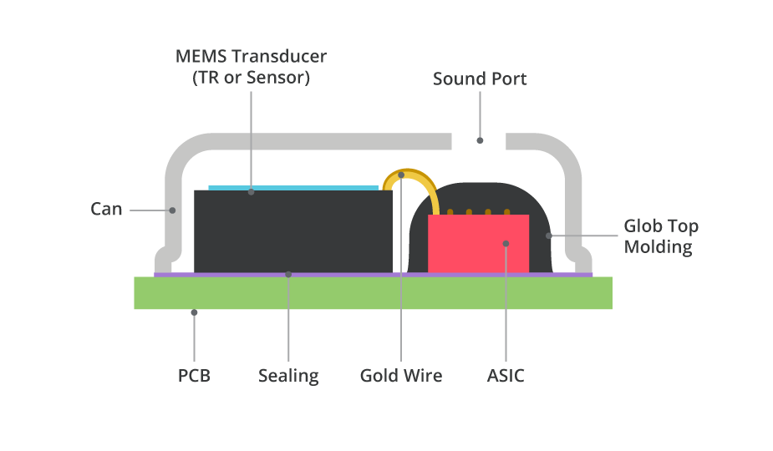
PART 1
MODERN TECHNOLOGIES
PART 3
PART 4
PART 5
Modern day microphones
MEMS Technology
MEMS (Micro-Electro-Mechanical System) Microphones use a MEMS component placed on a printed circuit board (PCB) and protected with a mechanical cover.
Low impedance
Small size
Analog PCB and ADC incorporated
10

Slide 8
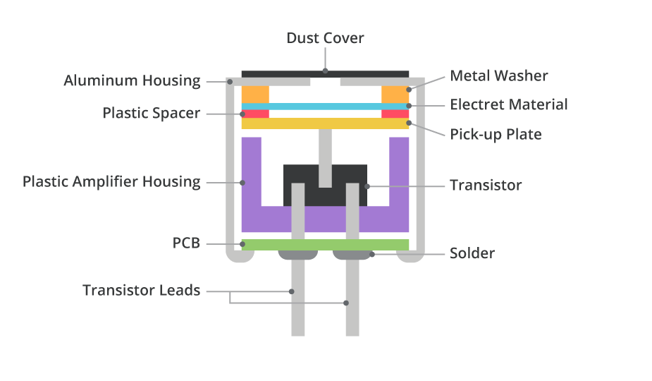
PART 1
MODERN TECHNOLOGIES
PART 3
PART 4
PART 5
Modern day microphones
ECM Technology
No need for a polarizing power supply.
Three mayor types depending on the positioning of the electret: Electret as diaphragm itself, front electret and back electret.
Better protection from dust and moisture
Larger physical size
Wider operating voltage range
10

Slide 9
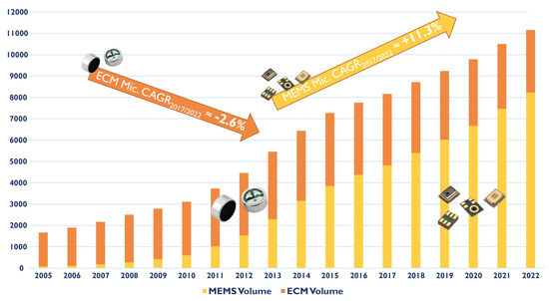
PART 1
MODERN TECHNOLOGIES
PART 3
PART 4
PART 5
Considerations
Market and usage
ECM are mainly used for high performances while MEMS are more common, due to area constraint, in common small devices
Our project was then oriented to the MEMS and the devices that implemented these microphones
10

Slide 10
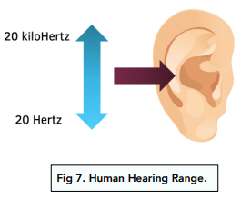
PART 1
MODERN TECHNOLOGIES
PART 3
PART 4
PART 5
Inaudible sounds
What can we hear
Humans can detect sounds in a frequency range from about 20 Hz to 20 kHz, varying from person to person
If a signal stays outside of this range is not audible from humans
How can we exploit this trait?
10

Slide 11
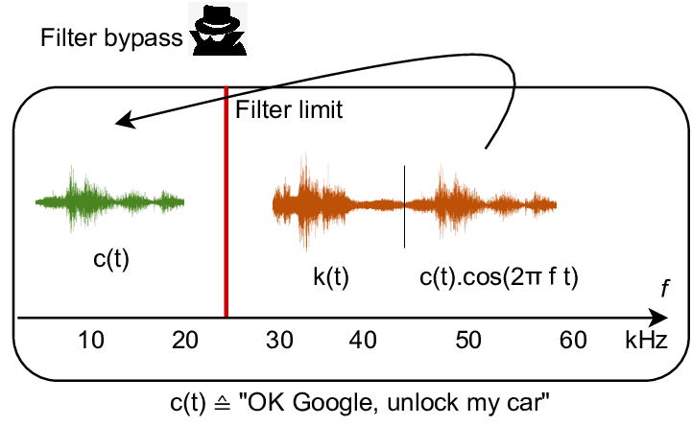
PART 1
MODERN TECHNOLOGIES
PART 3
PART 4
PART 5
Non linearity in MEMS Microphones
How it works
Modules inside a microphone are mostly linear systems
Non Linearity works with very high frequencies, outside the cut off frequency of the microphone
Thanks to these frequencies, we have an observable result inside the cut off frequencies
10

Slide 12




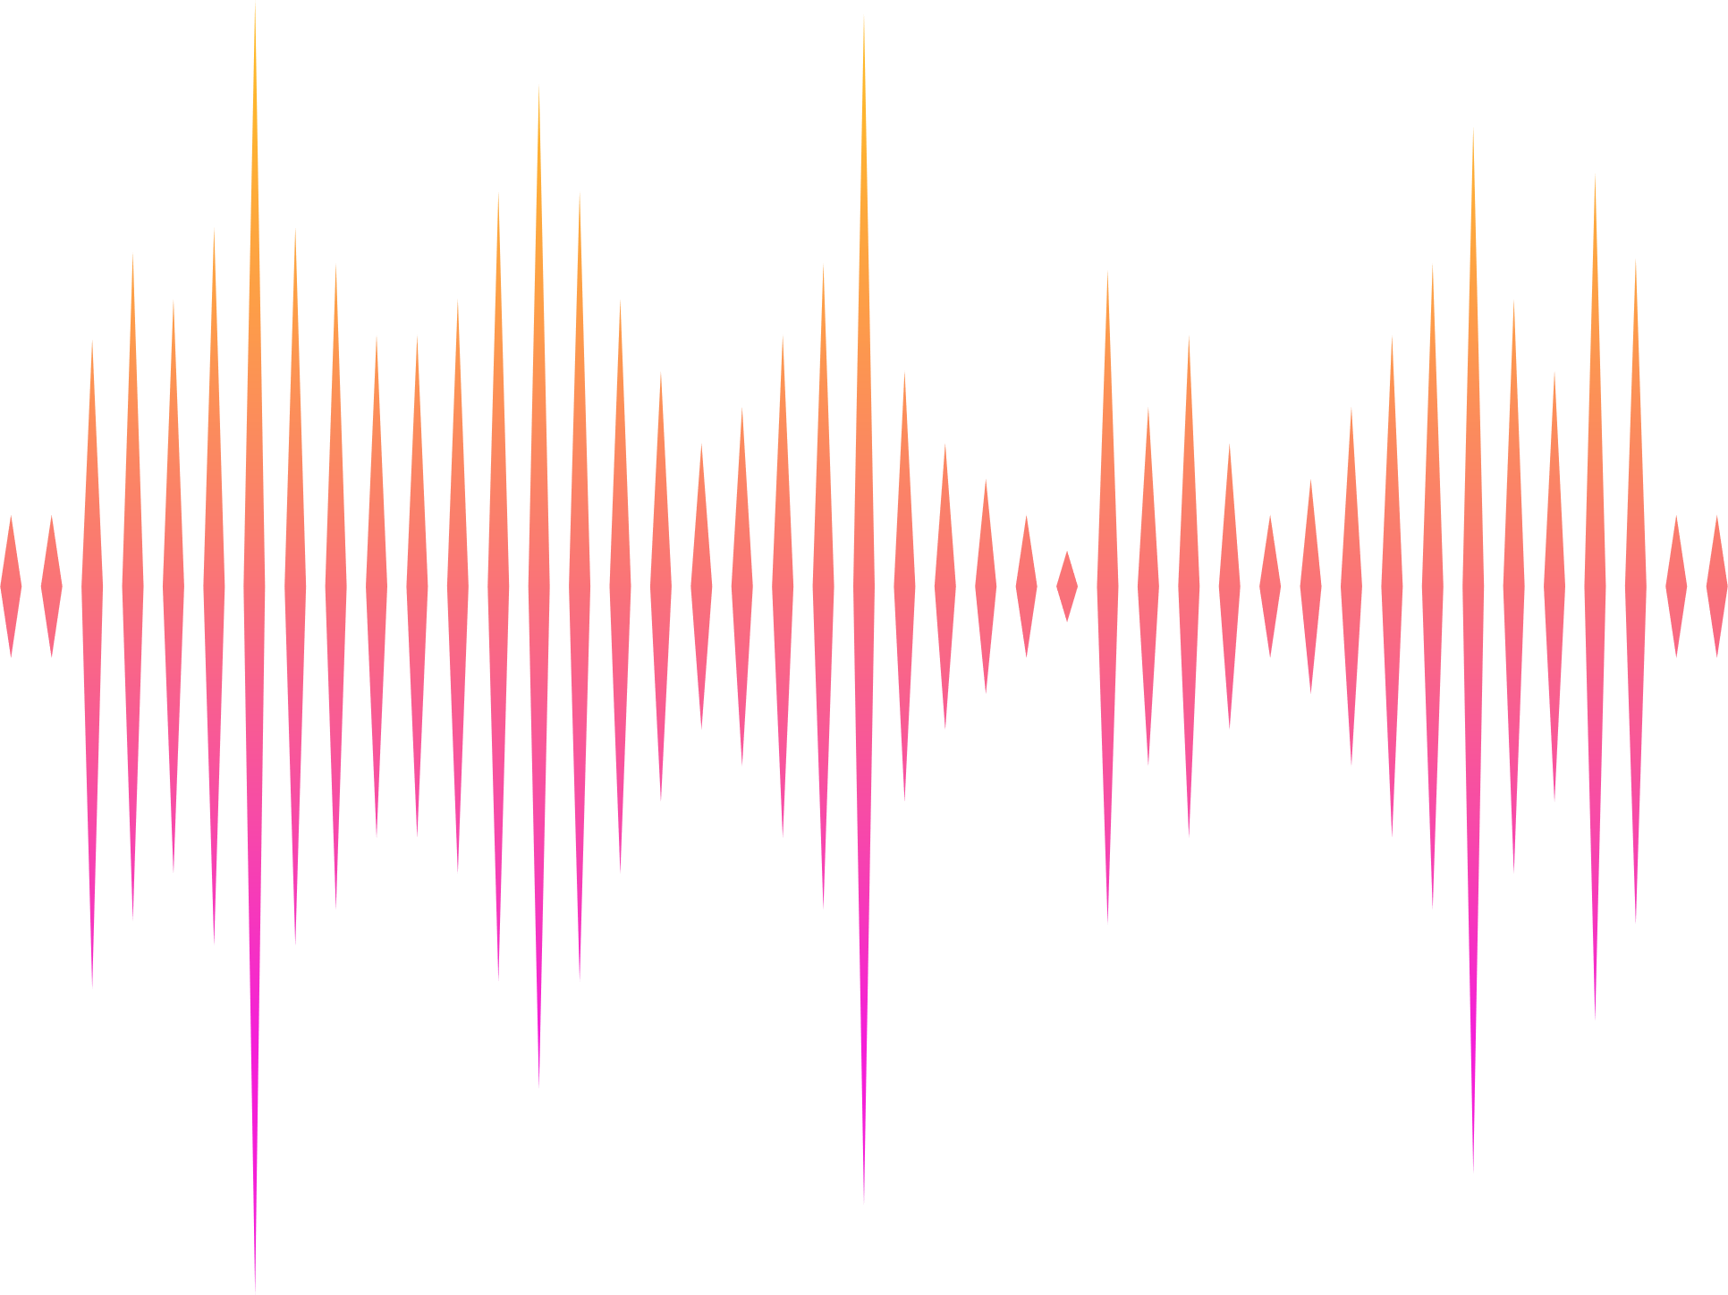

PART 1
PART 2
PROJECT OVERVIEW
PART 4
PART 5
Implementation idea
A personal device
The most common portable device almost every person owns: a smartphone.
It can be used to embed into the recording any relevant information about the user or the moment of the recording.
Exploiting the smartphone hardware, information like geolocalization, can be automatically retrieved and integrated in the recorded sample.
Most smartphone nowadays are capable of reproducing High-fidelity audio, with playback sampling rate higher than 48kHz
23

Slide 13
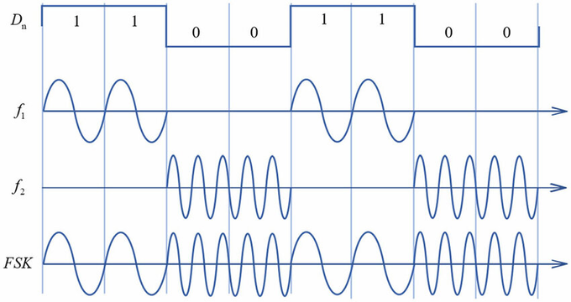
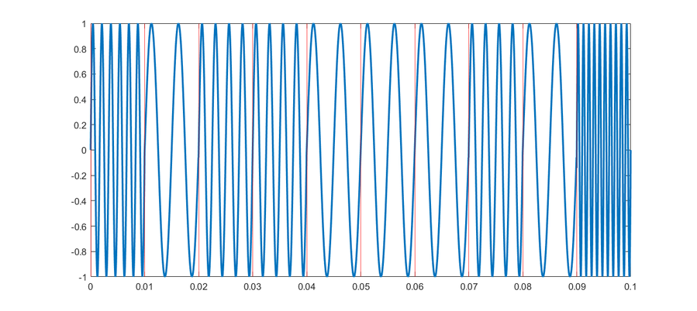
PART 1
PART 2
PROJECT OVERVIEW
PART 4
PART 5
Design of the watermarking signal
Digital modulation
The signal is encoded with Frequency Shift Keying, therefore is made of tones of different frequencies.
The symbols to represent are 4 (start, stop, bit0, bit1) therefore 4 distinct frequency above 18 kHz are needed.
Pseudo-code of the watermark transmission:
generate_tone(start)
for bit in DataToTransmit:
if(bit=’0')
generate_tone(bit0)
else
generate_tone(bit1)
end for
generate_tone(stop)
EXAMPLE OF FSK BINARY TRANSMISSION
start
bit0
bit1
bit1
bit0
bit0
bit0
bit1
bit0
stop
Ttone
FSK transmission for string ‘b’
23

Slide 14
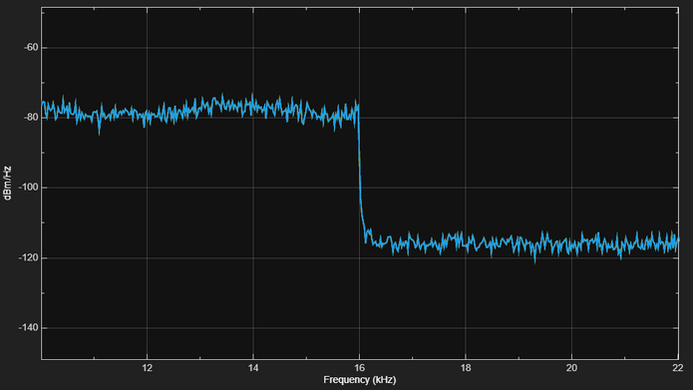
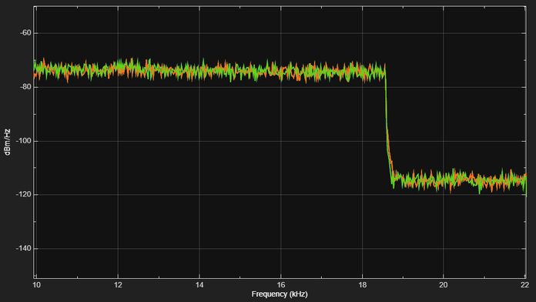
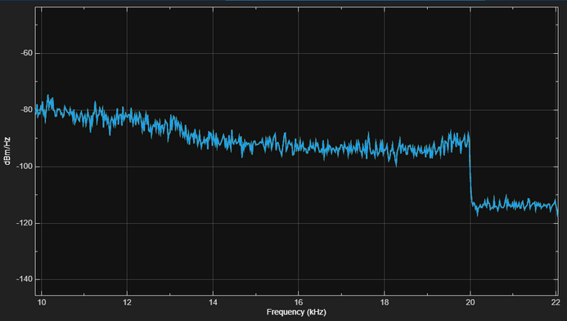
PART 1
PART 2
PROJECT OVERVIEW
PART 4
PART 5
Design of the watermarking signal
Limited Frequency range
From empirical analysis, the device tested is able to generate tones above 20kHz, but the same device, along with others from different brand, limits the recording input frequency, as shown in these power frequency spectums.
APPLE DEVICE
WINDOWS LAPTOP DEVICE
SAMSUNG DEVICE
23

Slide 15
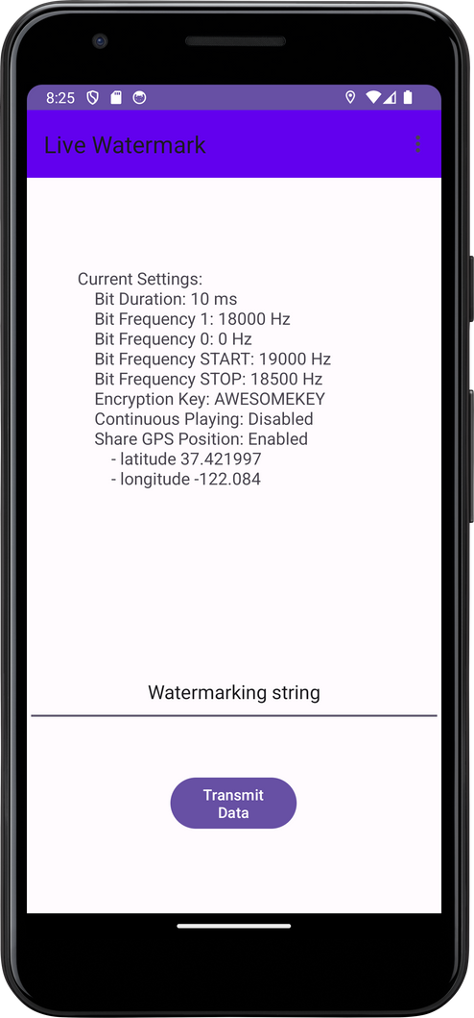
PART 1
PART 2
PROJECT OVERVIEW
PART 4
PART 5
Transmission of the watermark
Application overview
In the home page the user can decide a string to send as a watermark.
After pressing the button the string is transmitted through the smartphone speaker.
The string can contain any textual information, from the name of the user to his fiscal code, phone number, email etc.
23

Slide 16
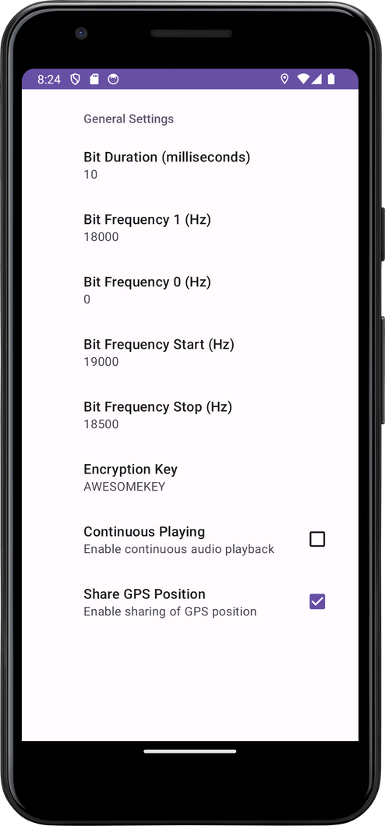
PART 1
PART 2
PROJECT OVERVIEW
PART 4
PART 5
Transmission of the watermark
Application overview
The application has a setting page that allows the user to customize the watermark signal.
Other than changing the duration and frequency of the symbols, the user can decide to share (in addition to the string) the GPS position.
All the data can be encrypted using an “AES-256” algorithm, if the user sets a KEY.
The streaming of the watermark can be continuously played, or just played once when tapping the button in the homescreen
23

Slide 17
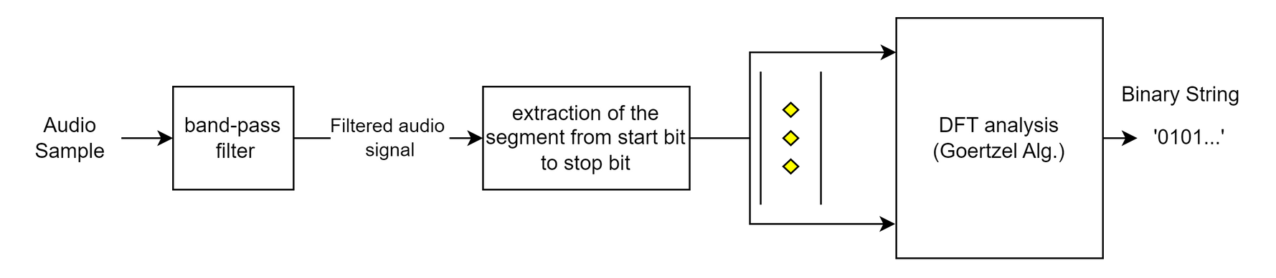
PART 1
PART 2
PART 3
DEMO
PART 5
A demo example
Example of extraction of the watermark from a recording
Decoding algorithm flow
28

Slide 18
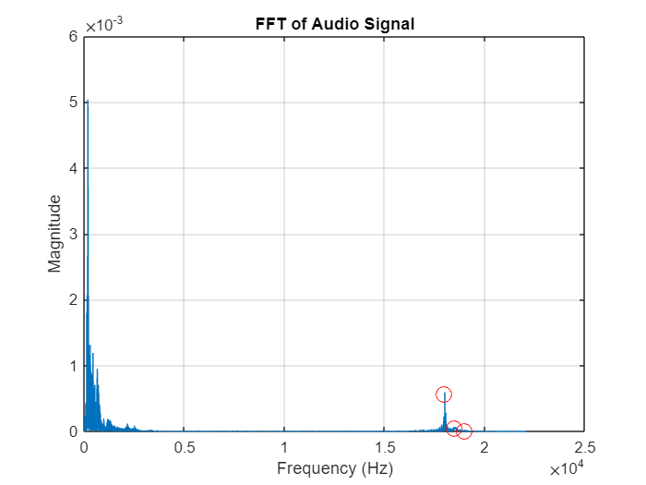
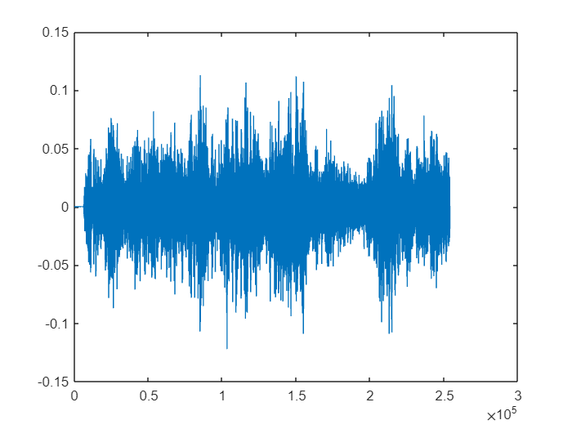

PART 1
PART 2
PART 3
DEMO
PART 5
A demo example
Example of extraction of the watermark from a recording
Filtering: original signal
28

Slide 19
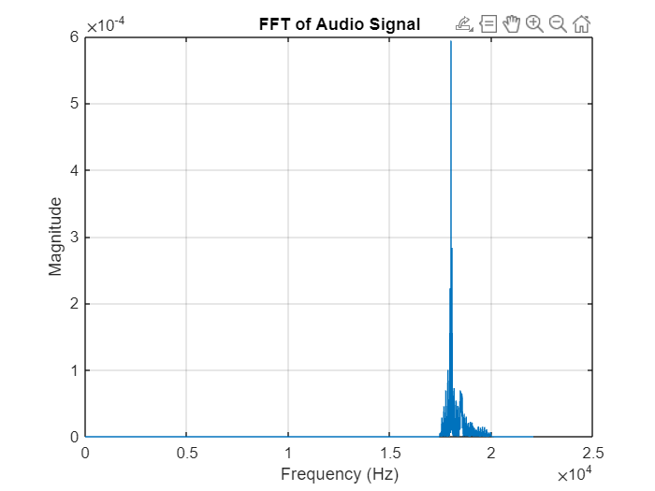
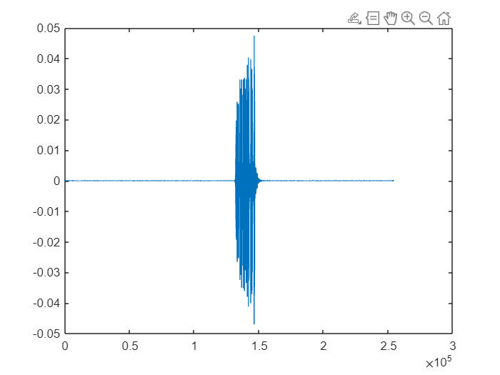
PART 1
PART 2
PART 3
DEMO
PART 5
A demo example
Example of extraction of the watermark from a recording
Filtering: processed signal
28

Slide 20
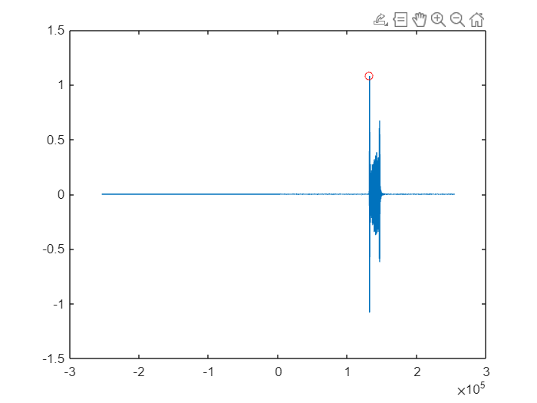
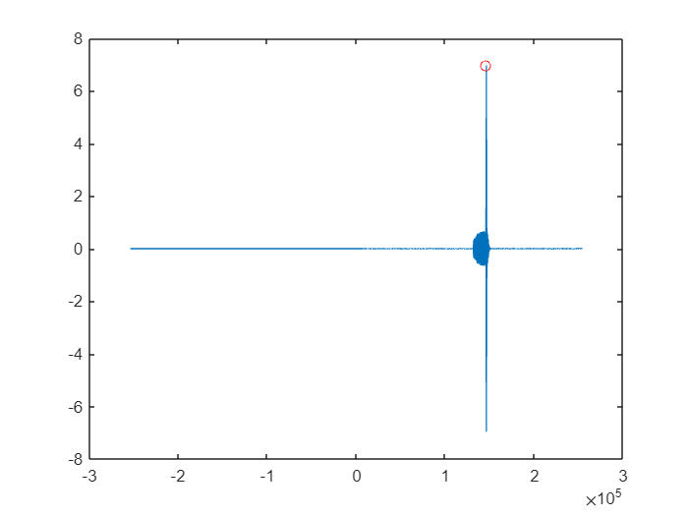
PART 1
PART 2
PART 3
DEMO
PART 5
A demo example
Example of extraction of the watermark from a recording
Segment extraction
CROSS-CORRELATION WITH START TONE
CROSS-CORRELATION WITH STOP TONE
28

Slide 21
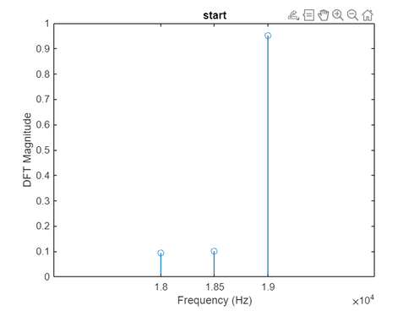
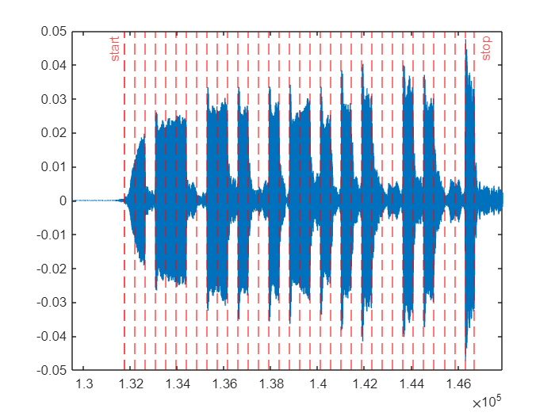
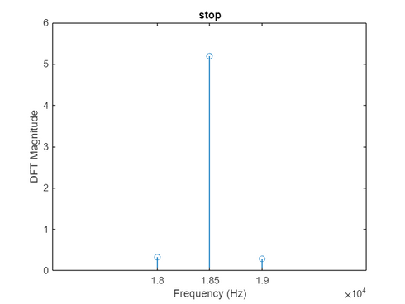
PART 1
PART 2
PART 3
DEMO
PART 5
A demo example
Example of extraction of the watermark from a recording
Analysis with Goertzel Algorithm
28

Slide 22
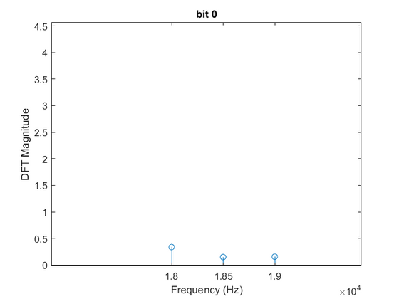
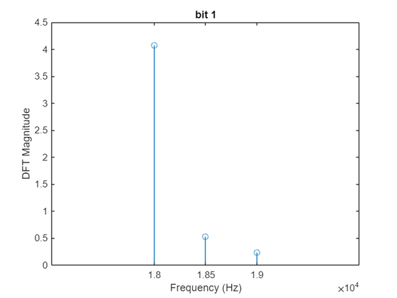
PART 1
PART 2
PART 3
DEMO
PART 5
A demo example
Example of extraction of the watermark from a recording
Analysis with Goertzel Algorithm
28

Slide 23
PART 1
PART 2
PART 3
DEMO
PART 5
A demo example
Example of extraction of the watermark from a recording
Decryption
¹¥®(
ciao
28

Slide 24
PART 1
PART 2
PART 3
PART 4
CONCLUSIONS
Conclusions
Known issues and future works
The smartphone speaker exhibit non linearities, thus resulting in a crackling sound that depends on the volume of the smartphone and the length of the watermark.
The available bandwith is limited.
KNOWN ISSUES
Improving the quality and the power of the signal by means of an additional external device, e.g. a mini “speaker” made of transducer reproducing indipendently the right and the left channel of the generated audio.
Improving the post processing analysis, developing a live processing technique
Exploiting ultrasound to inject a signal in the near ultrasound range
FUTURE WORKS
The implementation has been kept simple, and it is sufficient to embed a watermarking data into a recording, considering the limitation.
THIS PROJECT
31

Slide 25
THANK you for your attention

