Slide 1
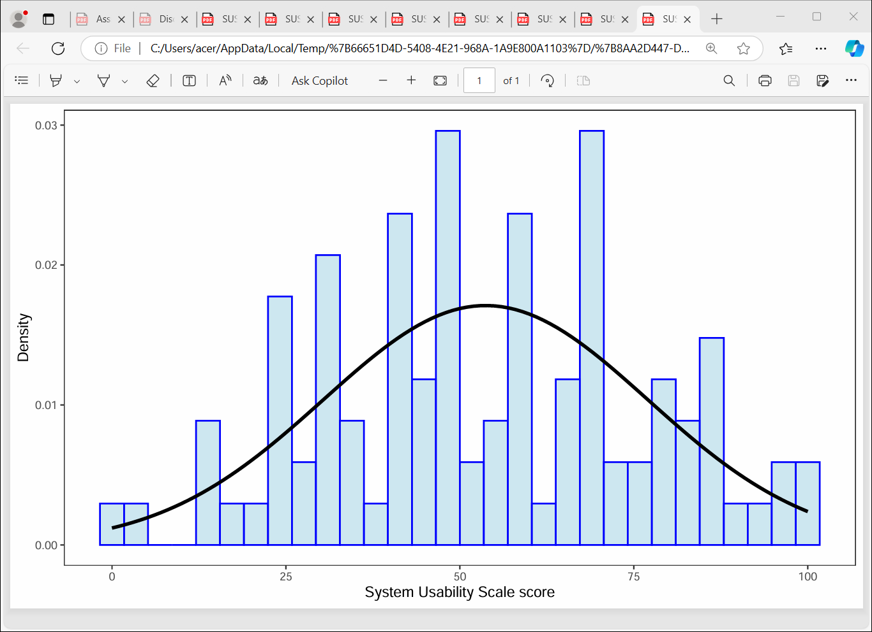
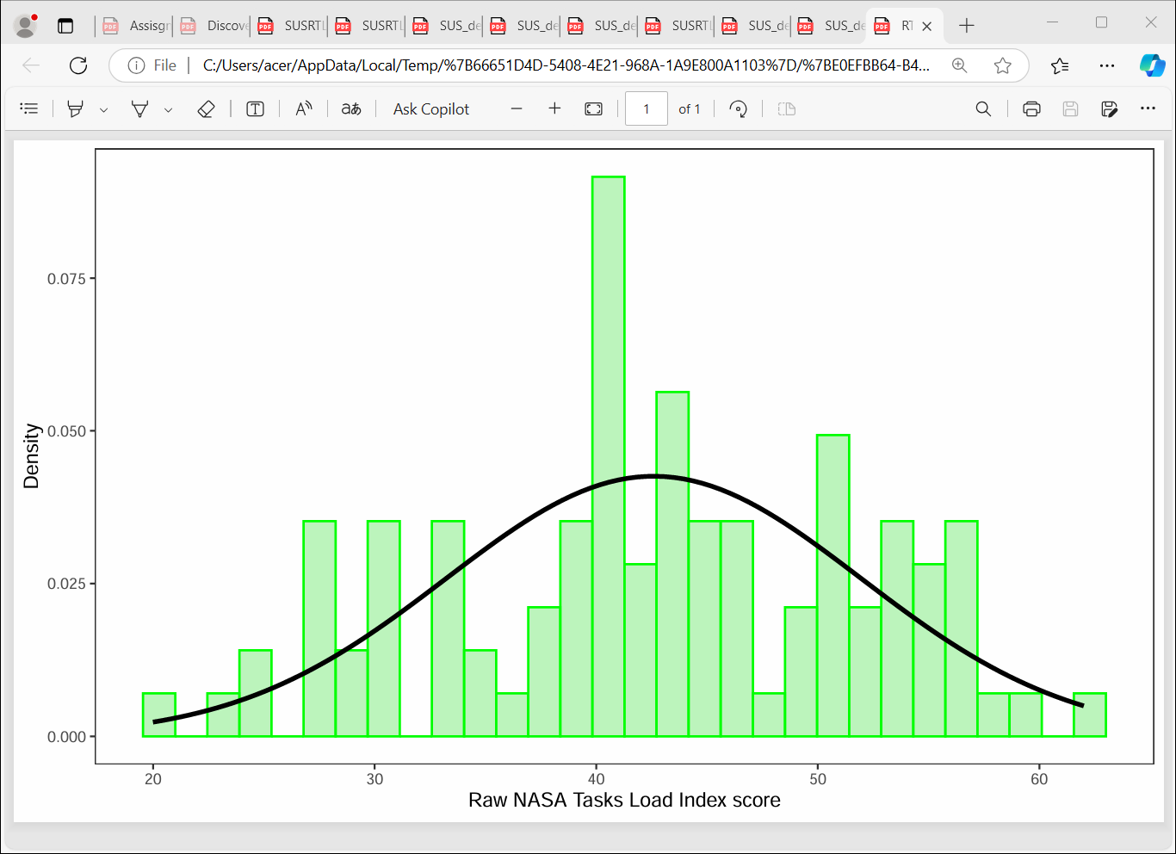
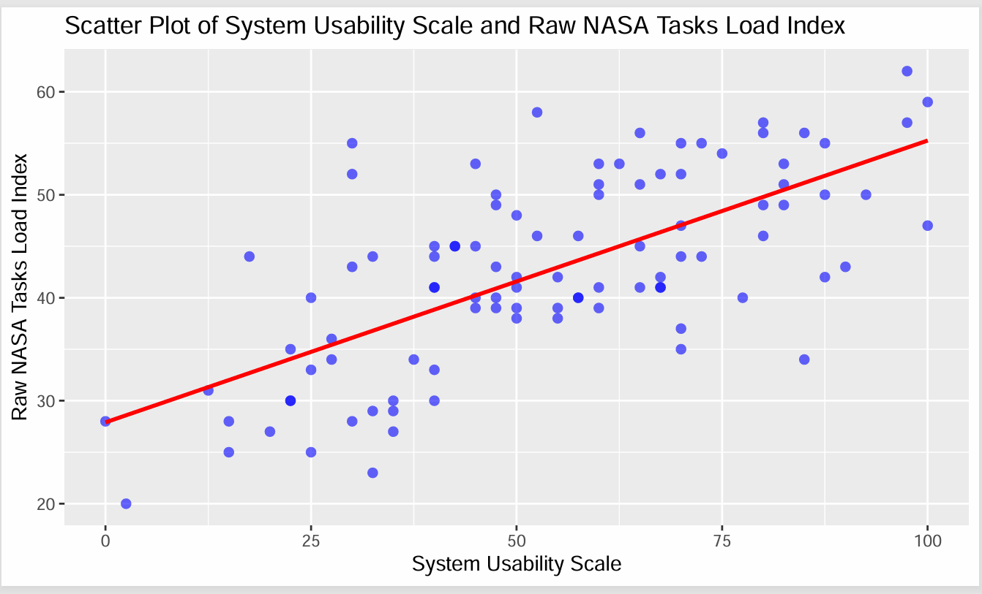
Relationship between Subjective Workload and perceived System Usability with Amazon Alexa usage
Isaac Kwame Essien Obeng
Quantitative Data Analysis Assignment 1
Hypotheses
Table 1: Descriptive statistics of system usability scale (SUS) and the raw NASA task load index (RTLX) scores
H0: There will be no statistically significant relationship between RTLX and SUS.
H1: There will be a statistically significant relationship between RTLX and SUS.
VARIABLE | MEAN | MEDIAN | STD | MIN | MAX
SUS | 53.70 | 53.08 | 23.32 | 0.00 | 100.00
RTLX | 42.59 | 42.50 | 9.37 | 20.00 | 62.00
STD = standard deviation, Min = minimum value, Max = maximum value
Results
Limitations
Table 1 presents the descriptive statistics of our two variables: Raw NASA task load index-RTLX (Hart & Staveland, 1988; Hart, 2006) and System usability scale-SUS (Brooke, 2013) with similarity between the Mean and Median showing how the values are evenly distributed. Therefore, both variables were found to likely come from a normal distribution, which are depicted with the probability density and histogram plot of Fig. 2 and Fig. 3. The R programming language was used for the analysis with the dataset cleaned by removing a negative value and a value exceeding maximum range score for SUS. Since our sample data is continuous a parametric correlation analysis was employed (Field et al., 2012).
The Pearson’s correlation results obtained was r(96)=.68, p<.001 with degrees of freedom (n-2) and the relationship between subjective workload and the perceived computer system usability are presented with a scatter plot and a best fit line in Fig. 1 to show the closeness of the data points to line. The strong positive correlation coefficient obtained at 1% level of significance shows an observed significantly likely positive association between the two variables. The correlation results tend to reject the null hypothesis of no association. The reported 95% confidence level lying between the boundaries of .56 and .77 shows how less likely the existing relationship could have been due to chance. Therefore, the dataset is likely to support our hypothesis of statistical significance relationship between RTLX and SUS.
Our dataset and research hypothesis did not allow us to ascertain the existence of any confounding variables that could have influence the relationship. Therefore, we cannot be sure if the relationship observed was due to certain observables that was omitted. So future studies could consider much more extensive dataset which aimed at analysing and controlling for several attributes and/or variables that could be exhibited by the dataset.
Also, we could not investigate any causality between our two variables, though intuitively, one could think of either an increasing subjective workload being because of a perceived difficulty in system usage or vice versa. Such a study may need to go beyond just investigating the associated relationship into employing a multiple regression analysis.
One important consideration is to assess the relationship between subjective workload and system usability across different genders. This could be interesting for future studies since various constructs measured by the RTLX may be gender bias, which should be considered in the development of computer information systems.
Fig. 2: Histogram of the perceived system usability scores obtained
Fig..3: Histogram of the raw NASA task load index scores obtained
Discussion
We found a significant positive relationship between subjective workload experiences by participants and their perceived usability of systems being employed. This generally means an increasing workload of digital systems everyday usage is likely to be associated with improvements in perception of systems usage (Longo & Dondio, 2015). Although difficulty in workload, has been reported in the literature, imposes higher burden on those engaged in them and therefore adversely affecting their performances (Huey & Wickens, 1993) and experiences. One possible reason for our findings could be the engagements in routine and/or familiar tasks is characterised by the desire to explore better/advanced alternatives thereby improving perceived systems usage and experiences. Wu et al. (2020), for instance, though found increase in mental workload with the use of intelligent personal assistance (IPAs), notably this was much more pronounced with nonnative speakers compared to native speakers, suggesting that cognitive workload is relatively reduced with innate familiarity. Using empirical analysis Yang et al. (2022) found that IPAs enhance learning performance and fluency. Also, Jafari et al. (2020) found high mental workload is experienced when tasks are done unfrequently but the use of technology systems in occasional train driving situations helps improve workload. These findings, ultimately, supports perceived digital systems usability enhancements being associated with difficulty in workload, especially, when users possess some innate cognitive familiarization or characteristics of tasks or have some experience with tasks (Haga et al., 2002).
Another key reasons for our findings could be the excitements users’ experiences in their daily digital routines and their propensity to improve their tasks with much more advanced technology. This is in support of Longo and Dondio (2015), when separate tasks were analysed, they found positive relationship between mental workload and perceived system usability because of the enjoyment experienced with tasks.
Conclusion
The study hypothesized that there will be a statistically significant relationship between RTLX and SUS. After analysing a dataset of 100 participants, we found a likely support to our hypothesis and therefore rejected the null hypothesis of no relationship. Although, our findings tend to disagree with a popular no relationship found between both variables in the literature, our findings were in support of the literature that found that higher subjective workload was associated with enhancement in perceived system usability due to tasks: experiences, cognitive familiarity, enjoyments experienced and application of technology. Like previous studies we also, suggest a complementary employment of both RTLX and SUS measures, but with the reasons that both assessments target different aspects of the digital user experiences.
Fig. 1: Scatter plot of relationship between the system usability score and the raw NASA task load index

Slide 2
References
Brooke, J. (2013). SUS: A retrospect. Journal of Usability Studies, 8(2), 29-40.
Field, A., Miles, J., & Field, Z. (2012). Discovering Statistics using R. Sage Publications.
Haga, S., Shinoda, H., & Kokubun, M. (2002). Effects of task difficulty and time-on-task on mental workload. Japanese Psychological Research, 44(3), 134-143.
Hart, S. G., & Staveland, L. E. (1988). Development of NASA-TLX (Task Load Index): Results of empirical and theoretical research. In human mental workload.
Advances in Psychology, 52, 139-183.
Hart, S. G. (2006). NASA-task load index (NASA-TLX); 20 years later. In proceedings of the human factors and ergonomics society annual meeting. Sage Journals, 50(9).
https://doi.org/10.1177/154193120605000909
Huey, B. M., & Wickens, C. D. (1993). Workload transition: implication for individual and team performance. Washington, DC: National Academy Press.
Jafari, M-J., Zaeri, F., Jafari, A. H., Payandeh Najafabadi, A. T., Al-Qaisi, S., & Hassanzadeh-Rangi. (2020). Assessment and monitoring of mental workload in subway train operations
using physiological, subjective, and performance measures. Human Factors and Ergonomics in Manufacturing and Service Industries, 165-175. https://doi.org/10.1002/hfm.20831
Longo, L., & Dondio, P. (2015). On the relationship between perception of usability and subjective mental workload of web interfaces. In 2015 IEEE/WIC/ACM
International Conference on Web Intelligent Agent Technology (WI-IAT), 1, 345-352. IEEE.
Wu, Y., Edwards, J., Cooney, O., Bleakley, A., Doyle, P. R., Clark, L., Rough, D., & Cowan, B. R. (2020). Mental workload and language production in non-native speaker IPA interaction.
In Proceedings of the 2nd Conference on Conversational User Interfaces (CUI ‘20). Association for Computing Machinery, New York, NY, USA, 3(8), 1-8. https://doi.org/10.1145/3405755.3406118
Yang, C. T. Y., Lai, S. L., & Chen, H. H. J (2022). The impact of intelligent personal assistants on learners’ autonomous learning of second language listening and speaking.
Interactive Learning Environments, 1-21. https://doi.org/10.1080/10494820.2022.2141266

