Slide 1
Hand Sign Gesture Recognition
Iker Vazquez Lopez

Slide 2
Preprocessing
Extraction
Feature definition and extraction
Laplace filter
Training and classification
ANN
Normalization (depth and size)
Image capture
Ideal world definition
Fourier transform
Gabor filter
…
RDF
…
Hole filling
Image operations

Slide 3
Image capture

Slide 4
Image capture
We are going to use the depth information of the scene to recognize the sign gestures.
A selection of the capturing sensor is required.
At this moment we are not going to use any other image source (color, infrared…).
For this thesis an ideal world is going to be defined to capture the images.
This ensures low environment variance.

Slide 5
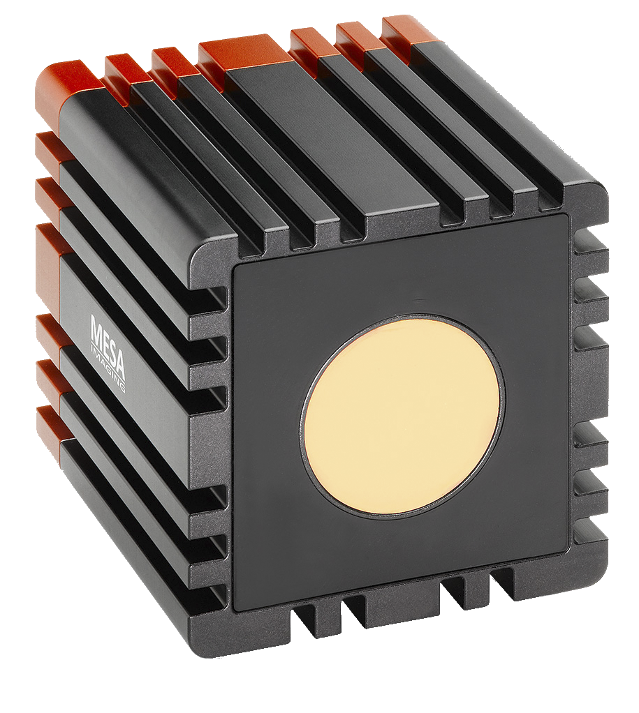
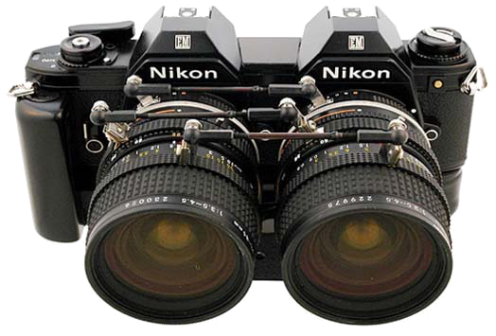
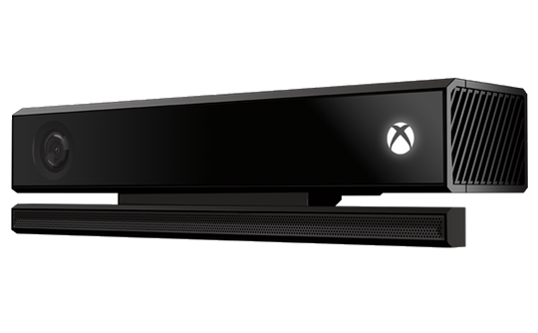
Image capture – Depth sensor types
Time of Flight (ToF)
Xbox Kinect
Stereoscopic camera
Low resolution.
High frame rate.
1080px resolution.
Acceptable frame rate.
Different sensor types.
SDK for body tracking.
Different resolutions.
Different frame rates.
Low depth precision.
Can be built with two normal cameras.

Slide 6
Image capture – Sensor selection
Kinect
It is very cheap for the offering resolution and precision.
Depth sensor, color camera and infrared sensor.
30fps enough to track (30>24).
SDK for tracking.
Many people has used it.
A lot of papers and forums.
Does not work well with bright lighting: use a special environment.
Small optimal range: use a special environment.
Does not capture well the depth map depending on the type of surface.

Slide 7
Image capture – Ideal world definition
White wall for background (no reflective materials).
Subject sitting or standing up? (Select one).
Subject position:
2m from the Kinect.
“Center” of the Kinect field of view.

Slide 8
Preprocessing

Slide 9
Preprocessing
We are going to focus only on the hands.
Crop the hands from the original image.
For sign comparing we need to normalize them.
Size normalization.
Depth normalization

Slide 10
Preprocessing – Hand extraction
Kinect camera provides the body information of the user.
We know where are the hands in the scene → We can crop the image around that part of the scene.
The cropped image contains depth data from the background which it is necessary to discard to keep only the hand.
Thresholding from the hand joint keeps only the hand depth data.

Slide 11
Preprocessing – Normalization
People has different hand sizes → the images are different.
Due to the perspective projection of the camera, objects in the back seem smaller than the objects in the front.
In this case the values of the image are different too, objects in the back have higher depth values (distance).
We can use the body information to scale the hand for normalization.
Compute the average depth value of the hand and translate to a “ideal” location in the 3D space to normalize the depth.

Slide 12
Feature definition and extraction

Slide 13
Feature definition and extraction
For classification purposes we have to define some features to compute from the segmented hand images.
We have to study which are the best features commonly used in image processing to use them in this problem.
Laplace filter.
Gabor filter.
Fourier Transform.
…

Slide 14
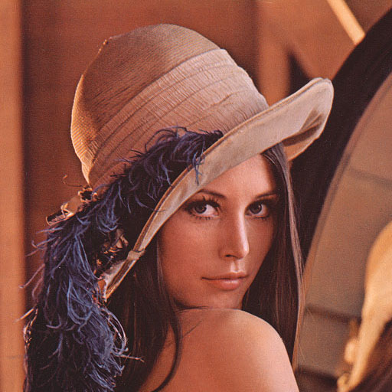
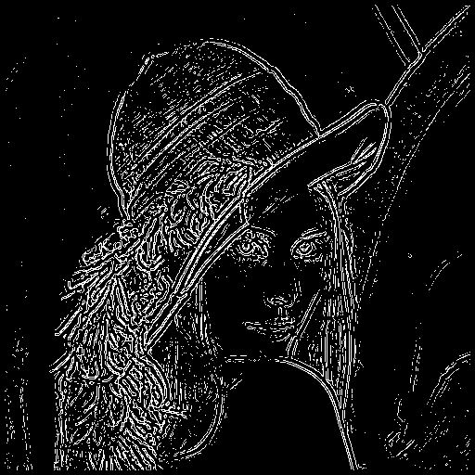

Features – Laplace Filter
The laplacian matrix usually is used to detect the edges or borders in the image.
$$\left[\begin{matrix}0 & 1 & 0 \\ 1 & 4 & 1 \\ 0 & 1 & 0\end{matrix}\right]$$
Laplace matrix

Slide 15
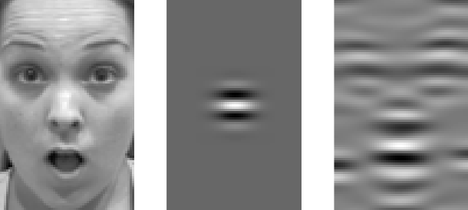
Features – Gabor filter
The Gabor filter has been used for edge detection in the frequency domain and for face recognition.
This filter uses different frequencies and orientations to detect patterns in the image.

Slide 16
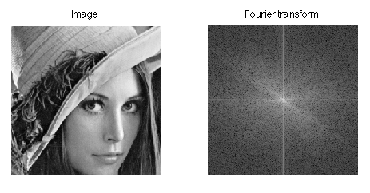
Features – Fourier transform
The Fourier transform encodes the image in the frequency domain. This transformation is invariant to the scale an rotation.
Fourier Transform

Slide 17
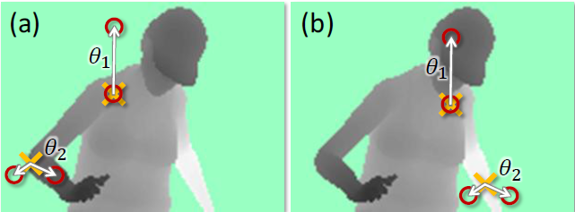
Features - Custom
Instead of using commonly used filters in images processing we can define our own features, like the one it is used in [RealTimeHandPoseEstimationUsingDepthSensors].

Slide 18
Gesture recognition

Slide 19
Gesture recognition
At this moment we propose two different ways, which have to be studied, to recognize the gestures.
Operations between images.
Machine Learning models.
The recognition is not limited to these two approaches, if we consider that there is another option that fits better with the system requirements we are going to use it.

Slide 20
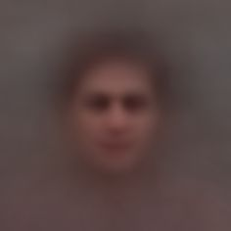
Gesture recognition – Operations between images
We can use two different methods for image comparison:
Difference between images.
Correlation between images.
The two approaches have the same base: from the known gestures compute the average of the images for each gesture, then we can compare against this new image instead of all of them.

Slide 21
Gesture recognition – Operations between images – Difference
We can compute the difference between the average of each gesture and the input gesture.
We will know how similar is the gesture to one of the known gestures in the database.
There are different metrics to know how similar are two images from the difference:
Average error.
Min Square Error.
Standard deviation.
…

Slide 22
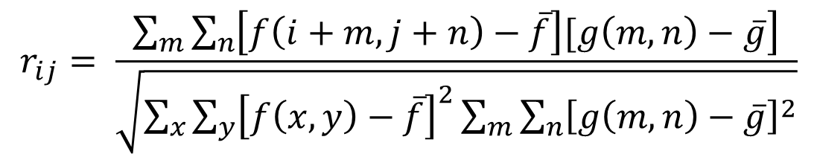
Gesture recognition – Operations between images – Image correlation
Correlation between two images provides the similarity of them.
When the images are of different sizes, all the pixels have to be considered as starting points and the window (the smaller image) has to be shifted over the bigger image.
This provides a metric for each pixel in which the value is the correlation value for that starting point.
$$r_{ij}= \frac{\sum_{m}{\sum_{n}{\left.\left[f\left(i+m, j+n\right)−\overline{f}\right][g\left(m,n\right)−\overline{g}\right]}}}{\sqrt{\sum_{x}{\sum_{y}{{\left[f\left(x,y\right)−\overline{f}\right]}^{2}}}\sum_{m}{\sum_{n}{{\left[g\left(m,n\right)−\overline{g}\right]}^{2}}}}}$$

Slide 23
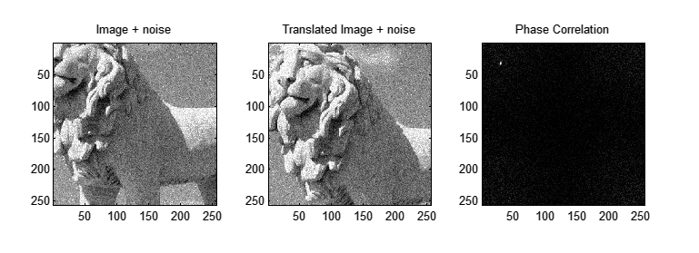
Gesture recognition – Operations between images – Image correlation

Slide 24
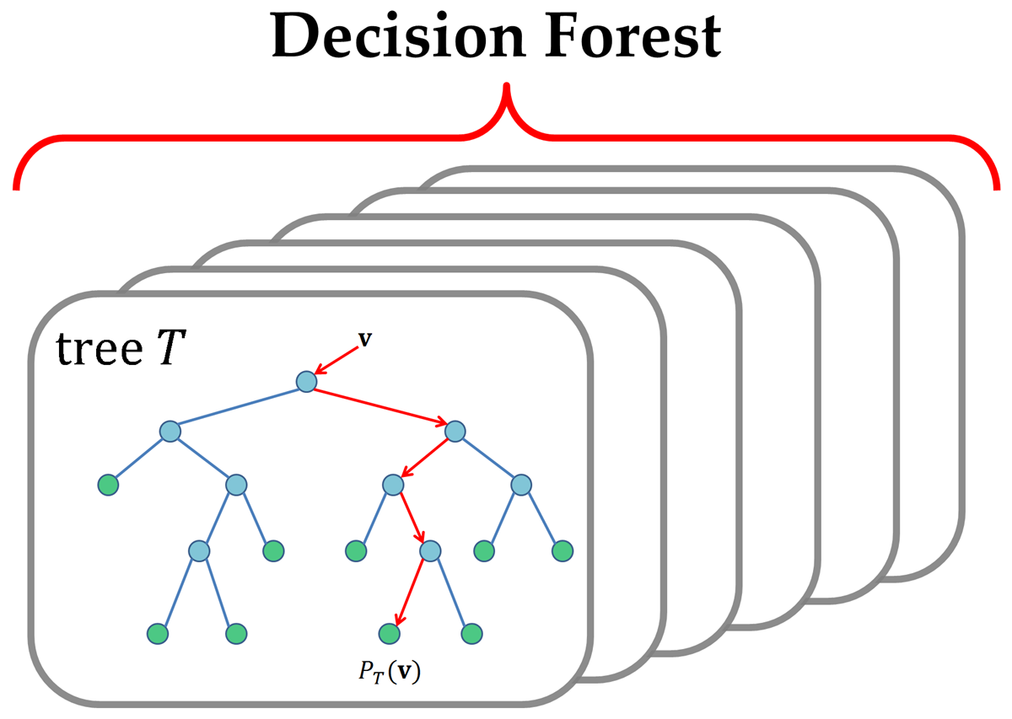
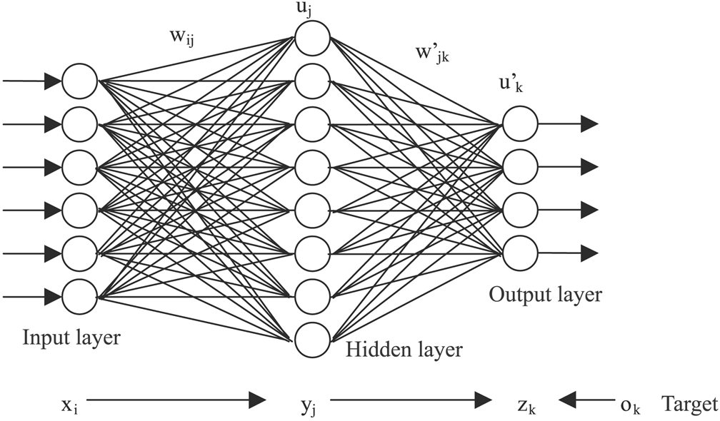
Machine Learning models
Generating machine learning models from the database to let the system learn is another option we have to consider.
From the captured image database we can train models using different algorithms and study which is the best that fits for this problem.
There are many different algorithms for training, but we are going to focus on the ones that have been used in the prior work: ANN and RDF.

Slide 25
Machine Learning models - Boosting
Since Sign Language has a lot of gestures, in the future we are going to need to add more of them to the database, therefore the resulting precision of the models after retraining will decrease considerably.
To avoid this problem we have to consider using the boosting technique which will allow, using different types of models and configurations, to achieve better accuracy.

Slide 26
Testing in real world

Slide 27
Testing in real world
We are going to ask to the Sign Language department at Boise State University to get some student volunteers to perform some gestures in front of the camera.
With this test we will know if the system is capable to recognize the gestures, work in real time and if the accuracy is enough for the problem.

