Slide 1



F1_post1
View in Power BI
Last data refresh:
10/7/2026 4:02:24 PM UTC
Downloaded at:
10/7/2026 4:03:33 PM UTC

Slide 2
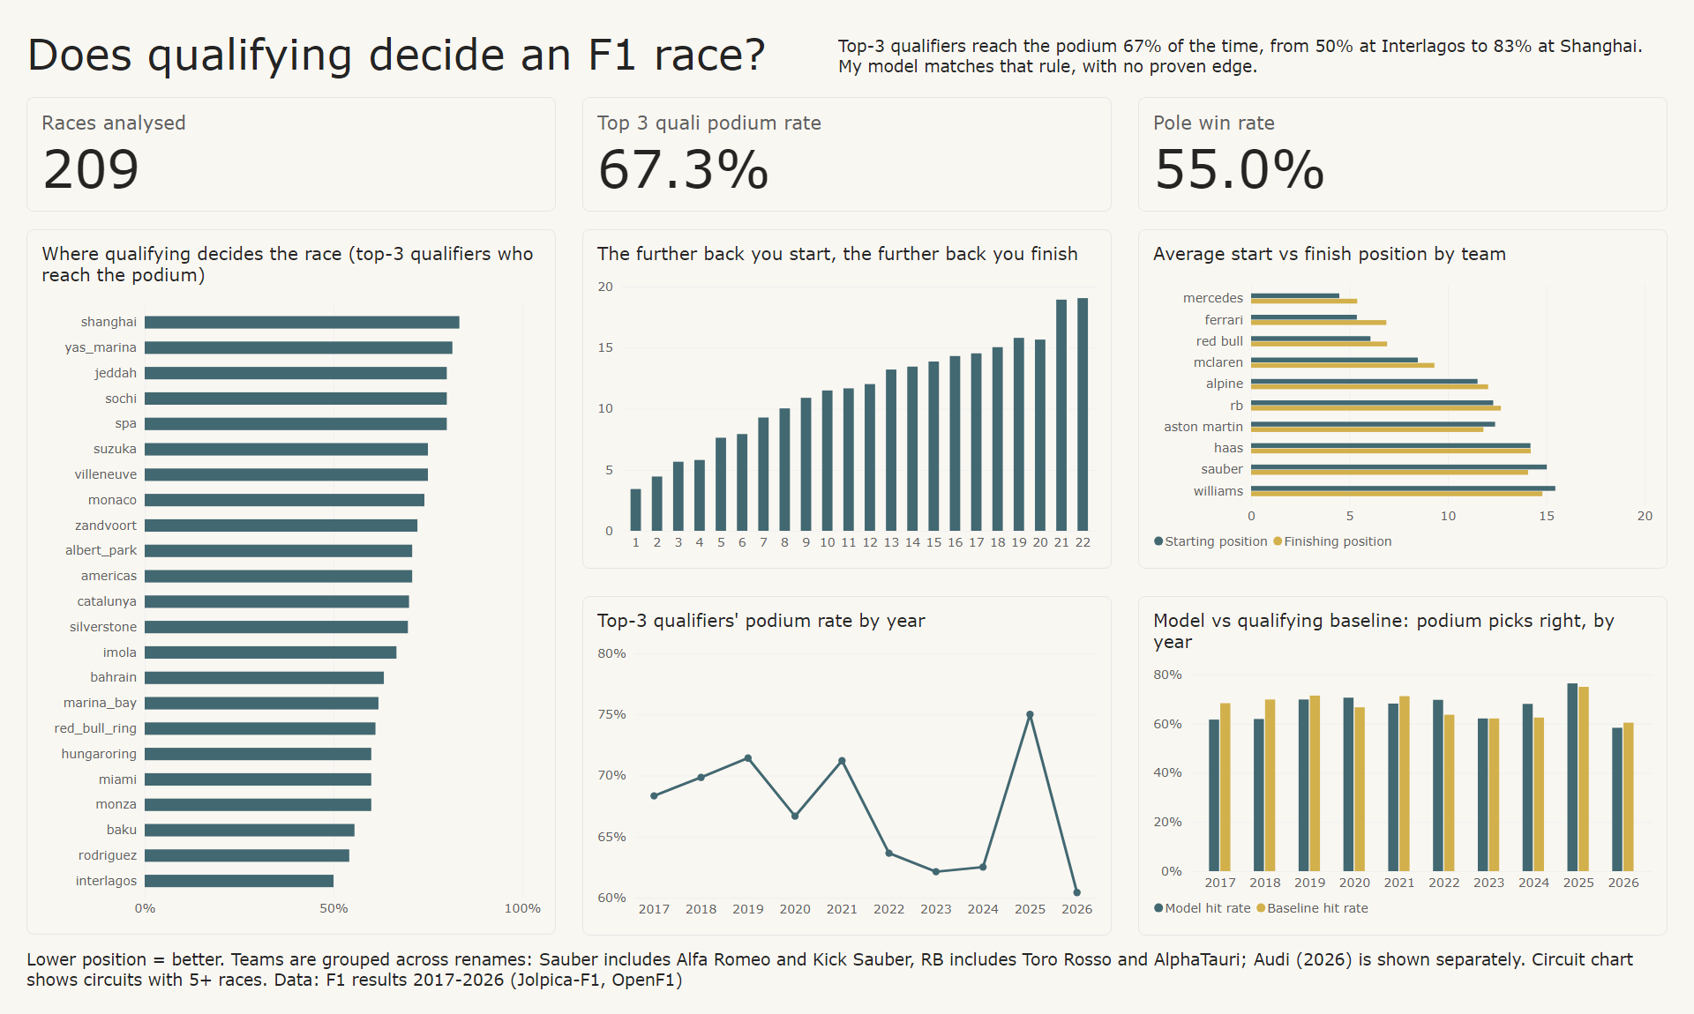
Circuts
Notes:
cardVisual
No alt text provided
textbox
No alt text provided
Top-3 qualifiers' podium rate by year
No alt text provided
textbox
No alt text provided
textbox
No alt text provided
Where qualifying decides the race (top-3 qualifiers who reach the podium)
No alt text provided
cardVisual
No alt text provided
cardVisual
No alt text provided
The further back you start, the further back you finish
No alt text provided
Average start vs finish position by team
No alt text provided
Model vs qualifying baseline: podium picks right, by year
No alt text provided

