Slide 1

Evaluation of South Korean NPI against COVID-19
Effectiveness of Non-Pharmaceutical Interventions
By $R_{0}$ & $R_{t}$ computation
Ikgyu Tom Shin

Slide 2
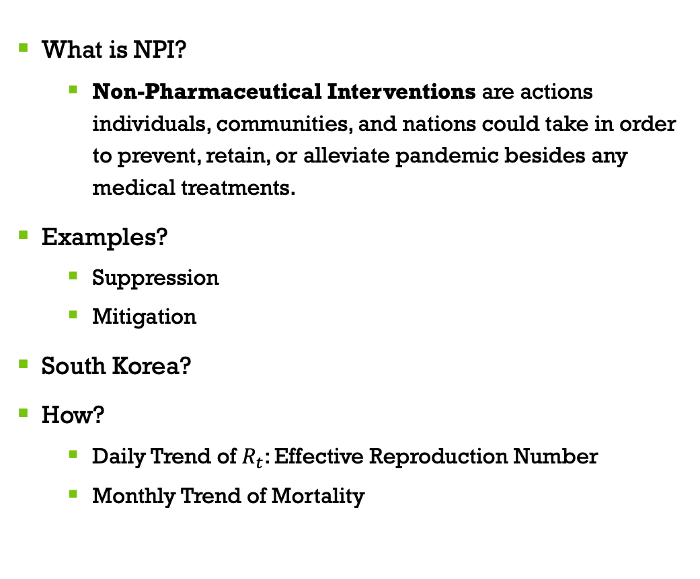
Abstract
What is NPI?
Non-Pharmaceutical Interventions are actions individuals, communities, and nations could take in order to prevent, retain, or alleviate pandemic besides any medical treatments.
Examples?
Suppression
Mitigation
South Korea?
How?
Daily Trend of $R_{t}$: Effective Reproduction Number
Monthly Trend of Mortality

Slide 3


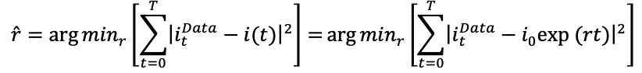

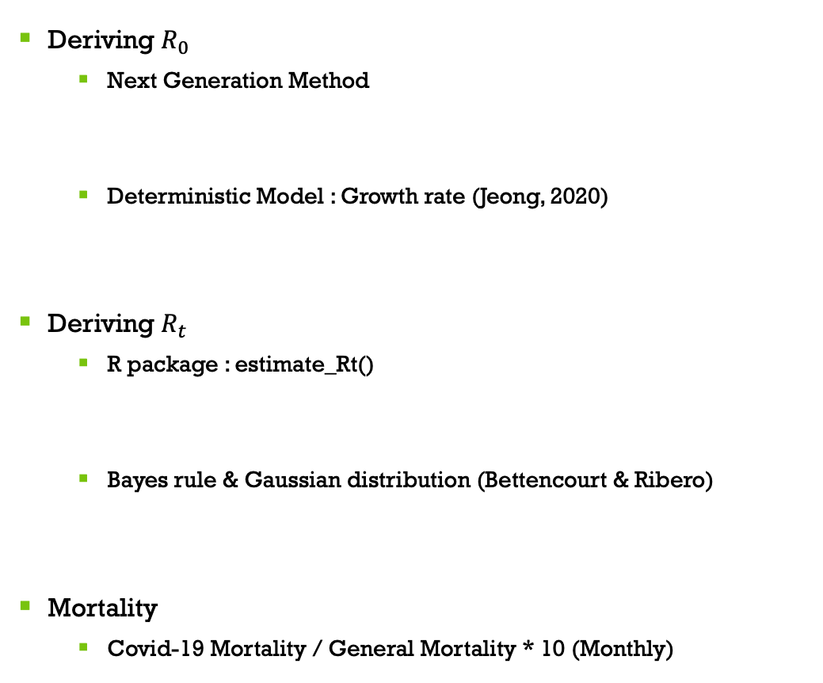
Methods & Models
Deriving $R_{0}$
Next Generation Method
Deterministic Model : Growth rate (Jeong, 2020)
Deriving $R_{t}$
R package : estimate_Rt()
Bayes rule & Gaussian distribution (Bettencourt & Ribero)
Mortality
Covid-19 Mortality / General Mortality * 10 (Monthly)
sk_Rt = estimate_Rt(
seoul_covid_daily,
…
config = list(mean_si=5.195, std_si=0.83))

Slide 4
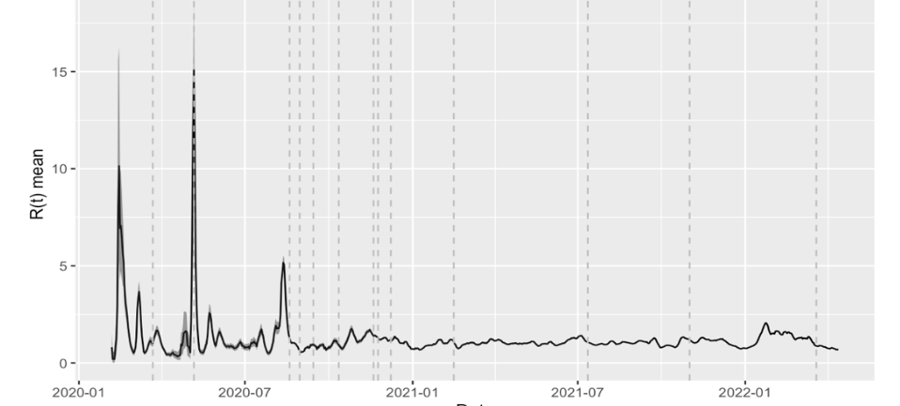
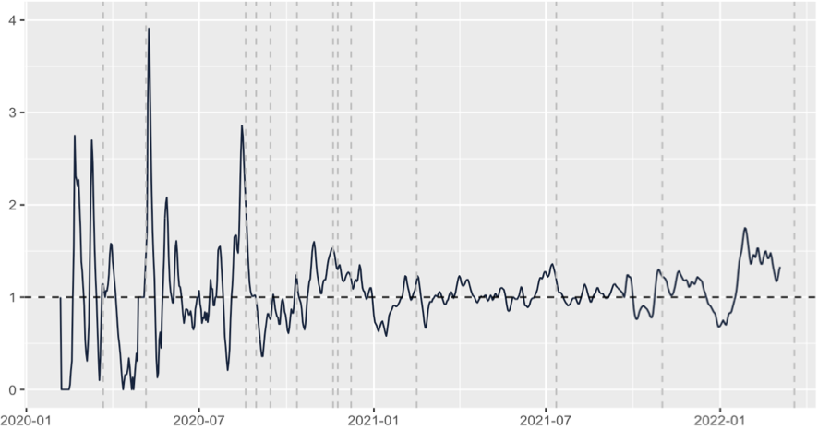
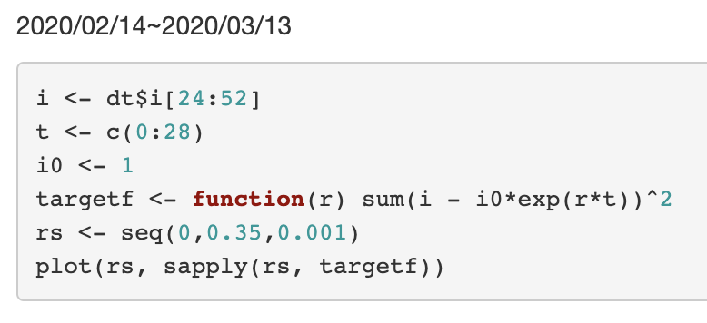
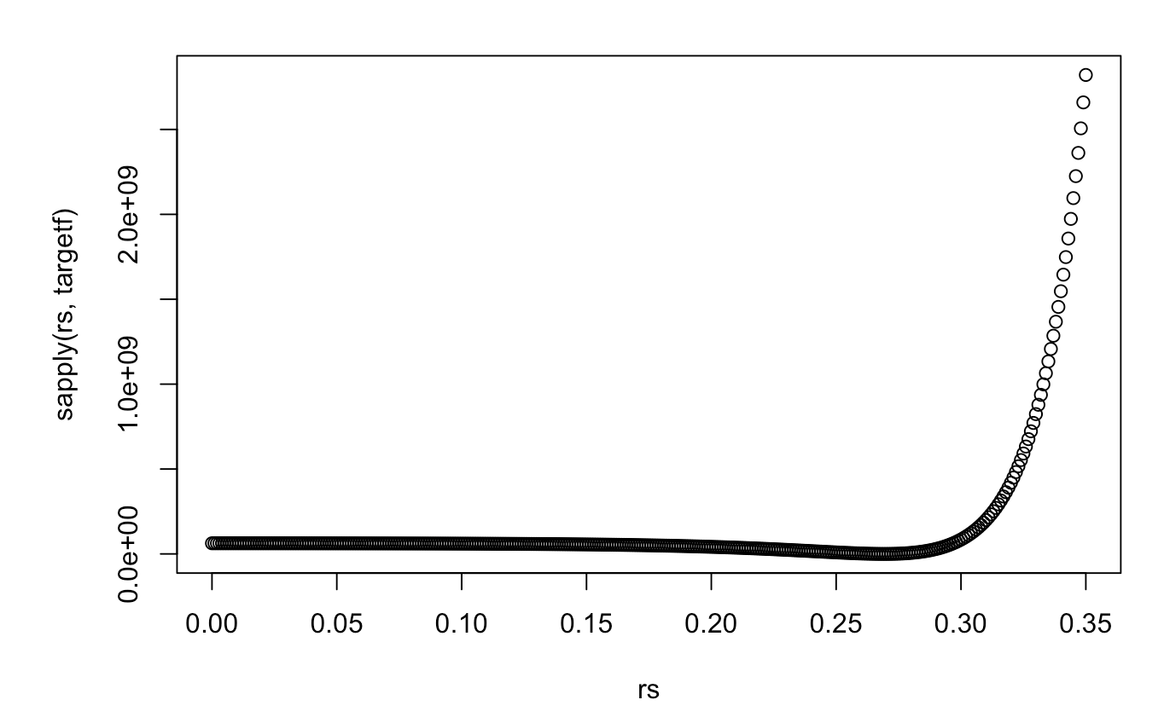
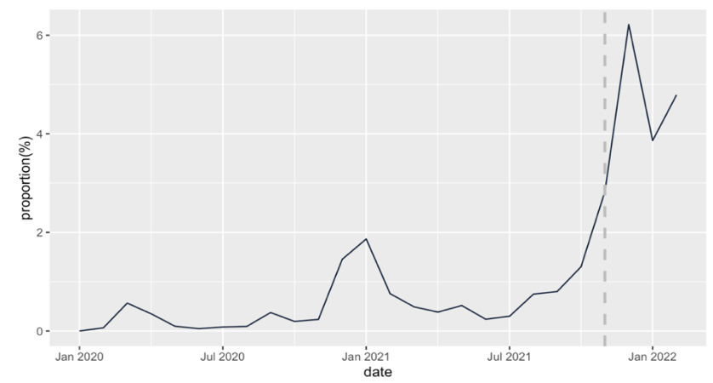


Visualization & Results
$$R_{t}$$
Mortality
$$R_{0}=$$
3.79

Slide 5
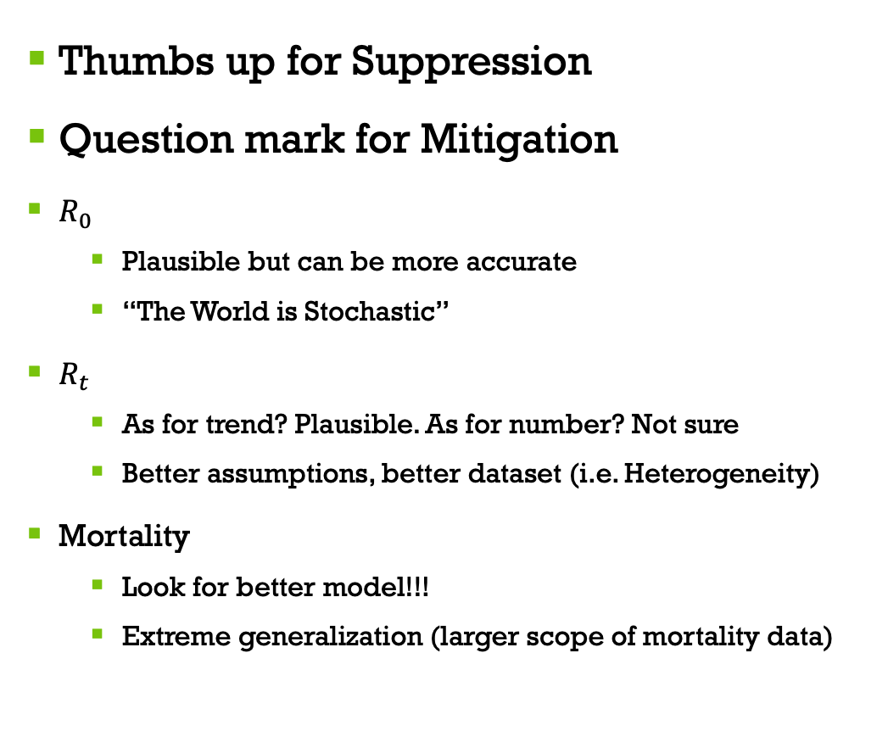
Discussion & Future note
Thumbs up for Suppression
Question mark for Mitigation
$R_{0}$
Plausible but can be more accurate
“The World is Stochastic”
$R_{t}$
As for trend? Plausible. As for number? Not sure
Better assumptions, better dataset (i.e. Heterogeneity)
Mortality
Look for better model!!!
Extreme generalization (larger scope of mortality data)

